Slide 1
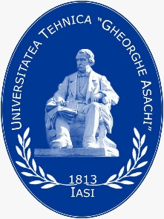



Fashion DIET
CHANCES AND RISKS OF A SUSTAINABLE TEXTILE AND CLOTHING PRODUCTION IN THE EUROPEAN MARKET

Slide 2

European textile and clothing industry- overview
The European textile and clothing industry has undergone significant changes under the influence of the recent pandemic.
EURATEX has published its Spring Report, which gives a detailed insight into the trade figures for the European textile and clothing industry in 2021.
CC BY Euratex, Mobile.Twitter
Notes:
EURATEX 2022 SPRING REPORT: PUTTING THE EU TEXTILES STRATEGY IN A GLOBAL CONTEXT, (2022). This report is an analysis about EU textile &clothing external trade in 2021. See: EURATEX.EU/ news, available at: https://euratex.eu/news/euratex-2022-spring-report-putting-the-eu-textiles-strategy-in-a-global-context/
Image Source: Euratex@euratex_eu.Aug.14
https://mobile.twitter.com/euratex_eu

Slide 3
Learning Objectives
After reading this material, the learner/student will be able to:
Understand the role and importance of the textile and clothing industry in the European economy;
Describe the challenges in the European textile and clothing market;
Describe the threats in the European textile and clothing market;
Present the principle of sustainability in textile and clothing production.

Slide 4
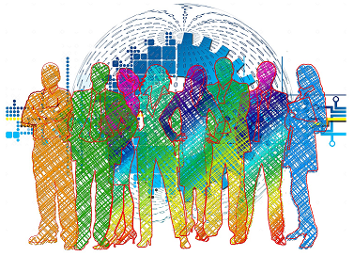
Summary
European textile and clothing industry- overview
Challenges in the European textile and clothing market
Threats in the European textile and clothing market
Sustainability in textile and clothing production
Reflections on the topics presented
Questions to think about
References and further reading.
CC0 Unknown author, Pixabay
Notes:
Image source: Business People, by Unknown author, CC0, pixabay.
https://pixabay.com/illustrations/transformation-business-people-3753413/

Slide 5
European textile and clothing industry- overview
It is said that ″the numbers are encouraging: comparing with the dramatic corona-year 2020, EU exports of textile and clothing articles increased by +10.6%, while imports dipped by -7.5%.
As a result, the EU trade deficit improved, even it remains significant (- €48 billion). Furthermore, import prices went slightly down in clothing and dropped in textiles, following a strong decrease of Chinese import prices of face masks and protective medical supplies″ (EURATEX 2022 SPRING REPORT, 2022).
CC BY Euratex, Mobile.Twitter
Notes:
EURATEX 2022 SPRING REPORT: PUTTING THE EU TEXTILES STRATEGY IN A GLOBAL CONTEXT, (2022). This report is an analysis about EU textile &clothing external trade in 2021. See: EURATEX.EU/ news, available at: https://euratex.eu/news/euratex-2022-spring-report-putting-the-eu-textiles-strategy-in-a-global-context/
Image Source: Euratex@euratex_eu.Aug.14
https://mobile.twitter.com/euratex_eu

Slide 6
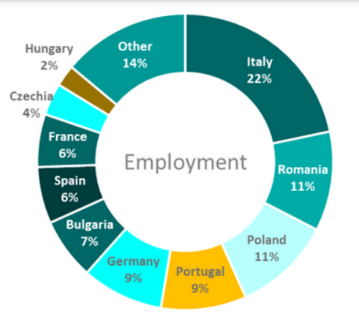
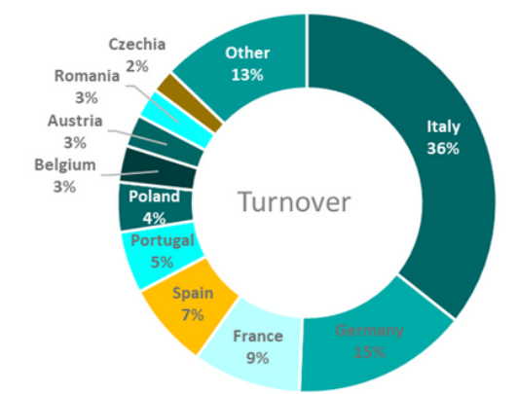
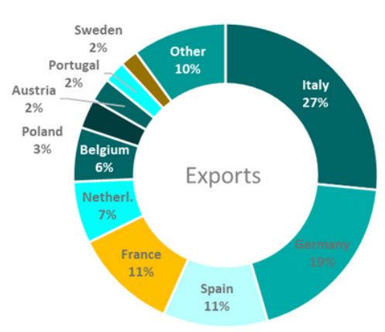
European textile and clothing industry- overview
Europe is a strong apparel market with continued growth in the world. The largest European markets include Germany, France, Spain, Italy, the Netherlands and Poland, which together account for almost 75% of all EU apparel imports worldwide and 79.5% of all imports within the EU.
CC BY Euratex Report (2022), p.8
Notes:
EURATEX 2022 SPRING REPORT: PUTTING THE EU TEXTILES STRATEGY IN A GLOBAL CONTEXT, (2022). This report is an analysis about EU textile &clothing external trade in 2021. See: EURATEX.EU/ news, available at: https://euratex.eu/news/euratex-2022-spring-report-putting-the-eu-textiles-strategy-in-a-global-context/
Image Source: EURATEX Facts & Key Figures, 2022, p.8
httpshttps://euratex.eu/wp-content/uploads/EURATEX_FactsKey_Figures_2022rev-1.pdf

Slide 7
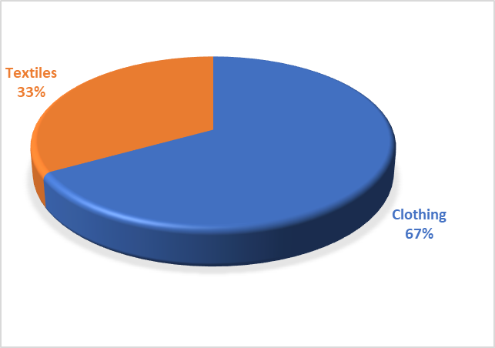
European textile and clothing industry- overview
Small and medium-sized enterprises predominate in this area.
99,8% are micro and SMEs’ companies.
Number of employees | Share (%)
Micro [0-9] | 88,8
Small and medium sized enterprises [10-249] | 11,0
Large>250 | 0,2
CC0 Avadanei, adapted from EURATEX Facts & Key Figures (2022), p.9
CC0 Avadanei, adapted from EURATEX Facts & Key Figures (2022), p.9
Notes:
EURATEX 2022 SPRING REPORT: PUTTING THE EU TEXTILES STRATEGY IN A GLOBAL CONTEXT, (2022). This report is an analysis about EU textile &clothing external trade in 2021. See: EURATEX.EU/ news, available at: https://euratex.eu/news/euratex-2022-spring-report-putting-the-eu-textiles-strategy-in-a-global-context/
Table and graph Source: EURATEX Facts & Key Figures, p.9 (2022)
https://euratex.eu/wp-content/uploads/EURATEX_FactsKey_Figures_2022rev-1.pdf

Slide 8
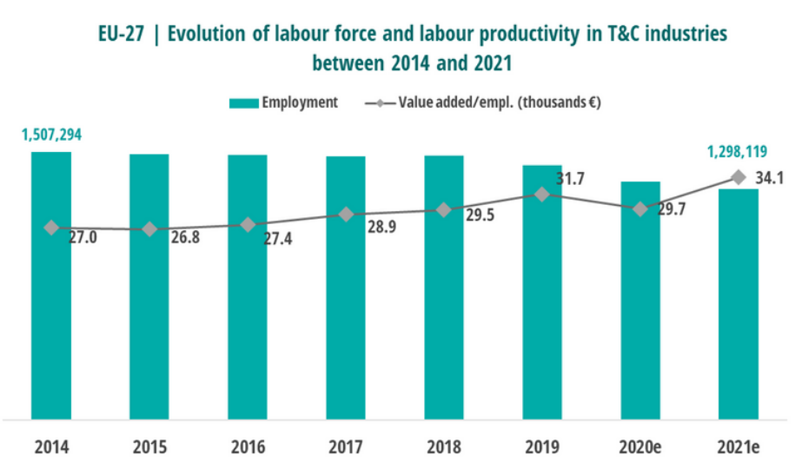
European textile and clothing industry- overview
CC BY Euratex Facts & Key figures (2022),p.10
Notes:
EURATEX 2022 SPRING REPORT: PUTTING THE EU TEXTILES STRATEGY IN A GLOBAL CONTEXT, (2022). This report is an analysis about EU textile &clothing external trade in 2021. See: EURATEX.EU/ news, available at: https://euratex.eu/news/euratex-2022-spring-report-putting-the-eu-textiles-strategy-in-a-global-context/
Table and graph Source: EURATEX Facts & Key Figures, p.10 (2022)
https://euratex.eu/wp-content/uploads/EURATEX_FactsKey_Figures_2022rev-1.pdf

Slide 9
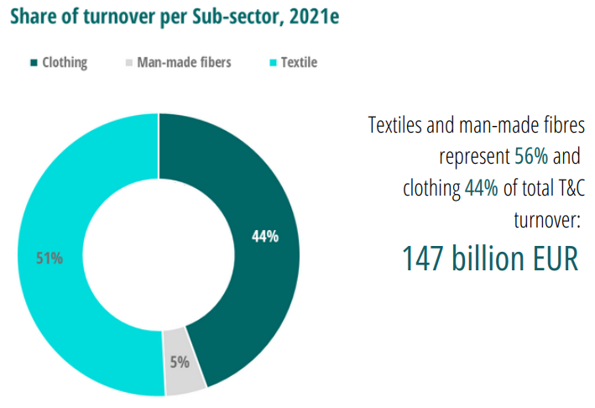
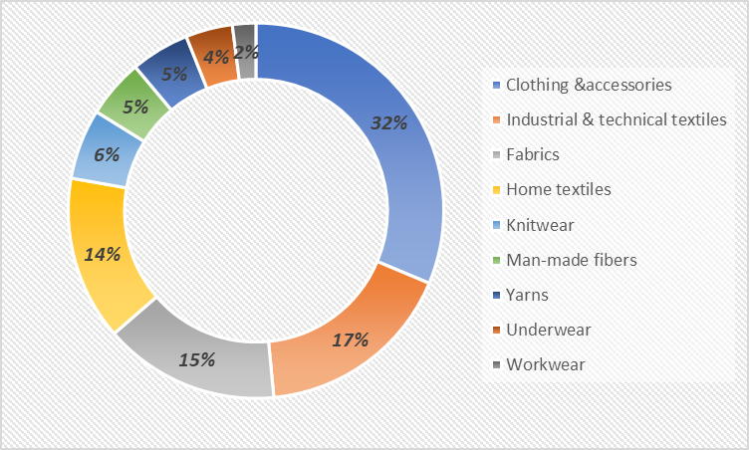
European textile and clothing industry- overview
CC0 Avadanei, adapted from EURATEX Facts & Key Figures (2022), p.13
CC BY Euratex Facts & Key figures (2022),p.12
Notes:
EURATEX 2022 SPRING REPORT: PUTTING THE EU TEXTILES STRATEGY IN A GLOBAL CONTEXT, (2022). This report is an analysis about EU textile &clothing external trade in 2021. See: EURATEX.EU/ news, available at: https://euratex.eu/news/euratex-2022-spring-report-putting-the-eu-textiles-strategy-in-a-global-context/
Graph Source: EURATEX Facts & Key Figures, p.12-13 (2022)
https://euratex.eu/wp-content/uploads/EURATEX_FactsKey_Figures_2022rev-1.pdf

Slide 10
Challenges in the European textile and clothing market
The global and European economy has problems: political conflicts, financial and economic crises, climate change, dwindling reserves of natural resources, population migration, development of production technology (automation, robotisation), dynamics of jobs, consumer behaviour and profiles, etc.
The Fashion and apparel companies have to deal with (Flavio Sciuccati, 2022):
“Chameleon-like” Brand Strategy (especially for major brands)
The growth of “Retailing”
Notes:
Flavio Sciuccati (2022), The 10 challenges for today’s Fashion and Luxury industry
Available at: https://www.ambrosetti.eu/en/news/the-10-challenges-for-todays-fashion-and-luxury-industry/

Slide 11
Challenges in the European textile and clothing market
3. Omnichannel, digital resources and Direct-to-Consumer models
4. Creative collaboration
5. Pressure on costs and mark-up
Vertical strategies of major groups
Greater aggregation
Re-shoring e Near-shoring
Sustainability, Social Responsibility and ESG issues
New digital skills
Notes:
Flavio Sciuccati (2022), The 10 challenges for today’s Fashion and Luxury industry
Available at: https://www.ambrosetti.eu/en/news/the-10-challenges-for-todays-fashion-and-luxury-industry/

Slide 12
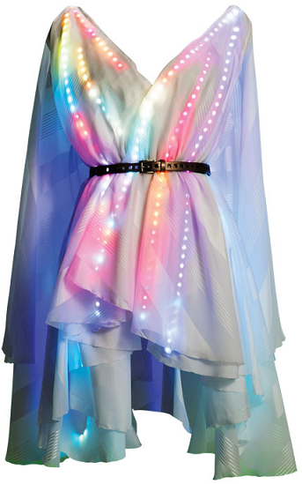
Challenges in the European textile and clothing market
“Chameleon-like” Brand Strategy (Flavio Sciuccati, 2022)
It requires constant innovation and adaptability in all industrial sectors and all product categories (products, materials, processes, technologies, etc.). The brand has had to renew itself on all three strategic fronts - product line, communication, consumer engagement and distribution - often completely changing its exterior.
CC BY Ryan Hayslip (2015)
Notes:
Flavio Sciuccati (2022), The 10 challenges for today’s Fashion and Luxury industry
https://www.ambrosetti.eu/en/news/the-10-challenges-for-todays-fashion-and-luxury-industry/
Image source: Ryan Hayslip ), from the article by MARY LOGAN BIKOFF (2015), Cool high-tech “wearables” coming out of Georgia Tech, available on the following address
https://www.atlantamagazine.com/style/cool-high-tech-wearables-coming-out-of-georgia-tech/
This chameleon-like dress with 600 LED lights, programmable in any colour, can reflect the uploaded image or the environment. It is customisable in real time (via a computer or smartphone app) in case the customer decides to change their wardrobe at the last minute. The model was designed by Zane Cochran and Sonia McCall.

Slide 13
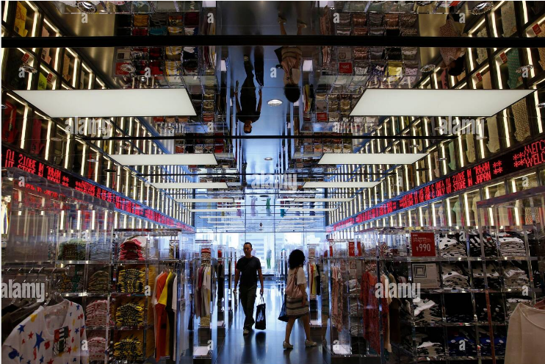
Challenges in the European textile and clothing market
The growth of “Retailing” (Flavio Sciuccati, 2022)
The gradual transition from wholesale to retail inevitably means that the industry and its supply chains are providing "demand-driven" and "event-driven" services, rather than being exclusively or primarily oriented around a seasonal timeframe or "delivery cycles".
CC BY Toru Hanai (2013)
Notes:
Flavio Sciuccati (2022), The 10 challenges for today’s Fashion and Luxury industry
https://www.ambrosetti.eu/en/news/the-10-challenges-for-todays-fashion-and-luxury-industry/
The retail channel needs to be constantly “stimulated” in a dynamic way with ideas, new propositions and events, always with the consumer at the centre.
Image source: REUTERS / Alamy Stock Photo/Toru Hanai (2013), Image ID:2CYPDPM. Fast Retailing's Uniqlo casual clothing store in Tokyo.

Slide 14
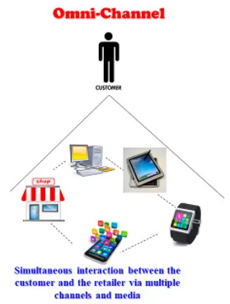
Challenges in the European textile and clothing market
Omnichannel, digital resources and Direct-to-Consumer models (Flavio Sciuccati, 2022)
A company usually has 4-5 different physical and online channels (DOS, multi-brand business, franchising, business partner, travel, outlet, e-commerce, etc.).
CC BY Hokey Min (2021)
Notes:
Flavio Sciuccati (2022), The 10 challenges for today’s Fashion and Luxury industry
https://www.ambrosetti.eu/en/news/the-10-challenges-for-todays-fashion-and-luxury-industry/
The supply chains (both for product development and for production and logistics) are under considerable pressure as they have to ensure speed, flexibility and versatility (which is of course related to the level of complexity/diversity of the products and processes the company has chosen to monitor and manage).
Image source: Hokey Min (2021), Exploring Omni-Channels for Customer-Centric e-Tailing, Logistics 2021, 5(2), 31; https://doi.org/10.3390/logistics5020031, article available on the following address
https://www.mdpi.com/2305-6290/5/2/31/htm

Slide 15
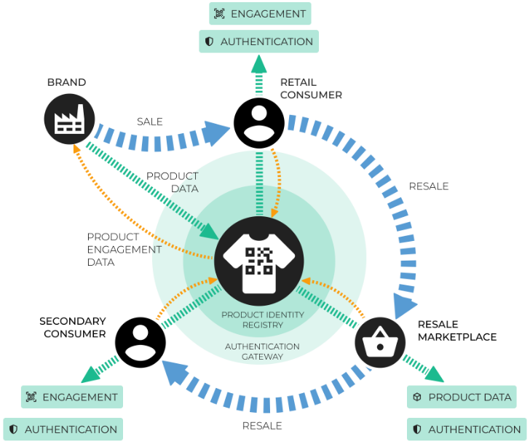
Challenges in the European textile and clothing market
Creative collaboration (Flavio Sciuccati, 2022)
Fashion and apparel companies are involved in different types of projects or specific processes through their scope of activities and processes (both structured projects and individual initiatives).
CC BY Circular Economy (2021)
Notes:
Flavio Sciuccati (2022), The 10 challenges for today’s Fashion and Luxury industry
https://www.ambrosetti.eu/en/news/the-10-challenges-for-todays-fashion-and-luxury-industry/
The 'creative cycle' of success in terms of following and attention is of limited duration and therefore needs to be constantly re-provided and renewed. As a result, existing supply chains - which are inherently structured to be stable and achieve economies of scale - are challenged and changed, reinvented with new product types and a very fast 'time to market'.
Image Source: Circular Economy (2021), World Economic Forum, available on the following address:
https://www.weforum.org/agenda/2021/06/how-digital-authentication-could-drive-a-resale-revolution-for-fashion/
This image presents a digital authentication platform for the textile industry.

Slide 16
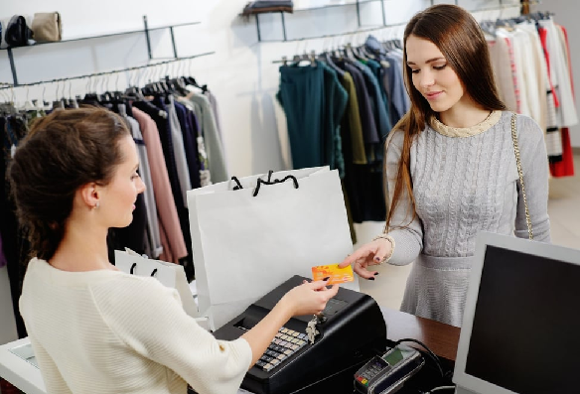
Challenges in the European textile and clothing market
Pressure on costs and mark-up (Flavio Sciuccati, 2022)
There are fierce debates between the production supply chains and the brands and their distribution caused by the costs (the material and production costs do not represent more than 15-20% of the final price for the consumer; the costs of skilled labour represent 40-50% of the final price).
CC BY Olivier Guyot/ Shutterstock (2022)
Notes:
Flavio Sciuccati (2022), The 10 challenges for today’s Fashion and Luxury industry
https://www.ambrosetti.eu/en/news/the-10-challenges-for-todays-fashion-and-luxury-industry/
The debates between the production supply chains and brands are well known in the "value chain", but it is right to ask in which direction the balance will tip in the coming years in order to make all the necessary investments in material technology, product sustainability and traceability in the supply chain, as well as in energy and energy transition costs. In this sector, some companies are not able to absorb these additional costs within their margins.
Image source: Olivier Guyot (2022), Caught between inflation and rising costs, fashion seeks to strike new balance, July 19
Article available on the following address:
https://ww.fashionnetwork.com/news/Caught-between-inflation-and-rising-costs-fashion-seeks-to-strike-new-balance,1424510.html

Slide 17
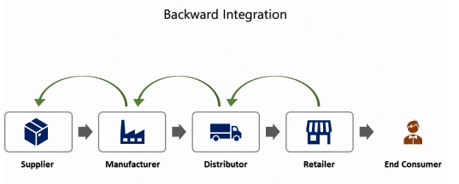
Challenges in the European textile and clothing market
6. Vertical strategies of major groups (Flavio Sciuccati, 2022)
Famous brands, such as Hermes, Chanel, Gucci, Louis Vuitton, etc., are opting for verticalisation of the industry and "insourcing" (or "making") by acquiring and investing in outstanding companies in all categories of the production sector - ready-to-wear clothing, accessories and jewellery - mainly in Italy and especially in the country's many industrial areas.
CC BY RUSITH (2021)
Notes:
Flavio Sciuccati (2022), The 10 challenges for today’s Fashion and Luxury industry
https://www.ambrosetti.eu/en/news/the-10-challenges-for-todays-fashion-and-luxury-industry/
Image source: RUSITH (2021), Vertical Integration: Explanation with Real Industry Examples, December 26, available on the following address:
https://learnbusinessconcepts.com/vertical-integration-explanation-with-real-industry-examples/

Slide 18
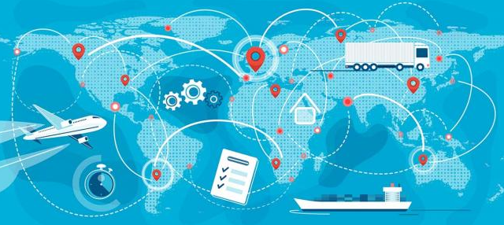
Challenges in the European textile and clothing market
7. Greater aggregation (Flavio Sciuccati, 2022)
The entrepreneurs in the manufacturing sector have launched "aggregation" projects: they seek complementarity in their product line system, greater scale and thus greater synergies and savings, which also require simplified, efficient and transparent governance systems.
CC BY CGS (2021)
Notes:
Flavio Sciuccati (2022), The 10 challenges for today’s Fashion and Luxury industry
https://www.ambrosetti.eu/en/news/the-10-challenges-for-todays-fashion-and-luxury-industry/
Image source: CGS(2021), The Future of the Fashion Supply Chain Is Fully Connected, May 06
Available on the following address: https://www.cgsinc.com/blog/future-fashion-supply-chain-fully-connected-bc

Slide 19

Challenges in the European textile and clothing market
Re-shoring e Near-shoring (Flavio Sciuccati, 2022)
The pandemic has shown that some decisions to move production to the East and South of the world are out of date. Supply chains and logistics networks are emerging that are decentralised, closer to markets and highly integrated with local suppliers.
CC BY Thierry Vanelslander & Edwin Van Hassel (2020)
Notes:
Flavio Sciuccati (2022), The 10 challenges for today’s Fashion and Luxury industry
https://www.ambrosetti.eu/en/news/the-10-challenges-for-todays-fashion-and-luxury-industry/
Image source: Thierry Vanelslander & Edwin Van Hassel (2020), Supply Chain trends: from offshoring to reshoring/nearshoring, June 02
Available at the following address: https://blog.antwerpmanagementschool.be/en/supply-chain-trends-from-offshoring-to-reshoring-nearshoring

Slide 20

Challenges in the European textile and clothing market
Sustainability and Social Responsibility (Flavio Sciuccati, 2022)
The fashion and clothing industry consumes more energy than the entire transport sector, wastes about 20% of total water resources and is responsible for almost 10% of global CO2 emissions, absolutely and urgently needs to change. However, the most difficult and by no means obvious aspect concerns the entire industry and all supply chains (national and global) in the sector, not just the big, downstream brands that are in more direct contact with increasingly sensitised consumers.
CC BY UN Alliance for Sustainable Fashion (2021)
Notes:
Flavio Sciuccati (2022), The 10 challenges for today’s Fashion and Luxury industry
https://www.ambrosetti.eu/en/news/the-10-challenges-for-todays-fashion-and-luxury-industry/
Our duty is to leave the next generations a world that is both environmentally and socially livable means that all companies (large and small, upstream and downstream) are faced with the compelling need to move to a development model that is sustainable, circular, transparent and accountable.
Image source: Praveen Menon (2021), Fashion brands and their efforts to stay sustainable, May 31. According to a study by the UN Alliance for Sustainable Fashion, fashion industry contributes 8-10% of global carbon emissions
Available at the following address: https://apparelresources.com/business-news/sustainability/fashion-brands-efforts-stay-sustainable/

Slide 21
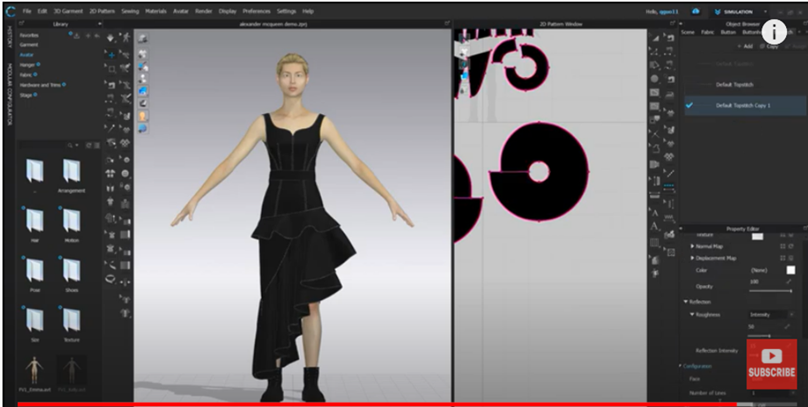
Challenges in the European textile and clothing market
New digital skills (Flavio Sciuccati, 2022)
Digital transformation is an overarching challenge that relates to all of the above and affects the entire fashion and luxury industry.
CLO 3D Timelapse Alexander McQueen /Dress Demo (2020)
Notes:
Flavio Sciuccati (2022), The 10 challenges for today’s Fashion and Luxury industry
https://www.ambrosetti.eu/en/news/the-10-challenges-for-todays-fashion-and-luxury-industry/
The industry will have a growing need in this area for people who are highly competent in all matters related to 3D, digital tools and Web 3.0, or who are able to use artificial intelligence tools for forecasting and resource planning, or who are experts in process digitalisation and "blockchain" solutions, and much more.
Video Source: CLO 3D Timelapse Alexander McQueen/Dress Demo (2020)
QGcutes
https://youtu.be/GCtW-1n5PUc
CLO is a 3D model layout software that enables digital, lifelike visualization of garments with state-of-the-art simulation technology for the fashion industry.

Slide 22
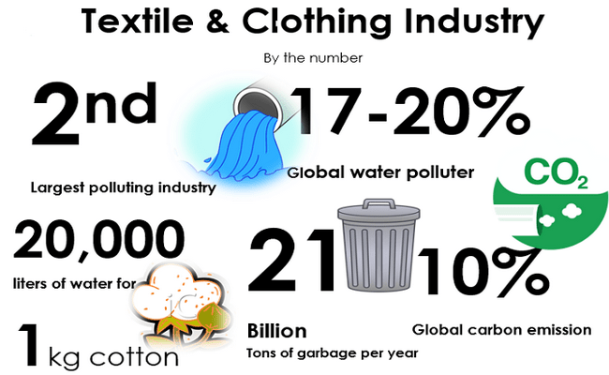
Threats in the European textile and clothing market
The clothing industry has some specific threats (FAIR & SUSTAINABLE TEXTILES,2020) :
pollution from hazardous chemicals used in production;
depletion of resources and loss of biodiversity;
greenhouse gas emissions;
huge amounts of waste;
environmental footprint.
CC BY Mayedul Islam (2020)
Notes:
FAIR & SUSTAINABLE TEXTILES: European Strategy for Sustainable Textile, Garments, Leather and Footwear, (2020). This is a non-official (or “shadow”) proposal for an ambitious and integrated EU strategy in support of fair and sustainable textile, garments, leather and footwear (TGLF) value chains. Available at: https://fairtrade-advocacy.org/wp-content/uploads/2020/07/Civil-Society-European-Strategy-for-Sustainable-Textiles.pdf
Besides those, there are specific threats:
-pollution from hazardous chemicals used in production (especially in wet processes such as dyeing and finishing);
-depletion of resources and loss of biodiversity (through unsustainable use of materials and water). Natural materials require a lot of land and water (wool, cotton, etc.), while synthetic fibres/yarns are mainly based on fossil raw materials and lead to microplastic pollution;
-greenhouse gas emissions. The textile and clothing industry consumes a significant proportion of primary raw material use by households in the EU, and research suggests that the production of clothing and footwear generates more greenhouse gas emissions than international air and sea transport combined;
-huge amounts of waste. In 2013, the EU generated about 5.6 million tonnes of textile waste. Current collection rates for textiles (for reuse or recycling) in the EU are estimated at 20-25%, but with important differences between the EU members.
Image Source: Mayedul Islam (2020), Sustainability Issues in Current Textile and Apparel Industry
https://textiletutorials.com/sustainability-issues-in-current-textile-apparel-industry/

Slide 23
Threats in the European textile and clothing market
Pollution from hazardous chemicals
Fossil fuels that produce carbon dioxide
Chemicals in toxic dyeing and finishing processes
Synthetic fibres in the clothes
CC0 Avadanei, adapted from FAIR & SUSTAINABLE TEXTILES,2020
Notes:
Pollution from hazardous chemicals are:
-fossil fuels that produce carbon dioxide, which contributes to global warming by trapping heat in the atmosphere.
-chemicals in toxic dyeing and finishing processes. They affect workers' health and seep into rivers and groundwater systems, damaging soil, threatening drinking water and killing fish.
-synthetic fibres in the clothes we wear every day affect our oceans, rivers and marine life. When these clothes are washed, tiny plastic microfibres enter in the water system and food chain.

Slide 24
Threats in the European textile and clothing market
Depletion of resources and loss of biodiversity
The fashion and garment industry produces amazing products, but at the same time “contributes to biodiversity loss. Apparel supply chains are directly linked to soil degradation, conversion of natural ecosystems, and waterway pollution” (Anna Granskog & all, 2020).
“Biodiversity loss includes the worldwide extinction of different species, as well as the local reduction or loss of species in a certain habitat, resulting in a loss of biological diversity. The latter phenomenon can be temporary or permanent, depending on whether the environmental degradation that leads to the loss is reversible through ecological restoration/ecological resilience or effectively permanent (e.g. through land loss).” (Wikipedia)
Notes:
Anna Granskog, Franck Laizet, Miriam Lobis, and Corinne Sawers, (2020, July 23), Biodiversity: The next frontier in sustainable fashion.
https://www.mckinsey.com/industries/retail/our-insights/biodiversity-the-next-frontier-in-sustainable-fashion
Wikipedia The Free Encyclopedia
https://en.wikipedia.org/wiki/Biodiversity_loss

Slide 25
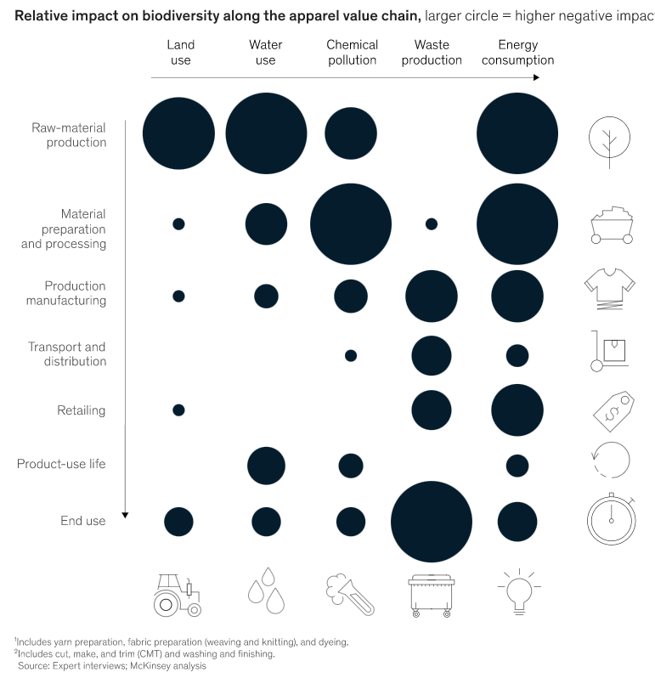
Threats in the European textile and clothing market
Depletion of resources and loss of biodiversity
The negative impacts result from the following stages of the value chain: raw material production, material preparation and processing, and end of life (Anna Granskog & all, 2020).
CC BY Mc. Kinsey (2020)
Notes:
Anna Granskog, Franck Laizet, Miriam Lobis, and Corinne Sawers, (2020, July 23), Biodiversity: The next frontier in sustainable fashion.
Available at https://www.mckinsey.com/industries/retail/our-insights/biodiversity-the-next-frontier-in-sustainable-fashion
Image source: Mc. Kinsey analysis, Expert interviews
https://www.mckinsey.com/industries/retail/our-insights/biodiversity-the-next-frontier-in-sustainable-fashion

Slide 26
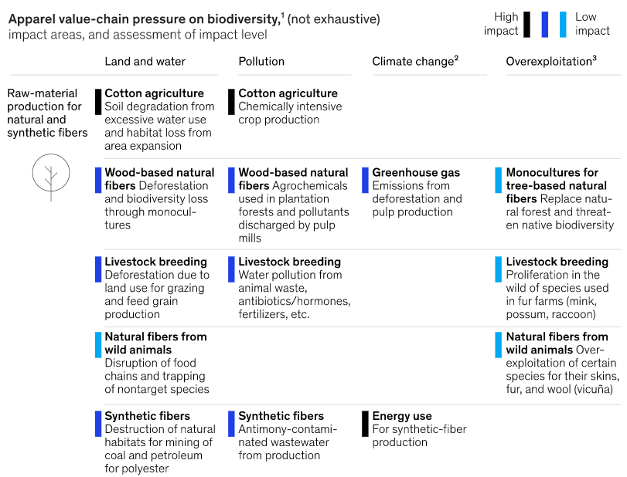
Threats in the European textile and clothing market
Depletion of resources and loss of biodiversity
CC BY D.Aiama et.al (2016)
Notes:
Image source: D. Aiama et.al (2016), Biodiversity risks and opportunities in the apparel sector, International Union for Conservation of Nature, portals.iucn.org
https://www.mckinsey.com/industries/retail/our-insights/biodiversity-the-next-frontier-in-sustainable-fashion

Slide 27
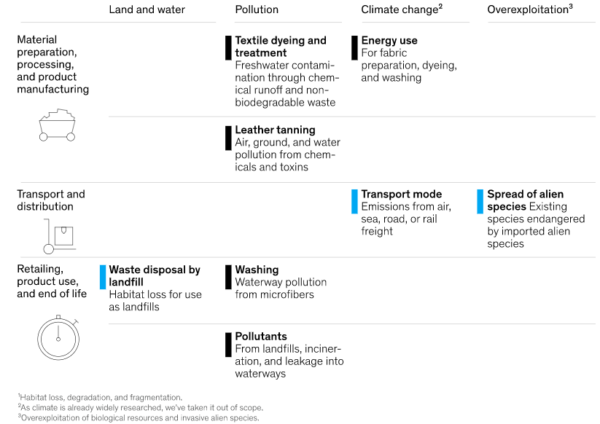
Threats in the European textile and clothing market
Depletion of resources and loss of biodiversity
CC BY D.Aiama et.al (2016)
Notes:
Image source: D. Aiama et.al (2016), Biodiversity risks and opportunities in the apparel sector, International Union for Conservation of Nature, portals.iucn.org
https://www.mckinsey.com/industries/retail/our-insights/biodiversity-the-next-frontier-in-sustainable-fashion

Slide 28
Threats in the European textile and clothing market
Depletion of resources and loss of biodiversity
According to the analysis by Anna Granskog et al. (2020), the following sectors contribute to biodiversity loss:
Cotton agriculture;
Wood-based natural fibers/man-made cellulose fibers (MMCFs);
Textile dyeing and treatment;
Microplastics;
Waste.
CC BY D.Aiama et.al (2016)
Notes:
Anna Granskog, Franck Laizet, Miriam Lobis, and Corinne Sawers, (2020, July 23), Biodiversity: The next frontier in sustainable fashion.
-cotton is the most widely used non-synthetic fibre in the world. It grows on only 2.4 per cent of the world's arable land and is responsible for 22.5 per cent of the world's insecticide use - more than any other crop - and 10 per cent of all pesticide use. Cotton is also a water-intensive crop; 2,700 litres of water are needed to produce one T-shirt;
-wood-based natural fibres/man-made cellulose fibres (MMCFs). MMCFs are made from cellulose, which is mainly derived from wood. More than 150 million trees are felled annually for MMCFs. In addition, the pollution of water and soil by chemicals used in plantation forests and pulp processing leads to habitat loss and endangers species if the process is not 100 percent complete;
-textile dyeing and treatment. About 25 % of industrial water pollution comes from textile dyeing and treatment. These processes overuse freshwater resources and pollute waterways with chemical effluents and non-biodegradable liquid wastes;
-microplastics. A normal load of laundry releases an average of 700,000 fibres, and half a million tonnes of microfibres (which are a type of microplastic) enter the oceans every year. Toxic chemicals in synthetic microfibres poison marine fauna;
-waste. Only 12% of textile waste is downcycled (broken down into its component parts), and less than one percent is recycled in a closed loop. Almost three quarters – 73% - of textile waste is incinerated or ends up in landfills, which release pollutants into the environment and contribute to habitat loss.
Available at https://www.mckinsey.com/industries/retail/our-insights/biodiversity-the-next-frontier-in-sustainable-fashion

Slide 29
Threats in the European textile and clothing market
Greenhouse gas emissions
The production and consumption of textiles have a significant impact on the environment, climate and society. A major problem of this industry is the consumption of resources, water, land and chemicals, as well as the emission of greenhouse gases and pollutants.
The experts of the European Environment Agency said that ″the production of textiles generates around 15-35 tonnes of CO2 equivalent per tonne of textiles produced. The upstream value chain of clothing, footwear and household textiles consumed in the EU is the fifth highest greenhouse gas emission pressure category.″ (EEA, 2020)
Notes:
European Environment Agency (2020), Textiles in Europe's circular economy
Available at: https://www.eea.europa.eu/publications/textiles-in-europes-circular-economy/textiles-in-europe-s-circular-economy

Slide 30
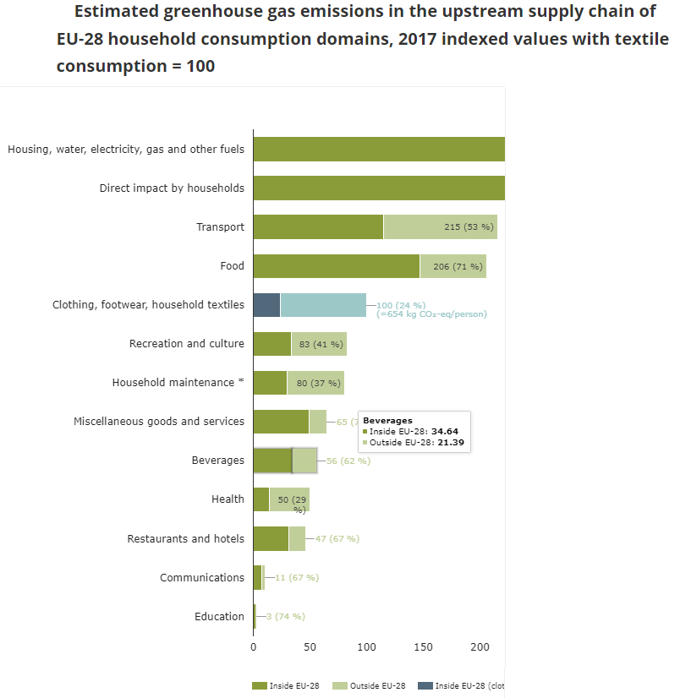
Threats in the European textile and clothing market
CC BY European Environment Agency (2020)
Greenhouse gas emissions
Notes:
Image source: European Environment Agency (2020), Textiles in Europe's circular economy
Available at: https://www.eea.europa.eu/publications/textiles-in-europes-circular-economy/textiles-in-europe-s-circular-economy
The production and handling of clothing, footwear and household textiles consumed in the EU-28 generated emissions of 654 kg CO2 equivalent per person in 2017. Only 25 % of this took place inside the EU-28.

Slide 31
Threats in the European textile and clothing market
Huge amounts of waste
The production of textiles is an environmentally damaging process. Textiles consume large amounts of natural resources such as water, oil and land, they use toxic chemicals and produce large amounts of carbon dioxide.
The article titled "SOURCING TEXTILE WASTE" (2019) mentions that:
9.4 billion tonnes of textile waste is either landfilled or incinerated in the European Union.
In America, an estimated 12.3 million tonnes are either landfilled or incinerated.
In China, the total annual generation of pre- and post-consumer textile waste is estimated at over 26 million tonnes.
Notes:
The Article SOURCING TEXTILE WASTE (2019) is available on https://static1.squarespace.com/static/582d0d16440243165eb756db/t/5dcd14454658fc2b8e087c6a/1573721165094/LEARN_Sourcing_ENG_Nov2019.pdf

Slide 32
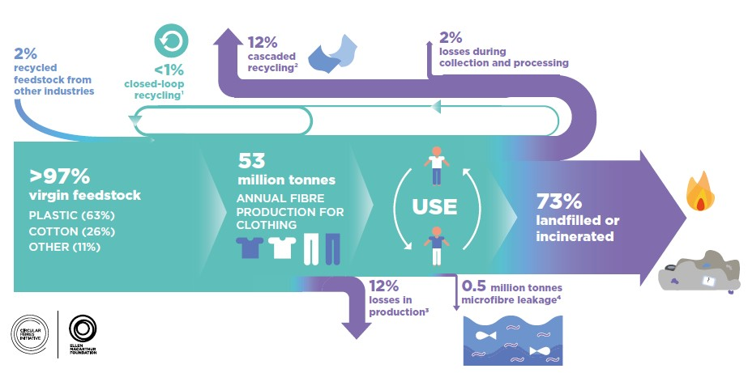
Threats in the European textile and clothing market
Huge amounts of waste
Textile waste is defined as material that becomes unusable or worthless at the end of the production process of any textile product.
Additional waste from the fashion industry is generated when clothes are thrown away or burned (Ellen MacArthur, 2017).
CC BY Allen Mac Arthur (2017)
Notes:
Textile waste is generated at any stage of the manufacturing process, e.g. spinning, weaving, knitting, dyeing, finishing, clothing and during consumer use and disposal.
In Allen Mac Arthur report is mentioned that only 13% of clothing is recycled and less than 1% is made into new clothing. In contrast, the report estimates that 73% of clothing ends up in landfills or is incinerated.
Image source: Ellen MacArthur Foundation (2017), A new textiles economy: Redesigning fashion’s future
https://climatefeedback.org/claimreview/the-clothing-industry-produces-3-to-10-of-global-greenhouse-gas-emissions-as-accurately-claimed-in-patagonia-post/

Slide 33
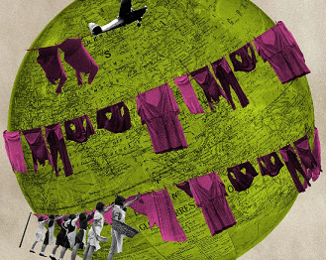
Threats in the European textile and clothing market
Environmental footprint
Garments have a complex and a long supply chains that make it difficult to account for all the emissions that go for example in a pair of trousers or coat. Added to this is how the clothing is transported and disposed of when the consumer no longer wants it.
The fashion industry - from material sourcing to supply chains to laundering and waste - is responsible for 8-10% of global carbon emissions, according to estimates from UN (United Nation for Climate Change), while other estimates between 2% and 8.1%. The production of clothing also requires significant amounts of freshwater, which is a major source of water pollution. (Laura Paddison,2021 ).
CC BY Getty Images/ Alamy/Javier Hirschfeld
Notes:
Laura Paddison (2021), The fashion industry contributes between 2-10% of global carbon emissions – so how might it have to change to enable a net zero world by the middle of the century?
https://www.bbc.com/future/article/20211105-how-carbon-might-go-out-of-fashion
Image source: Getty Images/Alamy/Javier Hirschfeld. Fashion industry is responsible for more carbon emissions than those that come from aviation.

Slide 34
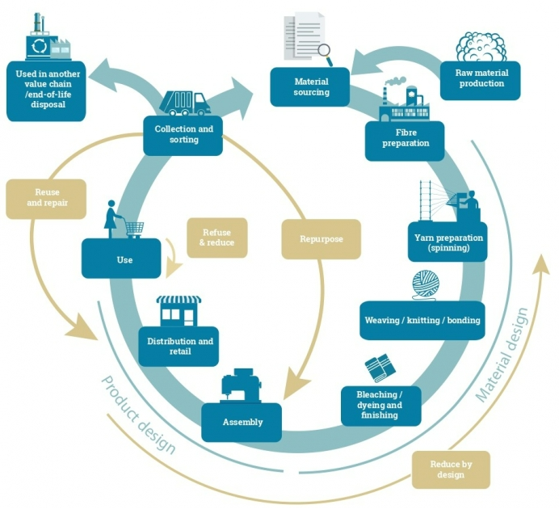
Sustainability in textile and clothing production
The future of the fashion, textile and clothing industry is based on the principle of sustainability.
Sustainable textiles must be environmentally friendly and should meet rational conditions to respect social and environmental quality by avoiding pollution or installing pollution control technologies (Mayedul Islam, 2020).
CC BY UN environment programme
Notes:
Mayedul Islam (2020), Sustainability Issues in Current Textile and Apparel Industry, December 14
Available at the following address:
https://textiletutorials.com/sustainability-issues-in-current-textile-apparel-industry/
Image source: UN environment programme, Sustainable and circular textile.
The United Nations Environment Programme (UNEP) works on providing strategic leadership and encouraging sector-wide collaboration to accelerate a just transition towards a sustainable and circular textile value chain, while supporting sound management of chemicals.
Available at the following address: https://www.unep.org/explore-topics/resource-efficiency/what-we-do/sustainable-and-circular-textiles

Slide 35
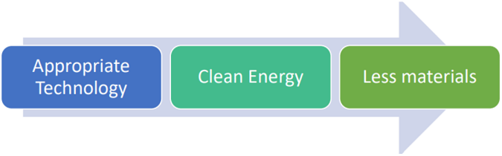
Sustainability in textile and clothing production
Sustainable development is hardly conceivable without:
1) a change from a predominantly linear economy to a consistent circular economy;
2) the simultaneous reduction of overconsumption;
3) the rapid reduction of CO2 emissions.
CC BY Maeen Md. Khairul Akter (2019)
Notes:
Image source: Maeen Md. Khairul Akter, Managing Editor, Textile Focus (2019), Sustainability in Textile Industry; Reality and Challenges, February 21
Available at the following address:
https://textilefocus.com/sustainability-textile-industry-reality-challenges/

Slide 36
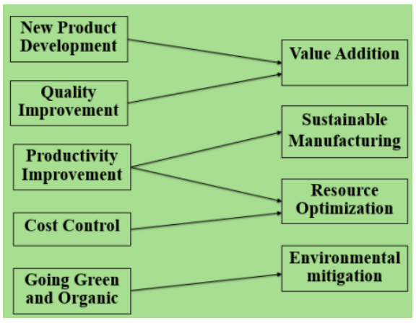
Sustainability in textile and clothing production
A company can become sustainable without compromising its competitiveness by:
Developing new products;
Improving quality;
Increasing productivity;
Controlling costs by introducing green and environmentally friendly initiatives.
CC BY Maeen Md. Khairul Akter (2019)
Notes:
Image source: Maeen Md. Khairul Akter, Managing Editor, Textile Focus (2019), Sustainability in Textile Industry; Reality and Challenges, February 21
Available at the following address:
https://textilefocus.com/sustainability-textile-industry-reality-challenges/

Slide 37
Sustainability in textile and clothing production
In April 2021, the European Commission launched a campaign aimed at raising awareness of the environmental impact of the fast fashion industry (Christine Boland, 2021).
With the growing environmental awareness of European consumers and governments, the issue of sustainability is becoming the focus of trends and strategies in the apparel industry. Manufacturers are approaching the issue from different angles, including carbon neutrality, use of sustainable and alternative materials, material recycling and upcycling, more sustainable production techniques, chemical management and animal friendliness (Christine Boland, 2021).
Notes:
Christine Boland (2021), Which trends offer opportunities or pose threats in the European apparel market?, November 23.
This study has been carried out on behalf of CBI by M-Brain GmbH by Christine Boland, International Trend Watcher and Consultant.
Available at the following address:
https://www.cbi.eu/market-information/apparel/trends#sustainability-is-new-industry-standard

Slide 38
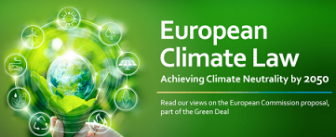
Sustainability in textile and clothing production
Environment protection/ climate neutrality /carbon neutrality
Garment manufacturers plan to reduce their emissions through various measures, such as increasing the use of low-carbon materials, focusing on energy efficiency, using less water in production, using renewable energy and committing not to install new coal-fired boilers or other coal-fired energy sources (Christine Boland, 2021).
Garment companies are expected to set increasingly stringent carbon emission targets. For suppliers, this means that they will have to work on reducing their emissions already in the next 3-5 years and develop a longer-term strategy to further reduce emissions.
CC BY Orgalim (2020)
Notes:
Christine Boland (2021), Which trends offer opportunities or pose threats in the European apparel market?, November 23.
This study has been carried out on behalf of CBI by M-Brain GmbH by Christine Boland, International Trend Watcher and Consultant.
Available at the following address:
https://www.cbi.eu/market-information/apparel/trends#sustainability-is-new-industry-standard
Image source: Orgalim Europe’s Technology Industry (2020), European Climate Law - Achieving climate neutrality by 2050, March 4
Available at the following address: https://orgalim.eu/news/european-climate-law-achieving-climate-neutrality-2050

Slide 39
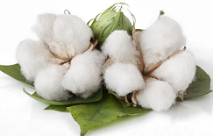
Sustainability in textile and clothing production
Sustainable materials/mixes/alternative materials
Clothing companies are increasingly committing to using more sustainable materials (Christine Boland, 2021).
H&M has set a goal to use only recycled or sustainably sourced materials by 2030 and has therefore launched its Conscious Collection made of organic cotton and recycled polyester.
Adidas and the Bestseller Group have committed to using only sustainably produced cotton and will reduce the use of polyester in the next 3 to 5 years.
CC BY Kiran Patil, Shutterstock (2020)
Notes:
Christine Boland (2021), Which trends offer opportunities or pose threats in the European apparel market?, November 23.
This study has been carried out on behalf of CBI by M-Brain GmbH by Christine Boland, International Trend Watcher and Consultant.
Available at the following address:
https://www.cbi.eu/market-information/apparel/trends#sustainability-is-new-industry-standard
Image source: Kiran Patil (2020), Organic Cotton- Benefits, Uses & Production, February 25. Organic cotton/ Photo Credit: Shutterstock
Available at the following address: https://www.organicfacts.net/organic-cotton.html

Slide 40
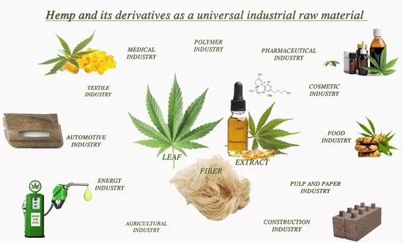
Sustainability in textile and clothing production
Sustainable materials/mixes/alternative materials
Companies are turning to environmentally friendly, biodegradable fibres made from hemp, flax, banana plants or nettles, and developing alternative fibres from agricultural waste such as corn fibre or by-products from citrus juice, milk or naturally occurring biopolymers (Christine Boland, 2021).
Sustainable man-made alternatives in the form of lyocell fibres such as Tencel, Modal Micro and Ecovero offer closed-loop systems that reuse water and chemicals to produce yarns.
CC BY Karol Tutek, Anna Masek (2022)
Notes:
Christine Boland (2021), Which trends offer opportunities or pose threats in the European apparel market?, November 23.
This study has been carried out on behalf of CBI by M-Brain GmbH by Christine Boland, International Trend Watcher and Consultant.
Available at the following address:
https://www.cbi.eu/market-information/apparel/trends#sustainability-is-new-industry-standard
Image source: Karol Tutek, Anna Masek (2022), Hemp and Its Derivatives as a Universal Industrial Raw Material (with Particular Emphasis on the Polymer Industry)—A Review, March 31, https://doi.org/10.3390/ma15072565.
Available at the following address: https://www.mdpi.com/1996-1944/15/7/2565

Slide 41
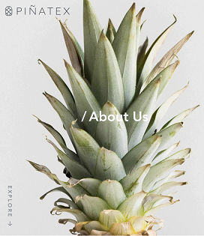
Sustainability in textile and clothing production
Sustainable materials/mixes/alternative materials
Another factor is to reduce the use of animal materials (Christine Boland, 2021).
Asos requires its suppliers not to use animal materials that belong to endangered, threatened, exotic or wild-caught species.
H&M and Inditex also have an animal welfare policy.
Leather alternatives are currently made from apples, pineapples and mushrooms.
CC BY Blacksmith International
Notes:
Christine Boland (2021), Which trends offer opportunities or pose threats in the European apparel market?, November 23.
This study has been carried out on behalf of CBI by M-Brain GmbH by Christine Boland, International Trend Watcher and Consultant.
She said that Europe is currently the largest market for sustainable material alternatives.
Available at the following address:
https://www.cbi.eu/market-information/apparel/trends#sustainability-is-new-industry-standard
Image source: Blacksmith International , 5 Sustainable Fabric Alternatives That Are Gaining Attention. Pineapple leaves are usually discarded, but their strong fibers can be used to create soft, but durable fabric similar to leather. Piñatex, manufactured by Ananas Anam Ltd, specializes in manipulating this food by-product into a beautiful and eco-friendly leather alternative. In 2019, fashion giant H&M incorporated a jacket and cowboy boots made from Piñatex into their Conscious Collection.
Available at the following address: https://blacksmithint.com/sustainable-fabric-alternatives/

Slide 42
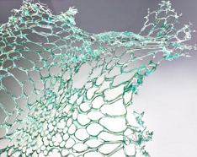
Sustainability in textile and clothing production
Sustainable materials/mixes/alternative materials
The production of innovative, sustainable and biodegradable materials is an opportunity for suppliers from developing countries, especially if the fibre material can be sourced locally and has significantly lower water and energy consumption than conventional materials (Christine Boland, 2021).
CC BY Material District (2020)
Notes:
Christine Boland (2021), Which trends offer opportunities or pose threats in the European apparel market?, November 23.
This study has been carried out on behalf of CBI by M-Brain GmbH by Christine Boland, International Trend Watcher and Consultant.
Available at the following address:
https://www.cbi.eu/market-information/apparel/trends#sustainability-is-new-industry-standard
Image source: Material District (2020), BIODEGRADABLE TEXTILE MADE FROM ALGAE AND SILK PROTEIN, September 17. Awarded the LVMH Maison/0 Green Trial prize 2020, the project explores in sustainable design solutions through combing bio design, digital fabrication, 3D generative simulation into traditional fashion design.
Available at the following address: https://materialdistrict.com/article/biodegradable-textile-made-from-algae-and-silk-protein/

Slide 43
Sustainability in textile and clothing production
Sustainable production techniques
Apparel companies are trying to use sustainable techniques that reduce water and energy consumption and limit the use of chemicals in their processes.
DyeCoo's CO2-based technology eliminates the use of chemicals and reduces energy consumption.
Levi uses digital laser and fabric printing to reduce chemical processing, shorten processing time and personalise the model.
Notes:
Christine Boland (2021), Which trends offer opportunities or pose threats in the European apparel market?, November 23.
This study has been carried out on behalf of CBI by M-Brain GmbH by Christine Boland, International Trend Watcher and Consultant.
The general use of more environmentally friendly dyes and processes such as aniline-free dyes and new dyeing technologies such as Colorifix, which are produced naturally by organisms such as microbes, plants, animals or insects, can help improve the current situation. However, leading fashion brands have signed the New Plastics Economy Global Commitment, which aims to reduce plastic waste. (Christine Boland, 2021).
Available at the following address:
https://www.cbi.eu/market-information/apparel/trends#sustainability-is-new-industry-standard

Slide 44

Sustainability in textile and clothing production
Recycling and circular business models
A circular business model reuses materials and transforms them into new fabrics or garments using new recycling technologies.
In 2018, the European Parliament adopted a strategy on plastics and new waste legislation to reduce the amount of waste going to landfill.
CC BY European Commission (2020)
Notes:
Christine Boland (2021), Which trends offer opportunities or pose threats in the European apparel market?, November 23.
This study has been carried out on behalf of CBI by M-Brain GmbH by Christine Boland, International Trend Watcher and Consultant.
In 2021, the European Parliament also agreed on the Circular Economy Action Plan, which will serve as a framework for future legislation for a (textile) circular system and against greenwashing and false environmental claims. At the same time, the European textile association Euratex announced plans to open 5 hubs (called "ReHubs") in Europe, focusing on textile waste treatment and coordinating upcycling processes in the region(Christine Boland, 2021).
Available at the following address:
https://www.cbi.eu/market-information/apparel/trends#sustainability-is-new-industry-standard
Image source: European Commission (2020), Environment/ Circular economy action plan

Slide 45
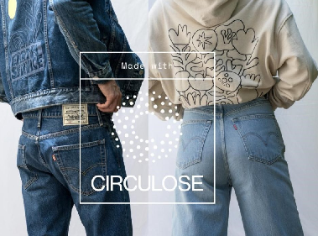
Sustainability in textile and clothing production
Recycling and circular business models
There are new technologies that are able to separate the most common blends of cotton and polyester, such as Worn Again and Blend Re:wind. Some companies are innovating textile recycling: Resyntex, Re:newcell and Evrnu Technologies (they produce secondary raw materials from textile waste), Infinited Fiber turns textile, cardboard and agricultural waste into new cotton, Worn Again Technologies turns polyester polymers and cellulose from cotton, non-reusable textiles and PET bottles and packaging into new textile raw materials.
CC BY Brett Mathews (2020)
Notes:
Christine Boland (2021), Which trends offer opportunities or pose threats in the European apparel market?, November 23.
This study has been carried out on behalf of CBI by M-Brain GmbH by Christine Boland, International Trend Watcher and Consultant.
The Swedish forest company Södra announced a new recycling technology that can recycle large quantities of blended textiles at once (Christine Boland, 2021).
Available at the following address:
https://www.cbi.eu/market-information/apparel/trends#sustainability-is-new-industry-standard
Image source: Brett Mathews (2020), Levi’s and Re:newcell partner on Circulose jeans, July 22. SAN FRANCISCO – Swedish recycling business, Re:newcell, has announced a new collaboration with US denim giant Levi’s. Levi’s has launched two new lines which will be produced using Circulose, a recycled materials which is made at Re:newcell’s plant in Kristinehamn.
Available at the following address: https://apparelinsider.com/levis-and-renewcell-partner-on-circulose-jeans/

Slide 46
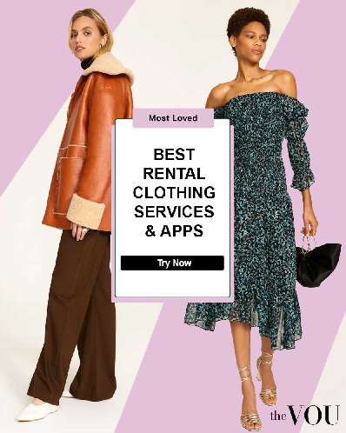
Sustainability in textile and clothing production
Recycling and circular business models
Clothing rental is offered by companies such as Rent the Runway, MUD Jeans and Tchibo. &Other Stories, Patagonia, R.E.I and the French luxury department stores Galeries Lafayette are entering the fashion resale market.
H&M has set up a repair and fitting department in its shops in France, Germany and Norway.
CC BY the VOU(2021)
Notes:
Christine Boland (2021), Which trends offer opportunities or pose threats in the European apparel market?, November 23.
This study has been carried out on behalf of CBI by M-Brain GmbH by Christine Boland, International Trend Watcher and Consultant.
The recycling trend creates opportunities for companies that find good ways to make fashion production more circular and for those that produce higher quality garments that last longer (Christine Boland, 2021).
Available at the following address:
https://www.cbi.eu/market-information/apparel/trends#sustainability-is-new-industry-standard
Image source: Ana Alves, the VOU(2021), 15 Best Clothing Rental Subscription Services Online, November 30.
Available at the following address: https://thevou.com/fashion/best-clothing-rental-subscription-service/

Slide 47
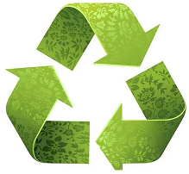
Sustainability in textile and clothing production
Recycling and circular business models
The Circular Design software provides a platform for material suppliers, fashion brands and recyclers to create an identification scheme for reusable materials to simplify their allocation for use by garment manufacturers. It is linked to sorting software, product development tools and circular design guidelines.
Evolving recycling technology could lead to more nearshoring as it makes fibre material available at production sites.
CC BY Fibre2Fashion
Notes:
Christine Boland (2021), Which trends offer opportunities or pose threats in the European apparel market?, November 23.
This study has been carried out on behalf of CBI by M-Brain GmbH by Christine Boland, International Trend Watcher and Consultant.
The resale, refurbishment and upcycling of used clothing could lead to a decrease in demand for new clothing in the form of the "ReCommerce" trend and consumers' desire to "buy less".(Christine Boland, 2021).
Available at the following address:
https://www.cbi.eu/market-information/apparel/trends#sustainability-is-new-industry-standard
Image source: Fibre2Fashion, Textile recycling
Available at the following address: https://www.fibre2fashion.com/industry-article/3197/textile-recycling

Slide 48
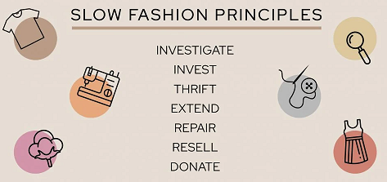
Sustainability in textile and clothing production
Slow Fashion
The Centre for Sustainable Fashion has introduced the term Slow Fashion. The term contrasts with 'fast fashion', which was introduced 20 years ago.
Slow fashion brands focus on producing high-quality clothing from sustainable, high-quality materials such as linen.
The style of these fashions is meant to be 'timeless' rather than fashionable and they are often permanent collections that are launched no more than three times a year. (Christine Boland, 2021).
CC BY Carla Jonas (2022)
Notes:
Christine Boland (2021), Which trends offer opportunities or pose threats in the European apparel market?, November 23.
This study has been carried out on behalf of CBI by M-Brain GmbH by Christine Boland, International Trend Watcher and Consultant.
Available at the following address:
https://www.cbi.eu/market-information/apparel/trends#sustainability-is-new-industry-standard
Image source: Carla Jonas (2022), Slow Fashion Guide: 21 Changes You Can Make Today, July 4.
Available at the following address: https://www.thepearlsource.com/blog/slow-fashion/

Slide 49
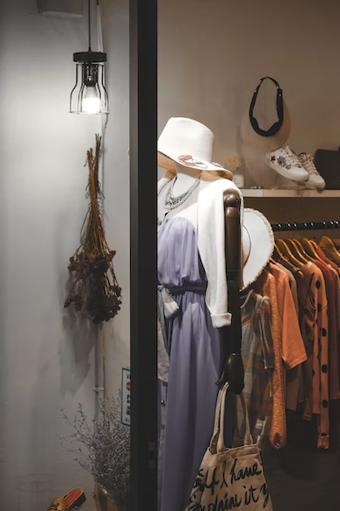
Sustainability in textile and clothing production
Slow Fashion
The products are mainly made locally "to order" to avoid waste and often sold in small (local) shops rather than in big fashion chains. This is in line with the trend of a customer group that is willing to pay more for better quality than to buy a large amount of fashion at once at a lower price.
It is expected that the environmental and sustainability practises of clothing companies will be an important purchasing criterion for European consumers in the future. (Christine Boland, 2021).
CC0 Henry&Co, Unsplash
Notes:
Christine Boland (2021), Which trends offer opportunities or pose threats in the European apparel market?, November 23.
This study has been carried out on behalf of CBI by M-Brain GmbH by Christine Boland, International Trend Watcher and Consultant.
Available at the following address:
https://www.cbi.eu/market-information/apparel/trends#sustainability-is-new-industry-standard
Image source: Slow fashion, Henry&Co, Unsplash
https://unsplash.com/photos/nBwE7fknBpE

Slide 50
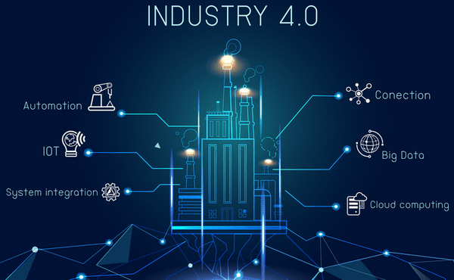
Sustainability in textile and clothing production
The clothing industry is driven by technology
The textile production is now increasingly driven and influenced by technology.
Developments in digital technologies, automation, artificial intelligence, data analytics and IT platforms are making product development, production and distribution faster and more efficient.
Technological innovations are also changing the power dynamics between consumers, brands and retailers (Christine Boland, 2021).
CC BY Mazharul Islam Kiron (2021)
Notes:
Christine Boland (2021), Which trends offer opportunities or pose threats in the European apparel market?, November 23.
This study has been carried out on behalf of CBI by M-Brain GmbH by Christine Boland, International Trend Watcher and Consultant.
Available at the following address:
https://www.cbi.eu/market-information/apparel/trends#sustainability-is-new-industry-standard
Image source: Mazharul Islam Kiron (2021), Impact of Technology in Textile and Apparel Industry, May 26.
Available at the following address: https://textilelearner.net/technology-in-apparel-industry/

Slide 51
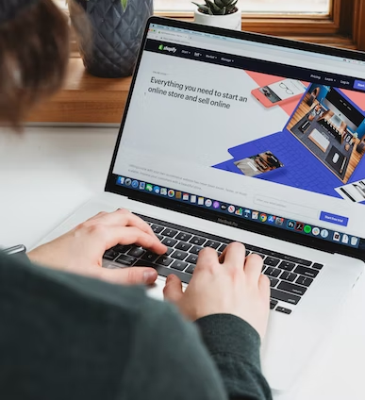
Sustainability in textile and clothing production
E-Commerce and mobile commerce
All well-known brands and suppliers present their products and services on professionally designed websites. This enables companies to network and find new customers.
Manufacturers can use online distribution channels to sell their products directly to customers and bypass the brand or fashion retailer. On the other hand, manufacturers often benefit from the services of online wholesalers who offer them the opportunity to distribute their products worldwide (Christine Boland, 2021).
CC0 Roberto Cortese, Unsplash
Notes:
Christine Boland (2021), Which trends offer opportunities or pose threats in the European apparel market?, November 23.
This study has been carried out on behalf of CBI by M-Brain GmbH by Christine Boland, International Trend Watcher and Consultant.
It is mentioned that the growing number of online shops poses an increasing threat to local shops, but also increases the potential of companies that operate mainly online.
Available at the following address:
https://www.cbi.eu/market-information/apparel/trends#sustainability-is-new-industry-standard
Image source: E-commerce, Roberto Cortese, Unsplash
https://unsplash.com/photos/ejhjSZKTeeg

Slide 52
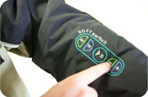
Sustainability in textile and clothing production
The Internet of Things and smart clothing
Through the use of (invisible) crisps and sensors, garments can be equipped with information that can be easily read and interpreted by customers, manufacturers, fashion retailers and anyone else with a device that can read the information.
The technology is particularly popular for wearables and sportswear that help customers track their activity and health. But other garments can also be equipped with the technology to communicate information about the material, the care required and the location (Christine Boland, 2021).
CC BY ASD Reports (2014)
Notes:
Christine Boland (2021), Which trends offer opportunities or pose threats in the European apparel market?, November 23.
This study has been carried out on behalf of CBI by M-Brain GmbH by Christine Boland, International Trend Watcher and Consultant.
Available at the following address:
https://www.cbi.eu/market-information/apparel/trends#sustainability-is-new-industry-standard
Image source: ASD Reports (2014), Sensors and Materials for Smart Clothing: The Rise of a Pair of Billion-Dollar Markets, According to the New Study on ASDReports, October 24. Amsterdam.
Available at the following address: https://www.asdreports.com/news-3401/sensors-materials-smart-clothing-rise-pair-billiondollar-markets-according-new-study-asdreports

Slide 53

Sustainability in textile and clothing production
Artificial Intelligence (AI) and data analytics
Data analytics and machine learning algorithms use historical shopping and search data to understand consumer preferences and predict consumer demand. These technologies help companies gain an automated overview of production processes and industry news and developments.
AI-powered tools can help retailers reduce forecasting errors by up to 50% while reducing inventory by 20-50% (Christine Boland, 2021).
CC BY Rachel Ramirez (2018)
Notes:
Christine Boland (2021), Which trends offer opportunities or pose threats in the European apparel market?, November 23.
This study has been carried out on behalf of CBI by M-Brain GmbH by Christine Boland, International Trend Watcher and Consultant.
Available at the following address:
https://www.cbi.eu/market-information/apparel/trends#sustainability-is-new-industry-standard
Image source: Rachel Ramirez (2018), WEARABLES, September 28.
Available at the following address: https://www.asicentral.com/news/web-exclusive/september-2018/artificial-intelligence-and-the-apparel-industry/

Slide 54
Sustainability in textile and clothing production
Artificial Intelligence (AI) and data analytics
Artificial intelligence is useful for fashion retailers who focus on a (pure) online distribution of products.
The algorithms implemented in the webshops analyse the customer's buying behaviour and guide the customer to further products and a personalised product portfolio that could match the customer's style and choice. This aims to increase the volume of the customer's digital shopping basket (Christine Boland, 2021).
CC BY Rachel Ramirez (2018)
Notes:
Christine Boland (2021), Which trends offer opportunities or pose threats in the European apparel market?, November 23.
This study has been carried out on behalf of CBI by M-Brain GmbH by Christine Boland, International Trend Watcher and Consultant.
Available at the following address:
https://www.cbi.eu/market-information/apparel/trends#sustainability-is-new-industry-standard
Image source: Rachel Ramirez (2018), WEARABLES, September 28.
Available at the following address: https://www.asicentral.com/news/web-exclusive/september-2018/artificial-intelligence-and-the-apparel-industry/

Slide 55

Sustainability in textile and clothing production
Virtual and Augmented Reality (VR and AR)
Virtual and augmented reality are increasingly used for marketing purposes. Fashion retailers are using this technology to bridge the gap between the online and brick-and-mortar customer experience (Christine Boland, 2021).
In most cases, fashion brands work with specialised technology companies, as the implementation of VR and AR requires a high level of expertise .
CC0 Barbara Zandoval, Unsplash
Notes:
Christine Boland (2021), Which trends offer opportunities or pose threats in the European apparel market?, November 23.
This study has been carried out on behalf of CBI by M-Brain GmbH by Christine Boland, International Trend Watcher and Consultant.
Available at the following address:
https://www.cbi.eu/market-information/apparel/trends#sustainability-is-new-industry-standard
Image source: Wonderspace, Barbara Zandoval, Unsplash
https://unsplash.com/photos/w0lI3AkD14A

Slide 56

Sustainability in textile and clothing production
Robotics and automation
The use of automation and robotics enables companies to produce faster, more demand-oriented, cheaper and more flexibly (Christine Boland, 2021).
Automation is already used extensively in the footwear industry and is now increasingly finding its way into garment production.
Key automation technologies include sewing automation and 3D knitting and finishing technologies (such as digital and laser printing).
Other areas that can benefit from automation include fabric control, spreading, cutting, sewing, ironing and material handling.
CC0 Possessed Photography, Unsplash
Notes:
Christine Boland (2021), Which trends offer opportunities or pose threats in the European apparel market?, November 23.
This study has been carried out on behalf of CBI by M-Brain GmbH by Christine Boland, International Trend Watcher and Consultant.
Available at the following address:
https://www.cbi.eu/market-information/apparel/trends#sustainability-is-new-industry-standard
Image source: Technology/Innovation, Possessed Photography, Unsplash
https://unsplash.com/photos/jIBMSMs4_kA

Slide 57
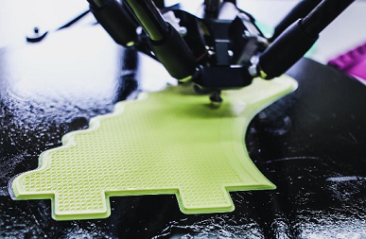
Sustainability in textile and clothing production
3D Printing
Technology companies such as Intel continue to work on the commercialisation of 3D printing for the apparel industry, in many cases in combination with smart technologies for athletes and other athletically active people (Christine Boland, 2021).
Designers already actively working on 3D fashion include Annie Foo, Anouk Wipprecht, Ganit Goldstein, Iris van Herpen, Julia Koerner and many more. Manufacturers like Shima Seiki transform balls of yarn into a complete, seamless garment in less than an hour.
CC BY Christine Boland (2021)
Notes:
Christine Boland (2021), Which trends offer opportunities or pose threats in the European apparel market?, November 23.
This study has been carried out on behalf of CBI by M-Brain GmbH by Christine Boland, International Trend Watcher and Consultant.
Available at the following address:
https://www.cbi.eu/market-information/apparel/trends#sustainability-is-new-industry-standard
Image source: Christine Boland (2021), Which trends offer opportunities or pose threats in the European apparel market?, November 23
Available at the following address:
https://www.cbi.eu/market-information/apparel/trends#sustainability-is-new-industry-standard

Slide 58
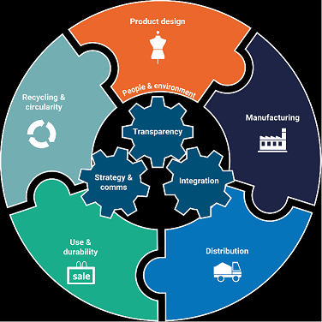
Reflections on the topics presented
The idea of sustainability has become a buzzword lately and has turned some heads. Just as consumers are now taking a closer look at the food they consume and the chemicals they put in their bodies, they are also shifting their purchasing decisions to create a cleaner environment through the clothes they wear.
Some fashion brands are aware of their unsustainable practises, but it is not always easy for them to change. Nevertheless, the growing consumer demand for ethical products is already forcing the fashion industry to adapt, as evidenced by the increasing number of campaigns promoting sustainable practises in the fashion industry.
It is time for consumers to pay attention to everything they own, including their clothes, to learn more about where and by whom their clothes are made, to act responsibly and to use their purchasing decisions to change the way manufacturers see them.
CC BY Anthesis
Notes:
Image Source: Anthesis, Sustainability in the Apparel, Textiles, Footwear and Homeware Industries
https://www.anthesisgroup.com/retail-sector/apparel-footwear-textiles/

Slide 59
Questions to think about
What challenges does the European textile and clothing market face?
What is the position of the European textile and clothing market compared to the other soft goods industries?
What are the particular threats in the European textile and clothing market??
How can the principle of sustainability be applied in textile and clothing production?

Slide 60
References and further reading
Dennit Quewan Adams et al. (2018), What has Industry 4.0 got to do with us? A review of the Literature, Proceedings of the International Conference on Industrial Engineering and Operations Management Pretoria / Johannesburg, South Africa, October 29 – November 1, 2018, http://ieomsociety.org/southafrica2018/papers/136.pdf
John R. Bryson, Chloe Billing, William Graves, Godfrey Yeung (2022), Chapter 1: Reframing manufacturing research: place, production, risk and theory, Monograph Chapter, Collection: Geography, Planning and Tourism 2022,Published: 11 Jan 2022, Page Range: 1–32, DOI: https://doi.org/10.4337/9781789908510.00010
(https://www.elgaronline.com/view/edcoll/9781789908503/9781789908503.00010.xml)
Sarah Cornell et al. (2021), A sustainable and resilient circular fashion and textiles industry: towards a circular economy that respects and responds to planetary priorities, A Research Report by Stockholm University’s Stockholm Resilience Centre for the Ellen MacArthur Foundation and H&M Group, DOI: 10.5281/zenodo.4561847
https://www.stockholmresilience.org/download/18.66e0efc517643c2b8103605/1617805679501/Sustainable%20Textiles%20Synthesis%20Report.pdf
Ebru Gökalp et al. (2018). Industry 4.0 revolution in clothing and apparel factories: Apparel 4.0. Industry 4.0 From the Management Information Systems Perspectives.169-184 (https://www.researchgate.net/profile/Ebru-Goekalp/publication/332410328_Industry_40_Revolution_in_Clothing_and_Apparel_Factories_Apparel_40/links/5d7212064585151ee4a0d94a/Industry-40-Revolution-in-Clothing-and-Apparel-Factories-Apparel-40.pdf)
Annika Hedberg , Stefan Sipka (2020), Towards a green, Competitive and resilient EU economy: How can digitalisation help?/ Discussion paper. European Policy Centre (https://www.epc.eu/content/PDF/2020/Towards_a_green_competitive_and_resilient_EU_economy.pdf)

Slide 61
References and further reading
Kay H. Hofmann, Axel Jacob, Massimo Pizzingrilli (2022), Overcoming Growth Challenges of Sustainable Ventures in the Fashion Industry: A Multinational Exploration, Sustainability 2022, 14(16), 10275;
(https://doi.org/10.3390/su141610275)
Sojin Jung, Byoungho Jin (2016), Sustainable Development of Slow Fashion Businesses: Customer Value Approach, Sustainability 2016, 8(6), 540;
(https://doi.org/10.3390/su8060540)
Deniz Köksal ,Jochen Strähle, Martin Müller (2018), Social Sustainability in Apparel Supply Chains—The Role of the Sourcing Intermediary in a Developing Country, Sustainability 2018, 10(4), 1039
(https://doi.org/10.3390/su10041039)
Mateusz Lewandowski (2016), Designing the Business Models for Circular Economy—Towards the Conceptual Framework, Sustainability 2016, 8(1), 43; https://doi.org/10.3390/su8010043
Cristina Maranesi, Pietro De Giovanni (2020), Modern Circular Economy: Corporate Strategy, Supply Chain, and Industrial Symbiosis, Sustainability 2020, 12(22), 9383;
(https://doi.org/10.3390/su12229383)
Meital Peleg Mizrachi and Alon Tal (2022 ), Regulation for Promoting Sustainable, Fair and Circular Fashion, Sustainability 2022, 14, 502
(https://doi.org/10.3390/su1401050)
Rudrajeet Pal (2017), Sustainable Design and Business Models in Textile and Fashion Industry (book chapter), Sustainability in the Textile Industry DOI: 10.1007/978-981-10-2639-3_6 https://www.researchgate.net/publication/309173543_Sustainable_Design_and_Business_Models_in_Textile_and_Fashion_Industry

Slide 62
References and further reading
https://single-market-economy.ec.europa.eu/sectors/fashion/fashion-and-high-end-industries/fashion-and-high-end-industries-eu_en
https://ec.europa.eu/commission/sites/beta-political/files/political-guidelines-nextcommission_en.pdf;
https://www.sas.com/sas/offers/20/artificial-intelligence-of-things.html?utm_source=google&utm_medium=cpc&utm_campaign=iot-gen-emea&gclid=Cj0KCQiAr5iQBhCsARIsAPcwRONleFVHa31kgobhR7X_RC9bgvjUywbrAIOaxQEJnyLOR5nd3zSTxq4aAoASEALw_wcB
https://in.apparelresources.com/technology-news/manufacturing-tech/industry-4-0-technologies-apparel-manufacturing-challenges-ahead/
https://www.sgtgroup.net/en/expert-solutions-for-sustainable-textiles-and-apparel-production
https://unsplash.com

Slide 63
Contact
The ″Gheorghe Asachi“ Technical University of Iasi- Romania
Faculty of Industrial Design and Business Management
Department of Knitting and Clothing Technology
Professor dr.habil. Manuela Avadanei
Professor dr.habil Mirela Blaga
E-mails: manuela_avadanei@yahoo.com; mavad@tex.tuiasi.ro
mirela_blaga@yahoo.com

