Slide 1




Supplier Relationships

Slide 2
Learning Objectives
After this lecture students should be able to:
Apply the network theory to the business environment
Describe the role of relationships in business
Explain how business relationships are developed over time
Differentiate factors that impact supplier relationships
Explain the role of trustworthiness in supplier relationships
Outline the structure of fashion supply chains

Slide 3
Network Theory
No company is an island!
Markets are constituted of networks: economic activities are embedded in social networks
Companies are not isolated but embedded and connected through relationships with other units or actors, which they exchange knowledge, goods or information with
Mutual dependency: the company is not able to implement a certain strategy completely independent but needs to consider other opinions

Slide 4
Network Theory
A network consists of a set of actors or nodes along with a set of ties of a specified type (such as friendship) that link them
The ties interconnect through shared end points to form paths that indirectly link nodes that are not directly tied
The pattern of ties in a network yields a particular structure, and nodes occupy positions within this structure
Networks present essential conduits of information and know-how and provide firms access to useful information and resources

Slide 5
Network Mapping
Network mapping helps companies to cope with relation complexity
It illustrates the relationships of the different parties within the environment of the respective firm
Helps to identify the different and the most important linkages and nodes
Contributes to building awareness of the company´s position, embedded in a complex environment of dependencies and relationships
Looking at an illustration of its network will make it easier for a company to set the scope of its strategy and enable them to focus marketing efforts

Slide 6
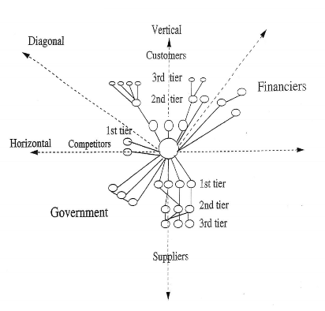
Network Mapping

Slide 7
Network Mapping
Three dimensions branch off either side:
The vertical dimension includes customers, suppliers and consultants
The horizontal dimension takes up major competitors
The diagonal dimension covers financiers and government
All dimensions can be divided into different tiers:
Direct relationships between the company and external parties are clustered in the first tier; includes linkages with customers, suppliers, competitors, governments, financiers, internal units

Slide 8
Network Mapping
All direct essential relationships are allocated in the first tier
The second tier comprises indirect relationships of the company (e.g. the suppliers´ suppliers)
The third tier might be found or not: This is a decisive point when drawing a network map → the network is too huge to be entirely covered
A reasonable limitation needs to be set to remain clear and handy

Slide 9
Network Density
Each network is characterized by a potentially varying network density
Network density describes the degree of interconnection among the various parties within the network
A high degree of interconnection sets a higher density
→ it represents the strength of relationship between the different nodes

Slide 10
Relationships in Business Networks

Slide 11
Overall Relationships and Individual Episodes
Complexity of buyer-seller relations and importance of mutual adaptations → the analysis of relationships must be separated between the overall relationship itself and its individual episodes
Every product delivery, price negotiation or social meeting takes place within the context of the overall relationship
Every episode is affected by the norms, atmosphere, conflicts and procedures of the relationship
Ford (1980), p.341
Notes:
Ford, D. (1980). The development of buyer‐seller relationships in industrial markets. European journal of marketing.

Slide 12
Overall Relationships and Individual Episodes
Each episode affects the overall relationship → a single episode can change it radically, e.g., a relationship can be broken off because of a single failure in delivery
It is important to analyze both individual episodes and the overall relationship to understand the interaction between the two
Ford (1980), p.341
Notes:
Ford, D. (1980). The development of buyer‐seller relationships in industrial markets. European journal of marketing.

Slide 13
The Development of Buyer-Seller Relationships
The process of establishment and development of relationship over time can occur in different stages in their evolution
The stages are dependent on factors related to experience and learning: reduction or increase of uncertainty and commitment between both parties
All steps are followed subsequently over time
BUT: establishing relationships is not an inevitably developing process:
    There is no certainty to evolve and proceed to the next stage
    Failure or regress of development might occur
Ford (1980)
Notes:
Ford, D. (1980). The development of buyer‐seller relationships in industrial markets. European journal of marketing.

Slide 14
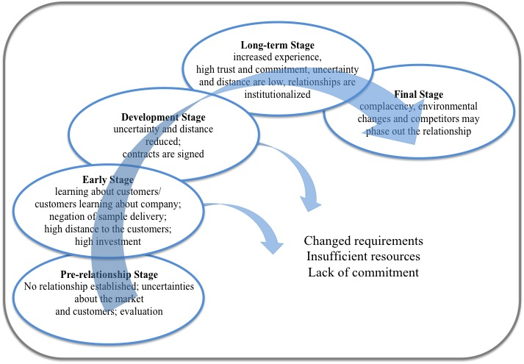
Relationships in Business Networks
Modified from Ford (1980)
Notes:
Ford, D. (1980). The development of buyer‐seller relationships in industrial markets. European journal of marketing.

Slide 15
Stage 1: Pre-relationship stage
The evaluation of a potential new supplier will take place without any commitment to that supplier at this stage
It is conditioned by three factors: experience, uncertainty, distance
Experience in existing and previous relationships provides the criteria by which the potential and performance of a new partner is judged
With a partner of which the company has no experience, it will face uncertainty about the potential costs and benefits
Ford (1980), p.343
Notes:
Ford, D. (1980). The development of buyer‐seller relationships in industrial markets. European journal of marketing.

Slide 16
Stage 1: Pre-relationship stage
Costs for making a change to a particular partner
Opportunity costs involved in the continuing relationship, when compared with alternative partners, e.g., in a buyer having to accept less frequent deliveries
The distance which is perceived to exist between buyer and seller has several aspects (see next slide)
Ford (1980), p343
Notes:
Ford, D. (1980). The development of buyer‐seller relationships in industrial markets. European journal of marketing.

Slide 17
Stage 1: Pre-relationship stage - Distance
Social distance: the extent to which both the individuals and organizations in a relationship are unfamiliar with each others' ways of working
Cultural distance: the degree to which the norms, values or working methods between two companies differ because of culture
Technological distance: the differences between the two companies' product and process technologies
Time distance: the time which must elapse between establishing contact or placing an order, and the actual transfer of the product or service involved
Geographical distance: physical distance between the companies' locations
Ford (1980), p.343
Notes:
Ford, D. (1980). The development of buyer‐seller relationships in industrial markets. European journal of marketing.

Slide 18
Stage 2: The Early Stage
Time to negotiate or develop a specification for a purchase
Experience
At this early stage in their relationship, both buyer and seller are likely to have little experience of each other
They will only have a restricted view of what the other party requires of them, or even of what they hope to gain from the relationship
Ford (1980), p.344
Notes:
Ford, D. (1980). The development of buyer‐seller relationships in industrial markets. European journal of marketing.

Slide 19
Stage 2: The Early Stage
Uncertainty
Human resource investment will be made at a time of considerable uncertainty, when the potential rewards from the relationship will be difficult to assess and the pattern of future costs is undetermined
Distance
There will have been little opportunities to reduce the distance between the parties at this early stage in their dealings
Ford (1980), p.344
Notes:
Ford, D. (1980). The development of buyer‐seller relationships in industrial markets. European journal of marketing.

Slide 20
Stage 2: The Early Stage
Social distance
Absence of personal relationships between the individuals involved
→Judgements made of each company will be on their reputation
Geographical distance
Beyond the control of the seller
Can be reduced by the establishment of a local sales office or by sending staff out to the customer on a residential basis
Ford (1980), p.345
Notes:
Ford, D. (1980). The development of buyer‐seller relationships in industrial markets. European journal of marketing.

Slide 21
Stage 2: The Early Stage
Cultural distance
Can be reduced by employment of local nationals
Potential lack of trust between the companies, e.g. a supplier may believe that he is simply used as a source of information
The distrust of an individual supplier can cause a purchaser to place emphasis on cultural stereotypes — e.g., a customer may attach importance to the alleged "discipline" of German suppliers / "undisciplined" British suppliers
Ford (1980), p.345
Notes:
Ford, D. (1980). The development of buyer‐seller relationships in industrial markets. European journal of marketing.

Slide 22
Stage 2: The Early Stage
Time distance
At the beginning: agreements/transactions which may only come to fruition at some considerable time in the future
Maximizes the buyer's concern whether he will receive the product in the specified form/at the promised price/time
Similarly, the seller will be concerned as to whether orders being discussed will ever materialize in the way it expects
Ford (1980), p.345
Notes:
Ford, D. (1980). The development of buyer‐seller relationships in industrial markets. European journal of marketing.

Slide 23
Stage 2: The Early Stage
Commitment
Both companies will be aware of the risks and will have little/no evidence on the partner's commitment
Commitment of both parties might be low at this time
Commitment is strongly influenced by factors outside the relationship (e.g. number/importance of its other customers or suppliers)
Ford (1980), p.345
Notes:
Ford, D. (1980). The development of buyer‐seller relationships in industrial markets. European journal of marketing.

Slide 24
Stage 3: The Development Stage
The development stage of a relationship occurs as deliveries of continuously purchased products increase
Experience
Increasing experience between the companies of the operations of each other's organizations
The individuals involved acquired knowledge of each other's norms & values
Ford (1980), p.346
Notes:
Ford, D. (1980). The development of buyer‐seller relationships in industrial markets. European journal of marketing.

Slide 25
Stage 3: The Development Stage
Uncertainty
Uncertainties in the relationship are reduced by experience
The adaptations required to meet the wishes of the partner company will have become more apparent and the costs involved in these adaptations will also become clearer
Each company will be better able to judge the adaptations to meet its own requirements: includes those made by itself and those which it should require from its partner
Ford (1980), p.346
Notes:
Ford, D. (1980). The development of buyer‐seller relationships in industrial markets. European journal of marketing.

Slide 26
Stage 3: The Development Stage
Social distance
Reduced by the constant social exchange
Increasing of each other through personal relations → trust
Geographical and cultural distance
The seller company may reduce geographical/cultural distance through the establishment of a local office employment of locals
Ford (1980), p.346
Notes:
Ford, D. (1980). The development of buyer‐seller relationships in industrial markets. European journal of marketing.

Slide 27
Stage 3: The Development Stage
Technological distance
The adaptations reduce the technological distance between them
Their respective products, production and administrative processes become more closely matched with each other
Savings for one or both parties
Ford (1980), p.346
Notes:
Ford, D. (1980). The development of buyer‐seller relationships in industrial markets. European journal of marketing.

Slide 28
Stage 3: The Development Stage
Time distance
Time distance between negotiation and delivery is eliminated in the case of continually delivered products
In the case of irregular purchases of each cycle of order and delivery can be marked by similar time distances
Commitment
It is not possible to put a timetable on the process by which a relationship reaches the long-term stage → reached after continuously purchased products have occurred
Ford (1980), p.346
Notes:
Ford, D. (1980). The development of buyer‐seller relationships in industrial markets. European journal of marketing.

Slide 29
Stage 4: The Long-Term Stage
Experience
The considerable experience of the two companies in dealing with each other leads to the establishment of standard operating procedures, trust, and norms of conduct
Prices are negotiated on an annual basis
Ford (1980), p.347
Notes:
Ford, D. (1980). The development of buyer‐seller relationships in industrial markets. European journal of marketing.

Slide 30
Stage 4: The Long-Term Stage
Uncertainty
Uncertainty reduction can create problems: “institutionalization”
It is possible that routine ways of dealing with the partner will cease to be questioned by this stage
Institutionalized practices may also allow a company to drift into overdependence on a partner or incur excessive costs in its dealings
One company may exploit the other's institutionalized practices and lack of awareness → reduce its own costs at the expense of the partner
Ford (1980), p.347
Notes:
Ford, D. (1980). The development of buyer‐seller relationships in industrial markets. European journal of marketing.

Slide 31
Stage 4: The Long-Term Stage
Social distance
Minimized in the long-term stage: An extensive contact pattern will have developed between the companies
Strong personal relationships developed between individuals in the two companies → it may be difficult to separate personal relationships from the business relation
Interactions by the different functions may become separated: e.g., the technical problem solving between a supplier and its customers can be separate from the commercial transactions which take place
Can lead to problems of coordination and control if different departments are not to work in conflict with each other
Ford (1980), p.347
Notes:
Ford, D. (1980). The development of buyer‐seller relationships in industrial markets. European journal of marketing.

Slide 32
Stage 4: The Long-Term Stage
Technological distance
Successive contracts and agreements between the companies lead to extensive formal adaptations → motivated by cost reduction for both companies
Commitment
It is likely to be difficult for a company to balance the need to demonstrate commitment against the danger of becoming overly dependent on that client
A customer's perception of a supplier's commitment to a relationship may differ from the actual level: because the required investment of resources has largely been incurred before the long-term stage is reached
Ford (1980), p.349
Notes:
Ford, D. (1980). The development of buyer‐seller relationships in industrial markets. European journal of marketing.

Slide 33
Stage 5: The Final Stage
This stage is reached in stable markets over long periods of time
Marked by an extension of the institutionalization process to a point where the conduct of business is based on industry codes of practice
These may have relatively little to do with commercial considerations, but correspond more to a "right way to do business", e.g., the avoidance of price cutting and restrictions on changes
Ford (1980), p.349
Notes:
Ford, D. (1980). The development of buyer‐seller relationships in industrial markets. European journal of marketing.

Slide 34
Companies should examine their existing relationships to see which of the stages described here they fall into:
What is the likely potential of this relationship?
What resources are required to fulfill this potential?
Where do the threats to this development come from?
Where does this relationship fit within the context of the company's overall operations and resource allocation in that market?
Are the current efforts devoted to the relationship appropriate to this overall strategy?
Are we overcommitted to this customer?
Are our ways of dealing with this customer appropriate both to its needs and our strategy or are they dealings based on habit or history?
Ford (1980), p.352

Slide 35
Trustworthiness
One way to develop and maintain mutual, long-term relationships through the social linkage within the company´s relationship network is based on trustworthiness
Of high importance throughout the entire process and considered crucial for a successful business relationships
“Trust is the mutual confidence that no party to an exchange will exploit another’s vulnerabilities” (Barney, 1994, p.176)
Trustworthiness refers to the particular action one side expects from the other side

Slide 36
Trustworthiness
Trustworthiness takes place within the relationship between an individual and an organization
It is, e.g., reflected by a company´s belief that the customer will meet his payment obligations or a buyer´s confidence in the promised quality or delivery on time
When trust exists, uncertainty is reduced and individuals are more willing to share resources and collaborate
Creating trust between partners is therefore a distinctive governance mechanisms that undergirds the establishment of network ties
Trust may evolve from an cognitive or emotional direction

Slide 37
Trustworthiness
Cognitive trust
Arises from an accumulated knowledge that allows predictability and reliability that the partner will meet his obligations
It is rather formal and instrumental than emotional

Slide 38
Trustworthiness
Affective trust
Trust that is rooted in human emotions
Based on friendship, sympathy or affiliation to a particular (social or cultural) group
Occurs if individuals feel genuinely concerned for their partners´ welfare; are personally and emotionally involved into the relationship
Implies that network ties are “relationally embedded” which means that they are embedded within social relationships

Slide 39
Supplier Relationships in the Fashion Industry

Slide 40
Global Apparel Supply Chains
Global sourcing gained increasing attention during the early seventies when the advantages of offshore production have been realized, particularly in terms of costs as the most dominant driving factor
Outsourcing = Arrangement between a company and its independent supplier to manufacture components or to provide services according to defined specifications
Single or multiple steps of the manufacturing process can be transferred to a foreign contractual partner: Pre-production, final production, refining or complete production

Slide 41
Global Apparel Supply Chains
Benefits: Cost savings – especially in labor-intensive production processes in low-wage countries; savings in taxation, lower energy costs; raw material; Concentrate on core competences (e.g. product design, marketing, etc.)
Different integration levels of sourcing resulting in global sourcing strategies that involves worldwide geographically fragmented locations
The operationalization of global supply chain networks comprising multi-tier suppliers (first- and lower tier suppliers) is a highly challenging task and needs strategic management actions

Slide 42
Global Apparel Supply Chains
In practice, apparel retailers approach their outsourcing and offshoring activities in three ways:
direct sourcing,
sourcing intermediaries,
or sourcing hubs

Slide 43
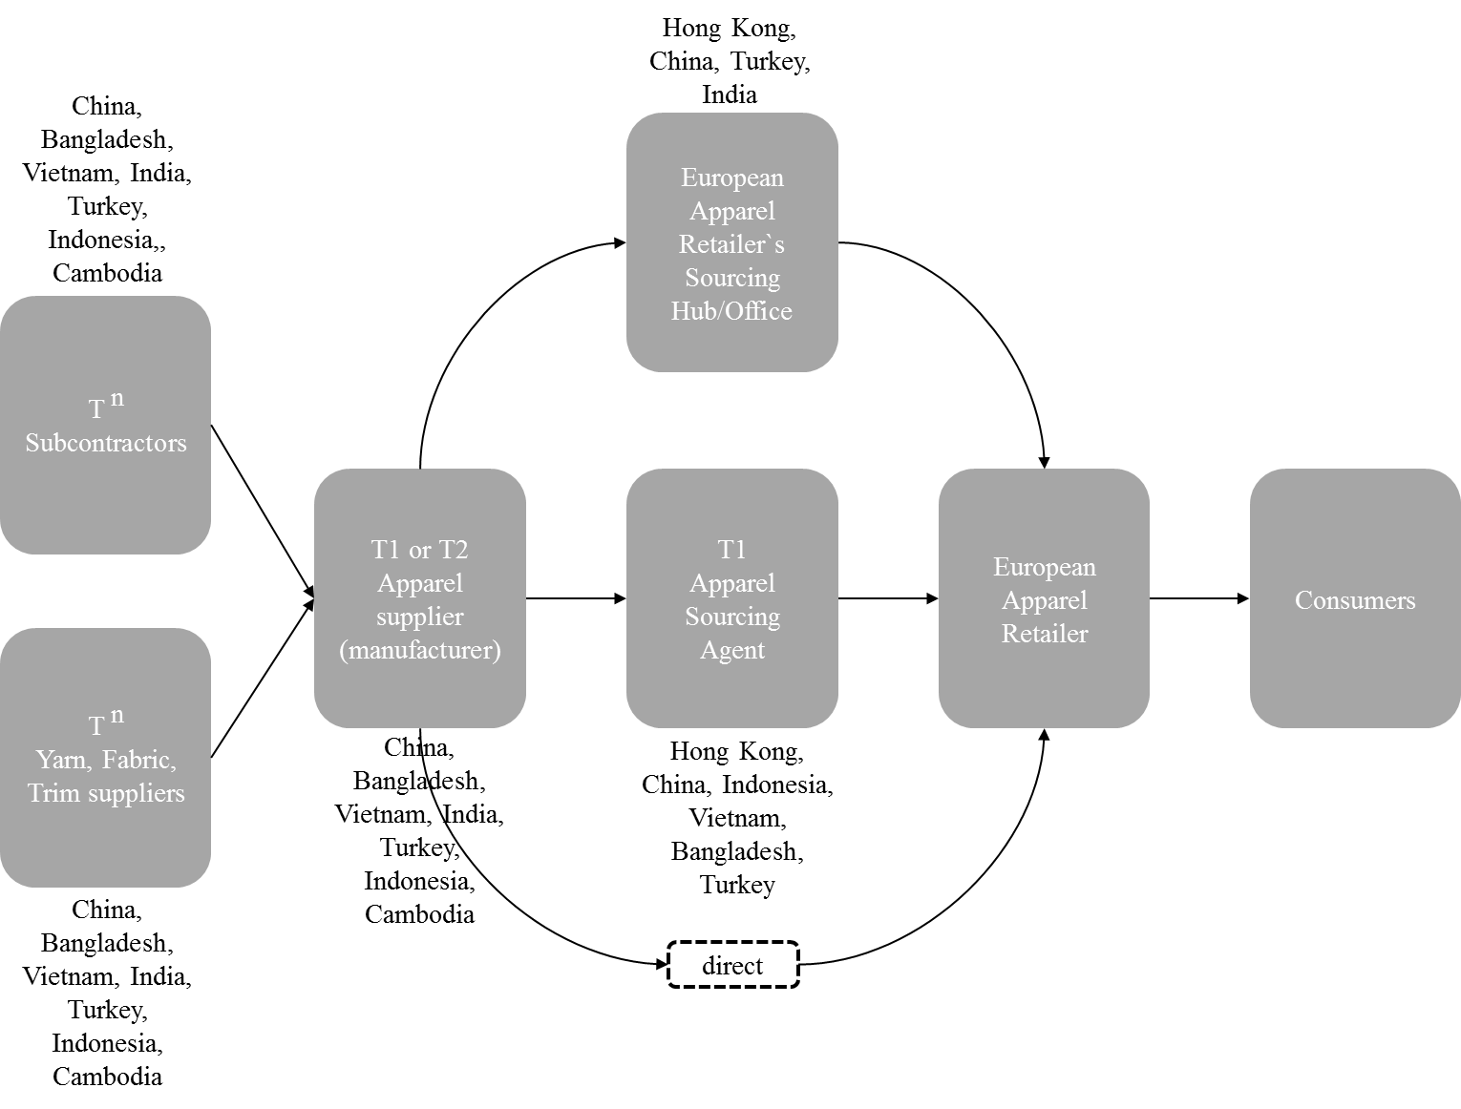
Global Apparel Supply Chains
Notes:
Typically, prominent European apparel retailers adopt a mix of each of the three presented ways to source their garments
FIGURE: Own illustration by Deniz Köksal

Slide 44
Global Apparel Supply Chains
Lower-tier suppliers are considered being less responsive for social and environmental issues and have weak relationships with the downstream supply chain
Due to the complex and long supply chains there is a substantial lack of visibility as they indicate that apparel retailers might even not know the suppliers who manufacture their garments what can induce considerable social risks such as the use of child labour

Slide 45
Social SSCM
in order to achieve compliance with social standards, five main supplier practices are suggested that retailers should make use of:
supplier evaluation and selection,
supplier communication,
supplier auditing,
supplier development,
supplier monitoring.

Slide 46
Contact
Dr. Marcus Adam
Marcus.adam@reutlingen-university.de
Prof. Dr. Jochen Strähle
Jochen.straehle@reutlingen-university.de
Dr. Deniz Köksal
https://www.soundofgarments.com/

