Slide 1




Social Risk Management in Fashion Supply Chains

Slide 2
Learning objectives
After this lecture students should be able to:
Describe the reasons for the need for Social Risk Management
Outline glopal fashion supply chains
Explain the concept of Sustainable Supply Chain Management
Explain barriers and drivers of Sustainable Supply Chain Management

Slide 3
Global Apparel Supply Chains
Global sourcing gained increasing attention during the early seventies when the advantages of offshore production have been realized, particularly in terms of costs as the most dominant driving factor.
Primary reasons for outsourcing and offshoring activities are: lower prices, access to locally unavailable products, technologies, and scarce resources, higher quality, increase of supplier base, and the opportunities to develop a foreign market
Notes:
Citation / Reference
The literature on global sourcing gained increasing attention during the early seventies when the advantages of offshore production have been realized, particularly in terms of costs as the most dominant driving factor (Fernie, Maniatakis, & Moore, 2009). During the nineties the discussion on global sourcing strategies developed further as academics sought to better understand why multinational corporations (MNCs) engage in international sourcing activities (Jia, Lamming, Sartor, Orzes, & Nassimbeni, 2014).
As summarized by Jia et al., (2014), the primary reasons for outsourcing and offshoring activities are: lower prices, access to locally unavailable products, technologies, and scarce resources, higher quality, increase of supplier base, and the opportunities to develop a foreign market.

Slide 4
Global Apparel Supply Chains
This has led to different integration levels of sourcing ultimately resulting in global sourcing strategies that involves worldwide geographically fragmented locations
Therefore, the operationalization of global supply chain networks comprising multi-tier suppliers (first- and lower tier suppliers) is a highly challenging task and needs strategic management actions
Notes:
Citation / Reference
This has led to different integration levels of sourcing ultimately resulting in global sourcing strategies that involves worldwide geographically fragmented locations (Fernie et al., 2009). Therefore, the operationalization of global supply chain networks comprising multi-tier suppliers (first- and lower tier suppliers) is a highly challenging task (Lambert & Cooper, 2000) and needs strategic management actions calling for the need of SCM in order to achieve purely economic objectives: lower costs, increased customer value and satisfaction, and finally competitive advantage (Ashby et al., 2013; Lambert & Cooper, 2000; Mentzer et al., 2001).

Slide 5
Global Apparel Supply Chains
This calls for the need of Supply Chain Management (SCM) in order to achieve purely economic objectives: lower costs, increased customer value and satisfaction, and finally competitive advantage
Many definitions have been provided since SCM faced rising importance during the early 1990s.
In this respect, we can observe three degrees of supply chain complexity i.e., direct supply chain, extended supply chain and ultimate supply chain.
Notes:
Citation / Reference
Many definitions have been provided since SCM faced rising importance during the early 1990s (Svensson, 2007). In this respect, researchers identify three degrees of supply chain complexity i.e., direct supply chain, extended supply chain and ultimate supply chain (Mentzer et al., 2001).
Within each degree, the supply chain actors engage in upstream and downstream activities such as the flows of products, services, information, or finances. A direct supply chain is the simplest form including a focal company, a supplier (Tier 1), and a customer. Whereas the extended supply chain involves suppliers (Tier 2) of the immediate supplier (Tier 1) and the customers of the immediate customer of a focal company. The ultimate supply chain is the most complex including every supply chain actor from the ultimate supplier (Tier^{n}) to the ultimate customer, whilst all represent active members of the upstream and downstream supply chain. As such, in order to control and coordinate upstream and downstream activities, supply chain management actions such as information sharing, shared risks and rewards, cooperation, or the creation of long-term relationships are, among others, critical and necessary in which trust and commitment between the supply chain actors play vital roles (Mentzer et al., 2001).

Slide 6
Global Apparel Supply Chains
Ultimately, Mentzer et al. (2001, p. 18) define SCM as
“the systemic, strategic coordination of the traditional business functions and the tactics across these business functions within a particular company and across businesses within the supply chain, for the purposes of improving the long-term performance of the individual companies and the supply chain as a whole”.
Notes:
Mentzer, J. T., DeWitt, W., Keebler, J. S., Min, S., Nix, N. W., Smith, C. D., & Zacharia, Z. G. (2001). Defining supply chain management. Journal of Business logistics, 22(2), 1-25.

Slide 7
Global Apparel Supply Chains
In practice, apparel retailers approach their outsourcing and offshoring activities in three ways:
direct sourcing,
sourcing intermediaries,
or sourcing hubs
Notes:
In practice, apparel retailers approach their outsourcing and offshoring activities in three ways: through direct sourcing from suppliers, through sourcing intermediaries, or via sourcing hubs (Fernie et al., 2009; Perry, 2013). The simplest way of sourcing directly from suppliers is through the headquarters of an apparel retailer who are in direct contact with their suppliers and hence obtain better control over the manufacturing process. Moreover apparel retailers set up subsidiaries in the respective sourcing countries, so called sourcing hubs/offices or international purchasing offices (Fernie et al., 2009; Jia et al., 2014; Sartor, Orzes, Nassimbeni, Jia, & Lamming, 2014). Lastly, apparel retailers usually employ (import or export) sourcing intermediaries, also typically referred to as e.g. sourcing agents or full-service vendors (Belavina & Girotra, 2010; Cook & Kozar, 2017; Masson et al., 2007; Perry, 2013; Popp, 2000), who usually bridge apparel retailers in developed countries and manufacturers in developing countries.

Slide 8
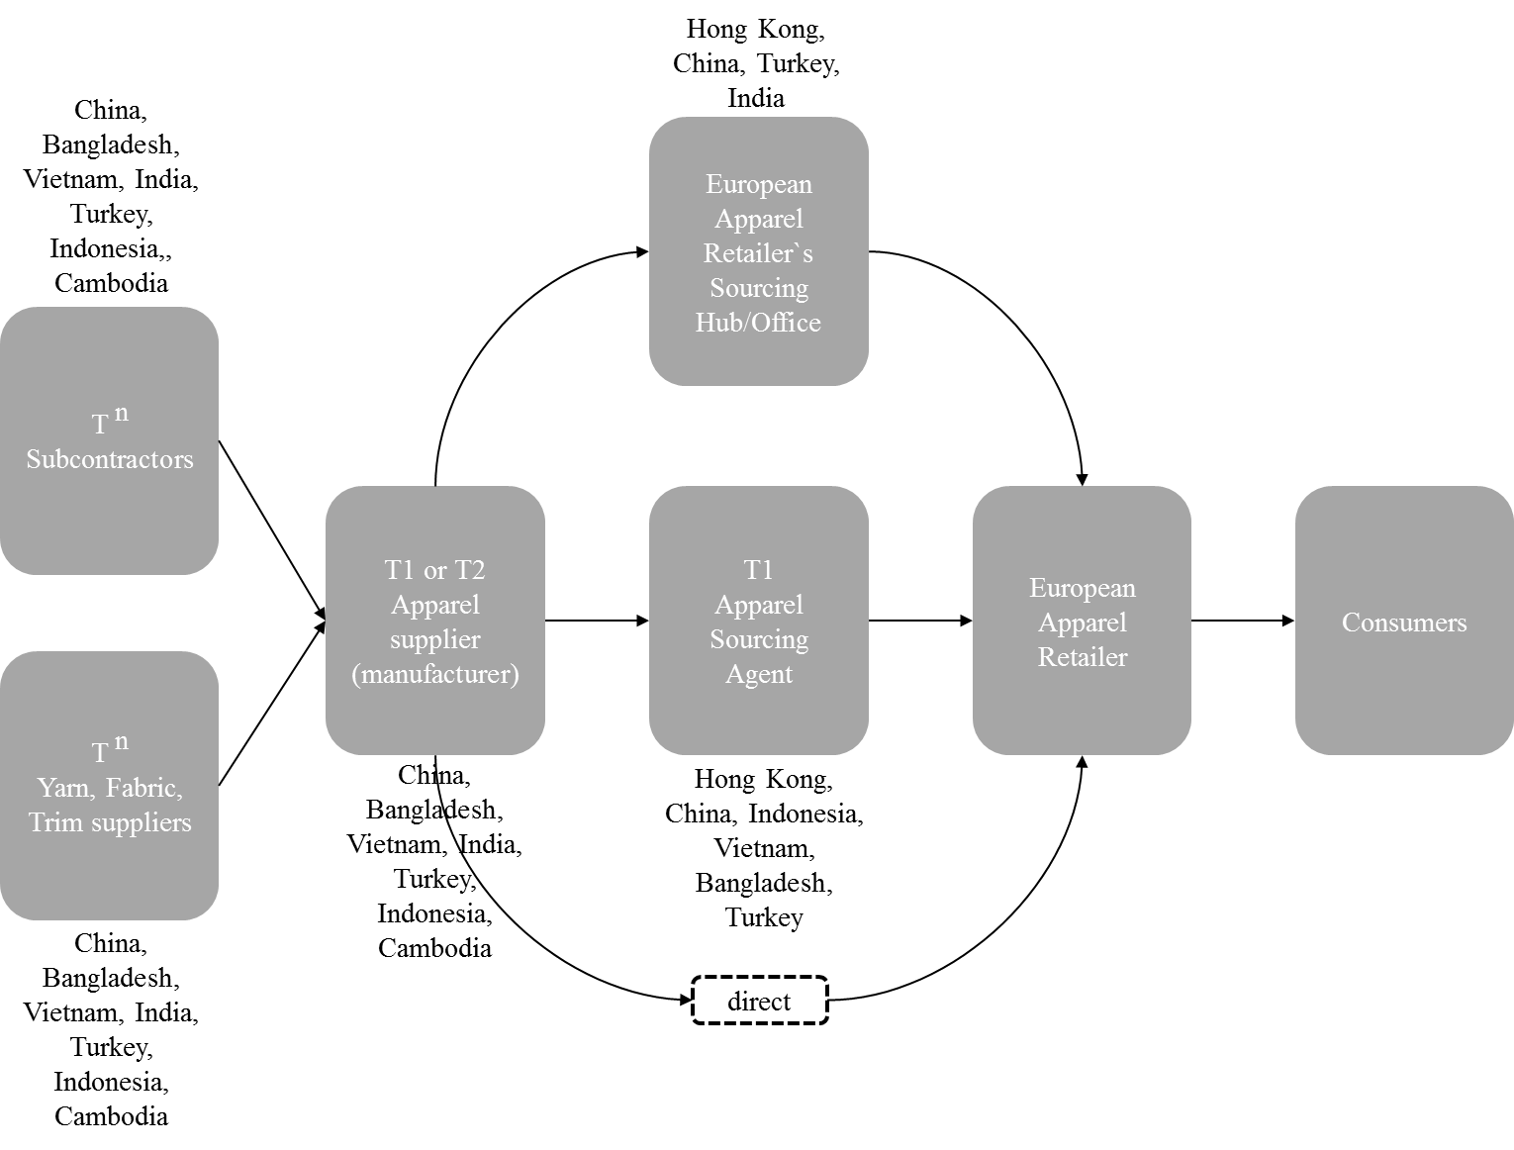
Global Apparel Supply Chains
Notes:
Typically, prominent European apparel retailers adopt a mix of each of the three presented ways to source their garments, which is exemplary illustrated in Figure 2 depicting a typical multi-tier apparel supply chain by considering leading apparel export countries in Asia (WTO, 2018).
FIGURE: Own illustration (Deniz Köksal)

Slide 9
Global Apparel Supply Chains
As a consequence, the management of numerous suppliers and sub-suppliers (multi-tier Tn) in globally dispersed locations is extremely difficult entailing e.g. various internal and external risks such as supply, process, demand, and control risks
Notes:
However, the management of numerous suppliers and sub-suppliers (multi-tier T^{n}) in globally dispersed locations is extremely difficult entailing e.g. various internal and external risks such as supply, process, demand, and control risks

Slide 10
Global Apparel Supply Chains
In light of the globally dispersed apparel supply chain network the intense involvement of lower-tier suppliers in apparel supply chains makes it complicated to manage environmental and social issues because the buying firms lack of information and have less impact on lower-tier suppliers

Slide 11
Global Apparel Supply Chains
Lower-tier suppliers are considered being less responsive for social and environmental issues and have weak relationships with the downstream supply chain
due to the complex and long supply chains there is a substantial lack of visibility as they indicate that apparel retailers might even not know the suppliers who manufacture their garments what can induce considerable social risks such as the use of child labour
Notes:
Lower-tier suppliers are considered being less responsive for social and environmental issues and have weak relationships with the downstream supply chain (M. Tachizawa & Yew Wong, 2014). Masson et al. (2007) supports that due to the complex and long supply chains there is a substantial lack of visibility as they indicate that apparel retailers might even not know the suppliers who manufacture their garments what can induce considerable social risks such as the use of child labour

Slide 12
Sustainable Supply Chain Management (SSCM)
Carter and Rogers (2008, p. 368), define SSCM as “the strategic, transparent integration and achievement of an organization's social, environmental, and economic goals in the systemic coordination of key interorganizational business processes for improving the long‐term economic performance of the individual company and its supply chains”
Notes:
Carter, C. R., & Rogers, D. S. (2008). A framework of sustainable supply chain management: moving toward new theory. International journal of physical distribution & logistics management.

Slide 13
Sustainable Supply Chain Management (SSCM)
Ahi and Searcy (2013, p. 339) define SSCM as “creation of coordinated supply chains through the voluntary integration of economic, environmental, and social considerations with key inter-organizational business systems designed to efficiently and effectively manage the material, information, and capital flows associated with the procurement, production, and distribution of products or services in order to meet stakeholder requirements and improve the profitability, competitiveness, and resilience of the organization over the short- and long-term”.
Notes:
Ahi, P., & Searcy, C. (2013). A comparative literature analysis of definitions for green and sustainable supply chain management. Journal of cleaner production, 52, 329-341.

Slide 14
Sustainable Supply Chain Management (SSCM)
The integration of economic, ecological and social aspects of business practices and theory to SCM will result in SSCM
SSCM demands a broader perspective of SCM
One concept that concisely shaped the literature on sustainability and its operationalisation is the assessment of a firm`s performance under the umbrella of the triple bottom line (TBL), which recommends the simultaneous commitment to environmental, social, and economic dimensions

Slide 15
Sustainable Supply Chain Management (SSCM)
Managing sustainability risks and reputation, meeting consumer demands and stakeholder pressures, or gaining competitive advantages are among the primary motivations for focal companies to approach SSCM
However, there are notable barriers for efficient and effective SSCM such as higher costs, coordination complexity and insufficient or missing communication in the supply chain

Slide 16
Sustainable Supply Chain Management (SSCM)
Therefore, supplier evaluation requires specific governance mechanisms and supply chain management capabilities
SCM tenets offer great potential to translate sustainability theory into practice in order to achieve effective SSCM

Slide 17
Sustainable Supply Chain Management (SSCM)
A focal company will consider the adoption of supplier management for risks and performance
integrate management systems such as the SA8000 or CoC`s and complement this further with monitoring, evaluation, reporting, and sanctions as supportive means.

Slide 18
Sustainable Supply Chain Management (SSCM)
The preferred outcome translates into the avoidance and mitigation of environmental, social, and economic risks
enhancing the economic, social and environmental performance of the chain by creating win-win situations, addressing trade-offs or assuring minimum sustainability performance

Slide 19
Social SSCM
According to the Commission of the European Communities (2011, p. 1), CSR is defined as: “The responsibility of enterprises for their impacts on society […] have a process in place to integrate social, environmental, ethical human rights and consumer concerns into their business operations and core strategy in close cooperation with their stakeholders”.

Slide 20
Social SSCM
The intersection of CSR and SCM research results in in the adoption for social management strategies which comprise communication, supplier development, and compliance strategies that ultimately have an impact on social performance outcomes as ways of addressing social issues in supply chains.

Slide 21
Social SSCM
The communication strategy includes the adoption CSR reports and labelling of products in order to communicate social responsibility to internal and external stakeholder of a firm.

Slide 22
Social SSCM
Supplier development strategies are initiated by the focal/buying company in order to develop the capacities of its suppliers in managing social issues
  Direct supplier development
  Indirect supplier development

Slide 23
Social SSCM
Compliance strategies involve the implementation of CoC`s and social standards complemented further by social monitoring and auditing practices for measuring the social performance of suppliers against the respective codes and standards required by the focal/buying company

Slide 24
Social SSCM
In order to achieve compliance with social standards, five main supplier practices are suggested that retailers should make use of:
supplier evaluation and selection,
supplier communication,
supplier auditing,
supplier development,
supplier monitoring.

Slide 25
Social SSCM
However, traditional compliance strategies seem not to be sufficient and should be complemented by a more commitment oriented strategy in which apparel buyers and suppliers engage in joint problem solving, information sharing, and trust which builds on learning,
capacity building, incentives, and mutual respect.

Slide 26
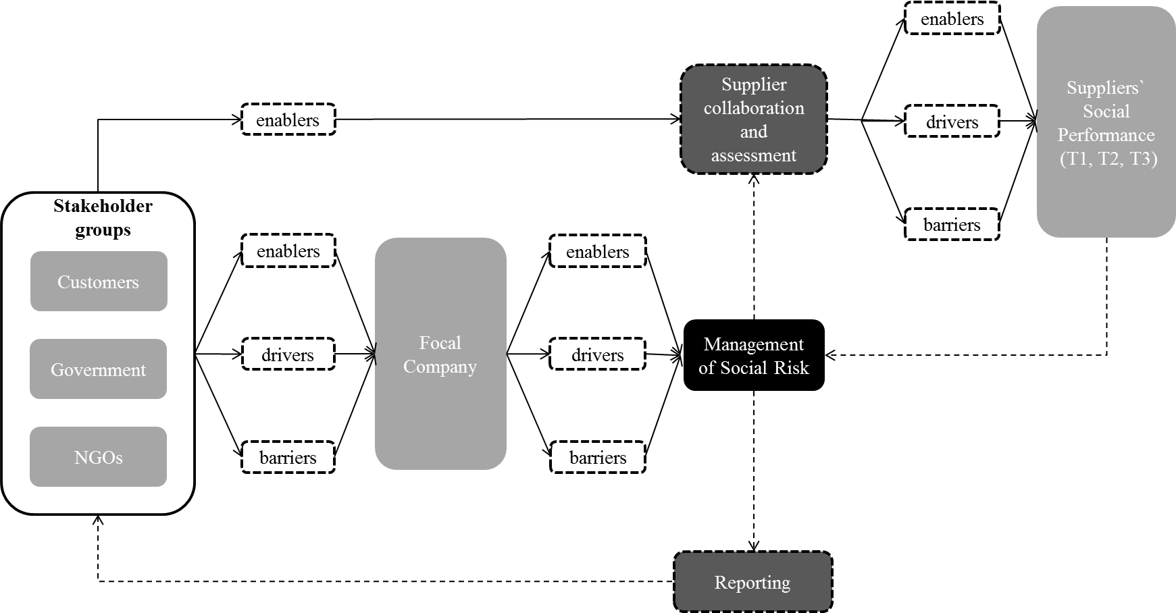
Social Risk Management in Apparel Supply Chains
Köksal et al., (2017)
Notes:
Köksal, D., Strähle, J., Müller, M., & Freise, M. (2017). Social sustainable supply chain management in the textile and apparel industry—A literature review. Sustainability, 9(1), 100.

Slide 27
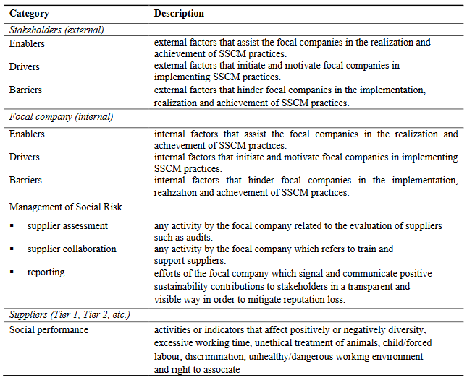
Social Risk Management in Apparel Supply Chains
Köksal et al, 2017
Notes:
Köksal et al, (2017)

Slide 28
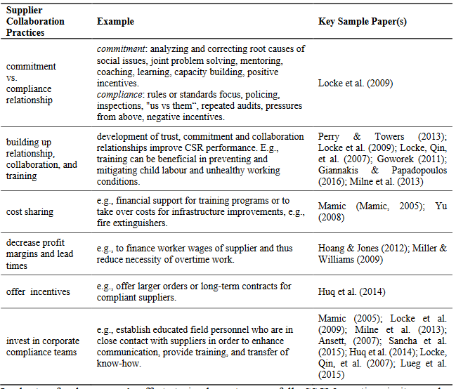
Social Risk Management in Apparel Supply Chains
Köksal et al, 2017
Notes:
Köksal et al, (2017)

Slide 29
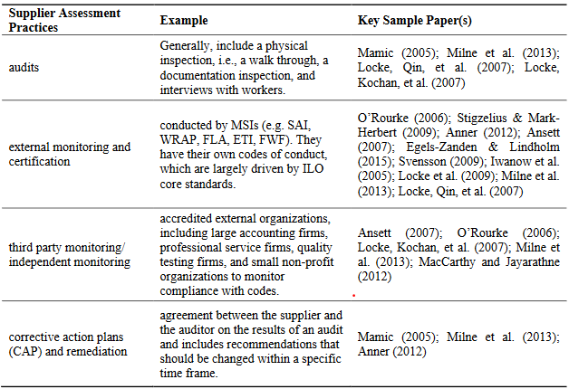
Social Risk Management in Apparel Supply Chains
Köksal et al, 2017
Notes:
Köksal et al, (2017)

Slide 30
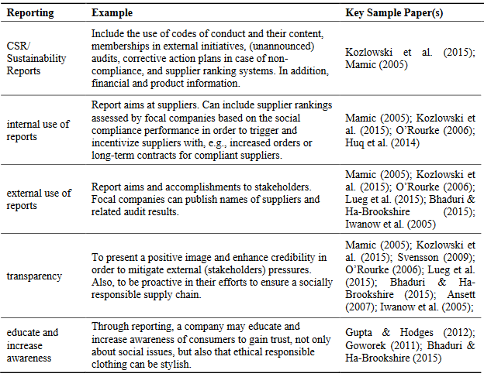
Social Risk Management in Apparel Supply Chains
Köksal et al, 2017
Notes:
Köksal et al, (2017)

Slide 31
Social Risk Management in Apparel Supply Chains
Social performance metrics are predominantly addressed by improving a supplier ́s performance for:
Human Rights/Rights to associate with groups or union
Unfair wages
Excessive working time
Child/forced labour
Unhealthy/dangerous working conditions,
Discrimination
Diversity
Treatment of animals
Notes:
Human Rights/Rights to associate with groups or union, Unfair wages, Excessive working time, Child/forced labour, Unhealthy/dangerous working conditions, Discrimination, Diversity, Treatment of animals

Slide 32
Social Risk Management in Apparel Supply Chains
Enablers
A company’s (focal or supplier) internal orientation is one of the main assisting factors for sustainable supply chain management practices.
Drivers
Generally, stakeholders such as NGOs, media and consumers act as watchdogs, hence pressure and target focal companies.
Barriers
  MSIs initiate many barriers
  governments hinder social responsibility through corruption and lack of commitment to ILO standards, especially in developing countries.
  Despite increasing awareness, consumers demands still focus on price, quality, and style.
  CSR practices are often instrumentalized.
Notes:
Enablers
A company’s (focal or supplier) internal orientation is one of the main assisting factors for sustainable supply chain management practices. Coherence to previous studies in the field can be found, as Beske et al. (2014) applied to the food industry and critically analyzed the literature regarding SSCM. They found also that their paper sample placed high importance on a company’s proactive commitment to SSCM. Further, they highlight similar risk management practices and point at the significance of collaboration efforts (Beske et al., 2014). This seems to be reasonable, because both of the industries are dynamic in nature. From the stakeholder’s
perspective, MSIs are increasingly analyzed and discussed by researchers. They play a crucial role in assisting companies (focal or supplier) in their collaboration, assessment, and reporting efforts.
Drivers
Generally, papers identified NGOs and media as watchdogs and reported that they are targeting focal companies. Contradictory to the findings of Seuring and Müller (2008), governmental pressures seem not to be one of the major stakeholder drivers for the implementation of social risk management practices. At least, not for the textile/apparel industry, as revealed during the analysis. Focal companies strive to mitigate these external risks and formulate codes of conduct, or become members of MSI groups to gain legitimacy and enhance their brand image. Consequently, focal companies put pressure on their suppliers to be compliant with their codes.
However, not only aforementioned factors drive companies (focal and supplier) to implement social risk practices, but also they can be extrinsically motivated to be more competitive, e.g., through differentiation strategies.
Barriers
Predominantly and paradoxically, MSIs initiate many barriers. Moreover, governments hinder social responsibility through corruption and lack of commitment to ILO standards, especially in developing countries. Consumer demands still focus on price, quality, and style. Code implementation and monitoring are perceived as a financial risk for both the focal company and supplier. To fulfil consumer needs and maximize profits, focal companies typically engage with a long and dispersed supply chain, making use of unfavorable buying practices and avoiding investments to support suppliers. While requiring their suppliers to be compliant, they readily
ignore code violence. At the same time, suppliers also seek profit maximization and strive to ensure the lowest prices and on-time delivery. To avoid further costs, mock compliance is not a rare practice. Further barriers from the suppliers view, i.e., lack of awareness of workers, no trust in unions, communication and comprehension issues, and misalignment between codes and local culture are identified. Studies summarize that the implementation of CSR practices are merely instrumental.
Lastly, it is important to emphasize that a specific category of one SSCM actor can be interrelated to the category of another SSCM actor. For instance, motivating factors for a focal company can create barriers for suppliers.

Slide 33
Contact
Dr. Deniz Köksal
Deniz.koeksal@reutlingen-university.
soundofgarment.com
Dr. Marcus Adam
Marcus.adam@reutlingen-university.de

