Slide 1
Transparency in Fashion Business

Slide 2
Learning Objectives
After this lecture students should be able to:
Describe what transparency is
Discuss why transparency is important in fashion business
Outline benefits and risks of corporate transparency
Explain the background and mechanism of non-financial reporting
Discuss the future of transparency in fashion business

Slide 3
Transparency
Decision of an organization to reveal all the relevant information regarding its products and internal policies and practices to legitimate partners or stakeholders, so intellectual property rights are not at risk.
Notes:
Garcia-Torres, S., Rey-Garcia, M., Sáenz, J., & Seuring, S. (2021). Traceability and transparency for sustainable fashion-apparel supply chains. Journal of Fashion Marketing and Management: An International Journal, 26(2), 344-364.

Slide 4
Transparency involves…
“The corporate disclosure of:
the names of the suppliers involved in producing the firm’s products;
information about the sustainability conditions within these suppliers’ facilities; and
the buying firms’ purchasing practices”
(Egels-Zandenet al., 2015, p. 96)
Notes:
Garcia-Torres, S., Rey-Garcia, M., Sáenz, J., & Seuring, S. (2021). Traceability and transparency for sustainable fashion-apparel supply chains. Journal of Fashion Marketing and Management: An International Journal, 26(2), 344-364.

Slide 5
Consumers want transparency

Slide 6
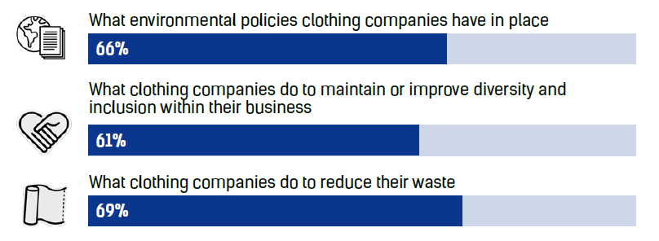
How many consumers are interested in learning about...
Fashion Revolution (2020), p.10
Notes:
Fashion Revolution (2020). Consumer Survey Key Findings. https://www.fashionrevolution.org/resources/consumer-survey/

Slide 7
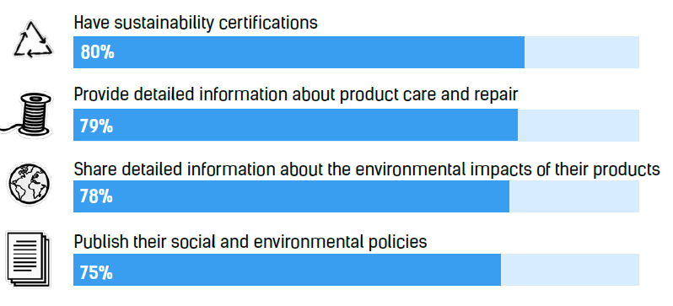
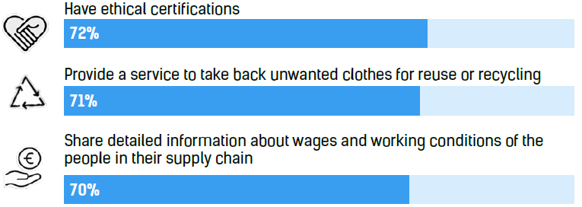
When choosing a clothing brand to buy from, how many consumers agreed that it is important for brands to...
Fashion Revolution (2020), p.9
Notes:
Fashion Revolution (2020). Consumer Survey Key Findings. https://www.fashionrevolution.org/resources/consumer-survey/

Slide 8
When it comes to supply chain transparency, people agree that fashion brands should publish…
Fashion Revolution (2020), p.10
Notes:
Fashion Revolution (2020). Consumer Survey Key Findings. https://www.fashionrevolution.org/resources/consumer-survey/

Slide 9
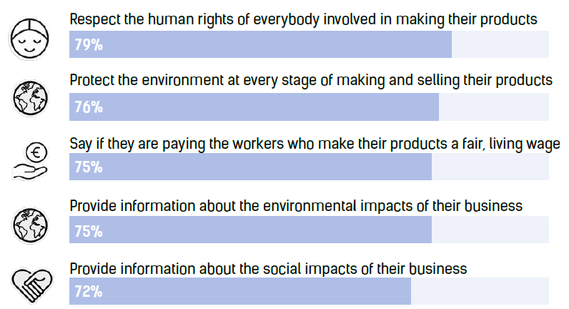
How many people agreed that fashion brands should be required by law to...
Fashion Revolution (2020), p.11
Notes:
Fashion Revolution (2020). Consumer Survey Key Findings. https://www.fashionrevolution.org/resources/consumer-survey/

Slide 10
The Fashion Transparency Index
= The Fashion Transparency Index ranks 250 brands with annual turnover of at least 400 million USD on the information they publicly disclose about sustainability, across 246 categories from animal welfare and biodiversity to purchasing practices, working conditions and recycling.
Fahion Revolution (2022)
Notes:
Fahion Revolution (2022). Fashion transparency index. https://www.fashionrevolution.org/about/transparency/

Slide 11
The Fashion Transparency Index
Access the Fashion Transparency Index: https://www.fashionrevolution.org/about/transparency/
Discuss:
How does your favorite brand score?
Go through the list of companies - any surprises?
Discuss how the scores are calculated (see next slides or in the fashion Transparency Index on page 35): Would you weight diffeently or are wightings fine?
Notes:
Fahion Revolution (2022). Fashion transparency index. https://www.fashionrevolution.org/about/transparency/

Slide 12
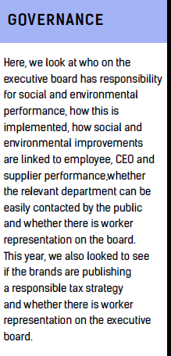
The Fashion Transparency Index - Weighting of the scores
4.4%
13.2%
Fahion Revolution (2022), p.35
Notes:
Fahion Revolution (2022). Fashion transparency index. https://www.fashionrevolution.org/about/transparency/

Slide 13
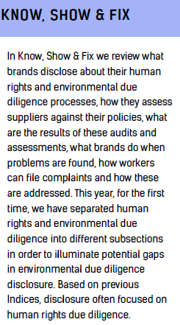
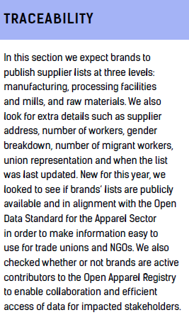
The Fashion Transparency Index - Weighting of the scores
20%
29.2%
Fahion Revolution (2022), p.35
Notes:
Fahion Revolution (2022). Fashion transparency index. https://www.fashionrevolution.org/about/transparency/

Slide 14
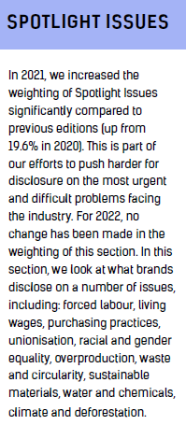
The Fashion Transparency Index - Weighting of the scores
33.2%
Fahion Revolution (2022), p.35
Notes:
Fahion Revolution (2022). Fashion transparency index. https://www.fashionrevolution.org/about/transparency/

Slide 15
The Fashion Transparency Index – Key Issues in 2022
Progress on transparency in the global fashion industry is still slow among 250 of the world’s largest fashion brands and retailers, with brands achieving an overall average score of just 24% (= up 1% from 2021)
More brands than ever (48%) are disclosing their first tier suppliers, however, half still disclose nothing
Less than a third of major brands disclose a decarbonization target covering their entire supply chain
Fahion Revolution (2022)
Notes:
Fahion Revolution (2022). Fashion transparency index. https://www.fashionrevolution.org/about/transparency/

Slide 16
The Fashion Transparency Index – Key Issues in 2022
Most (85%) major brands still do not disclose their annual production volumes despite mounting evidence of overproduction and clothing waste
Most retailer take-back programs simply divert clothing from local communities and ship it off to secondhand markets in the Global South, where we know much of the clothing ends up in landfills, burnt or swept out to sea
Only 11% of brands publish their supplier wastewater test results, despite the textile industry being a leading contributor to water pollution
Fahion Revolution (2022)
Notes:
Fahion Revolution (2022). Fashion transparency index. https://www.fashionrevolution.org/about/transparency/

Slide 17
The Fashion Transparency Index – Key Issues in 2022
As new and proposed legislation focuses on greenwashing claims, almost half of major brands (46%) publish targets on sustainable materials yet only 37% provide information on what constitutes a sustainable material
Only 24% of brands disclose how they minimize the impacts of microfibres despite textiles being the largest source of microplastics in the ocean
Just 12% of brands publish a purchasing code of conduct indicating that most are still reluctant to disclose how their purchasing practices could be affecting suppliers and workers
Fahion Revolution (2022)
Notes:
Fahion Revolution (2022). Fashion transparency index. https://www.fashionrevolution.org/about/transparency/

Slide 18
The Fashion Transparency Index – Key Issues in 2022
The vast majority of major brands and retailers (94%) do not disclose the number of workers in their supply chains paying recruitment fees → paints an unclear picture of the risks of forced labor
Only 13% of brands disclose how many of their supplier facilities have trade unions
The industry’s reliance on low-wage female labour continues yet most brands (94%) neglect to disclose the key issue of how prevalent gender-based labor violations are
Most major brands and retailers (96%) do not publish the number of workers in their supply chain paid a living wage, nor do they disclose if they isolate labor costs in their pricing
Fahion Revolution (2022)
Notes:
Fahion Revolution (2022). Fashion transparency index. https://www.fashionrevolution.org/about/transparency/

Slide 19
Let`s work!
Do some research and list scandals that fashion brands were involved:
What brands were involved?
Which countries were involved?
What kind was the mistreat (human rights, environmental…)?

Slide 20
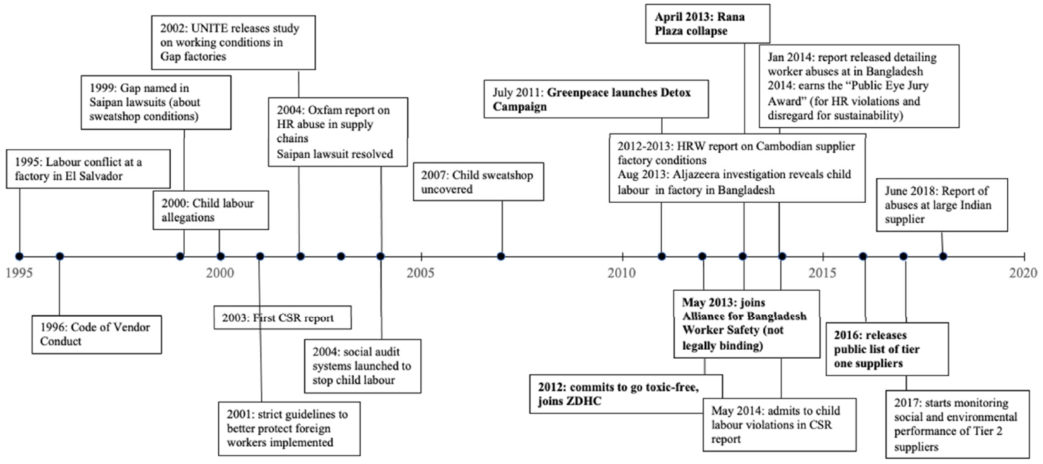
Inditex scandal and CSR timeline
Fraser & van der Ven (2022), p.17
Notes:
Fraser, E., & van der Ven, H. (2022). Increasing Transparency in Global Supply Chains: The Case of the Fast Fashion Industry. Sustainability, 14(18), 11520.

Slide 21
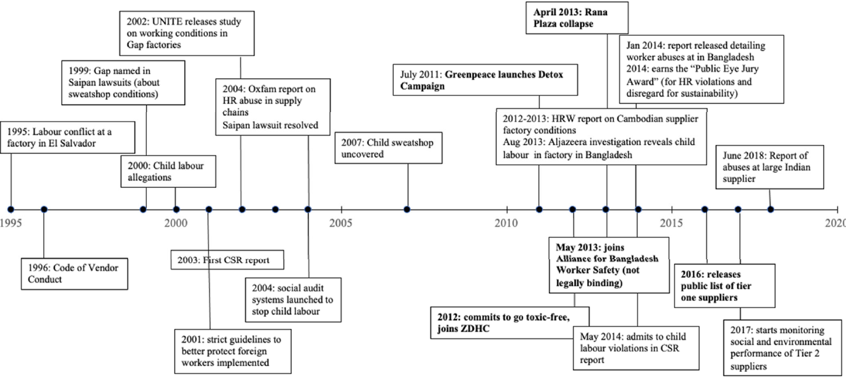
GAP scandal and CSR timeline
Fraser & van der Ven (2022), p.18
Notes:
Fraser, E., & van der Ven, H. (2022). Increasing Transparency in Global Supply Chains: The Case of the Fast Fashion Industry. Sustainability, 14(18), 11520.

Slide 22
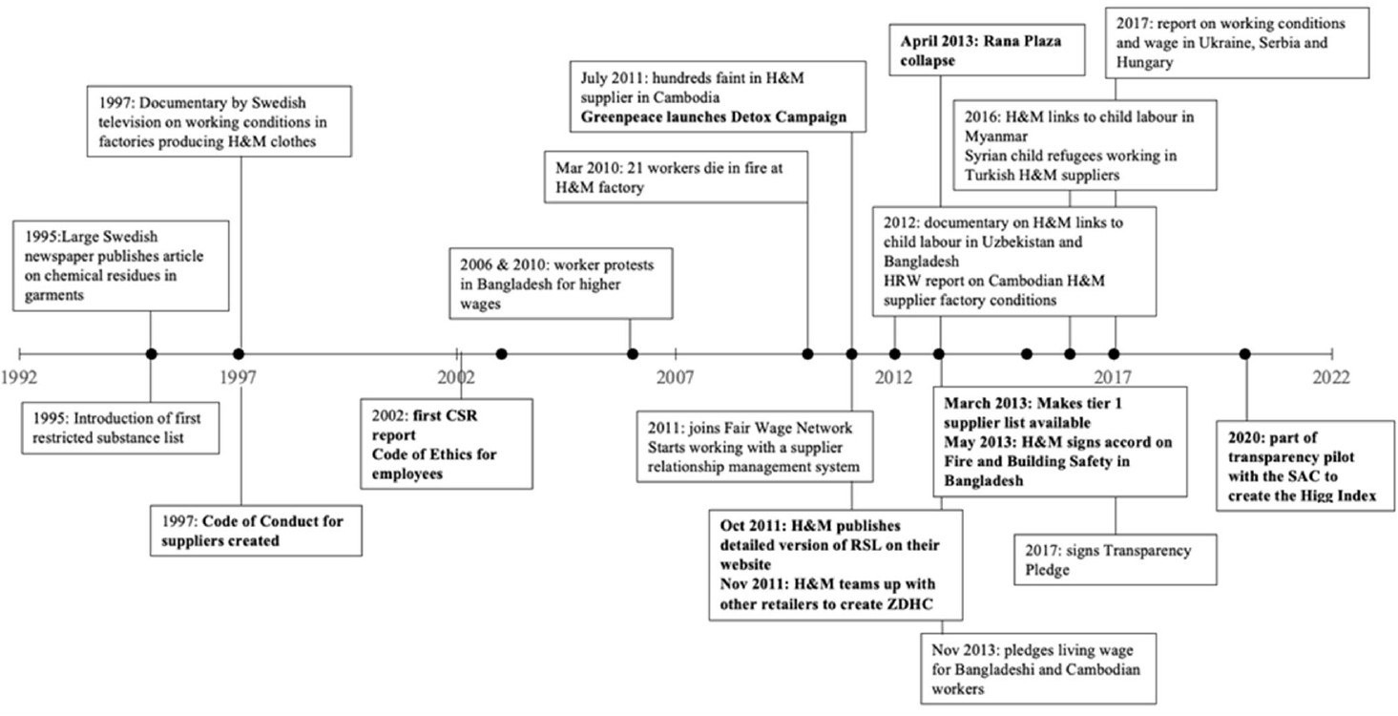
H&M scandal and CSR timeline
Fraser & van der Ven (2022), p.17
Notes:
Fraser, E., & van der Ven, H. (2022). Increasing Transparency in Global Supply Chains: The Case of the Fast Fashion Industry. Sustainability, 14(18), 11520.

Slide 23
Benefits of transparency
Reducing or preventing negative market signals regarding environmental and social impacts and building trust
Facilitating the assessment of regulatory and voluntary compliance
Enhancing the efficiency and quality of SSCM
Being associated with attitudes towards purchase intention
Garcia-Torres et al. (2021)
Notes:
Garcia-Torres, S., Rey-Garcia, M., Sáenz, J., & Seuring, S. (2021). Traceability and transparency for sustainable fashion-apparel supply chains. Journal of Fashion Marketing and Management: An International Journal, 26(2), 344-364.

Slide 24
Risks of transparency
Increased exposure to name and shame campaigns
Risk of innovation lifespan reduction
Distrust derived from certificates not backed up by a government agency
Garcia-Torres et al. (2021)
Notes:
Garcia-Torres, S., Rey-Garcia, M., Sáenz, J., & Seuring, S. (2021). Traceability and transparency for sustainable fashion-apparel supply chains. Journal of Fashion Marketing and Management: An International Journal, 26(2), 344-364.

Slide 25
Requirements on corporate reporting
Within in the EU, legislation for corporate reporting differentiates between companies which are of public interest (PIEs) and those who are not (non-PIEs):
In general, non-PIEs need to fulfill the requirements set by the respective member state they are located in *)
Def. as credit institutes, insurers and capital market-oriented companies
PIEs need to follow the requirements steming from Regulation (EC) No 1606/2002 which among others asks for application of the International Financial Reporting Standards (IFRS) as endorsed by the EU
*) Still, harmonization on EU level has been applied since the contract of Lissabon.

Slide 26
Legal background and requirements

Slide 27
International Financial Reporting Standards (IFRS)
Issued by the International Accounting Standards Board (IASB), the standard setting body of the IFRS Foundation
Required by approx. 170 jurisdictions worldwide
Objective is to provide users of financial statements information that is useful for decision-making
Companies should present a true and fair view of their financial position, its performance and the cash flows; means for this are
Statement of financial position
Statement of comprehensive income
Statement of cash flows
Discuss: How do the IFRS contribute to the concept of accountability?

Slide 28
Brief reflection of reporting requirements
Financial statements comprise information linked to the past
Decision usefulness might be limited in relation to forecasts
General necessity of further requirements regarding non-financial information
Financial information
Non-financial information
?

Slide 29
Further aspects on potential relevance of non-financial information
Changes in economic and geopolitical realities after the pandemic
Acceleration of digitization
Changes due to the virtualization of the working world (New Work)
Conversion to sustainable and climate-neutral economic processes
Future reporting will need to include non-financial information more comprehensively to reflect these developments.
Source: KPMG (2021)
Notes:
Where corporations are currently changing.

Slide 30
Non-financial reporting
Under IFRS companies might provide a management commentary which is not compulsory
On national level, EU members already require economic outlooks by the management, e.g. the German Lagebericht (§289 HGB)
Risk management objectives and methods
Presentation of hedges of important types of transactions
Dealing with price change, default and liquidity risks, etc.
Non-financial performance indicators, such as information on environmental and employee issues
Opportunities and RIsks
Obligation only for corporations with over 500 employees

Slide 31
Implementation of the current requirements by the companies (headlight Germany)
Compliance with §289 of the German Commercial Code (HGB) in conjunction with the concretization by GAS 20 by medium-sized companies
Despite legal requirement, low level of risk assessment
Assessments of current megatrends (environmental protection, digitization, globalization) are hardly to be found in the companies' management reports
Discuss: What could be the reasons here?
Source: Müller/Seebeck/Weeger (2021), n=100
Notes:
It is striking that there is hardly any reporting on current megatrends such as climate change, digitization and globalization, although enormous risks are likely to lie dormant here for many companies.
Reasons: We can only speculate, but conceivable ones might be:
It is questionable whether companies are not making an assessment because
they do not have the necessary risk management systems to do so,
simply have no knowledge of a reporting obligation,
are afraid of the high costs of reporting, or
fear the competitive costs that could arise from disclosing competitively sensitive information.

Slide 32
Critical view on current requirements
Information is not relevant, not reliable, rarely comparable (critics were investors and other stakeholders).
How should non-financial information then be considered, e.g., for investments?
Also, too few companies committed.
Summary:
Corporates
Investors
Public

Slide 33
Importance of sustainable reporting
Study by Baumgartner/Ernst/Fischer (2020) points out the comparatively low significance of sustainable reporting for various groups of addressees
Discuss: What is your perception of the importance of this information?

Slide 34
Voluntary sustainability reporting
Nonwithstanding current legal requirements, companies may develop their own sustainability requirements and report about it
economic necessities
own beliefs
Positive effects on financial parameters (sales/profit) may not occur until much later!
Two important currencies: Credibility and trust!
Topic: What can the company do for society?
Discuss: What could be the downside of voluntary reporting in terms of sustainable aspects?
Notes:
Trust has been shaken in the past for various reasons (financial crisis or special textile Rana Plaza).
Some are obliged, some do it voluntarily,
Therefore we have a few BP examples
Downside: no legal boundaries for the reporting, there could be an incentive for green-washing.

Slide 35
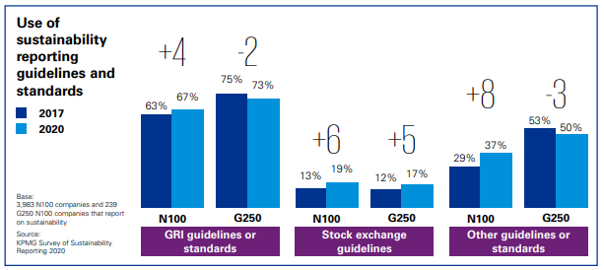
Excursus: No consistent source for sustainable reporting, but…
Examples:
→ Larger companies most commonly use GRI:
ISO 9001
Notes:
Until now, companies have been able to use different frameworks for their reporting, such as the German Sustainability Code or the standards of the Global Reporting Initiative (GRI).

Slide 36
Würth MODYF GmbH & Co. KG
Company
Products
Workwear and safety footwear manufacturer
Place, Age
Künzelsau, 1997 as a subsidiary of Adolf Würth GmbH & Co. KG
Size
Employees: 144 / Sales: 56 million euros / Balance sheet total:
Reporting
Type
Voluntary reporting according to GRI standards, separate report, since 2020
Scope
84 pages
Contect
Linking the five focus topics with the company's strategic orientation
Products
Supply chain
Resources
Climate protection
Employees
ISO 9001, ISO 14001
GRI Index
Notes:
Company figures 31.12.2019
Würth MODYF publishes the first sustainability report under the name LOOPthinkING. The 2019 status report shows the starting basis, the sustainability performance set in motion so far and the "future loop" in the focus tasks.
Examples:
Products: Certification, product lifecycle management
Supply chain: supplier management, fair working conditions, ecological responsibility, highest quality standards
Resources: environmental compatibility (avoidance of waste/environmental pollution), resource efficiency (e.g. packaging quantities, paper consumption, transport logistics), health
Climate protection: share of renewable energies, CO2 emissions
Employees: diversity of workforce, social commitment
ISO 9001: implementation of generally recognized quality management systems Core = continuous improvement process (KPV)
ISO 14001: internationally recognized and applied standard for environmental management systems for planning, implementing, controlling and improving environmental performance, targets and commitments

Slide 37
Wolford AG
Company
Products
Luxury skinwear (legwear, bodywear, lingerie)
Place, Age
Bregenz (Austria), founded 1950
Size
Employees: 1,243 / Sales: 119 million euros / Balance sheet total: 162 million euros
Reporting
Type
Separate sustainability report since 2017/18 (obligated qua legal from (AG))
Scope
44 pages
Contect
Responsible corporate governance and compliance
Sustainability issues and stakeholders involved
Consequences for the sustainability strategy (concrete KPIs)
Areas of responsibility (environment, employees, supply chain)
Energy consumption, CO2 emissions, wastewater, waste, water
Working hours, fluctuation, occupational safety, diversity
Certification, materials
GRI index
Notes:
Company figures from 30.04.2020, because 2020 was a short fiscal year
since 2017/18, because NaDiVeG (Sustainability and Diversity Improvement Act).
In September 2018, Wolford launched the first organic recyclable sweaters, T-shirts and leggings. These products, developed as part of the Austrian Smart Textiles initiative, are fully compostable. In April 2019, the company received the "Cradle to Cradle Certified™ (Gold)" award for the development of technically recyclable (i.e. completely recyclable) products - in 2020, the first technically recyclable tights, the "Aurora 70 Tights", could be launched. Wolford is the first and so far only company in the apparel and textile industry to be certified "Gold" by "Cradle to Cradle" for the development of environmentally neutral products in both categories ("biodegradable" and "technically recyclable").

Slide 38
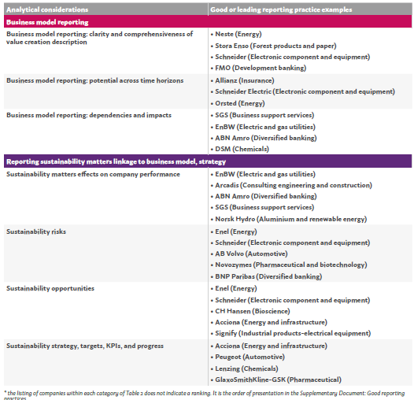
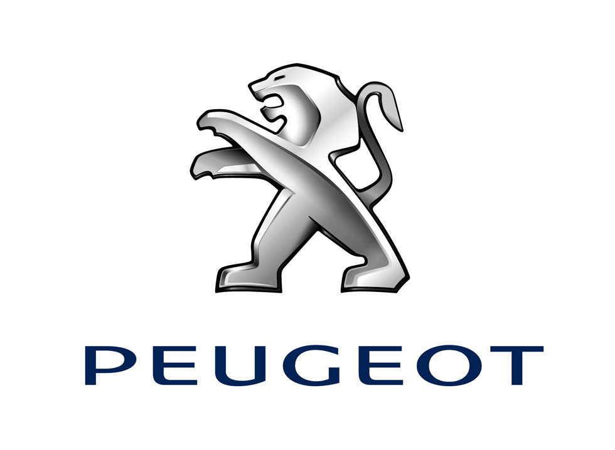
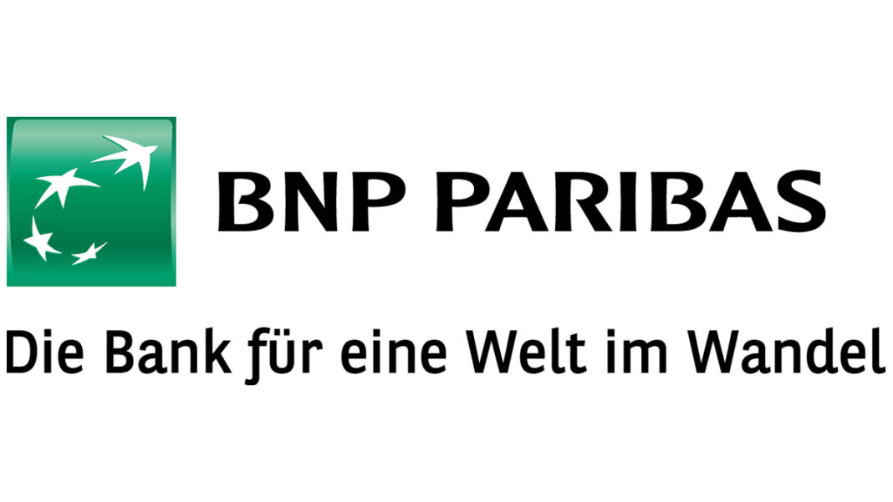
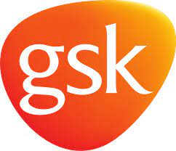
Further examples of good practise
Source: report of the EFRAG Task Force
Notes:
Studie der European Financial Reporting Advisory Group (EFRAG)
Anwendung von etablierten Standards (GRI, UN Global Compact, TCFD (Task Force on Climate Related Financial Disclosure), IIRC (Interational Integrated Reporting Committee) IR Framework, NFRD Framework (EU))
Ausführliche Einschätzung der Risiken und Chancen
Verknüpfungen der Aussagen mit dem Geschäftsmodell und der strategischen Ausrichtung des Unternehmens
Ausführungen zu KPIs

Slide 39
The big BUT…
To map sustainable developments in the companies is one thing
In order to implement actual sustainable developments it is necessary:
CAPITAL
Understanding of the capital providers
working business cases
Discuss the following statement:
“Regulation, and be it via reporting standards, will help along the way.”
Notes:
"Non-financial information is of increasing importance to stakeholders and will soon have the same relevance as financial reporting. Currently, a lack of standards and a lower level of expertise among reporting companies and audit institutions give the topic a special appeal."

Slide 40
Where we go to?

Slide 41
Necessity of sustainability reporting requirements
Contrary to the study by Baumgartner et al.
Stakeholders of companies with increasing interest in information about the consideration of sustainability in corporate activities
Sustainability reporting recognized by politicians → Instrument in the context of combating climate change as well as increasing importance of ecological and social aspects
Decision-making by companies in the interest of a more ecological and social world, first of all transparency about these aspects of decisions
Discuss: Is the dominance of financial aspects eroding?
Notes:
Previous statements applied mainly to D, EU-wide it does not look better
Therefore appearance of the European Union in the form of the European Commission
Conflict between level of regulation and stakeholder expectations
If the companies do not do it themselves, then politics must become active.

Slide 42
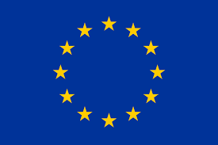
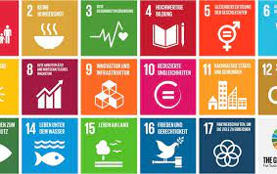
Reporting standards to be used and place of reporting
EU-wide single source:
To be defined
From no consistent source so far to the Vision of the EU Commission
Publication of sustainability information in the management report of the companies.
Format: annual financial statements and management reports electronically in xhtml format.
Aspects of sustainability reporting are to be digitally identified (tagging)
Notes:
Until now, companies have been able to use different frameworks for their reporting, such as the German Sustainability Code or the standards of the Global Reporting Initiative (GRI). In order to improve the comparability and quality of sustainability reporting, companies are now required to use uniform reporting standards which, among other things, specify the information to be reported and the type of reporting (e.g. structure of the report). It should be noted that the standards should also cover corporate governance aspects. The standards will be issued by the EU Commission by way of delegated acts; for SMEs, standards are envisaged which take into account the special features of these companies. A staggered timetable is envisaged for the adoption of the standards (see timeline). The EU Commission is required to take into account the technical advice of the European Financial Reporting Advisory Group (EFRAG) when developing the standards.

Slide 43
Revision of the CSR Directive by the EU
EU Green Deal: climate-neutral continent by 2050
Small building block to this: Complete revision of the existing CSR Directive.
Publication of the draft in April 2021, with the objectives:
More transparency on sustainable aspects
Eye-to-eye with financial reporting
Ending the "two-tier society" of financial and non-financial information
Regulation of clear responsibilities
Alignment with the EU Action Plan on Sustainable Finance/EU Green Deal

Slide 44
Extension of the scope of application
Factor 10x
Capital market-oriented companies and companies with more than 250 employees
Previous obligation for approx. 500 companies in Germany alone
New regulation affects approx. 5,000 companies in Germany
Larger corporates obligated as of 01.01.2023 (=elimination of capital market and employee criteria)
Capital market-oriented small and medium-sized enterprises (SMEs) as of 01.01.2026
Large capital market-oriented companies
Notes:
The Commission's proposal now addresses these points of criticism: The group of companies that will have to report on non-financial aspects in the future is growing strongly. In principle, all companies listed on a regulated market in the EU (with the exception of micro-entities), as well as large non-capital-market-oriented companies and most banks and insurance companies, will be required to report on non-financial indicators in the future, thus contributing to greater transparency on sustainable aspects.

Slide 45
Expansion and specification of reportable information
Regulatory content expanded and specified
Focus on environmental, social and employee issues
Corporate governance aspects added (e.g. role of management board and supervisory board)
Furthermore reporting on:
Inclusion of the supply chain
Requirement that reporting is retrospective and forward-looking (in the short, medium and long term), qualitative and quantitative
Disclosures on intangible assets, such as "human capital" or "social capital
Reporting on measures taken to prevent, mitigate or eliminate negative impacts
Targets and target achievement in relation to sustainability aspects
Consideration of stakeholder interests and sustainability aspects within the framework of the business model and corporate strategy
Compatibility of corporate planning with the Paris climate target (1.5 degree target)
Resilience of the business model and corporate strategy

Slide 46
As of today: Questions remain unanswered...
Solutions
No generally accepted imaging system
So far only little regulated
Many proposals, concepts, approaches discussed and tried out
Standardization is missing (also key figures)!
Depiction horizon of sustainability aspects >> Period of other reporting
NBE deals with the entire value chain and should refer to the entire product life cycle
Consideration of all modes of impact required
Time frame for implementation
New directive will not apply to the majority of companies until 2026 at the earliest
Agenda to achieve climate neutrality by 2050 on the one hand, critical points by 2030 on the other hand
new EU standards ?
(Relevance, Reliability, Comparability)
Double materiality - environment on company and company on environment ?
Previous commitment or self-commitment after all
Notes:
Information is not relevant, not reliable, rarely comparable
EU sustainability standards to become legally binding, before 2023
Orientation to GRI standards conceivable, due to cooperation with GRI since mid-2021.
Due to the expansion of reporting to consider the entire value chain (from design to production to distribution of products), many (also non-) companies are already facing the following challenges
However, many medium-sized companies (including non-capital market-oriented ones) are already facing concrete demands for sustainability information from external parties. In addition
In addition, these companies are of course also affected by the social trend toward sustainability.
First of all, internal management systems should be systematically designed so that financial and non-financial as well as economic, ecological and social aspects can be considered together.
can be considered together. Only on this basis is sustainable corporate management and external NB possible in a credible and decision-relevant manner.
However, implementation is made considerably more difficult by the fact that concrete requirements are not yet available. The mandatory standards for the NL adopted by the EU are not expected to be available until
be available in October 2022. Nevertheless, it is already advisable for SMEs to look into the GRI, for example, and to set up or expand non-financial reporting systems. This should
be seen as an opportunity to achieve competitive advantages through sustainable entrepreneurial action. Also due to the requirements for credit institutions, SMEs should strive to take equal account of the sustainable
business success on an equal footing with existing corporate reporting processes in order to contribute to greater trust and transparency vis-à-vis capital providers, investors and the general public.
transparency vis-à-vis lenders, investors and customers.

Slide 47
Appreciation of the EU Directive
1.
2.
3.
4.
Reconsider timetable for introduction
Take better account of findings from risk and opportunity reporting
Binding specifications for key figures to be reported across all industries
Digitalization in accounting must generally advance
Bring commitment forward, but reduce audit rigor in first few years after implementation
esp. with regard to already identified/known needs for action and potential for improvement:
E.g.: assessment/categorization of risks, information regarding gross vs. net view.
Systems only as good as the data they contain
Need for knowledge carriers
Notes:
Three theses on the innovations in sustainability reporting formulated (cf. vhb-experts dated January 26, 2021):
The requirements for sustainability reporting are noticeably increasing: Since 2017, certain companies in the EU have been required to account for their sustainability performance - in the form of so-called non-financial reporting. With the upcoming revision of the CSR Directive, it is expected that sustainability reporting will be far more comprehensive in the future. At the same time, it is foreseeable that access will be made easier through digital provision and mandatory external auditing.
Medium-sized companies will have to deal more intensively with sustainability reporting: With the revision of the CSR Directive, large or listed companies in particular will be required to provide non-financial reporting. However, it cannot be ruled out that - sooner or later - SMEs could also be affected. In any case, companies that are obliged to report on sustainability must also report on sustainability performance in their supply chain.
Increased linkage of capital costs to sustainability reporting: The increased linkage of capital costs to sustainability reporting results from the requirements that have recently been imposed on financial companies when determining their investment decisions. Corresponding EU pronouncements urge financial companies to integrate sustainability considerations into their processes when making investment decisions.

Slide 48
A spark of hope?
It is not only the EU Commission that has taken up the issue of sustainability reporting:
IFRS Foundation - responsible for the internationally recognized accounting standards IFRS - has founded a new entity, the International Sustainability Standards Board (ISSB), which is to develop global basic standards (Global Baseline) in the area of sustainability reporting in the future.
The ISSB was already joined by a number of voluntary initiatives when it was founded.
With the founding of the ISSB, two prototypes were published on the topics:
Climate reporting and
general requirements for the disclosure of sustainability-related financial information.
The ISSB is based in Frankfurt am Main
"Competition" stimulates business.
Plus tendencies to align among ISSB, GRI and EFRAG.
Notes:
Current aspects:
mergers, such as the formation of the International Sustainability Standards Board (ISSB),
cooperations, such as the Global Reporting Initiative (GRI) with the European Financial Reporting Advisory Group (EFRAG),
supporting statements (and thus no longer to own proposals), as in the context of the review of sustainability reports on 15.9.2022 by the International Organization of Securities Commissions (IOSCO).

Slide 49
Contact
Prof. Dr. Jochen Strähle
Jochen.straehle@reutlingen-university.de
Prof. Dr. Malte Wessels
malte.wessels@reutlingen-university.de
Dr. Marcus Adam
Marcus.adam@reutlingen-university.de

