Slide 1

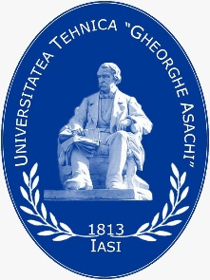


Summary, Reflections and Outlook
Part 2: Sustainable Textile Technologies and Fashion in the European Market

Slide 2
Structure of the ESD Module
Sustainable Textile Technologies and Fashion
Sustainability and Entrepreneurship
Didactic and Methodological Implementation of ESD
Part I
Part II
Part III
CC BY-SA Grundmeier

Slide 3
Teaching Units of Part II
Sustainable Raw Materials and Textile Materials
Sustainable Knitting Production
Dyeing and Printing in the Context of Sustainability
Finishing in the Context of Sustainability
Fashion Design in the Context of Sustainable Development of the Fashion and Textile Industry (Part 1)
Fashion Design in the Context of Sustainability (Part 2)
Pattern Making in the Context of Sustainability
Best Practices of Sustainable Product Development through 3D-Design and Visualization
Clothing Technology and Production Methods in the Context of Sustainability
Social, Health and Environmental Impact in Textile and Apparel Manufacturing Processes
Selected Student Projects at Partner Universities (Part 1)
Selected Student Projects at Partner Universities (Part 2)
Chances and Risks of a Sustainable Textile and Clothing Production in the European Market
Summary, Reflections and Outlook

Slide 4
Initial situation
The textile industry in Europe includes a wide range of products and processes such as spinning, knitting, weaving and finishing of textiles, followed by the production of industrial and technical textiles.
The sector employs a total of 636,000 workers in 62,100 companies across Europe, 99% of which are small and medium-sized enterprises. The largest EU countries in terms of employment are Italy, Germany, UK, followed by Poland and Portugal. In addition, the textile industry is the sector with the greatest gender balance among all TCLF sectors, as 51% of employees are women.
All textile education stakeholders are making efforts to develop programmes that reflect the modernity of these industries and the wide variety of career opportunities they offer today. The workforce is the greatest asset of the textile and apparel industry, which must preserve the existing know-how, and this is only possible if it employs qualified people (https://s4tclfblueprint.eu/project/tclf-sectors/european-clothing-industry/).

Slide 5

1st Lecture
Lecture on “Sustainable Raw Materials and Textile Materials’’.
This module focuses on information about the classes of textile raw materials, as well as information about the global fibre market and statistics on megatrends.
The unit provides a detailed description of natural and man-made fibres, their production and existing categories.
A comprehensive presentation of various existing sustainable fibre initiatives, projects and programmes is available to stakeholders.
The lesson links knowledge of fibres and textile materials to sustainability issues and applies mindfulness and ethical thinking to this subject area.
CC BY Vie Studio, Pexels

Slide 6
Reflections on 1st Lecture
Sustainability is about producing more environmentally friendly materials that are produced in a way that does not have harmful effects on the physical properties of the environment, soil, air, and water.
The sustainability of textile products is based on a durable product design with a recyclable raw material input.
More environmentally friendly materials are either made from organic raw materials, recycled, or require little energy during the manufacturing process.
Growing awareness regarding sustainability has increased demand for textiles from natural materials.
Environmentally friendly fabrics are being made from environmentally sound materials such as: organic cotton, lyocell and recycled materials.
Due to the growing world population and the increase in global demand for fibre, high resource throughput is the most pressing problem. The real problem, then, is consumption based on short fashion cycles and a textile economy that is not yet able to recycle.

Slide 7
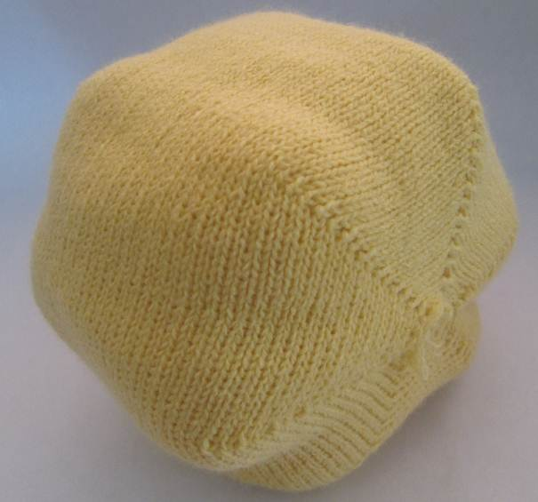
2nd Lecture
Lecture on “Sustainable Knitting Production’’.
This paper presents the general context of trends related to sustainable textile production and discuss the particular situation of knitting technology as one of the oldest existing technologies.
The knitted materials can be designed outstanding properties such as: great flexibility in manufacturing, controlled mechanical properties, excellent formability, and stretchability.
Learners will become familiar with categories of knitting and with methods of producing knitted products, exploring the technical features of electronic flat knitting machines.
The sustainable aspects of knitting technology take a central place in the module and concrete solutions are shown.
Digitalization is an ongoing process in the knitting industry that contributes to its sustainable future, so this unit reflects on some available trends and solutions.
CC BY-NC-ND - BLAGA

Slide 8
Reflections on 2nd Lecture
Achieving sustainability requires the involvement of all stakeholders in the knitwear industry. Emphasis is placed on reusing, recycling and upcycling raw materials and reducing or even eliminating knitwear waste.
Manufacturers and users have rethought processes, production and consumption volumes by selecting sustainable raw materials for knitwear production, using energy-efficient technologies, minimizing or eliminating emissions, using environmentally friendly chemicals and minimizing waste.
Wholesalers and retailers should promote the business of sustainable knitwear produced using a sustainable approach.
Consumers are generally aware of sustainable products and should be appropriately informed and make purchasing decisions based on the environmental impact of the product rather than the price.

Slide 9
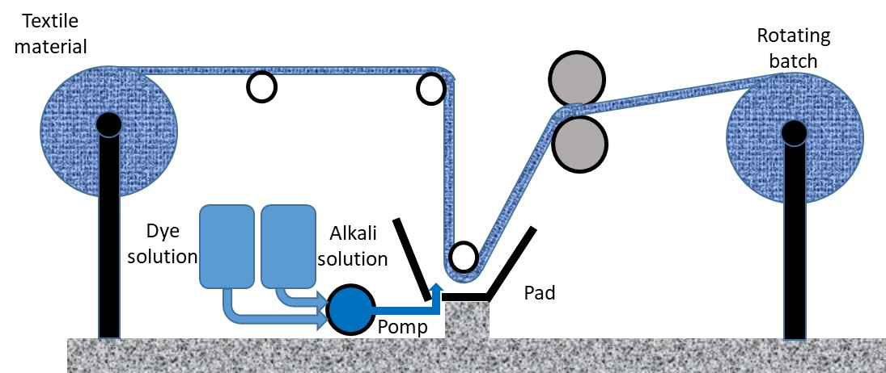
3rd Lecture
Lecture on “Dyeing and Printing in the Context of Sustainability’’.
This learning unit introduces the main topics related to sustainability in textile dyeing and printing.
In particular, the modules outline the sustainability aspects associated with the use of textile dyes.
An important part deals with the presentation of the possibilities to optimize existing technologies and to replace environmentally harmful products.
CC BY-SA BERTEA

Slide 10
Reflections on 3rd Lecture
In the field of chemical processing of textiles, there are numerous problems associated with the vast majority of specific processes. Special attention should be paid to the problems related to the presence of dyes in the wastewater from the dyeing process and the possibilities of wastewater recycling.
One approach to solving environmental problems associated with dyeing and printing processes is to optimize existing technologies. Process efficiency is fundamentally linked to environmentally friendly technologies. Doing more with less" is the first step toward sustainability.
Producing quality products with less energy, raw and auxiliary materials, and generating little and non-toxic waste naturally leads to an increase in company profits and is good for the environment at the same time.
A second way is to develop completely new dyeing and printing technologies that ensure low water consumption, reduce the use of chemical auxiliaries, achieve a high degree of dye fixation and thus protect the environment.

Slide 11
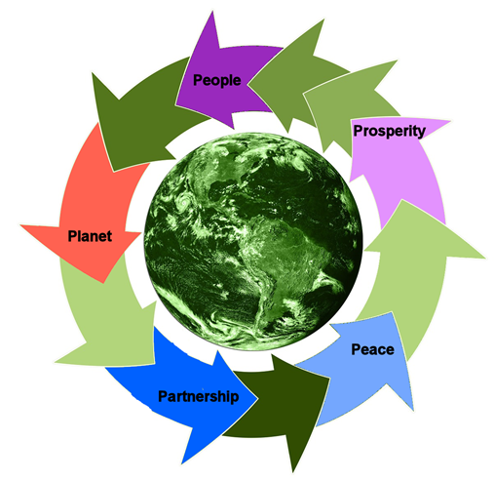
4th Lecture
Lecture on “Finishing in the Context of Sustainability’’.
The focus of the topic is to understand the main issues related to sustainability in textile finishing, namely: high wastewater and water consumption, low-maintenance finishing, potential environmental risks related to halogenated flame retardants, etc.
One of the points covered in the unit is the issue of sustainability related to the use of textile auxiliaries.
The lecture provides information on the possibilities of optimizing existing technologies and replacing environmentally harmful products.
The module provides knowledge about the revolutionary new eco-friendly finishing technologies.
CC0 BERTEA, adapted from Musahara (2016)

Slide 12
Reflections on 4th Lecture
The textile industry is one of the biggest polluters, which is why approaches to introduce environmentally friendly processing are increasingly in demand. Increased consumer awareness of pollution reduction is driving textile manufacturers to eliminate or at least reduce toxicity during the production and life cycle of textiles.
Modern textile finishing aims to use sophisticated processes that are more environmentally friendly. Nanotechnology has revolutionized the textile industry in recent decades by providing a new way to add new properties to the textile surface without affecting other properties.
Although the use of nanotechnology is generally considered to be environmentally friendly, future research should aim to investigate in detail the environmental aspects of the use of nanoparticles.

Slide 13
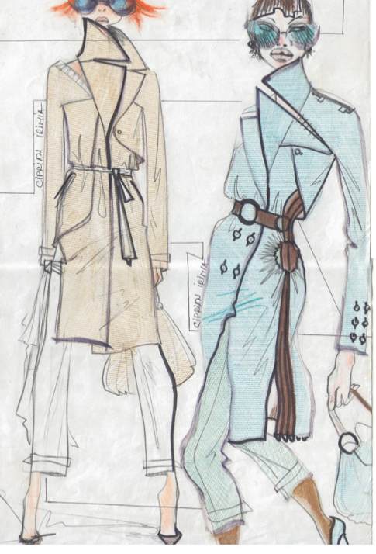
5th Lecture
Lecture on “Fashion Design in the Context of Sustainability (Part 1)”.
The unit deals with the argumentation regarding the need for sustainable approaches in the fashion and textile industry and sustainable fashion approaches.
It explains the role of design and fashion designers in sustainable development and useful tools in design for sustainability.
The module discusses why education is an important factor in creating a truly sustainable fashion industry by teaching young designers to design with low waste and consider the product life cycle.
Success stories and practices that can serve as inspiration for young designers are presented.
CC BY-NC-ND – Designer
Constantin Ciprian Irimia

Slide 14
Reflections on 5th Lecture
Launched in May 2016, the European Clothing Action Plan aims to encourage industry, academics and creatives to rethink how we design and make products, how we use and consume products, and to redefine the reuse and recycling of those products. Recycling and upcycling play a major role in the sustainability criteria of economic, environmental and social dimensions.
The fashion industry can take a collaborative approach to design and production to accelerate sustainable design and innovation across the industry.
Industry and education can develop a symbiotic relationship that can lead the fashion industry to a sustainable future.
Education is an important factor in creating a truly sustainable fashion industry by teaching young designers to design with low waste and consider the product life cycle.
Sustainable approaches and practises in the operations of designers can help reduce the amount of microfiber released into the environment, reduce toxic waste and support animal welfare, develop clothing that is distinctive and unique, put less strain on the planet's resources, and do no harm to people.

Slide 15
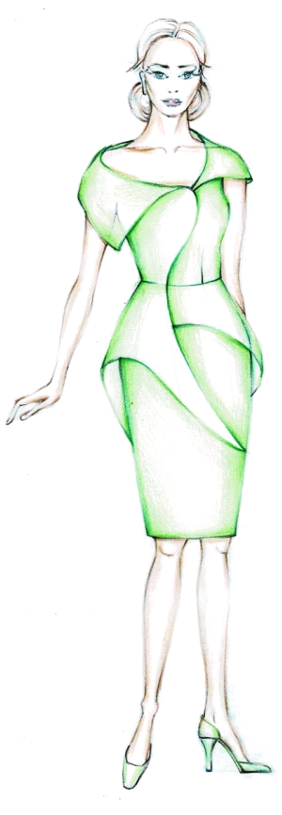
6th Lecture
Lecture on “Fashion Design in the Context of Sustainability (Part 2)”.
The teaching unit teaches about the slow fashion, based on the long life fashion elements: different types of drapes, other 3D elements, peplums, and non volume silhouettes.
The lecture gives information about applying of the golden ratio and Fibonacci sequence as sustainable proportions in fashion design.
The topic teaches the students to design clothes applying sustainable long life fashion elements: different types of drapes, other 3D elements, peplums and combined silhouettes.
The unit also trains the students to design clothes, textiles and accessories using sustainable proportions of the golden ratio and Fibonacci sequence, and applying geometrical figures and tiles, based on the golden ratio and Fibonacci sequence.
CC BY Ilieva

Slide 16
Reflections on 6th Lecture
A study on the application of the long life fashion elements in design of women’s clothes shows some reasons for their sustainability in trends:
  They are with high aesthetic value and are elegant and feminine ones.
  They can be combined easily each other or with other elements of fashion design.
The applying of the sustainable golden ratio and Fibonacci sequence proportions gives beauty, harmony and sustainability in fashion design of clothes and accessories, and textile design.
The use of the golden section and Fibonacci series bring aesthetics in designs, based on different sustainable conceptions (zero waste, upcycled, circular designs, etc.) and can be applied as emphasizers of the long life fashion elements.

Slide 17
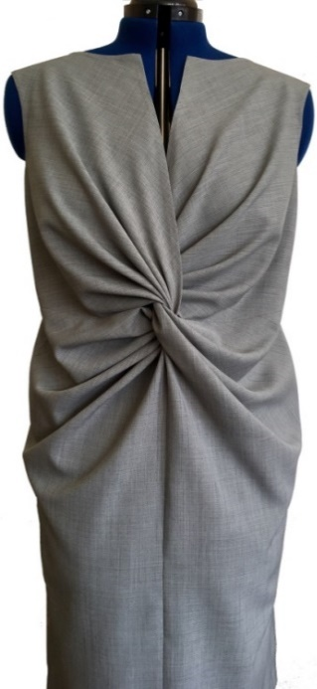
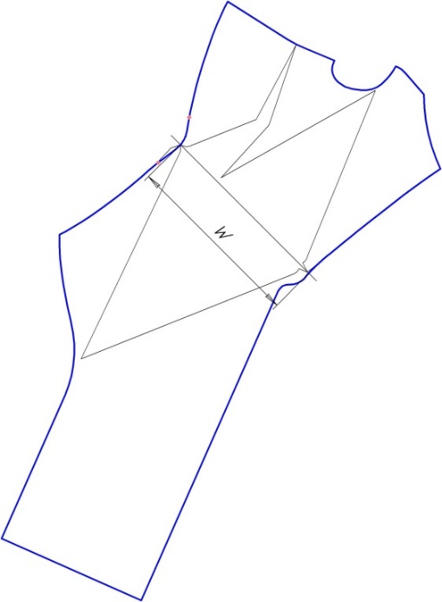
7th Lecture
Lecture on “Pattern Making in the Context of Sustainability”.
The unit teaches how to make correct patterns of women’s clothes with sustainable long life fashion elements of all types of drapes using facilitated constructional sequences and easy calculations and to make accurate patterns of women’s clothes with long life fashion element of peplum.
The lecture trains how to design patterns with sustainable proportions of the golden ratio and Fibonacci sequence in direct use or with application of geometric figures.
The topic also teaches to create pattern designs with lower consumption of textile material and minimizing or zero cutting waste.
CC BY Kazlacheva

Slide 18
Reflections on 7th Lecture
The accuracy of presented approaches of pattern making of women’s clothes with drapes is based on the correct and facilitated geometric sequences of constructing of the fourth types of draperies, and the correct and easy formulas, used for the twist knot and twisted draperies. The applying of the formulas lead to correct pattern design for all possible combinations of sizes of the elements of drapes.
The presented pattern designs are examples of sustainable and correct pattern making of women’s clothes with sustainable long life fashion elements of all types of drapes, peplums, and 3D elements; sustainable golden and Fibonacci sequence proportions through direct proportioning or geometric figures; lower consumption of textile material and minimizing waste cutting; zero waste pattern cutting; and combinations between them.

Slide 19
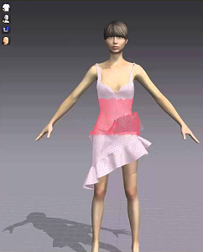
8th Lecture
Lecture on “Best Practices of Sustainable Product Development through 3D-Design and Visualization”.
The unit teaches students to characterize the concept of sustainability and digitalization for fashion and textiles and to describe the importance of digital innovations for a sustainable fashion and textile industry.
The module trains students to characterize product development for the mass customization fashion industry and presents sustainable solutions for product development - fashion and apparel industry.
The topic also informs students how to characterize digital apparel development and describe best practices of sustainable product development - fashion and apparel industry.
Video Source: Marvelous Designer Cloth Simulator 101 (2015)

Slide 20
Reflections on 8th Lecture
The constant evolution of virtual technology that defines our personal and professional lives inspires and amazes us. The ever-expanding digital world opens up new possibilities, both for the creative process and for how we interact with and discover fashion.
The trend toward digital transformation is on the rise. It aims to meet consumers' needs, involve them in the creation process, protect the environment and the world's resources, help companies adjust their cost structures, improve the value chain and consolidate their position in the market.
It is the time to think about how we can use digital technology to produce what is necessary at an efficient cost, without harming the environment and producing excessive amounts of waste.

Slide 21
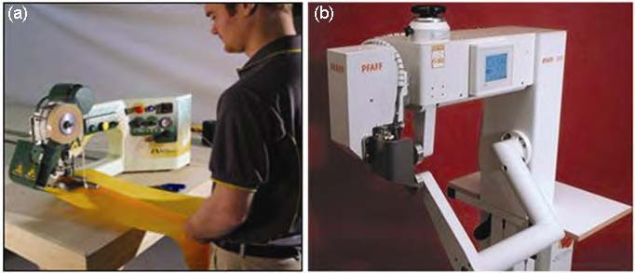
9th Lecture
Lecture on “Clothing Technology and Production Methods in the Context of Sustainability”.
The lecture teaches the students to describe sustainable manufacturing system.
The topic trains the students to characterize the functional sportswear and to describe new technologies in functional sportswear.
The unit also teaches the assembling technologies for functional sportswear and to understand the design and clothing technology for disassembly.
T3 from Miller Weldmaster, Source: http://www.weldmaster.com
PFAFF 8320-010 hotwedge welding, Source: http://www.pfaff-industrial.de

Slide 22
Reflections on 9th Lecture
The distinctive features of sports-functional apparel manufacturing and the development of assembly technologies such as sewing, welding and gluing, along with the upcoming challenges in this field are presented. New technologies for the production of sports-functional clothing fabrics presents.
Combining of natural and synthetic materials in apparel products caused problems with material recovery, reuse, recycling, or composting at the end of product life. The concept of disassembly design and its application to the designing and making of men's jacket presented. With this type of design, consumers and manufacturers can easily compost, recycle, or reuse different materials and components at the end of the garment’s usable life.
The presented clothing technologies for sustainable sportswear production offer examples to search for new ideas for sustainable clothing technologies and realize new fashion designs with minimal environmental footprint.

Slide 23
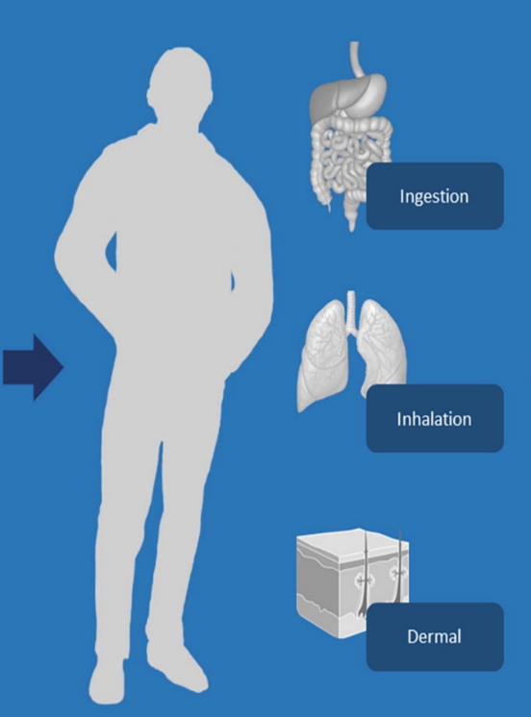
10th Lecture
Lecture on “Social Health and Environmental Impact
of Textile and Apparel Manufacturing Processes“.
The teaching unit gives knowledge of the core health impacts of textile and clothing production in producing countries, in particular the impact on textile workers.
The lecture offers information about the environmental impact in textile and clothing manufacturing processes on social health, and the physical, chemical, environmental and occupational hazards in textile manufacturing processes.
The topic also teaches the students to exemplify pros and cons of sustainable textile use and care in terms of a less unhealthy impact in textile production and to reflect and reason their consumer behavior and sustainable impact on the society and health of textile workers.
CC BY Prata et al., 2019

Slide 24
Reflections on 10th Lecture
Safety and health measures play an important role in the textile and clothing industry. It is essential that the workers are aware of the various occupational (physical, chemical and environmental) hazards.
Textile workers even suffer from a lack of informal education regarding
occupational safety.
It is necessary that the management and regulations take the necessary steps to protect workers from potential hazardous situations.
Consumers in high income countries have a role to play in supporting companies and practices that minimise their negative impact on humans and the environment.

Slide 25
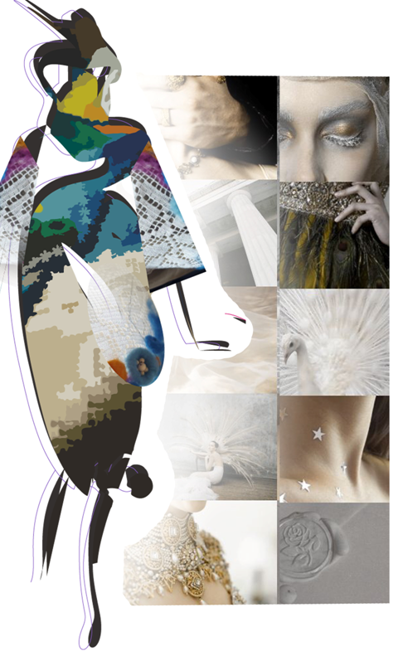
11th Lecture
Lecture 11 on “Selected Student Projects at Partner Universities (Part 1)”.
The module briefly presents the studies developed by students from the Master's studies specializing in modelling and clothing design, within the discipline of Sustainability in fashion, at Faculty of Industrial Design and Business Management, TUIASI Romania.
First student's collection was developed around the concept of personalizing worn/used clothing through handmade painting. Personalizing clothing gives a sense of uniqueness, reinforces the sense of identity and creates a more personal experience.
The second project proposes the reintegration of textile waste into an experimental-creative collection, representing a challenge in finding both technical and aesthetic solutions.
The third collection includes 8 stylized models, in which lace elements are superimposed with felted surfaces. All designs are decorated with shapes made by felting directly on the lace and embellished with wooden beads to keep the vintage style.
CC BY JOANDREA Maria-Mirabela

Slide 26
Reflection on 11th Lecture
As a conclusion from the work presented, it can be said that fashion is no longer about buying what's hot and ending up with a pile of clothes that never see the light of day after being worn once or not at all.
These spontaneously purchased garments only add to the already existing and ever-growing waste in landfills and do significant harm to the ecosystem.
In the future, a conscious step must be taken to stop promoting the concept of fast fashion, which has greatly affected the ecosystem and life in general, and instead turn to more sustainable fashion that is healthier for the planet and future generations.
Sustainable fashion is defined as clothing, footwear and other accessories that are produced and used in the most sustainable way possible, taking into account both the environment and socio-economic aspects.

Slide 27
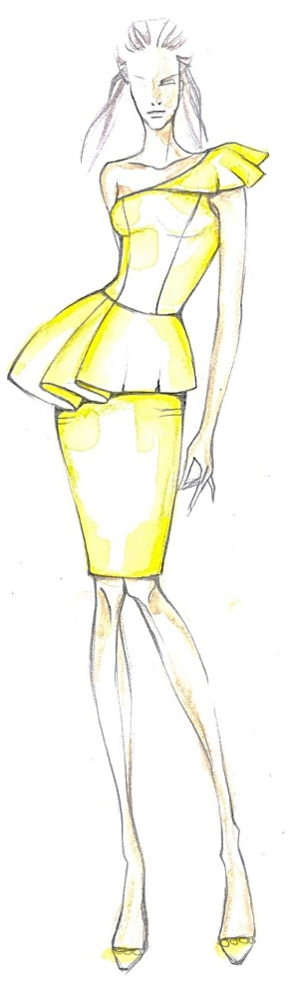
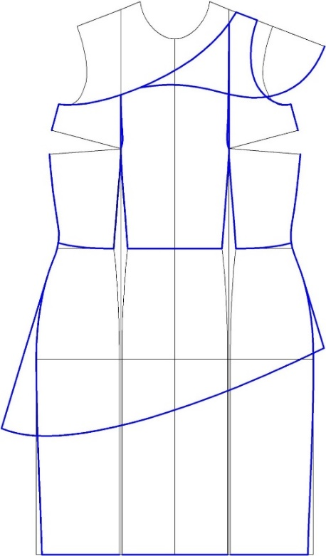
12th Lecture
Lecture 12 on “Selected Student Projects at Partner Universities (Part 2)”.
The unit trains how the students to design clothes applying sustainable long life fashion elements: drapes, other 3D elements and peplums, and to design clothes using sustainable proportions, based on the golden ratio and Fibonacci sequence.
The lecture teaches the students how to make correct patterns of draped clothes using easy calculations and design accurate patterns of 3D peplum dresses.
The topic also trains how to create pattern designs with lower consumption of textile material and minimizing or zero cutting waste.
CC BY Dineva

Slide 28
Reflection on 12th Lecture
The presented students’ projects of Master degree and PhD students of the Faculty of Technics and Technologies of Yambol, Trakia University, Bulgaria on sustainable design and pattern making of women’s clothes can be seen as examples for development of new ideas and creation of new slow fashion designs with:
Different types of long life fashion elements: all types of drapes, other 3D elements, peplums;
The golden and Fibonacci proportions;
Minimizing waste;
And combinations between long life elements, sustainable proportions, and minimizing waste.

Slide 29
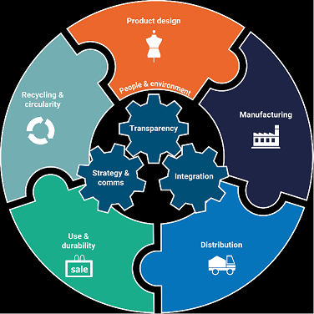
13th Lecture
Lecture 13 on “Chances and risks of a sustainable textile and clothing production in the European market”.
The teaching module provides an overview of the European textile and clothing industry.
The unit discusses the challenges in the European textile and clothing market and the threats in the European textile and clothing market.
The theme offers information on sustainability in textile and apparel production, which is hardly conceivable without the transformation from a predominantly linear economy to a consistent circular economy, the simultaneous reduction of overconsumption and the rapid reduction of CO2 emissions.
Reflections on the topics presented and thought-provoking questions round out this relevant topic for the textile industry.
CC BY ANTHESIS

Slide 30
Reflection on 13th Lecture
The idea of sustainability has become a buzzword lately and has turned some heads. Just as consumers are now taking a closer look at the food they consume and the chemicals they put in their bodies, they are also shifting their purchasing decisions to create a cleaner environment through the clothes they wear.
Some fashion brands are aware of their unsustainable practises, but it is not always easy for them to change. Nevertheless, the growing consumer demand for ethical products is already forcing the fashion industry to adapt, as evidenced by the increasing number of campaigns promoting sustainable practises in the fashion industry.
It is time for consumers to pay attention to everything they own, including their clothes, to learn more about where and by whom their clothes are made, to act responsibly and to use their purchasing decisions to change the way manufacturers see them.
Notes:
Image Source: Anthesis, Sustainability in the Apparel, Textiles, Footwear and Homeware Industries
https://www.anthesisgroup.com/retail-sector/apparel-footwear-textiles/

Slide 31
Outlook

Slide 32
European textile and fashion industry dimension
The European textile and fashion industry, together with the clothing industry, plays an important role both among manufacturing industries and as a representative of European cultural heritage, creativity and innovation. Although often perceived as a traditional sector, the industry has made great strides in product innovation and technologically advanced and more sustainable production processes in recent decades (www.euratex.eu).
Textiles are the most important raw material for the apparel industry. They also provide many innovative solutions that facilitate the daily lives of European citizens in furnishing their homes and households, and enable the functionality of many technical applications in the fields of transport, construction, energy, agriculture, healthcare, sports and personal protection.
Clothing products manufactured in the EU are characterised by particular environmental friendliness, consumer safety and workers' rights. Due to the nature of production, the industry is closely linked to the textile and leather sectors.

Slide 33
European textile and fashion industry status
The fashion industry has been impacted directly by the pandemic situation, as the Textile, Clothing, Leather and Footwear (TCLF) sector is a cross-sectoral industry providing intermediate goods for almost every economic sector and finished consumer products. Therefore, it is vital to provide the sector’s human resources with the skills that the “new normality” will require (www.euratex.eu).
Fashion industry players, their product ranges and organisations, as well as textile and fashion researchers in Europe are under pressure to address the growing demand for a sustainable textile chain and fashion market. Technological progress and globalisation are constantly changing the industry and the world economy. This phenomenon requires qualified people who are able to adapt to a constantly changing work environment.
With the aim of developing sector-specific skills solutions, the European Commission's New Skills Agenda has launched the Blueprint for Sectoral Cooperation on Skills, as a framework for developing strategic cooperation between key stakeholders in each sector of the economy (companies, education and training institutions, research institutes, public authorities), https://euratex.eu/projects/skills4smart-tclf-industries-2030.

Slide 34
Updated technical lectures content
There is a constant need to update the technical content of lectures in engineering education. In this context, the second part of ESD introduces relevant topics for the fashion industry and focuses on their particular sustainable aspects.
These modules seek to create awareness of the key issues of each topic in relation to the development of sustainable products. They have been developed to improve teachers' professional skills and their content can be part of curricula at different educational levels or a valuable source of documentation for teachers.
Current curricula should be accompanied by innovative learning methods that are better suited to teach today's generations of students how to deal with the need for more sustainable production processes and products, and how to use key technologies to meet the demands of the economy and take advantage of global opportunities.
The didactic and methodological concepts presented in the first part of the ESD module provide useful information and suggestions for improving teaching and learning processes and can be adapted to the specific case of the specialised topics dealt with in this second pillar.

Slide 35
Required skills for implementing ESD
Education for sustainable development (ESD) in the context of fashion and textiles should become a guiding principle in the curricula of universities and further education institutions, because only knowledgeable teachers and learners can make right decisions in the context of the industrial constant development.
To embed ESD in curricula, teacher’s capacity development is setup at EU level, as a key priority, e.g., Roadmap 2030 from UNESCO, 2020.
For this, teachers need an understanding of transformative action processes that can be developed through knowledge and their own experience with transformative learning approaches.
Lecturers, teachers, and trainers also need critical design competencies based on expertise, skills, and sustainability-related knowledge, motivation, and reflection on their own thinking.

Slide 36
Key points for implementing ESD
Finding and adapting the right methods for implementing ESD in technical courses is a challenge for teachers at all levels of education. In addition to technical skills, they should correctly identify the learning outcomes of their lectures and, above all, find the most efficient way to achieve them, taking into account the diversity and motivation of learners.
Ensuring curriculum quality is more than just consulting a framework and developing a comprehensive plan. Curriculum quality is the foundation for quality teaching practice in higher education. It is about ensuring that the process of design, development, and delivery meets both sector and institutional standards, frameworks, and strategic plans to ensure successful program delivery and student learning outcomes (https://federation.edu.au/staff/learning-and-teaching/teaching-practice/course-design/design-for-learning).

Slide 37
Approaches for design learning activities
The essence of learner-centered design, whether at the program or course level, is a focus on the learner and learning. The approach to designing learning activities must be evidence-based to support the successful achievement of intended learning outcomes and assessment tasks (https://federation.edu.au/staff/learning-and-teaching/teaching-practice/course-design/design-for-learning).
There are several approaches to designing learning activities used by higher education institutions around the world. Some of these might be worth trying for teaching technical subjects, as the following examples show. These can be adapted and tailored to the specific topics and learning outcomes covered in the available technical modules.

Slide 38
Approaches for design learning activities
Active learning is a process whereby students engage in activities, such as reading, writing, discussion, or problem solving that promote analysis, synthesis and evaluation of class content. A combination of cooperative learning, collaborative learning, problem-based learning and the use of case methods are some approaches that promote active learning (https://federation.edu.au/staff/learning-and-teaching/teaching-practice/course-design/design-for-learning).
Cooperative Learning involves structuring classes around small groups that work together in such a way that each group member's success is dependent on the group's success. Students who engage in cooperative learning learn significantly more, remember it longer, and develop better critical-thinking skills than their counterparts in traditional lecture classes. Students enjoy cooperative learning more than traditional lecture classes, so they are more likely to attend classes and finish the course.

Slide 39
Approaches for design learning activities
Collaborative learning is an important component of active learning and sits within a community of inquiry theoretical framework. It provides opportunities for a group of individuals to collaborate in purposeful critical discourse and reflection to construct personal meaning and mutual understanding.
Project-based learning involves deep learning as it focuses on real-world problems and challenges and emphasises problem solving, decision making, and investigative skills. Project-based learning begins with the final product or presentation in mind, which requires learning specific knowledge, creating a context/a reason to learn and understand the concepts.
Team-based learning is a structured form of small-group learning that emphasises student preparation out of class and application of knowledge in class.
Small groups learning refers to any method of student–tutor interaction that involves a group of 3–25 students, which may meet only once or several times throughout a semester, and which tends to be focused upon the discussion of predefined subject specific material.

Slide 40
Teaching practices
Quality teaching practices are about more than expertise and a passion for sharing information. It is about providing a range of opportunities to motivate students from diverse backgrounds to acquire knowledge, perfect their skills, and apply that knowledge and skills to enter successful employment in industry and in our community https://federation.edu.au/staff/learning-and-teaching/teaching-practice).
In a learner-centred approach, teaching practices can be divided into eight domains:
  - Learning – understanding your learners and their needs
  - Assessment – creating effective ways to demonstrate learning
  - Course Design – designing an inclusive learning journey
  - Development – building your learning space
  - Facilitation – engaging f2f and online teaching practices
  - Feedback – providing quality feedback for learning
  - Monitoring – monitoring engagement in learning
  - Evaluation – reviewing for future enhancements.

Slide 41
Teaching practices
Constructive alignment is the practice of ensuring that intended learning outcomes for a course of study are effective, clear and purposeful and that learning activities, and assessment tasks are developed in alignment with these outcomes (https://federation.edu.au/staff/learning-and-teaching/teaching-practice/constructive-alignment).
It must be ensured that intended learning outcomes are written, and assessments are developed, and learning activities are designed in accordance with the principles of constructive alignment.
There are two basic concepts behind constructive alignment:
Learners construct meaning from what they do to learn.
The teacher intentionally aligns planned learning activities with learning outcomes and determines how to measure the achievement of those outcomes.

Slide 42
OER Explanation
OER Licence CC BY-SA except the logos and where otherwise stated e.g. images, photos, pictures.
A full citation of text and image sources is always given at the first mention of the authors in the notes beneath the slide, otherwise short citation in the text or on the slide.

Slide 43
Contact
The “Gheorghe Asachi” Technical University of Iasi, Romania
Faculty of Industrial Design and Business Management
Department of Clothing and Knitting Engineering
Prof. Dr. Habil. Eng. Mirela Blaga
E-mail: mirela.blaga@academic.tuiasi.ro
Trakia University of Stara Zagora, Bulgaria
Faculty of Technics and Technologies of Yambol
Assoc. Prof. Dr. Zlatina Kazlacheva
E-mail: zlatinka.kazlacheva@trakia-uni.bg

