Slide 1




Education for Sustainable Development (ESD) as a Guiding Principle in the Context of Fashion and Textiles

Slide 2
Learning Objectives
After this lecture you should be able to:
Describe and reflect sustainability models in the context of fashion and textiles.
Explain the meaning of ESD and Design Competence with its sub-competences.
Explain the core competencies of Global Development Education.
Discuss ESD and Design Competence in the context of textiles and fashion.
Reflect on your consumer behaviour and its impact on a sustainable fashion and textile market.

Slide 3

Guiding Principle of Sustainable Development
[…] to do business today, to shape politics and to live in such a way that conditions worth living in are created or made possible for present and future generations. This is possible – according to the concept of sustainability – when ecology, economy and social issues are viewed together as interdependent. Combining economic prosperity with socially just conditions, while minimizing environmental pollution and conserving natural resources, and not imposing burdens on future generations that would impair their life chances compared with today’s, has become the objective of both international and national policy.
(de Haan, 2008, pp. 23-24)
CC0 Anna Shvets, Pexels
Notes:
De Haan, G. (2008). Gestaltungskompetenz als Kompetenzkonzept der Bildung für nachhaltige Entwicklung. [Design competence as a competence concept of Education for Sustainable Development.] In I. Bormann & G. de Haan (Eds.), Kompetenzen der Bildung für nachhaltige Entwicklung. Operationalisierung, Messung, Rahmenbedingungen, Befunde [Competences of Education for Sustainable Development: Operationalisation, measurement, frameworks, findings] (pp. 23–43). VS Verlag für Sozialwissenschaften.
Gerhard de Haan is a German educational scientist, most recently employed at the Freie Universität Berlin. From 2005 to 2014, he was Chair of the National Committee for the United Nations Decade of Education for Sustainable Development.
Image Source: Holding Green Leaves, Anna Shvets, Pexels, https://www.pexels.com/license/, https://www.pexels.com/photo/person-holding-green-leaves-5029853/

Slide 4
Three-Pillar Model of Sustainable Development
The three-pillar model (Triple Bottom Line) assumes that sustainable development can only be achieved through the simultaneous and equal implementation of environmental, economic and social goals.
The three aspects are interdependent in order to ensure and improve the ecological, economic and social performance of a society.
The term Triple Bottom Line has become established as an approach to developing and maintaining principles of sustainability in corporate policy
over the long term.
Sustainable Development
Social
Ecological
Economic
CC0 Grundmeier

Slide 5
Target Dimensions of Sustainability
Ecology
Society
Economy
Preservation of the natural foundations of life
Equality and equal rights, opportunity of a fulfilling life, right to human dignity for all
Satisfaction of needs and prosperity for all
CC0 Grundmeier

Slide 6
Priority Model of Sustainability
It is being criticised that the three-circle model represents economic, ecological and social sustainability as being of equal importance to each other.
In fact, the goal of ecological sustainability should be given priority since the protection of natural living conditions is the basic prerequisite for economic and social stability in the sense of the priority model: ecology before social justice and economic efficiency.
Global Ecosystem
Society
CC0 Grundmeier
Economy
Notes:
Simplified, the priority model can be summarised as follows: There is no economy without society and no society without planet Earth.

Slide 7
Weighted Pillar Model of Sustainability
Pillar model according to Stahlmann (2008), in which ecology with natural resources and the climate provide the basis.
The culture pillar stands for a culture of sustainability without an overexploitation the planet.
Sustainable Development
CC0 Grundmeier, adapted from Stahlmann, 2008, p. 61
Economy
Culture
Social Aspects
Ecology (Natural Resources & Climate)
Notes:
Stahlmann, V. (2008). Lernziel: Ökonomie der Nachhaltigkeit: eine anwendungsorientierte Übersicht. [Learning Objective: Economics of Sustainability: an application-oriented overview.] Oekom.
Zimmermann, F. M. (2016). Was ist Nachhaltigkeit – eine Perspektivenfrage? [What is sustainability - a question of perspective?] In F. M. Zimmermann (Ed.), Nachhaltigkeit wofür? [Sustainability for what?] (pp. 1–24). Springer. https://doi.org/10.1007/978-3-662-48191-2_1
On the one hand, the culture pillar stands for a culture of sustainability without overexploitation of the planet, but on the other hand it also stands for a commercialisation of education, art as well as science; genetic modifications of organisms or interventions in evolutionary processes should no longer occur (Stahlmann, 2008, pp. 46-48). According to Zimmermann this is the attempt to resolve the tension between ecology, economy and social issues and to design a realistic “building” of sustainability (Zimmermann, 2016, p. 18).
The common feature of the models is that the three dimensions of ecology, economy and social aspects are always taken into account for sustainable development. The weighted pillar model according to Stahlmann shows, however, through the integration of a fourth dimension and ecology as a basis that there are other pillars in addition to the three already known, which can also be of importance for sustainable development.

Slide 8
Sustainability Model for Fashion and Textiles
Textile Ecology:
Production Ecology
Human Ecology
End-User Ecology
Disposal Ecology
Social Sustainability Along the Textile Value Chain
Economy:
Natural Fibre Production
Man-made Fibre Production
Textile and Fashion Industry
Textile and Fashion Trade
Used Clothing Market, Textile Recycling and Disposal
CC BY-SA Grundmeier
Notes:
In the context of fashion and textiles or the textile and fashion industry, the three-pillar model has become established.

Slide 9
Fields of Textile Ecology
Production Ecology
Production Ecology: environmental relevance (output of energy, raw materials, emissions to air, water and soil, residues, etc.) of the textile value chain.
Human Ecology
Disposal Ecology
End-User Ecology
End-User Ecology: utilisation phase of textiles and environmental impact of washing, cleaning and other processes of textile care.
Human Ecology:
effects of textiles and their chemical ingredients on human health and well-being.
Disposal Ecology: recycling (return to the use and production cycle) and disposal (incineration or landfilling).
CC BY-SA Grundmeier
Notes:
Cf. on the segmentation of textile ecology Forschungsinstitut Hohenstein (Ed.). (1991). Das 1. Hohensteiner Fachsymposium Ökologie in der Textilen Kette. Tagungsband 22./23.10.1991. [The 1st Hohenstein Symposium on Ecology in the Textile Chain. Proceedings 22/23 October 1991.] Hohenstein Institutes.

Slide 10
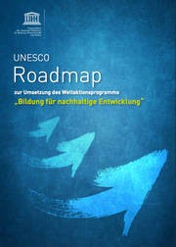
Education for Sustainable Development (ESD)
The term Education for Sustainable Development emerged from the Johannesburg Summit in 2002.
In the UNESCO Roadmap for the Implementation of the Global Action Programme ‘Education for Sustainable Development’, ESD is defined as follows:
ESD empowers learners to make informed choices and act responsibly to protect the environment, sustain the economy and create a just society for current and future generations, while respecting cultural diversity. (German Commission for UNESCO, 2014, 12).
https://sustainabledevelopment.un.org/index.php?page=view&type=400&nr=1674&menu=1515
Notes:
Deutsche UNESCO-Kommission e.V. [German Commission for UNESCO] (Ed.). (2014). Roadmap zur Umsetzung des Weltaktionsprogramms „Bildung für nachhaltige Entwicklung“. [Roadmap for the implementation of the World Programme of Action "Education for Sustainable Development".] https://www.unesco.de/sites/default/files/2018-01/unesco_roadmap_bne_2015.pdf
Education for Sustainable Development (ESD) has its origins in Agenda 21, the official outcome document of the 1992 World Conference on Environment and Development. It is a development policy and environmental policy document with a commitment to global cooperation in the field of development and environment. For a new, sustainable form of justice between people and nations in the world, a connection between development policy insights and ecological necessities is to be created, aiming at sustainable development.
Bund-Länder-Kommission für Bildungsplanung und Forschungsförderung [Federal-State Commission for Educational Planning and Research Promotion] (BLK) (Ed.). (1999). Bildung für eine nachhaltige Entwicklung – Gutachten zum Programm von Gerhard de Haan und Dorothee Harenberg. [Education for Sustainable Development - Expert opinion on the programme by Gerhard de Haan and Dorothee Harenberg.] Issue No. 72. http://www.blk-bonn.de/papers/heft72.pdf
The education campaign Education for Sustainable Development emerged from the UN Decade of the same name, which was proclaimed by the United Nations for the years 2005 to 2014.
The global vision underlying the decade was to provide all people worldwide with educational opportunities that enable them to acquire values and knowledge as well as the behaviours and lifestyles necessary for positive social change and a future worth living (German Commission for UNESCO, 2011).
Deutsche UNESCO-Kommission e. V. (2011). UN-Dekade „Bildung für nachhaltige Entwicklung“ 2005-2014. [UN-Decade „Education for Sustainable Developement“ 2005-2014.] https://www.unesco.de/sites/default/files/2018-05/UN_Bro_2011_NAP_110817_a_02.pdf
Cf. further Deutsche UNESCO-Kommission [German Commission for UNESCO] (2019, June 28). Deutsche UNESCO-Kommission fordert Stärkung von Bildung für nachhaltige Entwicklung. [German Commission for UNESCO calls for strengthening Education for Sustainable Development.] https://www.unesco.de/bildung/mannheimer-appell-lernen-die-welt-zu-veraendern

Slide 11
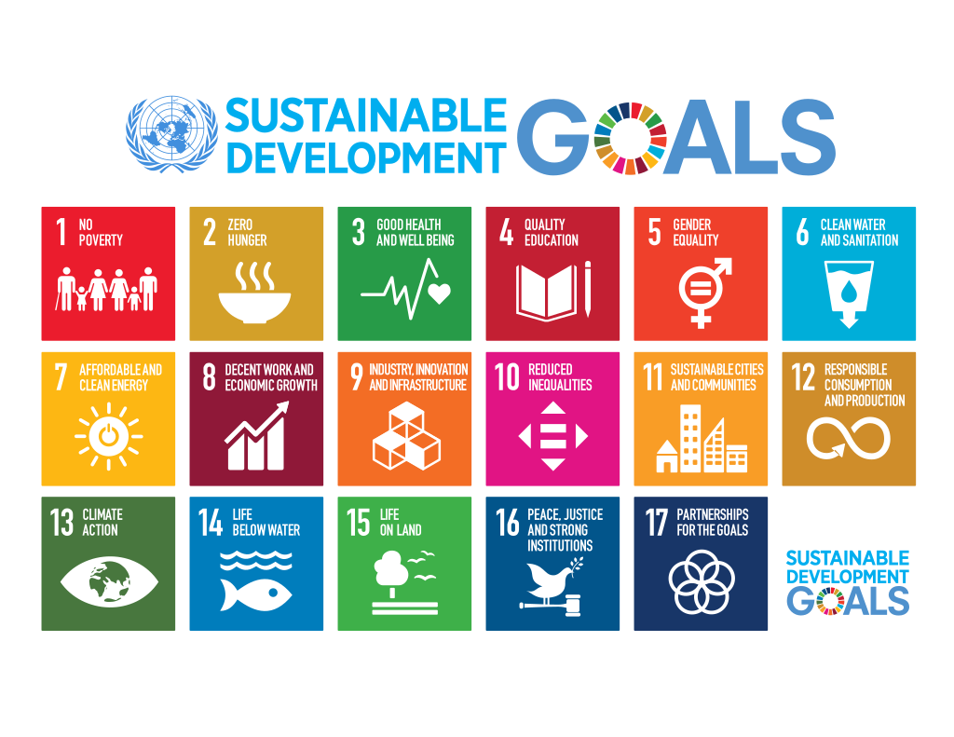
ESD – Understanding Education
Education plays a central role in the implementation of the 2030 Agenda, which was adopted by the United Nations and includes the 17 Sustainable Development Goals (SDGs).
(Sachs et al., 2019)
CC0 The Sustainable Development Goals, adopted on 25 September 2015 as a part of the 2030 Agenda.
Notes:
Sachs, J., Schmidt-Traub, G., Kroll, C., Lafortune, G. & Fuller, G. (2019). Sustainable Development Report 2019. Bertelsmann Stiftung and Sustainable Development Solutions Network (SDSN).
Image Source: The Sustainable Development Goals, Unknown author, Wikimedia Commons, https://commons.wikimedia.org/wiki/Commons:Licensing/de, https://commons.wikimedia.org/w/index.php?search=Sustainable+Development+Goals&title=Special:MediaSearch&go=Go&type=image, Traced from File:Sustainable Development Goals.png, originally at un.org

Slide 12

ESD Goals
The societal transformation meets the demands of present and future generations.
With regard to central societal challenges (e.g. climate, resources,
energy, preservation of ecosystems), the consideration of global interdependencies and perspectives are indispensable.
ESD aims to analyse risks of non-sustainable development and
global hazards perceivable in everyday life and to develop
responsible and sustainable future options for different areas
also in collaboration with other social agents.
(Quality Seal Association for Continuing Education, n. d.).
CC0 anncapictures, Pixabay
Notes:
Bundesministerium für Bildung und Forschung [Federal Ministry of Education and Research] (BMBF) (n. d.-a). Was ist BNE?. [What is ESD?] https://www.bne-portal.de/bne/de/einstieg/was-ist-bne/was-ist-bne
Gütesiegelverbund Weiterbildung e.V. [Quality Seal Association for Continuing Education] (n. d.). Professionalisierung und Qualitätsentwicklung. Support für die Praxis der außerschulischen BNE-Bildungsarbeit. [Professionalisation and quality development. Support for the practice of extracurricular ESD educational work.] https://guetesiegelverbund.de/bne/rund-um-bne/
Kehren, Y. (2016). Bildung für nachhaltige Entwicklung. Zur Kritik eines pädagogischen Programms. [Education for Sustainable Development: on the critique of a pedagogical programme.] Schneider Verlag Hohengehren.
ESD is an educational mandate with the aim of anchoring sustainability, or sustainable development, as a guiding principle in all areas of education, so that global problems such as overexploitation of nature, climate change or poverty can be solved (Kehren, 2016, p. 106; BMBF, n. d.-a).
In the UN Decade of Education for Sustainable Development, people around the world got involved to investigate how this project can actually be implemented in education systems. This led to the development of the ESD education campaign, which has lasted beyond the UN Decade and aims to empower people to think and act in a sustainable way. The campaign is based on the realisation that the current way of living and doing business cannot be continued without causing a (worldwide) increase in ecological, economic and social risks and injustices. The aim is therefore to enable people to understand and influence the impact of their own actions on the world (BMBF, n. d.-a).
Image Source: Naturaleza tierra sustentabilidad, Annacapictures, Pixabay, https://pixabay.com/es/service/license/, https://pixabay.com/es/photos/naturaleza-tierra-sustentabilidad-3289812/

Slide 13

Six Principles of ESD
Education for Sustainable Development
  concerns each and every one of us,
  is a continuous process and contributes to the
  acceptance of change processes in society,
  is a cross-sectional task and has an integrating
  function,
  aims to improve the living environment of people,
  creates individual, social and economic opportunities for the future and
  promotes global responsibility (BMBF, n. d.-b).
CC0 Akil Mazumder, Pexels
Notes:
Bundesministerium für Bildung und Forschung [Federal Ministry of Education and Research] (BMBF) (n. d.-b). Nationaler Aktionsplan Bildung für nachhaltige Entwicklung. [National Action Plan on Education for Sustainable Development.] https://www.bne-portal.de.
Image Source: Die eine grüne Pflanze, Akil Mazumder, Pexels, https://www.pexels.com/de-de/lizenz/, https://www.pexels.com/de-de/foto/person-die-eine-grune-pflanze-halt-1072824/
Task:
Make notes of the contents that you consider particularly important. Discuss the contents in the plenary.

Slide 14

ESD – Educational Concept
In its classic formulation or its most widespread discourse figure, the “triangle of sustainability”, ESD includes and combines three dimensions: ecological compatibility, economic performance and social responsibility.
Associated with this are challenges to:
  the global change of ecosystems,
  intergenerational and intragenerational equity and
  growth criteria.
  In order to meet these challenges, the educational concept of an ESD design competence should be promoted. In this context, reflection processes are a prerequisite for the implementation of ESD (Maack, 2018, p. 22).
CC0 Gerd Altmann, Pixabay
Notes:
Maack, L. (2018). Hürden einer Bildung für nachhaltige Entwicklung. Akteurinnen und Akteure zwischen Immanenz und Reflexivität. [Hurdles of Education for Sustainable Development. Stakeholders between immanence and reflexivity.] Julius Klinkhardt.
Image Source: Nachhaltigkeit Energie Globus, Gerd Altmann, Pixabay, https://pixabay.com/de/service/license/, https://pixabay.com/de/photos/nachhaltigkeit-energie-globus-3300869/

Slide 15
ESD – Relevant Competencies
ESD-relevant competencies pertain to informed decision-making, responsible action and respect for cultural diversity. (Rieß, 2013)
On the one hand, learners need to acquire the necessary knowledge to make informed decisions, act responsibly and understand the importance of cultural diversity.
On the other hand, learners must be able to act based on this knowledge, i.e. acquire competencies and apply them.
What kind of knowledge this entails is evident from the definition by relating responsible action to environmental protection, sustainable economy and a just society.
Notes:
Rieß, W. (2013). Bildung für nachhaltige Entwicklung. Theoretische Analysen und empirische Studien. [Education for Sustainable Development: theoretical analyses and empirical studies.] Beltz Juventa.

Slide 16

Competency Concept According to Weinert
According to Weinert (2001, pp. 27-28), competencies are the cognitive abilities and skills available or learnable by individuals to solve specific problems, as well as the associated motivational, volitional and social readiness and skills to use these solutions successfully and responsibly in variable situations.
Competence
CC0 Grundmeier, modified from ann-h, Pexels
Notes:
Weinert, F. E. (2001). Vergleichende Leistungsmessung in Schulen. Eine umstrittene Selbstverständlichkeit. [Comparative performance assessment in schools.: a controversial matter of course.] In F. E. Weinert (Ed.), Leistungsmessungen in Schulen [Performance assessment in schools] (2nd ed., pp. 17-31). Beltz.
Image Source: Gelbes Puzzleteil, Ann H, Pexels, https://www.pexels.com/de-de/lizenz/, https://www.pexels.com/de-de/foto/gelbes-puzzleteil-3482442/

Slide 17
Sustainability Competencies as the Overarching Goal of ESD
Based on Weinert’s concept of competency, Rieß, Mischo and Waltner (2018, p. 299) determine sustainability competencies as the overarching goal of ESD:
“Sustainability competencies compromise the entirety of cognitive abilities and skills as well as related motivational, volitional and social readiness in order to solve sustainability-related problems and to shape sustainable development in private, social and institutional contexts”.
Notes:
Rieß, W., Mischo, C., & Waltner, E.-M. (2018). Ziele einer Bildung für nachhaltige Entwicklung in Schule und Hochschule: Auf dem Weg zu empirisch überprüfbaren Kompetenzen. [Goals of Education for Sustainable Development in schools and universities: towards empirically verifiable competencies.] GAIA Ecological Perspectives for Science and Society, 27, 298–305.

Slide 18
Development of Design Competence
The National Action Plan on ESD also makes a distinction between the two levels of ESD (knowledge level and skills level).
The aim of ESD is to impart basic knowledge for tackling key social problems, as well as to acquire so-called design competence (BMBF, 2017, p. 100).
Design competence was already appointed as a general learning objective of ESD by the Federal-State Commission for Educational Planning and Research Promotion (1999, p. 61) in 1999. It is part of the overarching educational objective of the Orientation Framework for Global Development Learning (Schreiber & Siege, 2016, p. 18).
This was mandated by the Kultusministerkonferenz (Conference of Ministers of Education) and the Federal Development Ministry and is used in many federal states to implement ESD (BMBF, 2020, p. 61).
Notes:
Bundesministerium für Bildung und Forschung [Federal Ministry of Education and Research] (BMBF) (2020). Zwischenbilanz zum Nationalen Aktionsplan Bildung für nachhaltige Entwicklung. [Interim balance sheet of the National Action Plan on Education for Sustainable Development.] https://www.bmbf.de/files/Zwischenbilanz_NAP_BNE_1.pdf
Schreiber, J. & Siege, H. (2016). Orientierungsrahmen für den Lernbereich Globale Entwicklung im Rahmen einer Bildung für nachhaltige Entwicklung. [Orientation Framework for Global Development Learning in the Context of Education for Sustainable Development.] The Kultusministerkonferenz (literally “Conference of Ministers of Education") is the assembly of ministers of education of the German federal states. https://www.kmk.org/fileadmin/Dateien/veroeffentlichungen_beschluesse/2015/2015_06_00-Orientierungsrahmen-Globale-Entwicklung.pdf

Slide 19
Competency Models in Regard to ESD
There are various other competency models for ESD, including the concept of design competence by Gerhard de Haan (2008).
The twelve sub-competencies of the concept of design competence are formulated in a relatively general way, focusing on generic competencies and being rather of basic importance for school education as the competency model by Lehmann and Nieke (2000).
Action Competence
ProfessionalCompetence
Methodo-logical Competence
Social Competence
Personal Competence
CC BY Grundmeier
Notes:
Lehmann, G. & Nieke, W. (2000). Zum Kompetenz-Modell. [To the competence model.] http://sinus.uni-bayreuth.de/fileadmin/sinusen/PDF/modul10/text-lehmann-nieke.pdf
Competency model based on Lehmann and Nieke, in which action competence is regarded as the overriding goal of teaching.
Lehmann & Nieke see the development of action competence as a central goal, pupils should be enabled to act competently and remain capable of action even in out-of-school situations.
This necessarily includes the promotion of subject and methodological competence (e.g. independent planning of work steps) as well as social and personal competence (e.g. willingness to communicate and cooperate).
Professional competence: In addition to professional knowledge, this also includes the ability to establish connections and to be able to use the knowledge in a targeted manner.
Methodological competence: This includes the ability to acquire knowledge, to work rationally, to master problem-solving strategies appropriate to the situation and to structure results.
Self-competence: This includes the willingness to perform, recognising one's own strengths and weaknesses as well as self-confidence and independence.
Social competence: It includes the willingness and ability to work together with others, to act tolerantly and empathetically and to be able to deal with conflicts.

Slide 20

Concept of Design Competence
Design competence refers to the ability to apply knowledge about sustainable development and to recognise problems of non-sustainable development. This means being able to draw conclusions about ecological, economic and social developments in their interdependence from analyses of the present and studies of the future. Furthermore, it also includes being able to make, understand and individually, collectively and politically implement decisions based on these conclusions, with which sustainable development processes can be realised.
(de Haan, n. d.).
CC0 palomaironique, Openclipart
Notes:
The concept of design competence was developed and tested by Prof. Dr. Gerhard de Haan and Dr. Dorothee Harenberg within the framework of the school model programme of the Federal-State Commission for Educational Planning and Research Foundation (BLK) "21" and the follow-up programme Transfer-21. De Haan, G. (n. d.). Teilkompetenzen der Gestaltungskompetenz. [Sub-competences of the design competence.] http://www.transfer-21.de/indexe2aa.html?p=294
Image Source: Eye can see the world Europe, Africa and Middle East, palomaironique, Openclipart, https://openclipart.org/share, https://openclipart.org/detail/65905/eye-can-see-the-world-europe-africa-and-middle-east-from-cammorris-and-narrowhouse-works

Slide 21

Sub-Competences of Design Competence
To build up knowledge in an open-minded way and to integrate new perspectives.
To be able to analyse and assess developments with foresight.
To gain knowledge and act in an interdisciplinary manner.
To recognise and consider risks, dangers and uncertainties.
To plan and act in cooperation with others.
To consider conflicting goals when reflecting on strategies for action.
To participate in collective decision-making processes.
To motivate oneself and others to become active.
To reflect on one's own guiding principles and those of others.
To use ideas of justice as a basis for decision-making and action.
To plan and act independently.
To show empathy for others. (de Haan, n. d.).
CC0 ElisaRiva, Pixabay
Notes:
The concept of design competence assumes that it can be divided into 12 sub-competences (de Haan, n. d.)
Image Source: Gehirn Geist Psychologie Idee, ElisaRiva, Pixabay, https://pixabay.com/de/service/license/, https://pixabay.com/de/illustrations/gehirn-geist-psychologie-idee-2062057/

Slide 22
Orientation Framework for Global Development Education
The Orientation Framework for Global Development Education defines 11 core competencies to be acquired in the context of sustainable development (Schreiber & Siege, 2016, p. 95).
They focus more on sustainable development and are directly connectable for competence-oriented subject teaching (Schreiber & Siege, 2016, p. 85).
Therefore, the teaching and learning materials are oriented towards the 11 core competencies of the Orientation Framework for Global Development Education.
Notes:
Overwien, B. (2016). Bildung für nachhaltige Entwicklung in der Schule. [Education for sustainable development in schools.] In M. K. W. Schweer (Ed.), Bildung für nachhaltige Entwicklung in pädagogischen Handlungsfeldern. Grundlagen, Verankerung und Methodik in ausgewählten Lehr-Lern-Kontexten [Education for Sustainable Development in Pedagogical Fields of Action: Foundations, anchoring and methodology in selected teaching-learning contexts.] (pp. 33-48). PL Academic Research Lang.
Global Learning has its own competency model, which in many respects resembles that of ESD design competence (Orwien, 2016). The competency concept and the associated goal of being able to use knowledge, skills and attitudes in a self-organised way against the background of the guiding principle of sustainable development correspond to the basic elements of the concept of ESD design competence. The competency concept also ties in with Weinert's (2001) competency concept and the key competencies formulated by the OECD and is also compatible with the European reference framework "Key Competencies for Lifelong Learning" (Schreiber & Siege, 2016, p. 85).

Slide 23
Core Competencies of Global Development Education (Overview)
Each core competency is assigned to one of the three competence areas: recognise, evaluate, act (Schreiber & Siege, 2016, pp. 117-119).
Only when key problems are recognised, critically reflected upon and evaluated, responsible action is possible.
The core competencies are intended to enable students to shape their lives in a way that is fit for the future, to participate in society and to assume global co-responsibility (Schreiber & Siege, 2016, p. 18).
In addition to acquiring the ability to shape and act, it is also about becoming aware of one’s own responsibility and the effects of one’s own actions.

Slide 24
Core Competencies of Global Development Education – Recognising
The students are able to …
R E C O G N I S I N G | 1. Acquisition and processing ... acquire information on topics of globalisation and development and process them topic-relatedly.
 | 2. Recognising diversity ... recognise the socio-cultural and natural diversity in the One World.
 | 3. Analysis of global change ... analyse processes of globalisation and development by using the concept of sustainable development.
 | 4. Differentiation between levels of action ... recognise levels of action from the individual up to the global level in their respective function for development processes.
Learners are able to ... means in this context that they have the relevant competency, but are free to decide whether to apply it to a given situation.
(Schreiber & Siege, 2016, p. 95)

Slide 25
Core Competencies of Global Development Education – Assessing
The students are able to …
A S S E S S I N G | 5. Change of perspectives and empathy ... realise, appreciate and reflect upon own and others’ values and their significance for life.
 | 6. Critical reflection and comment ... comment on issues of globalisation and development by critically reflecting and orienting at the international consensus, at the principle of sustainable development and at human rights.
 | 7. Evaluation of development projects ... work out approaches to evaluate development projects (here and in other parts of the world), take diverse interests and general conditions into account, and come to self-reliant conclusions.
(Schreiber & Siege, 2016, p. 95)

Slide 26
Core Competencies of Global Development Education - Dimension Action
The students are able to …
A C T I N G | 8. Solidarity and shared responsibility ... realise areas of personal co-responsibility for humans and the environment, and accept the respective challenge.
 | 9. Understanding and conflict resolution ... contribute to overcoming socio-cultural barriers and self-interest by communicating and cooperating, and contribute to conflict resolutions.
 | 10. Ability to act in times of global change ... ensure the ability to act socially in times of global change, most of all in personal and professional fields, by openness and readiness to innovate as well as by an appropriate reduction of complexity, and to bear open situations.
 | 11. Participation and active involvement Students are able and willing, based on their autonomous decision, to pursue objectives of sustainable development in private, school and professional fields and to participate in their implementation in society and politics.
(Schreiber & Siege, 2016, p. 95)

Slide 27
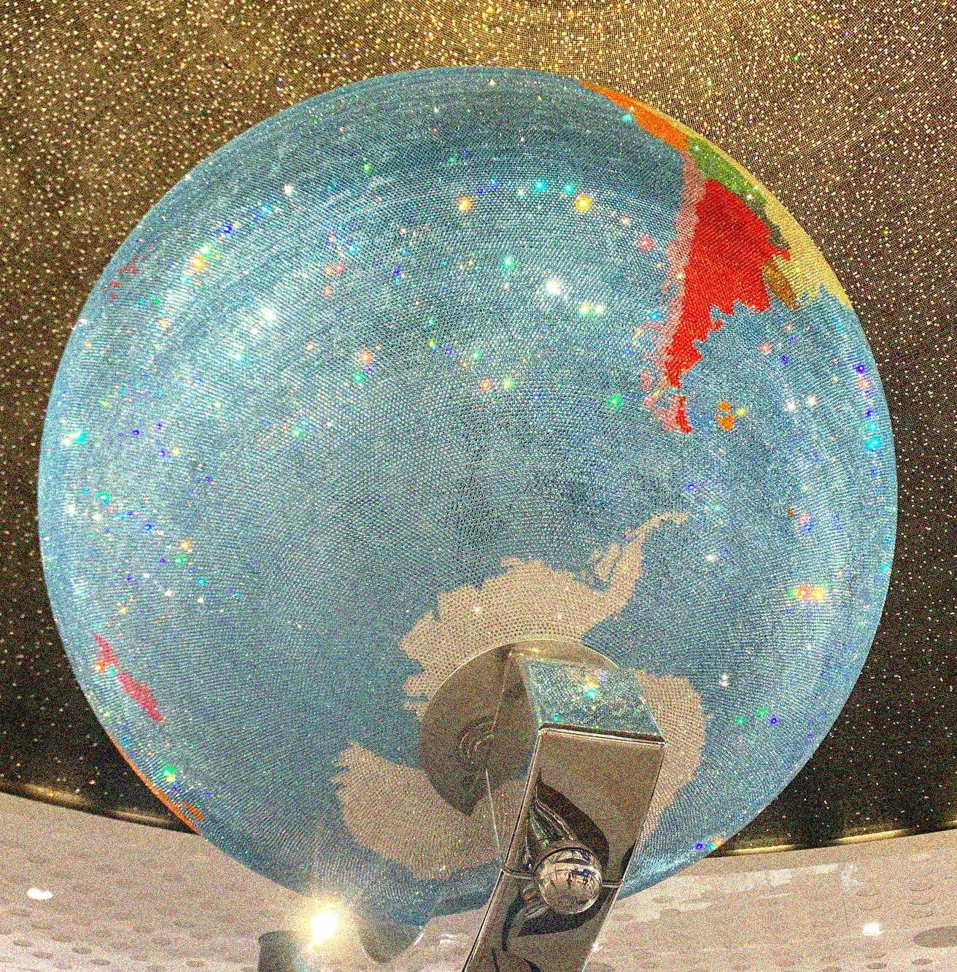
UNESCO Programme ESD 2030
With "ESD 2030", a new ESD decade begins in 2021.
The UNESCO's ESD 2030 Roadmap summarises the central contents of the new ESD programme. It shows how Education for Sustainable Development will be implemented over the next ten years and serves as a roadmap for member states and ESD actors (Deutsche UNESCO-Kommission, n. d.).
Ecology
Society
Economy
ESD
CC BY-SA-ND Grundmeier
Notes:
Deutsche UNESCO-Kommission [German Commission for UNESCO] (n. d.). UNESCO-Programm „BNE 2030“. [UNESCO Programme "ESD 2030".] https://www.unesco.de/bildung/bildung-fuer-nachhaltige-entwicklung/unesco-programm-bne-2030

Slide 28
Research Field ESD
The concept of ESD has developed as an independent field of educational research since the 1990s and has become increasingly differentiated.
ESD plays a role in empirical educational research with a view towards evidence-based development and empirical verification of educational measures (Barth & Rieckmann, 2016, pp. 37-49) .
Intensive efforts are still required in the research field of teacher education and teaching-learning scenarios for sustainable development that relates to and develops existing practice (Waltner et al., 2021 ).
Notes:
Barth, M. & Rieckmann, M. (Eds.). (2016). Empirische Forschung zur Bildung für nachhaltige Entwicklung. Themen, Methoden und Trends. [Empirical research on education for sustainable development: topics, methods and trends.] Barbara Budrich.
Waltner, E.-M., Rieß, W., Mischo, C., Hörsch, C. & Scharenberg, K. (2021). Abschlussbericht: Bildung für nachhaltige Entwicklung – Umsetzung eines neuen Leitprinzips und seine Effekte auf Schüler/-innenseite. [Final report: Education for Sustainable Development - Implementation of a new guiding principle and its effects on pupils.] Pädagogische Hochschule Freiburg.
Waltner, E.-M., Rieß, W. & Mischo, C. (2019). Development and Validation of an Instrument for Measuring Student Sustainability Competencies. Sustainability, 11, 1717. https://doi.org/10.3390/su11061717

Slide 29
ESD Research Findings in Secondary Schools
Research Question: What do teachers think and know about ESD and how do they implement it in secondary school classes in Baden-Wuerttemberg, Germany?
Findings (Waltner et al., 2020):
  In some aspects ESD still lacks concrete structural implementation in educational contexts.
  From the teachers’ perspective, more abstract policies are not needed.
  Teachers ask for very concrete support that is close to teaching and the schools’ objectives.
Notes:
The results of the study can help steer society in a more sustainable direction by highlighting the remaining challenges to these broad goals.
Waltner, E.-M., Scharenberg, K., Hörsch, C. & Rieß, W. (2020). What Teachers Think and Know about Education for Sustainable Development and How They Implement it in Class. Sustainability, 12(4), 1690. https://doi.org/10.3390/su12041690

Slide 30
ESD in the Context of Fashion and Textiles
Ecology
Society
Economy
Fashion as a worldwide business with global supply chains is also
an extremely energy-consuming, polluting and wasteful system.
Fast fashion has accelerated the traditional business model in the fashion industry, encouraging people to buy more clothes by offering low prices
and increasing the number of new seasons per year.
Along with this growth in consumption comes a growth in ecological and social impact during the whole textile chain.
In light of a growing world population (expected to reach nearly 10 billion by 2050 (UNFPA, 2017)), meeting the world’s demand for fibres and textiles is seen as a global challenge, not least against the backdrop of an advancing climate change.
Therefore, a profound change in the textile value chain and consumption habits in the fashion market is essential.
ESD
CC0 Grundmeier
Notes:
United Nations Population Fund (UNFPA) (2017). World population trends. Population prospects. https://www.unfpa.org/world-population-trends#readmore-expand

Slide 31
McKinsey Analyses of the Fashion System
During the corona pandemic many fashion companies have taken time to reshape their business models, streamline their operations, and sharpen their customer propositions.
The primary driver will continue to be digital channels, reflecting the trend established before the COVID-19 crisis and the reluctance of people in many countries to gather in crowded environments (Amed et al., 2020).
Even as some countries recover from the pandemic situation, apparel sourcing faces challenges such as demand volatility, supply-chain disruptions, rising costs and profit pressure.
To address theses challenges, a fundamental shift toward a flexible, fast, sustainable, digitally enhanced and consumer-centric sourcing is required (Hedrich et al., 2021).
Notes:
Amed, I., Berg, A., Balchandani, A., Hedrich, S., Rölkens, F., Young, R., Jensen, J. E. & Peng, A. (2020). The State of Fashion 2021. McKinsey Report. https://www.mckinsey.com/~/media/mckinsey/industries/retail/our%20insights/state%20of%20fashion/2021/the-state-of-fashion-2021-vf.pdf
Hedrich, S., Hügl, J., Ibanez, P. & Magnus, K.-H. (2021). Revamping fashion sourcing: Speed and flexibility to the fore. McKinsey Apparel CPO Survey 2021. https://www.mckinsey.com/~/media/mckinsey/industries/retail/our%20insights/revamping%20fashion%20sourcing%20speed%20and%20flexibility%20to%20the%20fore/revamping-fashion-sourcing-speed-and-flexibility-to-the-fore.pdf

Slide 32
Mediation of ESD
Create Participation & Reference to the World in which We Live
Promote Networked & Systemic Thinking
Considering Temporal & Spatial Dimensions
Initiate Cross-disciplinary Working
Enable Value Reflection & Change of Perspectives
CC0 Grundmeier
Notes:
Task:
Discuss these theoretical approaches to education for sustainable development in the context of fashion and textiles.

Slide 33

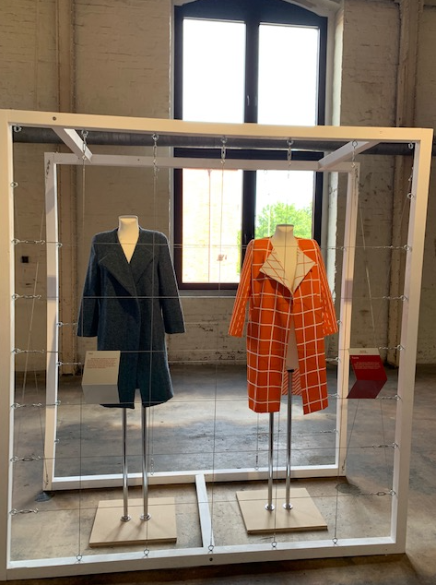
Effects of ESD on Professionalism
Adopting disciplinary and interdisciplinary perspectives on global problems and their regional and local manifestations.
Evaluating the significance of subject-specific focal points of sustainable development.
Gaining new perspectives on professionalism.
CC BY-SA-ND Grundmeier

Slide 34
Fashion Revolution Week
Since 2013, the Fashion Revolution Week has taken place every year at the end of April. In 2021, it was held from April 19th to 25th.
It is a worldwide event that connects people with the aim of setting a common example for a fairer fashion industry.
It was founded in response to the Rana Plaza factory collapse in Bangladesh on 24 April 2013, which killed 1,138 people and injured more than 2,500. The victims were mostly young women working as seamstresses.

Slide 35
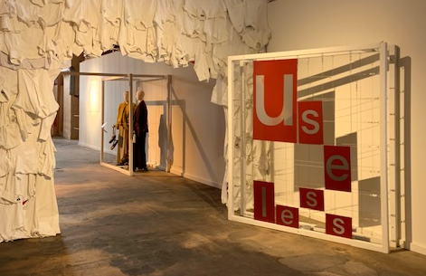
Green is the New Black
Clothes to me are a valuable treasure that must be guarded for as long as possible.
Clothes are either ‘unused’ or ‘no longer used’.
I can make them attractive and wearable again in a versatile and creative way. I can repair them and reassemble them [...].
I prefer a wild mix of second hand and new fashion that is recyclable and good for the environment and for humans.
(Glomb, 2014; FEMNET, 2021)
CC BY-SA-ND Grundmeier
Notes:
Glomb, M. (2014). Mode in der postfossilen Gesellschaft: Redesign, Upcycling und Zero Waste: Modedesign-Konzepte aus Hannover für energieärmere Entwicklung von Bekleidung. [Fashion in the post-fossil society: redesign, upcycling and zero waste: fashion design concepts from Hanover for lower-energy development of clothing. ] In D. Fürst, A. Bache & L. Trautmann (Eds.), Postfossile Gesellschaft (= Stadt und Region als Handlungsfeld) [Postfossil Society (= City and Region as Field of Action)] (pp. 131-146). PL Academic Research Lang.
FEMNET e. V. (2021). Fair Fashion Guide. Experteninterview mit Martina Glomb. [Fair Fashion Guide: expert interview with Martina Glomb.] https://www.fairfashionguide.de/index.php/act-for-good/item/4-experteninterview-mit-martina-glomb

Slide 36
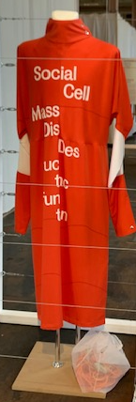
Use-less Travelling Exhibition
The travelling exhibition “Use-less – Slow Fashion against waste and ugly clothes” is dedicated to conscious and sustainable fashion consumption.
In the interactive and holistic exhibition, the creation of resource-saving fashion can be experienced and understood along the entire textile cycle.
At the centre of the exhibition are the designs of Hanover fashion design students under the direction of Professor Martina Glomb.
CC BY-SA-ND Grundmeier
Notes:
Hannover University of Applied Sciences and Arts (2020, September 24). use-less-Wanderausstellung. [use-less travelling exhibition.] https://f3.hs-hannover.de/aktuelles/news/use-less-wanderausstellung/

Slide 37
Example Circular.Fashion
Circular.Fashion, an agency for sustainable change, communicates product and system innovations for a circular economy in the textile and fashion segment:
The Circular Design Kit is a selection of 20 strategies, solutions and product information on how to design apparel fashion in the spirit of material circularity and longevity.
The Circular Design Software is intended to enable recyclable product design.
Circularity.IDs in garments contain information to bring them back into the cycle (Circular Fashion, n. d.).
Notes:
Circular.Fashion (n. d.). Let’s enable the products of today to become the resources of tomorrow. https://circular.fashion/en/

Slide 38
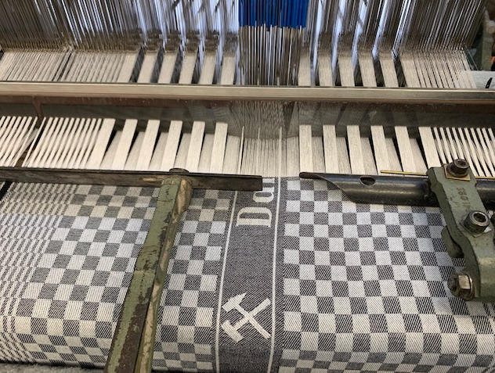
Emotional and Material Longevity
An emotional and material longevity can be based on the following strategies:
Cyclability: monomaterial design, design for disassembly
Material cycle: recyclability or biodegradability
Design for adaptability: e.g. modular,
multi-functional design, adjustable sizes
Design for longevity: e.g. repairability, aesthetics,
emotional durability and also product types
(Niinimäki, 2018, p. 110).
© CC BY-SA-ND Grundmeier
Notes:
Niinimäki, K. (Ed.). (2018). Sustainable Fashion in a Circular Economy. Aalto Arts Books.
Schmidt, M. & Budde, I. (2021). Eine holistische Methode für die Kreislaufwirtschaft. [A holistic approach to the circular economy.] TEXTILplus, 9(5/6), 6-10.
Photo: In the past, the pit cloth was to be found in any kitchen or work area. It was popular in the cole mines' washrooms because the coal dust remained invisible when it dried out. Millions of meters of the blue and white checked cotton cloth were delivered to the Ruhr area by weaving mills located in the Münsterland. This “classic” pattern was also woven in red and white or tone on tone; sometimes the checks were small, sometimes large - the number of variations was unlimited. Today the pit cloth is woven in different colours on historical machines at the TextilWerk Bocholt.

Slide 39

Circular Fashion System (CFS)
Circular Product Check
Material Supplier
Circular Material Database
Circular Design Guidelines
Fashion Brands
Costumer Interface
Sorting Company
Sorting Software
Recycler
Costumer
Circular Design Software
Reverse Supply Chain Intelligence
CC0 Gordon Dylan Johnson, Openclipart
CC BY Grundmeier, adapted from Circular.Fashion, 2021
Circularity.ID
Collaborative
Consumer
Notes:
Image Source: Shopping Woman Illustration, Gordon Dylan Johnson, Openclipart, https://openclipart.org/detail/289403/shopping-woman-illustration, Shopping Woman Illustration from Pixabay

Slide 40
How to Educate Consumers for a CFS?
Approximately 60 to 70 percent of all human learning processes take place in our everyday lives, at work, in the family and in our free time (BMBF, n. d.-c).
The teaching of ESD in schools and universities as a guiding principle and cross-sectional competence is part of formal education.
In addition to the formal education system, non-formal and informal education offer opportunities to implement ESD: oeco station, consumer advice centre, sewing classes, family, youth scenes, circle of friends, etc.
Notes:
Bundesministerium für Bildung und Forschung [Federal Ministry of Education and Research] (BMBF) (n. d.-c). Non-formale, informelle Bildung. [Non-formal, informal education.] https://www.bne-portal.de/de/non-formale-informelle-bildung-1776.html

Slide 41
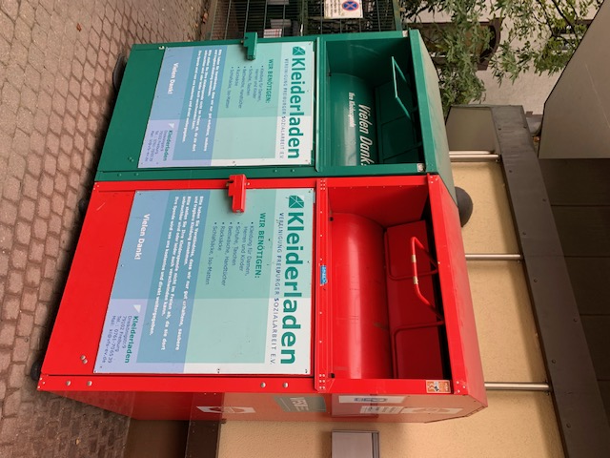
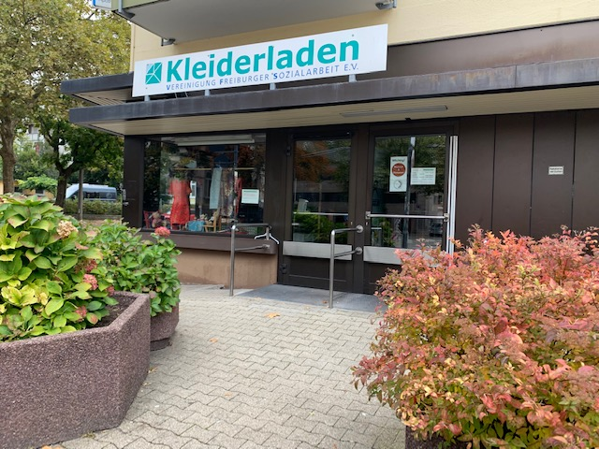
How to Experience Circular Fashion
The manager of the second-hand clothing shop in Freiburg and her team organise the collection, the sorting and the transfer of clothes and shoes to the needy.
The manager shows her depot and explains the business model to student teachers and pupils.
In an informal way, she teaches ESD and supports a student-teacher-scientist project.
In this way, informal ESD training is integrated into school and higher education.
© CC BY-SA-ND Grundmeier

Slide 42
ESD: Knowledge Acquisition and Empathy
Besides the acquisition of knowledge, it is about ...
the willingness to engage and to take responsibility,
the willingness to manage risks and uncertainty,
empathy for other people’s circumstances and solid judgement on questions about the future.
ESD empowers students as consumers and at work to contribute to sustainable development through civil society engagement and political action.

Slide 43

Key Words of ESD
The anchoring of the guiding principle is substantiated by the following terms:
Significance of and threats to sustainable development
Complexity and dynamics of sustainable development
Values and norms in decision-making situations
Criteria for actions that promote and impede
sustainability
Participation, involvement and co-determination
Capacity for democracy
Peace strategies
CC0 TikiGiki, Openclipart
Notes:
Image Source: Eco Peace 001, TikiGiki, Openclipart, https://openclipart.org/share, https://openclipart.org/detail/170396/eco-peace-001

Slide 44
ESD as Guiding Principle in Textile Education
ESD
Universities with Fashion and Textile Departments
University Lecturers
ESD
Vocational and General Schooling
Teachers
Extracurricular Venues and Family
Consumer Advice Centre, Providers of Sewing Classes, Clubs, etc.
ESD
ESD
Textile & Fashion Industry and Market
Trainers, Professionals in Industry and Trade
ESD

Slide 45


ESD for a Circular Textile Economy
Design
Trade, Acquisition Phase
Usage Phase: textile care, repairs
Post Consumer Phase:
collect, sort, swap, sell, pass on
Recycling,
Disposal
Textile Production
Garment Production
ESD
CC0 netalloy, Openclipart
CC0 Gordon Dylan Johnson, Openclipart
Collaborative Production and Trade
Collaborative Consumer
CC BY-SA-ND Grundmeier
Notes:
Image Source: Population, netalloy, Openclipart, https://openclipart.org/share, https://openclipart.org/detail/101989/population

Slide 46
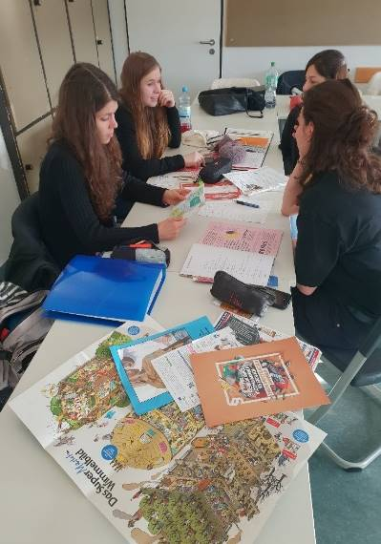
ESD at School: InFAIRmation-Box
Information box with teaching units on circular textile economy and sustainable consumption
Theoretical and practical learning material for schools
Goal: reflection on consumer behaviour and action competences in the fashion market
Developed by trainee fashion seamstresses in their second
year of apprenticeship at the Kerschensteiner Vocational
School in Stuttgart
Project Manager: Cathrine Strobel-Theunissen
CC BY-SA-ND Strobel-Theunissen

Slide 47
What Characterises ESD in Consumption?
How do my daily consumption decisions affect future generations?
How can I influence the use of resources through my consumer behaviour?
What is the global impact of my fashion/clothing consumption?
Notes:
Reflect and discuss the following question in the plenary:
How can Education for Sustainable Development contribute to transform the linear model of the textile chain into a circular model?

Slide 48
References and Further Reading
Blum, P. (2021). Circular Fashion: Making the fashion industry sustainable. Laurence King Publishing.
Ellen MacArthur Foundation (2017). A new textiles economy: Redesigning fashion’s future. http://www.ellenmacarthurfoundation.org/publications
Hemkhaus, M., Hannah, J., Malodobry, P., Janßen, T., Griefahn, N. S. & Linke, C. (2019). Circular Economy in the Textile Sector: Study for the German Federal Ministry for Economic Cooperation and Development (BMZ). https://www.adelphi.de/en/system/files/mediathek/bilder/GIZ_Studie_Kreislaufwirtschaft_Textilsektor_2019_final.pdf
Muthu, S. S. & Gardetti, M. A. (Eds.). (2020). Sustainability in the Textile and Apparel Industries: Consumerism and Fashion Sustainability. Springer. DOI 10.1007/978-3-030-38532-3
WWF Switzerland (Ed.). (2017). Changing Fashion: The clothing and textile industry at the brink of radical transformation. https://www.wwf.ch/sites/default/files/doc-2017-09/2017-09-WWF-Report-Changing_fashion_2017_EN.pdf

Slide 49
OER Explanation
OER Licence CC BY-SA except the logos and where otherwise stated e.g. images, photos, pictures.
Blur effects of the image edges have been done by the author for Fashion DIET.
A full citation of text and image sources is always given at the first mention of the authors in the notes beneath the slide, otherwise short citation in the text or on the slide.

Slide 50
Contact
University of Education Freiburg
Institute of Everyday Culture, Sports and Health
Department Fashion and Textile
Prof. Dr. Anne-Marie Grundmeier
E-Mail: grundmeier@ph-freiburg.de

