Slide 1




Design Thinking – a Suitable Method for Implementing Education for Sustainable Development (ESD) in Textile Education

Slide 2
Learning Objectives
After this lecture you should be able to:
Describe the historical development of Design Thinking.
Explain the method Design Thinking with its different phases and core elements.
Explain the potential of Design Thinking for implementing Education for Sustainable Development (ESD) in education.
Discuss the acquaintance of design competence through Design Thinking.
Reflect on how to integrate Design Thinking into your professional activities/studies.

Slide 3
Key Competencies of the 21st Century
Creativity, problem-solving skills and collaborative working are defined in numerous international studies as well as by the OECD (2017) as key competencies to manage the challenges of the 21st century.
Perspectives and expertise of interdisciplinary teams, the ability to think in a networked way and to work on joint solutions are required for this purpose (Kay & Greenhill, 2011).
The essential learning and innovation skills are described by pairs of two: creativity and innovation, critical thinking and problem-solving skills, communication and collaboration (Trilling & Fadel, 2012).
Creativity can be seen as a special form of problem-solving ability and can therefore already be important for the learning success at school (Theurer et al., 2012).
Notes:
Kay, K., & Greenhill, V. (2011). Twenty-First Century Students Need 21st Century Skills. In G. Wan & D. Gut (Eds.), Bringing Schools into the 21st Century. Explorations of Educational Purpose (pp. 41–65). Springer. https://doi.org/10.1007/978-94-007-0268-4_3
OECD (2017). PISA 2015 Results (Volume V): Collaborative Problem Solving. OECD Publishing. http://dx.doi.org/10.1787/9789264285521-en
Theurer, C., Berner, N., & Lipowski, F. (2012). Die Entwicklung der Kreativität im Grundschulalter. Zur Kreativitätsmessung im PERLE-Projekt. [The development of creativity in primary school age: On the measurement of creativity in the PERLE project.] Journal for Educational Research Online 4(2), 174-190.
Trilling, B., & Fadel, C. (2012). 21st Century Skills: Learning for Life in Our Times. Jossey-Bass/Wiley.

Slide 4


Tea or coffee – what do you prefer?
CC BY Unknown Author, Creative Commons
CC BY-SA Unknown Author, Creative Commons
Notes:
Tasks:
Please answer the question in the plenary: What do you prefer – tea or coffee?
What do we learn from this exercise?
There is not only black/white, two pigeonholes, but many different subgroups, shades.
Impulse comes from the persons themselves, they divide themselves.
This leads to a different result than "being pigeonholed".
→ Become active and act.
Image Sources:
Hot tea with dry tea, Unknown Author, Creative Commons, https://creativecommons.org/licenses/by/3.0/, https://foto.wuestenigel.com/cup-of-hot-tea-with-dry-tea/
No title, Unknown Author, Creative Commons, https://creativecommons.org/licenses/by-sa/3.0/, http://www.picserver.org/t/tea-green01.html

Slide 5
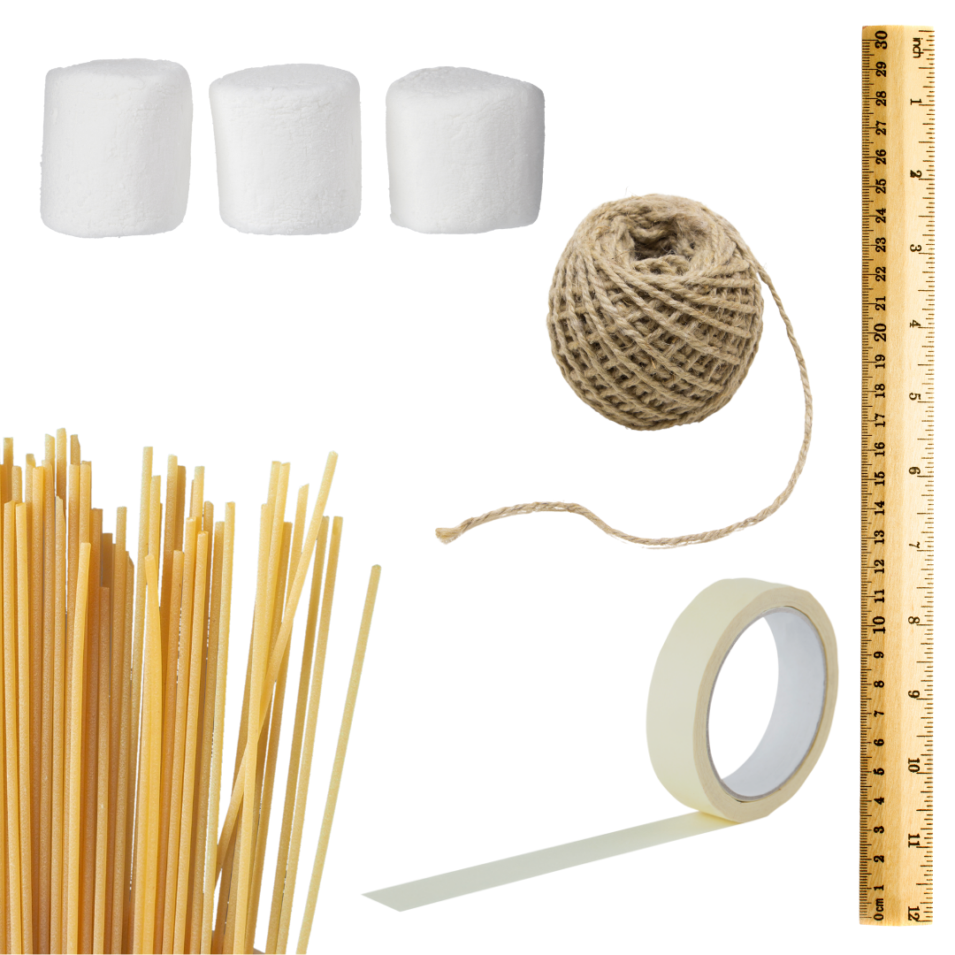
Spaghetti Marshmallow Challenge
Form teams of 3 to 4 people.
Build the tallest freestanding tower.
Use as much and as little of the material as possible.
Spaghetti, strings and tape may be shortened.
One marshmallow must go on top and
must stay there.
The highest construction wins!
Duration: 15 minutes
Presentation: 3 minutes
CC BY-ND-SA Sophie Schucker
Notes:
This activity is meant for beginners in Design Thinking in order to practice prototyping in testing.
Hasso Plattner Institute of Design at Stanford University (n. d.). Spaghetti Marshmallow Challenge. https://dschool.stanford.edu/resources/spaghetti-marshmallow-challenge
Image Source: Graphic created with Canva by means of the image pool of the Pro version.
Copyright of the images:
Spaghetti: c claudiodivizia
Marshmallow: c delmonte1977 | Getty Images
Ruler: c Valengilda | Getty Images
Jute Rope c simm49 | Getty Images
Adhesive Tape: c Billion Photos

Slide 6
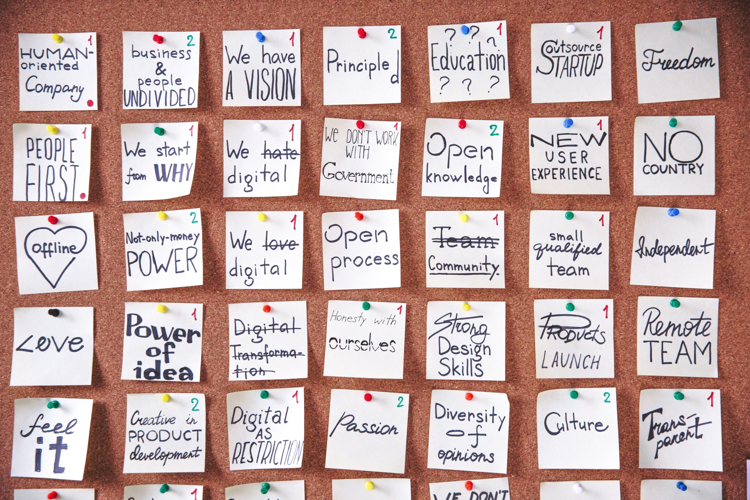
What is Design Thinking?
CC BY Polina Zimmermann, Pexels
Notes:
Questions for the Plenary:
Have you heard of Design Thinking before?
If so, what do you know about it?
Have you ever worked with this method?
What do you think is it good for?
What does this have to do with the teaching and learning in higher education?
Design Thinking is a creativity method inspired by the way designers have been working for many decades.
Goal: Solve complex problems in an innovative and user-centered way.
Image Source: Haftnotizen an Bord, Polina Zimmermann, https://www.pexels.com/de-de/lizenz/, https://www.pexels.com/de-de/foto/haftnotizen-an-bord-3782235/

Slide 7

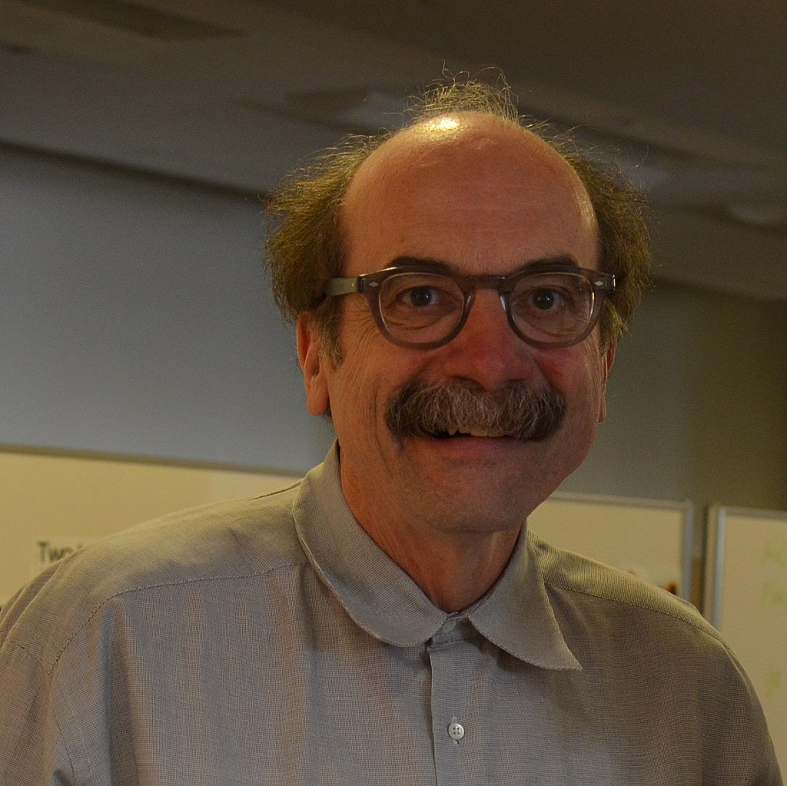
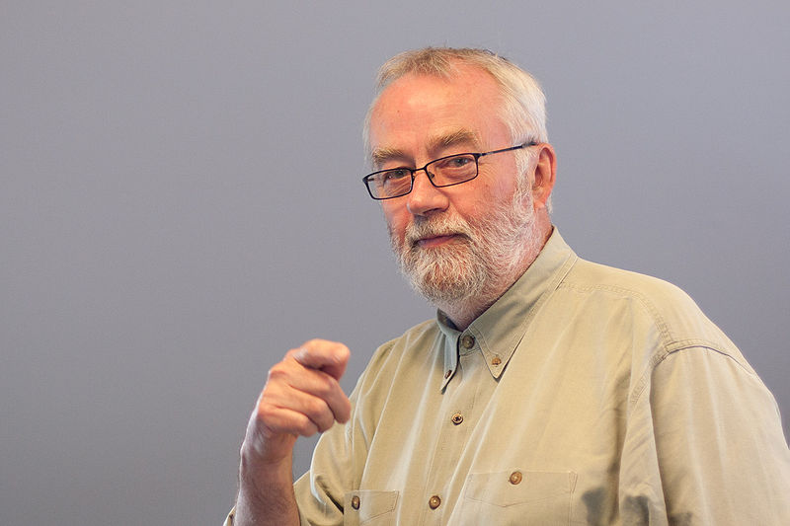

History of Design Thinking
1969
Design as Way of Thinking
1991
Methodical Design Process for Projects at IDEO
2003
Foundation of d.school, Stanford University
2007
Foundation of HPI School of Design Thinking, Potsdam
Herbert A. Simon
The Sciences of the Artificial
David Kelley & Bill Moggridge, IDEO
David Kelley, IDEO
Hasso Plattner
Notes:
In 1969 Herbert Alexander Simon, a U.S. social scientist, professor of computer science, psychology and administration, began thinking about design as a way of thinking.
In 1978 he received the Nobel Memorial Prize for research on decision-making processes in business organisations.
In 1991, David Kelley and colleagues, founders of the design and innovation agency IDEO in Palo Alto/USA, used design as a process for technology projects.
In 2005, Larry Leifer, professor at Stanford University, brought Design Thinking to the Hasso Plattner Institute of Design, the so-called d.school, where it has been taught ever since.
Image Sources:
Herbert A. Simon: Nobel Foundation archive, https://www.nobelprize.org/prizes/economic-sciences/1978/simon/facts/
David Kelley: CC BY David Kelley in 20212, Jonathan Chen, Wikimedia Commons, https://creativecommons.org/licenses/by/2.0/deed.en, https://commons.wikimedia.org/wiki/File:David_M_Kelley_(9375796736)_(cropped).jpg
Bill Moggridge: CC BY-SA Bill Moggridge giving an open lecture at the Copenhagen Institute of Interaction Design, June 2010, mayonissen, https://creativecommons.org/licenses/by-sa/3.0/deed.en, https://commons.wikimedia.org/wiki/File:Billmoggridge_ciid_2010.jpg
Hasso Plattner: Hasso Plattner Institut, https://hpi.de/medien/video-und-bildmaterial/fotos.html

Slide 8
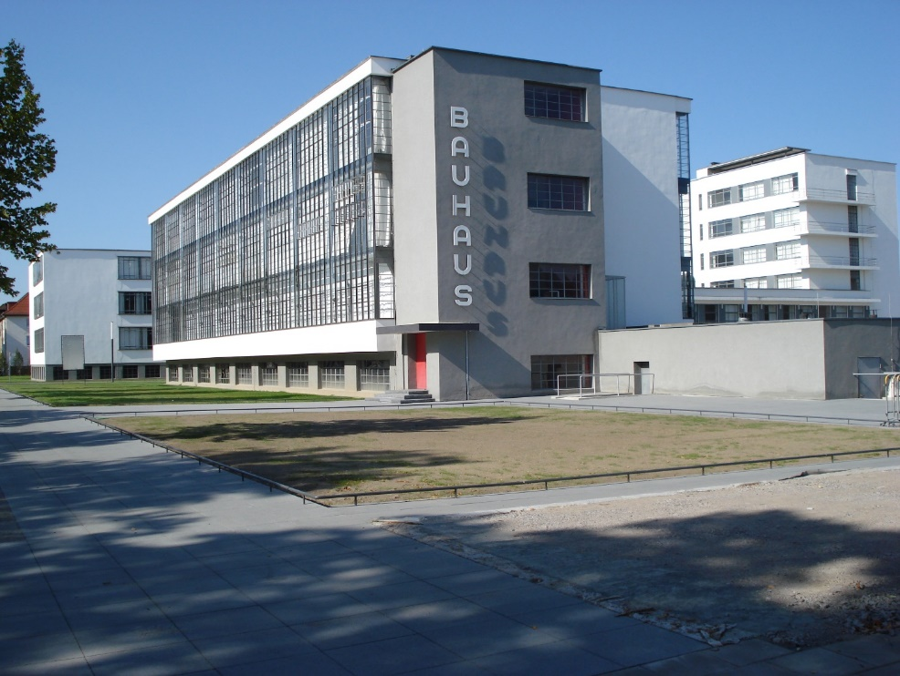
Bauhaus Dessau as Inspiration
CC BY-SA Lelikron, Creative Commons
Notes:
Larry Leifer cites the Bauhaus movement, which originated in Germany about 100 years ago, as the source of inspiration for the Design Thinking method.
The Bauhaus Dessau (Bauhaus Building Dessau) is a building complex in Dessau-Roßlau in the eastern part of Germany. It was built between 1925 and 1926 according to plans made by the German architect Walter Gropius as a school building for the Bauhaus School of Art, Design and Architecture.
The building and the master houses built in the immediate vicinity established the Bauhaus's reputation as an "icon of modernism.“
The design-theoretical approach, the bringing together of different disciplines such as theatre, music, fine arts, architecture and design, was intended to increase the problem-solving competence for complex social issues.
Image Source:
Bauhaus Dessau aktuell, Lelikron, Creative Commons, https://creativecommons.org/licenses/by-sa/3.0/deed.en, https://de.wikipedia.org/wiki/Stiftung_Bauhaus_Dessau#/media/Datei:Dessau_Bauhaus_neu.JPG

Slide 9

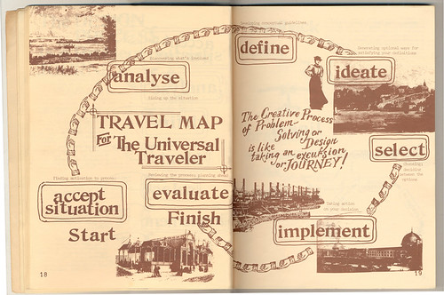
From Design Process to Design Thinking
Recognise Problems
Analyse
Define
Develop Ideas
Decide
Realise
Evaluate
Burdick, 2011
Book Cover: Koberg & Bagnall, 1976
CC BY Grundmeier
Notes:
Image Sources:
Koberg, D., & Bagnall, J. (1976). The universal traveler. A soft-systems guide to: creativity, problem-solving, and the process of reaching goals. W. Kaufmann.
Burdick, A. (21.02.2011). Anne Burdick navigates the hippy aesthetics of The Universal Traveler. http://www.eyemagazine.com/blog/post/gods-eye-view

Slide 10

Design Thinking as a Method
“Thinking like a designer can transform the way you develop products, services, processes—and even strategy.” (Brown, 2008)
Design Thinking is a creativity method and problem-solving method that is based on the way designers think and work.
It aims to produce innovations that are oriented towards the needs of users.
CC BY Andrea Piacquadio, Pexels
(Meinel et al., 2015)
Notes:
When innovations in the technology sector stagnated, consideration was given to transferring the method that designers have already been using for many decades to areas that no longer have anything to do with design in the actual sense.
In the past the focus was often on technical innovations, but nobody wanted/needed them because they were often far too complicated, for example a remote control with 84 buttons.
Also, users were not asked what they needed in the first place. Design Thinking aims to capture the actual needs.
Brown, T. (2008). Design Thinking. Harvard Business Review, (6), pp. 1-9. https://readings.design/PDF/Tim%20Brown,%20Design%20Thinking.pdf
Meinel C., Weinberg U., & Krohn T. (2015). Design Thinking Live. Murmann.
Image Source: Andrea Piacquadio, Pexels, https://www.pexels.com/de-de/lizenz/, https://www.pexels.com/de-de/foto/frau-zeichnen-sie-eine-gluhbirne-in-white-board-3758105/

Slide 11
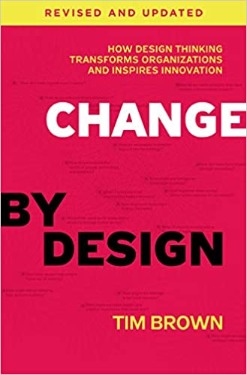
Dissemination of Design Thinking
The subject of Design Thinking is the rage at business schools, throughout enterprises, and increasingly in education.
This has happened in large part due to the work of IDEO, a leading US design firm.
Tim Brown, chairman of IDEO, uses this book to show what the techniques and strategies of design are like to produce innovations that are oriented towards the needs of users.
Book Cover: Brown, revised and updated edition, 2019
Notes:
Design Thinking is a method for discovering previously unrecognised possibilities that lead to the solution of complex problems.
Through a structured, iterative and creative process, products, strategic approaches, etc. are rethought with the active and co-creative involvement of users. The approach is characterised by working in interdisciplinary teams as well as (rapid) prototyping and testing of ideas in order to generate fast, innovative and practical solutions.
Tim Brown, English industrial designer and managing director at IDEO, made the method known worldwide through his publication: Change by Design.
In his book he describes the effects of design thinking on industry and society.
Brown, T. (2009). Change by Design: How Design Thinking Transforms Organizations and Inspires Innovation. Harper Business.

Slide 12


Dissemination by Universities and Schools
Hasso Plattner Institute at University of Potsdam
HPI School of Design Thinking
Stanford d.school at Stanford University
Joint research projects on the impact of Design Thinking in business and society
Workshops for companies and non-profit organisations
Projects at schools and universities
Notes:
Companies have their managers trained at the HPI Institute.
Secondary schools in particular work with the method.

Slide 13
Stanford d.school Design Thinking Process
Create a point of view that is based on user needs and insights. What are their needs?
Brainstorm and come up with as many creative solutions as possible. Wild ideas encouraged.
Empathize
Ideate
Build a representation of one or more of your ideas to show to others. How can I show my idea? Remember: A prototype is just a rough draft!
Define
Prototype
Learn about the audience for whom you are designing, by observation and interview.
Who is my user?
What matters to this person?
Test
Share your prototyped idea with your original user for feedback. What worked? What didn‘t?
CC BY-SA Grundmeier
Notes:
In five steps Design Thinking requires the learner to work within a specific scaffolding process to solve a design challenge:
Learning about the audience for whom you are designing.
Brainstorming and coming up with creative solutions.
Redefining and focusing your question on your insights from the empathy stage.
Building a representation of one or more of your ideas to show to others.
Returning to your original user group and testing your ideas for feedback.

Slide 14
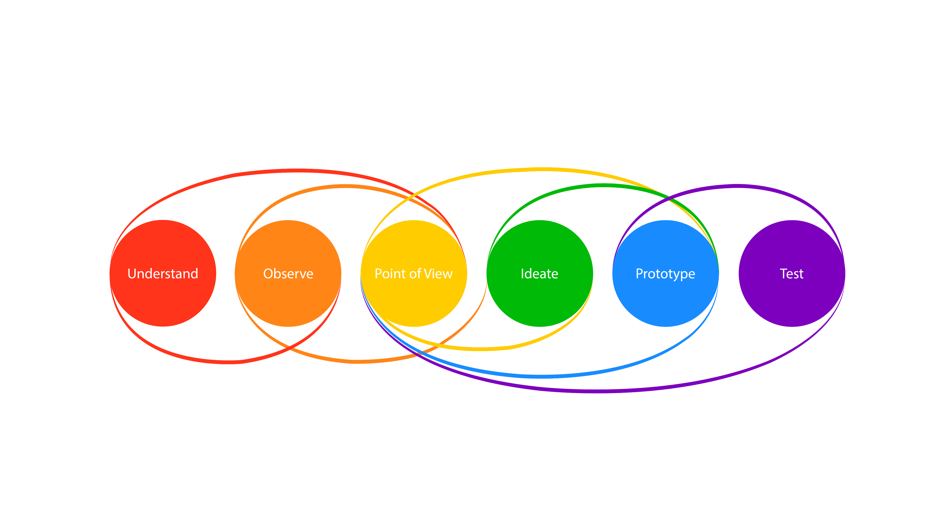
Design Thinking Process by HPI Academy
© Adapted from HPI Academy
Notes:
Source: HPI Academy (n. d.). Education for Professionals. What is Design Thinking? https://hpi-academy.de/en/design-thinking/what-is-design-thinking.html
Design Thinking Process in six phases:
First phase: Understanding
Get a feel and common understanding of the issue.
Grasp the context, so think 'broadly' and try to see more.
Think about all the areas in which the theme occurs.
Second phase: Observe
Put yourself in the life-world of users in order to understand their needs.
Develop empathy instead of your own interpretations and assumptions.
Third phase: Define the challenge
Draw conclusions from the “understanding” and “observing” phases.
Decide together on the central challenge.
Fourth phase: Finding ideas
Generate diversity of ideas with targeted creativity techniques.
Use the diversity of the team to create high-quality solutions.
Focus on one of the found ideas.
Fifth phase: Develop prototypes
Make ideas tangible, let them be experienced and communicate them.
Prototypes are opportunities to enter into a dialogue with users.
Structured action instead of endless discussions.
Sixth phase: Testing
Find out if the ideas really work for the target group.
Let the users try it out and think out loud.
Based on these insights, refine the concept until the best possible solution is found or the approach has to be discarded.

Slide 15
Trifecta for Innovation
Human Values:
Desirability
Business:
Viability
Technology:
Feasibility
Functional
Innovation
Emotional Innovation
Process
Innovation
© Adapted from IDEO
Notes:
If the intersection of technological feasibility, economic viability and human needs and desires is given, one speaks of an innovation.
Developed by IDEO founder David Kelley, Design Thinking is defined as “a human-centred approach to innovation that draws from the designer‘s toolkit to integrate to the needs of people, the possibilities of technology, and the requirements of business success”.
Thus, the method focuses on three main elements of a product or solution: people, technology and business. All of these aspects revolve around the user.
The ideal innovation process is the trifecta of desirability, feasibility and viability, an idea that originated from IDEO in the early 2000s.
If your idea meets all three criteria, then it is a desirable, feasible and profitable solution.

Slide 16

Design Thinking Mindset for Innovation
Explore the Problem Space.
Collaborate in Diverse Teams.
Think & Act in a Human-Centred Way.
Embrace Uncertainty.
Learn through Experimentation.
Envision a Radically New Future.
CC0 Unknown Author, Pexels
Notes:
Image Source: Klare Glühbirne, Unknown Author, Pexels, https://www.pexels.com/de-de/lizenz/, https://www.pexels.com/de-de/foto/klare-gluhbirne-355948/

Slide 17

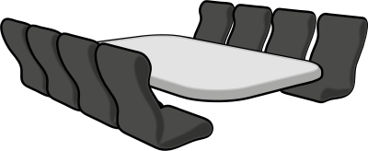
Core Elements of Design Thinking
Multidisciplinary Team
Variable Space
Iterative Process
CC0 Anonymous, gramzoon, Openclipart
Notes:
Image Sources:
Team, Anonymous, https://creativecommons.org/publicdomain/zero/1.0/, https://openclipart.org/detail/23589/team
Meeting room, gramzon, https://creativecommons.org/publicdomain/zero/1.0/, https://openclipart.org/detail/279488/meeting-room

Slide 18

Prerequisite: Multidisciplinary Teams
Design Thinking requires and enables collaborative work in teams/groups of people with different expertise and backgrounds, different ages, positions, etc.
Multidisciplinary Teams work together on a task
or solution because …
“Together we are smarter than any of us.“
  Creative Commons BY CC 3.0
Notes:
The team members learn …
to become aware of their own points of view and formulate them,
to listen to and respond to other team members’ points of view,
not to evaluate ideas and points of view at first.
Image Source: Design thinking methodiek, Unknown Author, https://creativecommons.org/licenses/by/3.0/, https://commons.wikimedia.org/wiki/File:Design_thinking_methodiek.png

Slide 19
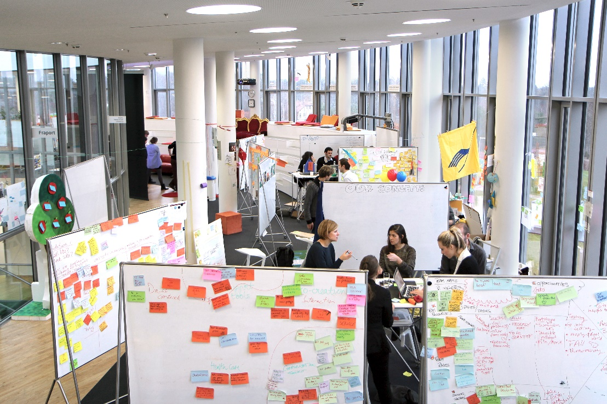
Prerequisite: Variable Space
© HPI School of Design Thinking /
Kay Herschelmann
Notes:
Variable space makes it possible to meet spontaneously with colleagues to exchange ideas and gather ideas.
No individual offices, but open, large rooms with adjustable tables and walls where people can visualise ideas.

Slide 20
Prerequisite: Iterative Process
User Environment
Point of View
Prototype
Understand
Observe
Ideate
Test
EMPATHISE
Developing the solution:
Creative ideas
Visualisation, model building
Presentation and test with the users
Understanding the problem:
Empathy for the users
Definition/formulation of the problem/task
CC BY-SA Grundmeier
Notes:
WHY empathise?
As a user-oriented designer/developer you need to understand the people you are designing for.
The problems you are trying to solve are rarely their own. They are the problems of the ones you are designing for.
In order to design a product for your users, you need to develop empathy for who they are and what is important to them.

Slide 21

Fail Faster, Succeed Sooner
Making mistakes is explicitly allowed and even encouraged (Meinel et. al, 2015).
Fear of mistakes often creates fear of the task as a whole. It prevents creativity, free thinking and action.
In the first phases, which are about recognising a problem, as well as in the creative phases, it is essential to put criticism aside.
“Fail early to succeed sooner.“ (Brown, 2009)
  CC BY-SA Unknown Author
Notes:
Failure in early phases leads to learning from mistakes and thus improving the desired product before its completion.
Failure offers the chance to achieve better results and to have more sustainable learning experiences when starting again or repeating individual phases of the iterative process. (Meinel et. al, 2015)
The earlier you make mistakes, the sooner you have the opportunity to correct them and to improve your joint work.
As the work takes place in the team there is no "guilty party“.
The solution for improvement is also found in the team.
Recommendations:
Develop your own point of view and at the same time be open to the others’ points of view.
Learn to listen without judging.
Learn to hold back prejudices and to put yourself in the other person's position by listening.
Image Source: No more Mistake!, Unknown Author, https://creativecommons.org/licenses/by-sa/3.0/, https://en.workflow-sample.net/2012_03_01_archive.html

Slide 22



Elements of Design Thinking
Process
Mindset
Encouraging creative ideas.
Fast, short, iterative cycles (sprints).
Strict orientation towards the users and their needs.
Tool Box
Visualise
Experiment
Clearly defined process and structure
Attitude, mindset
Craft, making, doing
CC0 Tarek Kiblawi, Birger Eriksson, j4p4n, Opencliart
Notes:
Cliparts:
© Business Process – Numbered, Tarek, Kiblawi, https://creativecommons.org/publicdomain/zero/1.0/, https://openclipart.org/artist/tkiblawi
© Brain training, Birger Eriksson, https://creativecommons.org/publicdomain/zero/1.0/, https://openclipart.org/artist/Eggib
© Simple Tool Box, j4p4n, https://creativecommons.org/publicdomain/zero/1.0/, https://openclipart.org/detail/292107/simple-tool-box

Slide 23


Defining Target Groups and Requirements
Immerse yourself in their experiences.
Go out and talk to people.
CC0 oksmith, Opencliart
Notes:
Empathy is the basis for a human-centred design process.
Observing users and their behaviour in everyday contexts.
Interacting with users, planned and short spontaneous interviews.
Immersion: Experiencing what their users experience.
Cliparts:
Classmates, oksmith, https://creativecommons.org/publicdomain/zero/1.0/, https://openclipart.org/detail/324413/classmates
Watching a snail, oksmith, https://openclipart.org/search/?query=Watching+a+snail

Slide 24

Finding Inspiration through Empathy
Problems
Conflicts
Contradictions
Get to talk
Observe
Immerse
Inspirations
Empathise
CC0 Unknown Author
Notes:
Image Source: Bulb, Unknown Author, https://cdn.pixabay.com/photo/2018/01/30/12/07/bulb-3118633_960_720.png

Slide 25

Building Empathy with the Target Group
What does the user think and feel? What are his/her hopes, fears, concerns?
What does the user hear? What do friends, parents, teachers and other influential people say?
What does the user see?
What do friends and like-minded people do? What offers are there in advertising, for example?
What does the user say and do? How does he/she appear, how does he/she typically behave? What are typical statements?
CC0 Thangalin, Opencliart
Notes:
Paraphrasing or active listening is a form of responding empathically to the emotions of someone by repeating in other words what this person has said while focusing on the essence of what they feel and what is important to them (Seehausen et al., 2012):
To me, it comes across as if you mean it this way/that way...
To me it comes across as if you feel good/bad ....
Seehausen, M., Kazzer, P., Bajbouj., M., & Prehn, K. (2012). Effects of empathic paraphrasing – extrinsic emotion regulation in social conflict. Frontiers in Psychology, 3(12), no. 482, 1-11. doi: 10.3389/fpsyg.2012.00482
Image Source:
Happy Face, Thangalin, https://creativecommons.org/publicdomain/zero/1.0/, https://openclipart.org/detail/242499/happy-face

Slide 26
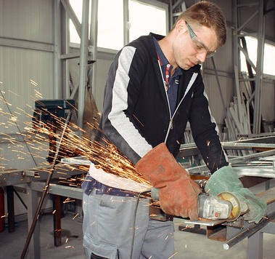

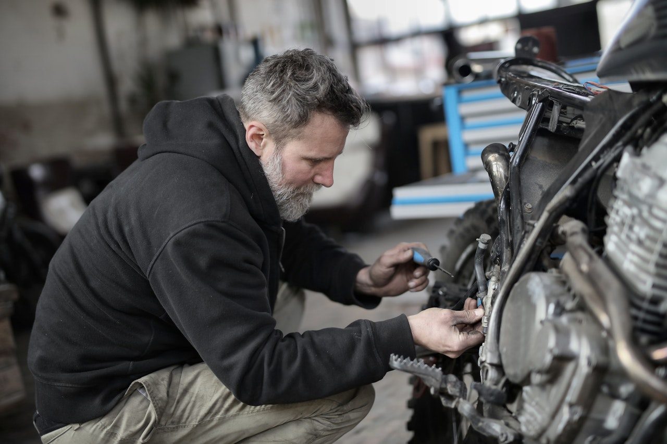
Target Group Definition: Man and Technology
CC0 emirkrasnic, Pixabay; Lukas_Rychvalsky, Pixabay; Andrea Piacquadio, Pexels
Notes:
Image Sources:
Meister-Arbeiter-Schleifer-Werkzeug, emirkrasnic, https://pixabay.com/de/service/license/, https://pixabay.com/de/photos/meister-arbeiter-schleifer-werkzeug-2223965/
Kamera-Fotograf-Stadt-Ansicht-Dach, Lukas_Rychvalsky, https://pixabay.com/de/service/license/, https://pixabay.com/de/photos/kamera-fotograf-stadt-ansicht-dach-2931883/
Bärtiger-Mann-der-Motorad-in-der-Werkstatt-repariert, Andrea Piacquadio, https://www.pexels.com/de-de/foto/bartiger-mann-der-motorrad-in-der-werkstatt-repariert-3822843/

Slide 27



Expanding the Target Group through a New Perspective
CC0 whitesession, Pixabay; Ly-HN, Pixabay; Artem Podrez, Pexels
Notes:
Image Sources:
Frau-Bauhelm-Werkzeug-Bauarbeiter, whitesession, https://pixabay.com/de/service/license/, https://pixabay.com/de/photos/frau-bauhelm-werkzeug-bauarbeiter-2759503/
Frau-Kamera-Fotograf-Werkzeug, Ly-HN, https://pixabay.com/de/service/license/, https://pixabay.com/de/photos/frau-kamera-fotograf-werkzeug-5584377/
Person-Frau-Arbeiten-Technologie, Artem Podrez, https://www.pexels.com/de-de/lizenz/, https://www.pexels.com/de-de/foto/person-frau-arbeiten-technologie-5726706/

Slide 28
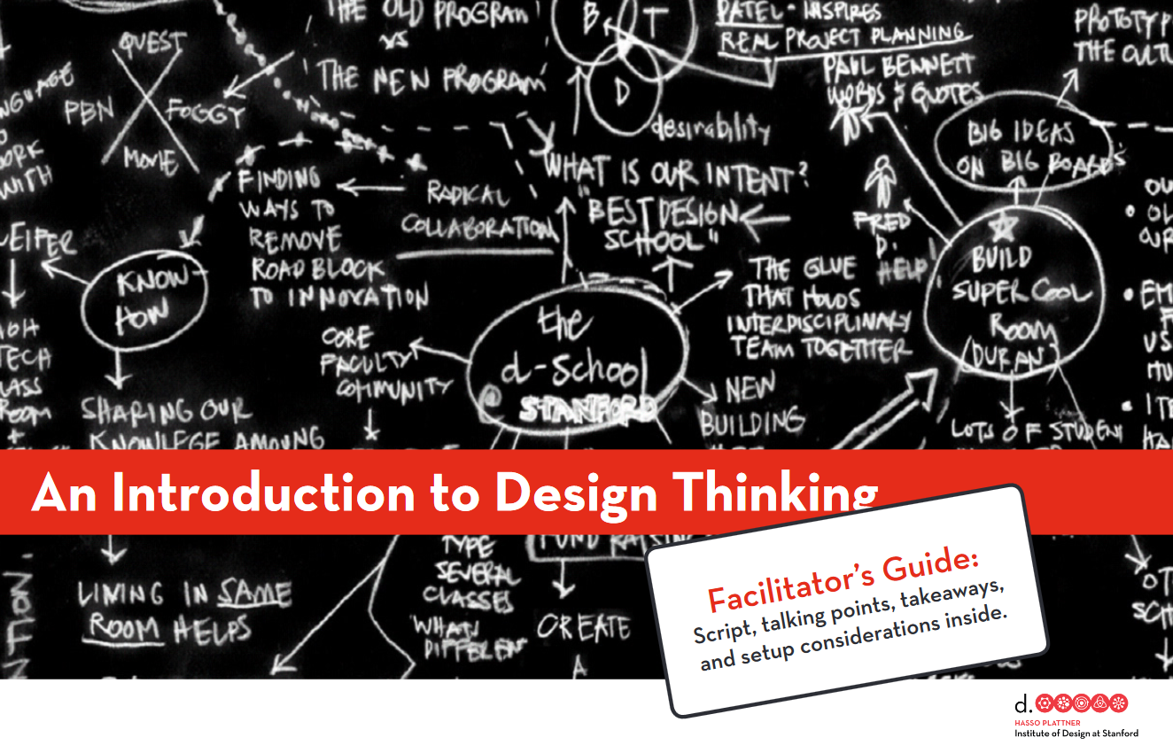
Wallet Project – Design Thinking Workshop
Goal: Introduction to Design Thinking in one hour with a tandem partner to convey the principles of Design Thinking through self-experience.
Split into tandems to create an improved, everyday purse for the respective team partner(s) according to the principles of Design Thinking. The tandems shall ...
find out more about the future user of the purse
(the tandem partner),
develop a set of design proposals based on these findings,
present the design proposals to the team partner and have
him/her evaluate them,
incorporate the feedback into an optimised design, test
it again and
reflect on their own approach together with their team partner.
https://hci.stanford.edu/dschool/resources/wallet/Wallet%20Facilitators%20Guide.pdf
Notes:
An Introduction to Design Thinking is an elaborated workshop concept including working materials of the Hasso Plattner Institute of Design at Stanford that aims to teach the principles of Design Thinking through self-experience. The participants are divided into tandems. In a series of exercises, they design an improved, everyday purse for their team partner according to the principles of Design Thinking. To do this, the participants have to work under strict time constraints.
A Wallet Project workshop is very tightly timed: the exercises flow into each other with minimal instructions from the facilitator(s). As self-awareness and practical experience are emphasised, there is only a short joint reflection and discussion phase at the end of the workshop.
The Wallet Project is an excellent basis for providing a quick, vivid and multi-layered insight into the world of Design Thinking.
It is criticised that the basic principle of "team" - the cooperation of people from different disciplines - is neglected in this introduction. On the one hand, the tandems are responsible for this, on the other hand, there is always an exchange of roles between designer and user in the exercises, but never a joint design.
Nevertheless, the Wallet Project conveys a lot of vivid experiential knowledge in one hour and thus is very well suited for an introduction to Design Thinking.
Hasso Plattner Institute of Design at Stanford (n. d.). An Introduction to Design Thinking. https://hci.stanford.edu/dschool/resources/wallet/Wallet%20Facilitators%20Guide.pdf

Slide 29
Short Task for Small Groups or Tandems
Design the perfectly suitable and sustainable purse for your colleague.
Use materials that are currently available to you at your desk: (coloured) paper and pencils, glue stick, scissors and further materials you might use for creating objects.
Work along the six phases of Design Thinking within 30 minutes.
Keep to a timetable (approximately 5 minutes per phase).
The individual phases can be announced by the facilitator.
You can use the original 60 minute time timer or
another stopwatch.
Please present your results in the plenary.
Time Timer

Slide 30
Process Sequence
Understand
Point of View
Prototype
Observe
Ideate
Test
Research: Exchange about a suitable and sustainable purse in the team.
Collating the
results:
Categorising and defining the task in the team: What do we want to implement?
Interviews:
Ask your colleague about his or her wallet handling habits.
Develop ideas and make sketches. →
How do you want to implement them?
Implementation as a model:
Building the prototypes
Presentation
to the plenary, receiving feedback.
CC BY-SA Grundmeier

Slide 31
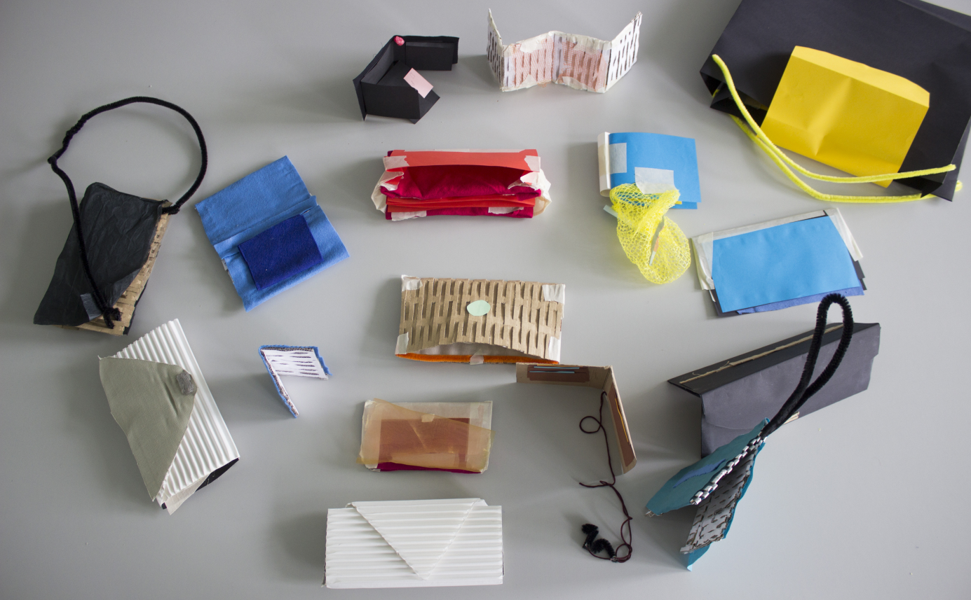
Presentation and Reflection
How did working and testing with a real person change the direction of your prototype?
What was it like to show unfinished work to another person?
How did the pace feel? Rapid iterative cycles - how did they feel about that compared to how they normally work?
Based on what they learned - what would they do next?
What would they like to do again?
To what extent can the method help you integrate ESD as a guiding principle in your projects?
CC BY-SA-ND Högsdal

Slide 32
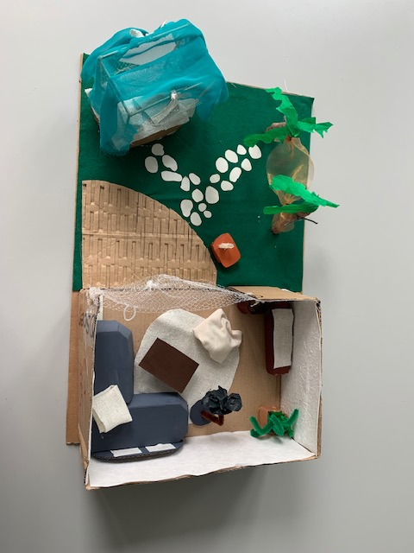
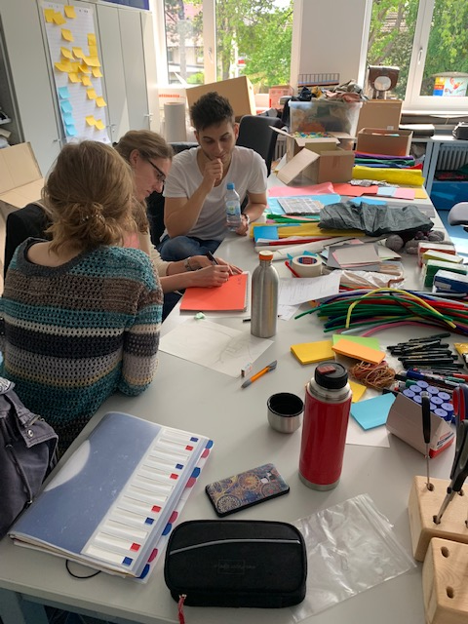
Design Challenge for Student Teachers:
Build the Perfect Reading Place!
CC BY-SA-ND Grundmeier
Notes:
Högsdal, S., & Grundmeier, A.-M. (2021). Integrating Design Thinking in Teacher Education: Student Teachers Develop Learning Scenarios for Elementary Schools. The International Journal of Design Education, 16(1), 1-26. http://doi:10.18848/2325-128X/CGP/v&16i01/1-26

Slide 33
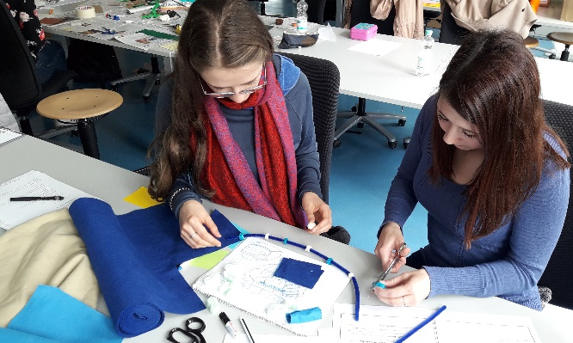
Students …
get to know the Design Thinking process and how to go through it.
learn how to apply methods and tools which are relevant to the respective process phases.
get to know ideas and suggestions for integrating
the method into their own projects.
learn how to build prototypes for their own
projects, including sustainability as a product
design requirement.
CC BY-SA-ND Högsdal

Slide 34
Promoting Collaborative Working
In the design process, communication between the team members in finding a solution is an important part of achieving a common result (Meinel et al., 2015).
Design Thinking promotes collaborative working among learners as well as the ability of teachers to evaluate learning outcomes, as more meaningful communication among learners becomes apparent (Koh et al., 2015).
On the one hand, Design Thinking has the potential to improve skills such as creativity, problem-solving skills, communication and teamwork, on the other hand, it can enable learners to develop empathy for others (Retna, 2016, p. 5).
Notes:
Koh, J. H. L., Chai, C. S., Wong, B., & Hong, H.-Y. (2015). Design Thinking for Education: Conceptions and Applications in Teaching and Learning. Springer.
Meinel, C., Weinberg, U., & Krohn, T. (2015). Design Thinking live. Wie man Ideen entwickelt und Probleme löst. [Design thinking live: how to develop ideas and solve problems.] Murmann.
Retna, K. S. (2016). Thinking about “design thinking”: a study of teacher experiences. Asia Pacific Journal of Education, 36(1), 5-19. https://doi.org/10.1080/02188791.2015.1005049

Slide 35
Results of Design Thinking Studies in
School Education
Design Thinking can lead to more sustainable learning for students and greater satisfaction for teachers in teaching subject matters through the use of creative and collaborative elements. (Carroll et al., 2010; Koh et al., 2015)
Participating teachers being part of an elementary school study in Germany are of the opinion that creativity is promoted above all. The participating school children see the emphasis on collaborative work. They appreciate the self-determined work that enables the free development of ideas. All interviewed participants are of the opinion that especially working in groups helps the children to solve problems. (Högsdal & Grundmeier, 2020).
Design Thinking enables and supports the implementation of ESD in diverse educational settings and subjects. (Dotson et al., 2020; Mueller et al., 2020; MacDowell, 2020; Högsdal & Grundmeier, 2021).
Notes:
Carroll, M., Goldman, S., Britos, L., Koh, J., Royalty, A., & Hornstein, M. (2010). Destination, Imagination and the Fires Within: Design Thinking in a Middle School Classroom. The International Journal of Art & Design Education, 29(1), 37–53.
Dotson, M. E., Alvarez, V., Tackett, M., Asturias, G., Leon, I., & Ramanujam, N. (2020). Design Thinking-Based STEM Learning: Preliminary Results on Achieving Scale and Sustainability Through the IGNITE Model. Frontiers in Education, 5:14. https://doi.org/10.3389/feduc.2020.00014
Högsdal, S., & Grundmeier, A.-M. (2021). Education for Sustainable Development through Design Thinking. Conference Paper International Conference on Technics, Technologies and Education ICTTE 2021 03.-05.11.2021 at Trakia University Stara Zagora, Bulgaria, 1-11.
Högsdal, S., & Grundmeier, A.-M. (2020). Der perfekte Leseort als Design Challenge – Pilotprojekt zur didaktisch-methodischen Implementierung des Design Thinking Ansatzes an Grundschulen in Baden-Württemberg. [The Perfect Reading Place as a Design Challenge: Pilot Project for the Didactic-Methodical Implementation of the Design Thinking Approach in Elementary Schools in Baden-Württemberg] In J. H. Park (Ed.), Designwissenschaft trifft Bildungswissenschaft – Schriftenreihe zur Designpädagogik. [Science of Design Meets Educational Science. Design & Education – Series of Publications on Design Pedagogy] (vol. 3, pp. 36-45). kopaed.
MacDowell, P. (2020). Design Principles for Teaching Sustainability Within Makerspaces. In D. Scott & J. Lock (Eds.), Teacher as Designer: Design Thinking for Educational Change (pp. 133-147). Springer.
Mueller, J., Peters, J., Dotson, L., Dietzel, J., Asturias, G., Cheatham, A., et al. (2020). Using Human-Centered Design to Connect Engineering Concepts to Sustainable Development Goals. Advances in Engineering Education, 8(2), 1-24.
Scheer, A., Noweski, C., & Meinel, C. (2012). Transforming Constructivist Learning into Action: Design Thinking in education. Design and Technology Education: an International Journal, 17(3), 8–19.

Slide 36
Objectives for the Implementation of
Design Thinking
Design Thinking-based education should promote creativity, problem-solving skills and collaborative working.
They are defined as key competencies of the 21st century in numerous international studies as well as by the OECD (2017).
Perspectives and expertise of interdisciplinary teams, the ability to think in a networked way and working on joint solutions are required (Kay & Greenhill, 2011).
Design Thinking thus also supports the implementation of ESD as a guiding principle.

Slide 37
Design Competence as the Core Element of ESD and Design Thinking as an Enabler
Design Competence refers to the ability to apply knowledge about sustainable development and to recognise problems of non-sustainable development. This means being able to draw conclusions about ecological, economic and social developments in their interdependence from analyses of the present and studies of the future.
Furthermore, it also includes being able to make, understand and individually, collectively and politically implement decisions based on these conclusions, with which sustainable development processes can be realised (Seybold, 2019).
Notes:
In Germany the promotion of design competence is part of the overarching educational goal of the Orientation Framework for Global Development Learning, which was commissioned by the Federal Ministry for Economic Cooperation and Development and the Conference of Ministers of Education in Germany. According to Gerhard de Haan (2008, n. d.), design competence is the core competence of ESD.
De Haan, G. (2008). Gestaltungskompetenz als Kompetenzkonzept der Bildung für nachhaltige Entwicklung. [Design competence as a competence concept of Education for Sustainable Development.] In I. Bormann & G. de Haan (Eds.), Kompetenzen der Bildung für nachhaltige Entwicklung. Operationalisierung, Messung, Rahmenbedingungen, Befunde [Competences of Education for Sustainable Development: Operationalisation, measurement, frameworks, findings] (pp. 23–43). VS Verlag für Sozialwissenschaften.
De Haan, G. (n. d.). Teilkompetenzen der Gestaltungskompetenz. [Sub-competences of the design competence.] http://www.transfer-21.de/indexe2aa.html?p=294
Seybold, H. (2019). (Didaktische) Prinzipien von Bildung für nachhaltige Entwicklung. In H. Macha & N. Meder (Eds.), Handbuch der Erziehungswissenschaft. Familie-Kindheit-Jugend-Gender /Umwelten [Handbook of Educational Science: Family-Childhood-Adolescence-Gender /Environments] (vol. 3, pp. 1199-1207). BRILL Schöningh. https://doi.org/10.30965/9783657765508_059

Slide 38
Sub-Competences of Design Competence
Build up knowledge in an open-minded way and integrate new perspectives.
Be able to analyse and assess developments with foresight.
Recognise and consider risks, dangers and uncertainties.
Reflect on one's own guiding principles and those of others.
Use ideas of justice as a basis for decision-making and action.
Gain knowledge and act in an interdisciplinary manner.
Plan and act in cooperation with others.
Consider conflicting goals when reflecting on strategies for action.
Motivate yourself and others to become active.
Plan and act independently.
Show empathy for others.
Participate in collective decision-making processes.
(de Haan, n. d.)
Notes:
The current concept of design competence by de Haan assumes that it can be divided into 12 sub-competences.
It is obvious that these 12 sub-competences of design competence developed by de Haan in order to implement ESD, show a high congruence to the Design Thinking principles described by Brown, 2009; Meinel et al., 2015 and Rauth et al., 2010.
Rauth, I., Köppen, E., Jobst, B., & Meinel, C. (2010). Design Thinking: An Educational Model towards Creative Confidence. DS 66-2: Proceedings of the 1st International Conference on Design Creativity (ICDC 2010). https://www.designsociety.org/publication/30267/Design+Thinking%3A+An+Educational+Model+towards+Creative+Confidence

Slide 39
Design Thinking Principles
1. Interdisciplinary Cooperation
4. Build on the Ideas of Others
7. Empathy
10. Show, Don’t Tell
2. Embrace Failure
5. Defer Judgement
8. Culture of Prototyping
11. Bias Toward Action
3. Embrace Experimentation
6. Focus in Human Values
9. Craft Clarity
12. Radical Collaboration
Notes:
In order to implement Design Thinking in textile education it is important to internalise its principles as a mindset (Brown, 2009; Meinel et al., 2015; Rauth et al., 2010).

Slide 40
Target Dimensions and Sustainability
Combining economic prosperity with socially just conditions, while minimising environmental pollution and conserving natural resources and not imposing burdens on future generations that would impair their life chances compared with today’s, has become the objective of both international and national policy (de Haan, n. d.).
Ecology: minimising environmental impact
Economy: economic prosperity
Society:
fair living conditions

Slide 41
Innovation Model through Design Thinking
Only when the intersection of all three areas is given, “real” innovation has been created.
Design Thinking is the tool, mindset and process which enables that kind of innovation.
De Haan’s target dimensions of sustainability are in accordance with IDEO’s and d.school’s definition of innovation.
Desirability
(human)
Viability
(economic)
Feasibility
(technological)
Notes:
In other words, Design Thinking brings together what is desirable from a human point of view with what is technologically feasible and economically viable in order to create user-centred innovation.

Slide 42
Innovation Model and Target Dimensions of Sustainability in Comparison
Innovation Model by IDEO
Target Dimensions of Sustainability by de Haan
Desirability
(human)
Viability (economic)
Feasibility (technological)
Society:
fair living conditions
Economy:
economic prosperity
Ecology:
Minimising environmental impact
Designing an ecologically oriented future can be understood as an innovation desired by mankind.
Modified from Högsdal & Grundmeier, 2021

Slide 43
Design Thinking as an Enabler of Design Competence with regard to ESD
At the beginning of the millennium, the US design agency IDEO pushed for innovation, especially in technology-related areas by applying Design Thinking as a new method.
This became necessary due to a standstill in the area of technological innovations (Brown, 2009; Meinel et al., 2015).
This circumstance can be compared with the situation in the textile and fashion sector that makes it difficult – but at the same time urgently requires – to implement an orientation towards sustainability.
The comparison leads to the assumption that Design Thinking has high potential to implement ESD in this industrial sector and should therefore be implemented in textile education.

Slide 44
Design Thinking as a Method of Research-Based Learning
Deep experiences, lively stimulation and imaginative encouragement on the part of the teachers should lead to the fact that children solve problems in a creative way and are enabled to draw their conclusions. (Foster, 1974).
Independent learning should be learned and learners’ autonomy should be enabled at every stage of the learning process. (Klafki, 2003).
One’s own actions should enable the acquisition and the advancement of knowledge and the ability to solve problems. (Winter, 2016, p. 3).
Notes:
The iterative process of Design Thinking comprises the phases of understanding, observing, defining perspectives, finding ideas, building prototypes and testing (Meinel et. al, 2015). It thus shows high similarities with the process of research-based learning described by Huber (2009).
Foster, J. (1974). Aktives Lernen. Konzeption des entdeckenden Lernens im Primarbereich. [Active learning: concept of discovery learning in primary education.] Maier.
Huber, L. (2009). Warum Forschendes Lernen nötig und möglich ist. [Why research-based learning is necessary and possible.] In L. Huber, J. Hellmer & F. Schneider (Eds.), Forschendes Lernen im Studium. Aktuelle Konzepte und Erfahrungen [Research-based learning in higher education. Current concepts and experiences ] (pp. 9–35). UniversitätsVerlag Webler.
Klafki, W. (2003). Selbstständiges Lernen muss gelernt werden! [Independent learning must be learned!] In F. Stübig, & C. Schäfer (Eds.), Selbstständiges Lernen in der Schule [Independent learning at school] (pp. 19-57). University Press.
Winter, H. W. (2016). Entdeckendes Lernen im Mathematikunterricht. Einblicke in die Ideengeschichte und ihre Bedeutung für die Pädagogik [Research-based learning in mathematics education: insights into the history of ideas and their significance for pedagogy] (3rd ed.). Springer Spektrum. https://doi.org/10.1007/978-3-658-10605-8

Slide 45
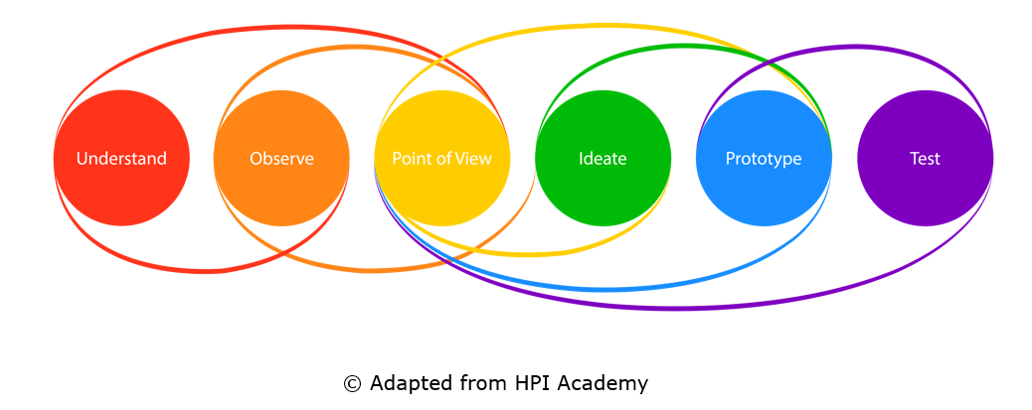
Design Thinking and Research Processes
  Perceive an initial problem or framework topic (introduction).
  Find a question and define the problem.
  Develop information and theoretical approaches (research situation).
  Select and acquire methodological knowledge.
  Develop a research design.
  Conduct the research activity.
  Develop and present the results.
  Reflect on the whole process.

Slide 46
Group Discussion
From your point of view, can Design Thinking promote the so-called “competencies of the 21st century” such as creativity, problem-solving skills and collaborative working?
From your point of view, can Design Thinking support ESD?
From your point of view, can Design Thinking support research-based learning?
From your point of view, can Design Thinking support the acquisition of empathy?
To what extent can you imagine to integrate Design Thinking into your professional activities/studies?
In which professional areas would you use Design Thinking?

Slide 47
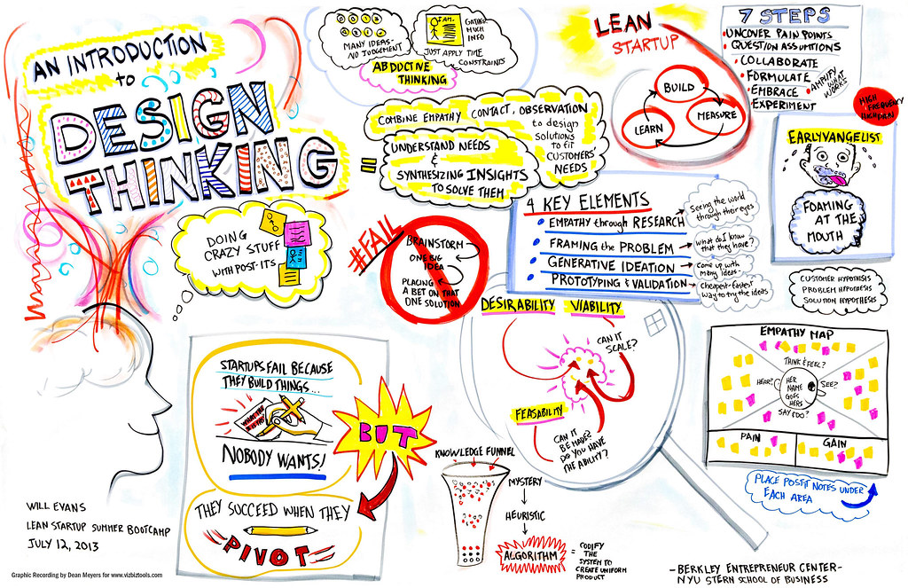
Tasks
Discuss the questions in small groups and
comment on the following statement:
“Design Thinking is not only a mindset
but also the confidence that we all can
take part in creating a more desirable
and sustainable future by facing and
dealing with challenges.”
Note down your ideas.
Add images (drawings, illustrations,
photos, etc.) to visualise your ideas.
Develop a poster or use a digital pinboard to record your ideas.
CC BY-ND Dean Meyers, Creative Commons
Notes:
Image Source:
An Introduction to Design Thinking, Creative Commons, https://creativecommons.org/licenses/by-nd/2.0/?ref=ccsearch&atype=rich, https://search.creativecommons.org/photos/20f4a51f-acbe-453a-ac24-8570eb8056d4

Slide 48
References for Further Reading
Meinel, C. & Krohn, T. (Eds.). (2022). Design Thinking in Education: Innovation Can Be Learned. Springer.
Lewrick, M., Link, P., & Leifer, L. (2020). The Design Thinking Toolbox: A Guide to Mastering the Most Popular and Valuable Innovation Methods. Wiley.
Lewrick, M., Link, P., & Leifer, L. (2018). The Design Thinking Playbook: Mindful Digital Transformation of Teams, Products, Services, Businesses and Ecosystems. Wiley.

Slide 49
OER Explanation
OER Licence CC BY-SA except the logos and where otherwise stated e.g. images, photos, pictures.
Blur effects of the image edges have been done by the author for Fashion DIET.
A full citation of text and image sources is always given at the first mention of the authors in the notes beneath the slide, otherwise short citation in the text or on the slide.

Slide 50
Contact
University of Education Freiburg
Institute of Everyday Culture, Sports and Health
Department Fashion and Textile
Prof. Dr. Anne-Marie Grundmeier
E-mail: grundmeier@ph-freiburg.de

