Slide 1
Sustainability Oriented Consumer Education in Fashion and Textiles

Slide 2
Learning Objectives
After this lecture you should be able to:
Demonstrate both basic and in-depth knowledge in the field of sustainability-oriented consumer education and decision-making.
Describe and discuss central terms used in and around consumer education as well as didactic and methodical approaches.
Explain instruments of consumer education and decision-making.
Link your knowledge of the textile and clothing industry and the textile value chain to consumer education and decision-making as a didactical field.
Apply consumer education and decision-making in your field of study.

Slide 3
Sustainable Consumption as Educational Challenge
Today consumption is considered a key driver of environmental change (Wilk, 2002) as consumer goods cause global pressure that has accumulated during their production, usage and disposal. Furthermore, consumption and the resulting human demand on the environment are unequally distributed. (Adomßent et al., 2014).
During the UN Conference on Environment and Development, known as the Earth Summit in Rio de Janeiro in 1992, the world leaders agreed on action to change what they identified as unsustainable patterns of production and consumption. (Quental et al., 2011).
Recent studies estimate that in 2050 we will be facing a world economy four times larger than today with about twice as much energy use, unless the prevailing extremely short-term political and economic models are abandoned. (OECD, 2012; Randers, 2012).
Notes:
Adomßent, M., Barth, M., Fischer, D., Richter, S., & Rieckmann, M. (2014). Learning to change universities from within: a service‐learning perspective on promoting sustainable consumption in higher education. Journal of Cleaner Production, 62(1), 72–81. http://dx.doi.org/10.1016/j.jclepro.2013.04.006
OECD – Organisation for Economic Co-Operation and Development (2012). OECD Environmental Outlook to 2050. The Consequences of Inaction. OECD Publishing.
Quental, N., Lourenço, J. M., & Da Silva, F. N. (2011). Sustainable development policy: goals, targets and political cycles. Sustainable Development 19(1), 15–29. https://doi.org/10.1002/sd.416
Randers, J. (2012). 2052: A Global Forecast for the Next Forty Years. Chelsea Green Publishing.
Wilk, R. (2002). Consumption, human needs, and global environmental change. Global Environmental Change, 12(1), 5–13. https://doi.org/10.1016/S0959-3780(01)00028-0

Slide 4
Consumer Education
Goal: “Development of responsible behaviour [...] by informing about consumption-related contents and acquiring competences in the sense of a reflected and self-determined consumer behaviour”.
Consumer education as a lifelong, reflexive learning process to “cultivate mature consumers”.
Consumer education is about informed decisions: “Against this background, consumer education follows mainly Education for Sustainable Development throughout.” (Resolution of the Secretariat of the Standing Conference of the Ministers of Education and Cultural Affairs in Germany (KMK), 12.09.2013).
Notes:
Sekretariat der Ständigen Konferenz der Kultusminister der Länder in der Bunderepublik Deutschland (KMK) [Secretariat of the Standing Conference of the Ministers of Education and Cultural Affairs] (Ed). (2013). Verbraucherbildung an Schulen (Beschluss der Kultusministerkonferenz vom 12.09.2013) [Consumer Education at Schools (Resolution of the Secretariat of the Standing Conference of the Ministers of Education and Cultural Affairs on 12 September 2013)]. https://www.kmk.org/fileadmin/Dateien/veroeffentlichungen_beschluesse/2013/2013_09_12-Verbraucherbildung.pdf

Slide 5
Consumer Behaviour in the Fashion Market
Consumption has become an expression of belonging and social identity that supports the development and practice of a socially accepted lifestyle.
Consumption permeates society and conveys to young people in particular that they are part of it.
Clothing proves to be a means of participation and integration. Its symbolically charged consumptive quality is conveyed above all via social media channels.
Influencers play an important role in offering orientation and inspiration with their topics of lifestyle, fashion, fitness and travel.

Slide 6
Influencers Influence Purchasing Decisions
Social media serves as a very important source of inspiration for buying products. Within one year, 21% of German internet users aged 16 and older bought a product at least once because it was advertised by a YouTuber.
18% said they followed the advice of Instagrammers when choosing purchases and services. (Birkner, 2021).
CC BY Altmann, Pixabay
Notes:
Birkner, H. (2021). So stark beeinflussen Influencer die Kaufentscheidungen junger Menschen [This is how strongly influencers influence young people's purchasing decisions]. https://www.textilwirtschaft.de/business/news/social-media-atlas-so-stark-beeinflussen-influencer-die-kaufentscheidungen-junger-menschen-231379
Image Source:
Social Media-Interaktion-Frau, Gerd Altmann, https://pixabay.com/de/service/license/, https://pixabay.com/de/illustrations/social-media-interaktion-frau-1233873/

Slide 7
Which of the following consumption-related characteristics apply to you?
The Allensbach Market and Advertising Media Analysis (AWA) determines attitudes, consumer habits and media use of the population in Germany on a broad statistical basis, among other things.
In 2021 around 59.1% of the German-speaking population aged between 20 and 29 agreed with the statement that it is important for them to be well dressed (Statista, 2022).
Item | 14- to 19-year-olds | 20- to 29-year-olds
I always like to try something new. | 63.6% | 61%
I enjoy buying clothes. | 56.1% | 50.8%
I often buy my clothes from chains like H&M, New Yorker and Zara. | 54.1% | 48.3%
I have certain fashion brands I particularly like, that I enjoy buying. | 46.5% | 48.2%
Study: AWA 2021, respondents aged 14 and older, living in Germany, Statista 2022
Notes:
Statista (2022). Welche der folgenden konsumbezogenen Eigenschaften treffen auf Sie zu? [Which of the following consumption-related characteristics apply to you?].
https://de.statista.com/statistik/daten/studie/815607/umfrage/persoenlich-zutreffende-eigenschaften-konsumverhalten-nach-altersgruppen/

Slide 8
Generation Overview
Baby-boomer 1950-1964
Gen X
1965-1979
Gen Y
1980 – 1994
Gen Z
1995 – 2009
Gen α
2010-2024
Gen β
2025 - …
Modified from Simon Schnetzer
Notes:
For further information on Generation Z and Generation Y: Schnetzer, S. (n.d.). Generation Z. https://simon-schnetzer.com/generation-z/

Slide 9
Consumption by Generation Z
The term “Gen (Generation) Z” unites approximately 11.6 million people who are roughly between 13 and 27 years old.
By 2025, they are expected to contribute about 30% of gross income, making them the largest generation of shoppers (Keylens, 2017).
Through pocket money, one-off cash allowances and mini-jobs, they have significant spending power and are already being targeted by the consumer goods industry because of their importance in the market economy.
In 2018, 14- to 24-year-olds in Germany had an average of around 731 euros per month at their disposal. The surveyed adolescents who were still attending school at the time of the survey had an average income of around 222 euros per month (Statista Research Department, 2018).
Notes:
Keylens Management Consultants (Ed.). (2017). Studie: Die Generation Z verstehen [Study: Understanding Generation Z]. http://www.keylens.com/wp-content/uploads/2017/12/KEYLENS-IHK-NRW-Tagung-Die-Generation-Z-verstehen.pdf
Statista Research Department (2018). Wie viel Geld steht Ihnen monatlich zur freien Verfügung? [How much money do you have at your free disposal each month?]. https://de.statista.com/statistik/daten/studie/504570/umfrage/monatlich-verfuegbares-einkommen-von-jugendlichen/

Slide 10
Factors Influencing the Purchasing Decisions of Gen Z in the Fashion Market
Results of the study “Eine Generation ohne Grenzen” [A Generation without Borders] with a total of 15,500 participants from Gen Z and three other generations from nine countries (OC&C Strategy Consultants, 2019):
Criteria such as style, uniqueness and individuality of products are high on the agenda, 17% of Gen Z want to have a unique style.
The preferred focus is on limited and customised products, individual and trendy clothing, beauty and care products.
The quest for individuality and uniqueness does not prevent adolescents from buying mainstream brands and wearing branded clothes with well-known logos.
Their desire to stand out from the crowd is also reflected in their attitudes. They show a growing interest in the ethical and socially responsible behaviour of companies.
Notes:
OC&C Strategy Consultants (Ed.). (2019). Eine Generation ohne Grenzen. Generation Z wird erwachsen [A generation without borders. Generation Z is growing up]. https://www.occstrategy.com/media/1904/eine-generation-ohne-grenzen_.pdf

Slide 11
Sustainable Fashion Consumption in Europe
For the European Fashion Report 2021, the market research institute You Gov® surveyed almost 11,500 people in ten European markets on the topic of sustainable fashion shopping (Rösch, 2021).
When asked in which sectors sustainability is most important to consumers, the fashion industry is in eighth place across Europe with 12%, behind technology and travel.
Across Europe, 42% of consumers find it important to buy ethical and sustainably produced clothing, but only 10% find it extremely important.
People mainly shop at Primark, H&M, Zara & Co: 46% of those surveyed across Europe said they shop in fast fashion stores.
Notes:
Rösch, B. (08.11.2021). Nachhaltigkeit: So ticken die deutschen Modekunden. TextilWirtschaft Online. https://www.textilwirtschaft.de/business/news/studie-von-you-gov-nachhaltigkeit-in-der-mode-233187?utm_source=%2Fmeta%2Fnewsletter%2Ftoday&utm_medium=newsletter&utm_campaign=nl8640-abonnent&utm_term=2bf39f8a4d5fbb58c3765d1dcf42c738

Slide 12
Features of Sustainable Fashion in Europe
Sustainable fabrics and materials are the most important criteria when buying sustainable clothing (39%).
Less or no chemicals and the so-called cruelty-free label (free from animal testing) are also considered important by more than a third of European consumers (36% each).
The least important factors for European consumers are the amount of water used in the production (18%) and a low resource consumption (9%).
Less than 3 out of 10 consumers in Europe have reduced their clothing purchases for ethical reasons (27%). (Rösch, 2021).

Slide 13
Clothing and Second Life in Europe
21% of European consumers sell clothes they no longer wear on the internet. Most private secondhand traders seem to be located in France (31%) and Finland (25%).
69 % of consumers donate clothes they no longer wear: Switzerland (78%), Austria (74%) and Denmark (73%). More than one in three (34%) give used clothes to friends. This practice is particularly popular in Spain (49%).
Discarded fashion items are thrown away by 13% of respondents in Europe. In Finland, almost one in four throws away discarded fashion items. In Sweden it is 21%, in Norway 17% of the respondents. In Switzerland and Austria it is 7% and 8% respectively. Germany is slightly below the average with 12%.
Overall, the disposal of old clothes via household waste ranks last among the five types of disposal surveyed. (Rösch, 2021).

Slide 14
Greta (Thunberg) Effect
The Greta Effect is attributed to the Swedish climate activist Greta Thunberg (Fopp et al., 2021).
As the initiator of the Fridays For Future demonstrations, she is the founder of the global climate strike.
As a result of the Greta Effect, adolescents and young adults in particular develop a pronounced awareness of their previous behaviour and its impact on the environment.
CC BY 2.0
Notes:
Fopp, D., Axelsson, I., & Tille, L. (2021). Gemeinsam für die Zukunft – Fridays For Future und Scientists For Future. Vom Stockholmer Schulstreik zur weltweiten Klimabewegung [Together for the Future - Fridays For Future and Scientists For Future. From the Stockholm school strike to the global climate movement]. transcript.
Image Source:
Greta Thunberg urges MEPs to show climate leadership, Pietro Naj-Oleari, Creative Commons 2.0, https://commons.wikimedia.org/w/index.php?curid=88931682

Slide 15
Cheap Fashion at All Costs?
According to a Greenpeace study (2015) with 502 adolescents aged between 12 and 19 ...
96% have heard that poor working conditions in the fashion industry are a known issue,
83% have heard that clothes are processed with harmful chemicals,
11% pay attention to the working conditions when buying clothes.
More than 80% buy their clothes from mainstream fashion chains.
For more than 81%, fashion is the most important factor, followed by price (49%).
nevertheless
Notes:
Greenpeace e. V. (2015). Saubere Mode hat’s schwer. Repräsentative Greenpeace-Umfrage beleuchtet Modekonsum von Jugendlichen [It's tough for clean fashion. Representative Greenpeace survey sheds light on fashion consumption of adolescents]. https://www.greenpeace.de/sites/www.greenpeace.de/files/publications/mode-unter-jugendlichen-greenpeace-umfrage_zusammenfassung_1.pdf

Slide 16
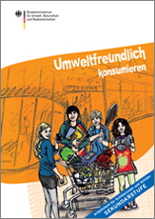
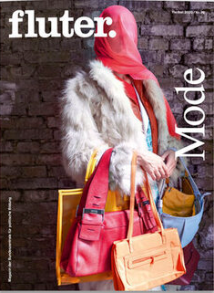
School Portal for Consumer Education
According to recent studies, adolescents in Germany show a pronounced awareness of problems when it comes to the topic of environmental protection (Federation of German Consumer Organisations, 2017).
The majority, however, hold the view that it is a task for society as a whole. They rarely act according to this attitude, especially in the fashion market.
Notes:
Verbraucherzentrale Bundesverband [Federation of German Consumer Organisations] (Ed.). (2017, August 9). Das Schulportal für die Verbraucherbildung. Nachhaltiger Konsum ist Jugendlichen wichtig, doch die Umsetzung fällt schwer [The school portal for consumer education: Sustainable consumption is important to young people, but implementation is difficult]. https://www.verbraucherbildung.de/artikel/nachhaltiger-konsum-ist-jugendlichen-wichtig-doch-die-umsetzung-faellt-schwer
Image Sources:
Cover Page: Bundesministerium für Umwelt, Naturschutz und Reaktorsicherheit (2013). Umweltfreundlich konsumieren. Bonifatius Druckerei
Cover Page: Fluter. Mode. 2020. No. 76. https://www.fluter.de/heft76

Slide 17
Fashion Consumption and Sustainable Lifestyles
Certain topics of sustainable development are still less strongly anchored in the consciousness of young people. In contrast to the topics of nutrition, plastic waste and mobility, young people still rarely associate sustainable action with fair and ecological textile consumption.
(Deckert & Ulmer, 2019, p. 28)
Notes:
Deckert, A., & Ulmer, F. (2019). Einfach Machen! Report: Jugend zu nachhaltigem Handeln und Engagement motivieren [Simply Do! Report: Motivating young people to act sustainably and get involved]. https://www.wir-ernten-was-wir-saeen.de/sites/default/files/einfach_machen_v10_desktop.pdf
Image Source:
Cutout of Cover Page: Deckert & Ulmer, 2019

Slide 18
Eco-friendly Behaviour among Adolescents in Germany
lower prices for environmentally friendly products
58%
29%
What might help you act more sustainably, i.e. in a more socially and environmentally responsible way, more often?
How important are the following aspects?
when technical devices no longer become obsolete as quickly
33%
clear labelling of environmentally friendly products
through plaques, seals and labels
44%
38%
more education and information about the
consequences of environmentally harmful consumption
44%
36%
39%
40%
when others also behave in an environmentally
conscious way
no loss of comfort and convenience
38%
40%
decreasing importance of property and status in
society
33%
38%
31%
33%
higher taxes on environmentally harmful products
and services from the state
24%
39%
more time to inform myself more thoroughly about
the consequences of my consumption for the
environment and the climate
Study by Federal Ministry for the Environment, Nature Conservation and Nuclear Safety (BMUV): June 2017, respondents: 14- to 22-year-old German-speaking residential population, online, Statista 2022
very important
Notes:
Statista (2022). Was könnte Dich dabei unterstützen, Dich häufiger nachhaltiger, also sozial- und umweltverträglicher, zu verhalten? Wie wichtig sind die folgenden Aspekte? [What might help you act more sustainably, i.e. in a more socially and environmentally responsible way, more often? How important are the following aspects?].
https://de.statista.com/statistik/daten/studie/801672/umfrage/anreize-fuer-umweltfreundliche-verhaltensweisen-von-jugendlichen-in-deutschland/

Slide 19
Quality Criteria for Fashion Consumption
Following a study by YouGov® (2019), almost two thirds of the age group between 18- and 24-year-olds in Germany buy their clothes from fast fashion brands like H&M and Zara.
As selection criteria, they most often mention price (62%), followed by quality (60%) and fit (55%).
One third of this target group says that the brand is relevant for the purchase decision, while 28% consider the current fashion trends as important for their purchase decision.
On the other hand, only 21% of this age group pay attention to the durability of a garment by their own account. Multiple answers were possible (YouGov®, 2019).
Study: omnibus survey of 18+years from 23.-25.10.2019. Basis: all respondents (n=2047), male (n=976), female (n=1071).
Notes:
YouGov® (2019). „Grüne Mode“ vs. “Fast Fashion“. Was den Deutschen beim Kleidungskauf wichtig ist ["Green Fashion" vs. " Fast Fashion". What is important to Germans when buying clothes].
Köln. https://d25d2506sfb94s.cloudfront.net/r/52/YouGov_Pressecharts_Gr%C3%BCne_Mode.pdf

Slide 20
In general, where do you prefer to buy your clothes (online and offline)?
Up to three items could be selected. Figures in percent. (YouGov®, 2019)

Slide 21
Which, and if any, environmentally friendly aspects are important to you when buying clothes?
All items that apply should be selected. Figures in percent. (YouGov®, 2019)

Slide 22
Possible Statements about Fashion Consumption
When you go shopping, you can buy two pairs of trousers and three T-shirts for 30 euros.
Those who imagine they are buying a T-shirt for 3.95 euros that was produced under fair conditions are deluding themselves.
CC By StockSnap, Pixabay
Notes:
Image Source:
Mädchen-Einkaufstaschen-Stehen, StockSnap, https://pixabay.com/de/service/license/, https://pixabay.com/de/photos/m%c3%a4dchen-einkaufstaschen-stehen-2581913/

Slide 23
Consumer Behaviour in the Fashion Market
Adults, children and young people are confronted with a wide range of consumption decisions in their everyday lives, while surfing the internet, using social media channels or during daily shopping.
Young people in particular are recognised by the fashion market as an important consumer group with a high propensity to consume due to their purchasing power and increasingly independent purchasing decisions.
The young generation is particularly aware and critical of social and ecological grievances in the textile chain. According to the afore mentioned studies, however, sustainability criteria play a subordinate role when buying clothes and fashion items.

Slide 24
Conflicting Goals in Fashion Consumption
Responsible consumption is demanded by numerous global initiatives in all areas of life. The implementation of social and sustainable standards in the textile sector is also demanded by the United Nations (2019; n.d.), which addresses students in the fashion sector, fashion and textile companies as well as consumers with its initiatives.
If consumers are analysed with regard to sustainable clothing consumption, a discrepancy can be found in their awareness of grievances in textile and clothing production and sustainable alternatives compared to actual consumption.
Studies show that consumers are certainly interested in ecological and ethical aspects, but when it comes to actual consumption, contrary behaviour patterns emerge (Bray et al., 2011).
Notes:
United Nations (Eds.). (2919). Guiding Principles on Business and Human Rights. Implementing the United Nations “Protect, Respect and Remedy” Framework. https://www.ohchr.org/documents/publications/guidingprinciplesbusinesshr_en.pdf
United Nations (Eds.). (n.d.). SDGs for better Fashion. https://sustainabledevelopment.un.org/partnership/?p=28041#updates
Bray, J., Johns, N., & Kilburn, D. (2011). An Exploratory Study into the Factors Impeding Ethical Consumption. Journal of Business Ethics, 98(4), 597–608. https://doi.org/10.1007/s10551-010-0640-9

Slide 25
Intention-Behaviour Gap
Intention-behaviour gap refers to the discrepancy between a person’s original behavioural intention and their actual behaviour (Wiedemann, 2021; Bray et al., 2011).
In the consumer sector, one refers mainly to the attitude-behaviour gap. Ethically oriented consumers pay attention to environmental aspects, social issues, health effects and animal welfare (Wiederhold & Martinez, 2018).
Limited financial resources in particular are cited in various studies as arguments of the subjects for clothing consumption contrary to their (ethical) attitude (Saricam et al., 2017; Sudbury-Riley & Boltner, 2010).
Notes:
Saricam, C., Erdumlu, N., Silan, A., Dogan, B. L., & Sonmezcan, G. (2017). Determination of consumer awareness about sustainable fashion. IOP Conference Series: Materials Science and Engineering, 254(17), 1-6. https://doi.org/10.1088/1757-899X/254/17/172024
Sudbury-Riley, L., & Boltner, S. (2010). Fashion marketing and the ethical movement versus individualist consumption: Analysing the attitude behaviour gap. Advances in consumer research. Association for Consumer Research (U.S.), 163–168.
Wiedemann, A. (28.04.2021). Intentions-Verhaltens-Lücke [engl. intention-behaviour gap]. In M. A. Wirtz (Ed.), Dorsch. Lexikon der Psychologie (20th ed.) [Dictionary of Psychology]. Hogrefe. https://dorsch.hogrefe.com/stichwort/intentions-verhaltens-luecke
Wiederhold, M., & Martinez, L. (2018). Ethical consumer behaviour in Germany: The attitude-behavior gap in the green apparel industry. International Journal of Consumer Studies, 42(4), 419-429. https://doi.org/10.1111/ijcs.12435

Slide 26
Consumer Reasons for the Attitude-Behaviour Gap in the Fashion Sector
Consumers state the following reasons:
limited financial resources and the possibility of getting more clothes for the same money,
not to think about ecological and ethical aspects during the purchase,
that feelings of guilt only set in after the purchase,
that there is skepticism about one’s own influence (Bray et al., 2011; Wiederhold & Martinez, 2018),
assumption in the sense of green washing that clothing advertised as sustainable is in fact hardly, if at all, produced more responsibly than conventionally produced clothing (Sudbury-Riley & Boltner, 2010).
Studies confirm that clothing sustainability is very complex, consumers are diverse in their ethical concerns and that clothing is not an altruistic purchase. (Harris et al., 2016).
Notes:
Harris, F., Roby, H., & Dibb, S. (2016). Sustainable clothing: challenges, barriers and interventions for encouraging more sustainable consumer behaviour. International Journal of Consumer Studies, 40(3), 309-331. https://doi.org/10.1111/ijcs.122578

Slide 27
Importance of Sustainability for Purchasing Decisions in the Fashion Market
Also, according to existing studies, there is an attitude-behaviour gap in the fashion market: Consumers do not seem to act according to their attitude that sustainable clothing is important to them at the time of the purchasing decision (Jacobs et al., 2018; Janz & Dallmann, 2020a, p. 13).
Representative panel study (unaided survey) with 2017 consumers in Germany aged 20-80 years, why more consumers do not buy sustainable clothing with the aim of identifying concrete recommendations of action for the fashion industry (Janz & Dallmann, 2020b).
Notes:
Jacobs, K., Petersen, L., & Hörisch, J. et al. (2018). Green thinking but thoughtless buying? An empirical extension of the value-attitude-behaviour hierarchy in sustainable clothing. Journal of Cleaner Production, (203)12, 1155-1169.
Janz, O., & Dallmann, L. (2020a). Die Bedeutung von Nachhaltigkeit für die Kaufentscheidung im Modehandel. Ergebnisse einer repräsentativen Konsumentenbefragung. [The importance of sustainability for purchasing decisions in the fashion trade. Results of a representative consumer survey]. Schriftenreihe Handelsmanagement DHBW [DHBW Retail Management Series]. BoD.
Janz, O., & Dallmann, L. (2020b). Sustainability in der Modebranche – Warum kaufen nicht mehr Menschen nachhaltige Mode? [Sustainability in the fashion industry - Why don't more people buy sustainable fashion?.] https://www.heilbronn.dhbw.de/de/news/beitrag/sustainability-in-der-modebranche-warum-kaufen-nicht-mehr-menschen-nachhaltige-mode.html

Slide 28
Selected Results
15.4% of the respondents often or always choose ecologically sustainable or fairly produced clothing.
54.7% answered yes or rather yes to the question whether they plan on buying ecologically and fairly produced clothing more often in the future.
In response to the question “Why don't you choose sustainable fashion more often?” …
48% answered: too expensive,
69.3% answered: sustainable clothing is not recognisable to them,
28.3% answered: not enough variety (Janz & Dallmann, 2020a, 2020b).

Slide 29
Importance of Sustainability for Purchasing Decisions in the Fashion Market
9.1% of the respondents state a criterion related to sustainability in at least one of the top three purchase criteria. The 20-29-year-olds are the largest group with 12.4%. They are also the largest group that would pay more for a pair of jeans produced in an environmentally friendly way, with 29.5%, and for a pair of jeans produced in a fair way, with 18.8%.
In response to the question "How important are the following decision-making criteria for you when buying clothes?" the following criteria are mentioned in descending order:
fit and comfort
quality and durability
price
design or style
environmentally friendly production (48.7%, of which 16.8% important, 31.9% rather important)
fair production (47.0%, of which 16.9% important, 30.1% rather important)
the brand (Janz & Dallmann, 2020a, 2020b)

Slide 30
Derived Recommendations for Action by the Fashion Industry and Conclusion
Make sustainable fashion visible in sales.
Inform your consumers better.
Create desire through stronger communicative engagement of high-end fashion brands.
Build trust through transparency.
Increase transparency through simple and informative product labelling. (Janz & Dallmann, 2020a).
Conclusion: It is mainly the younger consumers in this study as well as in other studies who are receptive to sustainable fashion. The question is how to reach them through a sustainable oriented consumer education.

Slide 31
Development of Assessment Competence
Through consumer education, students should be enabled to make well-founded and reflected consumption decisions. (Ministry of Education and Cultural Affairs, Youth and Sport Baden-Württemberg, 2016).
In order to participate competently in the social discourse on sustainable development and to be able to make well-founded and systematic decisions in complex, consumption-related situations, taking into account various options for action. (Göttingen model by Eggert & Bögeholz, 2006).
Decision-making processes (Ratcliffe, 1997) must be developed and thus evaluation skills – so-called assessment competence – must be acquired by means of decision-making strategies. (Eggert & Bögeholz, 2009).
Notes:
Ministerium für Kultus, Jugend und Sport Baden-Württemberg [Ministry of Education and Cultural Affairs, Youth and Sport Baden-Württemberg] (2016). Gemeinsamer Bildungsplan für die Sekundarstufe I. Alltagskultur, Ernährung, Soziales (AES) [Common educational plan for lower secondary level: Everyday Culture, Nutrition, Society]. http://www.bildungsplaene-bw.de/,Lde/LS/BP2016BW/ALLG/SEK1/AES
Eggert, S., & Bögeholz, S. (2006). Göttinger Modell der Bewertungskompetenz - Teilkompetenz „Bewerten, Entscheiden und Reflektieren“ für Gestaltungsaufgaben Nachhaltiger Entwicklung [Göttingen Model of Assessment Competence - Partial Competence "Assessing, Deciding and Reflecting" for Design Tasks of Sustainable Development]. Zeitschrift für Didaktik der Naturwissenschaften, 12, 177–197.
Eggert, S., & Bögeholz, S. (2009). Students' use of decision-making strategies with regard to socioscientific issues: An application of the Rasch partial credit model. Science Education, 1(4), 230-258. https://doi.org/10.1002/sce.20358
In regard to Ratcliffe (1997) decision-making is multi-faceted and therefore in need of a structure.
Ratcliffe, R. (1997). Pupil decision‐making about socio‐scientific issues within the science curriculum. International Journal of Science Education, 19(2), 167-182. https://doi.org/10.1080/0950069970190203

Slide 32
Quality Aspects for Textiles and Clothing
Quality is understood to be the totality of the properties and characteristics of a product, activity or service that are geared to its intended use, including its reliability and safety in use. Good quality is to be equated with the fulfilment of expectations during use.
The definition of quality as “fitness for use” makes it clear that the qualitative demands made by consumers are ultimately the measure of all things. While functional and fashion criteria are given a high priority for clothing, health, ecological and social aspects have been ignored for a long time.
Health aspects came into the discussion in the course of the establishment of clothing physiology as a scientific discipline on the function of clothing from the 1960s onwards. In the early 90s, ecological aspects increasingly found their way into the textile and clothing sector, followed by social criteria in the sense of eco-fair fashion. (Grundmeier, 2020, pp. 13-14).
Notes:
Grundmeier, A.-M. (2020). Qualitätsorientierte Bewertungskompetenz im Jugendmodemarkt [Quality-oriented assessment competence in the youth fashion market]. …textil… Wissenschaft Forschung Bildung, 91(3), 12-17.

Slide 33
Quality Circle Fashion and Textile
The quality circle represents a segmented matrix for making systematic and well-founded decisions in complex situations in the fashion and accessories consumption segment in the spirit of sustainable development.
Its structure is based on the Zielmat (Meisert, 2018), a tool for structuring assessment processes, which originates from research in biology didactics.
Zielmat is a structuring tool with eight segments for bioethical evaluation processes in the context of ESD.
Notes:
Meisert, A. (2018). Mit der Zielmat bewerten [Assessing with Zielmat]. In U. Spörhase & W. Ruppert (Eds.), Biologie Methodik [Biology Methodology] (4th ed., pp. 236-240). Cornelsen.

Slide 34
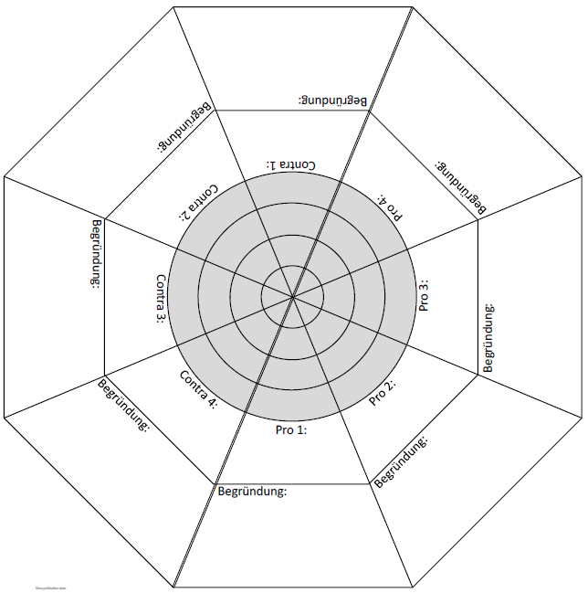
Zielmat: Bioethical Assessment Tool
pro- and/or con-argumentation
weighting of arguments in inner circles
inner fields (pro 1-4; con 1-4): keyword-like presentation of the argumentation
outer fields: reasons for or objections to the argument
con 1:
pro 1:
reason:
reason:
Turn Zielmat.
Meisert, 2017
Modified from Meisert 2017
Notes:
Meisert, A. (2017). Zielmat. https://www.researchgate.net/publication/320281665

Slide 35
Structure of the Decision-Making Processes with Zielmat
Approach with Zielmat:
Submit an idea for an argument.
Formulate reasons for or objections to the argument.
Compile further reasons or objections.
Conduct a weighting.
Meisert, 2017

Slide 36
Why Use the Zielmat to Assess?
Bioethical assessment processes in the context of ESD are characterised by the consideration and reflection of versatile information.
Support in the discussion of controversial issues.
There are challenges in assessment processes in the context of ESD with regard to
dealing successfully with complexity and
the multidimensionality of assessment processes (Meisert & Böttcher, 2019).
Notes:
Meisert, A., & Böttcher, F. (2019). Towards a Discourse-Based Understanding of Sustainability Education and Decision Making. Sustainability, 11, 5902, 1-21. https://www.mdpi.com/2071-1050/11/21/5902

Slide 37
Task: Assessment with the Zielmat
Step 1: Collect relevant pro and con arguments and write them down in the pro and con fields of the Zielmat!
Step 2: Research the arguments or work with relevant materials (facts, statements, etc.).
Step 3: Write down the reasons for each argument that underline or limit the importance of the argument (e.g. consequences, moral principles, etc.). By turning the Zielmat, everyone can add to each argument.
Step 4: Discuss the importance of each argument and mark it with a cross in the central target! Discuss the reasons given for each argument!
Step 5: Decide on the pro or con position collectively!
Notes:
Tasks:
Try to address the following topics via the Zielmat: use of viscose fibres in textiles and clothing, eco-labelling in the textile and fashion market.
Choose another problem in the context of fashion and textiles and proceed according to the Zielmat.

Slide 38
Structure of the Assessment Processes
Common concepts of assessment:
Have several sub-steps in the decision-making process.
When implementing the steps, the connection is easily lost.
The result is a loss of transparency for learners (Böttcher & Meisert, 2013).
Intervention study (Jafari & Meisert, 2019) shows that partially structured negotiation processes make most sense:
Learners should be given a structuring element.
However, there should be some freedom in the decision-making process to make decisions independently (Böttcher & Meisert, 2013).
Notes:
Böttcher, F., & Meisert, A. (2013). Effects of Direct and Indirect Instruction on Fostering Decision-Making Competence in Socioscientific Issues. Research in Science Education, 43, 479-506. https://doi.org/10.1007/s11165-011-9271-0
Jafari, M., & Meisert, A. (2019). Activating Students‘ Argumentative Resources on Socioscientific Issues by Indirectly Instructed Reasoning and Negotiation Processes. Research in Science Education, 32(9), 1-22. https://doi.org/10.1007/s11165-019-09869-x

Slide 39
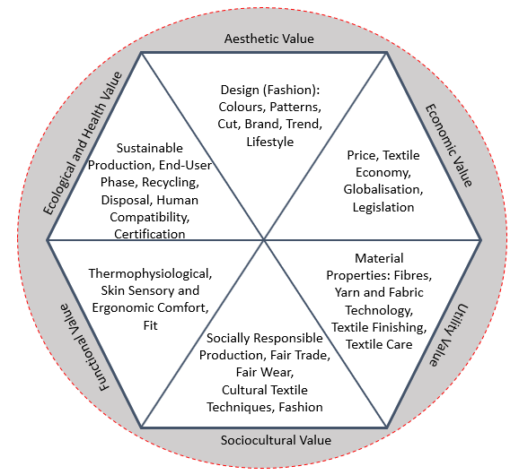
Quality Circle Fashion and Textile
The quality circle consists of six segments which represent different quality dimensions and values.
The technical terms represent content-related sub-aspects of the six segments.
CC BY-SA-ND Grundmeier

Slide 40
Quality-Oriented Assessment Competence
With the help of the Quality Circle learners should ask questions about clothing and accessories, find out something about them and analyse and assess them from several perspectives (Grundmeier, 2020).
In this way, abstract concepts such as sustainability, social justice and lifestyle should become tangible and understandable for the learning group. The aim is to be able to select clothing and accessories in a more reflective and quality-conscious way.
Only those who know quality criteria and their interrelationships can make qualitative assessments and decisions competently.

Slide 41
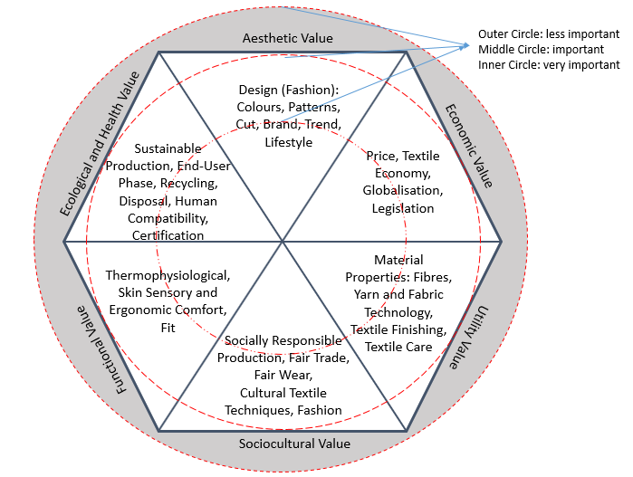
How to Use the Quality Circle
The more important an argument appears, the more an assessment point moves to the centre of the quality circle.
It is also possible to weight across all circle segments.
In this way, you can weight the quality dimensions from the quality circle according to your personal assessment.
CC BY-SA-ND Grundmeier
Notes:
Three circles are drawn in the quality circle, which allow a weighting of the respective quality dimensions. Weighting within the quality circle is possible in two dimensions: On the one hand, the degree of importance can be differentiated within a circle segment. The closer the circle is to the centre of the quality circle, the more important this segment with its sub-aspects is. On the other hand, a weighting across all circle segments is also possible.

Slide 42
Quality Circle Fashion and Textile
Fashionable Colour
Smart Shopper
Natural Fibres
wind- and waterproof
CC BY-SA-ND Grundmeier
Notes:
Tasks:
What do you associate with quality in (fashionable) clothing and accessories?
Collect the keywords.
If possible, assign the collected keywords to the six quality dimensions.

Slide 43
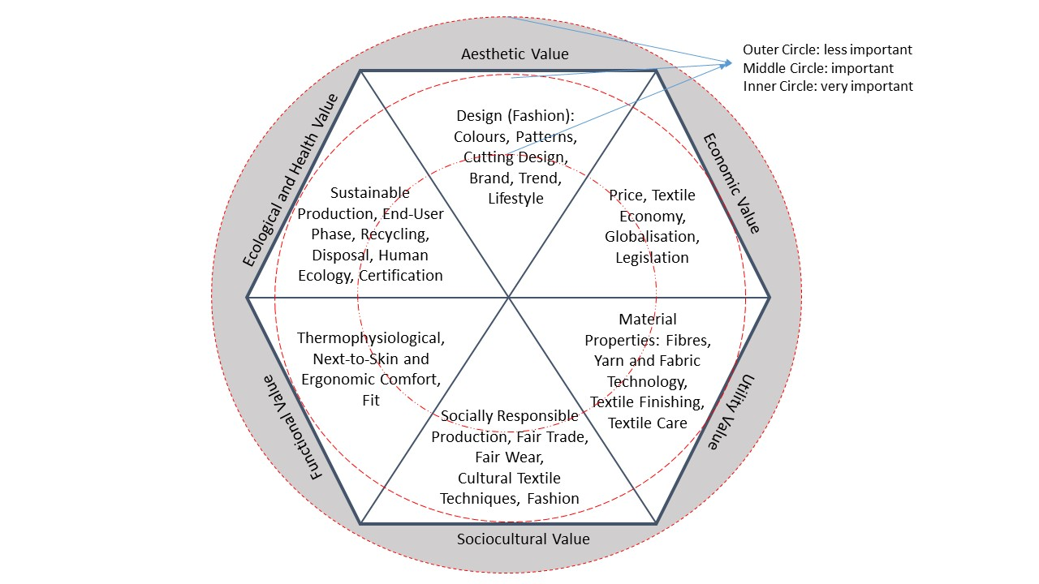
Quality Circle Fashion and Textile
1 star: less important
2 stars: important
3 stars: very important
Evaluate your items:
CC BY-SA-ND Grundmeier
Notes:
Tasks:
Evaluate selected items of clothing and accessories such as a pair of jeans, an outdoor jacket, a backpack according to the criteria.
Assign a maximum of 3 stars to weight one or a maximum of three quality dimensions.
Give reasons for your rating and discuss it in the plenary.

Slide 44
Discussion on Zielmat and Quality Circle
To what extent can the Zielmat or the Quality Circle be used to further differentiate and sensitise purchasing decisions?
For which target groups do you consider these instruments applicable?
Both instruments focus on a multi-perspective approach to complex purchase decisions. Describe how you approach such decisions in the context of fashion and textiles.
Discuss your individual approaches in the plenary.

Slide 45
Testing and Evaluating Apps
Non-profit apps shall help consumers to buy or rent sustainable fashion and reflect on sustainable clothing consumption.
Some apps are shopping platforms, others run as games in which consumers learn about their personal shopping behaviour.
Sometimes no prior knowledge about sustainability is needed to use the apps.
Consumers shall have options to consume fashion in a more sustainable way and become aware of whether their consumption behaviour.
CC By Peggy & Marco Lachmann-Anke, Pixabay
Notes:
Tasks:
Try out the apps presented on the following slides.
Discuss in groups and in the plenary about the handling of the apps.
How do you evaluate the usefulness of the apps for sustainable consumer behaviour in the fashion market?
Search for other apps.
Discuss how independent the organisations behind the apps are.
Image Source:
App-Software-Kontur-Einstellungen, Peggy and Marco Lachmann-Anke, https://pixabay.com/de/service/license/, https://pixabay.com/de/illustrations/app-software-kontur-einstellungen-1013616/

Slide 46
Good on You! Ethical Fashion App
The app, founded in Australia in 2015, features sustainable brands and creates ratings by culling information from independent labels like Global Organic Textile Standard (GOTS), Fair Trade and OKEO-TEX®, combining it with their own research in brand reliability and mission statements.
The brands are judged in several categories – from what chemicals they use and how by-products are disposed of, to their impact on the supply chain.
In addition, the app offers alternatives, including learning lessons on sustainable fashion.
Users receive offers from the brands, all assessed against a comprehensive rating system. Each brand undergoes a rating out of five from ‘Great’ to ‘We Avoid’ and individual scores for its impact on people, the planet and animals.
Source: https://goodonyou.eco
Notes:
GOOD ON YOU PTY LTD (n.d.). Good on You. https://goodonyou.eco/

Slide 47
App: Renoon
Amsterdam based Renoon combines the offering from personally favoured websites in regard to shop and rent sustainable fashion.
Users can find sustainable brands, second-hand and vintage pieces as well as fashion to rent. They can decide in which areas of sustainability brands they would like to focus such as organic, recycled and vegan fashion items.
The wide selection of fashion brands and platforms shall help to direct the way we consume fashion in a circular economy.
Source: https://renoon.com
Notes:
Renoon B.V. (n.d.). Renoon. Your Universe of Responsible Fashion. https://renoon.com/

Slide 48
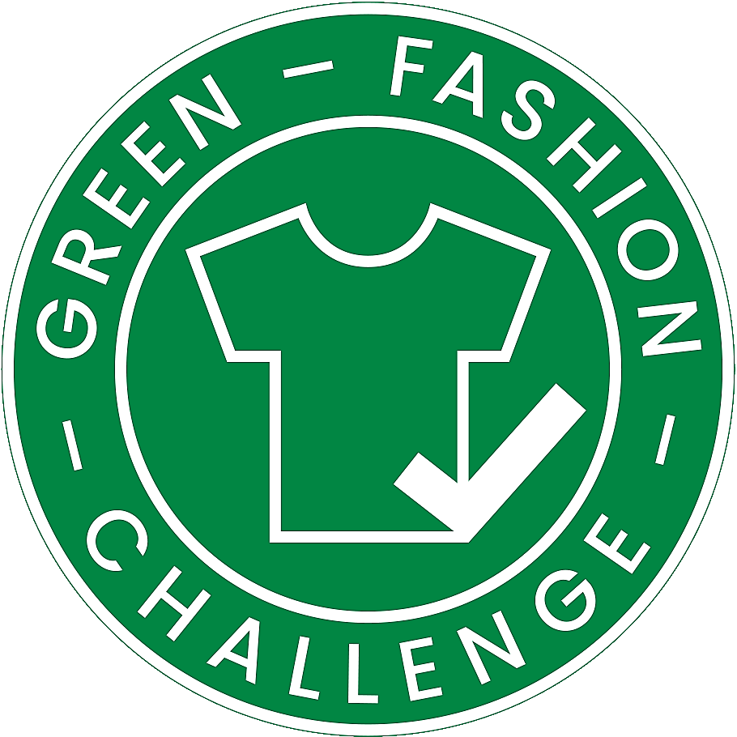
App: Green Fashion Challenge
Sustainability is rated as an important criterion for fashion consumption by 75% of German consumers. However, the share of ecologically or socially certified fashion (depending on the basis of measurement) still only accounts for approximately 1-4% of total sales. (CSM Leuphana University, 2021).
Green Fashion Challenge was developed by the Centre for Sustainability Management (CSM) of Leuphana University Lüneburg with the aim of reducing the attitude-behaviour gap in fashion consumption. Users set goals for how often and what they want to buy. They can invite friends and score points.
Source: https://green-fashion.app/
Notes:
Centre for Sustainability Management (CSM) Leuphana Universität (2021, April 19). Green Fashion Challenge App. https://www.leuphana.de/institute/csm/noekonomie-hoerisch/green-fashion-challenge-app.html
Leuphana Universität Lüneburg. Green Fashion Challenge App. https://green-fashion.app/

Slide 49
Final Discussion
“Patterns of consumption are considered as a main driver of unsustainable development. In the debate, education and educational organizations are unisonous considered as a key player to contribute to a more sustainable socialization of young consumers. Both schools and universities are challenged to become places and life-worlds in which sustainable consumption can be learned and experienced.” (Fischer, 2011, p. 66).
Notes:
Fischer, D. (2011). Monitoring Educational Organizations’ Culture of Sustainable Consumption: Initiating and Evaluating Cultural Change in Schools and Universities. Journal of Social Sciences, 7(1), 66-78. https://doi.org/10.3844/jssp.2011.66.78
Tasks:
Refer this quote to your university or school and discuss it in the plenary.
How can your institution become a place where sustainable consumption can be learned and experienced – not only in the context of fashion and textiles?
From your point of view, what are further fields of action at your institution and what can be done there?

Slide 50
Further References
Barth, M., Fischer, D., Michelsen, G., & Rode, H. (2012). Schools and their ‘culture of consumption’: a context for consumer learning. In R. Defila, A. Di Giulio, & R. Kaufmann‐Hayoz (Eds.), The Nature of Sustainable Consumption and How to Achieve it: Results from the Focal Topic From Knowledge to Action ‐ New Paths towards Sustainable Consumption (pp. 229‐244). Oekom.
Bielawska, K., & Grębosz-Krawczyk, M. (2021). Consumers’ Choice Behaviour Toward Green Clothing. European Research Studies Journal, 24(2), 238-256. https://doi.org/10.35808/ERSJ%2F2124
Fischer, D. (2011). Educational Organisations as ‘Cultures of Consumption’: cultural contexts of consumer learning in schools. European Educational Research Journal, 10(4), 595-610. https://doi.org/10.2304%2Feerj.2011.10.4.595
Grundmeier, A.-M. (2017). Why Sustainability within the Fashion Market Needs Education. Journal of Fashion Technology and Textile Engineering, 3, 1-7. https://doi.org/10.4172/2329-9568.S3-007
Jalil, M. H., & Shaharuddin, S. S. (2019). Consumer Purchase Behavior of Eco-Fashion Clothes As a Trend to Reduce Clothing Waste. International Journal of Innovative Technology and Exploring Engineering (IJITEE), 8 (12), 4224-4233. http://dx.doi.org/10.35940/ijitee.L2693.1081219
Pereira, L., Carvalho, R., Dias, Á., Costa, R., & Nelson, A. (2021). How Does Sustainability Affect Consumer Choices in the Fashion Industry? Resources, 10(38), 1-30. https://doi.org/10.3390/resources10040038

Slide 51
OER Explanation
OER Licence CC BY-SA except the logos and where otherwise stated e.g. images, photos, pictures.
Blur effects of the image edges have been done by the author for Fashion DIET.
A full citation of text and image sources is always given at the first mention of the authors in the notes beneath the slide, otherwise short citation in the text or on the slide.

Slide 52
Contact
University of Education Freiburg
Institute of Everyday Culture, Sports and Health
Department Fashion and Textile
Prof. Dr. Anne-Marie Grundmeier
E-mail: grundmeier@ph-freiburg.de

