Slide 1

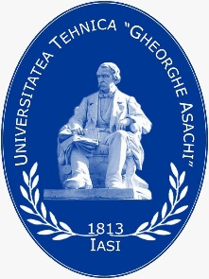


Summary, Reflections and Outlook
Part 1: Didactic and Methodological Implementation

Slide 2
Structure of the ESD Module
Sustainable Textile Technologies and Fashion
Sustainability and Entrepreneurship
Didactic and Methodological Implementation of ESD
Part I
Part II
Part III
CC BY-SA Grundmeier

Slide 3
Teaching Units of Part I
From Sustainability Triple-Bottom Line to Advanced Aspects in the Context of Textiles and Fashion
Education for Sustainable Development (ESD) as a Guiding Principle in the Context of Fashion and Textiles
Research-Based Learning in the Context of Textile Education
Design Thinking – a Suitable Method for Implementing Education for Sustainable Development (ESD) in Textile Education
Sustainability Oriented Consumer Education in Fashion and Textiles
Empathy, Mindfulness and Ethical Values in Fashion Consumption
Overcoming the Growth Dilemma – Rational Collective Economy
Life Cycle Assessment
Sustainable Accountability in the EU Textile Market
Societal Health Impact of Textile and Clothing Consumption
Microplastic Fibres and Particles in the Textile Chain – Environmental Impact and Health Effects
Clothing as a Medium of Communication
Cultural and Intercultural Learning in the Context of Fashion and Textiles
Summary, Reflections and Outlook

Slide 4
Initial Situation
Today, university lecturers as well as trainers in companies and teachers at secondary schools are not yet sufficiently sensitised and didactically and methodically trained to teach ESD in the textile and fashion sector and thus to act as multipliers for the younger generation, i.e., students and pupils.
Therefore, the didactic and methodological concepts presented within the first part of the ESD Module provide useful information, insights and ideas for improvement. In particular, it aims at strengthening attitudes and beliefs in ESD and sustainability in general.
Furthermore, it addresses a complex and integrating approach in the curricula in all areas and at several levels of education. It starts with vocational schools by offering participatory teaching and learning methods that motivate and empower learners to change their behaviour and take action for sustainable development.
ESD is not only necessary to transmit knowledge, but also to provide future graduates with competency-based training and skills such as autonomous action, participation in social decision-making processes, forward thinking as well as interdisciplinary knowledge.

Slide 5
1st Lecture
Overview lecture entitled “From Sustainability Triple Bottom Line to advanced Aspects in the Context of Textiles and Fashion”.
The teaching unit provides a detailed profiling of the clothing and textile industry, including its levels of sustainability, its stretched, complex and fragmented supply chain, the top retailers, up to the relationship of brands with their customers.
The audience is also familiarised with the triple bottom line concept, which describes a sustainable development that takes all stakeholders into account.
Students learn to define the terms sustainability and sustainability goals.
Ecology
ESD
Topics
Society
Economy
CC BY-SA Grundmeier

Slide 6
Reflections on 1st Lecture
The global textile and clothing industry is facing immense criticism due to its enormous environmental pollution and socially unethical business practices. While demonstrating a slow adoption, brands, retailers and manufacturers are recognising the unsustainable nature of the industry. To get to grips with the topic, it thus needs an unbiased view on the industry’s business profile. However, the plethora of information, ideas, suggestions, and strategies make it difficult to get a holistic idea of the sustainability challenges that the industry is facing and the necessary actions it should take. Despite the complexity of its topic, the lecture provides detailed insights.
Moreover, the lecture acquaints students with the triple bottom line concept, a universal method for building economic, social and environmental resources while fostering sustainable livelihoods. So, while the environmental, social, and economic consequences associated with the textile and clothing supply chains are still serious, there are promising signs that a significant paradigm shift towards sustainability and a focus on the triple bottom line is gaining momentum.

Slide 7
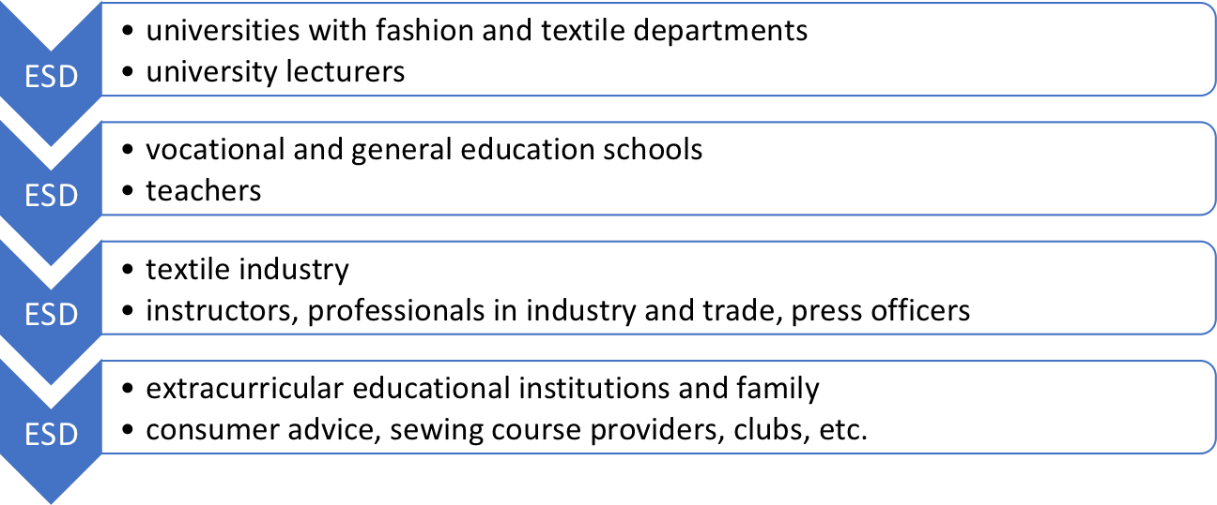
2nd Lecture
Lecture outlining “Education for Sustainable Development (ESD) as a Guiding Principle in the Context of Fashion and Textiles”.
The teaching unit provides a holistic and transformative view on ESD as a guiding principle in the context of fashion and textiles.
Students will learn to explain the meaning of ESD and design competence with its sub-competences.
ESD
CC BY-SA Grundmeier

Slide 8
Reflections on 2nd Lecture
The holistic and transformative view on ESD as a guiding principle in the context of fashion and textiles is also part of the UNESCO Roadmap 2030 for ESD and the National Action Plan on ESD.
Within this political framework, the lecture particularly encourages a reflection on the question “How can ESD contribute to transform the linear model of the textile chain into a circular model?” as circular economy is a serious political mission of the European Green Deal and the EU Action Plan behind it.
In order to accept ESD as a guiding principle, it is crucial that students know the global impact of their fashion/clothing consumption.
Methods with a higher degree of guidance by the educators tend to have a more valid claim of effectiveness for implementing ESD (Riess et al., 2022).
Notes:
Riess, W., Martin, M., Mischo, C., Kotthoff, H.-G., & Waltner, E.-M. (2022). How Can Education for Sustainable Development (ESD) Be Effectively Implemented in Teaching and Learning? An Analysis of Educational Science Recommendations of Methods and Procedures to Promote ESD Goals. Sustainability, 14, 3708. https://doi.org/10.3390/su14073708

Slide 9
3rd Lecture
Lecture three outlines the didactic concept of “Research-Based Learning in the Context of Textile Education”.
Research-based learning is an active teaching and learning strategy, aiming to support the development of the students’ critical-research and science-oriented basic attitude.
Based on the current state of science, a reflexive-analytical attitude towards the teaching-learning process might be a target-oriented approach to implement ESD.
Students will learn to link their knowledge of the textile and clothing industry and the textile value chain to research-based learning as a didactical and methodical concept.
Research Expertise
Motivation & Professional Identity
Professional & Interdisciplinary Competences
CC BY-SA Grundmeier

Slide 10
Reflections on 3rd Lecture
According to Huber (2009, p. 16), the mere application of research-based learning does not ensure that these effects will occur as much as any other form of teaching because that depends on the design.
However, based on relevant problems, research-based learning represents a valuable didactic-methodological approach to develop motivation, subject identity and interdisciplinary competences.
Through research-orientation in teaching, students can join courses or projects involving current research, actively participate in them and grow on an inter- and transdisciplinary level.
They can learn about and discuss current research (research-led learning), acquire specific research skills (research-oriented learning) and conduct research projects (research-based learning).
Notes:
Huber, L. (2009). Warum Forschendes Lernen nötig und möglich ist [Why research-based learning is necessary and possible]. In L. Huber, J. Hellmer & F. Schneider (Eds.), Forschendes Lernen im Studium. Aktuelle Konzepte und Erfahrungen [Research-based learning in higher education: Current concepts and experiences] (pp. 9-35). UniversitätsVerlag Webler.

Slide 11
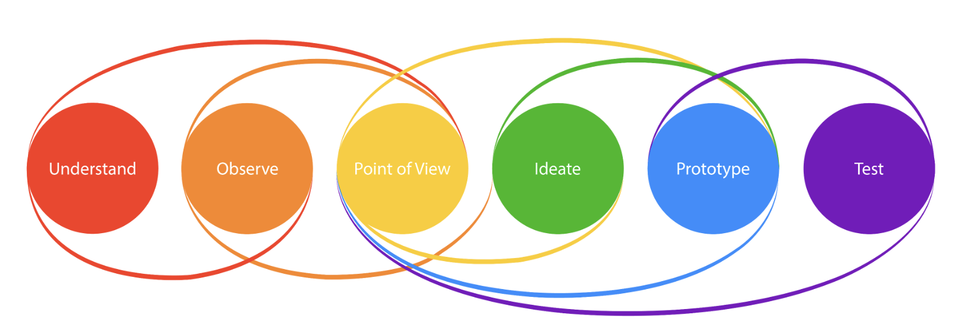
4th Lecture
Lecture on “Design Thinking - a Suitable Method for Implementing Education for Sustainable Development (ESD) in Textile Education”.
Creativity, problem-solving skills and collaborative working are key competencies to manage the challenges of the 21st century.
Design Thinking is an approach used for practical and creative problem-solving. It is based heavily on the methods and processes that designers use (hence the name), but it has actually evolved from a range of different fields—including architecture, engineering and business. Design Thinking can also be applied to any field; it does not necessarily have to be design-specific.
© Adapted from HPI Academy
Notes:
Image Source:
HPI Academy (n. d.). Education for Professionals. What is Design Thinking? https://hpi-academy.de/en/design-thinking/what-is-design-thinking.html

Slide 12
Reflections on 4th Lecture
As simple predictions based on linear causal relationships are very rare to solve sustainability issues of the textile and fashion industry, Design Thinking offers a systematic approach to complex problems from all areas of life - including ESD.
Thus, Design Thinking can be a useful method to support didactic concepts such as research-based learning. Additionally, the approach has the potential to foster ESD as a guiding principle in textile education as well as in textile and fashion companies.
As Design Thinking is both an ideology and a process that is about solving complex problems in a very user-centred way, students are encouraged to integrate Design Thinking into their professional activities/studies.

Slide 13
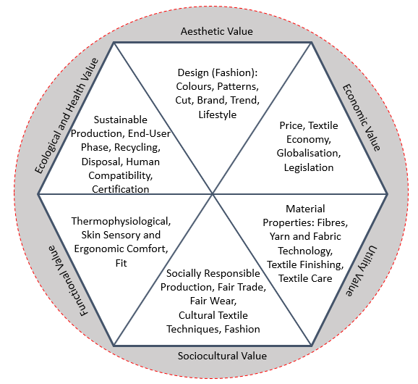
5th Lecture
“Sustainability Oriented Consumer Education in Fashion and Textiles” is subject of lecture five.
The teaching unit links knowledge of the textile and clothing industry and the textile value chain to consumer education and decision-making as a didactical field.
It acquaints participants with consumer behaviour, e.g. the attitude-behaviour gap. This term explains why consumers are aware of social and ecological grievances in the textile value chain although sustainability criteria play a subordinate role when buying clothing.
Quality Circle
CC BY-SA-ND Grundmeier

Slide 14
Reflections on 5th Lecture
According to Fischer (2011, p. 66.), “Patterns of consumption are considered as a main driver of unsustainable development. In the debate, education and educational organizations are unisonous considered as a key player to contribute to a more sustainable socialization of young consumers. Both schools and universities are challenged to become places and life-worlds in which sustainable consumption can be learned and experienced.” The consumption structures must therefore be broken up.
Today, consumers are becoming more aware of the sustainability issues of the textile and fashion industry and that they are highly influential in advancing it. To exert their influence more strongly, consumers need to become more collaborative, educated and conscious.
However, to overcome the attitude-behaviour gap of consumers, they need reflective decision-making processes and effective tools, such as the quality-circle, in order to analyse and judge from several perspectives with the aim of being able to select fashion and textiles in a more reflective and quality-conscious way.
Notes:
Fischer, D. (2011). Monitoring Educational Organizations’ Culture of Sustainable Consumption: Initiating and Evaluating Cultural Change in Schools and Universities. Journal of Social Sciences, 7(1), 66-78. https://doi.org/10.3844/jssp.2011.66.78

Slide 15
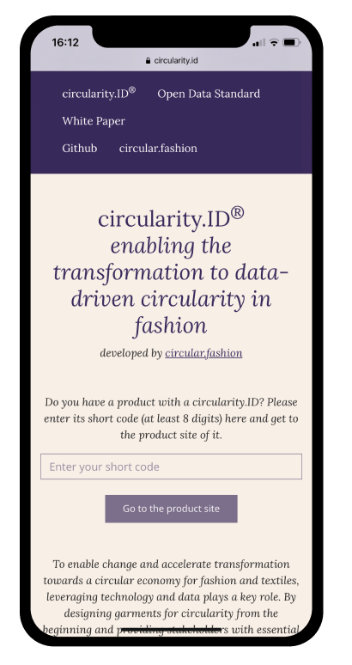
6th Lecture
Lecture on “Empathy, Mindfulness and Ethical Values in Fashion Consumption”.
The teaching unit offers information about the European clothing consumption and ways how to reuse, repair and recycle clothes. It also informs about circular economy approaches and the cradle-to-cradle concept.
The lecture is about building action knowledge and fostering sustainability-oriented action competencies in fashion, i.e. strategies that can help minimise the gap between consumers’ willingness to purchase items and their moral standards in respect to fair-trade clothes.
The lecture also helps students to apply mindfulness and ethical thinking in this field of study.
Circular.fashion UG, https://circular.fashion/en/software/circularity-id.html
Notes:
Image Source:
Circular.fashion UG (n.d.). https://circular.fashion/en/software/circularity-id.html

Slide 16
Reflections on 6th Lecture
The devastating impact of the textile and fashion industry cannot be prevented by an industrial transformation alone, if there is no simultaneous change in consumption patterns. This requires a habit change in the way that consumer think (knowledge) and act (skills) such as the handling of textiles and clothes.
Against this background, a new teacher’s role arises, so that they should show their students the way of decision-making and try to awaken their empathy without becoming moralising or prescribing a certain way of dealing with textiles and clothes. Rather, the goal is to encourage people to rethink fashion consumption as the first step towards true slow fashion.
Training students to adopt sustainable behaviour is therefore an essential aspect of this teaching unit. Especially, as fair trade and environmental protection have little importance as a purchasing motive compared to the price.

Slide 17
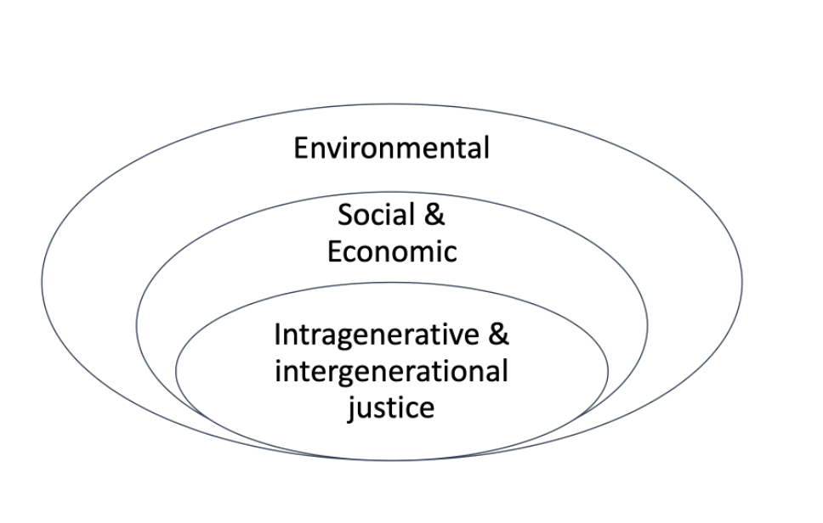
7th Lecture
Lecture on “Overcoming the Growth Dilemma - Rational Collective Economy”.
The lecture explains various sustainable economic models, such as Economy for the Common Good, Post-Growth Economy, Societal Contract, Green Growth, Moral Economics and Integrative Business Ethics.
The unit teaches how to distinguish business economics and behavioural economics. It also describes the growth dilemma and its hierarchy as well as the basic assumptions of rational collective economy including the challenges this theory faces.
CC BY-SA Fritsch

Slide 18
Reflections on 7th Lecture
The lecture discloses and discusses various sustainable economic models and confronts participants to reflect on further challenges in the implementation of the respective models.
Consumers and fashion managers today are confronted with the same preconditions: On the one hand, we want to continue to grow economically as before, on the other hand, we do not want to consume resources as before, poison the environment [...] and thus make the earth successively uninhabitable (Pietsch, 2021, p. 4).
As the current climate crisis is about nothing less than survival on this planet, we have to change our perspective towards sustainability not as an emotional goal but a rational necessity.
According to that, environmental protection is a basic prerequisite for all economic decisions. Consequently, it can be deduced that sustainability is the basic principle of any action.
Notes:
Pietsch, D. (2021). Die Ökonomie und das Nichts. Warum Wirtschaft ohne Moral wertlos ist [The economy and nothingness: Why economy without morality is worthless]. Springer. https://doi.org/10.1007/978-3-658-33277-8_1

Slide 19
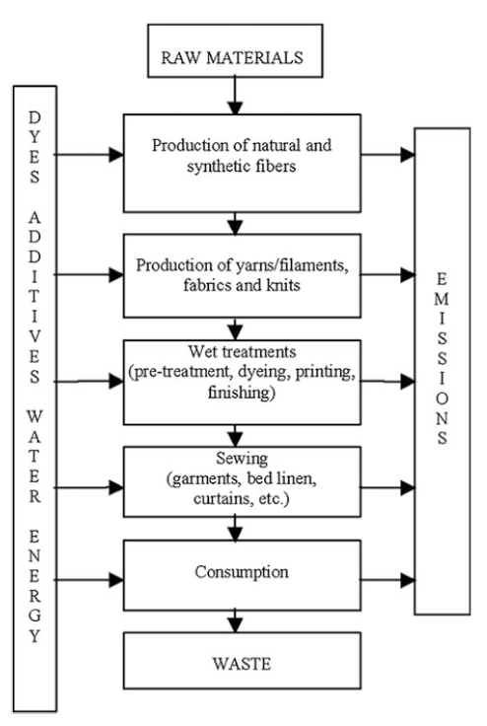
8th Lecture
Figure 1: Simplified linear textile product chain
Lecture eight explains the “Life Cycle Assessment (LCA)” of the textile value chain.
The LCA technique was developed in the 1970s and, apart from the carbon footprint method, assesses the environmental impacts associated with all stages in the life cycle of a product, from raw material extraction, through material processing, manufacturing, distribution, use, repair as well as maintenance, and disposal or recycling.
Students will learn about the strengths and limitations of the LCA technique.
© Choudhury (2014, p. 3)
Notes:
Choudhury, A. K. R. (2014). Environmental Impacts of the Textile Industry and Its Assessment Through Life Cycle Assessment. In S. S. Muthu (Ed.), Roadmap to Sustainable Textiles and Clothing: Environmental and Social Aspects of Textiles and Clothing Supply Chain (pp. 1-39). Springer. https://doi.org/10.1007/978-981-287-110-7_1:

Slide 20
Reflections on 8th Lecture
LCA is comprehensive and involves a systematic scientific approach to examine the environmental impacts of the entire life cycle. It is also not simply the quality of the product, nor the amount of waste ending up in a landfill or an incinerator, but the life cycle of the product that determines its environmental impact. Accordingly, LCA is also a means of measuring whether or not green improvements have been achieved (Muthu, 2015).
In contrast to LCA, carbon footprinting is the central method for assessing the impact of textiles on climate change that encompasses the entire life cycle of a product or service.
As LCA depends on assumptions and scenario, it assesses the real world in a simplified model (Finkbeiner et al., 2014).
Therefore, LCA studies, often performed according to the ISO 14040 standard series, have limitations that need to be documented in the scope and goal definition.
Notes:
Finkbeiner, M., Ackermann, R., Bach, V., Berger, M., Brankatschk, G., Chang, Y. J., Grinberg, M. Lehmann, A., Martínez-Blanco, J., Minkov, N., Neugebauer, S., Scheumann, R., Schneider, L., & Wolf, K. (2014). Challenges in Life Cycle Assessment: An Overview of Current Gaps and Research Needs. In: Klöpffer, W. (Ed.), Background and Future Prospects in Life Cycle Assessment: LCA Compendium – The Complete World of Life Cycle Assessment (pp. 207-258). Springer. https://doi.org/10.1007/978-94-017-8697-3_7
Muthu, S. S. (Ed.). (2015). Handbook of Life Cycle Assessment (LCA) of Textiles and Clothing. Woodhead Publishing.

Slide 21
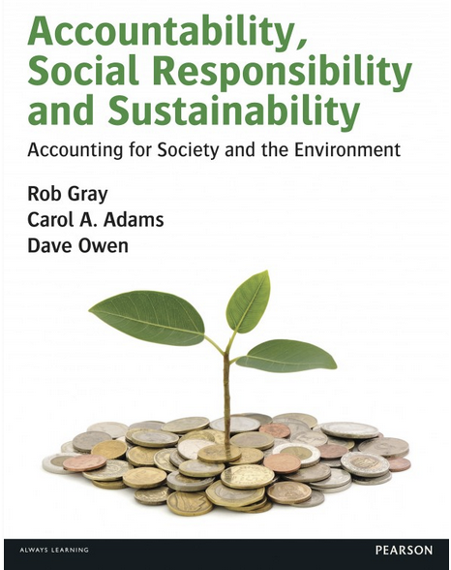
9th Lecture
Lecture nine deals with the topic of “Sustainable Accountability in the EU Textile Market”.
The lecture leads students to understand the concept of accountability in the context of business.
It provides an overview of current requirements on sustainable business reporting.
It also invites participants to critically reflect sustainable business reporting requirements, their currently foreseeable development and lists some examples of good practice from the EU textile market.
Notes:
Image Source:
Gray, R.H., Adams, C.A., & Owen, D.L. (2014). Accountability, Social Responsibility, and Sustainability: Accounting for Society and the Environment. Pearson Education Limited.

Slide 22
Reflections on 9th Lecture
Notwithstanding the current legal requirements, companies may develop their own sustainability requirements and report about them.
However, as voluntary reporting on sustainable aspects has major disadvantages, the importance of corporate sustainability reporting is increasing and the requirements for corporate sustainability reporting will change fundamentally. This results from the new EU Corporate Sustainability Reporting Directive (CSRD).
Furthermore, it is not only the EU Commission that has taken up the issue of sustainability reporting: IFRS Foundation - responsible for the internationally recognised accounting standards IFRS - has founded a new entity, the International Sustainability Standards Board (ISSB), which is to develop global basic standards (Global Baseline) in the area of sustainability reporting in the future.
Notes:
European Commission (n.d.). Corporate sustainability reporting. https://finance.ec.europa.eu/capital-markets-union-and-financial-markets/company-reporting-and-auditing/company-reporting/corporate-sustainability-reporting_en
IFRS. International Financial Reporting Standards, commonly called IFRS, account standards issued by the IFRS Foundation and the International Accounting Standards Board (IASB) (2007).

Slide 23
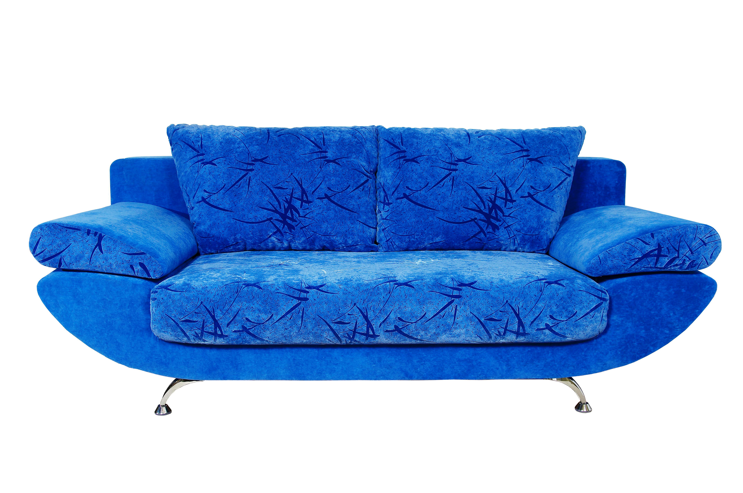
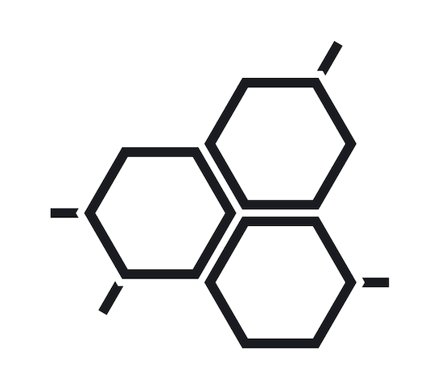

10th Lecture
Lecture on “Societal Health Impact of Textile and Clothing Consumption“.
The teaching unit addresses the topic of human ecology - the interrelation of consumers with its inanimate fabric environment - by giving a brief overview of understanding the chemical health risks of textile and clothing consumption.
Within this lecture, the impact of textile chemicals and its exposure to the body are disclosed and the effectiveness of regulations and eco-labels are discussed.
CC0, Colourbox
© RAL gemeinnützige GmbH
Notes:
Image Sources:
'couch, sofa, blau‘, by Lieferant #53741, CC0, Colourbox. https://www.colourbox.de/bild/couch-sofa-blau-bild-5389509
Schwarze Piktogramme / Icons zum Thema Chemie, by 259070, CC0, Colourbox. https://www.colourbox.de/vektor/black-icon-set-chemistry-i-vektor-36135422
RAL gemeinnützige GmbH (n.d.). The Green Button. The government-run certification label for sustainable textiles. https://www.gruener-knopf.de/en

Slide 24
Reflections on 10th Lecture
Although consumers are exposed to potentially toxic chemicals mainly through skin-contact textiles or clothes, contaminations can hardly be assessed by consumers.
Since this problem cannot be solved by the consumers themselves, they should at least be informed. At the same time, consumers should be supported by effective international regulations.
There are important control measures for many hazardous compounds in the EU, such as REACH. However, the textile production in countries with fewer environmental restrictions and lower occupational health standards, the complex raw material supply chains as well as the large numbers of operators involved in the different production steps make a strict control on the presence of some toxic chemicals in textiles in general, and in clothes in particular, very difficult.
Until the rise of a federally regulated transparency in the supply chain, voluntary eco-labels allow consumers to make first comparisons among products regarding healthy (and environmentally preferable) products.

Slide 25

11th Lecture
Lecture on “Microplastic Fibres and Particles in the Textile Chain – Environmental Impact and Health Effects”.
The environmental and health risks assigned to small microplastic particles, released during the production and use of fabrics, likewise affect both consumers and producers of textile and fashion articles.
The teaching unit provides knowledge about a risk assessment of microplastics and the impact on the health of ecosystems including humans.
CC0 by Ron Lach, pexels
Notes:
Image Source:
meer-strand-frau-wasser-9038216, by Ron Lach, CC0, Pexels. https://www.pexels.com/de-de/foto/meer-strand-frau-wasser-9038216/

Slide 26
Reflection on 11th Lecture
In the EU, a variety of regulatory measures have been taken over the last few years to tackle the microplastic issue, such as the OECD Extended Producer Responsibility (EPR), passed in 2016, the EU Microplastic Positioning Paper (2018), the EU ban on throwaway plastics (2019) and the EU Green Deal, adopted in 2020.
However, a stewardship policy is not enough to solve the problem. It is therefore also up to consumers to change their shopping, use and care behaviour in order to reduce the input of microparticles into the environment. Its entry into biospheres can largely be reduced by a sustainable washing behaviour and consumption.
Notes:
OECD (n.d.). Extended producer responsibility. https://www.oecd.org/env/tools-evaluation/extendedproducerresponsibility.htm
European Environmental Bureau (n.d.). Position paper on EU restriction of microplastic. https://eeb.org/library/ngo-position-on-eu-restriction-of-microplastic/
European Parliament (2019). Parliament seals ban on throwaway plastics by 2021. Press Releases. https://www.europarl.europa.eu/news/en/press-room/20190321IPR32111/parliament-seals-ban-on-throwaway-plastics-by-2021

Slide 27
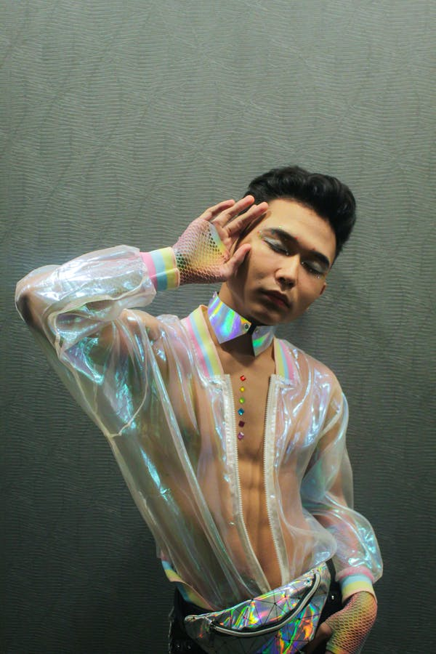
12th Lecture
Lecture 12 deals with “Clothing as a Medium of Communication”.
The teaching unit explains the historical development of clothing and fashion as predominantly non-verbal means of communication and fashion theories as well as the scientific discourse on clothing and fashion.
The historical development of fashion is considered as well as the influence of social media on fashion.
Students learn to link their knowledge in the field of fashion theory to a sustainable fashion consumption.
CC0 by Slaytina, pexels
Notes:
Image Source:
Foto des Mannes, der sein Gesicht berührt, by Slaytina, CC0, Pexels, https://www.pexels.com/de-de/lizenz/, https://www.pexels.com/de-de/foto/foto-des-mannes-der-sein-gesicht-beruhrt-2907100/

Slide 28
Reflection on 12th Lecture
Today we dress to communicate who we are or who we would like to be or others to think we are. In this way, we tell fashion narratives through our adornment.
The fashion system has been democratised through fast fashion, high-low collaborations and social media, which complicates the dynamic of identity displays and creates tension between personal statements and social performances.
Mackinney-Valentin (2017) explores how this tension is performed through fashion production and consumption by means of case studies. She argues that we are in an epoch of “status ambivalence”, in which fashioning one’s own identity has become complicated.
Notes:
Mackinney-Valentin, M. (2017). Fashioning Identity: Status Ambivalence in Contemporary Fashion. Bloomsbury Publishing.

Slide 29
13th Lecture
Basic Functions of Clothing
Adornment to express beauty, creativity, uniqueness.
Identification to be recognised as a member of a specific group.
Social status to show the position or rank within a group.
Protection from the environment (climate, sun radiation, mechanical abrasion).
Modesty as a belief about the proper way of covering the body.
Lecture 13 on “Cultural and Intercultural Learning in the Context of Fashion and Textiles”.
The lecture builds up competences in intercultural and multicultural interactions
It discloses the benefits of cultural and intercultural education and the implementation of sustainability aspects and ESD.
CC BY-SA Grundmeier

Slide 30
Reflection on 13th Lecture
Students should learn to distinguish between clothing and fashion and to consider clothing as a universal phenomenon and fashion as a temporal phenomenon.
Dressing oneself can be interpreted as an act of personal identity.
Vestimentary knowledge is focussed on the accordance of clothing and social rank. It is formulated and passed on by the education and conversation teachings, which always deal with outer appearance as well.

Slide 31
Reflections on Part I (1)
The topics of the first part of the ESD module raise the question of the actors’ roles, i.e., policymakers, the industry and consumers as well as educators.
The numerous companies that see sustainability as a fad and move towards greenwashing (Amed et al., 2022, pp. 77-81) by spreading narratives on their sustainability through the media show that self-renewal on the part of the industry alone will not bring about a transformation – they have not yet realised that it is time for a reset, not a restart.
For a sustainable reset of the future textile value chain and fashion market, it needs the industry to accept the consumer as a partner on eye level. Hence, the ESD module’s first part targets at consumers to become educated, conscious and collaborative partners of a circular economy, and not a simple pawn in the game.
Notes:
Amed, I., Berg, A., Balchandani, A., André, S., Devillard, S., Straub, M., Rölkens, F., Grunberg, J., Kersnar, J., & Grump, H. (2022). The State of Fashion 2023. https://www.mckinsey.com/industries/retail/our-insights/state-of-fashion

Slide 32
Reflections on Part I (2)
Admittedly, consumer behaviour should be considered as a prerequisite to transform the textile value chain and fashion market into a circular system, as the argument of an “unchangeable consumer demand” should not turn out as an upcoming, highly appreciated fig leaf, an alibi the textile and fashion industry would have to follow.
This is where Education for Sustainable Development (ESD) comes into play. Using ESD as a guiding principle, knowledge, decision-making and action in the context of fashion and textiles can be sustainably transformed. It should be taken into account that ESD must be linked to current socio-political issues such as inclusion, digitalisation and climate protection.
ESD as a guiding principle in the context of fashion and textiles is presented from various didactic and methodological perspectives, including overviews and deeper insights.

Slide 33
Conclusion
Responsibility for more sustainable consumption is often put on the shoulders of individual citizens. But while individual behaviour change is important, to truly address these problems, policymakers, on the one hand, need to set new legislation to make textiles sustainable by default, so that sustainability becomes the norm and not a luxury available to only the most affluent consumers. This means, holding the industry accountable and responsible for the externalities of its activities. However, for a sustainable reset of future textile consumption, it also needs, on the other hand, the ethically acting consumer. Hence, the ESD module’s first part mainly targets at lecturers, teachers and trainers in vocational education and their students as further employees in the textile and fashion industry – being consumers at the same time – to become educated, conscious and collaborative partners of a circular economy.

Slide 34
Outlook

Slide 35
Science Communication as a Task of Higher Education
On the one hand, the sciences and humanities embody progress, but on the other hand, they are also perceived as a threat to human security. The more the sciences tangibly change the conditions of life individually, the more they are also called upon to publicly justify and publicly discuss such changes. (Stifterverband für die Deutsche Wissenschaft, 1999, p. 58).
Science communication is thus the dialogue between science and society.
In addition to research and teaching, the transfer of knowledge is the “third mission” of universities.
Notes:
Stifterverband für die Deutsche Wissenschaft [Donors’ Association for the Promotion of Sciences and Humanities in Germany] (1999). Dialog Wissenschaft und Gesellschaft. Präambel [Dialogue Science and Society: Preamble] (pp. 58-61). https://www.hrk.de/fileadmin/redaktion/hrk/02-Dokumente/PUSH-Memorandum.pdf

Slide 36
Goals of Scientific Communication
“Improving the population’s beliefs about science.”
“Generating social acceptance.”
“Generating public epistemic and moral trust.”
“Collect citizens’ input about acceptable/worthwhile research aims and applications of science.”
“Generating political support for science.”
“Collect and make use of local knowledge.”
“Make use of distributed knowledge or cognitive resources to be found in the citizenry.”
“Enhance the democratic legitimacy of funding, governance and application or science or specific segments of science.” (Kappel & Holmen, 2019, pp. 3-6).
Notes:
Kappel, K., & Holmen, S. J. (2019). Why Science Communication, and Does It Work? A Taxonomy of Science Communication Aims and a Survey of the Empirical Evidence. Frontiers in Communication, 4, 1-12. https://doi.org/10.3389/fcomm.2019.00055

Slide 37


Aspects of Understanding Science
Understanding of Science
Nature and Extent of Knowledge
Prerequisites and Basics of Knowledge
Reliability of Knowledge Claims
Possibilities, Conditions and Limits of Knowledge
“Science doesn’t just take place in laboratories. You can have fun with and make use of science in everyday life.” (University of Berkeley, n.d.)
CC BY-SA Grundmeier
Notes:
University of Berkeley (n.d.). Understanding Science 101. https://undsci.berkeley.edu/understanding-science-101/

Slide 38
Beliefs
Beliefs refer to ideas that people have developed before they are confronted with concrete scientific concepts. They stabilise their understanding of the world and enable the predictability, manageability and understanding of the meaning of recurring (everyday) phenomena.
We also speak of prior knowledge or pre-concepts that are referred to as mental structures to make it clear that they are represented via neuronal structures and activity patterns (Kandel et al., 2021, Part VIII).
This includes ideas about everyday phenomena as well as scientifically relevant phenomena such as climate change, which can also be subject to misconceptions. Therefore, scientists demand to teach a meaningful and self-regulated learning of science in higher and school education (Kreber et al., 2005; Moeed & Anderson, 2018).
Notes:
Kandel, E. R., Koester, J. D., Mack, S. H., & Siegelbaum, S. (2021). Principles of Neural Science (6th ed.). McGraw-Hill.
Kreber, C., Castleden, H., Erfani, N., & Wright, T. (2005). Self-regulated learning about university teaching: an exploratory study. Teaching in Higher Education,10(1), 75-97. https://doi.org/10.1080/1356251052000305543
Moeed, A., & Anderson, D. (2018). Learning Through School Science Investigation: Teachers Putting Research into Practice. Springer.

Slide 39
Beliefs and Knowledge
Beliefs are cognitive dispositions or pre-concepts with multiple levels of impact (Wilde & Kunter, 2016). Most of the time you are not aware of them and therefore they are also called “tacit knowledge”.
What is important about beliefs is that they are seen as true for teachers and learners and are therefore held with great vehemence (Calderhead, 2004). They have a lower epistemic status compared to knowledge (Fenstermacher, 1994, p. 53).
According to Pajares (1992, p. 325), knowledge and beliefs are inextricably intertwined, but the strong affective, evaluative and episodic character of beliefs makes them a filter through which new phenomena are interpreted.
Notes:
Calderhead, J. (2004). Teachers: Beliefs and Knowledge. In D. C. Berliner & R. C. Calfee (Eds.), Handbook of Educational Psychology (Part IV, pp. 709-725). Routledge.
Fenstermacher, G. D. (1994). The Knower and the Known: The Nature of Knowledge in Research on Teaching. Review of Research in Education, 20, 3-57. https://doi.org/10.2307/1167381
Pajares, M. F. (1992). Teachers' Beliefs and Educational Research: Cleaning Up a Messy Construct. Review of Educational Research, 62(3), 307-332. https://doi.org/10.3102/00346543062003307
Wilde, A., & Kunter, M. (2016). Überzeugungen von Lehrerinnen und Lehrern [Teachers‘ beliefs]. In M. Rothland (Ed.), Beruf Lehrer/Lehrerin. Ein Studienbuch [Profession Teacher: A study book] (pp. 299-315). Waxmann.

Slide 40


Teachers‘ Beliefs
Beliefs develop biographically and are shaped by personal worldviews, value systems and subjective ideas about education, teaching and learning.
Partly unconsciously, but persistently, beliefs
affect teachers’ perceptions and actions
(Reusser & Pauli, 2014).
Promoting reflective capacity is a strategy
to become aware of one’s own beliefs and
their impact and to critically engage with them
in relation to theoretical professional knowledge.
Beliefs
Knowledge
CC BY-SA Grundmeier
Notes:
Reusser, K., & Pauli, C. (2014). Berufsbezogene Überzeugungen von Lehrerinnen und Lehrern [Teachers' job-related beliefs]. In E. Terhart, H. Bennewitz, & M. Rothland (Eds.)., Handbuch der Forschung zum Lehrerberuf [Handbook of Research on the Teaching Profession] (2nd revised and expanded ed., pp. 642-661). Waxmann.

Slide 41

Dealing with Beliefs in Teaching-Learning Arrangements
It is important for teachers to know their own beliefs, ideas and convictions in order not to pass them on unconsciously and indirectly. This is part of professional competence.
However, it is also important to know the learners’ beliefs, ideas and convictions so that they can be brought into teaching-learning arrangements as part of the lifeworld and related to subject-specific concepts.
In order to recognise beliefs, ideas and convictions, reflective thinking is required, which should be facilitated in teaching-learning arrangements.
Beliefs
Ideas
Convictions
CC BY-SA Grundmeier

Slide 42
Professional Competence of Teachers
Aspects of Professional Competence
Professional Knowledge
Self-Regulatory Skills
Motivational Orientations
Beliefs / Values
The professional knowledge of teachers is based primarily on subject knowledge, practical skills and subject didactic knowledge.
Beliefs, motivation as well as self-regulatory skills are also part of the professional competences of teachers (Kunter et al., 2011).
CC BY-SA Grundmeier
Notes:
Kunter, M., Baumert, J., Blum, W., Klusmann, U., Krauss, S., & Neubrand, M. (Eds.). (2011). Professionelle Kompetenz von Lehrkräften. Ergebnisse des Forschungsprogramms COACTIV [Professional competence of teachers: Results of the research programme COACTIV]. Waxmann.

Slide 43
Professional Development and ESD
There are links between the professional development of teachers and Education for Sustainable Development (ESD).
In order to achieve the necessary sustainable transformation of society and the economy by 2030, the UNESCO’s roadmap 2030 (2020, p. 30) identifies the competence development of teachers as one of five priority areas for action.
For this, teachers need an understanding of holistic, transformative action processes, which can be developed, among other things, through knowledge and own experiences with approaches to transformative learning (Getzin & Singer-Brodowski, 2016; Singer-Brodowski, 2016).
Notes:
Getzin, S., & Singer-Brodowski, M. (2016). Transformatives Lernen in einer Degrowth-Gesellschaft [Transformative learning in a degrowth society]. Socience: Journal of Science-Society Interfaces, 1, 33-46. openjournals.wu.ac.at/ojs/index.php/socience/article/view/181
Singer-Brodowski, M. (2016). Studierende als GestalterInnen einer Hochschulbildung für nachhaltige Entwicklung. Selbstorganisierte und problembasierte Nachhaltigkeitskurse und ihr Beitrag zur überfachlichen Kompetenzentwicklung Studierender [Students as designers of higher education for sustainable development. Self-organised and problem-based sustainability courses and their contribution to the interdisciplinary competence development of students]. Berliner Wissenschafts-Verlag.
United Nations Educational, Scientific and Cultural Organization (UNESCO). (2020). Education for Sustainable Development: A roadmap. https://unesdoc.unesco.org/ark:/48223/pf0000374802

Slide 44
Emotions and Motivation
Various studies show that emotions and moral aspects, partly also in combination with each other, play a considerable role in ESD and that emotions can support sustainable action (Grund & Brock, 2020).
Researchers therefore suggest that the implementation of ESD should not focus exclusively on cognitive aspects, such as information and coherent argumentation, but should also consider emotions and moral aspects. Linked to this is the criticism that the role that emotions have played so far was too small (Brosch & Steg, 2021; Dunlop & Rushton, 2022; Trott, 2021).
At the same time, studies indicate that teachers are uncertain about how to deal with students’ emotions in the context of ESD (Dunlop & Rushton, 2022; Grund & Brock, 2020).
Notes:
Brosch, T., & Steg, L. (2021). Leveraging emotion for sustainable action. One Earth, 4(12), 1693-1703.
Dunlop, L., & Rushton, E. A. C. (2022). Education for Environmental Sustainability and the Emotions: Implications for Educational Practice. Sustainability, 14(8), 4441. https://doi.org/10.3390/su14084441
Grund, J., & Brock, A. (2020). Education for Sustainable Development in Germany: Not Just Desired but Also Effective for Transformative Action. Sustainability, 12(7), 2838. https://doi.org/10.3390/su12072838
Trott, C. D. (2021). Climate change education for transformation: exploring the affective and attitudinal dimensions of children’s learning and action. Environmental Education Research, 28(7), 1023-1042. https://doi.org/10.1080/13504622.2021.2007223

Slide 45
Goal: Sustainable Action Competence
Sustainability-oriented action requires the ability to think in a networked way and to critically weigh ecological, economic and socio-cultural dimensions of sustainability and their conflicting goals in order to be able to make justifiable decisions despite insoluble complexity and contradictions (Pettig, 2021, p. 8).
This claim of a critical-emancipatory ESD (Getzin & Singer-Brodowski, 2016, p. 39) is not content with imparting sustainable values, attitudes and behaviours that have been declared as correct by experts (Schild et al., 2019, p. 35).
Therefore, critical-emancipatory reflection, decision-making and action skills are aimed for.
Notes:
Pettig, F. (2021). Transformative Lernangebote kritisch-reflexiv gestalten. Fachdidaktische Orientierungen einer emanzipatorischen BNE [Designing transformative learning opportunities critically and reflectively: Subject didactic orientations of an emancipatory ESD]. GW-Unterricht, 162(2), 5-17.
Schild, K., Leng, M., & Hammer, T. (2019). Die Rolle von Transformativem Lernen für eine Bildung für Nachhaltige Entwicklung an der Hochschule [The Role of Transformative Learning for Education for Sustainable Development at Higher Education Institutions]. Bulletin VSH-AEU, 45(2), 34-40.

Slide 46
Teaching and Learning for Change
The promotion of the necessary skills of knowledge acquisition, critical reflection, autonomous decision-making and action (Getzin & Singer-Brodowski, 2016, p. 40) is a joint task of subject-specific, (subject-)didactic, pedagogical and school-practical training and further education of teachers.
For even so-called green technologies and design approaches are not sufficient to achieve the global sustainability goals, is the criticism from a degrowth perspective with reference to social inequality in the globalised economy (Getzin & Singer-Brodowski, 2016).
Consequently, teachers in the context of fashion and textiles are repeatedly confronted with the question of how complex problem areas can be developed in the theory and practice of the subject - taking into account all dimensions of (non-)sustainable development.

Slide 47
Transformative Learning Processes
In order to meet this challenge, lecturers, teachers and trainers need a critical-emancipatory design competence, which is based on subject knowledge, skills as well as sustainability-related knowledge, motivation and reflection of their own beliefs and convictions.
In addition, critical self-reflection and examination of ESD-relevant concepts in relation to one’s own subject understanding are necessary in order to recognise the potential of one's own subject contribution to shaping a sustainable future.
Based on this, the ability to be able to make responsible decisions for the planning and design of teaching-learning arrangements from an informed and reflective attitude, despite high complexity and existing contradictions, can be developed.

Slide 48
Further References
Eberth, A., Goller, A., Günther, J., Hanke, M., Holz, V., Krug, A., Rončević, K., & Singer-Brodowski, M. (Eds.). (2022). Bildung für nachhaltige Entwicklung – Impulse zu Digitalisierung, Inklusion und Klimaschutz [Education for sustainable development - impulses for digitalisation, inclusion and climate protection]. Barbara Budrich. https://elibrary.utb.de/doi/book/10.3224/9783847417514
Khine, M. S., & Nielsen, T. (Eds.). (2022). Academic Self-efficacy in Education: Nature, Assessment, and Research. Springer. https://doi.org/10.1007/978-981-16-8240-7
Kommers, P. (2022). Sources for a Better Education: Lessons from Research and Best Practice. Springer. http://dx.doi.org/10.1007/978-3-030-88903-6
Vries, M. J. de (Ed.). (2017). Handbook of Technology Education. Springer.
Williams, P. J., & von Mengersen, B. von (Eds.). (2022). Applications for Research in Technology Education: Helping Teachers Develop Research-Informed Practice. https://doi.org/10.1007/978-981-16-7885-1

Slide 49
OER Explanation
OER Licence CC BY-SA except the logos and where otherwise stated e.g. images, photos, pictures.
A full citation of text and image sources is always given at the first mention of the authors in the notes beneath the slide, otherwise short citation in the text or on the slide.

Slide 50
Contact
University of Education Freiburg
Institute of Everyday Culture, Sports and Health
Department Fashion and Textile
Prof. Dr. Anne-Marie Grundmeier
Prof. Dr. Dirk Höfer
E-mail: grundmeier@ph-freiburg.de
E-mail: dirk.hoefer@ph-freiburg.de

