Slide 1
Sustainable Raw Materials and Textile Materials

Slide 2
Learning Objectives
After this lecture you should be able to:
Demonstrate both basic and in-depth knowledge in textile raw materials.
Illustrate central terms concerning fibres and their production.
Describe and apply different research approaches to textile raw materials.
Link your knowledge in the field of fibres and textile materials to sustainability aspects.
Apply mindfulness and ethical thinking in this field of study.
Fashion DIET
2

Slide 3
Content
Definition and Classification of Textile Raw Materials
Global Fibre Market and Megatrends
Plant and Animal Fibres
Down and Leather
Manmade Cellulosic and Synthetic Fibres
Environmental Impact
Sustainable Standards and Certifications
Alternative Resources and Processes
Fashion DIET
3

Slide 4
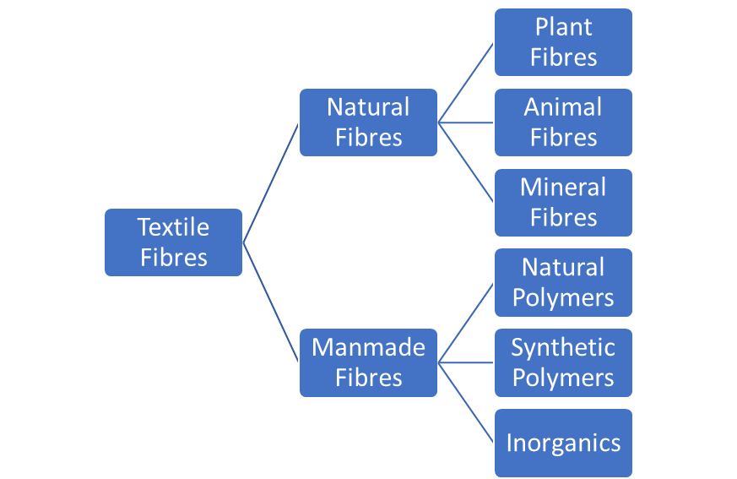
Classification of Fibres as Textile Raw Materials
Based on their origin, textile raw materials are classified into two main categories: natural and manmade fibres.
Natural fibres are provided by nature in ready-made form and need only to be extracted.
Manmade fibres are generated by humans from raw materials which were not in fibre form previously.
CC BY-SA Grundmeier
Fashion DIET
4
Notes:
4

Slide 5
Natural Fibres
Natural fibres have been used for thousands of years. They exist in fibre form and have mechanical or textual properties.
Fibres obtained from plants, vegetables or animal sources are the dominant natural fibres. One of the most used mineral fibres was asbestos, but it has been banned in most countries because it is considered harmful to health.
Plant-based fibres can be produced from plant leaves, seeds, fruit, grass, stalk or liber, e.g., the leaves of sisal and abacá, the bast of flax, jute, hemp, ramie and kenaf, the seeds of cotton and kapok.
Animal fibres include cashmere, mohair, qiviut (musk ox), alpaca, llama, vicuña, guanaco, Bactrian camel, yak, bison, angora (rabbit) and silk. (Bunsell, 2018).
Fashion DIET
5
Notes:
Bunsell, A. R. (2018). Introduction to the science of fibers. In A. R. Bunsell (Ed.), Handbook of Properties of Textile and Technical Fibres (2nd Ed.) (pp. 1-20). Woodhead Publishing.
5

Slide 6
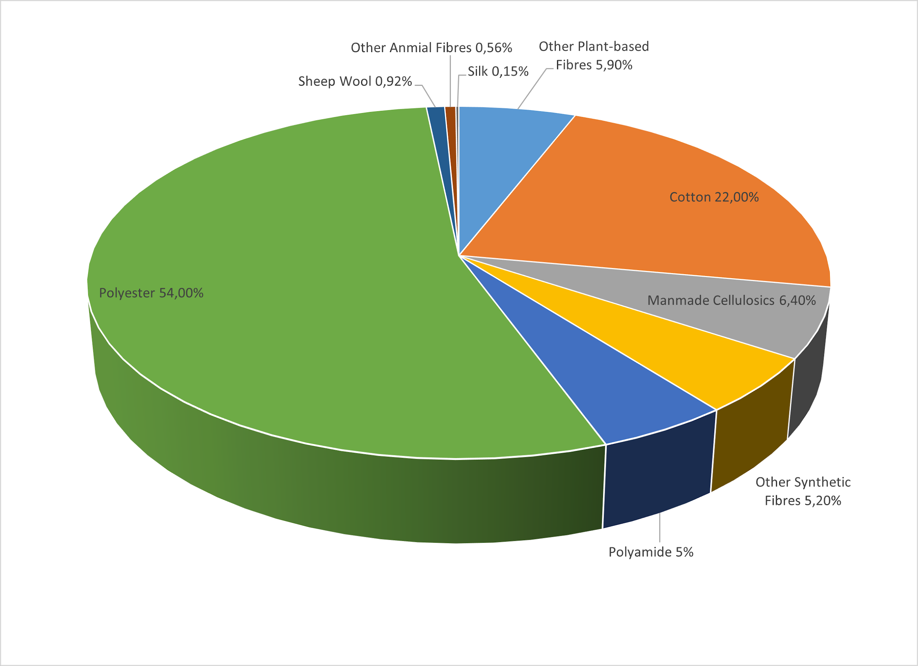
Global Fibre Market
In 2021, 113 million tonnes of fibres were produced.
Source of rounded percentage values: Textile Exchange, 2022a
Fashion DIET
6
Notes:
Textile Exchange (2022a). Preferred Fiber and Materials Market Report. October 2022. https://textileexchange.org/wp-content/uploads/2022/10/Textile-Exchange_PFMR_2022.pdf
6

Slide 7
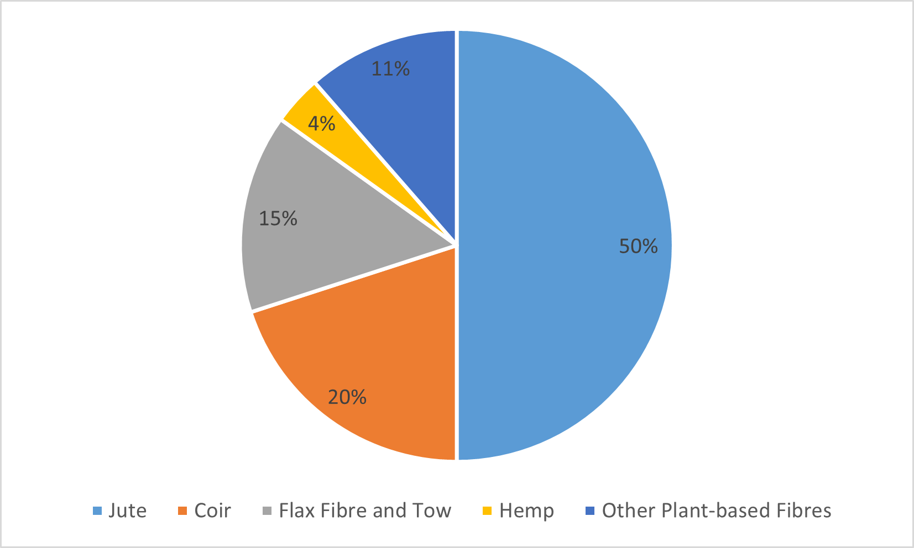
World Production of Plant Fibres
In 2021, 31.4 million tonnes of plant-based fibres were produced worldwide (27.9%).
Cotton is the most important natural fibre with approximately 24.7 million tonnes. In the last 10 years, its share fell to 22%.
Besides cotton, jute and coir (3.4 and 1.3 million tonnes) are the most important plant-based fibres.
Other plant-based fibres include abacá, agave, kapok, lotus, nettle, ramie and sisal.
Some of the natural fibres such as abacá are mainly used regionally.
Source of rounded percentage values: Textile Exchange, 2022a
Fashion DIET
7
Notes:
7

Slide 8
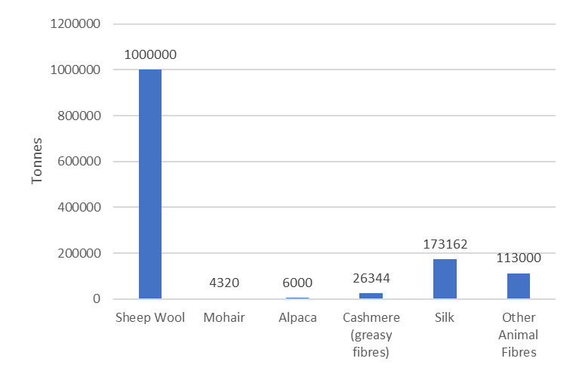
Animal Fibres
Over the years, the global wool production has been declining, while the number of sustainable wool programmes has been increasing.
In 2021, the greasy wool production was nearly 2 million tonnes.
(Textile Exchange, 2022a, p. 37)
Source of rounded percentage values: Textile Exchange, 2022a
Fashion DIET
8

Slide 9
Megatrends of the Global Fibre Market
Megatrends
Application Factors
Supply Development
Population Growth
Cotton
farmland
water
Rising Prosperity
fibre consumption
increases
Manmade Cellulose Fibres
wood
Cellulose Gap
structural change in
fibre demand
Sustainability/ Climate Change
Synthetic Fibres
oil
CC BY-SA-ND Grundmeier
Fashion DIET
9
Notes:
The global megatrends of population growth, rising prosperity, sustainability and climate change will continue to influence the world fibre market.
A shortage in the supply of natural fibres increases the demand for cellulose fibres and further biopolymers.
9

Slide 10
Global Fibre Market Trends
In the last 20 years, the global fibre production has almost doubled from 58 million tonnes in 2000 to 113 million tonnes in 2021. The global fibre market is expected to boom to 149 million tonnes by 2030 if business as usual continues.
The global fibre production increased from 8.4 kilograms per person in 1975 to 14.3 kilograms per person in 2021 and is estimated to reach 17.5 kilograms per person in 2030.
As the growth in fibre production has significant impacts on people and the planet, there is an urgent need for establishing a circular economy instead of the linear textile chain.
Furthermore, we have to promote awareness and a more responsible use of resources and decouple growth from resource consumption especially in order to limit global warming to 1.5° Celsius. (Textile Exchange, 2022a, p. 9).
Fashion DIET
10
Notes:
10

Slide 11
Development of World Production of Manmade Fibres
Synthetic Fibres
Cellulosic Fibres
© Industrievereinigung Chemiefaser e.V., https://ivc-ev.de/de/weltproduktion-von-chemiefasern-balkendiagramm
Fashion DIET
11
Notes:
Industrievereinigung Chemiefaser e. V. [Association of Manmade Fibres Industries] (2022). Weltproduktion von Chemiefasern [World production of manmade fibres]. https://ivc-ev.de/de
11

Slide 12
Production Value of Synthetic Fibres
Synthetic fibres have dominated the world market since the mid-nineties. This development is mainly due to the low price of fossil raw materials.
Polyester holds the highest market share of any fibre with 54%, of which only 14.8% is recycled (Textile Exchange, 2022a, p. 72).
Polyamide fibres have a market share of 5% and are thus the second most used synthetic fibres. The recycling rate is only 1.94% and still offers a lot of potential (Textile Exchange, 2022a, p. 81).
Bio-based polyester and polyamide fibres have a very small market share of 0.02% for polyester (Textile Exchange, 2022a, p. 78) and 0.4% for polyamides (Textile Exchange, 2022a, p. 83).
Fashion DIET
12

Slide 13
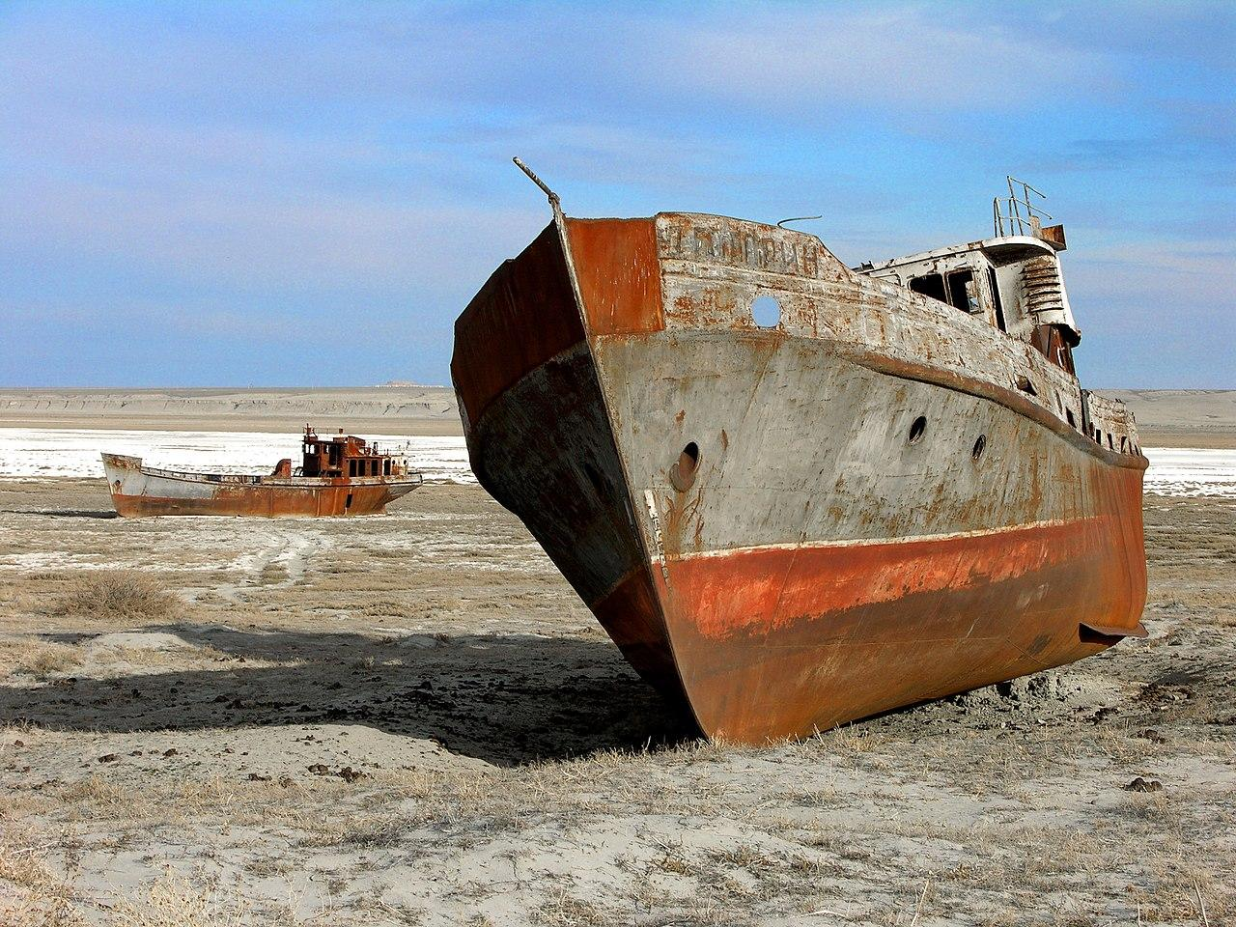
Facts of Cotton Cultivation
Cotton helps alleviate poverty in some of the least developed countries and provides employment for millions of people around the world. Cotton is a source of income for over 100 million families worldwide, many of whom are smallholder farmers in rural communities in developing countries (UNCTAD, 2022).
There are about 152 million working children worldwide, 71% of whom work in agriculture: cotton is one of the most common products that children are employed to harvest and process (Gemeinsam für Afrika, n.d.).
Cotton is a plant susceptible to diseases and pests. According to the International Cotton Advisory Committee it is one of the world’s most pesticide intensive crops (PAN, n.d.).
The cotton plant also needs a lot of water during the growth phase. Huge amounts of fresh water are needed to irrigate the cotton plantations, as some of them are grown in areas that are too dry or the irrigation systems are not efficient.
The loss of the Aral Sea, once the world‘s fourth largest lake, and the devastation of the surrounding area is one of the most shocking examples of the true costs of the cotton industry (Hoskins, 2014).
CC BY-SA 3.0 Zhanat Kulenov
Fashion DIET
13
Notes:
Gemeinsam für Afrika [Together for Africa] (n.d.). Kinderarbeit auf Baumwollplantagen in Afrika [Child labour on cotton plantations in Africa]. https://www.gemeinsam-fuer-afrika.de/kinderarbeit-auf-baumwollplantagen-in-afrika/
Hoskins, T. (01.10.2014). Cotton production linked to images of the dried-up Aral Sea basin. The Guardian. https://www.theguardian.com/sustainable-business/sustainable-fashion-blog/2014/oct/01/cotton-production-linked-to-images-of-the-dried-up-aral-sea-basin
Pesticide Action Network UK (n.d.). Pesticide concerns in cotton. https://www.pan-uk.org/cotton/
United Nations Conference on Trade and Development (UNCTAD) (07.11.2022). Tapping the full potential of cotton in developing countries. https://unctad.org/news/tapping-full-potential-cotton-developing-countries
Image Source:
Schiffe auf dem Trockenen, Desertifikation am Aralsee, Zhanat Kulenov, CC BY-SA 3.0 igo, https://commons.wikimedia.org/w/index.php?curid=37385990
Diese Datei wurde von der UNESCO (unesco.org) als Teil einer GLAMwiki-Partnerschaft zur Verfügung gestellt.
13

Slide 14
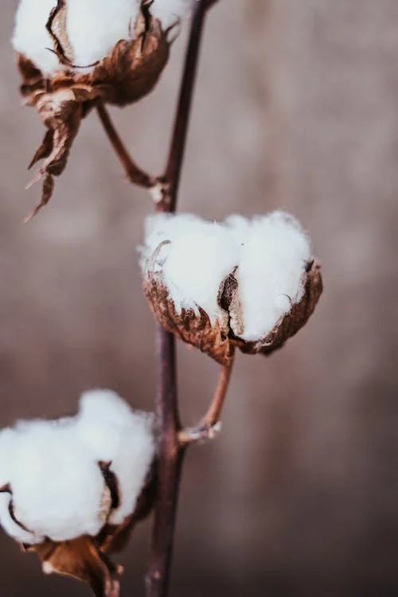
Data of Conventional Cotton
In 2021, about 75% of approximately 25 million tonnes of cotton were produced conventionally worldwide. The global market for recycled cotton is just under 1%, sustainable and organically grown cotton accounts for about 24%. (Textile Exchange, 2022a).
The ten largest producers are: China, India, US, Brazil, Pakistan, Australia, Turkey, Uzbekistan, Argentina and Mali (Shahbandeh, 2022).
About 2.4% of the world’s agricultural land is devoted to cotton production, but about 4.7% of the global pesticide market (herbicides, fungicides, insecticides) goes to the cotton industry (PAN, n.d.).
CC BY Vie Studio, Pexels
Fashion DIET
14
Notes:
Shahbandeh, M. (01.08.2022). Leading cotton producing countries worldwide in 2021/2022. https://www.statista.com/statistics/263055/cotton-production-worldwide-by-top-countries/
Image Source:
blatter-weiss-ast-weich, Vie Studio, https://www.pexels.com/de-de/lizenz/, https://www.pexels.com/de-de/foto/blatter-weiss-ast-weich-6168150/
14

Slide 15
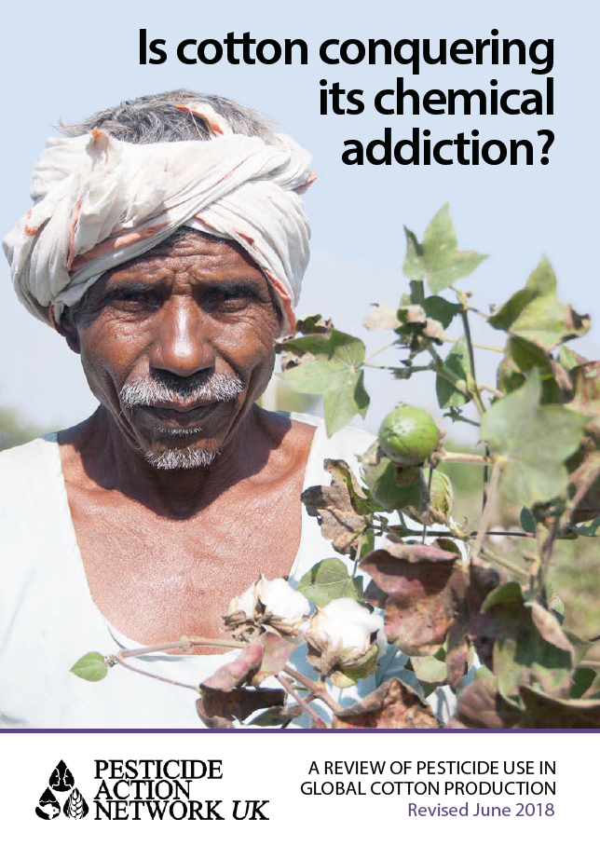
Effects of Pesticide Use on Health
Global pesticide poisonings have risen from 25 million since 1990 to about 385 million. Based on 860 million people working in agriculture, about 44% of them are poisoned annually.
Many more suffer from chronic diseases such as cancer and leukaemia, neurological diseases and reproductive problems such as infertility, miscarriages and birth defects. (Boedeker et al., 2020).
Fashion DIET
15
Notes:
Boedeker, W., Watts, M., Clausing, P., & Marquez, E. (2020). The global distribution of acute unintentional pesticide poisoning: estimations based on a systematic review. BMC Public Health, (20), 1875, 1-19. https://doi.org/10.1186/s12889-020-09939-0
15

Slide 16
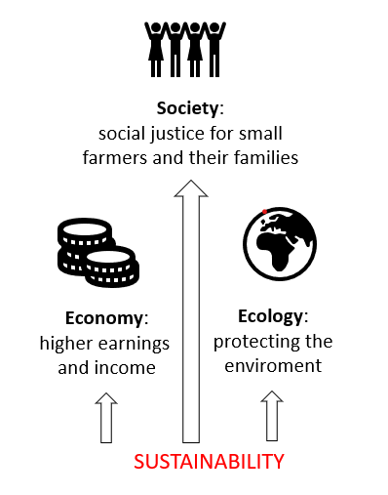
Aspects of Sustainably Produced Cotton
There are various initiatives, projects and programmes for sustainable cotton production, but these are to be distinguished from organic cotton, cotton cultivation without pesticides and artificial fertilisers.
Smallholder cotton farmers spend up to 60% of their annual income on pesticides. At the beginning of the season, they buy agrochemicals on credit. (PAN, n.d.).
Often the yields at the end of the season are too low to pay for these costs. Even a poor harvest can plunge them into debt.
CC BY-SA-ND Grundmeier
Fashion DIET
16
Notes:
16

Slide 17
Variety of Cotton Standards
There are several initiatives to produce sustainable cotton, such as organic cotton, Cotton made in Africa (CmiA), Fairtrade Cotton and Better Cotton. They focus either more on environmental or social measures.
Aid by Trade Foundation is an umbrella organisation for three cotton standards: CmiA, Cotton made in Africa Organic (CmiA Organic) and the Sustainable Cotton Standard (SCS), which is currently not used.
These standards were developed to improve the living conditions of African smallholder farmers and the working conditions in ginning factories and to promote more environmentally friendly cotton production. (ATAKORA Fördergesellschaft, n.d.).
Integrated pesticide management (IMP) means careful use of all pest control options to limit the use of pesticides as much as possible.
Natural methods of pest control such as pheromone traps are preferred.
Fashion DIET
17
Notes:
ATAKORA Fördergesellschaft GmbH. (n.d.). Our Standards System. https://cottonmadeinafrica.org/en/standards-system/
17

Slide 18
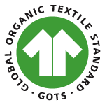
Organic Cotton Standards
Unlike terms such as “natural” or “sustainable”, the principles of organic farming are legally controlled. The criteria are set by governing authorities. The rules include requirements around soil health and the prohibition of artificial fertilizers, hazardous synthetic pesticides and genetically modified organisms.
After the cotton has left the farm, it is not automatically covered by the same legal protections.
Private standard-setting organisations offer voluntary standards that manage the chain of custody of the organic cotton from gin to the finished product.
The most common of these finished product standards are the Global Organic Textile Standard The most common of these finished product standards are the Global Organic Textile Standard (GOTS) (Global Standard, 2021) and Textile Exchange‘s Organic Content Standard (OCS) (Textile Exchange, n.d.).
Both standards accept organic cotton from farms certified by the International Federation of Organic Agriculture Movements (IFOAM – Organics International). (Textile Exchange, 2022b, p. 11).
© Global Standard
Fashion DIET
18
Notes:
Global Standard (2021). Global Organic Textile Standard (GOTS). https://global-standard.org/
International Federation of Organic Agriculture Movements (n.d.). IFOAM Family of Standards. https://www.ifoam.bio/our-work/how/standards-certification/organic-guarantee-system/ifoam-family-standards
Textile Exchange (n.d.). Organic Content Standard (OCS). https://textileexchange.org/standards/organic-content-standard/
Textile Exchange (2022b). Organic Cotton Market Report. October 2022. https://textileexchange.org/wp-content/uploads/2021/07/Textile-Exchange_Organic-Cotton-Market-Report_2022.pdf
Image Source:
Global Standard (2021). Global Organic Textile Standard (GOTS). https://global-standard.org/
Tasks:
Get together in small groups and do research on the websites of both standards in order to find out more about them. Another group shall focus on the certification by the International Federation of Organic Agriculture Movements.
Present the standards with their goals in the plenary and compare their impact.
18

Slide 19
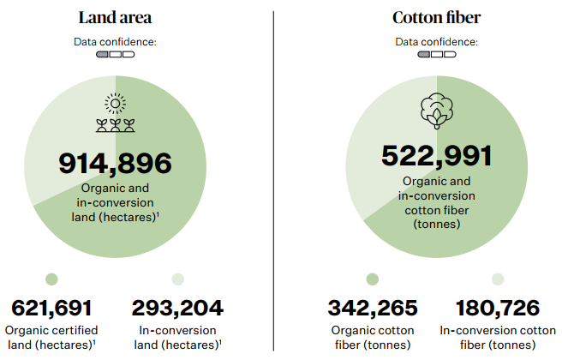
Global Organic Cotton Production
Textile Exchange (2022b, p. 17) estimates that in 2020/21 342,256 tonnes of organic cotton fibres were produced on 621,691 hectares of certified organic land.
180,725 tonnes of in-conversion fibres were produced on 293,204 hectares.
Compared to the organic cotton production in 2019/20, this represents an estimated growth of 37%. (Textile Exchange, 2022b, p. 17).
Nevertheless, organic cotton has a share of 1.5% of the worldwide cotton market.
© Textile Exchange, 2022b, p. 17
Fashion DIET
19
Notes:
19

Slide 20
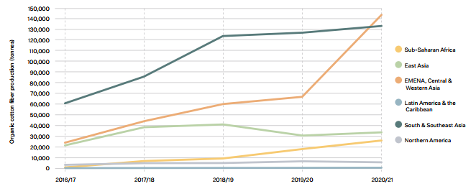
Regional Organic Cotton Production over the Past Five Years
© Organic Cotton Market Report, Textile Exchange, 2022b, p. 19
Fashion DIET
20
Notes:
20

Slide 21
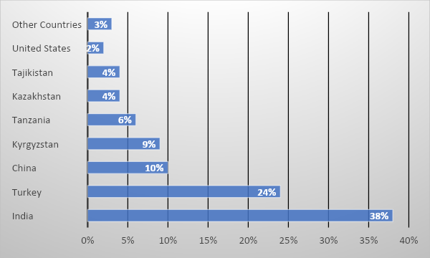
Countries Producing Organic Cotton
97% of organic cotton’s global production comes from eight countries: predominantly India and Turkey, followed by China, Kyrgyzstan, Tanzania, Kazakhstan, Tajikistan and the US.
Genetically modified cotton is grown on approximately 79% of the cultivated area. The land area planted with genetically modified cotton worldwide rose to 25.7 million hectares in 2019. There are 18 countries involved (Forum Bio- und Gentechnologie e. V., 2021).
Organic Cotton Producing Countries Source: Textile Exchange, 2022b, p. 18
Fashion DIET
21
Notes:
Forum Bio- und Gentechnologie e. V. [Biotechnology and Genetic Engineering Forum] (05.02.2021). Gentechnisch veränderte Baumwolle: Anbauflächen weltweit [Genetically modified cotton: Cultivated areas worldwide]. https://www.transgen.de/anbau/452.gentechnisch-veraenderte-baumwolle-anbauflaechen-weltweit.html
21

Slide 22
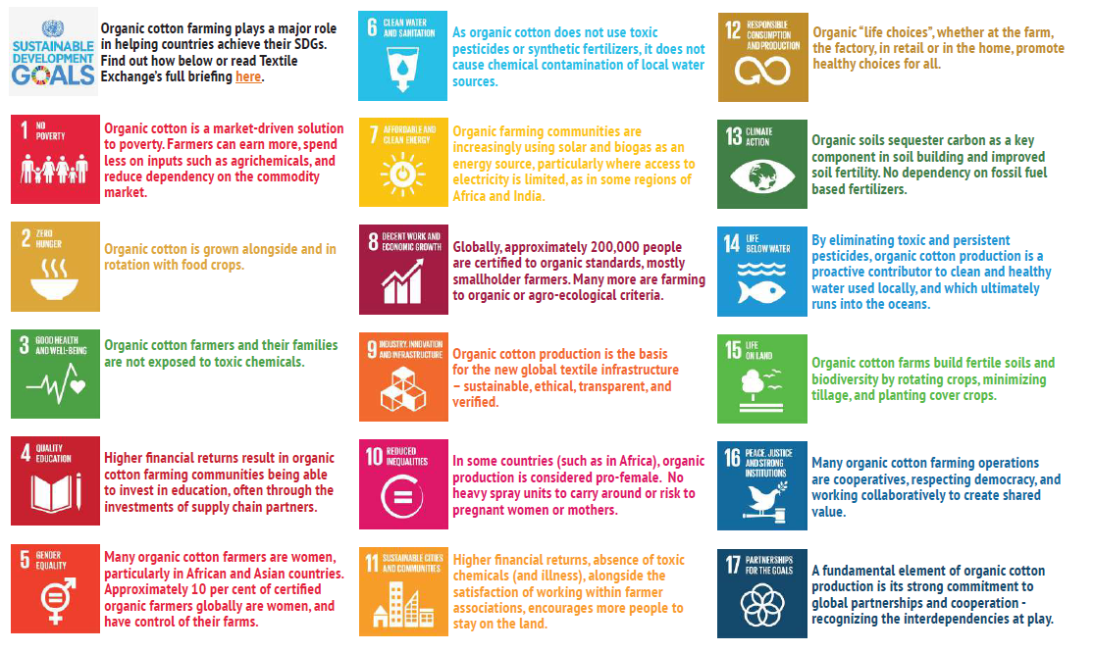
Organic Cotton & Sustainable Development Goals
© United Nations, n.d. & Textile Exchange, 2016
Fashion DIET
22
Notes:
Task:
The Sustainable Development Goals (SDGs) can be achieved through the cultivation of organic cotton. Explain the statements of the chart in your own words.
United Nations (n.d.). #Envision2030: 17 goals to transform the world for persons with disabilities. https://www.un.org/development/desa/disabilities/envision2030.html
Textile Exchange (2016). Organic Cotton & Sustainable Development Goals. Achieving SDGs through Organic Cotton. https://textileexchange.org/wp-content/uploads/2021/07/Textile-Exchange_Achieving-SDGs-Through-Organic-Cotton.pdf
22

Slide 23
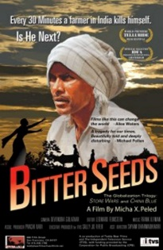
Genetically Produced Cotton
Bt proteins are produced by the soil bacterium Bacillus thuringiensis (Bt) and have a very specific effect, i.e., they are only toxic to the relevant target organisms.
If the corresponding genes are inserted into the genetic material of cotton plants, they produce Bt protein and thus repel insect pests such as the cotton bollworm or bollworm.
Bt cotton needs three times as much water as conventional plants and therefore requires an artificial irrigation system.
It is particularly susceptible to pests such as fungi, against which its poison is ineffective, and resistance develops.
It is not possible to grow seed from the seeds. (Kathage & Quaim, 2012; Plewis, 2021).
© Peled
Fashion DIET
23
Notes:
Until 2005, the cost of Bt seeds was about three times higher than for conventional seeds, and at the same time the expenditure on insecticides in conventional cotton cultivation was considerably higher than for Bt cotton.
Kathage, J., & Qaim, M. (2012). Economic impacts and impact dynamics of Bt (Bacillus thuringiensis) cotton in India. Proceedings of the National Academy of Sciences (PNAS). DOI: 10.1073/pnas.1203647109
Plewis, I. (25.01.2021). Genetically modified cotton: How has it changed India? https://researchoutreach.org/articles/genetically-modified-cotton-how-changed-india/
Peled, M. X. (Director). (2011). Bitter Seeds [Film]. ITVS. USA. Bitter Seeds Trailer: https://www.youtube.com/watch?v=gxjCfEArkt0
Image Source:
Peled, M. X. (Director). (2011). Bitter Seeds [Film]. ITVS. USA.
Tasks:
1. For more information on the effects of genetically modified cotton, watch the film Bitter Seeds or at least the trailer.
2. Compare the statements of the film with those of the long-term study.
23

Slide 24
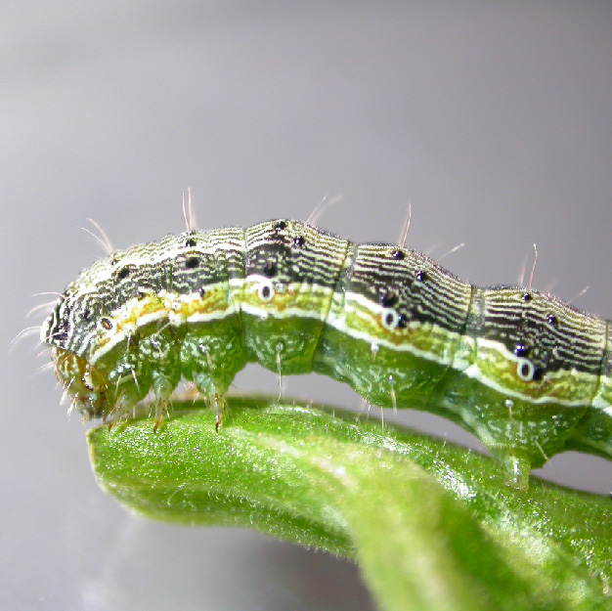
Production Data on GM Cotton
The caterpillars of the cotton bollworm prefer to feed in flowers, shoot tips or fruits and bore into plant parts.
Bt cotton was first grown in the USA in 1996.
In 2019, cotton was planted on 32.5 million hectares. Genetically modified (GM) cotton is grown on approximately 79% of the cultivated area (25.7 million hectares). (Forum Bio- und Gentechnologie e. V., 2021).
Only textiles made from certified organic cotton are guaranteed to be free from genetic engineering.
Photo: Caterpillar of the cotton bollworm © AGES/Kahrer
Fashion DIET
24
Notes:
Forum Bio- und Gentechnologie e. V. [Biotechnology and Genetic Engineering Forum] (23.08.2021). Transparenz Gentechnik. Baumwolle [Transparency Genetic Engineering. Cotton]. https://www.transgen.de/datenbank/1941.baumwolle.html
Image Source:
Raupe des Baumwollkapselwurmes [Caterpillar of the cotton bollworm], Ages/Kahrer, https://www.ages.at/pflanze/pflanzengesundheit/schaderreger-von-a-bis-z/baumwollkapselwurm#page
24

Slide 25
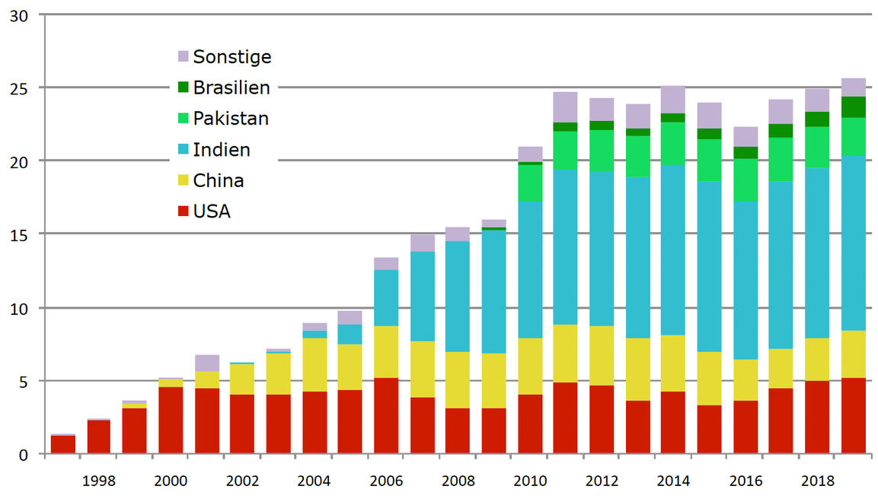
Cultivated Areas of GM Cotton
Others Brasil
Pakistan
India
China
USA
In million hectares
Source Figures: ISAAA
© Forum Bio- und Gentechnologie e. V.
Fashion DIET
25
Notes:
Sources: ISAAA Global Status of Commercialized Biotech/GM Crops, FAOSTAT, USDA Foreign Agricultural Service
Image Source:
Forum Bio- und Gentechnologie e. V. [Biotechnology and Genetic Engineering Forum] (23.08.2021). Transparenz Gentechnik. Baumwolle [Transparency Genetic Engineering. Cotton]. https://www.transgen.de/datenbank/1941.baumwolle.html
25

Slide 26
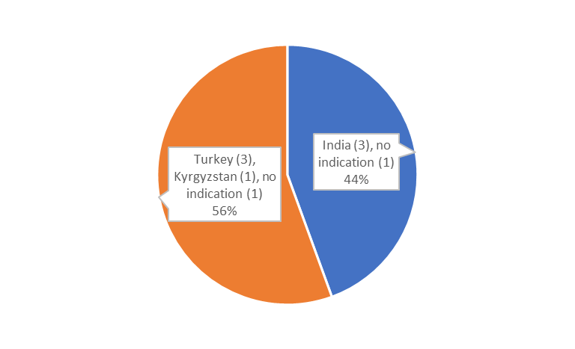
Testing for GM Cotton
DNA verification for genetically modified cotton by radioactive measuring of genetically modified molecules.
There are so-called marker genes for genetically modified cotton.
The raw cotton is tested as the DNA becomes less and less detectable with further processing of the cotton.
Certified organic cotton should not be genetically modified, but Indian cotton samples have shown that this is not always the case (Waiblinger & Martin, 2015).
Organic Cotton
GM Cotton
CC BY-SA Grundmeier
Fashion DIET
26
Notes:
In 4 out of 9 samples of largely unprocessed raw cotton (picking cotton) declared as organic cotton, the CVUA Freiburg detected genetically modified (GM) cotton.
Waiblinger, H. -U., & Martin, N. (14.01.2015). Alles bio? Gentechnik in Bio-Baumwolle und -Textilien [All organic? Genetic engineering in organic cotton and textiles]. https://www.ua-bw.de/pub/beitrag.asp?subid=0&Thema_ID=17&ID=2013&Pdf=No&lang=DE
26

Slide 27
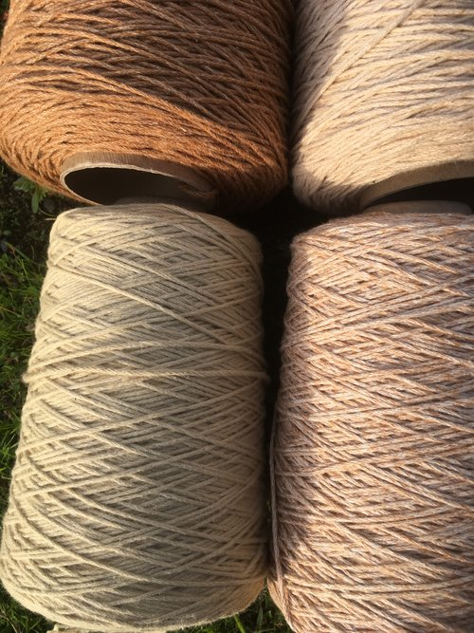
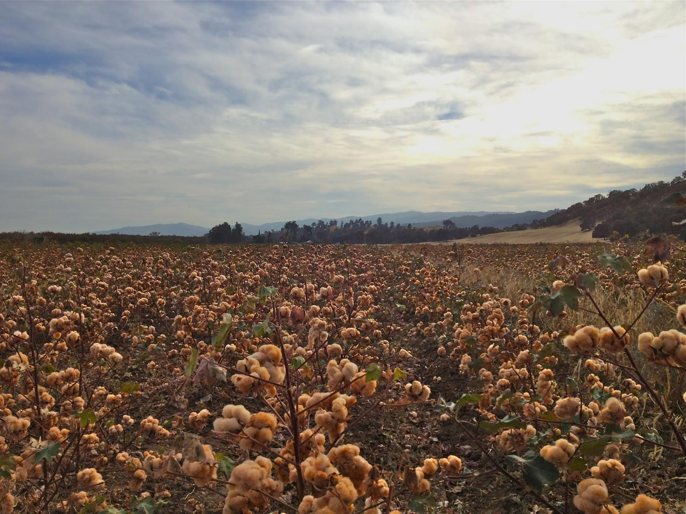
Coloured Cotton
The originally coloured cotton is resistant to pests. It is organically bred and grown in the US.
Sally Fox, a cotton breeder from California, had already rediscovered coloured cotton before the turn of the millennium.
In her 40th year of work (2022), she is still finding new cottons in her breeding nursery.
The natural reddish-brown and green shades of the cotton fibres become more intense after washing.
© Sally Fox, Vreseis Limited
Fashion DIET
27
Notes:
Image Sources:
Coloured Cotton Field, © Sally Fox, https://www.vreseis.com/
Foxfibre®, colororganic® worsted weight yarn, © Sally Fox, https://www.vreseis.com/
27

Slide 28
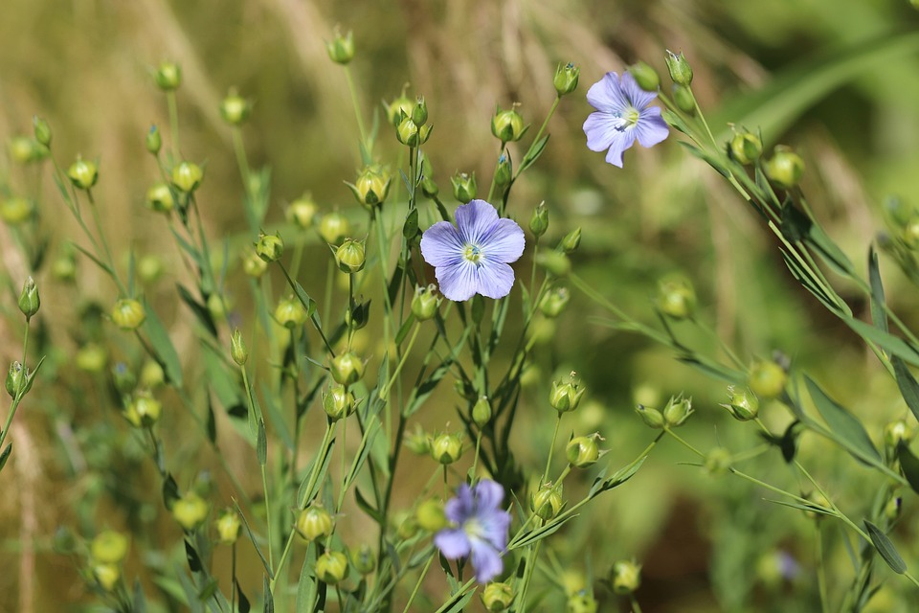
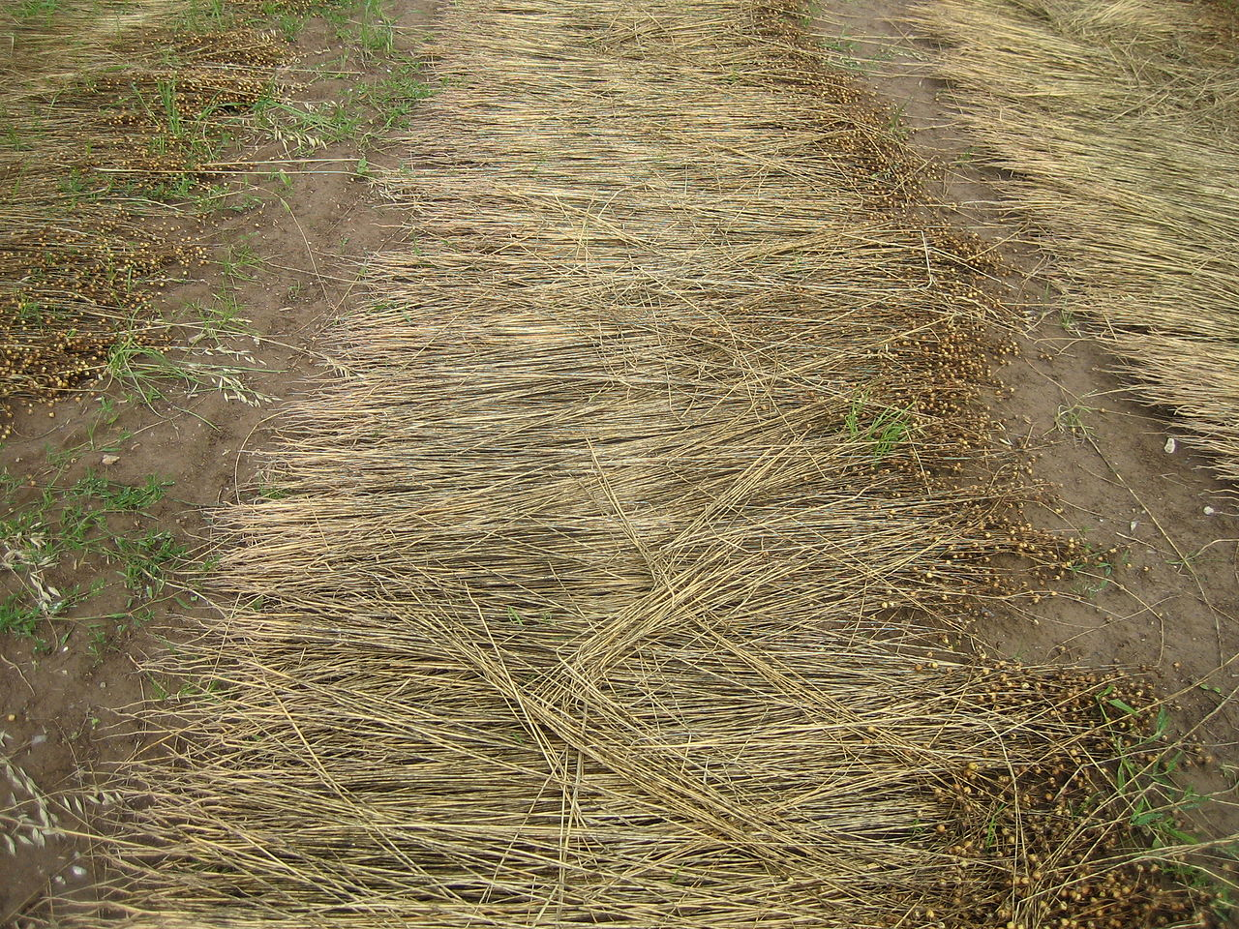
Organic Linen
80-85% of flax is grown in Europe, of which about 0.5% is organically controlled (Textile Exchange, 2022a, p. 27).
In 2005, the German company hessnatur started a linen cultivation project with the Institute for Biodynamic Research in Darmstadt.
hessnatur guarantees the acceptance of the harvest and takes care of the ecologically oriented further processing.
The main focus is on high ecological quality because regional flax cultivation does not require the use of any chemicals.
Today, linen can be produced using modern technologies and traditional processes such as the sustainable dew retting process on the fields (Chabbert et al., 2020).
Flax plants, CC0 Nennieinszweidrei
Dew retting on the field, CC BY-SA 3.0 Rilegator
Fashion DIET
28
Notes:
hessnatur (n.d.). Hessen-Leinen. Comeback eines verdrängten Stoffes [Hessian linen: Comeback of a forgotten substance]. http://www.hessnatur.com/corporate/en/projekt/hessen-linnen/
Chabbert, B., Padovani, J., Djemiel, C., Ossemond, J., Lemaître, A., Yoshinaga, A., Hawkins, S., Grec, S., Beaugrand, J., & Kurek, B. (2020). Multimodal assessment of flax dew retting and its functional impact on fibers and natural fiber composites. Industrial Crops and Products, 148(6), 112255. https://doi.org/10.1016/j.indcrop.2020.112255
Image Source:
Flachs, Nennieinszweidrei, https://pixabay.com/de/service/license/, https://pixabay.com/de/photos/wilder-flachs-lein-4322342/
Tauröste auf dem Feld, Rilegator, CC BY-SA 3.0, https://commons.wikimedia.org/w/index.php?curid=14690380
28

Slide 29
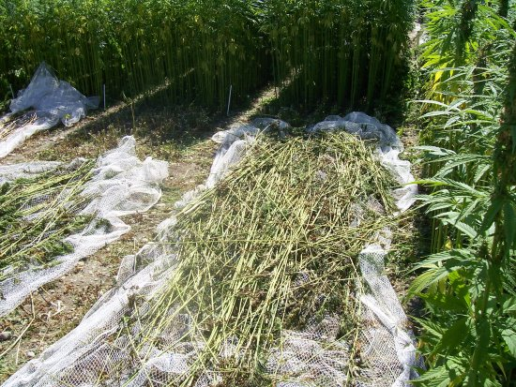
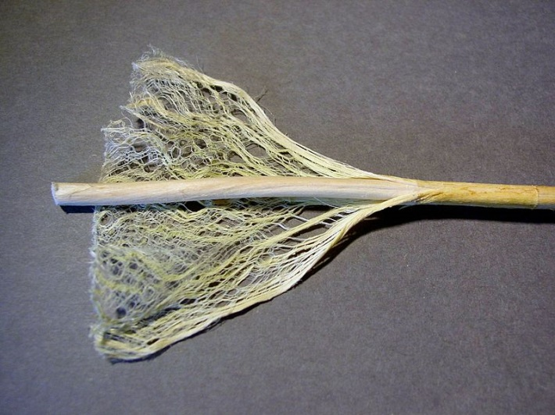
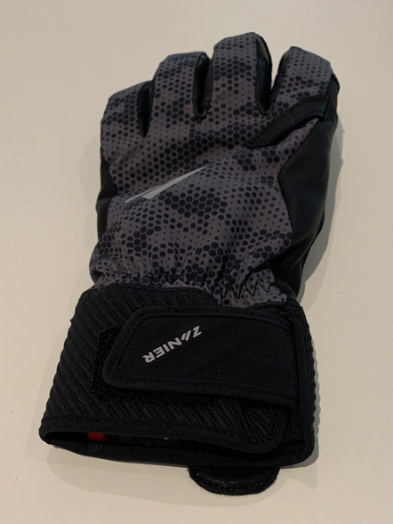
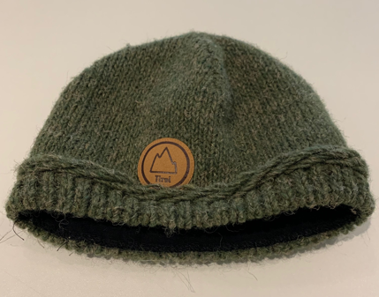
Hemp as a “New” Alternative Fibre
Like flax, hemp is a very frugal plant that enables high crop yields.
The global production of hemp fibre and tow is estimated at around 254,692 tonnes in 2021.
The market share of hemp is thus about 0.2% of the total fibre market in 2021.
Fibre-hemp is mainly grown in China, but there is more and more sustainable cultivation of hemp in Europe and the USA. (Textile Exchange, 2022a, p. 26).
Photo of hemp harvest: CC BY-SA Lossenelin
Photo of hemp stalk: CC0 Natrij
Photos of hemp products: CC BY-SA Grundmeier
Fashion DIET
29
Notes:
Image Source:
Hemp being harvested, Lossenelin, CC BY-SA, https://commons.wikimedia.org/wiki/File:Hempharvesting2.jpg
Hanfstängel, Natrij, CC0, https://commons.wikimedia.org/wiki/File:Hanfstengel.jpg
29

Slide 30
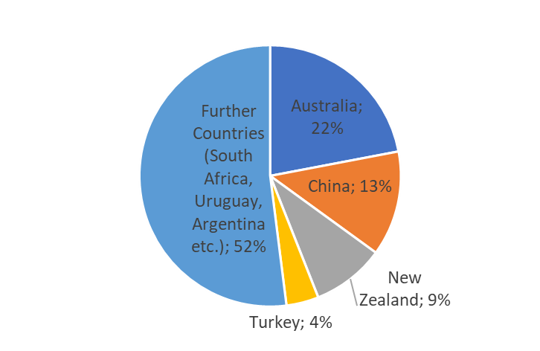
Wool Production
Wool is produced in about 100 countries worldwide. The leading producing countries are Australia, China, New Zealand and Turkey. Further countries are South Africa, Uruguay, Argentina (Textile Exchange, 2022a, p. 39).
Recycled wool has a long tradition. With an estimated production volume of around 70,000 tonnes, the market share of recycled wool is estimated at around 6% of the total wool market.
The Italian district of Prato is a major producer of recycled wool, where approximately 22,000 tonnes of wool are recycled every year. (Textile Exchange, 2022a, p. 50).
CC BY-SA Grundmeier
Source: Textile Exchange, 2022a, p. 39
Fashion DIET
30
Notes:
Task:
Watch the film about wool recycling in Prato, Italy, and sum up the different processes, which are necessary from a post-consumer wool product to recycling wool fibres.
BBC News (16.12.2020). Recycling fashion: The town turning waste into clothes [Video Documentation]. https://www.youtube.com/watch?v=7i0QMnz4ExY
30

Slide 31
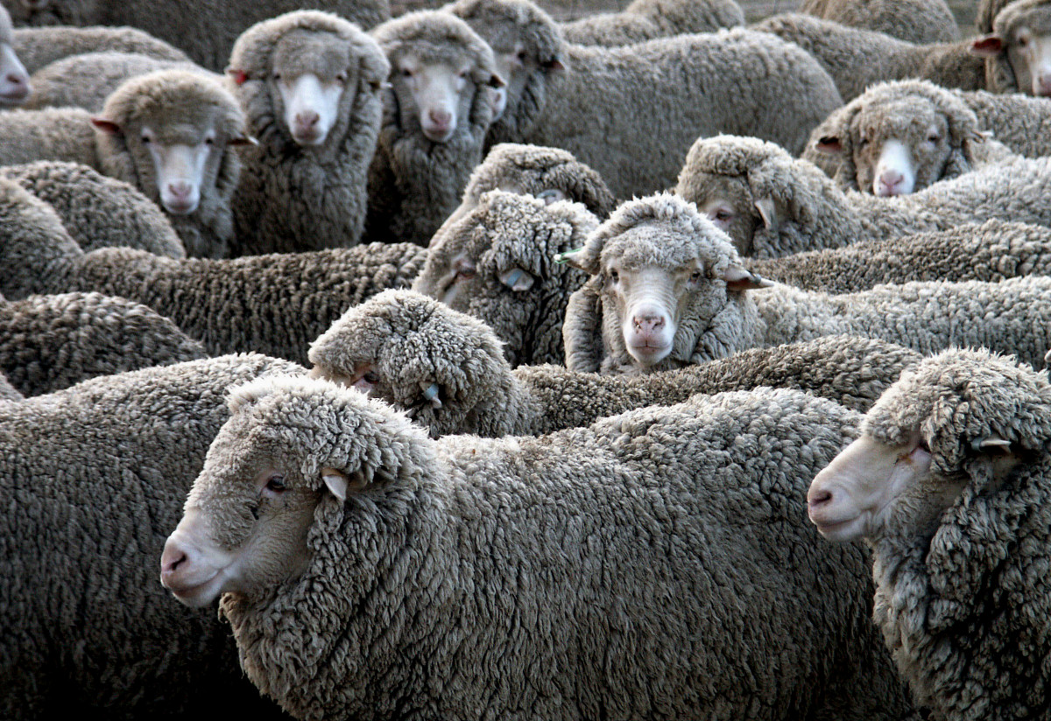
Ban of Mulesing
Mulesing means the removal of wool-bearing strips of skin from between the hind legs of sheep – the so-called the “breech” area – to avoid problems of fly strike. This practice, which is very painful for the animals, remains a key issue of wool production.
With the ban of mulesing in New Zealand in 2018, Australia is the only country where mulesing is still practiced.
Regarding Australia’s high market share of the global clean wool market, the “risk of sourcing wool produced with mulesing practices remains high if no traceability system is in place to ensure that the wool is mulesing-free” (Textile Exchange, 2022a, p. 40).
Merinos, CC0 1.0
Fashion DIET
31
Notes:
Image Source:
No title, unknown author, https://creativecommons.org/publicdomain/zero/1.0/, https://pxhere.com/de/photo/174452?utm_content=shareClip&utm_medium=referral&utm_source=pxhere
31

Slide 32
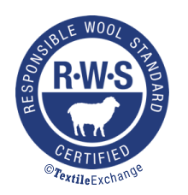
Responsible Wool Standard (RWS)
The Responsible Wool Standard (RWS), which has been in place since 2016, certifies the gentle extraction of wool.
The living and shearing conditions of the sheep are assessed particularly strictly. Mulesing or other cruel practices are prohibited.
The scope of RWS covers the entire value chain from farms to wool producers and garment factories.
The inspection and certification of the sites is carried out through annual auditing. (Textile Exchange, 2021).
© Textile Exchange
Fashion DIET
32
Notes:
Textile Exchange (2021). Responsible Wool Standard 2.2. https://textileexchange.org/app/uploads/2020/08/RAF-101a-V2.2-Responsible-Wool-Standard.pdf
Image Source:
RWS, RESPONSIBLE WOOL STANDARD, and the RWS Logo are trademarks of Textile Exchange.
32

Slide 33
Process Chain for RWS
The certification is performed by a third-part organisation. © Textile Exchange, 2021, p. 11
Fashion DIET
33
Notes:
33

Slide 34
Sustainable Animal Fibre Standards
The RWS market share is about 2.6% - together with other certifications it is about 3 % - of the greasy wool production. The largest share of RWS-certified wool comes from merino sheep. (Textile Exchange, 2022a, p. 37-38).
With the release of RWS 2.0, the supply chain certification for RWS, the Responsible Mohair Standard (RMS) and the Responsible Alpaca Standard (RAS) were combined in the Responsible Animal Fiber Standards (RAF).
Silk programs include organic standards such as the Indian National Programme for Organic Production (NPOP), the Organic Content Standard (OCS) and the Global Organic Textile Standard (GOTS). (Textile Exchange, 2020).
The aim of these standards is to ensure that the potential for high animal welfare for animals raised in extensive grazing and free ranging farming systems is realised.
Fashion DIET
34
Notes:
Textile Exchange (2020). Responsible Animal Fiber Standards Terms of Reference. https://textileexchange.org/wp-content/uploads/2020/06/RAF-Terms-of-Reference-June-2020.pdf
34

Slide 35
Wool from Controlled Organic Animal Husbandry
According to the guidelines of organic farming, wool and animal hair can come from organic or controlled organic animal husbandry in accordance with the guidelines of IFOAM Organics Europe (n.d.) or the EC Organic Regulation (EC No 834/2007).
No use of pesticides and ban on fattening aids.
The animals reproduce naturally and any intervention on the animal, such as tail docking or mulesing, is prohibited.
The use of pharmaceuticals for the animals is strongly decimated.
Genetically modified feed and animal meals are prohibited.
Grazing on meadows treated with artificial fertiliser is prohibited.
The guiding principle in organic agriculture is a closed farm cycle. State-approved, independent inspection bodies annually inspect organic producers and processors for compliance with strict production and processing guidelines.
Fashion DIET
35
Notes:
Council Regulation (EC) No 834/2007 of 28 June 2007 on organic production and labelling of organic products and repealing Regulation (EEC) No 2092/91. Official Journal of the European Union, 20.07.2007, L 189/1-189/23. https://eur-lex.europa.eu/legal-content/EN/TXT/PDF/?uri=CELEX:32007R0834&from=DE
IFOAM Organics Europe (n.d.). Green claims & preventing greenwashing. https://www.organicseurope.bio/
35

Slide 36
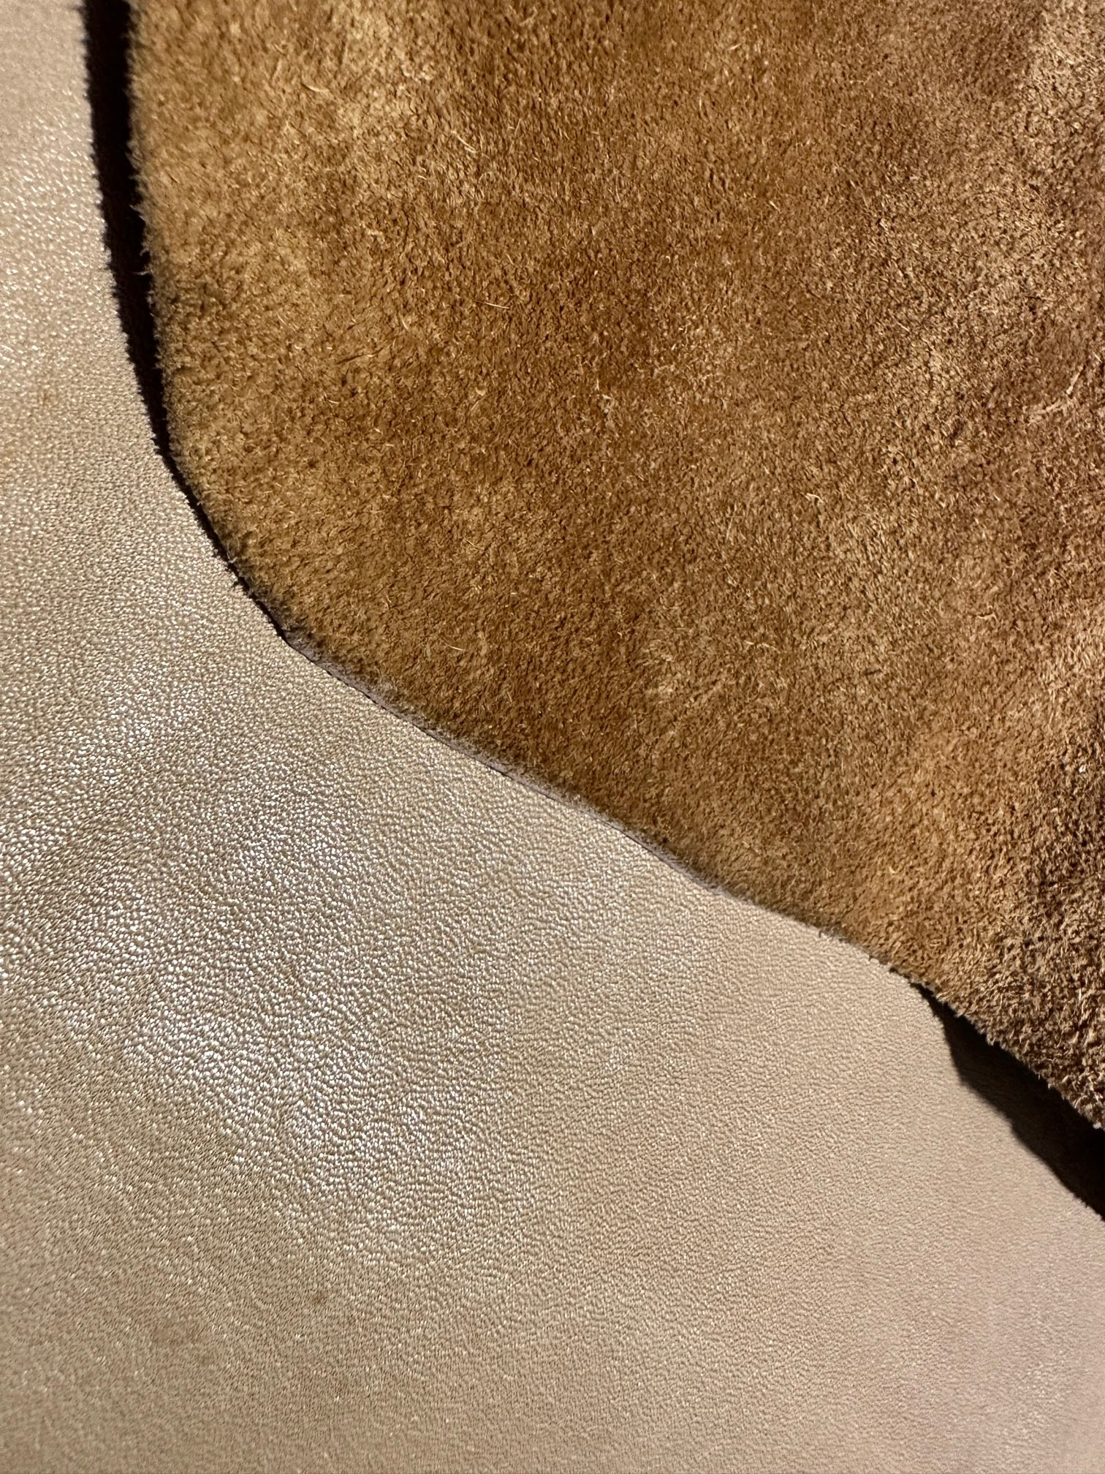
Recycled Leather and Leather Alternatives
Leather production in the form of animal hides from slaughter cattle such as sheep, goats and cattle amounts to approximately 12.5 million tonnes in 2021 (Textile Exchange, 2022a, p. 5).
Around 800 thousand tonnes of leather waste are generated annually (Textile Exchange, 2022a, p. 58). To produce 150 kg of leather from 1000 kg of rawhide, 75 kg of tanning waste, 9 kg of finishing waste and up to 110 kg of cutting waste are produced and can be used for recycled leather fibres (European Outdoor Group (2019, p. 17).
Most of the recycled leather is made from production waste and processed into bonded leather. It is either made from recycled leather fibres and binders or it is made into artificial leather by applying recycled leather fibres to the surface of a synthetic material.
CC BY-SA Grundmeier
Fashion DIET
36
Notes:
European Outdoor Group (2019). Recycled Leather. A Primer for Industrials to Better Understand Alternative Materials to Virgin Leather. https://assets-global.website-files.com/5ed628f951e6c112227290bb/5f384b3918ce2437d8968b58_EOG%20Recycled%20Leather_low%20res.pdf
Image Source:
Green Future Club (n.d.). Green Product Award. Recyc Leather™. https://www.gp-award.com/de/pre-selection/recycled-leather
36

Slide 37
Pineapple Leaves for Vegan Leather
The use of crop residues, such as rice straw, pineapple leaves, banana tree trunks and sugar cane bark, is an emerging field (Textile Exchange, 2022a, p. 28).
The raw material that forms the base of Piñatex® is a by-product of the pineapple harvest.
Dr. Carmen Hijos, a leather goods expert, is the founder of Ananas Anam, the makers of Piñatex®, a vegan leather made from waste pineapple leaf fibres. Their use creates an additional income for the farmers on the Philippines.
© Vegan Leather by Piñatex®
Fashion DIET
37
Notes:
Image Source:
Ananas Anam (n.d.). Ananas Anam. https://www.ananas-anam.com/
Tasks:
Do research on alternative leather products, their manufacturers and product designers.
Research on alternative materials, products made of them and areas of use.
Examples are: Amadou Leather™, Enspire Leather, Flyleather, Mylo™ - Bolt Threads, RECYC LEATHER™, Vegatex.
37

Slide 38
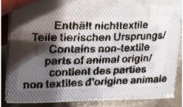
Animal Products in Fashion
Real fur trimmings are in fashion. They are not only found on hoods as wind protection, but also on hats, as accessories, etc. They mainly originate from the Chinese tanuki, but also fox and mink, rabbit and other fur animals. One third of the fur produced in China comes to Germany.
According to the EU Textile Labelling Regulation, real fur must be labelled with “Contains non-textile parts of animal origin” on products that consist of at least 80% textile fibres (Europäische Union, 2011, L 272/2 (8)). The type of real fur does not have to be specified. Parts of animal origin can be e.g., down, fur, leather or horn.
Real fur can be recognised by the shine and the leather skin underneath the fur. In the case of a woven fur, you would recognise the fabric or knitted fabric by combing apart the pile.
Photo: © Deutscher Tierschutzbund
Fashion DIET
38
Notes:
Europäische Union [European Union] (18.10.2011). VERORDNUNG (EU) Nr. 1007/2011 DES EUROPÄISCHEN PARLAMENTS UND DES RATES vom 27. September 2011 über die Bezeichnungen von Textilfasern und die damit zusammenhängende Etikettierung und Kennzeichnung der Faserzusammensetzung von Textilerzeugnissen und zur Aufhebung der Richtlinie 73/44/EWG des Rates und der Richtlinien 96/73/EG und 2008/121/EG des Europäischen Parlaments und des Rates [REGULATION (EU) No 1007/2011 OF THE EUROPEAN PARLIAMENT AND OF THE COUNCIL of 27 September 2011 on textile fibre names and related labelling and marking of fibre composition of textile products and repealing Council Directive 73/44/EEC and Directives 96/73/EC and 2008/121/EC of the European Parliament and of the Council]. Amtsblatt der Europäischen Union [Official Journal of the European Union], L 272/1-L272/64. https://eur-lex.europa.eu/LexUriServ/LexUriServ.do?uri=OJ:L:2011:272:0001:0064:DE:PDF, L 272/2 (8)
Image Source:
Deutscher Tierschutzbund [German Animal Welfare Association]
Mackensen, H., Nottebrock, Y., & Pietsch, T. (2016). Täuschung & Irreführung. Pelzkennzeichnung in Deutschland [Deception & Misleading: Fur Labelling in Germany]. https://www.tierschutzbund.de/fileadmin/user_upload/Downloads/Publikatonen_andere/Report_Pelzkennzeichnung_Deutschland.pdf
38

Slide 39
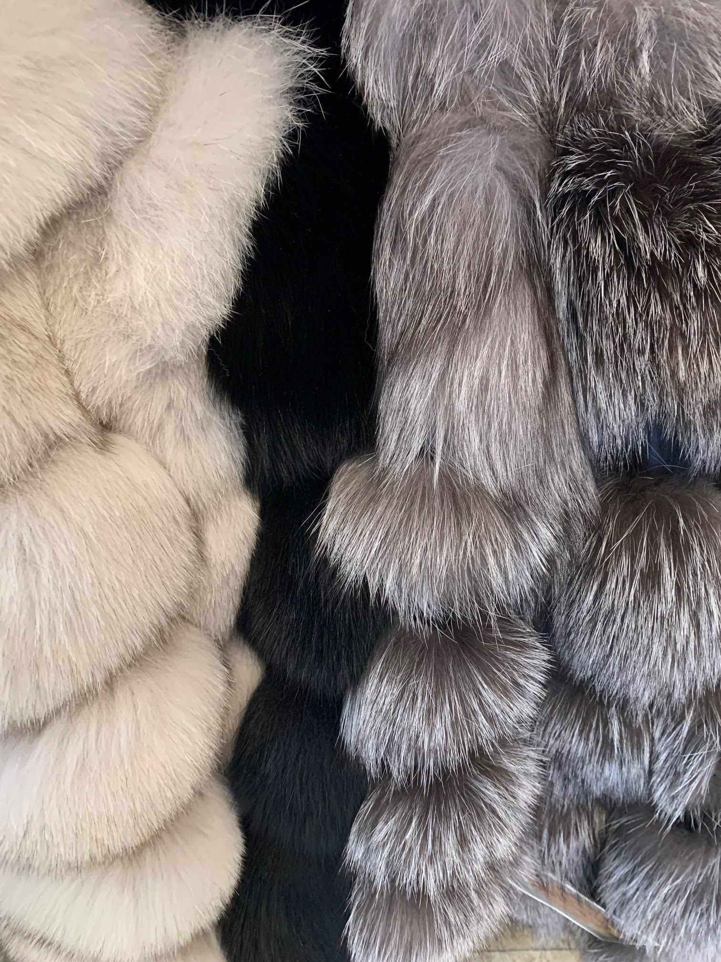
Renouncing Fur in the Fashion Industry
More and more fashion companies are renouncing the use of fur. They have been preceded by “vegetarian” designers such as Stella McCartney, who renounces the use of leather and fur in all her collections.
In 2022, Latvia became the 15th EU member state to vote for a complete ban on fur farming (Michel, 2022).
Woven fur or fake fur provide alternatives. These are fabrics with a high fibre pile of polyester or polyacrylic, which is introduced via fibre vents during fabric production.
They can look deceptively real by being printed with patterns and the pile is sheared, thermoplastically formed over rollers and given an animal fur-like structure.
Fake Fur
CC BY-SA-ND Grundmeier
Fashion DIET
39
Notes:
Michel, S. (11.10.2022). Lettland verbietet Pelztierzucht [Latvia bans fur farming]. textile network. https://textile-network.de/de/Business/Lettland-verbietet-Pelztierzucht
39

Slide 40
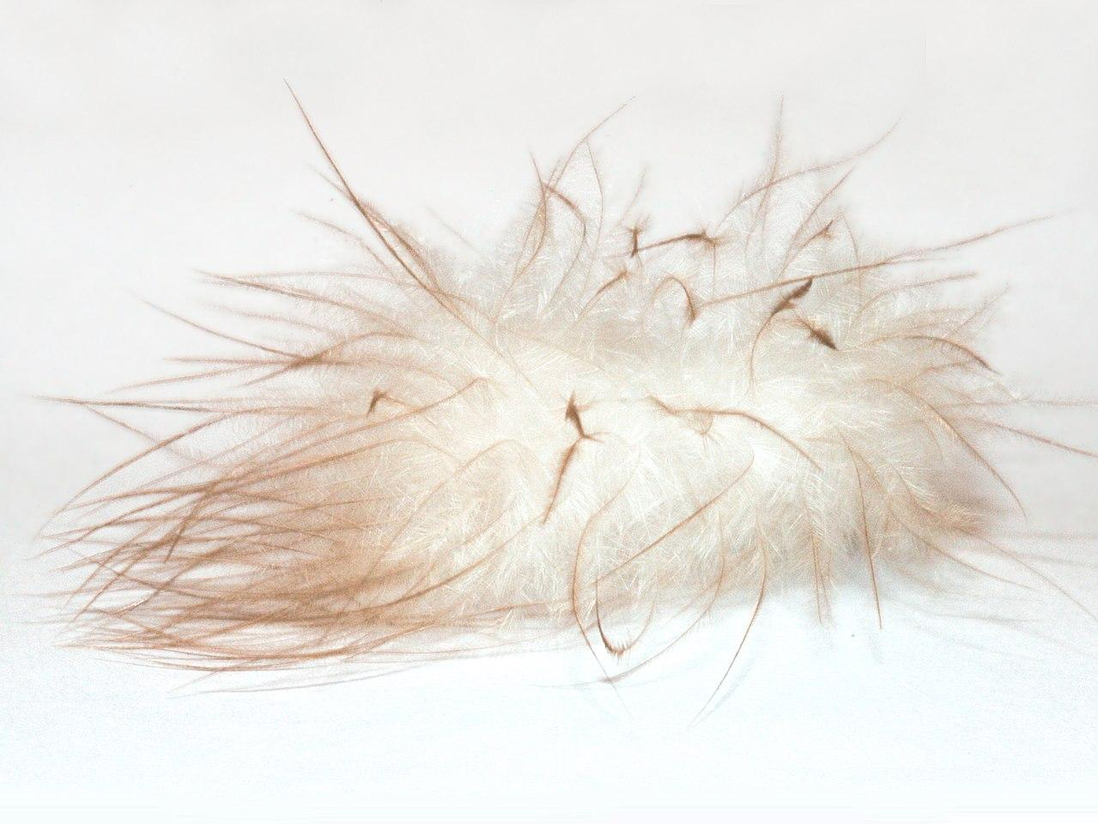
Down – Natural Heat Insulation
Down is made of thousands of very soft keratin fibres that grow radially outwards from a tiny centre. Unlike feathers, they have no keel in the middle.
The keratin fibres have countless small, branch-like fibres with almost invisible hooks. These ensure that the downs join together and tiny air chambers are created.
The higher the down content, the lighter and warmer the product. However, a down content of 100% is practically impossible, as the supporting power of the feathers is needed.
A maximum of 95% down is technologically possible. That means that with a mixing ratio of 95/5 - and a filling weight of 100 g - the product consists of 95 g down and 5 g feathers.
CC BY-SA 4.0 Yoky
Fashion DIET
40
Notes:
Image Source:
Daunenfeder, Yoky, CC BY-SA 4.0, https://commons.wikimedia.org/w/index.php?curid=3360627
40

Slide 41
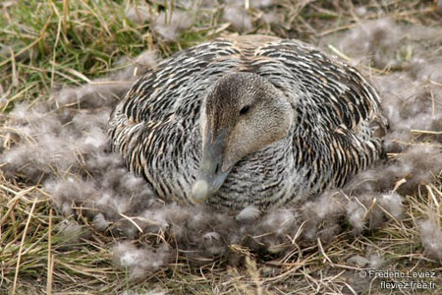
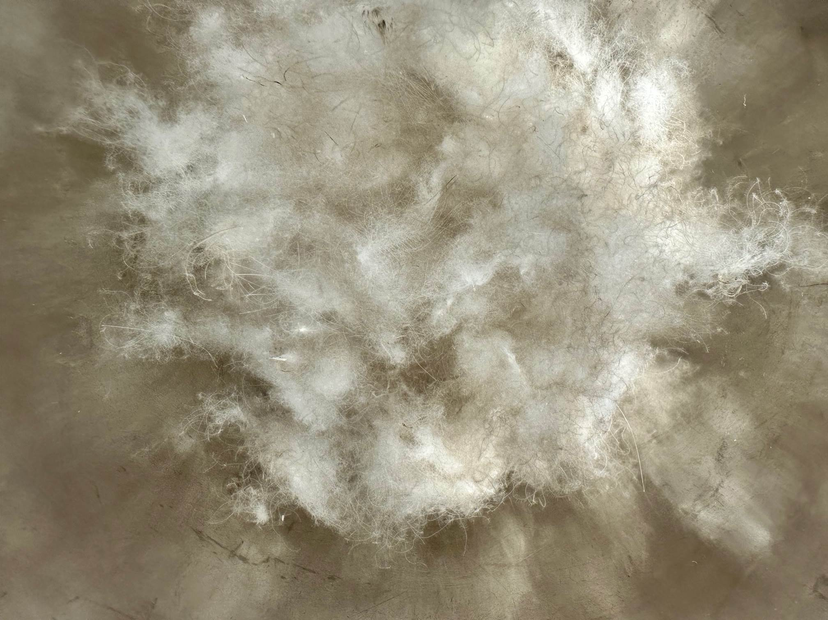
Down Production
The global production of feathers and down was estimated by Textile Exchange (2022a, p. 32-33) to be around 570,000 tonnes in 2021, with 70% coming from China (Future Market Insights, 2021).
The eider duck lives in the coastal regions of Iceland, Greenland and Canada. Eider down, the finest and at the same time the lightest down, is collected from their nests, no more than 20 g from one nest.
Around 500,000 to 1 million downs are needed for 1 kg. Real eider down is only available in very limited quantities.
CC BY-SA Fred.leviez
CC BY-SA Grundmeier
Fashion DIET
41
Notes:
Future Market Insights (2021). Down and Feather Market. https://www.futuremarketinsights.com/reports/down-and-feather-market
The global down and feather market size was valued at USD 2072.48 million in 2021 by Maia Research.
Maia Research (24.10.2022). Global Down Feather Industry Research Report 2022. Competitive Landscape, Market Size, Regional Status and Prospect. https://www.maiaresearch.com/market-report/1426431-Down-Feather-1426431.html
Image Source:
Eider à duvet, Fred.leviez, CC BY-SA 3.0, https://commons.wikimedia.org/wiki/File:Eider.a.duvet4.jpg
41

Slide 42
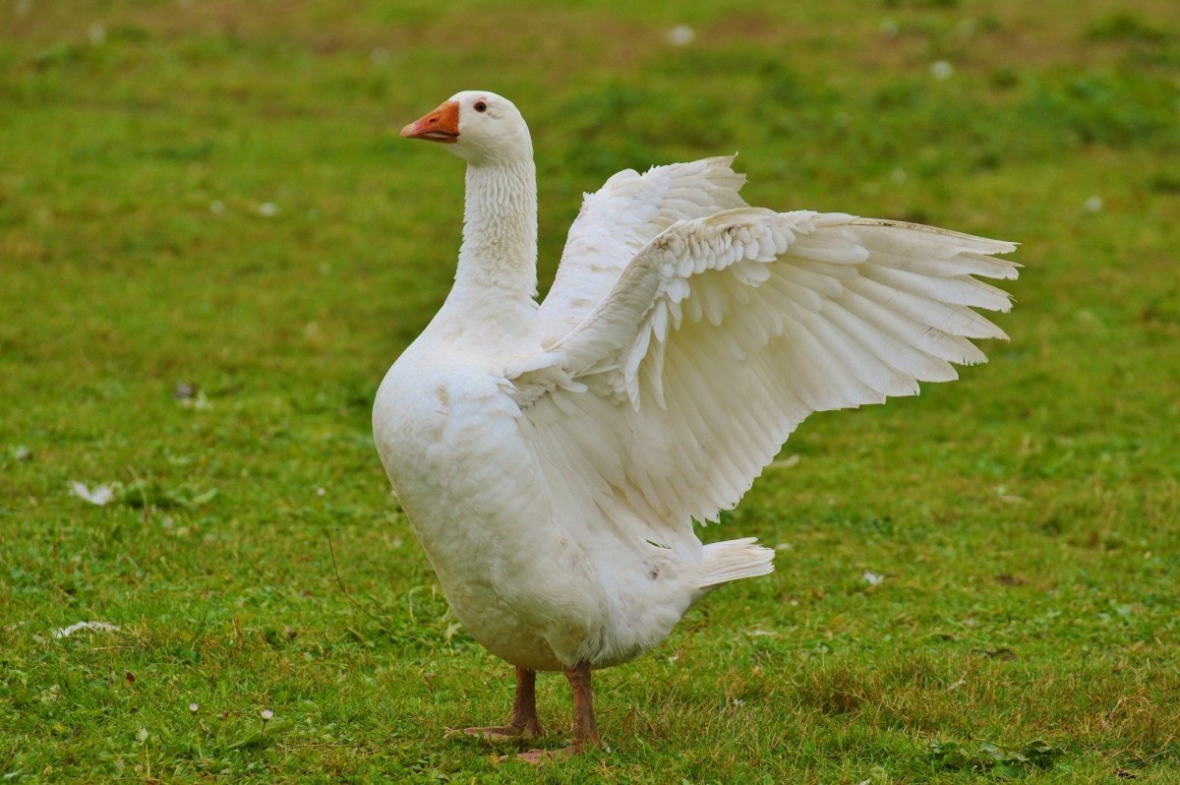
Down Plucking
Most of the world’s down and feathers are obtained through slaughter plucking. The animals, ducks and geese, are slaughtered and then plucked, mostly by machine, before the meat is sent for further processing.
Live plucking, unless it is moult plucking, is often painful for the animals and is criticised by animal welfare organisations. Therefore, more and more companies are speaking out against it.
Live plucking is banned in Europe, but the loophole of plucking during moulting remains for the poultry industry.
To avoid live plucking, the production chain is controlled.
CC0 1.0 Unknown author
Fashion DIET
42
Notes:
No title, unknown author, https://creativecommons.org/publicdomain/zero/1.0/, https://pxhere.com/de/photo/849713?utm_content=shareClip&utm_medium=referral&utm_source=pxhere
42

Slide 43
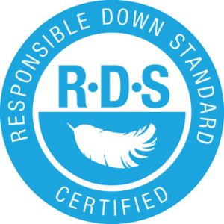
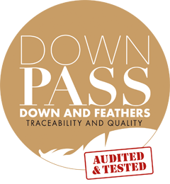
Sustainable Down Standards (1)
Animal welfare awareness has led to a successful rise in animal welfare standards such as the Responsible Down Standard (RDS) by Textile Exchange (n.d.), which has a market share of 3.2%, and the Downpass with a market share of 1.2% (Textile Exchange, 2022a, p. 32).
RDS is an independent certification standard that can be applied to all suppliers involved in down production. It aims to ensure the welfare of animals from chick to finished product and to change the down processing industry as a whole.
The DOWNPASS (Traumpass e. V., n.d.) shall guarantee high quality and the certainty that down and feathers are ethically sourced and come from tightly controlled and traceable supply chains.
© Textile Exchange
© Traumpass e. V.
Fashion DIET
43
Notes:
Textile Exchange (n.d.). The Responsible Down Standard aims to protect ducks and geese used for down. https://textileexchange.org/standards/responsible-down/
Traumpass e. V. (n.d.). DOWNPASS. https://www.downpass.com/en/homepage/
Image Sources:
Textile Exchange (n.d.). The Responsible Down Standard aims to protect ducks and geese used for down. https://textileexchange.org/standards/responsible-down/
Traumpass e. V. (n.d.). DOWNPASS. https://www.downpass.com/en/homepage/
43

Slide 44
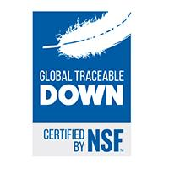
Sustainable Down Standards (2)
China is the largest producer of RDS certified down (Textile Exchange, 2022a, p. 32). In addition to external certifications, companies have introduced their own sustainable down standards.
Criteria are the traceability from the parent generation or the rearing of the chicks with regard to animal welfare.
Live plucking and force fed for foie gras production are prohibited. Controls along the entire supply chain ensure that these requirements are met by the suppliers. Only down that is purely a by-product of the food industry is used.
The Global Traceable Down Standard (Global TDS) was launched in 2015 by the US non-profit organisation NSF International as a result of a collaboration between the outdoor brand Patagonia, industry associations, animal welfare organisations and other NGOs. The certification is not only carried out at the product level but looks at the entire supply chain. (Henkel, n.d.; Patagonia, 2022).
Today, the Global TDS certifies that down in garments and other household and commercial products come from a responsible source that respects animal welfare and can be transparently traced (NSF International, n.d.).
© MCL Global
Fashion DIET
44
Notes:
NSF International (n.d.). Global Traceable Down Standard. https://www.nsf.org.cn/en/our-services/service-by-industry/Sustainability_and_Environment/responsible-sourcing/global-traceable-down-standard
Henkel, R. (n.d.). Maximaler Tierschutz: Global Traceable Down Standard [Maximum animal welfare: Global Traceable Down Standard]. https://www.ispo.com/maerkte/maximaler-tierschutz-global-traceable-down-standard
Patagonia (2022). Daune mit Herkunftsnachweis [Down with proof of origin]. https://eu.patagonia.com/de/de/our-footprint/traceable-down-standard.html
Image Source:
MCL Global (n.d.). A Guide to Environmental & Social Compliance. Textile Standards & Legislation. Global Traceable Down. https://www.textilestandards.com/standards/105-global-traceable-down
Tasks:
Research the down standards and certifications of outdoor suppliers.
Which standards and certifications do they use?
Present your results comparing the standards and certifications.
44

Slide 45
Sustainable Natural Fibre and Material Trends
Awareness of animal welfare has led to successful growth in the use of standards such as the Responsible Animal Fiber Standards (Textile Exchange, 2021).
Until recently, the focus has been on the risks associated with leather processing (tanning, chemical use), but there is growing interest in animal welfare, deforestation, land use (and associated loss of biodiversity) and climate change.
Textile Exchange (n.d.) has developed the Leather Impact Accelerator (LIA), which includes an incentivisation tool to enable companies to support farmers addressing deforestation and forest conversion, as well as animal welfare at all levels of cattle farming.
Other fibres and materials - ranging from hemp to natural rubber - are often not in the industry’s focus, despite significant sustainability potential and challenges.
Fashion DIET
45
Notes:
Textile Exchange (2021). Responsible Animal Fibers (RAF) Brand Sourcing Guide. https://textileexchange.org/app/uploads/2021/07/RAF-Brand-Sourcing-Guide-V1.0.pdf
Textile Exchange (n.d.). Join the Leather Impact Accelerator. https://textileexchange.org/leather-impact-accelerator/
45

Slide 46
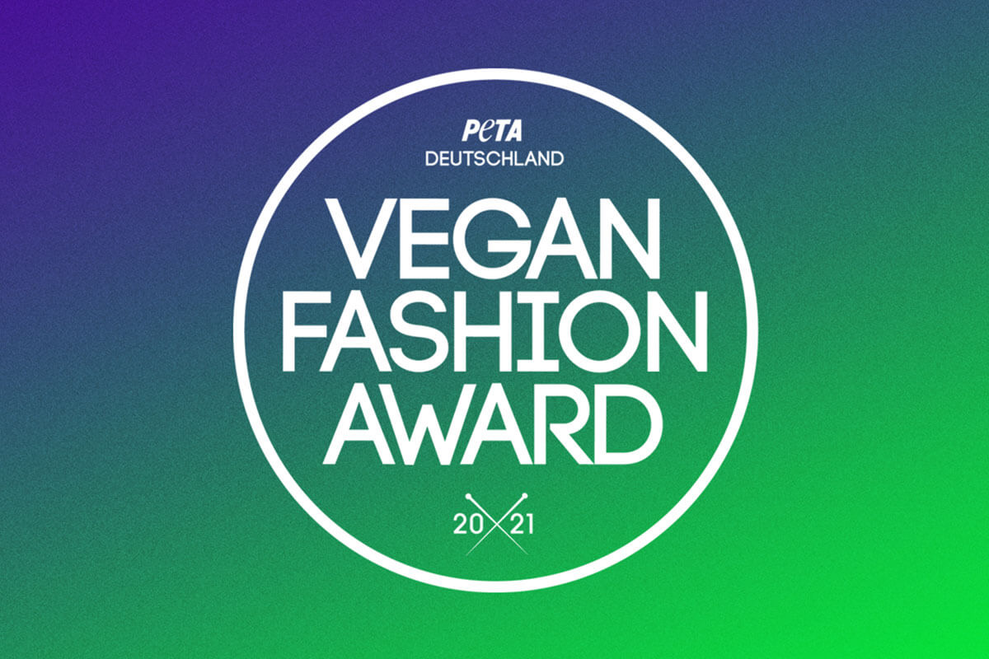
Vegan Fashion and Green Product Awards
The animal rights organisation PETA (People for the Ethical Treatment of Animals, n.d.) regularly presents the Vegan Fashion Award in Germany for “stylish, innovative, sustainable and vegan clothing”.
Products made from alternative raw materials such as plant-based leather substitutes or from renewable domestic raw materials such as flax and hemp as well as from recycled raw materials are awarded.
Other criteria include ecologically fair production and product design that is both fashionable and long-lasting.
The Green Future Club (n.d.) also awards sustainable bio products.
© PETA e.V. Deutschland
Fashion DIET
46
Notes:
People for the Ethical Treatment of Animals (PETA) e. V. (n.d.). Vegan Fashion Award. https://www.peta.de/schlagwort/vegan-fashion-award/
Green Future Club (n.d.). Green Product Award. Let’s design the future. https://www.gp-award.com/en
Image Source:
People for the Ethical Treatment of Animals (PETA) e. V. (30.11.2021). PETAs Vegan Fashion Award 2021: Das sind die Gewinner [PETA‘s Vegan Fashion Award 2021: These are the winners]. https://www.peta.de/neuigkeiten/vegan-fashion-award-2021/
Tasks:
Research the winners of the current Vegan Fashion Award by PETA e. V. and the Green Future Club.
Answer the following questions:
Which criteria were applied in each case for the award?
To what extent do you agree with the criticism of the use of animal raw materials in textile production?
In this context, do some research on designers like Stella McCartney, who do not use animal products in their collections.
Discuss in small groups whether you would or would not avoid the use of animal raw materials for textiles and clothing yourself.
46

Slide 47
Classification of Chemical Fibres
Plant origin
Cellulosic fibres
Paper fibres
Alginate fibres
Manmade fibres from natural polymeres
Viscose
Modal
Lyocell
Cupro Acetate
Spinnpaper
Cellulon
Alginate
Plant protein fibres
Rubber fibres
Rubber
Glycinin
Zein
Chemical Fibres
Animal origin
Animal protein fibres
Manmade fibres from synthetic polymeres
Casein
Addition polymers
Condensation polymers
Polyamide 6
Polyacrylic
Polypropylene
Polyethylene
Polyvinyl alcohol
Block copolymers
Polyester
Polyamide 6.6
Elastane
Elastodienne
Inorganics
Glass
Carbon
Metallic
CC BY-SA Grundmeier
Fashion DIET
47
Notes:
47

Slide 48
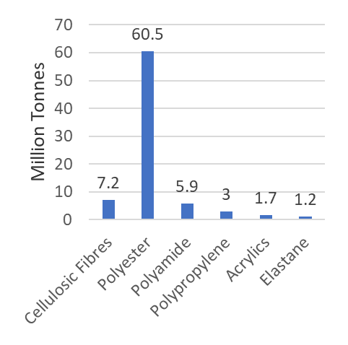
Market for Manmade Fibres in 2021
The production of manmade cellulosic fibres (MMCFs) including viscose, lyocell, modal, acetate and cupro increased to 7.2 million tonnes.
The production volume of polyester fibres increased to 60.5 million tonnes. Polyamide – the second most used synthetic fibre – accounted for 5.9 million tonnes.
The other synthetics – polypropylene, acrylics, and elastane – had a market share of 5.2%, with a combined production volume of 5.8 million tonnes: polypropylene around 3, acrylics 1.7 and elastane 1.2 million tonnes. (Textile Exchange, 2022a, p. 10).
CC BY-SA Grundmeier
Fashion DIET
48
Notes:
48

Slide 49
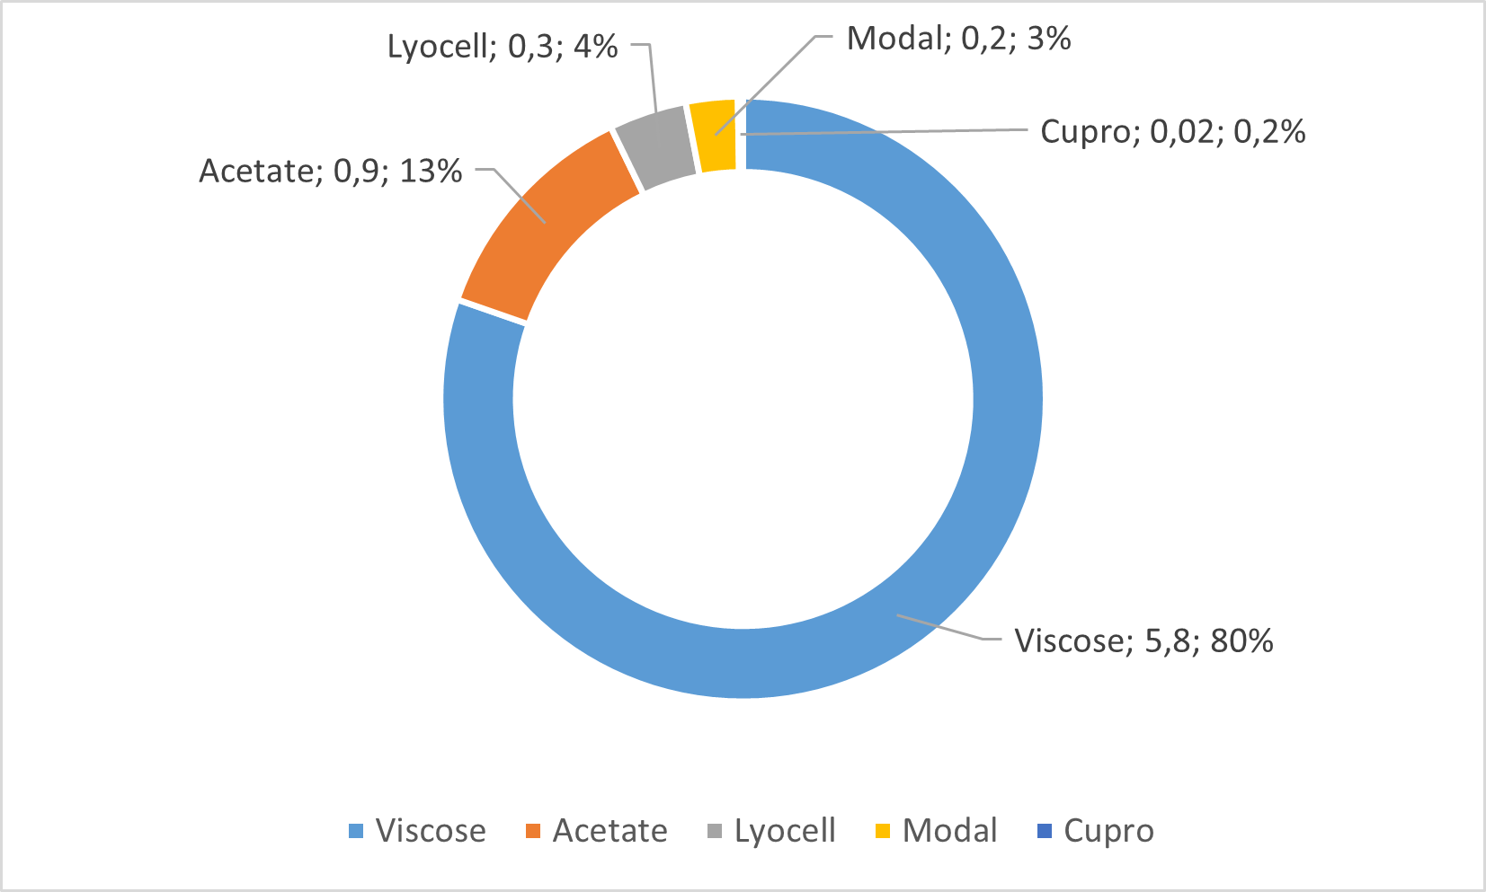
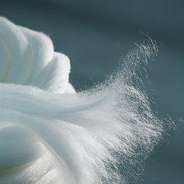
Gobal Market of MMCFs in 2021
Around 7.24 Million Tonnes
Lenzing fibres, © Lenzing AG
CC BY-SA Grundmeier, Source: Textile Exchange, 2022a
Fashion DIET
49
Notes:
Image Source:
Lenzing fibres, Markus Renner, © Lenzing AG, https://www.lenzing.com/newsroom/image-archive/filter1
49

Slide 50
Manmade Cellulosic Fibres from Sustainable Raw Materials
The market share of FSC- and/or PEFC-certified manmade cellulosic fibres (MMCFs) increased to around 60-65% of all MMCFs in 2021 (Textile Exchange, 2022a, p. 62).
FSC, founded in 1993, is an international member-led organisation with standards for responsible forest management and chain of custody (FSC, n.d.).
PEFC was founded in 1999. This global alliance of national forest certification systems holds the largest forest certification system worldwide. In 2018 the first PEFC-certified fabrics were launched. (PEFC, n.d.).
First MMCFs have also been certified according to the Organic Content standard (OCS) by Textile Exchange.
The audits of Canopy are the leading assessment of MMCF suppliers on their raw material sourcing practices. Canopy’s (n.d.) Hot Button Ranking and report is the primary fibre sourcing analysis tool for the fashion sector that focuses on forests (Canopy, n.d.).
Beech forest, © Lenzing AG
Fashion DIET
50
Notes:
Forest Stewardship Council (FSC® International) (n.d.). Temporary FSC Public Search – Certificate Data. https://connect.fsc.org/fsc-public-certificate-search
Programme for the Endorsement of Forest Certification (PEFC) (n.d.). Find Certified. https://pefc.org/find-certified
Canopy (n.d.). The Hot Button Ranking. Detailed Matrix of Viscose Producer Performance (2021 Edition). https://hotbutton.canopyplanet.org/
Image Source:
Beech forest, Markus Renner / Electric Arts, © Lenzing AG, https://www.lenzing.com/newsroom/image-archive/filter1
50

Slide 51
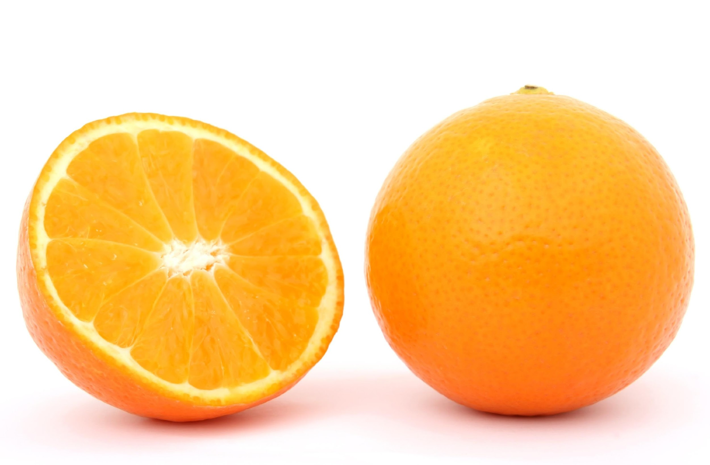
Recycling of Manmade Cellulosic Fibres
MMCFs are primarily produced from wood. Less than 1% is made from recycled or alternative feedstock (Textile Exchange, 2022a, p. 61).
Canopy (2020, p. 18) estimates that a recycling of 25% of global pre- and post-consumer cotton textile waste and 25% of MMCF waste could replace all wood fibres that are currently used to manufacture dissolving pulp.
Launched in 2020, the European Union-funded New Cotton Project (New Cotton Project Consortium, n.d.) is a three-year multi-stakeholder project which collects and sorts textile waste and chemically recycles it into new MMCF fibres that look and feel like cotton.
There are further projects to produce MMCFs from non-textile residues such as cardboard, paper and agriculture residues like wheat or rice straw and biomass waste products for example from the food industry. The Italian start-up Orange Fiber (n.d.) extracts cellulose from the by-products of the citrus industry to produce fibres and fabrics.
CC0 Pixabay
Fashion DIET
51
Notes:
Canopy (2020). SURVIVAL. A Plan for Saving Forests and Climate A Pulp Thriller. Next Generation Report. https://canopyplanet.org/wp-content/uploads/2020/01/SURVIVAL-Next-Gen-Pathway.pdf
New Cotton Project Consortium (n.d.). New Cotton Project. Going beyond cotton. https://newcottonproject.eu/about-us/
Orange Fiber S.r.l. (n.d.). Orange Fiber. https://orangefiber.it/
Image Source:
Orangenfrucht, unknown author, CC0 Pixabay, https://www.pexels.com/de-de/lizenz/, https://www.pexels.com/de-de/foto/orangenfrucht-161559/
51

Slide 52
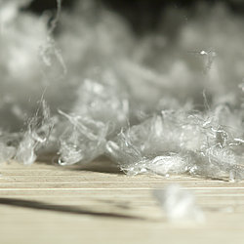
Standards for Pulp and Fibres
The Bluesign Technologies AG (n.d.) developed specific criteria for fibre production sites that are added as annex for fibre manufacturing to the bluesign® criteria.
The ZDHC Foundation (n.d.) has expanded the scope of its work for sustainable chemical management within the textile chain by including manmade cellulosic fibre production.
Further standards for pulp and fibres include the Cradle to Cradle Material Health Certificate Standard, SteP by OEKO-TEX® Further standards for pulp and fibres include the Cradle to Cradle Material Health Certificate Standard, SteP by OEKO-TEX® (OEKO-TEX Service GmbH, n.d.)and the EU Eco Label (European Commission, n.d.).
Pulp, © Lenzing AG
Lenzing fibres, © Lenzing AG
Fashion DIET
52
Notes:
Bluesign Technologies AG (n.d.). bluesign® CRITERIA for production sites. ANNEX: Fiber manufacturing. https://www.bluesign.com/downloads/criteria-2020/annex_fiber_manufacturing_2020-03.pdf
ZDHC Foundation (n.d.). Roadmap to Zero. https://www.roadmaptozero.com/
ZDHC Foundation (2020). ZDHC MMCF Responsible Fibre Production Guidelines. Version 1.0. April 2020. https://downloads.roadmaptozero.com/process/mmcf-responsible-fibre-production-guidelines
OEKO-TEX Service GmbH (n.d.). Certification according to OEKO-TEX® STeP. https://www.oeko-tex.com/en/apply-here/oeko-tex-step
European Commission (n.d.). EU Eco Label. https://environment.ec.europa.eu/topics/circular-economy/eu-ecolabel-home_en
Image Source:
Pulp, Franz Neumayr, © Lenzing AG, https://www.lenzing.com/newsroom/image-archive/filter1
Lenzing fibres, Markus Renner / Electric Arts, © Lenzing AG, https://www.lenzing.com/newsroom/image-archive/filter1
52

Slide 53
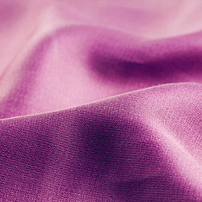
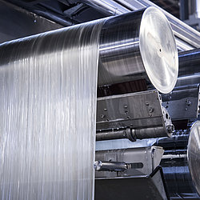
Lyocell - Sustainable Manmade Cellulosic Fibre
Cellulosic regenerated fibre
Spinning: direct solvent process
Raw material: mainly wood from renewable beech forests
Brand name: TENCEL™, TENCEL™ with REFIBRA™ technology. Not only certified wood but also fabric residues from the cutting of cotton clothing are used as raw materials for this fibre.
Disintegration time: 100 % in 16 weeks
Areas of use: denim, outerwear, workwear, functional clothing, underwear, bed linen, nonwovens products (fleece) for hygiene and cosmetic articles. (Lenzing AG, n.d.; Lenzing AG, 2022).
© TENCEL™ Fabric, Lenzing AG
© Lyocell Production, Lenzing AG
Fashion DIET
53
Notes:
Not only certified wood but also fabric residues from the cutting of cotton clothing are used as raw materials for TENCEL™ lyocell fibres with REFIBRA™ technology.
Lenzing AG (n.d.). What is TENCEL™. https://www.lenzing.com/de/produkte/tenceltm
Lenzing AG (2022). Wie bei Lenzing holzbasierte Cellulosefasern entstehen [How wood-based cellulose fibres are created at Lenzing]. https://www.lenzing.com/de/nachhaltigkeit/produktion/technologien
Image Sources:
Fabric made of TENCEL™ Fibres, Cheung Chi Lock, © Lenzing AG, https://www.lenzing.com/newsroom/image-archive/filter1?tx_filedownloads_file%5B%40widget_0%5D%5BcurrentPage%5D=2&cHash=cffac9fdb2f42a0dcd65d13a480b5c62
Lyocell production, © Lenzing AG, https://www.lenzing.com/newsroom/image-archive/filter1?tx_filedownloads_file%5B%40widget_0%5D%5BcurrentPage%5D=2&cHash=cffac9fdb2f42a0dcd65d13a480b5c62
53

Slide 54
Process Diagram of the NMMO Process
Wood from certified sustainable forestry
pulp
NMMO, water
The pulp is:
chemically converted => made dissolvable
dissolved
formed as fibre
regenerated
=> pure cellulose
dissolve
dissolvement recovery + sodium sulphate
filtration
spinning bath
spinning
wash, bleach,
Avivate,
dry, crimp, cut
distillate
disposal
water
Cibik, 2003; Rana, Pichandi, Parveen & Fangueiro, 2014
fibre
CC BY-SA Grundmeier
Fashion DIET
Fashion DIET
54
54
Notes:
N-methylmorpholine-N-oxide (NMMO) is an amino oxide that can dissolve cellulose. The recovery of the cellulose from the solution is achieved by diluting it with water.
Cibik, T. (2003). Untersuchungen am System NMMO/H₂O/Cellulose [Investigations on the NMMO/H2O/cellulose system]. Dissertation an der Technischen Universität Berlin [Dissertation at the Technische Universität Berlin]. Berlin. https://d-nb.info/969808143/34
Rana, S., Pichandi, S., Parveen, S., & Fangueiro, R. (2014). Regenerated Cellulosic Fibers and Their Implications on Sustainability. In Muthu, S. S. (Ed.), Roadmap to Sustainable Textiles and Clothing: Eco-friendly Raw Materials, Technologies, and Processing Methods (pp. 239-276). Springer.
54

Slide 55
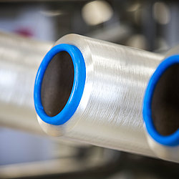
Ecological Advantages of NMMO and New Solvent Processes and Resources
Use of new cellulose resources such as hemp and hemp straw for a new very fine cellulose fibre called Lyohemp® (TITK, n.d.).
Reduction of the number of necessary process steps and sulphurous chemicals. Use of ecotoxicologically favourable organic solvents like N-methymorpholine-N-oxide (NMMO).
Limitation of chemicals to e.g., NMMO and sodium sulphate.
Massive reduction of environmentally harmful waste materials.
Recycling of the solvent through a recovery rate of approximately 99.7%. NMMO is 90% organically degradable. Recovery of sodium sulphate.
There is research about new ionic liquids to dissolve cellulose without sulphur emissions. TreeToTextile invested in constructing a demonstration plant for upscaling the process technology for a new cellulose fibre (TreeToTextile, n.d.).
© TENCEL™ Luxe branded lyocell filaments, Lenzing AG
Fashion DIET
55
Notes:
Thüringisches Institut für Textil- und Kunststoff-Forschung Rudolstadt e.V. (TITK). (n.d.). Cellulose-Forschung. Lyohemp® - nachhaltige Faser der neuesten Generation [Cellulose research: Lyohemp® - sustainable fibre of the latest generation]. https://www.titk.de/innovationen/lyocell-/-lyohemp/
TreeToTextile (n.d.). We offer a new technology to enable a new sustainable cellulosic fiber. https://treetotextile.com/
Image Source:
TENCEL™ Luxe branded lyocell filaments, Michael M. Vogl, © Lenzing AG, https://www.lenzing.com/newsroom/image-archive/filter1?tx_filedownloads_file%5B%40widget_0%5D%5BcurrentPage%5D=2&cHash=cffac9fdb2f42a0dcd65d13a480b5c62
55

Slide 56
Synthetic Fibres
Synthetic fibres are mostly based on oil as a non-regenerative raw material.
They are very important concerning their properties as thermoset and thermoplastic materials such as polyester and polyamide.
Specially for technical applications these polymers are very important but also the recycling processes are of high significance (Camlibel, 2018) as synthetic fibres are resistant to rotting and therefore not biodegradable.
Fibres cause plastic waste through used textiles. They also release microplastics through fibre abrasion, especially during textile care.
Fashion DIET
56
Notes:
Camlibel, N. O. (2018). Introduction to “Polyester – Production, Characterization and Innovative Applications”. In N. O. Camlibel (Ed.), Polyester: Production, Characterization and Innovative Application (pp. 1-4). Intech. http://dx.doi.org/10.5772/intechopen.72589
56

Slide 57
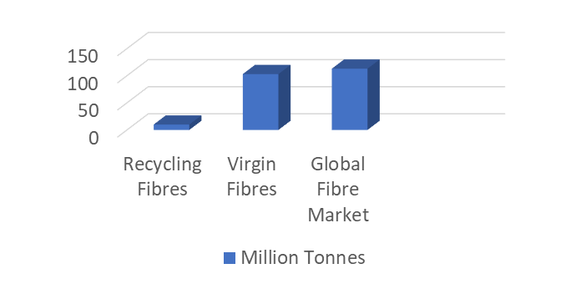
Global Recycled Fibre Market
In 2021, the overall uptake of recycled fibres compared to the total fibre production was around 8.5% including 7.9% recycled polyester from plastic bottles and around 0.6% of all fibres including all other recycled fibres.
Less than 1% of the global fibre market was from pre- and post-consumer recycled textiles.
In 2021, the market share of recycled fibres increased to 8.5% and the percentage of virgin fibres decreased to 91.5% . However, in absolute numbers the virgin fibre production volume increased to 103 million tonnes in 2021. (Textile Exchange, 2022a, p. 12).
CC BY-SA Grundmeier
Fashion DIET
57
Notes:
57

Slide 58
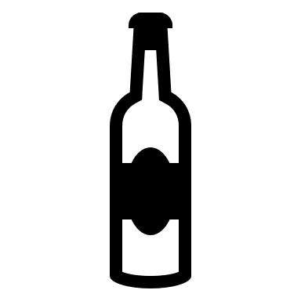
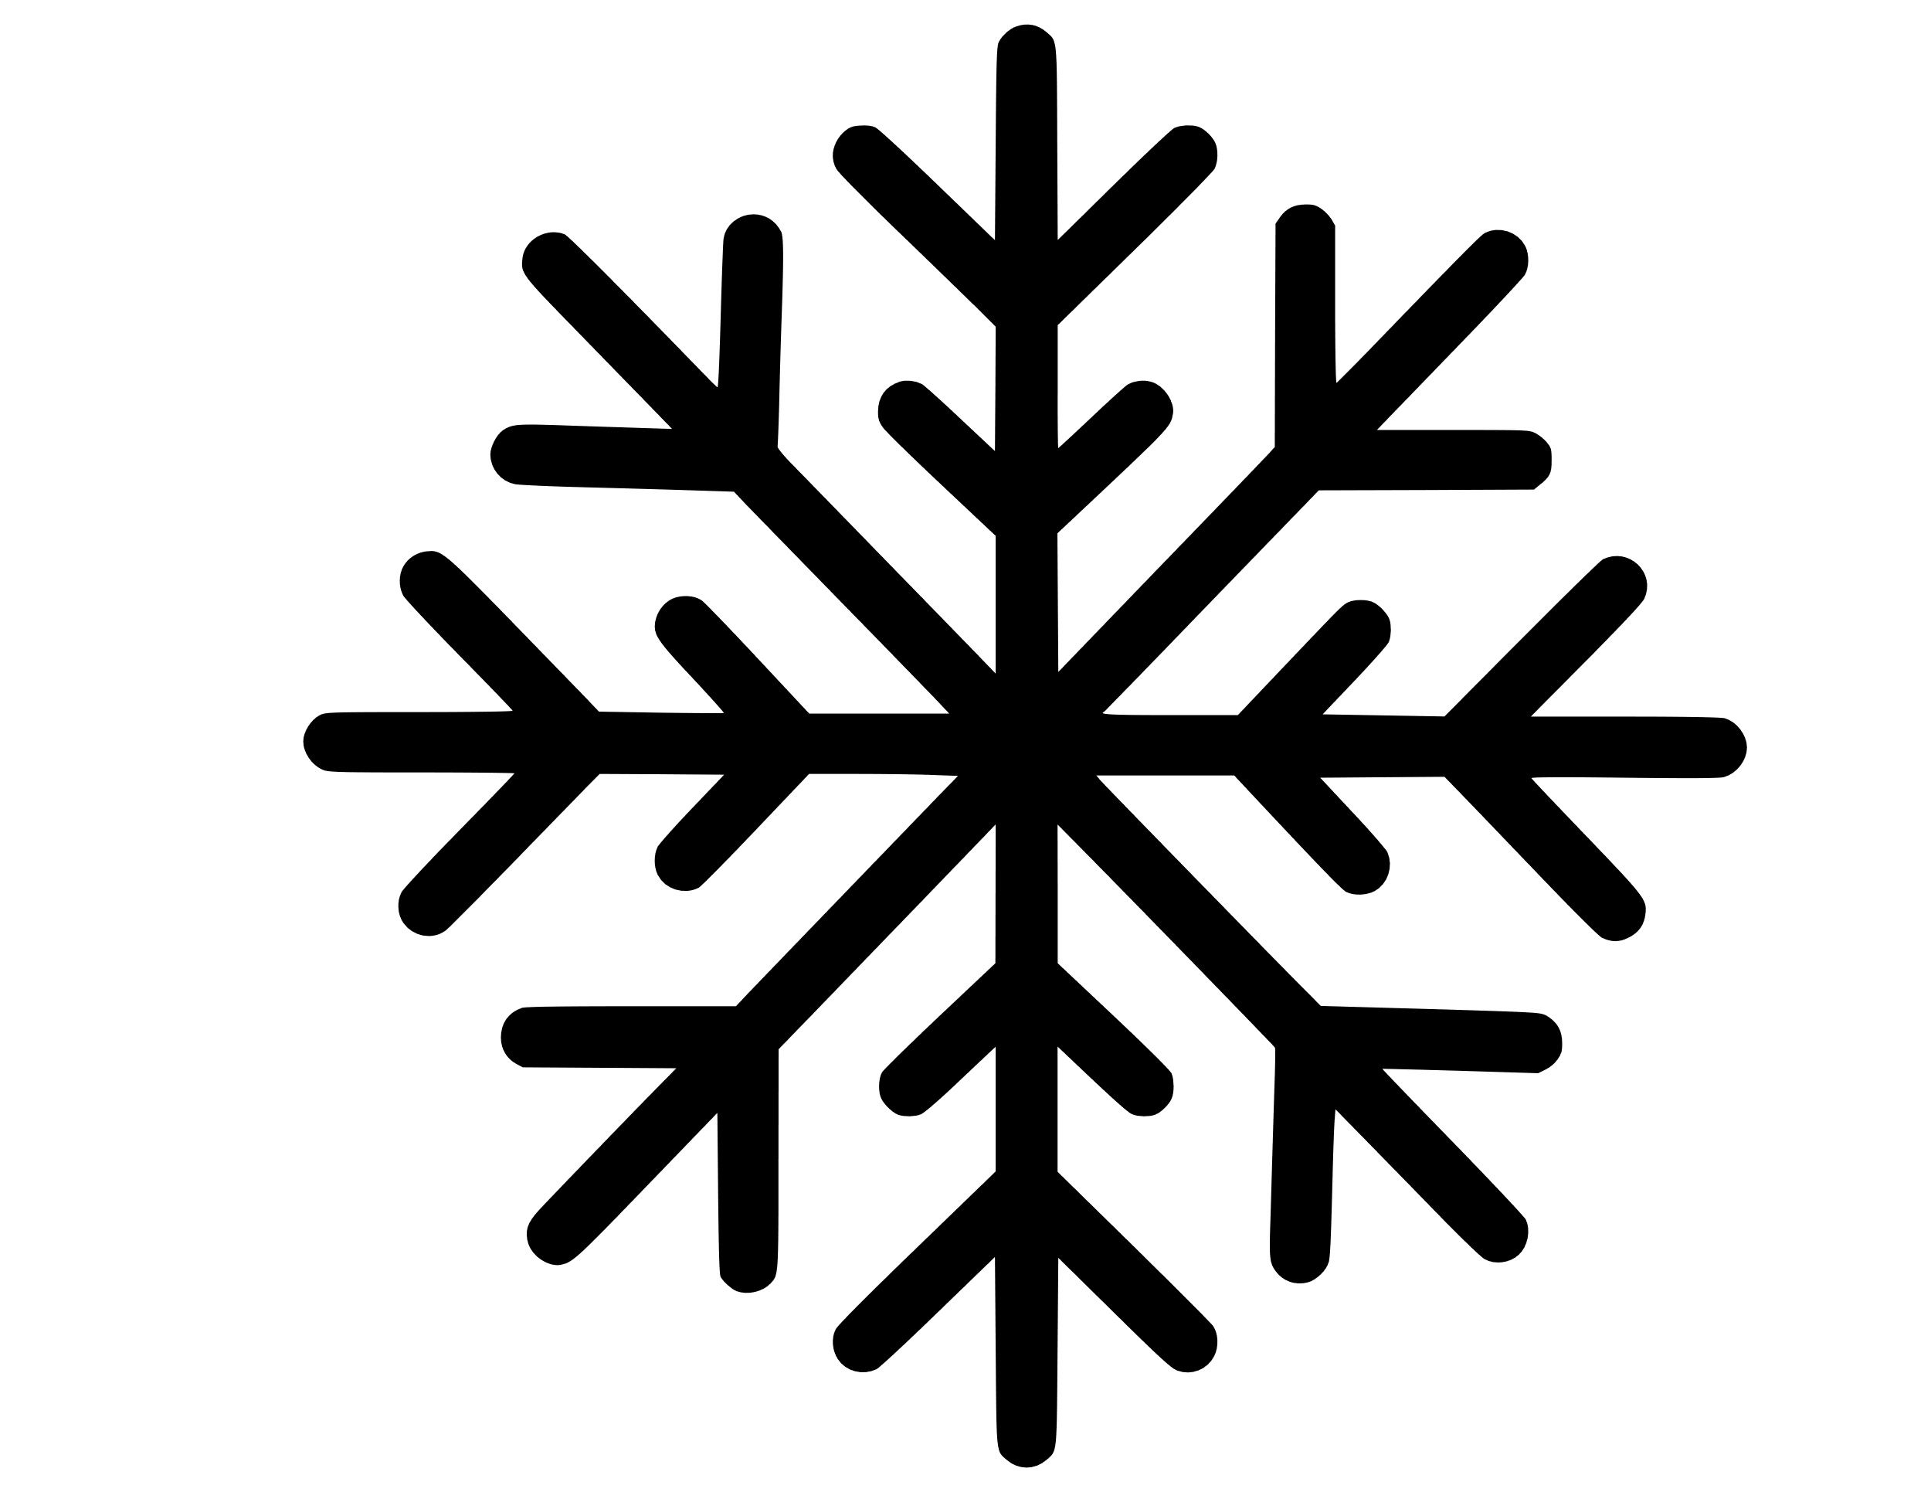
Polyethylene terephthalate (PET) Recycling
60% of the PET produced worldwide is used for fibre production (Lumitos, n.d.).
Fibres made from recycled polyester (rPET) use 33 to 53% less energy (byewaste, n.d.).
About 49% of the world’s clothing is made of polyester due to the ongoing trend towards sportswear (Elven, 2018).
Sustainable products obtained by recycling of PET are mainly used as textile fibres (Sarioğlu & Kaynak, 2018).
Label Removing
Crushing
Post-Consumer-Bottle
Bale Breaker
- Vibrating Seperator
Repolymerisation
of post-consumer PET
Fabric
Clean Flake
Dewatering and Drying
PET
Yarn
Polymerisation
CC BY-SA Grundmeier
Fashion DIET
58
Notes:
Duisters, C. (20.07.2022). The pros and cons of recycled polyester in clothing. https://www.byewaste.app/en/2022/07/20/recycled-polyester-pros-and/
Elven, M. v. (03.12.2018). Wie nachhaltig ist recyceltes Polyester wirklich? [How sustainable is recycled polyester really?] https://fashionunited.de/nachrichten/mode/wie-nachhaltig-ist-recyceltes-polyester-wirklich/2018120330207
Lumitos (n.d.). Encyclopedia. Polyethylene terephthalate. https://www.chemeurope.com/en/encyclopedia/Polyethylene_terephthalate.html
Sarioğlu, E., & Kaynak, H. K. (2018). PET Bottle Recycling for Sustainable Textiles. In N. O. Camlibel (Ed.), Polyester: Production, Characterization and Innovative Application (pp. 5-20). Intech. http://dx.doi.org/10.5772/intechopen.72589
Image Sources:
Photo of fabric by unknown author, licensed under CC BY-SA.
Task:
Research the process step of polyester recycling. How does the chemical recycling process differ from the physical recycling process and what quality differences arise?
58

Slide 59
Recycling of Synthetic Fibres in 2021
With around 9 million tonnes (15%) in 2021, Polyester had the highest recycled fibre percentage. Around 99% of the recycled polyester was PET bottle-based (Textile Exchange, 2022a, p. 99).
The main standards used for recycled polester are the Global Recycled Standard (GRS), the Recycled Claim Standard (RCS) and the SCS Recycled Content Standard (Textile Exchange, 2022a, p. 72).
The market share of mechanically and chemically recycled polyester is less than 1% because of the overall costs and energy costs, technological challenges, feedstock suitability and availability (Textile Exchange, 2022a, p. 73).
Textile Exchange (2022a, p. 12) estimated that the market share for recycled elastane was around 3%, for recycled polyamide around 2% and for recycled polypropylene around 0.2%.
Fashion DIET
59

Slide 60
Sustainable Strategies
At the moment the priority must be to keep synthetic fibres in a loop in order to avoid single-use plastic.
As more than 8 million tonnes of plastic end up in the oceans every year, the number of initiatives working on the collection of plastic in the ocean as a feedstock for recycling increases (Parker, 2019; Sorrentino, 2022).
Abandoned Plastic Waste (OBP) comprises microplastics, mezzo-plastics and macro-plastics, located within 50 km from shores where waste management is inexistent or inefficient (Ocean Bound Plastic, n.d.).
The European Textile and Clothing Trade Association EURATEX joined forces with CIRFS (chemical fibres), European Outdoor Group, FESI (sporting goods) and AISE (detergents) in 2018 to form an alliance against microplastic input from the washing of synthetic textiles. (see microplastics presentation)
CC BY Magda Ehlers, Pexels
Fashion DIET
60
Notes:
Sorrentino, L. M. (2022). A solution package for plastic pollution – from measurement to action. IUCN.
Zero Plastic Ocean (n.d.). What Is Ocean Bound Plastic (OBP)? https://www.obpcert.org/what-is-ocean-bound-plastic-obp/
Ocean Bound Plastic was indirectly defined by the following publication in Science:
Jambeck, J. R., Geyer, R., Wilcox, C., Siegler, T. R., Perryman, M., Andrady, A., Narayan, N., & Law, K. L. (2015). Plastic waste inputs from land into the ocean, Science (347)6223, 768-771. https://www.science.org/doi/10.1126/science.1260352
Parker, L. (07.06.2022). The world's plastic pollution crisis explained. https://www.nationalgeographic.com/environment/article/plastic-pollution
Image Source:
Foto von Plastikflaschen, Magda Ehlers, https://www.pexels.com/de-de/lizenz/, https://www.pexels.com/de-de/foto/foto-von-plastikflaschen-2602537/
60

Slide 61
Thermore® EVOdown®
The Milan-based company Thermore® (n.d.) specialises in batting/ warming fleeces with a high proportion of recycled fibres.
The EVOdown® thermal fleece is made from 100% recycled PET bottles. The fibres are encased in two outer layers.
A new fleece jacket can be made from about 25 PET bottles. Very little water is needed in the PET production process. In addition, the use of PET bottles helps to reduce waste and no new raw material is used. Every year, about 40% of PET bottles in Europe are processed into fibres.
This reduces the daily waste mountain of plastic bottles by 10 million, i.e., approximately 200.000 tonnes of primary raw materials are saved. (Industrievereinigung Chemiefaser e. V., n.d.)
© Thermore®
Fashion DIET
61
Notes:
Industrievereinigung Chemiefaser e. V. [Association of Manmade Fibres Industries] (n.d.). Recycling. https://ivc-ev.de/de/recycling
Thermore® (n.d.). EVOdown® Half fibers, half insulation, fully recycled. https://www.thermore.com/en/insulation-for-outerwear-products/evodown/
61

Slide 62
Engineered PET Depolymerase
Polyethylene terephthalate (PET) is the most common polyester plastic, produced annually worldwide for the use in textiles and packaging.
According to current estimates, 150-200 of the 359 million tonnes of plastic produced worldwide each year end up in landfills or in the environment.
The main recycling process for PET, which is thermomechanical, results in a loss of mechanical properties.
This raises the question of whether recycling within the same product cycle would not make more sense. When recycled polyester loses its buckling strength, more fibres enter the waterways and the environment through abrasion.
Therefore, new processes with highly efficient, optimised enzymes to depolymerise PET within a shorter time are developed. (Tournier et al., 2020).
CC BY Mali Maeder, Pexels
Fashion DIET
62
Notes:
Tournier, V., Topham, C. M., Gilles, A., David, B., Folgoas, C., Moya-Leclair, E., Kamionka, E., Desrousseaux, M.-L., Textier, H., Gavalda, S., Cot, M., Guémard, E., Dalibey, M., Nomme, J., Cioci, G., Barbe, S., Chateau, M., André, I., Duquesne, S., & Marty, A. (2020). An engineered PET depolymerase to break down and recycle plastic bottles. Nature 580, 216–219. https://doi.org/10.1038/s41586-020-2149-4
Image Source:
Verschiedene Plastikflaschen, Mali Maeder, https://www.pexels.com/de-de/lizenz/, https://www.pexels.com/de-de/foto/verschiedene-plastikflaschen-802221/
62

Slide 63
Alternative Bioplastics
There are polyester fibres whose polymers are partly derived from plants by replacing some structural components of the PET polymer.
Since the materials are partly of plant origin, they can help curb the consumption of fossil fuel resources and reduce greenhouse gases.
The properties are similar to petroleum-based polyethylene terephthalate (PET). Bioplastics are not necessarily more biodegradable than synthetic plastics.
Illustration: https://www2.teijin-frontier.com/english/sozai/specifics/plantpet.html
Fashion DIET
63
Notes:
Biodegradable plastics are also used in textiles. Biodegradable starch, polylactide (PLA), polybutylene succinate (PBS), polybutylene adipate terephthalate (PBAT) and polyhydroxyalkanoates (PHA) are the most common. The most commonly used bioplastic today is PLA - short for "polylactide acid“, also known as lactic acid. This substance is obtained from starch and is based on sugar cane, maize or potatoes.
According to DIN EN 13432, biodegradability means that a material must have degraded to more than 90 per cent to water, carbon dioxide (CO2) and biomass after a specified time under defined temperature, oxygen and humidity conditions in the presence of microorganisms or fungi.
However, biodegradable plastics are not necessarily made from renewable plant or animal raw materials; there are also plastics made from fossil, non-renewable resources that are biodegradable. Biodegradability is thus not linked to the raw material base but depends solely on the chemical structure of the material and its ability to transform into naturally occurring end products of metabolism through biological activity.
For more information, see Umweltbundesamt (2009). Biologisch abbaubare Kunststoffe [Biodegradable Plastics]. https://www.umweltbundesamt.de/sites/default/files/medien/publikation/long/3834.pdf
63

Slide 64
Polylactide (PLA)
Polylactides (PLA) are synthetic polymers based on renewable raw materials such as sugar cane or corn, which belong to the polyesters.
The material, which is made up of lactic acid molecules, is one of the biodegradable plastics - but only in industrial composting plants within a few months. PLA decomposes more slowly in nature. (Storz & Vorlop, 2013).
Polylactides of (S)-lactic acid (top) and (R)-lactic acid (bottom) (C₃H₄O₂)_{n}
Creative Commons CC0 1.0, Jü
Fashion DIET
64
Notes:
Polylactides were first described by Théophile-Jules Pelouze in 1845. In an attempt to purify lactic acid by heating and removing water, he observed a condensation of the lactic acid molecules and the formation of oligomers and polymers.
Storz, H., & Vorlop, K.-D. (2013). Bio-based plastics: status, challenges and trends. Applied agricultural and forestry Research, (4), pp. 321-332.
For more information, see Wikipedia (28.10.2022). Polylactide. https://de.wikipedia.org/wiki/Polylactide
Image Source:
Polylactides_Formulae, Jü, Creative Commons CC0 1.0, https://commons.wikimedia.org/wiki/File:Polylactides_Formulae_V.1.svg
64

Slide 65
Recycled Fibres on the Rise
The largest source of textile waste in Europe is discarded clothes and home textiles from consumers, which accounts for around 85% of the total waste.
Therefore, consumers have to be informed why and how to keep their clothes in the loop and finally return their clothes and home textiles.
A major problem for recycling are the fibre blends of used textiles. There are first companies developing technologies to separate cotton and polyester fibres for recycling.
Fibre-to-fibre recycling technologies must further expand their ability to handle fibre blends, lower their costs, and improve their output quality as these are the bottlenecks which prevent the circular textile economy from scaling.
By overcoming these barriers, fibre-to-fibre recycling could reach 18 to 26% of gross textile waste in 2030 (McKinsey Apparel, Fashion & Luxury Group, 2022, pp. 7-8) .
CC0, Unknown author
Fashion DIET
65
Notes:
McKinsey Apparel, Fashion & Luxury Group (2022). Scaling textile recycling in Europe—turning waste into value. https://www.mckinsey.com/industries/retail/our-insights/scaling-textile-recycling-in-europe-turning-waste-into-value
Image Source:
Unknown title, Unknown author, CC0 1.0, https://pxhere.com/de/photo/940716
65

Slide 66
Key Facts and Figures in 2021
GLOBAL FIBRE MARKET OVERVIEW
113 million mt In 2021
+ 30% In the next 10 years
149 million mt In 2030 if business continues as usual
x 2 In the last 20 years
POLYESTER (54%)¹
COTTON (22%)¹
MMCFs³ (6,4%)¹
OTHER (~16,6%)¹
~14.8% of polyester is recycled
DOWN (~0.5%)¹
~0,03% of polyester is biobased
WOOL (~1%)¹
24% of cotton is preferred cotton²
Only 7 years left until 2030
¹ Percentages of global fibre production volume in 2021.
² This includes BASF e3, Better Cotton, Cleaner Cotton, Cotton made in Africa (CmiA), Fairtrade, Fairtrade organic, in-conversion cotton, Israel Cotton Production Standard System (ICPSS), International Sustainability and Carbon Certification (ISCC), myBMP, Organic, REEL Cotton, Regenerative organic Certified (ROC), Responsible Brazilian Cotton (ABR) and U.S. Cotton Trust Protocol (USCTP).
³ Manmade Cellulosic Fibres.
<0.5% of MMCF is recycled
~60-65% of MMCF is FSC and/or PEFC certified
3% Responsible Wool Standard (RWS) and other sustainable certificates
4.4% sustainable standards (RDS, Downpass, TCS)⁴
© Source: Textile Exchange, 2022a, p. 5-6
Fashion DIET
66
Notes:
Tasks:
Interpret the facts and figures in this chart from Textile Exchange, 2022a. What does the NGO think the future looks like in terms of the world market for textile raw materials and materials?
Discuss the scenario for the future.
66

Slide 67
Conclusion and Discussion
How can the future of the fibre market be made sustainable?
What strategies for natural and synthetic polymers do you think make sense to accommodate the idea of a circular economy?
Discuss the following statement by Dr. Carmen Hijos, founder of Piñatex®:
“Design is a connecting tool between people, economics and the environment – and out of this communion, understanding and respect new ideas and products with integrity can come about.” (Ananas Anam, n.d.).
Fashion DIET
67
Notes:
67

Slide 68
Further References
Colangelo, F., Cioffi, R., & Farina, I. (2021). Handbook of Sustainable Concrete and Industrial Waste Management. Woodhead Publishing.
Fangueiro, R., & Rana, S. (2016). Natural Fibres: Advances in Science and Technology Towards Industrial Applications. RILEM Bookseries.
Lewin, M., & Sello, S. (Eds.). (2017). Handbook of Fiber Science and Technology: Volume 1. Routledge. https://doi.org/10.1201/9780203719275
McIntyre, J. E. (Ed.). (2004). Synthetic Fibres: nylon, polyester, acrylic, polyolefin. Woodhead Publishing.
Muthu, S. S. (Ed.). (2014). Roadmap to Sustainable Textiles and Clothing: Eco-friendly Raw Materials, Technologies, and Processing Methods. Springer.
Türk, O. (2014). Stoffliche Nutzung nachwachsender Rohstoffe. Grundlagen – Werkstoffe – Anwendung. Springer Vieweg. https://doi.org/10.1007/978-3-8348-2199-7_14
Fashion DIET
68
Notes:
68

Slide 69
OER Explanation
OER Licence CC BY-SA except the logos and where otherwise stated e.g. images, photos, pictures.
Blur effects of the image edges have been done by the author for Fashion DIET.
A full citation of text and image sources is always given at the first mention of the authors in the notes beneath the slide, otherwise short citation in the text or on the slide.
Fashion DIET
69

Slide 70
Contact
University of Education Freiburg
Institute of Everyday Culture, Sports and Health
Department Fashion and Textile
Prof. Dr. Anne-Marie Grundmeier
E-mail: grundmeier@ph-freiburg.de
Fashion DIET
70

