Slide 1

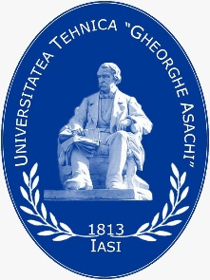


Dyeing and printing in the context of sustainability

Slide 2
Learning Objectives
After this lecture you should be able to:
understand the main issues related to sustainability in textile dyeing and printing.
know the sustainability issues associated with the use of textile dyes.
find out about the possibilities of optimizing existing technologies and replacing environmentally aggressive products.
learn about the revolutionary new printing and printing technologies that are environmentally friendly.

Slide 3
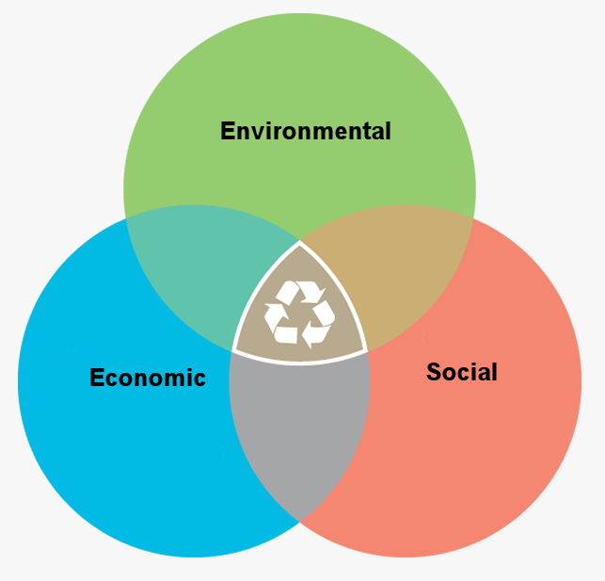
Introduction
Sustainable development
Notes:
The concept of sustainable development refers to the ability of society to develop economically and socially, meeting the requirements of current generations, without compromising or risking the chances of future generations.
The first crystallizations related to the concept of sustainable development can be found in the Club Report of Rome (Meadows Report), entitled "Limits of Growth", and published in 1972, which warns that the problems of economic growth are inseparable from those of environmental pollution, growth population explosions and resource depletion (Meadows et al., 1972). The three circles whose intersection is the concept of sustainability represent the pillars of sustainability (social, economic and environmental) (Purvis et al., 2019).

Slide 4
Sustainable issues in the textile industry
Natural resources
Recycle & reuse
Biodegradable materials
Low emissions
Fare trade (labor welfare)
Under age work prohibited
Force work prohibited
Smart growth
Long range planning
Cost saving
Business ethics
Notes:
The main problems of the textile industry related to the three pillars of sustainability are presented in the figure. The production and consumption of textile products is characterized by an advanced complexity, which is reflected in their impact on the environment. The main environmental problems associated with the textile industry are the depletion of material resources, high water consumption, the contribution to climate change, salination of water, soil fertility decline and the toxicity of some of the chemicals used (Blackburn, 2009).

Slide 5
Ecological issues regarding dyeing and printing
High water consumption - half of the total water consumed in the textile processing is used in textile wet treatment
CC0 Bertea, adapted from Mahmud & Kaiser (2020)
Notes:
Textile processing causes 20% of global water pollution, according to the World Bank (Scott, 2015). Water serves not only as a means of transporting dyes and the many chemical auxiliaries used, but also for the transport of the thermal energy, as most of the textile chemical finishing processes are carried out at temperatures exceeding 20ºC.
In addition to high water consumption, the vast majority of water is used for processing, so the degree of impurity is increased. More than half of the total water consumed in the textile processing is used in textile wet treatment. The largest share in terms of water consumption has the preparation processes (38%), while the water consumed in the dyeing and printing processes represents 24%. Water consumption in textile finishing depends mainly on the type of equipment and the technology used (discontinuous, semi-continuous or continuous). In the preparation, the largest amounts of water are consumed in the scouring and mercerizing. When dyeing fabrics, regardless of the characteristics of the chosen dyes, at the end of the actual dyeing, a washing step is mandatory to remove excess dye or dyes that have not adhered to the fibre. At this stage of washing, the water consumption is substantial. This is why water conservation and reuse became an imperative for the textile industry.

Slide 6
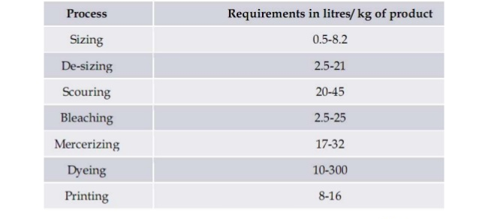
Ecological issues regarding dyeing and printing
High water consumption in dyeing
Notes:
Water consumption in textile finishing depends mainly on the type of equipment and the technology used (discontinuous, semi-continuous or continuous). In the preparation, the largest amounts of water are consumed in the scouring and mercerizing.

Slide 7
Ecological issues regarding dyeing
Coloured wastewater caused by incomplete fixation
Dyestuff class | Fiber | Fixation degree, % | Effluent loss, %
Acid | Polyamide | 80 – 95 | 5 – 20
Basic | Acrylic | 95 – 100 | 0 – 5
Direct | Cellulose | 70 – 95 | 5 – 30
Disperse | Polyester | 90 – 100 | 0 – 10
Metal –complex | Wool | 90 – 98 | 2 – 10
Reactive | Cellulose | 50 – 90 | 10 – 50
Sulphur | Cellulose | 60 – 90 | 10 – 40
Vat | Cellulose | 80 – 95 | 5 – 20
Notes:
The presence of dyes in wastewater is determined by incomplete exhaustion, which essentially depends on the nature of the dye, but also on the dyeing process used or the dyeing colour intensity. It is estimated that the dye losses are, on average, 10% for dark shades, 2% for medium shades and negligible for pale shades.
The degree of fixation varies from one class of dyes to another, and, consequently, the level of coloration of wastewater varies. The amount of unfixed dye remaining in the dye bath during the dyeing of the various textile fibres is shown in the table (Muthu, 2017). It can be seen that basic dyes have the highest degree of exhaustion (higher than 95%), while for reactive dyes the degree of fixation is relatively low (between 50 and 90%).

Slide 8
Ecological issues regarding dyeing
Dye class | Pollutants in the dyeing effluent
Direct dye | Salt, unfixed dyes (5-30%), copper salts, cationic fixing agents
Reactive dye | Salt, alkali, unfixed dyes (10-40%)
Vat dye | Alkali, oxidizing agents, reducing agents.
Sulphur | Alkali, oxidizing agents, reducing agents, unfixed dye (20–40%).
Chrome | Organic acids, heavy metal salts
Basic dyes | Acids, unfixed dye (0-5%), cationic retarder
Metal Complex | Organic acids, unfixed dye (2-10%)
Disperse dyes | Organic acids, reducing agents, carriers (if used)
Blackburn (2009)
Notes:
In addition to the colouring of wastewater, a series of auxiliaries that are not consumed in the process are introduced into the wastewater when dyeing: salt, in the case of direct, acid and reactive dyes (especially in the case of the latter), alkaline agents, reducing agents and oxidants when dyeing with vat and sulphur dyes, heavy metals when dyeing with chrome dyes, retarders for dyeing with basic dyes or carriers for dyeing with disperse dyes.

Slide 9
Ecological issues regarding dyes Respiratory/skin sensitizers
Hue | C I Name
Yellow dyes | Reactive Yellow 25, Reactive Yellow 39, Reactive Yellow 175
Orange dyes | Reactive Orange 4, Reactive Orange 12, Reactive Orange 14, Reactive Orange 16, Reactive Orange 64, Reactive Orange 67 Reactive Orange 86, Reactive Orange 91
Red dyes | Reactive Red 29, Reactive Red 65, Reactive Red 66, Reactive Red 123, Reactive Red 219, Reactive Red 225
Violet dye | Reactive Violet 33
Blue dyes | Reactive Blue 114, Reactive Blue 205
Black dye | Reactive Black 5
Notes:
The majority of allergic contact dermatitis caused by textiles is related to the presence on the surface of the material of substances used in the processing. The most common cases of allergic dermatitis were observed in the case of some reactive dyes, which are presented in the table. It should be noted that the undesirable effects occur only if the complete removal of the unstained dye is not achieved at the end of the dyeing process.
Respiratory symptoms have been identified in exposed workers working in textile dyeing factories, especially in the case of the same reactive dyes, but these undesirable effects can be greatly limited or even eliminated in the case of proper handling of dyes.

Slide 10
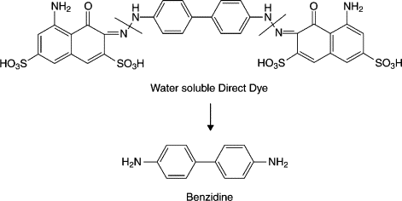
Ecological issues regarding dyes
Harmful azo dyes
Certain azo dyes, which break down to specific aromatic amines such as Benzidine, 2. 2-naphthylamine, 3. 4-aminodiphenyl or 4. 4-chloro-o-toluidine, which have a carcinogenic effect in humans, have been prohibited by Directive 2002/61/EC to use on consumer goods having regular skin contact.
Notes:
In the middle of this century, the risk of bladder cancer was significant for textile workers in dye houses. It was found that this effect was caused by some azo dyes, which break down to specific aromatic amines such as benzidine, 2. 2-naphthylamine, 3. 4-aminodiphenyl or 4. 4-chloro-o-toluidine, which have a carcinogenic effect in humans. These amines have been banned, and they are under two groups, Group A1 (amines that are proven carcinogens), and GroupA2 (amines that are suspected to be carcinogenic).
In 1994, the German government developed a second amendment to the Consumer Protection Act, which prohibits the use of azo dyes containing these carcinogenic amines. According to German legislation, some of the dyes that are considered carcinogenic are Acid Red 26, Basic Red 9, Basic Violet 14, Direct Black 38, Direct Red 28, Direct Blue 6, Disperse Yellow 3, Disperse Orange 11 and Disperse Blue 1.
The European Union, by the Directive 2002/61/EC, reformulated by the Directive 2004/21/CE, has banned the use of the azo dyes that, after cleavage, present the capacity to release aromatic amines. The Directive states that “azo dyes which, by reductive cleavage of one or more azo groups, may release one or more of the carcinogenic aromatic amines, in detectable concentrations, i.e. greater than 30 ppm in the finished articles or in their coloured parts, in accordance with standardized test methods, may not be used in textile and leather articles which may come into direct and prolonged contact with human skin or the oral cavity” (Eur-lex, 2004).

Slide 11
Ecological issues regarding dyes
Harmful azo dyes
The banned dyes belong to various dye classes:
82 Amine releasing Direct dyes | 3 Amine releasing Basic dyes
24 Amine releasing Acid dyes | 3 poisonous Azoic Dyes
2 poisonous Acid Dyes | 1 carcinogenic Disperse dye
4 carcinogenic Acid dyes | 24 allergenic Disperse dyes
8 carcinogenic Basic dyes
Notes:
Dyes with carcinogenic or allergic potential are part of various classes of dyes, as can be seen from the table. One can observe that most dyes with carcinogenic potential are direct dyes, but a significant number of such dyes can also be found in acid dyes. Approximately 70% of all dye being used by the textiles industry are azo dyes, but only a quarter of them are banned today (Kumari, 2003). Dyes with allergenic potential are mostly disperse dyes.

Slide 12
Ecological issues regarding printing
Urea | Hydrotropic agent | High levels of nitrogen can cause eutrophication
Ammonia | In pigment printing pastes | Introduce nitrogen that can cause eutrophication
Sulphates and sulphites | Residues of reducers used | Sulfites are toxic to aquatic organisms and sulphates can cause corrosion problems at concentrations higher than 500 mg / L.
Polysaccharides; | thickening agent | High COD; biodegradable
CMC derivatives | thickening agent | Hardly biodegradable and bioeliminable
Polyacrylates | thickening agent; Printable crosslinkers | Hardly biodegradable, but more than 70% bioeliminable
m-nitrobenzene sulfonate and other amine derivatives | In discharge printing on vat dyeing; When printing directly with reactive dyes | Heavy biodegradable
Polyvinyl alcohol | Adhesive for fixing on the printing table | Hardly biodegradable; bioeliminable in proportion > 90%
Aromatic amines | Result of reductive degradation of azo dyes | Hardly biodegradable and difficult to bioeliminate
Mineral oils / aliphatic hydrocarbons | thickening agent | Aliphatic hydrocarbons are readily biodegradable
Notes:
The most important pollutants generated when printing textiles are suspended solids, urea and ammonia, which introduce nitrogen that can cause eutrophication, sulphates and sulphites that appear as residues as a result of reduction processes when printing with vat dyes and are toxic to aquatic organisms and can cause corrosion, solvents, thickening agent which are hardly biodegradable, dyes from discarded print paste or colour kitchen operations, heavy metal ions, vapours released during drying and curing, solvents used to clean the screens or the machines.

Slide 13
Ecological issues regarding printing
Replacing urea when printing with reactive dyes
Urea can be completely replaced or at least the amount used can be substantially reduced by moisture-controlled application (10% relative to the mass of the fabric for cotton fabrics, 20% for viscose fabrics and 15% for cotton-type fabrics). Moisture can be applied either as a foam or by spraying, the first system being recommended, as it ensures advanced uniformity of application, even in the case of fine materials.
Notes:
Printing pastes with reactive dyes contain urea, whose role is to cause the swelling of cellulosic fibres, to increase the solubility of dyes, to facilitate the formation of condensation (in the steaming phase), which allows migration of the dye from the printing paste into the fibre, and reducing the sensitivity of the print to temperature variations. The presence of urea in wastewater from washing prints (along with its decomposition products, ammonia and ammonium ion) can be a cause of eutrophication, and causes additional energy consumption in the treatment stages for nitrification of nitrogen compounds.
Urea can be completely replaced or at least the amount used can be substantially reduced by moisture-controlled application or by replacing it with triethylene glycol, a nitrogen-free compound with good characteristics for improving moisture absorption (applicable to the printing of natural silk).

Slide 14
Ecological issues regarding printing
Reducing the amount of volatile organic compounds released when printing with pigments
Pigment printing involves the use of a printing paste containing the pigment and the binder, which is of the oil-in-water (O/W) emulsion type, where the oily component is kerosene. Kerosene causes difficulties related to its volatility and flammability.
Synthetic binders have been developed to replace kerosene, capable of reproducing the special rheological characteristics of kerosene-based emulsions. The same properties as those of kerosene can be achieved using acrylic copolymers or polyethylene glycol.
Notes:
Pigment printing paste are of the oil-in-water (O/W) emulsion type contains pigment and binder, which form an adhesive film, which encloses the pigment, after application on the textile material and heat treatment. The oily component in this paste is kerosene, which causes difficulties related to its volatility and flammability. Advanced removal of kerosene during drying is mandatory to avoid accumulation that could lead to concentrations at which explosions can occur during the heat treatment phase.
Synthetic binders such as acrylic copolymers or polyethylene glycol can replace kerosene, as they are capable of reproducing the special rheological characteristics of kerosene-based emulsions.
The use of these synthetic thickeners reduces the amount of pollutants, with only a small percentage of synthetic polymer (approximately 2%) being required to thicken the paste in order to obtain the correct rheology for printing, compared to the required 70% kerosene in the method based on oil. In addition, the release of gaseous hydrocarbons in the drying and heat treatment phases is eliminated.
Another source of emissions of organic compounds in pigment printing is the binder, responsible for the release of formaldehyde and alcohols (especially methanol). Binders with low formaldehyde content have now been developed, their use, combined with the application of an optimized printing process, leading to a reduction of more than five times the emissions of volatile organic substances.

Slide 15
Optimizations of existing technologies and substituting environmentally aggressive products
Foam Dyeing - To obtain the foam, a foaming agent is added to the composition of the treatment or painting solution. Foam, which is obtained by vigorous mechanical agitation, has a volume of up to 20 times greater than the volume of the initial solution. The foam is applied to the fabric, which is further passed through rollers, which have the role of breaking the foam and evenly distribute the chemicals.
CC BY-SA Bertea
Notes:
Foam is a colloidal system consisting in a dispersion of gas in liquid (Muthu, 2018). Foam technology can be used as a low add-on technology in many fields of textile processing like pre-treatments, dyeing, printing or finishing.
Foam dyeing is an alternative to traditional dyeing methods and it is characterized by protecting the environment and generating savings in the supply chain. By using foam, air is used instead of water to transport dyes and auxiliaries on the textile.
In foam treatment, the chemicals and/or dyes are formulated with a foaming agent in a concentrated dispersion, which is mechanically foamed. The foam is applied on the fabric and afterwards the foam collapse when the fabric is passed through squeeze rolls (Yu et al., 2014).

Slide 16
Foam Dyeing - Benefits
Save water and chemicals (0-20% minimum)
Reduce water pollution.
Save cost.
Faster production .
Less heat generation.
Reduction of shrinkage in width because of low liquor application
Greater productivity (around 25-50% more than conventional processes).
Fixation of dye into fiber can be improved.
Lower dyes migration.

Slide 17
Foam Dyeing - Drawbacks
High capital equipment cost.
Greater care and skill is necessary.
Limited range of applicable product.
In some cases problems with penetration and levelness.

Slide 18
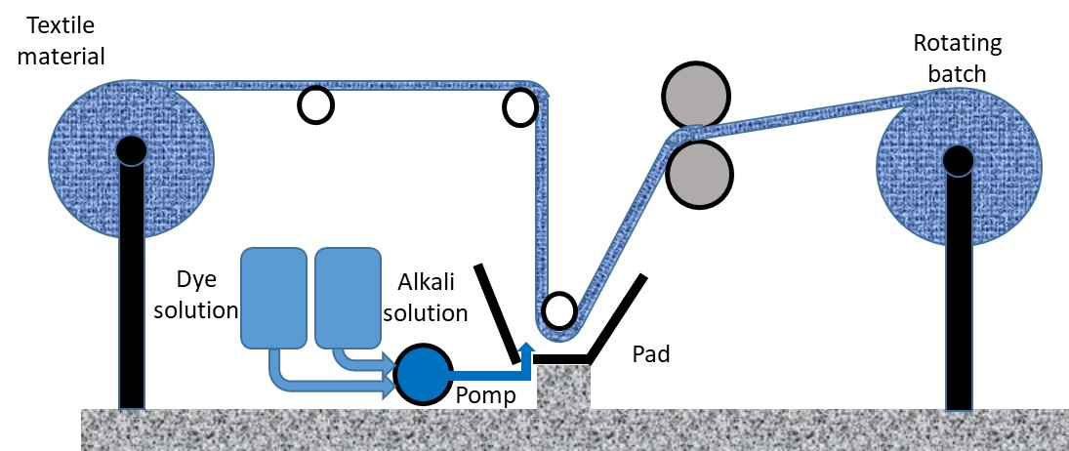
Pad-batch dyeing
In this method, the chemicals are padded in a padding mangle and then the fabric is kept at room temperature. This method claims 50% water savings over conventional methods.
CC BY-SA Bertea
Notes:
Pad-Batch Dyeing is one of most used the semi-continuous dyeing processes (Muthu, 2018). The Pad-batch dyeing procedure is simple, involving three phases:
padding the material with the solution containing the dye and (possibly) the electrolyte;
rolling of the impregnated material and cold storage for a period of 2 - 24 hours, depending on the reactivity of the dye and the used pH. It is usually practiced to wrap the roll with plastic foil to prevent the dyeing solution from evaporating on the exposed surface. Depending on the size of the roller and the degree of squeezing, it may be necessary to rotate the roller during storage to avoid dye accumulation at the bottom of the beam.
final washing.
Usually dye/alkali mixing and metering equipment is needed. Pad Batch offers the most economical and convenient method of dyeing cotton with reactive dyes.

Slide 19
Pad-batch dyeing - benefits
Simplicity of dyeing process.
Reduction in water consumption by up to 80% and in energy consumption by up to 60%.
Reduction in dyeing auxiliaries by up to 50%, due to elimination of salt and reduction of needed alkali.
Important reduction in labor costs.
Least possible fabric abrasion.
Very good shade reproducibility.
Notes:
This method is much more environmentally friendly than the exhaustion dyeing variant (Muthu & Gardetti, 2020), reducing the salt content of the effluent (the electrolyte can even be completely removed), the amount of dye in the effluent (as a result of the high degree of fixation), water and energy consumption, and producing substantially reduced effluent volumes. Reproducibility is high, and there are no nuance changes even in the case of large batches. The fabric often has a better touch and a better surface appearance because it is not continuously circulated in a dyeing machine. The relatively low speed of the fixing process leads to a good penetration of the dye into the fibres. In addition, the necessary equipment is simple, cheap and flexible.

Slide 20
Low-salt reactive dyes
Multifunctional reactive dyes, with high substantivity and reactivity, have been developed to avoid the use of large quantities of inorganic salts to suppress the negative charge at the fiber surface.
Another approach is the chemical modification of cotton to infix cationic sites to cellulose by low molecular weight cationic monomer and cationic polymer so that affinity of cotton is increased for anionic reactive dyes.
Among of the chemicals used for modification of cotton, the following may be mentioned: chitosan and its derivatives, cationic starch, dendric polymers.
Notes:
Exhaust dyeing of cellulosic materials with reactive dyes is characterized by the high consumption of electrolyte. Usually 50-60 g / l electrolyte is used, but it can reach up to 100 g / l in the case of dark shades. This entire electrolyte is found at the end of the dyeing process in the wastewater. The large amount of electrolyte (sodium chloride or sodium sulphate) used in dyeing results in a very high TDS of effluent, which cannot be reduced by conventional effluent treatment methods and expensive processes such as reverse osmosis and ultrafiltration are required (Muthu, 2017).
To limit the salt consumption, it is possible to optimise the dyeing technology - the use of equipment working on the reduced liquor ratio, in which conditions the substantivity of the dyes increases -, or by using reactive dyes with increased substantivity, which require only about two-thirds of the amount of salt required by traditional reactive dyes. This category includes dyes like Cibacron LS (Ciba), Levafix OS (Dystar), Procion XL + (Dystar) or Sumifix HF (Sumitomo). These are multifunctional dyes, characterized by high affinity for cellulose.
Reducing the need for salt improves the operation of wastewater treatment units and reduces the time of handling and dissolving salt, so the duration of the whole process is reduced. The fact that smaller amounts of salt are required facilitates the possible automation of the process of preparation and dosing of the required electrolyte.
It should be borne in mind that an energetic rinse is required under these conditions to remove the hydrolysed dye, because highly substantive reactive dyes have a more pronounced tendency to be retained by the cellulosic fibre than in the case of medium substantive reactive dyes.

Slide 21
Right First Time Dyeing
This concept involves checking the shade of the dyed fabric as soon as the dyeing process is completed.
In the traditional approach, the fabric is dyed, and after drying the obtained colour is checked with that provided in the specification sheet. When mismatches occur, as is often the case, the dyeing is repeated, which results in increased consumption of water, dye, dyeing auxiliaries, and the generation of increased amounts of wastewater. The Right First Time method allows the elimination of all these shortcomings by reaching the target shade at the first dyeing.
Notes:
The concept of Right-First-Time (RFT), which was introduced in 1970, assumes that with each painting the desired shade is reached for the first time, without the need for re-dyeing.
In the Right First Time method, the target shade is reached at the first dyeing.
The essential factors to obtain a RFT dyeing include the standardization of dyes, their compatibility and the compatibility with the auxiliaries, the detection of dyeing problems as early as possible in the dyeing process, the reduction or elimination of textile waste and the optimization of dyeing and quantification of final product quality.
In order to be able to intervene as quickly as possible when problems occur, monitoring systems are used, which allow the dyer to observe the concentration of each dye in the dyeing bath while simultaneously measuring the temperature, pH and conductivity of the dyeing bath.

Slide 22
One-bath Dyeing for Disperse/reactive Dyes on Polyester/Cellulose Blended Fabrics
Shortens the dyeing process, increases yield and reduces consumption of water and alkaline.
Alkaline is added when polyester/cotton blended fabrics are dyed by reactive dyes, and then acetic acid is added when polyester is dyed with disperse dyes.
Acetic acid and alkali neutralize, and sodium acetate and acetic acid form a buffer system, which improves dyeing reproducibility.
Notes:
The process involves the addition of alkalis after the cellulosic component has been dyed with reactive dye, followed by the addition of acetic acid in the step of dyeing the polyester with disperse dyes. The use of this dyeing method allows obtaining colour fastness similar to those obtained by the traditional process.

Slide 23
Enzyme-Assisted Dyeing
Use during pre-dyeing treatments of cotton and wool materials with enzymes such as α-amylases, amyloglycosidases and trypsin leads to improved shrinkage resistance and improved dye absorption, which ultimately reduces the amount of dye in wastewater from dyeing.
Notes:
The use of enzyme preparation treatments increases the penetration of dye into the fabric compared to conventional dyeing techniques. Pre-treatment with proteases increases the colour strength, without affecting the colour fastness (Muthu & Gardetti, 2020)

Slide 24
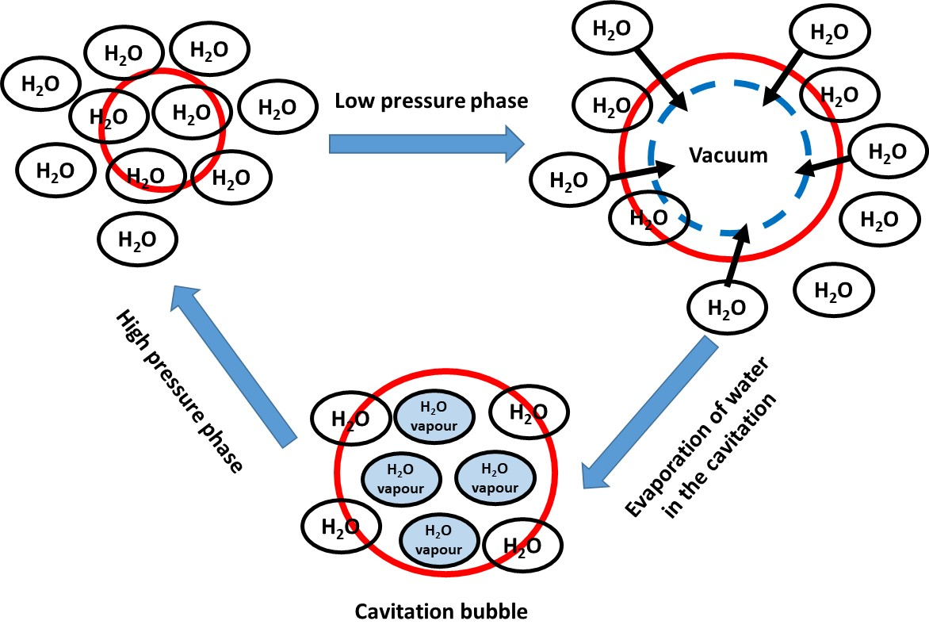
REVOLUTIONARY NEW DYEING AND PRINTING TECHNOLOGIES
Ultrasonic Wave Dyeing Technology
CC0 Bertea, adapted from Jung et al. (2011)
Notes:
Ultrasound can be defined as a sound with a frequency of 20 kHz – 500 MHz (Muthu, 2017), produced by a transducer that converts electricity into sound energy. Ultrasound causes the cavitation phenomenon, which consists in the explosive collapse of the liquid bubbles in the treatment solution and causes the appearance of areas with high temperature and pressure, capable of breaking chemical bonds. In this way, many chemical and physical processes can be improved. In the field of textile chemistry, the use of ultrasound accelerates the processes, so that lower temperatures and concentrations of dyes and auxiliaries can be used, obtaining effects similar to those of classical technology. The explanation for these phenomena is the rupture of bulky aggregates, resulting in uniform fine dispersions, associated with the facilitation of contact between the fibre and the dye by expelling dissolved air molecules from the dye solution (Gunay, M. 2013).

Slide 25
Ultrasonic Wave Dyeing Technology
higher color yield than the conventional dyeing
high color fastness
environmental improvements by reduced consumption of auxiliary chemicals
unaffected surface morphology
Notes:
In addition to better dye dispersion and the expulsion of dissolved or trapped air from the fibre capillaries, strong agitation of the liquid and swelling of the fibres, which increases the diffusion speed of the dye inside the fibre, also contribute to the improvement of the dyeing process (Gunay, 2013). The use of ultrasound in textile dyeing causes the processes to be accelerated, without affecting the quality of the dyeing. The process takes place at lower temperatures, and the concentration of chemicals used is lower (Vankar & Shanker, 2008).

Slide 26
Non-aqueous Dyeing of Reactive Dyes
Cotton dyeing with reactive dyes can be performed using various solvents and appropriate surfactants to ensure the dyes are dispersed stably.
The dye up-take reaches nearly 100% without any salt as accelerating agent.
Since just a little water is used in the process, hydrolysis of reactive dyes is restrained and the fixing rate is increased.
Notes:
When perchloroethylene is used instead of water in the dyeing, less energy is required for heating and vaporization, the drying of the textile material is faster, faster wetting, the swelling is reduced and the risk of mechanical deformation is lower and costs are lower.

Slide 27
Eco-friendly sulphur dyeing
To avoid sodium sulphide (Na₂S) use in sulphur dyeing, which is toxic, pollutes water, destroys marine life and has high COD, substitutes such as glucose, mercaptoethanol or thiourea dioxide may be used.
Dichromate, which is used in the oxidation phase of sulphur dyes and has environmental issues, can be substituted by sodium or potassium iodate or hydrogen peroxide.
Notes:
Sulphur dyes, which are amino/nitro aromatic compounds with –S=S– linkages (Muthu & Gardetti, 2016), are traditionally used to dye cellulosic fibres mostly with deep black, navy blue, khaki, green. They are economical and have good colour fastness (except against chlorine) (Chakraborty, 2014). Insoluble sulphur dyes are applied in the soluble form obtained by reduction in an alkaline medium and then transformed back into their original pigment form by oxidation. Sodium sulphide, the reducing agent used in the application of these dyes, is creating major effluent problems and can be substituted by glucose, mercaptoethanol or thiourea dioxide. Another substance with environmental issues is sodium dichromate, used in the oxidation phase, which can be substituted by sodium or potassium iodate or hydrogen peroxide.
A new sulphur dyeing process called the nitro process uses nitrogen to minimize the use of necessary reducing agents. The process involves purging inert nitrogen into the paint vessel, thus leading to a substantial reduction for the reducing agent, which makes the process more economical.

Slide 28
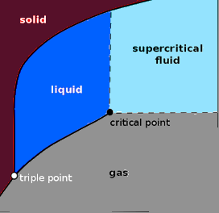
Supercritical carbon-dioxide assisted dyeing
Uses supercritical CO₂ as fluid (with properties between a liquid state and gas state while subjected to temperature and pressure higher than its critical point). The
high density of supercritical CO₂ enables dissolution of compounds (Mahapatra, 2015).
CC0 Bertea, adapted from Ahmed, N.S.E & El-Shishtawy, R.M. (2009)
Under the conditions of dyeing in supercritical CO₂ environment, the dissolution of dyes is fast and complete, which facilitates their penetration into the pores of the fabric.
Notes:
A supercritical fluid can be defined as a substance above its critical temperature and pressure, with unique properties because it does not condense or evaporate to form a liquid or gas, and has gas-like viscosities and diffusivities and liquid-like densities (Ozcan et al., 1998, Muthu, 2017). It can be said that supercritical fluids act as both solute and solvent (Muthu, 2018). The phase diagram of carbon dioxide shows the triple point, when all three phases coexist. Above the triple point, an increase in temperature leads the liquid into the vapour phase, while an increase in pressure brings the vapour back to the liquid, so that carbon dioxide retains its mobility characteristic of the gaseous state, but as the pressure increases, its density will increase to that of a liquid. The solubility power is proportional to the density, while the viscosity remains comparable to that of a normal gas, so that in this state carbon dioxide has remarkable penetration properties. Carbon dioxide is most used in the supercritical form, because the critical temperature and pressure in its case are easier to reach than in the case of other substances. Supercritical CO₂ is a dyeing medium that is a potential alternative to water because it has easily accessible critical conditions: pressure of 73.8 bar and a temperature of 31.1°C. In addition, CO₂ has the advantage over other gases of being non-flammable, non-explosive and non-toxic. Other advantages of using CO₂, besides its are low critical temperature and critical pressure, are the availability at a low cost, in conditions of high purity and low viscosity, and the fact that CO₂ emissions from fermentation, combustion or ammonia synthesis can be used, which helps reduce the greenhouse effect and turns a dangerous pollutant into a valuable substance (Gunay, 2013).

Slide 29
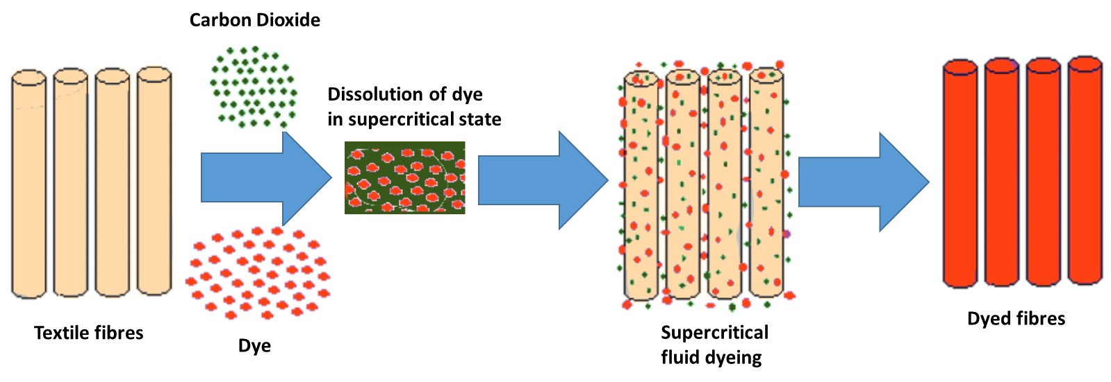
Supercritical carbon dioxide assisted dyeing
CC BY-SA Bertea
Notes:
The image shows the stages of the supercritical carbon dioxide dyeing process. Both synthetic and natural fibres can be dyed with disperse and reactive disperse dyes (modified disperse dyes with reactive groups) in supercritical carbon dioxide. However, the dyeing of natural fibres with water soluble dyes in supercritical carbon dioxide has not yet been successful, since dyes such as reactive, direct or acid dyes have little solubility in this medium due to their high polarity.

Slide 30
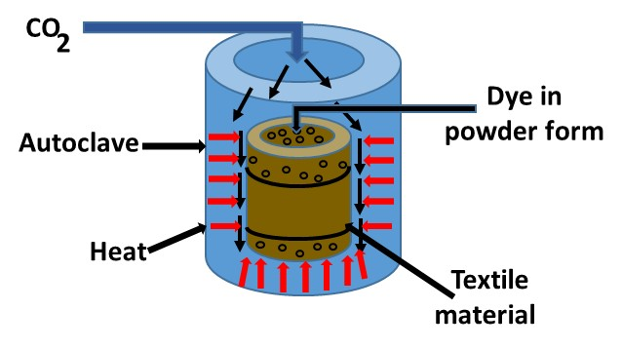
Supercritical carbon dioxide assisted dyeing equipment
temperature controller
vessel heater which surrounds
the vessel
stainless steel dyeing vessel
manometer
carbon dioxide pump
cooler
CC BY-SA Bertea
Notes:
Supercritical carbon dioxide assisted dyeing equipment, consisting in a temperature controller, a vessel heater that surrounds the vessel, stainless steel dyeing vessel, manometer, carbon dioxide pump and cooler is shown in the picture.

Slide 31
Supercritical carbon dioxide assisted dyeing
Benefits
Elimination of water consumption, and therefore of wastewater discharge
No need of surfactants and auxiliary chemicals
Fast dissolution of the solid dyestuff, which is evenly distributed on the fabric
Good colorfastness and easier color correction as compared to classic dyeing
Addition of small amounts of a co-solvent can considerably increase the solubility of solutes in supercritical CO₂
Elimination of the drying operation, so a significant reduction in energy consumption
95% recovery and reuse of CO₂
Ecologically harmless, non-toxic and non-explosive (Mahapatra, 2015; Mahmud & Kaiser, 2020)
Notes:
Dyeing textiles in supercritical carbon dioxide potentially overcomes all the disadvantages of the conventional dyeing process. Because supercritical fluids have a very high diffusivity and low viscosity, all transport processes are faster. Water use is completely avoided, so there is no wastewater. No auxiliary agents are used and the residual dye can be recovered in a reusable form.

Slide 32
Supercritical carbon dioxide assisted dyeing
Drawbacks
The technology is applicable on synthetic fibers and some artificial fibers; only experimental studies on natural fibers are available
High pressure and temperature is required
The non-uniformity of the fluid may result in staining of the textile and affects the evenness of dye distribution
Expensive

Slide 33
Air-Dye Technology
This process uses air instead of water to help the dye penetrate the fiber (Mahapatra, 2015).
Dyeing liquor is first atomized, then mixed with high-pressure airflow, finally sprayed on fabric to be dyed. Only a little quantity of water is consumed because the dye and the chemicals directly contact the fabric.
CC0 Bertea, adapted from Dodu, 2002
Notes:
Classic dyeing techniques involve the use of a large amount of water, which is then released as wastewater, thus polluting the environment. Air-Dye technology has been developed to overcome this problem (Muthu, 2018). This technology, known as “jet dyeing”, refers to a dyeing process in which the application of dyes to the textile substrate is carried out by the flow of air or by an advanced spray mechanism. The airflow is generated by a fan that finely disperses the dye molecules as the fabric runs in the machine. In this way, significant reduction of the consumption of water, energy and chemicals is achieved.
Unlike conventional dyeing techniques with reactive dyes, the aerodynamic dyeing technique allows low consumption due to the use of reactive dyes with high fixation, which need low salt additions, obtaining in these conditions fixation rates of over 90%. The advantages of this type of dyeing also include reducing the duration of the dyeing process and obtaining an improved fabric quality, as fabric creases are removed.

Slide 34
Air-Dye Technology
Benefits
Good Colorfastness
Dye both sides of the fabric simultaneously
Dyeing and printing can be done in a short time with full accuracy and efficiency. A reduction in the overall process time of approximately 25%.
Very good dye penetration into the fibers creating brilliant colours
Use 90 to 95% less water and save 86% of the energy
Very little harm to the environment.
Reduces the textile industry share of global warming (Mahmud & Kaiser, 2020)

Slide 35
Air-Dye Technology
Drawbacks
The technique works on synthetic materials. Dyeing of cotton fabrics can be done only after specialized treatment to the raw cotton.
Not applicable to wool.
Expensive

Slide 36
Use of natural dyes - Benefits
Less toxic than their synthetic counterparts.
Obtained from renewable sources.
Biodegradable.
They do not stain the adjacent fabrics in the
washing process because of the non‐substantive nature of the dye towards the fabric.
No or mild reactions involved in their preparation.
Cost effective
A full range of colors can be obtained using various mordants.
Notes:
The natural dyes are produced from renewable sources, are not carcinogenic, non-allergic and non-toxic to human skin, they produce dyeings with acceptable fastness properties with the use of the appropriate mordants, the process waste is biodegradable and some natural dyes have can absorb ultraviolet light. In addition, natural dyes can enhance the antioxidant properties of textiles and have insect repellent properties (Muthu, 2017).

Slide 37
Use of natural dyes - Drawbacks
The extraction from the raw materials is time consuming, resulting in soil waste.
Difficult to purify.
Natural dyes that are extracted from plants are dependent on the growing seasons.
Synthesis of same shades is difficult since crops may vary in season, time and place
Tend to fade faster than the synthetic dyes. Some of them are sensitive to pH changes
Repeatability is limited, as no two dye lots are identical.
Synthetic fibers cannot be dyed with natural dyes (Muthu, 2017).

Slide 38
Ecological dyeing of wool with biomordants
Natural dyeing of wool with metal mordants generates effluents rich in toxic metal ions, which have a negative impact on flora and fauna.
Natural mordants are obtained from renewable sources.
Completely biodegradable and nontoxic.
Best results:
Myrobalan
Pomegranate
Gallnut

Slide 39
Dyeing wastewater
Difficult to treat because the high variability of its composition, which depends on the nature of the dyed fiber.
The variety of fibre | The commonly used dyes
Cellulose fiber | Direct dyes, Reactive dyes, Vat dyes, Sulfide dyes, Azo dyes
Natural protein fibers | Acid dyes, chrome dyes, metal complex dyes, reactive dyes
Polyamides | Acid dyes, metal complex dyes, disperse dyes
Polyester | Azo dyes, Disperse dyes
Polyester-cotton | Disperse / Vat dyes, Disperse / Insoluble dye
Polyacrylonitrile fiber | Cationic dyes, Disperse dyes
Polyacrylonitrile fiber –wool | Cationic dyes, Acid dyes
Vinylon (polyvinyl alcohol fiber) | Direct dyes, Vat dyes, Sulfur dyes, Acid dyes
Notes:
Textiles can be dyed with a variety of classes of dyes, as can be seen from the table, which makes it difficult to treat wastewater from dyeing. In the case of cellulosic fibres alone, for example, more than five classes of dyes can be used, each with its own particularities. It is assumed that the amount of dyes discharged into the environment would represent on average up to 10% of the total dyes used, even more in the case of reactive dyes, which can cause considerable environmental pollution and is a serious risk factor for health.

Slide 40
Dyeing wastewater
Contains dyes, pigments, dyeing auxiliaries and chemicals used during dyeing. It contains BOD, COD, SS, heavy metals and most importantly the colour, which is easily visible even at low concentration.
Effluent composition | Chemicals used | Nature
Organic load (enzymes, surfactants, acetic acid) Color (dyes, scoured wool impurities) Nutrients (ammonium salts, urea phosphate–based buffers and sequestrants) Sulfur (sulfate, sulfide, hydrosulfide, salts, and sulfuric acid) Refractory organics (dyes, resins) PH and salt effects (silicate, sulfate) Toxicants (metals) | Urea, reducing agents, acetic acid, wetting agents | High in BOD, DS, SS, low heavy metals
Notes:
In addition to dyes, the dyeing solution can contain organic or inorganic acids, alkalis, soluble or dispersible dyes, sulphides, chlorides, reduction products, oxidation products, auxiliary products for wetting, levelling, softening and carriers. The degree of colouring and pollution of wastewater depends on the fibre being dyed, the class of dyes that is used, the structure of each dye, the type of the chosen technological process, respectively the type of machine, the choice of dyeing parameters: temperature, time, liquor ratio, additions of chemicals and organic auxiliaries.
Frequently wastewater from textile dyeing contains organic load (enzymes, surfactants, acetic acid), colour (dyes, scoured wool impurities), nutrients (ammonium salts, urea phosphate–based buffers and sequestrants), sulphur (sulphate, sulphide, hydrosulphide, salts, and sulphuric acid), refractory organics (dyes, resins), PH and salt effects (silicate, sulphate), toxicants (metals).

Slide 41
Dyeing wastewater
Main parameters of textile dyeing wastewater.
Parameters | Range
pH | 2–14
Temperature (°C) | 35–45
BOD5 (mg/L) | 110–5500
COD (mg/L) | 131–17900
TDS (mg/L) | 47.9–6106
TSS (mg/L) | 64–23900
Colour(Pt-Co) | >200
Turbidity (NTU) | 15–5700
Notes:
In order to achieve a quality dyeing, the water used in the process must meet a series of conditions in what regards pH, temperature, BOD₅, COD, TDS, TSS, colour and turbidity. The values that these parameters must have are presented in the table.

Slide 42
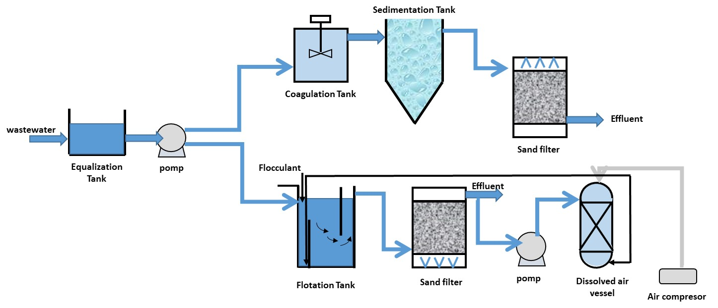
Conventional methods for textile dyeing wastewater treatment
Physico-chemical treatment of textile dyeing wastewater implies equalization and homogenization, floatation, sedimentation, coagulation - flocculation, adsorption. These methods has proved to be markedly ineffective, difficult, and highly expensive.
CC BY-SA Bertea
Notes:
Conventional methods for textile dyeing wastewater treatment are mainly physico-chemical methods such as equalization and homogenization, floatation, sedimentation, coagulation - flocculation, adsorption. These methods has proved to be markedly ineffective, difficult, and highly expensive. A diagram illustrating these processes, both in the sedimentation and in the flocculation variant, is shown in the figure.

Slide 43
Advanced methods
membrane filtration
microfiltration (MF) - limit of retention 0.1–1 μ
ultrafiltration (UF) - limit of retention 0.01–0.1 μ
nanofiltration (NF) - limit of retention 1–10 nm
reverse osmosis (RO) - limit of retention <1 nm (Matthes et al., 2021)
advanced oxidation processes (AOPs)
Notes:
Advanced treatment methods are grouped into membrane filtration methods (microfiltration, ultrafiltration, nanofiltration and reverse osmosis), respectively advanced oxidation processes. Microporous membranes of cellulose acetate, polyacrylonitrile, polyamide, polysulfone are used for membrane filtration.
Microfiltration, characterized by the lowest capacity to retain fine impurities, is relatively little used in the treatment of textile wastewater, but in can be used as pre-treatment of water for nano filtration or Reverse Osmosis (Muthu, 2018). The most commonly used process is textile wastewater treatment is ultrafiltration, which can achieve the recovery of indigo dyes. Nanofiltration removes most dyes and textile auxiliaries except for electrolytes and acidic or alkaline agents, and is therefore used to treat wastewater from dyeing, and it is even possible to reuse treated water in other finishing operations. Reverse osmosis allows the separation of molecules smaller than 1 nm from the permeate (Matthes et al., 2021).

Slide 44
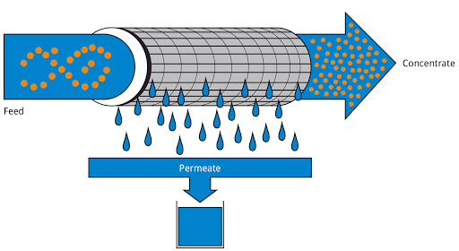
Membrane filtration
CC BY-SA Bertea
Notes:
Membrane filtration is a process by which small particles, which cannot be retained by sand filters, are removed using synthetic polymer membranes associated with high pressure, the membranes acting as a sieve.

Slide 45
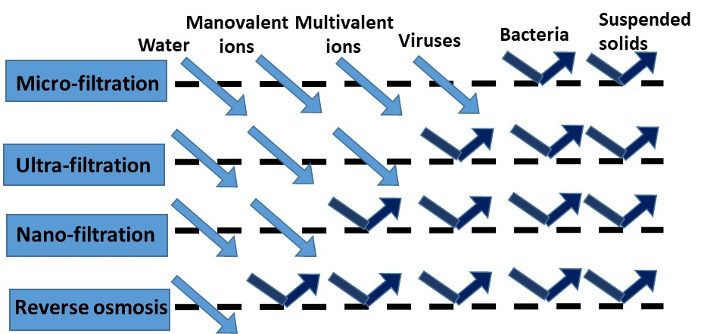
Membrane filtration
Membrane filtration
Notes:
Several types of membranes can be used to treat wastewater from textile dyeing: microfiltration (MF), ultrafiltration (UF), nanofiltration (NF) and reverse osmosis (RO) membranes, in this order decreasing the particle size that can be removed. Microfiltration membranes have relatively large pore size, being able to remove large particles and various microorganisms, and therefore their use in the treatment of wastewater from dyeing is limited. Ultrafiltration membranes have smaller pores, which can additionally remove soluble bacteria and macromolecules. Nanofiltration membranes have pores with dimensions of the order of ten angstroms or less, performing better than ultrafiltration, but lower than reverse osmosis. Reverse osmosis membranes have very low porosity and can remove particles with low molar mass, such as salt, organic ions, etc.

Slide 46
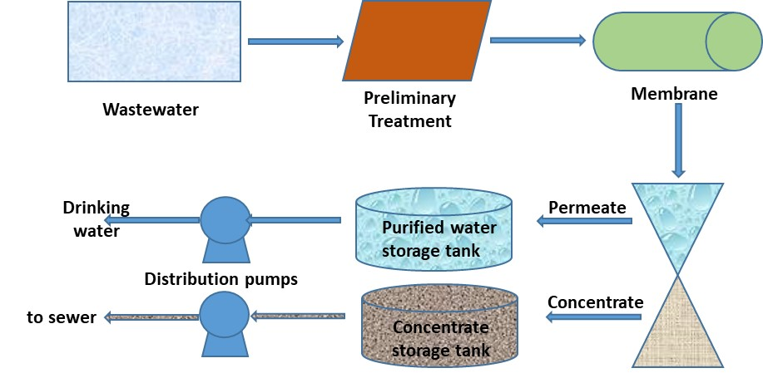
Nano-filtration membrane system
Notes:
Nanofiltration uses membranes of modified cellulose acetate, ceramic materials, polyimides, polysulfones or polyamide at working pressures up to 35 bar, at a current flow of 12 - 14 lmh / bar, removing divalent ions such as Ca or Mg, but not and the monovalent ones, such as Na. Nanofiltration membrane modules are usually manufactured in a spiral configuration.
The diagram of a nano-filtration system is shown in the figure.

Slide 47
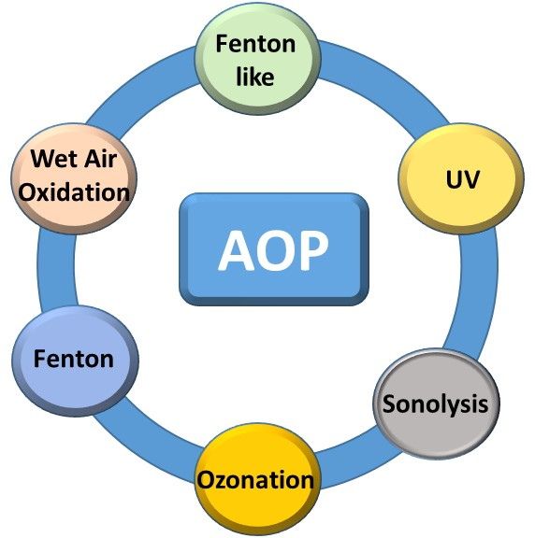
Advanced oxidation processes- AOP
AOP are aqueous phase oxidation methods consisting of highly reactive species used in the oxidative destruction of target pollutants.
O₃, O₃ / UV, O₃ / H₂O₂
Sonolysis
Wet air oxidation
Fenton reactive (H₂O₂ + Fe²⁺), Fenton like
UV / H₂O₂
UV / O₃ / H₂O₂
CC0 Bertea, adapted from Mishra et al., 2018, p. 471
Notes:
Many organic substances can be degraded by oxidative methods, this being a common method of water treatment, which is successfully applicable in the case of removal of dyes from dyeing wastewater. The oxidative treatment processes of wastewater are grouped in the category of Advanced Oxidation Process category (AOP), all based on the chemical oxidation of organic contaminants through hydroxyl radicals (• OH) generated. The oxidation potential of these radicals is very high, being exceeded only by that of fluorine. AOP includes processes such as ozone treatment, hydrogen peroxide, UV, UV / hydrogen peroxide, hydrogen peroxide / ozone, Fenton and photo-Fenton.

Slide 48
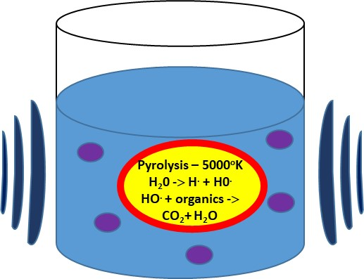
Sonolysis
Involves utilization of ultrasonic sound with a frequency range of 20 KHz -10 MHz.
Organic molecules are degraded due to the explosion of cavitation bubbles formed as a result of ultrasound / hydrodynamics.
CC0 Bertea, adapted from Mishra et al., 2018, p. 472
Notes:
Ultrasound is sound of a frequency that is above 20 KHz (Gunay, R. 2013). The sonolysis of the wastewater, based on cavitation with high temperatures and pressures, leads to the formation of highly reactive hydroxyl radicals (•OH), which degrades water pollutants. Organic molecules are degraded following the explosions of the cavitation bubbles formed because ultrasonic/hydrodynamics.

Slide 49
Wet Air Oxidation
Utilizes the molecular oxygen or air as oxidizer in high pressure and temperature environment. This extreme condition allows the generation of free radicals that decomposes the waste.
Notes:
Wet Air Oxidation utilizes the molecular oxygen or air as oxidizer in high pressure and temperature environment. This extreme condition allows the generation of free radicals that decomposes the waste. The main advantages of the process are the low operating costs and the low level of air pollution, while the main disadvantages are the high capital costs and safety implications associated with a system that operates in such severe operating conditions (temperatures of 400–573ºK and pressures in the range of 0.5–20 MPa).

Slide 50
Critical Review
To permit new sustainable dyeing and printing technologies to scale up to a commercial level, more has to be done by all the players in the field: smaller companies and larger fashion and chemicals companies.
For this to happen, it is necessary for the investments in the field to be consistent and the collaboration ties to be close and numerous.
This is the only way to achieve sustainable dyeing and printing practices that save valuable resources and no longer pollute the environment.

Slide 51
References and Further Reading
Meadows, D., Meadows, D., Randers, J. & Behrens, W. (1972). The Limits to Growth; A Report for the Club of Rome's Project on the Predicament of Mankind. Universe Books.
Purvis, B., Mao, Y & Robinson, D. (2019) Three pillars of sustainability: in search of conceptual origins. Sustainability Science,14(3), 681–695. https://doi.org/10.1007/s11625-018-0627-5
Mishara, N.S., Reddy, R., Kuila, A., Rani, A., Mukherjee, P., Nawaz, A. & Pichiah, S. (2017). A Review on Advanced Oxidation Processes for Effective Water Treatment. Current World Environment, 12(3), 470-490. http://dx.doi.org/10.12944/CWE.12.3.02
Gunay, M. (2013). Eco-Friendly Textile Dyeing and Finishing. Intech.
Ahmed, N.S.E & El-Shishtawy, R.M. (2009). The Use of New Technologies in Coloration of Textile Fibers. Journal of Material Science, 45(5), 1143-1153. https://doi.org/10.1007/s10853-009-4111-6
Blackburn, R.S. (2009). Sustainable textiles - Life cycle and environmental impact. Woodhead Publishing.
Chakraborty, J. N. (2014) Fundamentals and Practices in Colouration of Textiles (2_{nd} ed.) Woodhead Publishing India
Eur-lex. (2004) Commission Directive 2004/21/EC. https://eur-lex.europa.eu/legal-content/EN/TXT/PDF/?uri=CELEX:32004L0021&from=EN

Slide 52
Kumari, P., Singh, S.J. & Rose, N. (2013) Eco – Textiles: For Sustainable Development. International Journal of Scientific & Engineering Research. 4(4), 1379-1390
Yu, H., Wang, Y., Zhong, Y., Mao, Z. & Tan, S. (2014) Foam properties and application in dyeing cotton fabrics with reactive dyes. Coloration Technology, 130(4), 266–272. https://doi: 10.1111/cote.12088
Özcan, A.S., Clifford, A.A., Bartle, K.D. & Lewis, D.M. (1998) Dyeing of Cotton Fibres with Disperse Dyes in Supercritical Carbon Dioxide. Dyes and Pigments. 36 (2), 103-110. https://doi.org/10.1016/S0143-7208(97)00005-3
Jung, C., Budesa, B., Fässler, F., Uehlinger, R., Müller, T. & de Wild, M. (2011) Effect of cavitation in ultrasound-assisted cleaning of medical devices. European Cells and Materials. 22(1), 30. https://doi.org/10.22203/eCM
Vankar, P.S.& Shanker, R. (2008) Ecofriendly ultrasonic natural dyeing of cotton fabric with enzyme pretreatments. Desalination. 230(1-3), 62-69. https://doi.org/10.1016/j.desal.2007.11.016
Mahapatra, N.N. (2015) Textiles and environment. Woodhead Publishing India Pvt. Ltd.
Mahmud, Y. & Kaiser, S. (2020) Recent Progress in Waterless Textile Dyeing. Journal of Textile Science & Engineering. 10(6). https://doi.org/10.37421/jtese.2020.10.421
Matthes, A., Beyer, K., Cebulla, H., Arnold, M.G. & Schumann, A. (2021) Sustainable Textile and Fashion Value Chains - Drivers, Concepts, Theories and Solutions. Springer Nature Switzerland
Muthu, S.S. & Gardetti, M. A. (2016) Green Fashion - Volume 1. Springer Science+Business Media

Slide 53
Muthu, S.S. (2018) Sustainable Innovations in Textile Chemical Processes. Springer Nature.
Scott, A. (2015) Cutting Out Textile Pollution. Chemical & Engineering News. 93(41), 18-19. https://doi.org/10.1021/cen-09341-bus1
Muthu, S.S. & Gardetti, M. A. (2020) Sustainability in the Textile and Apparel Industries - Production Process Sustainability. Springer Nature Switzerland
Muthu, S.S. (2017) Textiles and Clothing Sustainability - Sustainable Textile Chemical Processes. Springer Science+Business Media

Slide 54
Contact
‘’Gheorghe Asachi’’ Technical University of Iasi, Romania
Faculty of Industrial Design and Business Management
Prof. Dr. Andrei Bertea
E-Mail: andrei_bertea@yahoo.co.uk

