Slide 1




Finishing in the Context of Sustainability

Slide 2
Learning Objectives
After this lecture, you should be able to:
Understand the main issues related to sustainability in textile finishing.
Understand the sustainability issues associated with the use of textile auxiliaries.
Identify the possibilities of optimizing existing technologies and replacing environmentally aggressive products.
Apply the revolutionary new finishing technologies that are environmentally friendly.

Slide 3
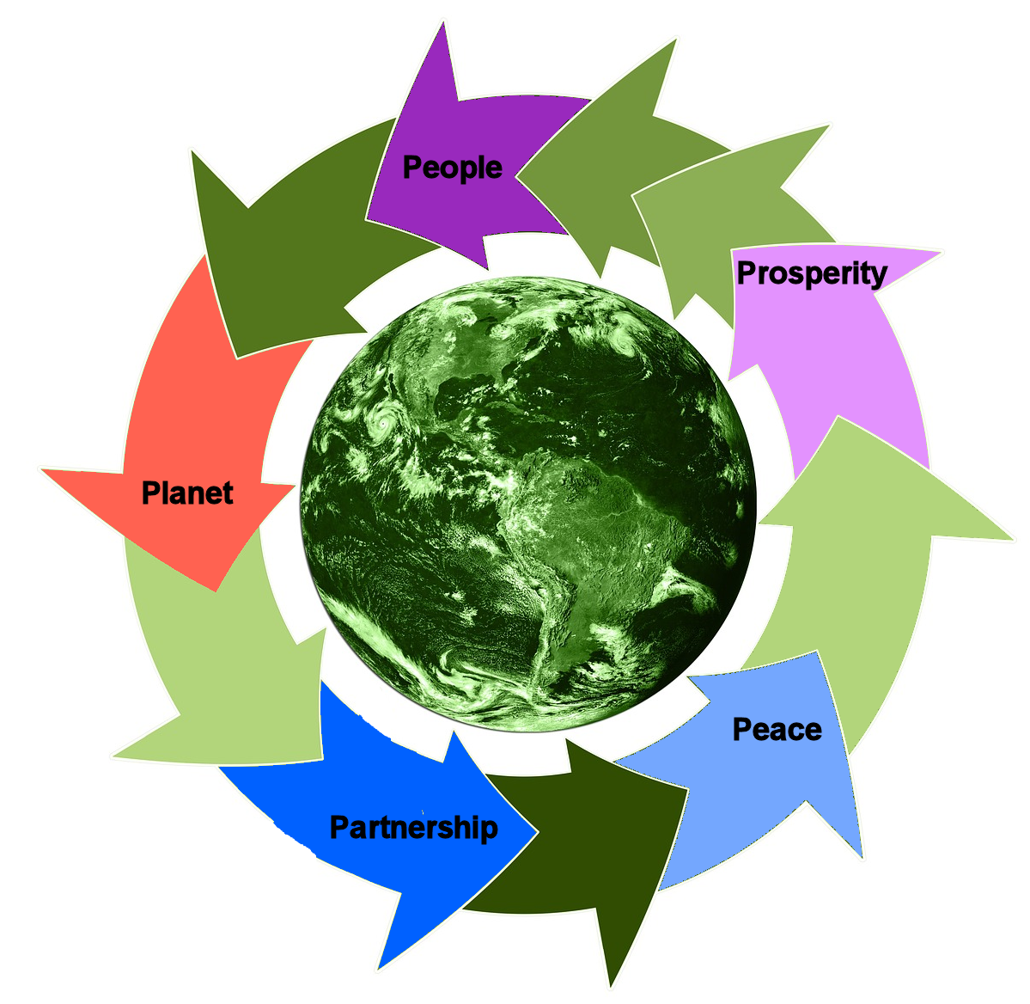
Introduction
Sustainable development is “development that meets the needs of the present without compromising the ability of future generations to meet their own needs (World Commission on Environment and Development, 1987”
CC0 Bertea, adapted from Musahara (2016)

Slide 4
Major Ecological and Social Challenges in Textile Industry
Water
Effluent
Energy
Chemistry
Land
Society
Raw ma-
terials
No effect
Spinning
Low effect
Weaving/
Knitting
High effect
Wet
processing
Very
high effect
Garment
Notes:
The textile industry involves a set of processes, each of them of high complexity. In recent years, sustainability is a main feature of textiles, which mainly considers the environmental aspects, but also the social and economic ones. Starting with the raw material and ending with the stage of return of the textile products to the environment, each of the stages has a more or less important impact on the environment. The main ecological and social challenges facing the textile industry, grouped by the main technological phases and with the presentation of the degree of influence, are presented in the table. As it can be seen from the table, the production stages with the greatest impact on the environment are the stages of chemical processing that take place in the wet state.

Slide 5
Ecological issues regarding textile finishing
• High effluent and water consumption.
• Use of formaldehyde as an agent during the manufacture and processing of flame retardants or in Easy-care finishing.
• Potential environmental risks associated with halogen containing
flame retardants, etc.
Notes:
Some of the most important ecological issues regarding textile finishing are the high effluent and water consumption, the use of formaldehyde as an agent during the manufacture and processing of flame retardants or in Easy-care finishing and the potential environmental risks associated with halogen containing flame retardants.

Slide 6
Optimizations of existing technologies and substituting environmentally aggressive products
Multifunctional finishing
Free ethylene urea and melamine derivatives in their “not cross-linked form” (cross-linking agents in easy-care finishes)
Substitution of formaldehyde compounds with those that contain no formaldehyde or with compounds that contain reduced amounts of formaldehyde, etc.
Impart crease recovery, UV protection, and antibacterial properties in single step by simultaneous application of organic and inorganic environmental friendly chemicals (Aslam et al., 2018)
Notes:
One way to reduce the environmental impact of textile finishing technologies is to optimize existing technologies and replace environmentally aggressive products. Some of the best ways to do this are to use multifunctional finishing, to use free ethylene urea and melamine derivatives in their “not cross-linked form” (cross-linking agents in easy-care finishes) and to substitute formaldehyde compounds with those that contain no formaldehyde or with compounds that contain reduced amounts of formaldehyde.

Slide 7
Optimizations of existing technologies and substituting environmentally aggressive products
Multifunctional finishing
ZnO nanoparticles for UV protection and antibacterial properties and butanetetracarboxylic acid for crease recovery;
chitosan with DMDHEU -dimethyloldihydroxyethyleneurea -for wrinkle free, antibacterial and flame retardant properties; in addition, the presence of chitosan contributes to the removal of odours.
CC0 Bertea, adapted from Shahid-ul-Islam and Butola (2019)
Notes:
Some examples of multifunctional finishing are the use of ZnO nanoparticles for UV protection and antibacterial properties, butanetetracarboxylic acid for crease recovery, chitosan with DMDHEU -dimethyloldihydroxyethyleneurea -for wrinkle free, antibacterial and flame retardant properties. In addition, the presence of chitosan contributes to the removal of odours.

Slide 8
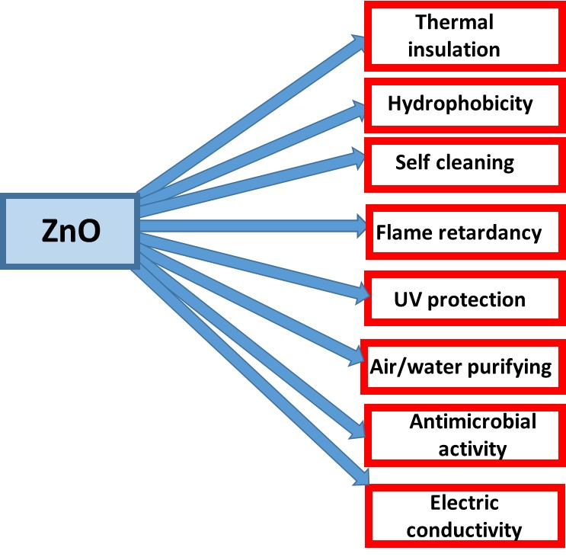
Optimizations of existing technologies and substituting environmentally aggressive products
Multifunctional finishing
butanetetracarboxylic acid and zinc oxide nanoparticles to impart wrinkle recovery, antibacterial activity, UV protection, bending rigidity and antistatic properties (Aslam et al., 2018; Verbic et al., 2019);
incorporation of metal oxide nanoparticles into an easy-care/softener finishing formulation leads to enhanced fabric resiliency and surface softness, along with improved UV-protection and antibacterial functionalities.
CC0 Bertea, adapted from Verbic et al. (2019)
Notes:
Other examples of multifunctional finishing are the use of butanetetracarboxylic acid and zinc oxide nanoparticles to impart wrinkle recovery, antibacterial activity, ultraviolet (UV) protection, bending rigidity, and antistatic properties and the incorporation of metal oxide nanoparticles into an easy-care/softener finishing formulation to an enhance the fabric resiliency and surface softness, along with a noticeable improvement in UV-protection and antibacterial functionalities.
Various coating techniques can be used to obtain functional textile substrates with ZnO, such as immersion coating, sol-gel process, padding, electrodeposition and chemical bath deposition.

Slide 9
Optimizations of existing technologies and substituting environmentally aggressive products
Multifunctional finishing
WET-ON-WET foam application of both crease-resist and antistatic finishes
uses successive foam treatments without intermediate drying to apply successive crease-resist and antistatic finishes
This process avoids the shortcomings of the traditional process, namely the release of significant amounts of effluent, which contains excess finishing and auxiliaries and the consumption of large amounts of energy to remove water (Miraftab and Horrocks, 2004).
Notes:
The classic wet-to-wet application of textile finishes uses large amounts of water, and therefore requires the consumption of large amounts of energy to remove it. By applying foam, the amount of water used as well as energy consumption are significantly reduced. Such processes can be used for the application of wrinkle-resistant finishes, associated with subsequent antistatic treatments, also made using foam.

Slide 10
Optimizations of existing technologies and substituting environmentally aggressive products
Non-formaldehyde Polyfunctional Crosslinking of Cotton
Because formaldehyde has been recognized as a probable human carcinogen, durable press finishes of cotton fabrics that do not contain formaldehyde, such as polycarboxylic acids, has become increasingly important.
Crosslinking of cotton with polycarboxylic acid, applied with catalysts based on phosphorus-containing inorganic acids, produces fabrics that release no formaldehyde at any stage of preparation or on storage.
Notes:
Cotton and cotton materials are currently undergoing final treatments aimed at increasing wrinkle strength and dimensional stability. The finishing agents used for this purpose are mainly resins based on urea, melamine, cyclic derivatives of urea and formaldehyde, with reactive groups of N-methylolic type (etherified or unmodified).
Formaldehyde-based crosslinkers can release free formaldehyde or partially hydrolysed formaldehyde, which is a carcinogenic chemical that can cause dermatitis following skin contact. The risk of formaldehyde release occurs both in the later stages of processing and in the end user. The maximum formaldehyde limit for products that come into contact with the skin is 30 ppm (European Eco-label). Furthermore, the Oeko-Tex 100 standard lowered the detection limit for formaldehyde in children's articles (Class I Products) to 16ppm.
Crosslinkers such as dimethylolurea, melamine formaldehyde condensation products or dimethylol dihydroxyethylene urea have high potential for formaldehyde release. Instead, products with a lower formaldehyde-releasing potential can be used, such as dimethyloldhydroxyethylene urea derivatives, or modified dimethyloldhydroxyethylene urea, which is free of formaldehyde.
In addition, crosslinking of cotton with polycarboxylic acid, applied with catalysts based on phosphorus-containing inorganic acids, produces fabrics that release no formaldehyde at any stage of preparation or on storage.
Other measures to reduce formaldehyde emissions include the appropriate choice of catalysts and heat treatment temperature.

Slide 11
Optimizations of existing technologies and substituting environmentally aggressive products
Reduction/Removal of Formaldehyde from Textile Flame Retardants avoiding N-methylol species
Equivalent or superior ease of application.
Zero formaldehyde-releasing properties.
Comparable textile service-life properties in terms of durability, effect on handle and tensile properties.
Overall comparable cost-effectiveness (and preferably cheaper).
Equivalent or superior toxicological and environmental impacts.
Notes:
In this way, equivalent or superior ease of application is obtained, with zero formaldehyde-releasing properties. The textile service-life properties in terms of durability, effect on handle and tensile properties are comparable to those obtained from the procedure with formaldehyde, the comparable cost-effectiveness is similar (and preferably cheaper), with equivalent or superior toxicological and environmental impacts.

Slide 12
Optimizations of existing technologies and substituting environmentally aggressive products
Reduction/Removal of Formaldehyde from Textile Flame Retardants - reactive flame-retardant bonding types
Cellulose combination after treatment | Properties
Cellulose-diacidhypophosphite | Resists 20 home wash cycles.
Cellulose/BCTA/triethanolamine | Resists 30 home wash cycles.
Cellulose phosphonate and derivatives | Resists >30 home wash cycles
Cellulose-polymer systems | Resists >30 home wash cycles
Cellulose ester with butyl tetracarboxylic acid (BCTA) | Modest wash resistance
Notes:
The table indicates the combinations between cellulose and a series of formaldehyde-free compounds, indicating the durability of the treatment.

Slide 13
Optimizations of existing technologies and substituting environmentally aggressive products
Replacing Bromine in Coating and Back-Coating Formulations
Toxic polybrominated dioxins are formed during incineration of brominated flame retardants, especially in the case of compounds based on polybrominated diphenyls and diphenyl oxides.
To avoid this, formulation mixtures formed by gradual replacement of the decabromodiphenyl ether-antimony III oxide content with bromine-free alternatives such as ammonium polyphosphate can be used.
Notes:
Products formed by the incineration of materials treated with polybrominated dioxin-based flame retardants are characterized by high toxicity, which is why it is recommended to replace them with bromine-free compounds, such as ammonium polyphosphate.

Slide 14
Optimizations of existing technologies and substituting environmentally aggressive products
Replacing alkyl and perfluoroalkyl compounds in textile formulations
Per- and polyfluorinated compounds are used in a variety of textile finishing applications, especially as water and oil repellents, in digital printing or as anti-microbial agents. Some of the commercial used products release per- and polyfluoroalkyl substances, which are persistent and accumulate in the human body.
In 2009, perfluorooctane sulfonic acid and related substances were declared persistent organic pollutants by the Stockholm Convention. Alternatives that can be used to replace toxic compounds include replacement of long-chain per- and polyfluoroalkyl compounds with shorter chain-length compounds d (e.g., perfluorobutansulfonic acid-based compounds) and non-fluorinated alternatives (siloxanes / polysiloxanes, dendrimers and wax).
.
Notes:
Besides the active antimicrobial agents, microbial growth can be hindered by the application of low adhesion agents, which create a coating on the fibres, decreasing the interactions between the microorganisms and textile material.
As the degradation of long perfluoroalkyl groups leads to the release of biopersistent perfluorooctanoic acid or perfluorooctane sulfonate into the environment—both of which can cause serious ecological problems -, these agents have been replaced with nonfluorinated water-repellent precursors.

Slide 15
New technologies for sustainable textile finishing
Smart (Nano) Coatings
Biofinishing (biopolishing, shrinkproofing for wool, etc);
Plasma treatment;
Use of bio-polymers, etc.
Notes:
The new technologies for sustainable textile finishing include smart (nano) coatings, biofinishing (biopolishing, shrinkproofing for wool, etc.), plasma treatment, use of bio-polymers, etc.

Slide 16
New technologies for sustainable textile finishing
Smart (Nano) Coatings technologies
Nanoparticle adsorption
Layer-by-Layer (LbL) deposition
Sol-gel treatments
Cold plasma deposition
Biomacromolecular engineering (Alongi et al, 2013)
Notes:
A revolutionary approach in the field of textile chemistry is the modification of the surface of the textile material so that subsequent treatments modify or add various new properties, without significantly affecting the properties of the material. For this, the surface changes must be applied at levels between micro and nano.
Nanotechnology is the use of materials measuring 10⁻⁹ m (Iheaturu et al., 2019). The use of nanotechnology in textile finishing has contributed to improving the quality and performance of textiles, providing new features and improving existing features, while substantially reducing the consumption of chemicals. Among the fields of textile chemistry where nanotechnology has been applied are flame retardant polymer coatings and back coatings.
Such smart coatings, which have an inorganic or hybrid composition, can be made with various technologies, such as:
• Nanoparticle adsorption
• Layer-by-Layer (LbL) deposition
• Sol-gel treatments
• Cold plasma deposition
• Biomacromolecular engineering
The first three technologies are used to add nanoparticles on the surface of the textile material: nanoparticles can be directly synthesized in situ on the textile material surfaces through sol–gel process, or preformed nanoparticles can be placed on the fabric surface by using Layer-by-Layer deposition or nanoparticle adsorption

Slide 17
New technologies for sustainable textile finishing
Nanoparticle adsorption
The adsorption of nanoparticles, which is one of the simplest ways to use nanoparticles to change the surface of a textile material, involves immersing the fabric in an aqueous suspension of nanoparticles, thus achieving the adsorption of nanoparticles on the surface of textile fibres. Using this technique on polyester with a hydrotalcite−silica combination proved to be a most efficient flame-retardant system, while on cotton best results are obtained with selected clays such as sodium Cloisite (Alongi et al., 2015).
Notes:
One of the easiest ways to change the surface of a textile material is nanoparticle adsorption. This process involves the adsorption of nanoparticles by immersing the textile material in an aqueous suspension of nanoparticles. This technique can be used to achieve effective flame retardant effects.

Slide 18
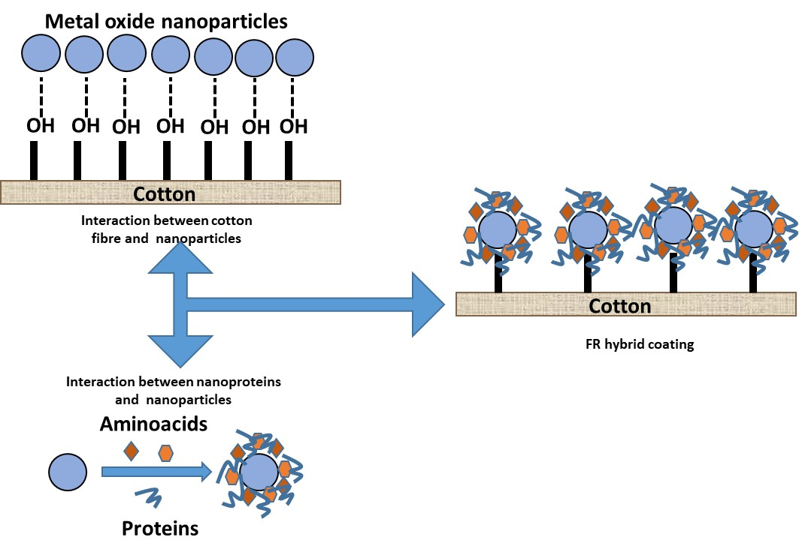
New technologies for sustainable textile finishing
Nanoparticle adsorption
Schematic representation of the coupling between inorganic phase (metal oxide TiO₂ NPs) and biomacromolecules to create a waterproof flame retardant treatment for cotton textile (Ortelli et al., 2018)
CC0 Bertea, adapted from Ortelli et al. (2018)
Notes:
Nanoparticles can be used to enhance the flame-retardant properties of synthetic and natural fabrics and their corresponding blends. The schematic representation in the figure shows the coupling between the inorganic phase (nanoparticles metal oxide TiO2) and bio macromolecules to create a waterproof flame retardant treatment for cotton textile material.

Slide 19
New technologies for sustainable textile finishing
Layer-by-Layer (LbL) deposition
Layer by Layer deposition represents the repeated adsorption of nanoparticles using different reagents at each adsorption stage, creating a structure of positively and negatively charged layers ‘piled up’ on the substrate surface.
The LbL nanoarchitectures are able to enhance PET flame
retardancy by increasing the time to ignition, decreasing the
combustion kinetics and reducing
the smoke production (Xu, 2021).
CC0 Bertea, adapted from Mittal and Bahners (2017)
Notes:
To obtain multilayer films, the substrate is immersed alternatively in solutions of polyelectrolytes or dispersion of nanoparticles with opposite charge, which determines a total reversal of the surface load after each immersion step, creates a structure of positively and negatively charged layers deposited on the surface of the material (Mittal and Bahners, 2017).
The LbL nanoarchitectures are able to enhance PET flame retardancy by increasing the time to ignition, decreasing the combustion kinetics and reducing the smoke production.

Slide 20
New technologies for sustainable textile finishing
Layer-by-Layer (LbL) deposition
A general scheme of the process is shown in the figure. The number of layers thus obtained is usually up to 10, but 50 layers can also be deposited. The techniques used are diving (used mostly in the laboratory phase) or spraying, which can be used on an industrial scale. The duration of each stage of the cycle varies from seconds to minutes, depending on the pH, the deposition temperature, the adsorption time and the type of substrate used.
CC0 Bertea, adapted from Malucelli (2020)
Notes:
To obtain multilayer films, the alternative immersion of the substrate in a solution of polyelectrolytes or dispersion of nanoparticles with opposite charge takes place, which determines a total reversal of the surface load after each immersion step, creates a structure of positively and negatively charged layers. deposited on the surface of the material.
The LbL nanoarchitectures are able to enhance PET flame retardancy by increasing the time to ignition, decreasing the combustion kinetics and reducing the smoke production. Chitosan, phytic acid and oxidized sodium alginate were used to improve the flame resistance of polyamide 66 textiles by making coatings with deposits of 10 to 15 layers. This stops dripping of melted textile material (Xu, 2021).

Slide 21
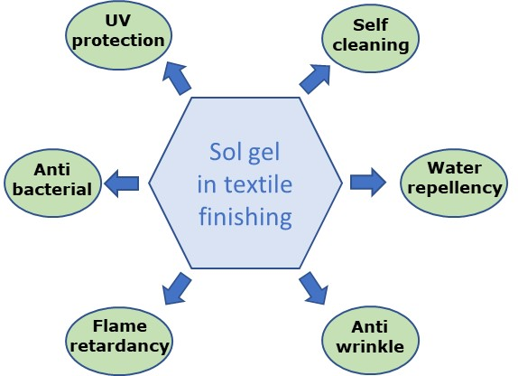
New technologies for sustainable textile finishing
Sol-gel treatments
Sol-gel technology has many applications in textiles finishing.
By sol‐gel method, high chemical concentration used in conventional methods can be significantly decreased. Using chemical materials without halogen, ecological, and economical flame‐retardant activity can be obtained.
CC0 Bertea, adapted from Chandra, 2017)
Notes:
This method, used to obtain various oxide coatings, such as nano-silver and nanoparticles of TiO2, is characterized by high purity of precursors, mixing on a molecular scale and obtaining products with high uniformity of chemical, physical and morphological properties (Shabbir et al., 2020). The sol-gel process has many applications in the field of textiles. Using this process, completely new textile characteristics can be induced, such as enhanced antimicrobial protection, UV resistance, antimosquito properties, water or oil repellency, increased dye fastness, anti-wrinkle properties, durable press or easy‐care effect, self‐cleaning (Busi et al., 2016) or soil repellency, super-hydrophobicity or photocatalytic properties.

Slide 22
New technologies for sustainable textile finishing
Sol-gel treatments
Sol‐gel technology makes enabling multifunctional properties in one step.
A layer of a fully inorganic or hybrid organic–inorganic 3D network is formed on the surface of the material that becomes Flame-Retardant.
The reactions can be carried out at or near ambient temperature.
The process produces low-MW (molecular weight) molecules (such as water and alcohols) as by-products during the condensation reactions.
Sol-gel treated fabrics are usually resistant to washing cycles, especially the cellulosic substrate.
On the other hand, sol‐gel technology has a disadvantage of high costs of precursor materials used.
Notes:
Sol-gel technology has some advantages compared to the conventional textile finishing process. Sol-gel technology is a method of applying a metal alkoxide or metal salts to textiles, which gives them high activity, durability and other multifunctional properties. An important advantage compared to traditional processes is that the application takes place from the same bath in a single step, using a low concentration of precursors. In addition, non-halogenated, formaldehyde-free chemicals are used.

Slide 23
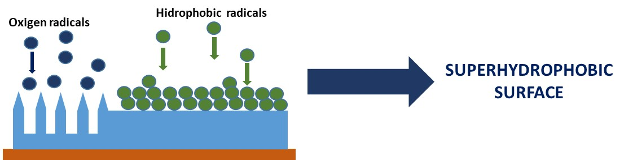
New technologies for sustainable textile finishing
Cold plasma deposition
A non-thermal plasma (cold plasma ) - a partially ionized gas containing high-energy electrons mixed with low-energy molecular species (ions, free radicals, etc.) in a way that the overall system remains close to room temperature.
CC BY-SA Bertea
Notes:
Plasma, considered to be the fourth form of existence of matter, make up more than 99% of visible matter in the universe. Plasma is a dynamic, electrically neutral gas mixture composed of ions, electrons, neutrons, photons, free radicals, excited metastable species and molecular and polymeric fragments (Chu and Lu, 2014, Choudhury, 2017).
The use of plasma is an ecological technology, which allows the creation of surfaces with new properties, which cannot be achieved by conventional processes (Mahapatra, 2015).
Under the action of plasma components, the surface of the textile fibres is functionalized, without the rest of the properties being affected. Numerous surface processes are possible following plasma treatments, including surface activation by breaking chemical bonds and forming active centres, grafting various functional groups, removing surface contaminants (cleaning / degreasing action) and depositing coatings. As a result of such processes a limited portion of the fibre surface (<1000 A) acquires new properties, while the rest of the fibre properties are not modified.
A non-thermal plasma (cold plasma) is a partially ionized gas containing high-energy electrons mixed with low-energy molecular species (ions, free radicals, etc.) in a way that the overall system remains close to room temperature.
The textile industry uses the use of atmospheric pressure plasma technology to give manufacturing processes increased durability, economy and efficiency. The use of continuous atmospheric plasma technology to improve the absorption and adhesion of dyes, coatings and adhesives can replace many polluting chemical processes in textile chemistry. In this way the use of water, harmful chemicals and energy is significantly reduced compared to conventional methods of treating textiles.

Slide 24
New technologies for sustainable textile finishing
Cold plasma deposition
Cold plasma can generally be classified into two categories:
● Low pressure or vacuum plasma.
● Atmospheric pressure plasma (Choudhury, 2017).
Applications of cold plasma treatments are numerous: plasma polymerization (gaseous monomers), grafting, polymer, chemicals and metal particles deposition.
Three categories of gases are used for cold plasma treatments:
● Chemically inert gases (most commonly helium, neon and argon).
● Reactive but non-polymerizable gases (ammonia, air and nitrogen).
● Reactive and polymerizable gases (tetrafluoroethylene, hexamethyldisiloxane).

Slide 25
New technologies for sustainable textile finishing
Cold plasma deposition
A non-thermal plasma (cold plasma) many advantages:
tailors the surface properties without changings the physical and mechanical properties of the bulk material;
high quality;
high productivity;
low water, energy and chemical consumption
low cost;
environmentally clean (Muthu, 2018).
Notes:
In the case of cold plasma, electrons are able to cleave covalent chemical bonds, obtaining physical and chemical changes in the surface of the treated substrate without changing the properties of the fibres; there is a minimum consumption of chemicals; no drying process is required; high compatibility with the environment; applicable to almost all types of fibres (Blackburn, 2009).

Slide 26
New technologies for sustainable textile finishing
Spray Pyrolysis
Pyrolysis by spraying is a process of chemical modification of the surface of the textile material by thermal stimulation, in which the precursor solution of the desired compound is sprayed on the substrate. Applications of surface modification of textiles by spray pyrolysis include obtaining photocatalytic, antimicrobial and flame retardant effects.
The atomization of the precursor solution takes place beforehand, with the formation of particles and thin films. Spraying is most often done using compressed air, ultrasound or an electric field (Shahid and Adivarekar, 2020).
Notes:
The modification of the surface is done by a chemically stimulated chemical process, in which the precursor solution of the compound used is sprayed on the textile material. Various methods can be used for spraying, such as the use of compressed air, ultrasound or an electric field.
Evaporation of the solvents from the spray droplets takes place before reaching the substrate, thus deposition of the desired compound in the form of particles or thin films.
This process of modifying the surface of textiles is used for antimicrobial or flame retardancy treatments.

Slide 27
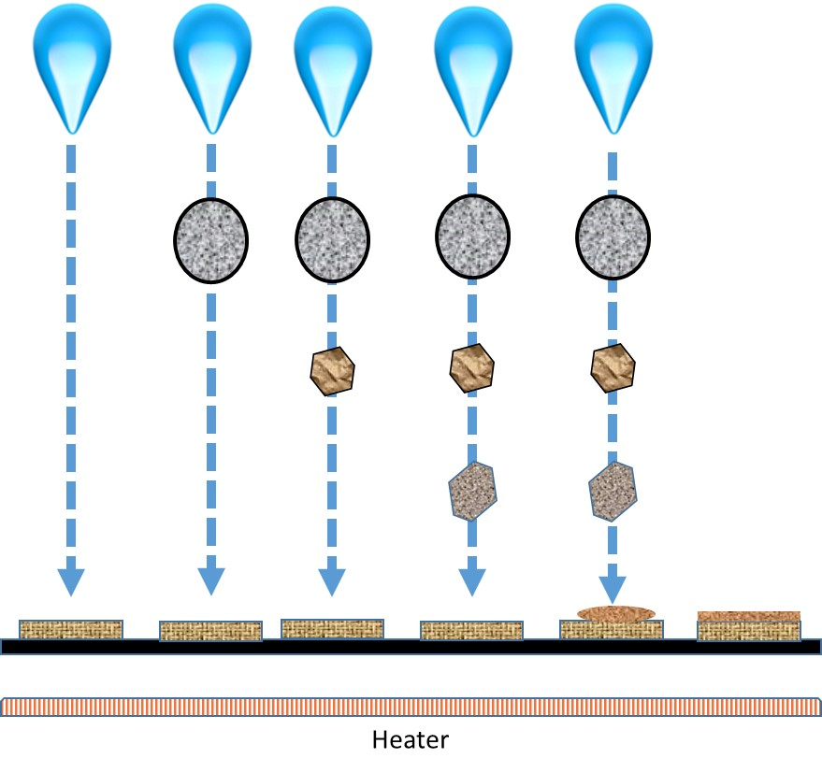
New technologies for sustainable textile finishing
Spray Pyrolysis
Stages of spray
pyrolysis technique
CC0 Bertea, adapted from Moholkar, 2011

Slide 28
Conclusions
The textile industry is one of the major polluters, which is why approaches to introduce processing with environmental protection are increasingly in demand. Greater than before consumer awareness of reducing environmental pollution leads textile manufacturers to eliminate or at least reduce toxicity during the production and life cycle of textiles.
Modern textile finishing aims to use sophisticated processes that are more environmentally friendly. Nanotechnology has revolutionized the textile industry in recent decades as it offers a new way to give new properties to textile surfaces without affecting other properties.
Although the use of nanotechnology is generally regarded as environmentally friendly, future research should aim to study in detail the environmental aspects of the use of nanoparticles.

Slide 29
References and Further Reading
World Commission on Environment and Development. (1987). Our common future. Oxford University Press.
Alongi, J., Tata, J., Carosio, F., Rosace, G., Frache, A. and Camino, G. (2015) A Comparative Analysis of Nanoparticle Adsorption as Fire-Protection Approach for Fabrics. Polymers, 7, 47-68. https://doi:10.3390/polym7010047
Blackburn, R. S. (2009) Sustainable textiles - Life cycle and environmental impact. Woodhead Publishing Limited and CRC Press LLC
Chandra, U. (2017) Recent Applications in Sol-Gel Synthesis. Intech
Chu, P. and Lu, X. (2014) Low Temperature Plasma. Technology, Methods and Applications. CRC Press, Taylor & Francis Group
Malucelli, G. (2020) Sol-Gel and Layer-by-Layer Coatings for Flame-Retardant Cotton Fabrics: Recent Advances. Coatings. 10, 333-351. https://doi:10.3390/coatings10040333
Iheaturu, N., Aharanwa, B., Chike, K., Ezeamaku, U., Nnorom, O. and Chima, C. (2019) Advancements in Textile Finishing. IOSR Journal of Polymer and Textile Engineering. 6(5), 23 – 31. https://doi: 10.9790/019X-06052331
Choudhury, A.K.R. (2017) Principles of Textile Finishing. Woodhead Publishing

Slide 30
Xu, Y. (2021) Flame Retardant and Thermally Insulating Polymers. Intech
Mahapatra, N.N. (2015) Textiles and environment. Woodhead Publishing India
Busi, E., Maranghi, S., Corsi, L. and Basosi, R. (2016). Environmental sustainability evaluation of innovative self-cleaning textiles. Journal of Cleaner Production, 133, 439–450. https://doi.org/10.1016/j.jclepro. 2016.05.072.
Miraftab, M. and Horrocks, A. R. (2004) Ecotextiles - The way forward for sustainable development in textiles. Woodhead Publishing Limited in association with The Textile Institute
Aslam, S., Hussain, T., Ashraf, M., Tabassum, M., Rehman, A., Iqbal, K. and Javid, A. (2018) Multifunctional finishing of cotton fabric. Autex Research Journal. 19(2), 1 – 10. https://doi: 10.1515/aut-2018-0048
Muthu, S.S. (2018) Sustainable Innovations in Textile Chemical Processes. Springer Nature Singapore
Shabbir, M., Ahmed, S. and Sheikh, J. (2020) Frontiers of Textile Materials - Polymers, Nanomaterials, Enzymes, and Advanced Modification Techniques. Scrivener Publishing
Mittal, K.L. and Bahners, T. (2017) Textile Finishing - Recent Developments and Future Trends. Scrivener Publishing
Alongi, J., Horrocks, R., Carosio, F. and Malucelli, G. (2013) Update on Flame Retardant Textiles: State of the Art, Environmental Issues and Innovative Solutions. Smithers Rapra Technology Ltd

Slide 31
Shahid-ul-Islam and Butola, B.S. (2019) The Impact and Prospects of Green Chemistry for Textile Technology. Woodhead Publishing
Aslam, S., Hussain, T., Ashraf, M., Tabassum, M., Rehman, A., Iqbal, K. and Javid, A. (2019 ) Multifunctional finishing of cotton fabric. AUTEX Research Journal, 19(2), 1-10. doi: 10.1515/aut-2018-0048
Ortelli, S., Malucelli, G., Cuttica, F. and Blosi, M. (2018) Coatings made of proteins adsorbed on TiO₂ nanoparticles: a new flame retardant approach for cotton fabrics. Cellulose, 25(4), 2755–2765, doi:10.1007/s10570-018-1745-z
Musahara, J. (2016) Inclusive Growth and Development Issues in Eastern and Southern Africa. Organisation for Social Science Research in Eastern and Southern Africa.
Shahid, M. and Adivarekar, R. (2020) Advances in Functional Finishing of Textiles. Springer Nature Singapore
Moholkar, A. (2011) Transparent Conductors: Studies On Sprayed Fluorine Doped Tin Oxide (FTO) and Tin Doped Indium Oxide (ITO) thin films. LAP LAMBERT Academic Publishing
Verbic, A., Gorjanc, M. and Simoncic, B. (2019) Zinc Oxide for Functional Textile Coatings: Recent Advances. Coatings, 9(550), 1-26, doi:10.3390/coatings9090550

Slide 32
Contact
‘’Gheorghe Asachi’’ Technical University of Iasi, Romania
Faculty of Industrial Design and Business Management
Prof. Dr. Andrei Bertea
E-Mail: andrei_bertea@yahoo.co.uk

