Slide 1
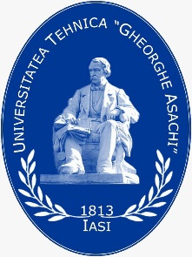
Fashion Design in the Context of Sustainability (Part 2)

Slide 2
Learning Objectives
After this lecture you should be able to:
Understand the slow fashion, based on the long life fashion elements.
Design clothes applying sustainable long life fashion elements: different types of drapes, other 3D elements and peplums.
Design clothes in combined sustainable silhouettes.
Design clothes using sustainable proportions, based on the golden ratio and Fibonacci sequence.
Design clothes using geometrical figures and tiles, based on the golden ratio and Fibonacci sequence.
Design textiles using geometrical figures, based on the golden ratio and Fibonacci sequence.

Slide 3
Slow Fashion
The slow fashion is an aspect of sustainable fashion and is the opposite concept of the fast fashion. The slow fashion offers sustainable fashion solutions, which are based on new strategies for design, manufacturing, consumption, use and re-use that challenge the global fashion system. The slow fashion involves a fashion awareness of the production and resources required to create clothing. The slow fashion promotes the purchase of higher-quality clothes with trendless design that will last longer, and fair treatment of people, animals, and the environment.
The trendless designs are based on application of the long life fashion elements.
Notes:
Staniforth, S. (2010). Slow Conservation. Studies in Conservation 55 (2): 74-80. https://doi.org/10.1179/sic.2010.55.2.74
Marquis, Ch. (2021). What Does Slow Fashion ‘Actually’ Mean?. Forbes. https://www.forbes.com/sites/christophermarquis/2021/05/14/what-does-slow-fashion-actually-mean/?sh=63114e1273b4
Clark, H. (2008). SLOW + FASHION – an Oxymoron – or a Promise for the Future …?. Fashion Theory 12 (4): 427–446
Kuusk, K., Tomico, O., Langereis, G., Wensveen, S. (2012). Crafting smart textiles – a meaningful way towards societal sustainability in the fashion field?. The Nordic Textile Journal 1: 6–15. http://hb.diva-portal.org/smash/get/diva2:869634/FULLTEXT01.pdf

Slide 4
Long Life Fashion Elements
A study of women’s fashion of the last decade of 20th Century and 21st Century from the beginning till now shows that there are elements, which stay in fashion for a longer period of time or in other words they are always in trends. The application of long live fashion elements in design is a precondition for the long life of clothes (slow fashion). These elements are:
Drapes. The draperies are always in fashion trends. The free and twist knot ones are the more popular types of drapes.
Other 3D elements. The tucks, pleats, gathers, and ruffles are with long life in fashion.
Peplums. Although they are not as popular as 10 years ago, they are in still in trends for a long time.
Non volume silhouettes. They are always in trends.

Slide 5
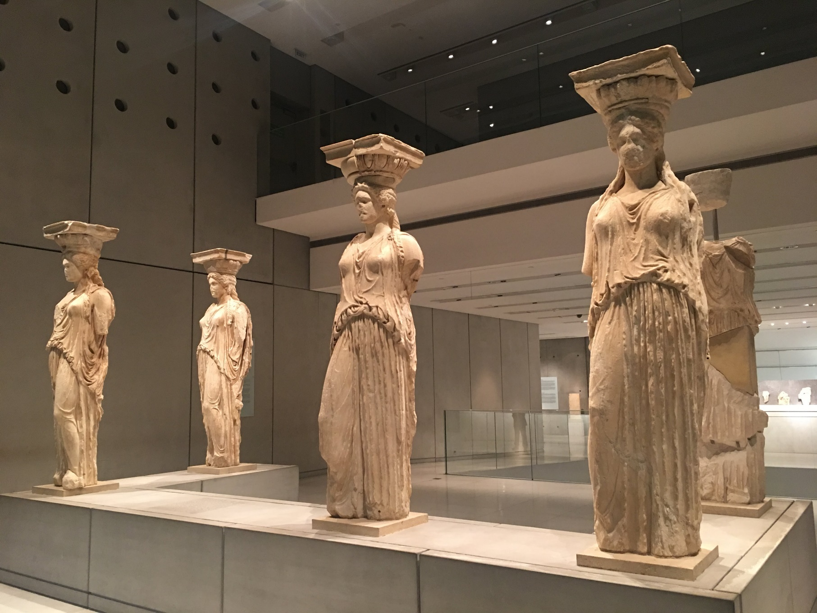
Back to fashion history
The long life fashion elements of drapes, other 3D ones, peplum and non volume silhouette in combination with zero waste construction can be seen in the women’s ancient Greek and Thracian chiton.
CC BY-SA-ND Kazlacheva

Slide 6
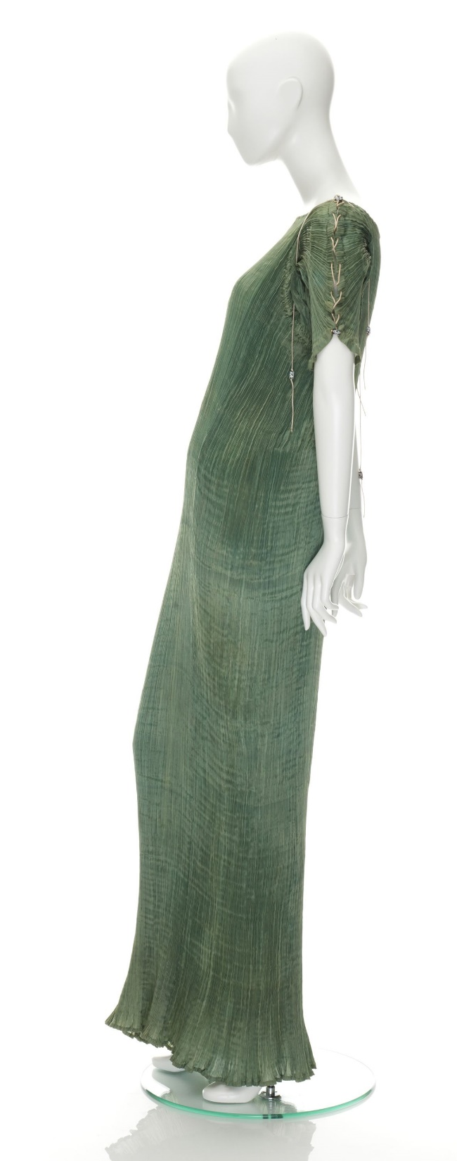
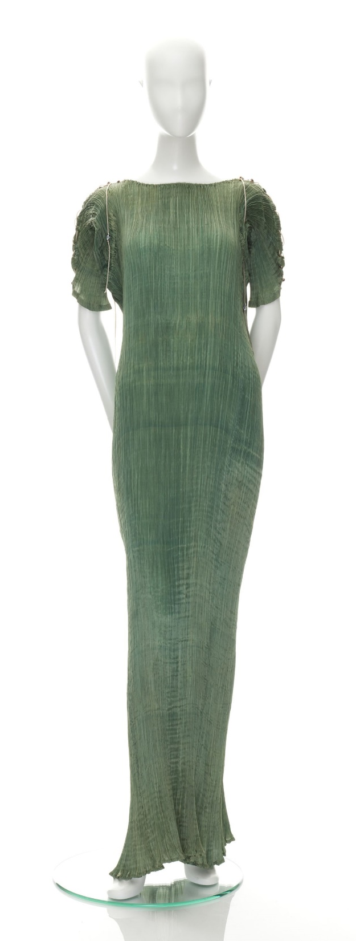
Drapes. History
Drapes take their place in the contemporary fashion in the first half of the 20th Century. Then Mariano Fortuny created his draped, inspired by ancient Greek costume, evening “Delphos” dresses.
“Delphos” evening dress by Mariano Fortuny, 1910-1920
Sourse:
Museum of Applied Arts & Sciences, https://ma.as/169168
Notes:
“Delphos” evening dress by Mariano Fortuny, 1910-1920. Museum of Applied Arts & Sciences. https://collection.maas.museum/object/169168

Slide 7
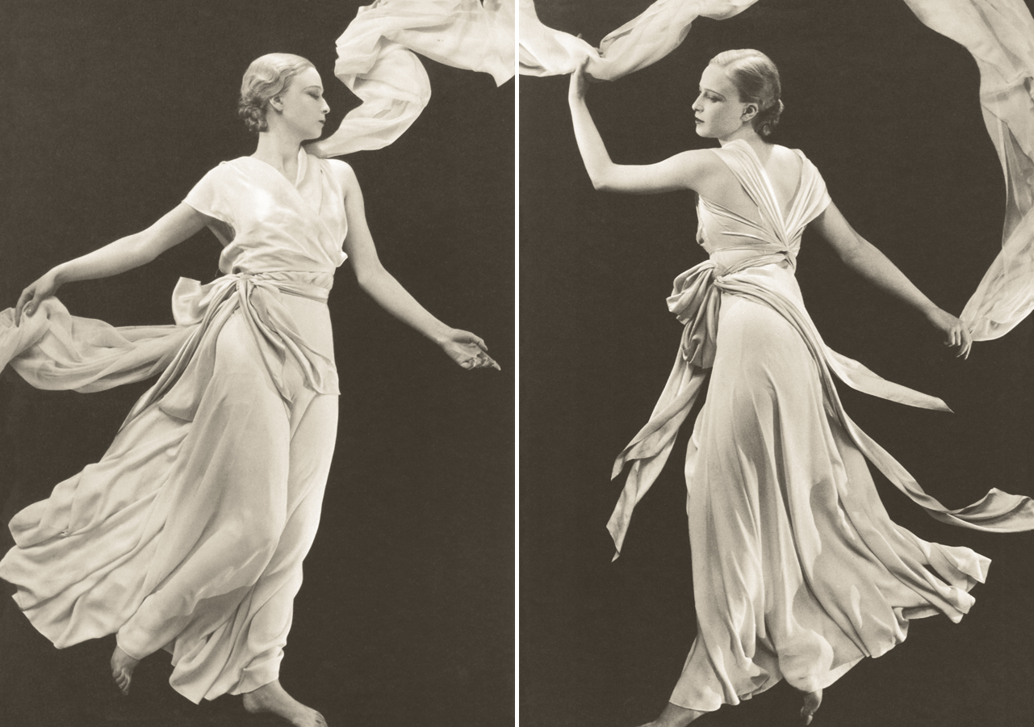
Drapes. History
Madeleine Vionnet, known for her elegant Greek inspired dresses, has been called the “Queen of the bias cut”. She introduced the bias cut to the fashion design.
Vionnet’s pink crêpe nightgowns, 1931
Photograph by Hoyningen-Huene
Sourse:
Berznak A., Vanity Fair, 2012, https://www.vanityfair.com
Notes:
Bereznak, Alyssa (2012). Photos: The Favorite Fashion Designer of *Downton Abbey’*s Lady Mary, Madeleine Vionnet. Vanity Fair. https://www.vanityfair.com/hollywood/2012/11/downton-abbey-lady-mary-vionnet?epik=dj0yJnU9dzdtOGQtdnBkRzNhZWl6NXNzUkRlLVRaeTd0NUd2cVUmcD0wJm49VDlxeVpCY1BENmFKbFBVaUk0aGdyUSZ0PUFBQUFBR0luVFNr
Queen of the bias cut. Design086-Blog. https://design086-blog.tumblr.com/post/3434557161/queen-of-the-bias-cut-history

Slide 8
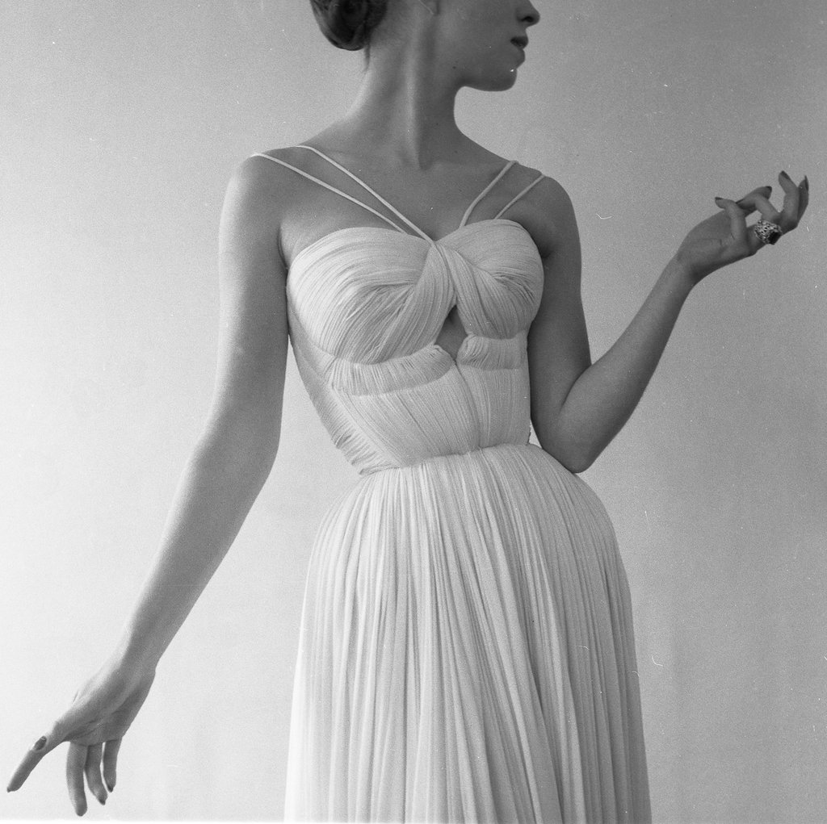
Drapes. History
Madame Grès has been called the “Queen of the drapery” and the “Master of the wrapped and draped dress”. She has been famous with her floor-length draped Grecian goddess gowns.
Draped Dress of Madame Grès, Paris, 1955
© Atelier Robert Doisneau courtesy of GAMMA-RAPHO Agency
Notes:
Gerakiti, Errika (2021). Madame Grès, The Sphinx of Fashion. Daily Art Magazine. https://www.dailyartmagazine.com/madame-gres-the-sphinx-of-fashion/
Robert Doisneau Retrospective. http://blog.ricecracker.net/2011/09/07/robert-doisneau-retrospective/
Phelan, Hayley (2012). 25 Women Designers Who Changed Fashion Forever. Fashionista. https://fashionista.com/2012/05/25-of-the-most-influential-female-designers-that-changed-fashion-forever#9
Rose, Cynthia (2011). Finding Fidelity within the Fashion House. Crafts

Slide 9
Types of Drapes
The drapes in today’s fashion on the base of their pattern design can be classified in four types:
Free drapery. The draped neckline, named Greek neckline is the most popular free drape;
Drape, formed with a seam or darts;
Twist knot drape, or drapery, fixed in a knot;
Twisted drapery.
The four types of drapes are presented in the next slides. According to the design principles, a drape has to be the main element of a composition.

Slide 10
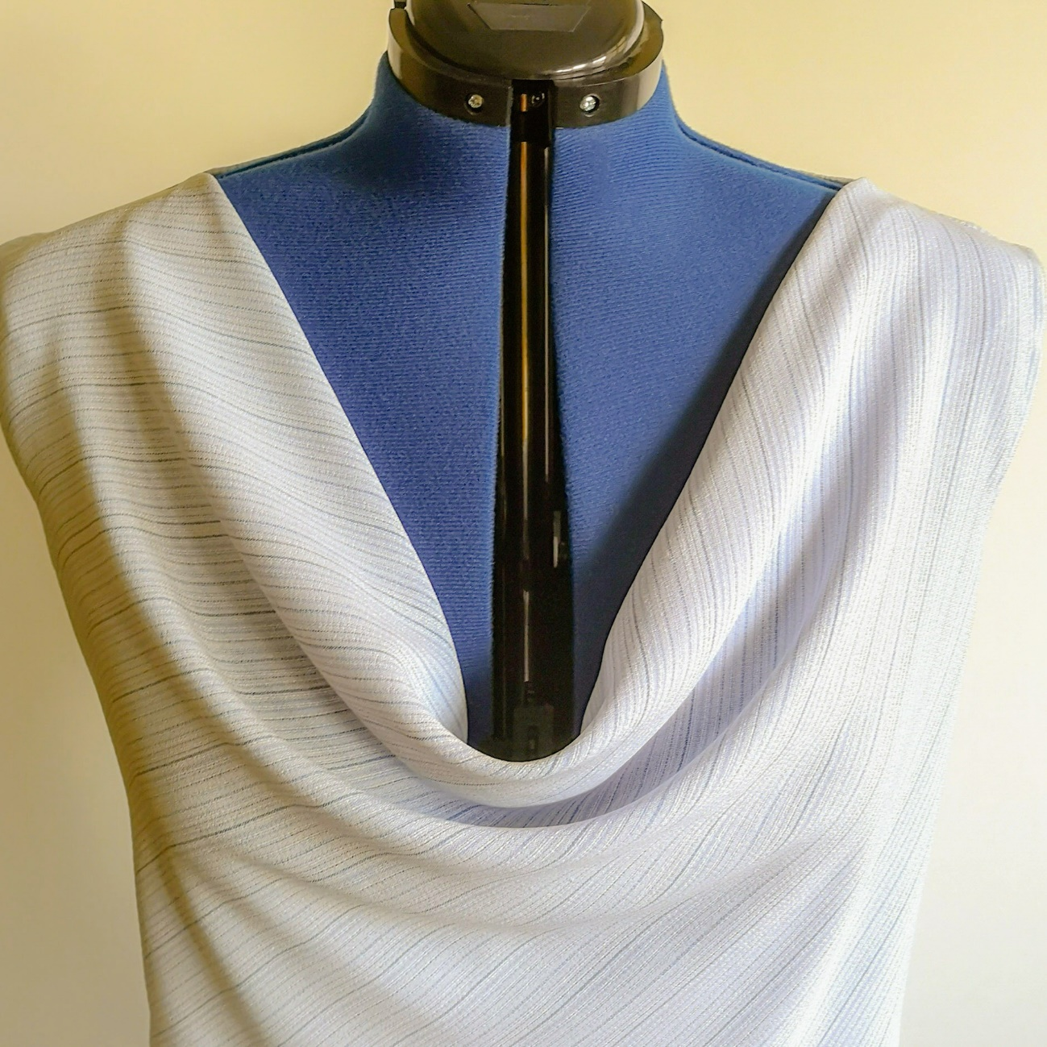
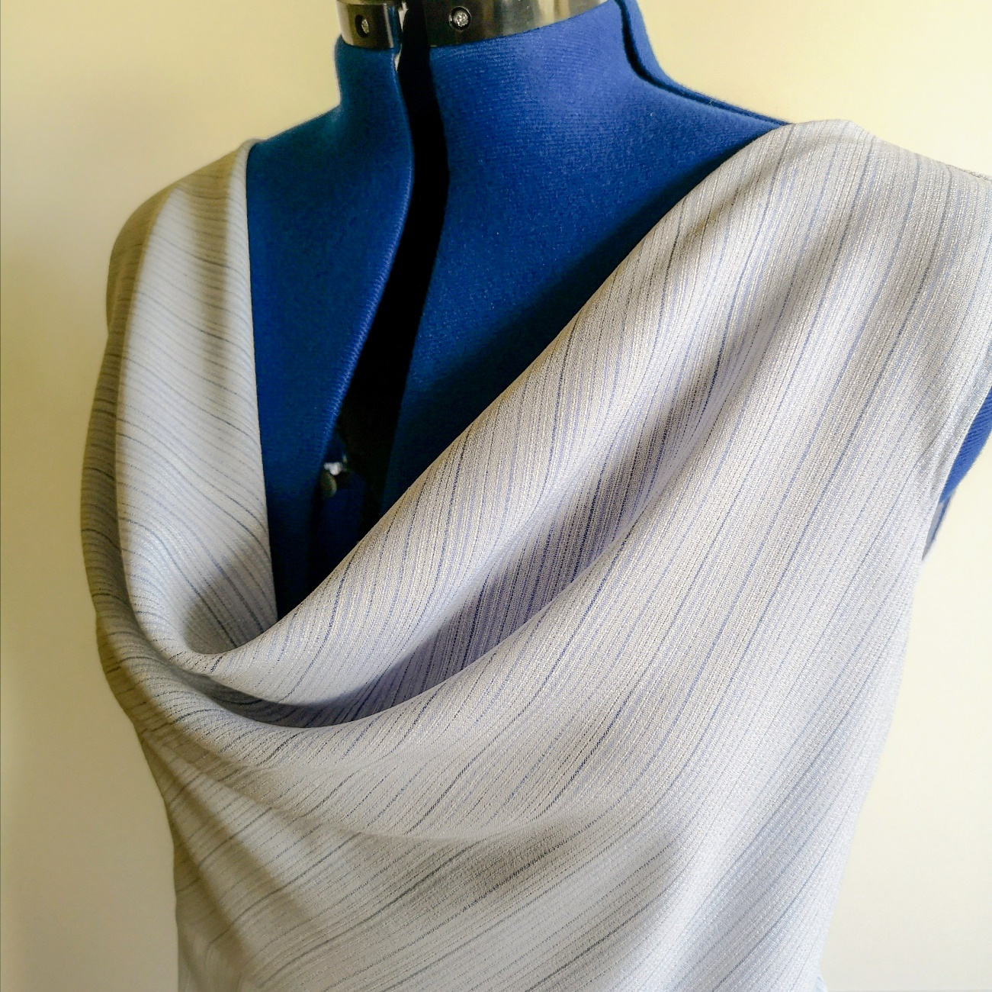
Free Drape
CC BY Kazlacheva
Notes:
The draped neckline, named Greek neckline, is the most popular free drape. Pattern making of clothes with this type of drape is presented in the topic of “Pattern making in the context of sustainability”.

Slide 11
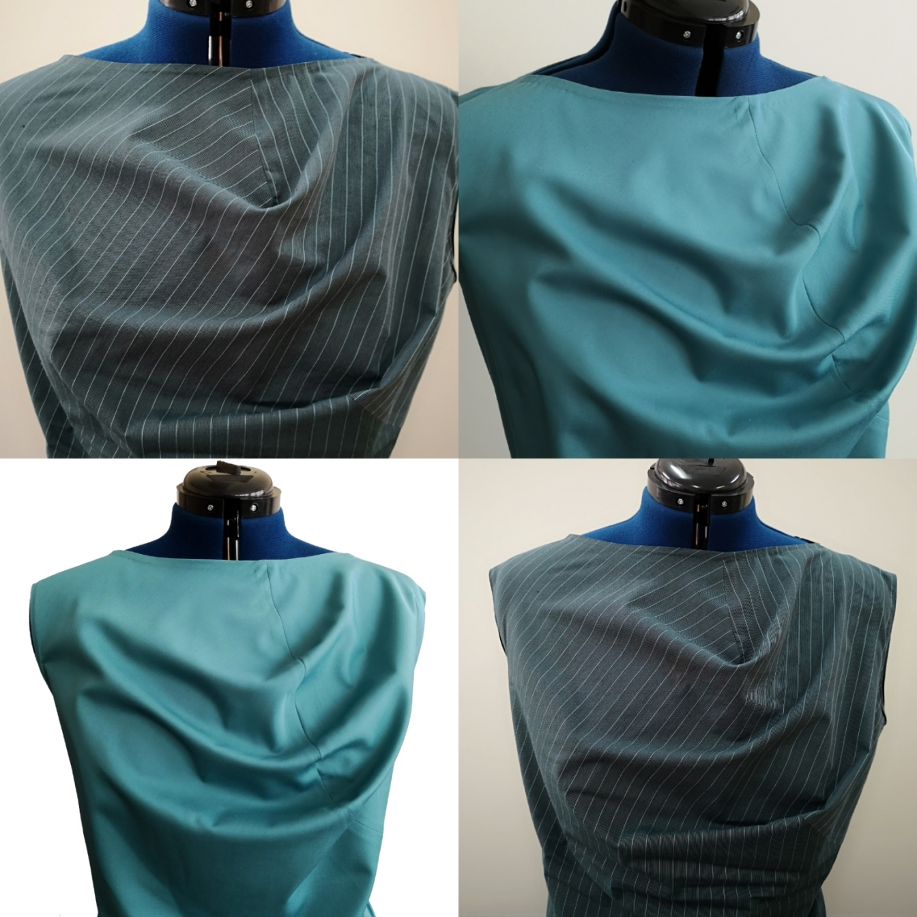
Drape Formed
with Seam
Drape formed with seam or darts. This type of drape can be formed in symmetric and asymmetric design. Presented asymmetric drapes are shaped with a seam (in blue) and darts (in green).
CC BY Kazlacheva
Notes:
Pattern making of clothes with this type of drape is presented in the topic of “Pattern making in the context of sustainability”.

Slide 12
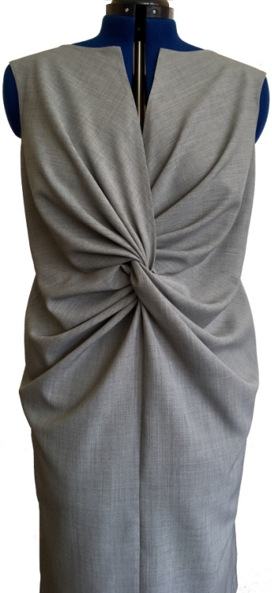
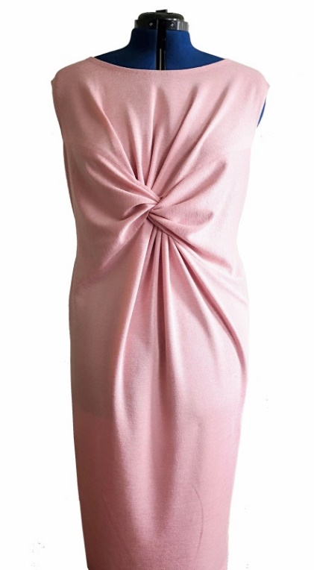
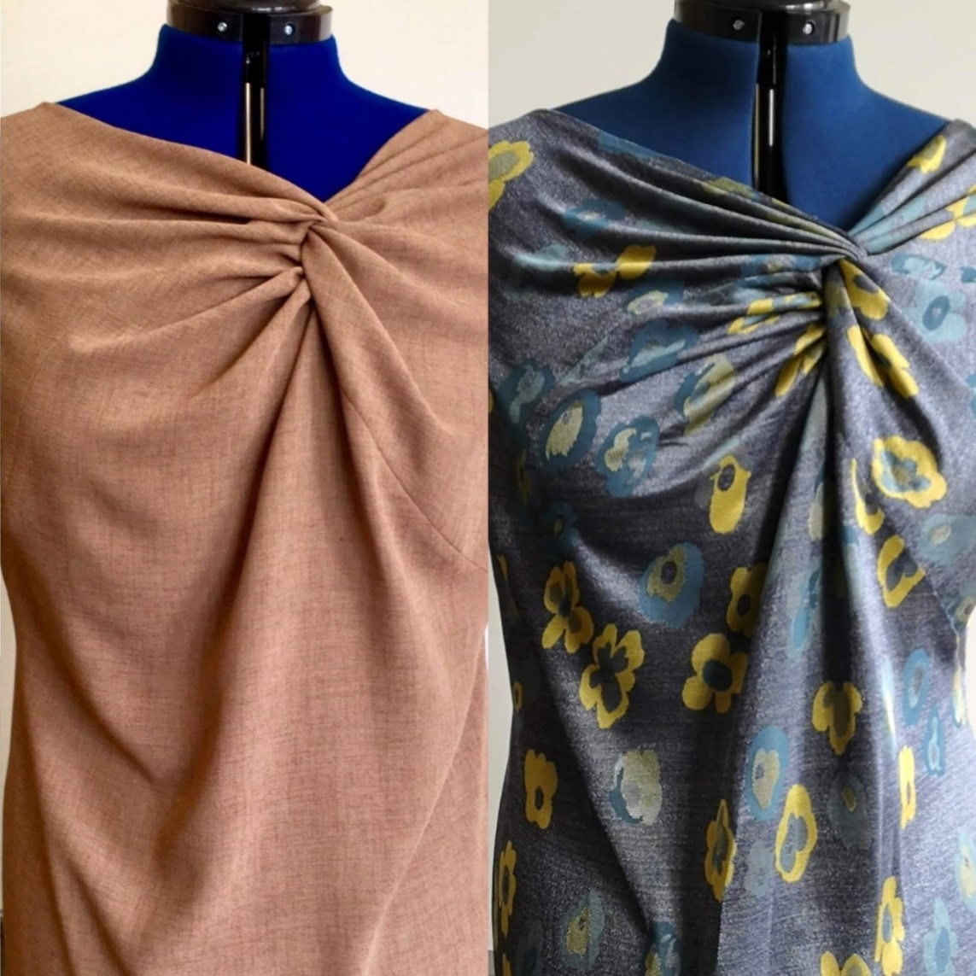
Twist Knot Drape
CC BY Kazlacheva
Notes:
Pattern making of clothes with this type of drape is presented in the topic of “Pattern making in the context of sustainability”.

Slide 13
Twist Knot Drape
This type of drape, as it is name shows, is formed by a twist between two pieces of a part. The twist and forming seams shape a drapery, fixed in a knot. Usually, twist knot drape is designed in the front in different places of the part, but it can be formed in the back of a women’s garment.
CC BY Kazlacheva
Notes:
Pattern making of clothes with this type of drape is presented in the topic of “Pattern making in the context of sustainability”.

Slide 14
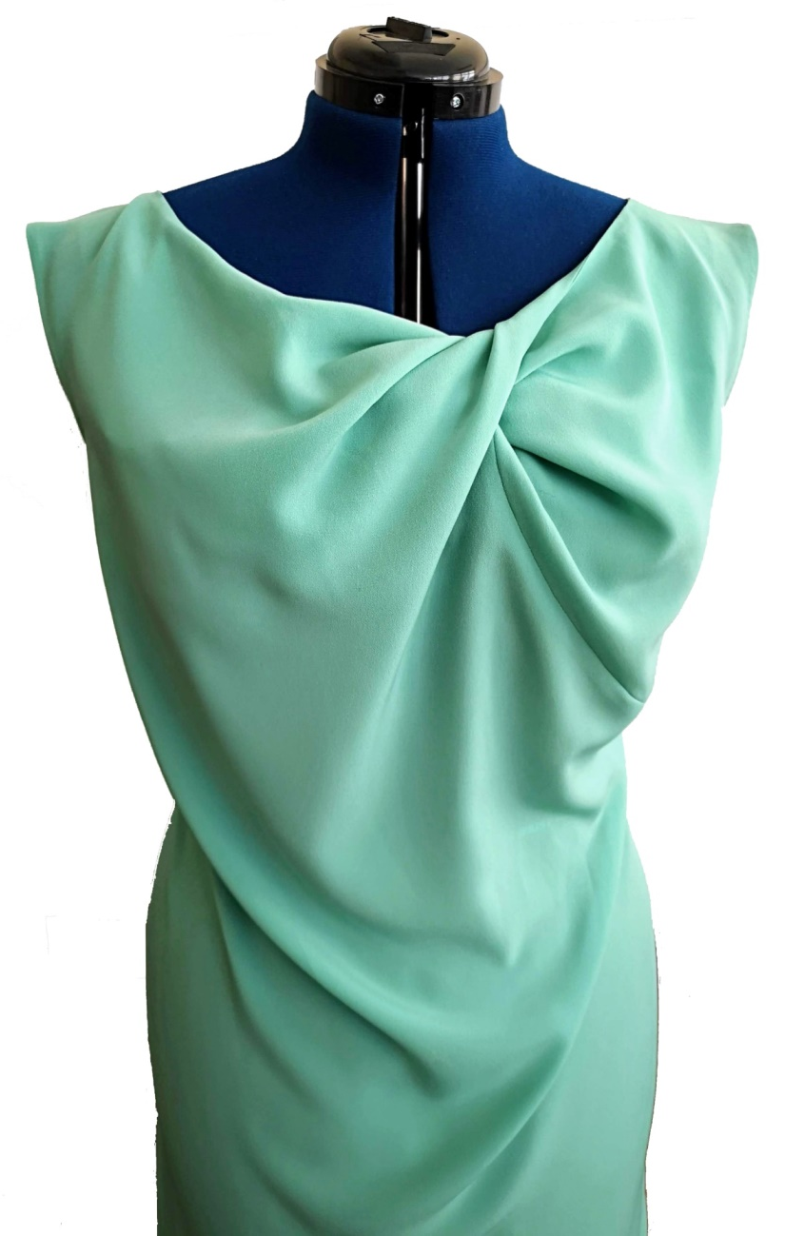
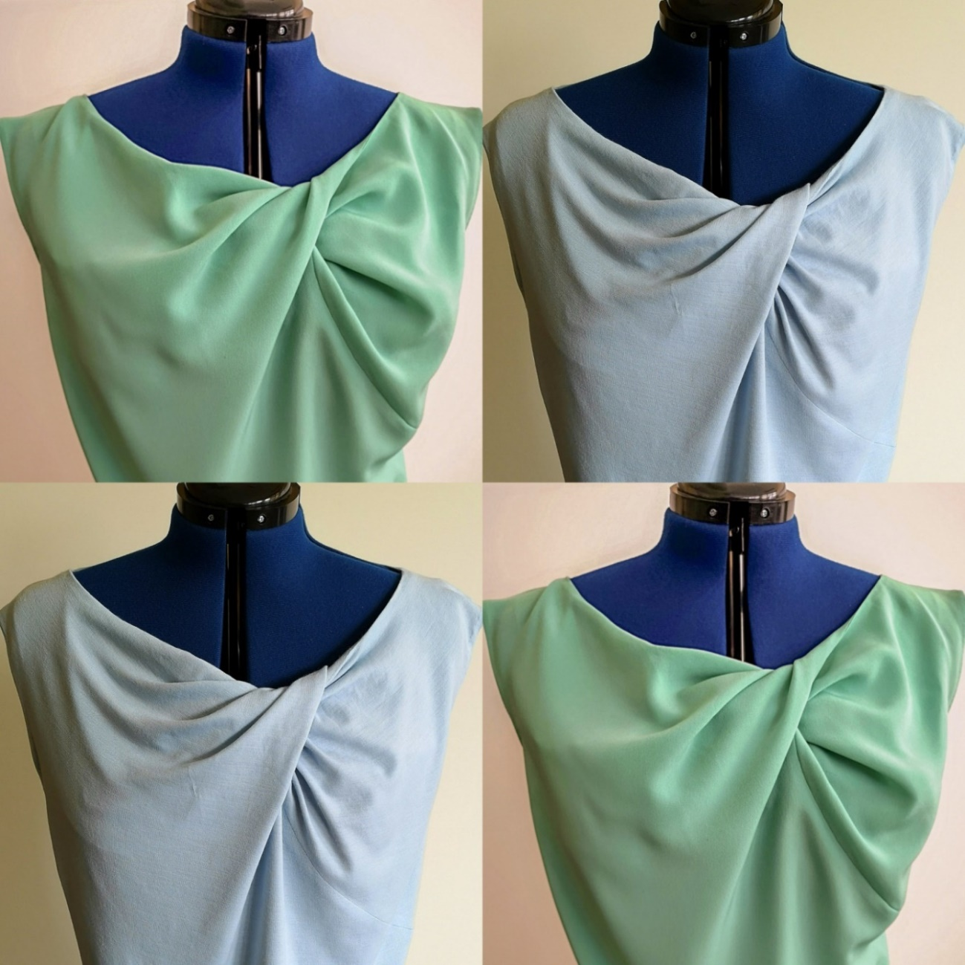
Twisted Drape
CC BY Kazlacheva
Notes:
Pattern making of clothes with this type of drape is presented in the topic of “Pattern making in the context of sustainability”.

Slide 15
Twisted Drape
This type of drape is formed by twisting of a piece or two pieces of a part. Similarly, to the twist knot drapery, usually, the twisted drape is designed in the front in different places of the part. The twisted drapery also can be formed in the back of a women’s garment.
CC BY Kazlacheva
Notes:
Pattern making of clothes with this type of drape is presented in the topic of “Pattern making in the context of sustainability”.

Slide 16
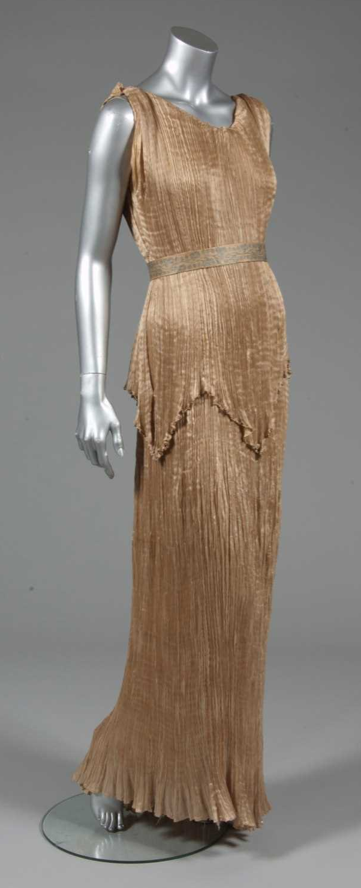
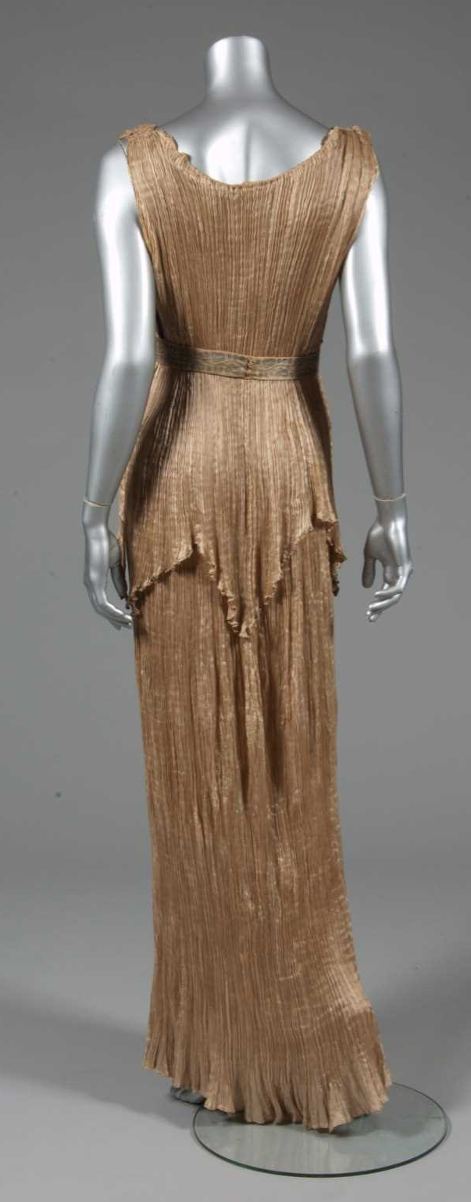
Peplum. History
The peplum comes in contemporary fashion from the ancient Greek overdress “peplos”. Mariano Fortuny has been inspired not only by drapes in ancient Greek costumes, but by peplos too.
A Mariano Fortuny apricot silk Peplos gown, circa 1920
Sourse:
Kerry Taylor Auctions, https://www.kerrytaylorauctions.com
Notes:
Kerry Taylor Auctions. https://www.kerrytaylorauctions.com/auction/lot/73-a-mariano-fortuny-apricot-silk-peplos-gown/?lot=18556&sd=1

Slide 17
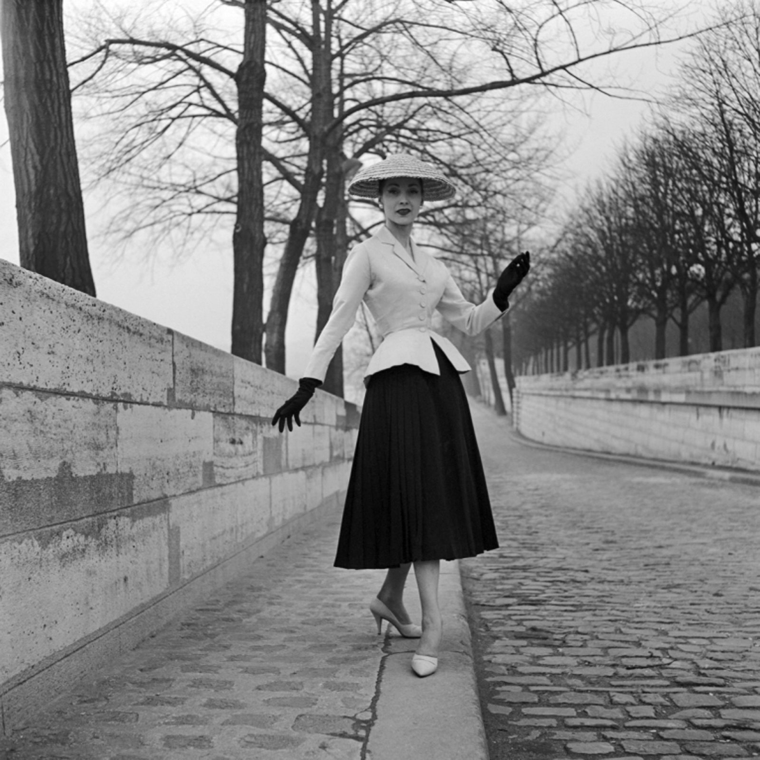
Peplum. History
Peplums have been seen in Christian Dior’s “New Look” designs.
Bar suit, haute couture spring/summer 1947 collection by Christian Dior
Photo: Associations Willy Maywald / ADAGP, 2020 / Courtesy of Christian Dior
Sourse:
Cardini T., Vogue, 2020, https://www.vogue.com
Notes:
Caedini, Tiziana (2020). Dior’s Bar Jacket: A Brief History. Vogue. https://www.vogue.com/article/christian-dior-bar-jacket-a-brief-history

Slide 18
Peplums
The sustainable long life fashion element peplum can be whole or partial one. It can be with uneven length, and it can be situated at the waist, as it is usually, or between the breast and waist, and under the waist area. The peplum can be combined with different types of 3D elements, which are sustainable long life fashion elements too.
The next slides presented dresses and jackets with peplums, which are whole and partial ones, with uneven length, situated in the waste or between the breast and the waist, and 3D elements: ruffles, unsmoothed and ironed one-sided and bi-sided pleats, symmetrical and asymmetrical situated ones, and gathers.
All presented peplum are in harmonic connections with other design elements, based on the main design principles.

Slide 19
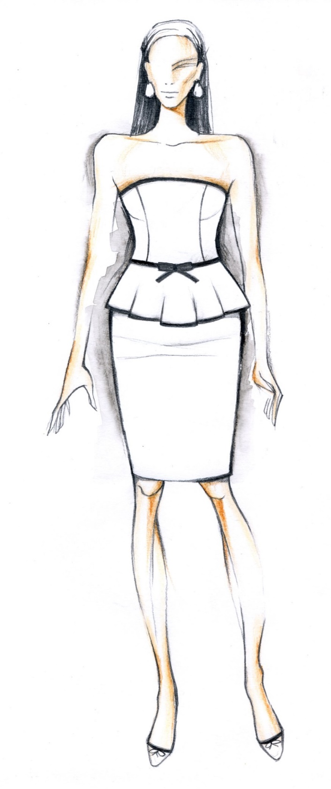
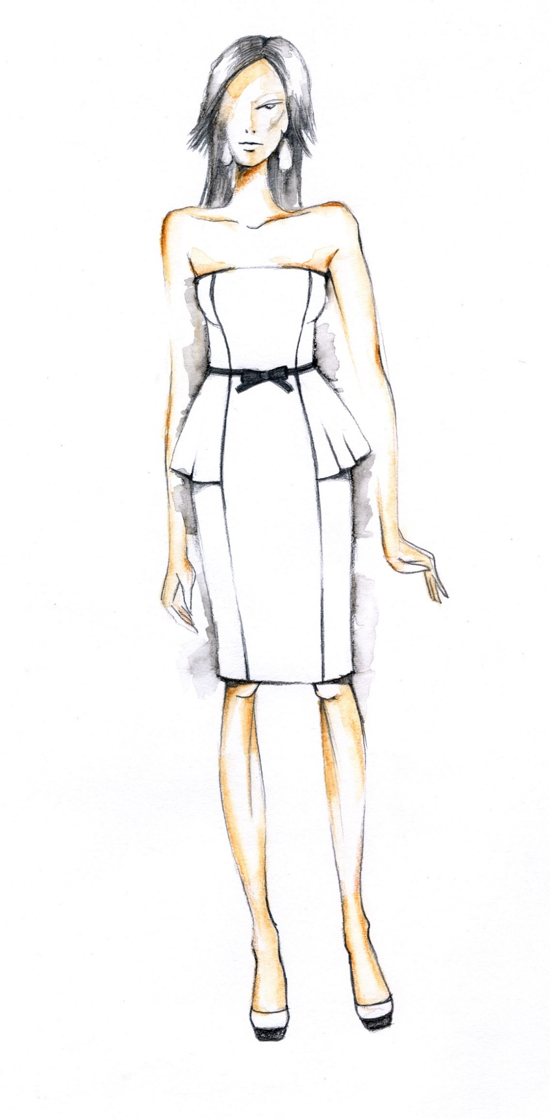
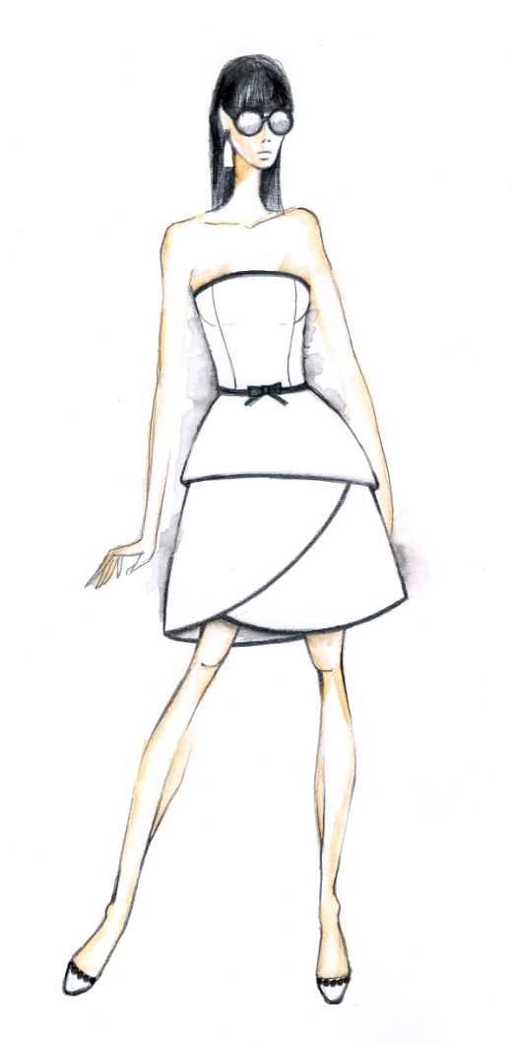
CC BY Dineva

Slide 20
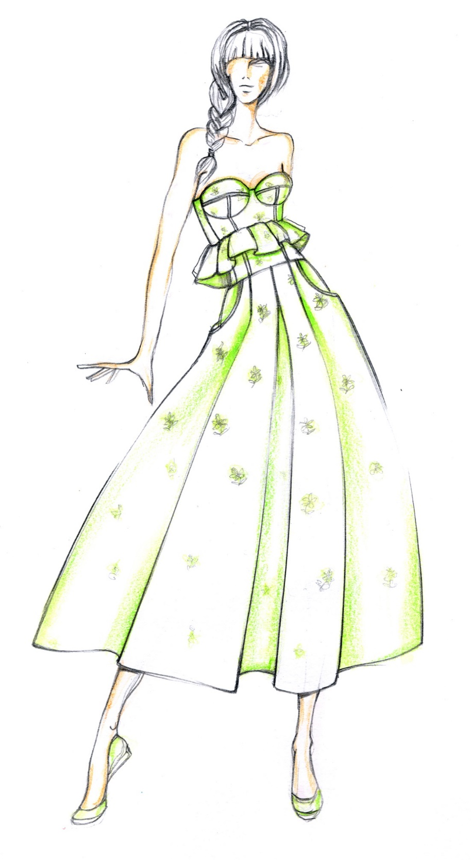
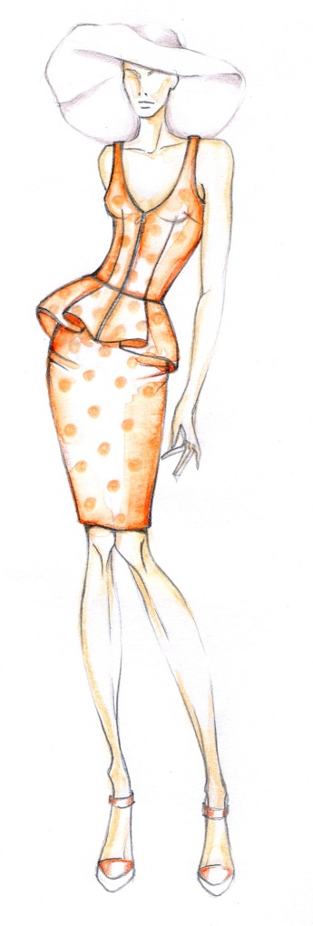
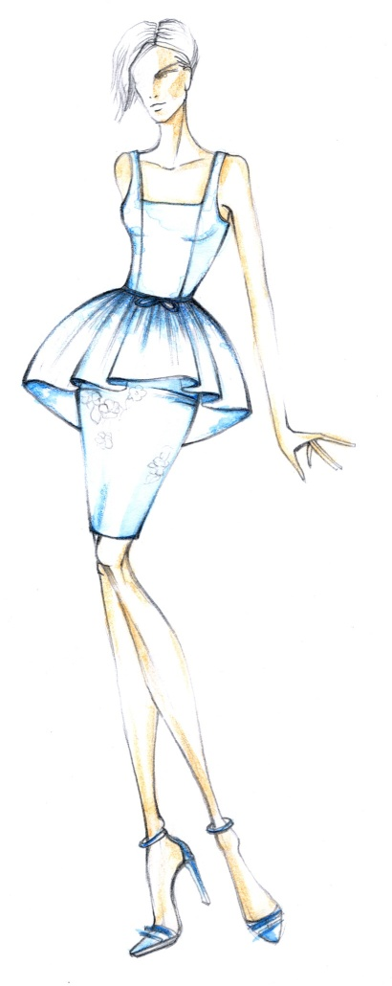
CC BY Dineva

Slide 21
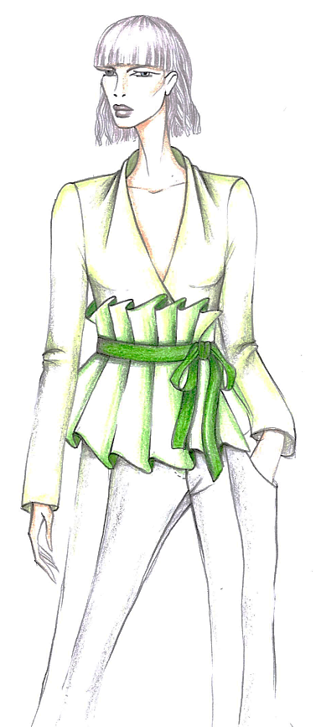
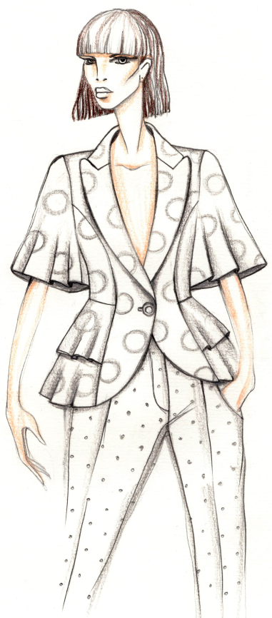
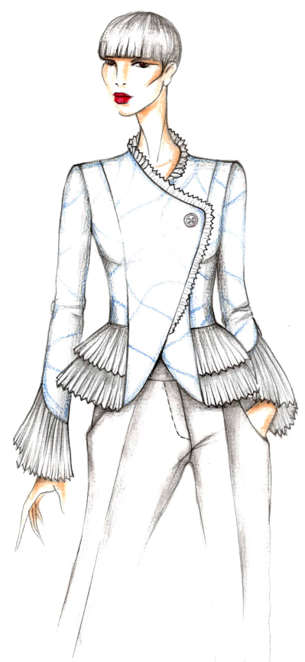
CC BY Dineva

Slide 22
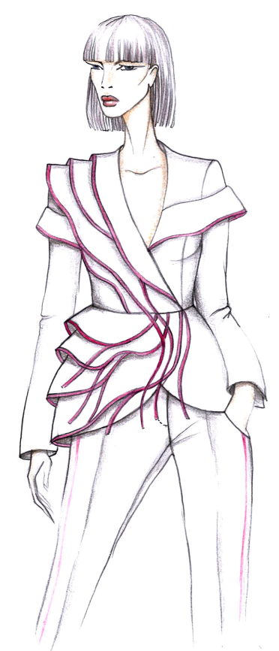
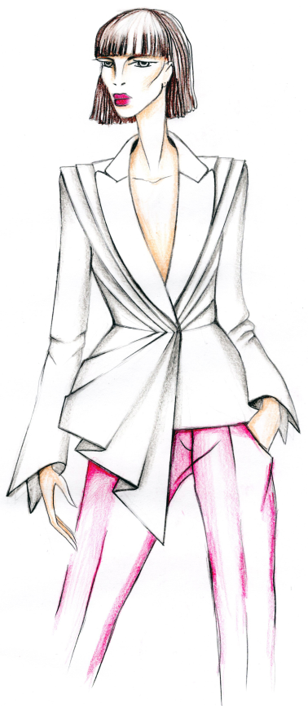
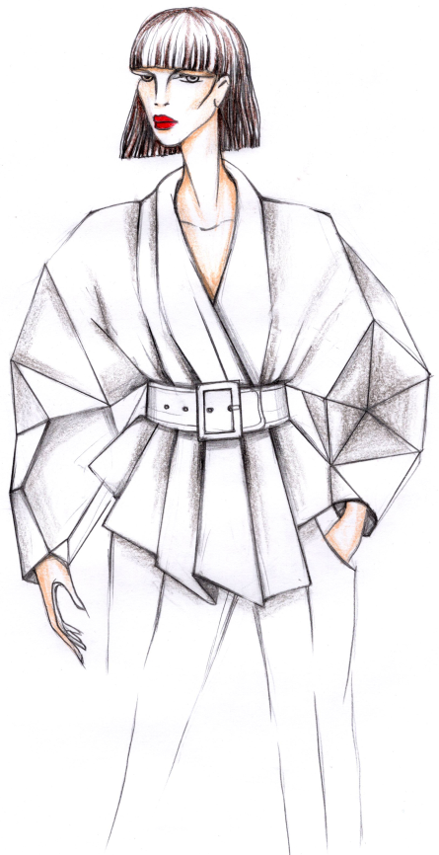
CC BY Dineva

Slide 23
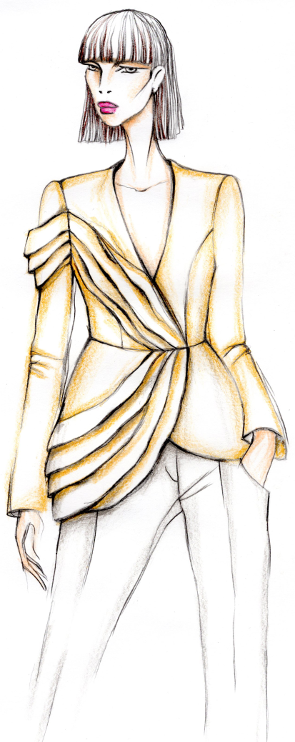
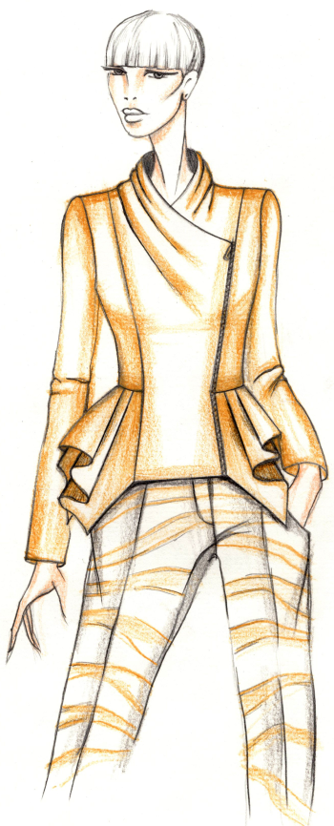
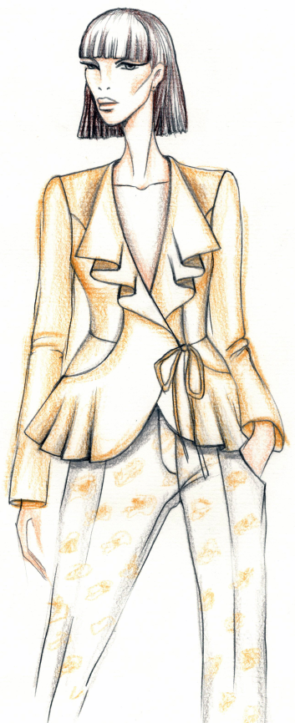
CC BY Dineva

Slide 24
Combined Silhouettes
The analysis of fashion of 21st Century shows that non volume silhouettes are always on trends. An analysis of the silhouettes of women’s clothing concludes that volume silhouettes will be for a long time in fashion if they are combined with non volume ones. The long life of garments can be result of combination of two volume silhouettes, formed with other long life elements.
The next slides present designs of women’s dresses in combined silhouettes. The volume parts are formed with the help of other long life fashion elements: drapes, 3D elements, peplums.
All elements in presented designs are in harmonic connections with other elements of compositions, based on the main design principles.

Slide 25
An asymmetric dress, combined Y line and vase silhouette. Y line is a result of the forms of the sleeves and the neck opening. The vase silhouette is a result of the peplum in a form of a turned trapezium. The right part of the peplum is designed with a free drapery.
CC BY Ilieva

Slide 26
An asymmetric dress, combined Y line and vase silhouette. Y line is a result of the forms of the sleeves and the neck opening. The vase silhouette is a result of a peplum in a form of a turned trapezium. The right part of the peplum is designed with tucks and the left part is formed with a frill.
CC BY Ilieva

Slide 27
An asymmetric dress with right part in vase silhouette and left part, combined Y line and vase silhouette. The Y line is a result of the form of the sleeve and the asymmetric neckline. The vase silhouette is a result of a peplum. The right part of the peplum is designed with a drapery. The left part of the peplum is formed with tucks and frills.
CC BY Ilieva

Slide 28
An asymmetric dress with an asymmetric peplum. The right part of the dress is in silhouette, which combine Y line and vase. The left part is in Y line. The peplum design combines a drape, a frill and tucks. Y line is a result of draped sleeves and an asymmetric neck opening.
CC BY Ilieva

Slide 29
An asymmetric dress in combined silhouette. The right part is in vase silhouette and the left part is in X line. The sleeve is designed by volume frills. The asymmetric peplum is formed with frills to, volume ones in the left and not too volume in the right. X line is a result of the volume frills in the sleeve and the peplum in the left. If the peplum is designed in smaller volume, the silhouette of the dress will be modified in mixed one, which is fitted in the right and combined Y line and vase in the left.
CC BY Ilieva

Slide 30
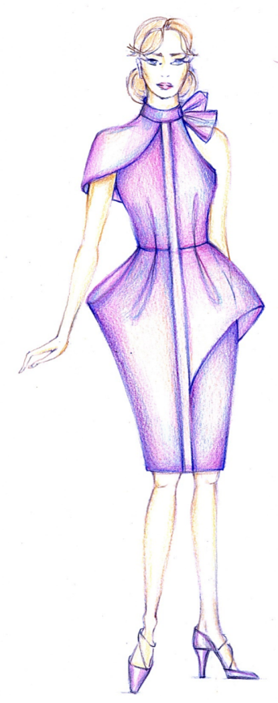
Combined asymmetric silhouette. The left part is in O under waist or vase silhouette. The right part combines Y line and vase. The lower part of the dress is asymmetric. It is formed by a peplum and a tuck in the left, and a drape and a tuck in the right. A bow in the collar balances the sleeve, which forms the Y line in the right.
CC BY Ilieva

Slide 31
An asymmetric dress, combined Y line in the left upperpart and vase silhouette. Y line is formed by the forms of the asymmetric neckline and the sleeve. The vase form is a result of a combined peplum, a doble peplum in the right and a single peplum in the left.
CC BY Ilieva

Slide 32
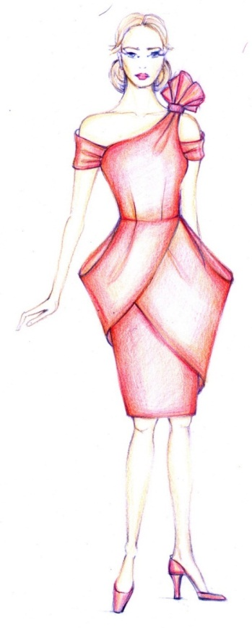
An asymmetric dress in a silhouette that combines vase form under the waist and Y line over the waist. The volume forms of the sleeves, which made Y line, and the peplum, which made vase form, are shaped by one-sided and bi-sided tucks. The asymmetric peplum is balanced by a bow in the left shoulder.
CC BY Ilieva

Slide 33
A dress in a silhouette, which combines vase form under the waist and Y line over the waist. Y line is shaped by a big collar and neckline. The vase form is formed by a peplum. The asymmetric peplum is balanced by the asymmetric neck opening and collar.
CC BY Ilieva

Slide 34
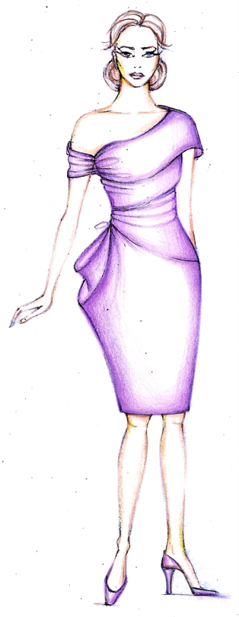
A dress in a silhouette, which combines Y line and vase in the right and Y line in the left. Y line is shaped by an asymmetric neckline and sleeves. The vase form in the right is formed by a drape. The asymmetric situated drape in the right is balanced by the bigger sleeve in the left.
CC BY Ilieva

Slide 35
Design Principles
In creation of sustainable fashion products, the designers must not compromise on the application of the design principles.
There are many examples of zero waste fashion designs, upcycled designs, circular designs, etc., which are with not so good aesthetic value. The balance have to be found between a sustainable fashion conception and the applying of the design principles, which are symmetrical and asymmetrical balance, proportions, rhythm, emphasis, unity.
There is a principle which is strongly connected with sustainability. It is the proportion. The proportions in combination with symmetrical or asymmetrical balance determine the next principles of rhythm, emphasis, and unity.
Notes:
Jirousek Ch. (1995). Art, Design and Visual Thinking. Cornell University. http://char.txa.cornell.edu/

Slide 36
Sustainable Proportions
The Golden ratio and Fibonacci sequence are applied as proportions in design as expressers and symbols of beauty and harmony.
Their symbolism is a result of strong connections in their mathematical nature.
The golden ratio has been applied as harmonic proportion in the art and architecture since the ancient times. In more recent times, the relations between Fibonacci numbers have been also beginning to be used as harmonic proportions. Therefore, the proportional relations of the golden ratio and Fibonacci sequence are the best examples of sustainable proportions.

Slide 37
The Golden Ratio
The Golden section is a number, introduced with Greek letter φ, which is found by dividing a line into two parts as the longer part divided by the smaller part is equal as the whole length of longer and smaller parts divided by the longer part, or
φ = a/b = (a+b)/a = 1.61803398874989484…
Sometimes the Golden ratio is presented in a turned way in which the number is equal to the division of the smaller by the longer part equal to the division of the longer part by the whole length of the line, or
b/a = a/(a+b) = 0.61803398874989484…
CC0 Kazlacheva

Slide 38
The oldest example of the applying of the golden ratio in clothing
Caryatids of Athens’ Acropolis. The peplos of the chiton divided the woman’s body in golden proportions.
CC BY-SA-ND Kazlacheva

Slide 39
Fibonacci Sequence
Fibonacci numbers are the sequence of numbers defined by the linear recurrence equation
F_{n} = F_{n-1} + F_{n-2}
with F₁ = F₂ = 1. As a result of the definition, it is conventional to define F₀ = 0.
The Fibonacci numbers for n = 1, 2, ... are 1, 1, 2, 3, 5, 8, 13, 21, ...

Slide 40
The Golden and Fibonacci Proportions
In fashion design the golden ratio and Fibonacci sequence can be used in creation of beautiful and harmonic forms directly or with the help of geometrical figures and tiles. The geometrical figures are:
The golden triangle: an isosceles acute-angled triangle with golden proportion φ between the lengths of both same sides and the base, which is equal to 1,618…;
The golden rectangle: a rectangle with golden proportion φ between the lengths of the sides;
The golden ellipse: an ellipse with golden proportion φ between both axes;
Figures in Fibonacci numbers proportions can be created similarly to the golden ones.

Slide 41
In directly use the golden section and Fibonacci numbers proportions can be in one and the same or different directions. In the application with the help of geometrical figures the golden ratio and Fibonacci sequence shapes combine proportioning and form creation. The golden section and Fibonacci series figures can be used directly as forms or as frames of forms creation of elements and pieces. Its application can be in different directions and location according the bodice. The golden ration and Fibonacci sequence can combine proportions with other principles of design as symmetrical and asymmetrical balance, rhythm, emphasis, and unity.

Slide 42
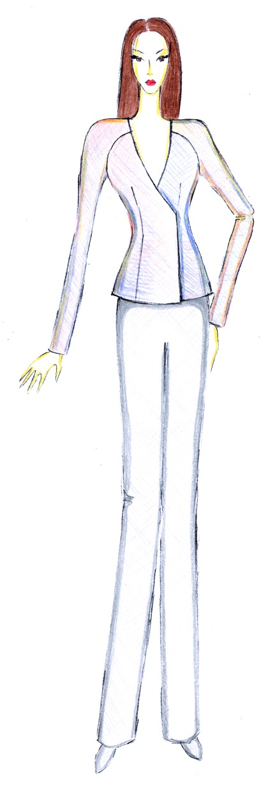
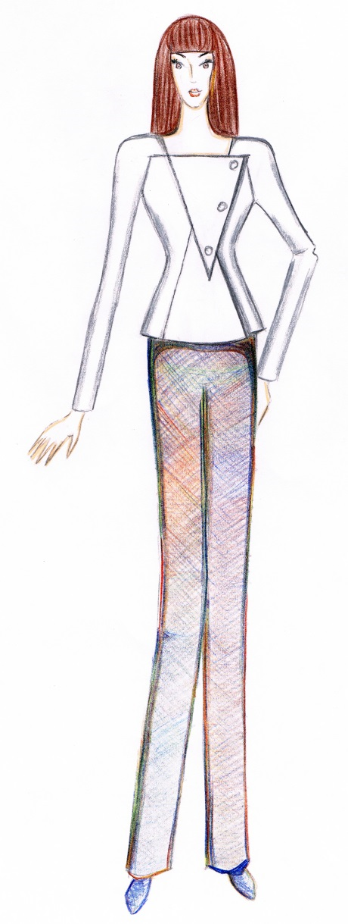
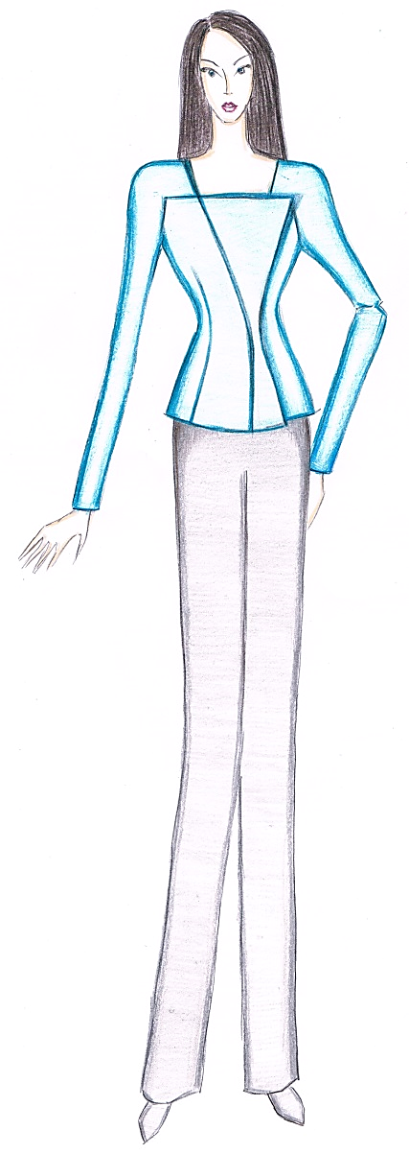
Application of the golden triangle in fashion design
The triangle is used directly or as a frame of forming of shapes of elements and pieces in presented designs.
CC BY Kazlacheva

Slide 43
Application of the golden rectangle and the golden ellipse in fashion design
The rectangle and ellipse are used directly or as a frame of forming of shapes.
CC BY Kazlacheva

Slide 44
The Golden and Fibonacci Tilings
The tiles are the other way of integration of the golden ratio and Fibonacci sequence in fashion design. The tilings are crated with geometric figures: triangles, squares and rectangles with ratio between sizes of their sides, equal to the golden and Fibonacci proportions. These tiles can be applied in design of clothes and accessories not only for applying of sustainable aesthetic and harmonic proportions, but they give possibilities of utilization of small pieces of fabrics. The most appropriate golden and Fibonacci tilings are:
The golden triangle tiling;
Fibonacci series tilings with squares (both types);
Fibonacci sequence tiling with quilateral triangles (Fibonacci rose).

Slide 45
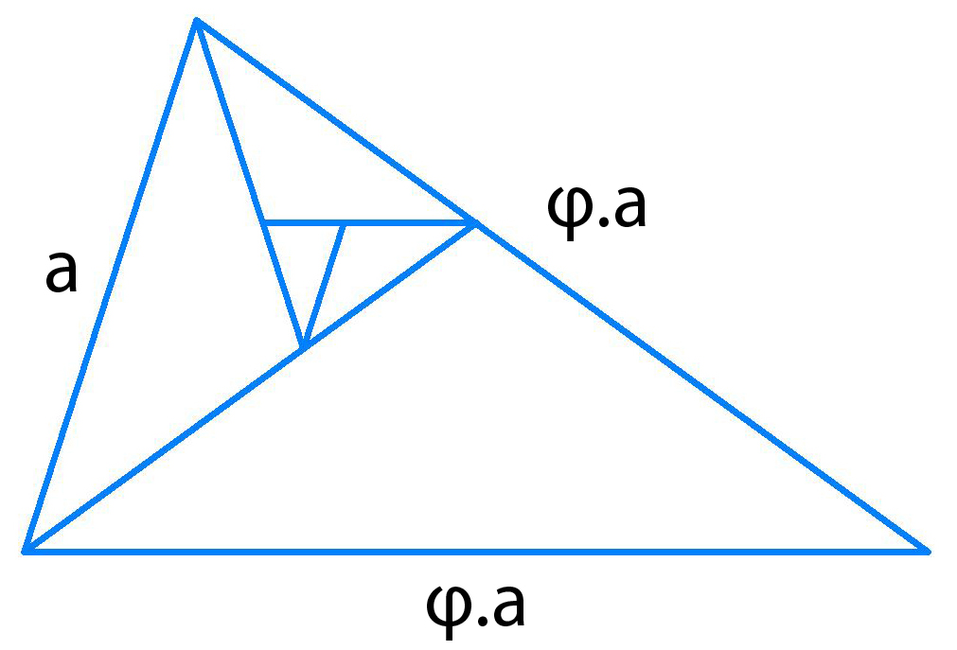
The Golden Triangle Tiling
The golden triangle is an isosceles acute-angled triangle with golden proportion φ between the lengths of both same sides and the base, which is equal to 1,618… The acute-angled golden triangle is a base of a tilling in which obtuse-angled golden triangles form a spiral. The obtuse-angled golden triangle is an isosceles triangle with golden ratio between the lengths of both same sides and the base, equal to 0,618…
CC0 Kazlacheva

Slide 46
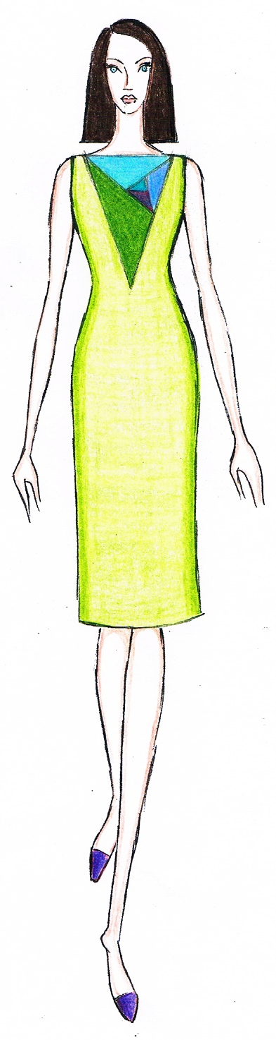
In presented designs of women’s dresses, the golden triangle tiling is used directly in whole.
CC BY Kazlacheva
Notes:
The triangles in the tiling are presented in different color models: combinations of 2, 3 and 4 colors.

Slide 47
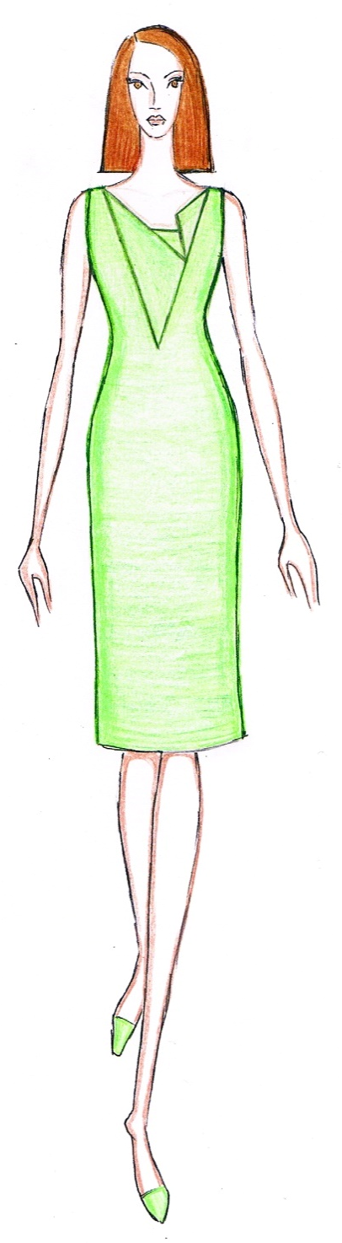
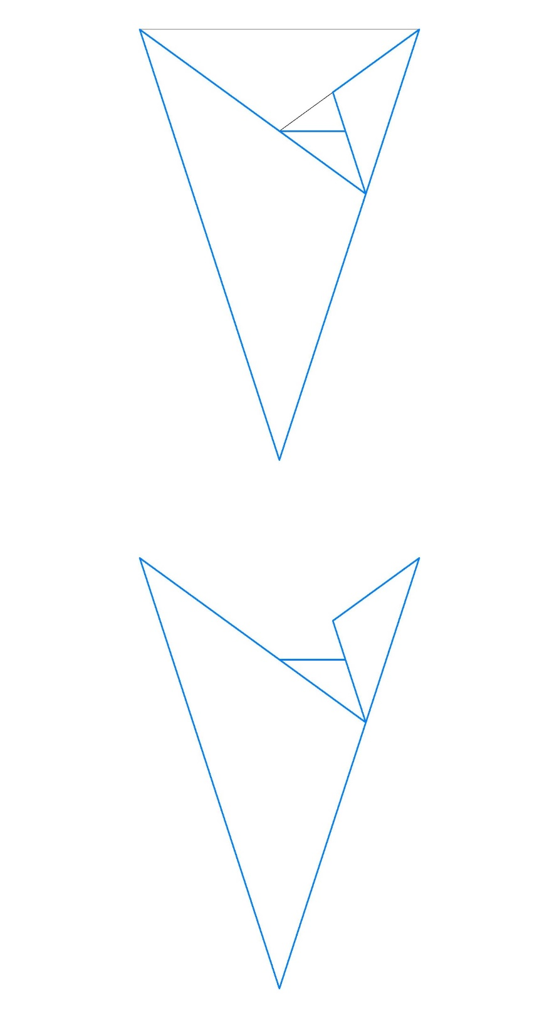
The golden triangle tiling is non whole applied in presented design.
CC BY Kazlacheva
CC0 Kazlacheva

Slide 48
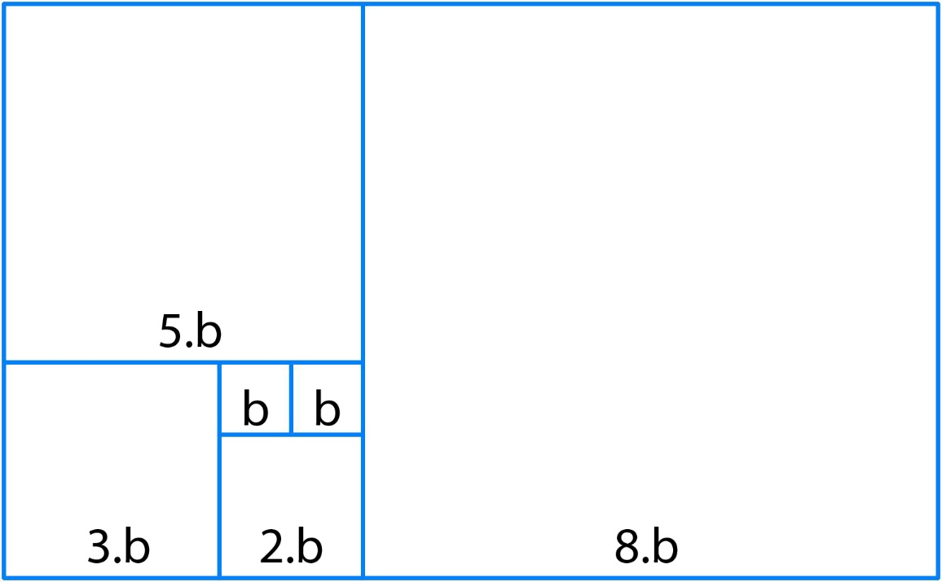
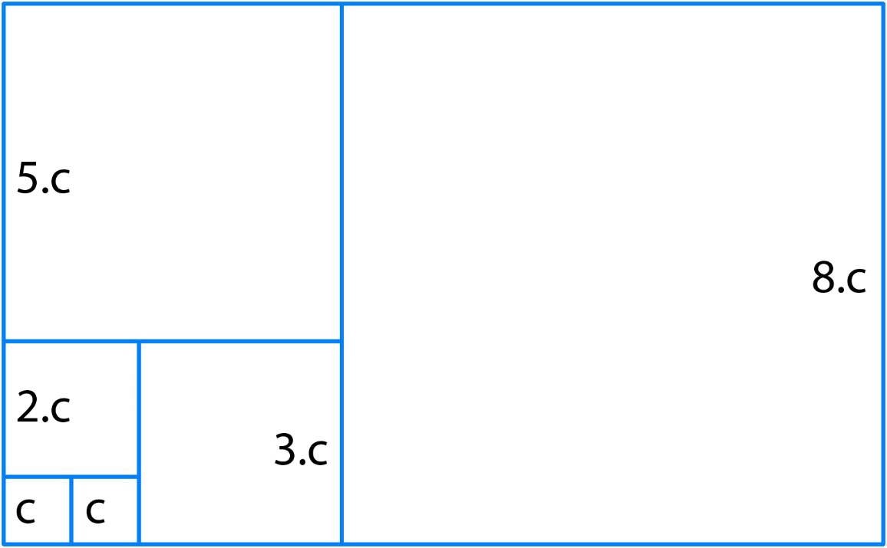
Fibonacci Series Tilings with Squares
There are two types of Fibonacci sequence tiles with squares, one, in which squares form a spiral (in left) and one with squares, which are set in two perpendicular directions (in right). In both tiles, the ratio between consecutive set squares is equal to Fibonacci numbers.
CC0 Kazlacheva

Slide 49
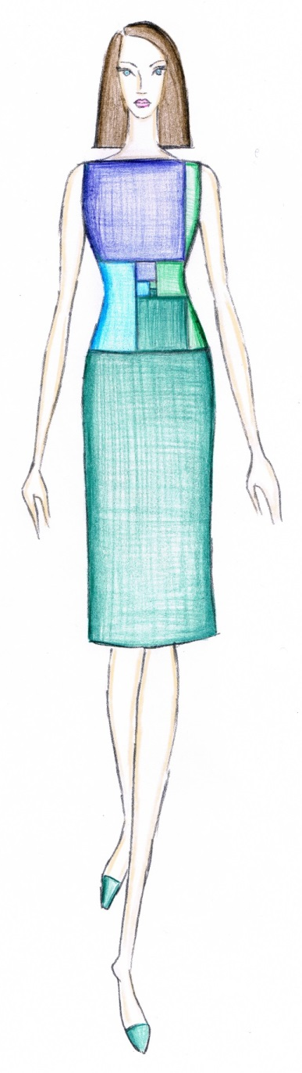
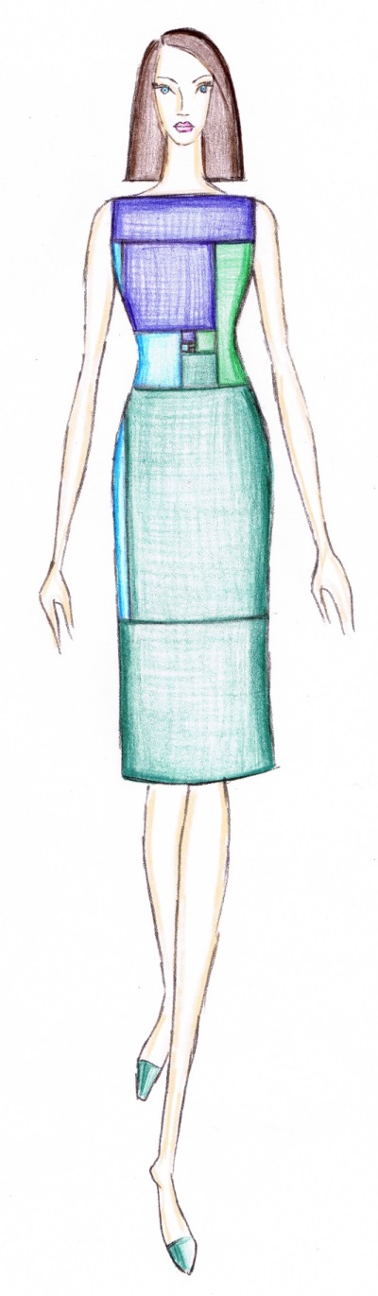
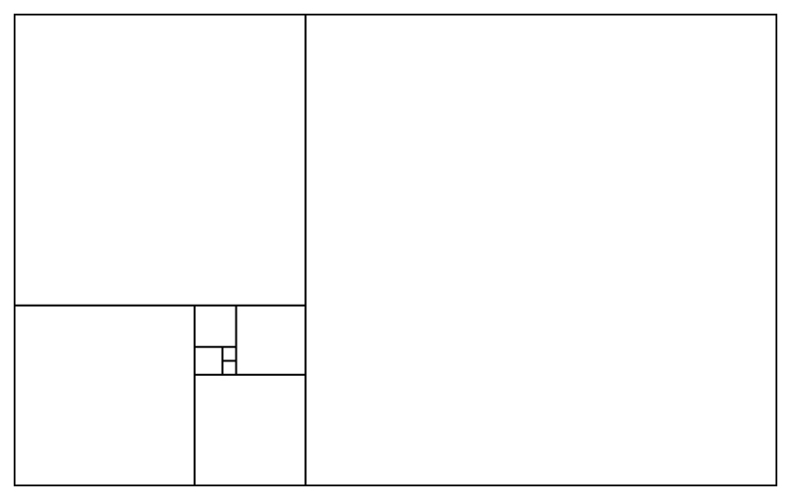
Fibonacci Square Spiral Tiling
CC0 Kazlacheva
Presented designs of women’s dresses are created with the use of Fibonacci series tiling with squares, which forms a spiral pattern.
CC BY Kazlacheva

Slide 50
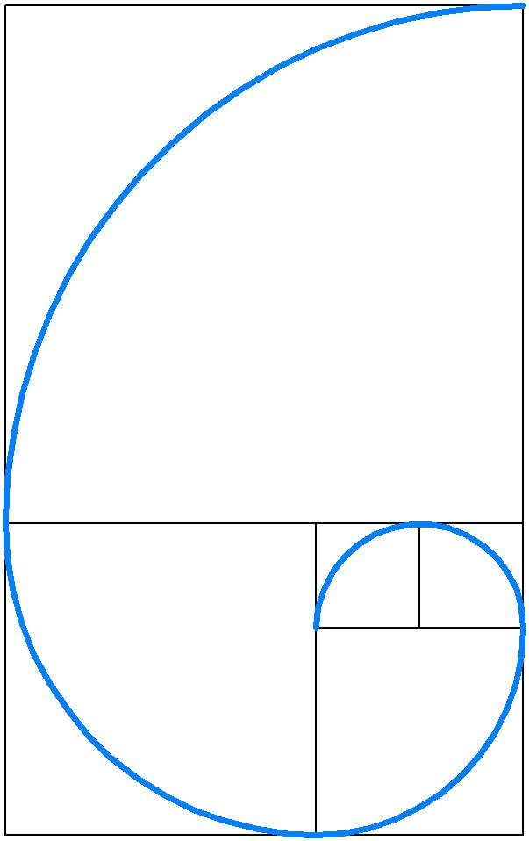
Fibonacci Spiral
Fibonacci series tiling with squares in a spiral pattern is used as a base of creating of Fibonacci spiral. Similarly, to Fibonacci spiral, the Golden spiral is created based on a tiling in a spiral form made by golden rectangles.
Fibonacci series tiling with squares in a spiral pattern and Fibonacci spiral can be used in creation in different forms. Similarly, to Fibonacci spiral, the Golden spiral can be used in fashion design.
CC0 Kazlacheva

Slide 51
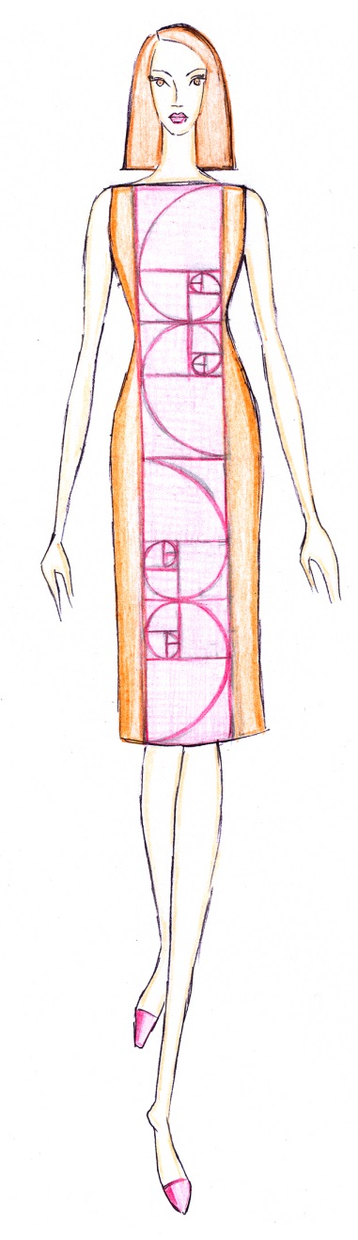
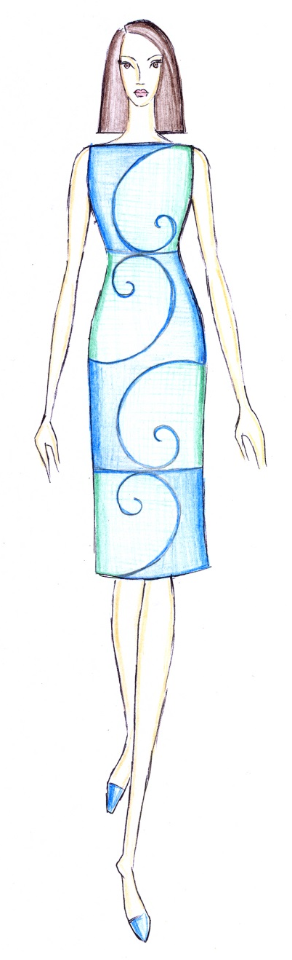
Presented designs of women’s dresses are with application of Fibonacci spiral with or without the frame of Fibonacci tiling with squares in a spiral form.
CC BY Kazlacheva

Slide 52
Fibonacci Butterfly
Two Fibonacci spirals in connection of a bilateral symmetry create a form of stylized butterfly, named Fibonacci butterfly.
CC0 Kazlacheva

Slide 53
Presented designs of women’s dresses are created applying Fibonacci butterfly with or without the frame of Fibonacci tiling with squares in a spiral form.
CC BY Kazlacheva

Slide 54
CC BY Kazlacheva, Ilieva
Jewels and accessories in form of Fibonacci butterfly, made by recycled materials.

Slide 55
The ornament of golden butterfly and its application as print in personalized designs of a bag, a watch, a laptop case, and a face mask. For personalization web-based services are used:
https://studio.shopvida.com, https://artofwhere.com, https://www.zazzle.com, etc.
CC BY Ilieva

Slide 56
Fibonacci Square Spiral Tiling
Fibonacci series tiling with squares in a spiral pattern can be used as a base of creating of spiral forms with different geometric elements or figures included in the tiling frame. For example, the figure shows circles, entered in the squares, which can be applied in design with or without the frame of the tiling.
CC0 Kazlacheva
CC0 Kazlacheva

Slide 57
Presented designs of women’s dresses are created with application of spirals made by geometrical elements or figures entered in squares of Fibonacci tiling with squares in a spiral form. The left design applies spirals based on diagonals in squares in the frame of the tiling. The left design is with entered circles without the frame of the tiling.
CC BY Kazlacheva

Slide 58
Fibonacci Hearth
Two Fibonacci spirals, made by diagonals of the squares of Fibonacci square spiral tiling in connection of a bilateral symmetry create a form of stylized hearth, named Fibonacci heart.
CC0 Kazlacheva

Slide 59
A women’s dress made with application of Fibonacci heart in style patchwork.
CC BY Kazlacheva

Slide 60
Fibonacci Tiling with Squares in Perpendicular Direction
Fibonacci series tiling with squares arranged in two perpendicular linear directions (put side by side, or parquet tiling) is not too popular as Fibonacci tiling with squares in a spiral form, but it gives opportunities of use in fashion design too. The tiling’s application in women’s dresses designs is presented in the next slide.
CC0 Kazlacheva

Slide 61
CC BY Kazlacheva

Slide 62
Fibonacci Series Tiling with Triangles
The figure presents the only one possible Fibonacci sequence tiling with equilateral triangles, known as Fibonacci rose.
In Fibonacci rose, the equilateral triangles with sides in proportional relationship of Fibonacci sequence, form two spirals.
CC0 Kazlacheva

Slide 63
In presented designs of women’s dresses, Fibonacci rose is used directly in whole.
CC BY Kazlacheva

Slide 64
Fibonacci rose is used as a base of creation of a double spiral. The double spiral can be applied in fashion design with or without Fibonacci rose tiling.
CC BY Kazlacheva

Slide 65
Fibonacci rose can be used as a base of creating of spiral forms with different geometric elements or figures included in the tiling frame. For example, the figure shows circles, entered in the triangles, which can be applied in design with or without the frame of the tiling.
CC BY Kazlacheva

Slide 66
A handbag made with application of Fibonacci rose in style patchwork.

Slide 67
Textile Designs
Textile pattern designs can be developed on the base of geometric elements of the golden and Fibonacci geometry. For example, fifth of them are presented. From left to right: a variant of flower of life, one of the most popular geometrical elements, which is floral one too; a rose, result of the golden circles spiral or Fibonacci circles spiral; a Venus flower, created by golden or Fibonacci spirals; a clover, created by golden or Fibonacci spirals; and a flower of life with approximation of circles with straight lines.
CC BY Ilieva

Slide 68
CC BY Ilieva

Slide 69
CC BY Ilieva

Slide 70
CC BY Ilieva

Slide 71
CC BY Ilieva

Slide 72
CC BY Ilieva

Slide 73
Conclusion
A study on the long life fashion elements shows some reasons for their sustainability in trends: They are with high aesthetic value and are elegant and feminine ones. They can be combined easily each other or with other elements of fashion design.
The applying of the sustainable golden ration and Fibonacci sequence proportions gives beauty, harmony and sustainability in fashion design of clothes and accessories, and textile design. The use of the golden section and Fibonacci series bring aesthetics in designs, based on different sustainable conceptions (zero waste, upcycled, circular designs, etc.) and can be applied as emphasizers of the long life fashion elements.

Slide 74
References and Further Reading
Staniforth, S. (2010). Slow Conservation. Studies in Conservation 55 (2): 74-80. https://doi.org/10.1179/sic.2010.55.2.74
Marquis, Ch. (2021). What Does Slow Fashion ‘Actually’ Mean?. Forbes. https://www.forbes.com/sites/christophermarquis/2021/05/14/what-does-slow-fashion-actually-mean/?sh=63114e1273b4
Clark, H. (2008). SLOW + FASHION – an Oxymoron – or a Promise for the Future …?. Fashion Theory 12 (4): 427–446
Kuusk, K., Tomico, O., Langereis, G., Wensveen, S. (2012). Crafting smart textiles – a meaningful way towards societal sustainability in the fashion field?. The Nordic Textile Journal 1: 6–15. http://hb.diva-portal.org/smash/get/diva2:869634/FULLTEXT01.pdf
Runway. Vogue. https://www.vogue.com/fashion-shows
Fortuni (2021). Delphos Fortuny: the story of a dress that became an icon. Fortuni. https://www.fortuny.shop/blog/stories/delphos-fortuny-the-story-of-a-dress-that-became-an-icon/
Queen of the bias cut. Design086-Blog. https://design086-blog.tumblr.com/post/3434557161/queen-of-the-bias-cut-history

Slide 75
Gerakiti, E. (2021). Madame Grès, The Sphinx of Fashion. Daily Art Magazine. https://www.dailyartmagazine.com/madame-gres-the-sphinx-of-fashion/
Phelan, H. (2012). 25 Women Designers Who Changed Fashion Forever. Fashionista. https://fashionista.com/2012/05/25-of-the-most-influential-female-designers-that-changed-fashion-forever#9
Rose, C. (2011). Finding Fidelity within the Fashion House. Crafts
Kazlacheva, Z., Kosinkova-Stoeva, A. (2021). An investigation of pattern design of draped necklines. IOP Conf. Ser.: Mater. Sci. Eng. 1031 012022. https://doi.org/10.1088/1757-899X/1031/1/012022
Kosinkova-Stoeva, A., Kazlacheva, Z. (2022). A study on making of patterns of asymmetric draped necklines. AIP Conference Proceedings (in print)
Kazlacheva, Z., Ilieva, J. (2018). An investigation of design of twist knot drape clothes. IOP Conf. Ser.: Mater. Sci. Eng. 459 012079. https://doi.org/10.1088/1757-899X/459/1/012079
Peneva, T., Kazlacheva, Z., Ilieva, J. (2021). Adaptation of a system for pattern design of twist knot draperies for knitted fabrics. IOP Conf. Ser.: Mater. Sci. Eng. 1031 012023. https://doi.org/10.1088/1757-899X/1031/1/012023

Slide 76
Kazlacheva, Z. (2019). Pattern Design of Twisted Draperies with Decorative and Constructive Function. ARTTE Applied Researches in Technics, Technologies and Education 7 (1): 1-9
Caedini, T. (2020). Dior’s Bar Jacket: A Brief History. Vogue. https://www.vogue.com/article/christian-dior-bar-jacket-a-brief-history
Dineva, P. (2022). Investigating sustainable design of 3D peplum clothes. AIP Conference Proceedings (in print)
Jirousek, Ch. (1995). Art, Design and Visual Thinking. Cornell University. http://char.txa.cornell.edu/
Hom, E. J. (2013). What is the Golden Ratio?. LifeScience. http://www.livescience.com/37704-phi- golden-ratio.html
Hom, E. J. (2013). What is the Fibonacci Sequence?. LifeScience. http://www.livescience.com/37470-fibonacci-sequence.html
Baird, E. (2009). Fibonacci Series Tiling, with Triangles. ErkDemon. http://erkdemon.blogspot.com/2009/06/fibonacci-series-tiling-with-triangles.html

Slide 77
Kazlacheva, Z., Ilieva, J. (2013). The Golden Triangle in Fashion Design. Proc. of International Symposium in Knitting and Apparel - ISKA 2013, Iasi, Romania: 187-193
Kazlacheva, Z. (2014). Fibonacci Squares in Fashion Design. ARTTE Applied Researches in Technics, Technologies and Education 2 (2): 91-98
Kazlacheva, Z. (2014). Fibonacci Rose in Fashion Design. ARTTE Applied Researches in Technics, Technologies and Education 2 (3): 224-230
Kazlacheva, Z. (2017). An investigation of application of the golden ratio and Fibonacci sequence in fashion design and pattern making. IOP Conf. Ser.: Mater. Sci. Eng. 254 172013. https://doi.org/10.1088/1757-899X/254/17/172013
Ilieva, J., Kazlacheva, Z., Dineva, P., Indrie, L. and Florea-Burduja, E. (2021). A study on application of the golden and Fibonacci geometry in design of fashion accessories. IOP Conf. Ser.: Mater. Sci. Eng. 1031 012026. https://doi.org/10.1088/1757-899X/1031/1/012026
Ilieva, J. (2021). Development of floral textile patterns on the base of the golden and Fibonacci geometry. IOP Conf. Ser.: Mater. Sci. Eng. 1031 012027. https://doi.org/10.1088/1757-899X/1031/1/012027

Slide 78
Contacts
Faculty of Technics and Technologies of Yambol,
Trakia University of Stara Zagora, Bulgaria
Assoc. Prof. Dr. Zlatina Kazlacheva
e-mail: zlatinka.kazlacheva@trakia-uni.bg
Asst. Prof. Dr. Julieta Ilieva
e-mail: zhulieta.ilieva@trakia-uni.bg
Asst. Prof. Dr. Petya Dineva
e-mail: petya.dineva@trakia-uni.bg

