Slide 1




Pattern Making in the Context of Sustainability

Slide 2
Learning Objectives
After this lecture you should be able to:
Make correct patterns of women’s clothes with sustainable long life fashion elements of all types of drapes using facilitated constructional sequences and easy calculations.
Make correct patterns of women’s clothes with long life fashion element of peplum.
Design patterns with sustainable proportions of the golden ratio and Fibonacci sequence in direct use or with application of geometric figures.
Create pattern designs with lower consumption of textile material and minimizing cutting waste.
Create zero waste pattern designs.

Slide 3
Slow Fashion Trendless Designs and Pattern Making
The slow fashion trendless designs are result of combinations of high quality design, making of high quality pattern, and high quality of fabrics and other materials.
In other words, the high quality design, based on the long life fashion elements, require high accuracy of the geometrical constructional approaches, used for pattern making of clothes with their application.

Slide 4
Long Life Fashion Elements
As it is shown in the previous topic, the elements with long life in fashion are:
Drapes: free drapery; drape, formed with a seam or darts; twist knot drape, or drapery, fixed in a knot; and twisted drapery.
Other 3D elements. The tucks, pleats, gathers, and ruffles are with long life in fashion too.
Peplums.
Non volume silhouettes. They are always in trends.
The next slides present geometrical approaches of accurate and facilitated pattern design of clothes with the fourth types of drapes.

Slide 5
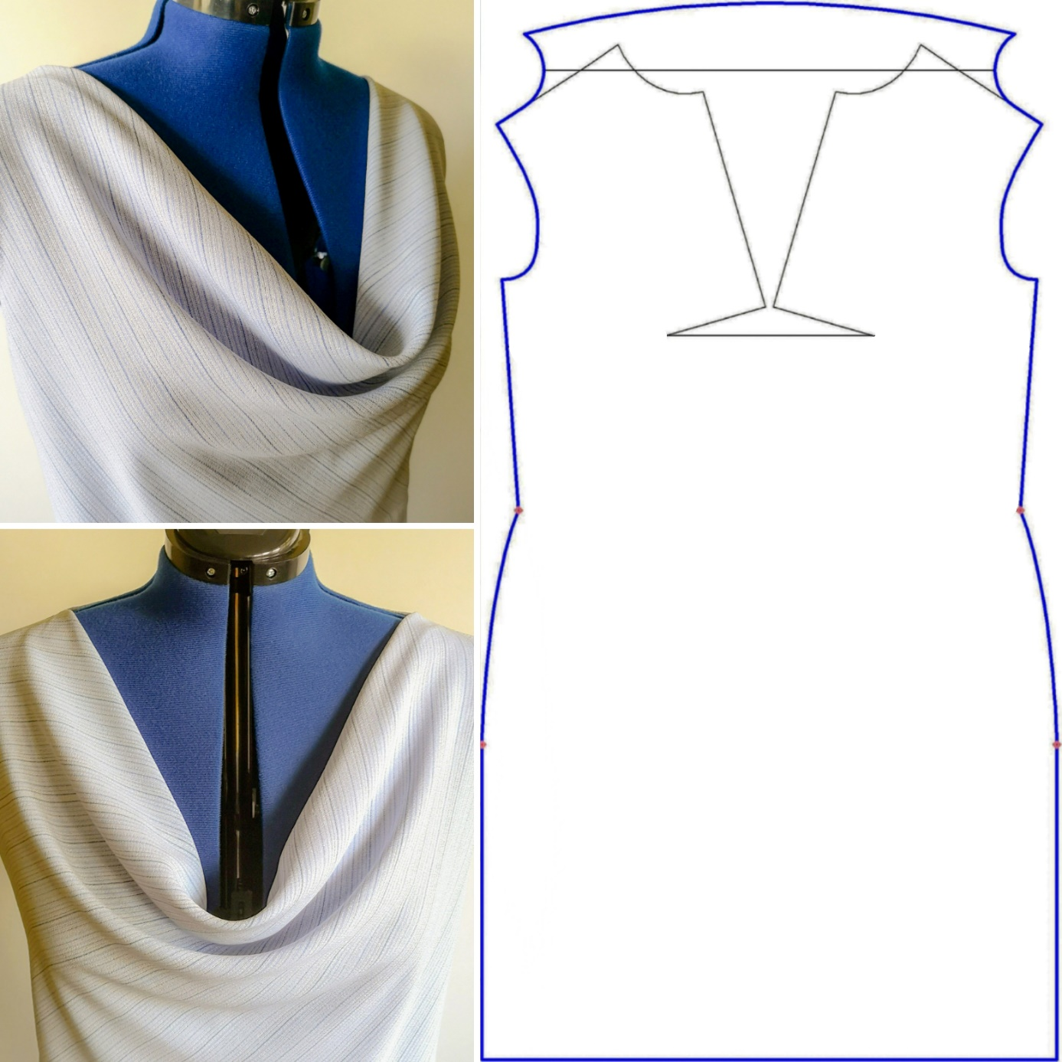
Draped Neckline
The volume of drape folds is a result of darts’ rotation. The drape sometimes needs additional opening in the rotated darts or seldom in other splits of the piece. The easy and correct pattern design is realized through zero or minimized number of splits of the piece, as the number of the drape folds depends on the form of the curves of shoulders.
CC BY Kazlacheva
Notes:
The draped neckline, named Greek neckline, is the most popular free drape.
Kazlacheva, Z., Kosinkova-Stoeva, A. (2021). An investigation of pattern design of draped necklines. IOP Conf. Ser.: Mater. Sci. Eng. 1031 012022. https://doi.org/10.1088/1757-899X/1031/1/012022

Slide 6
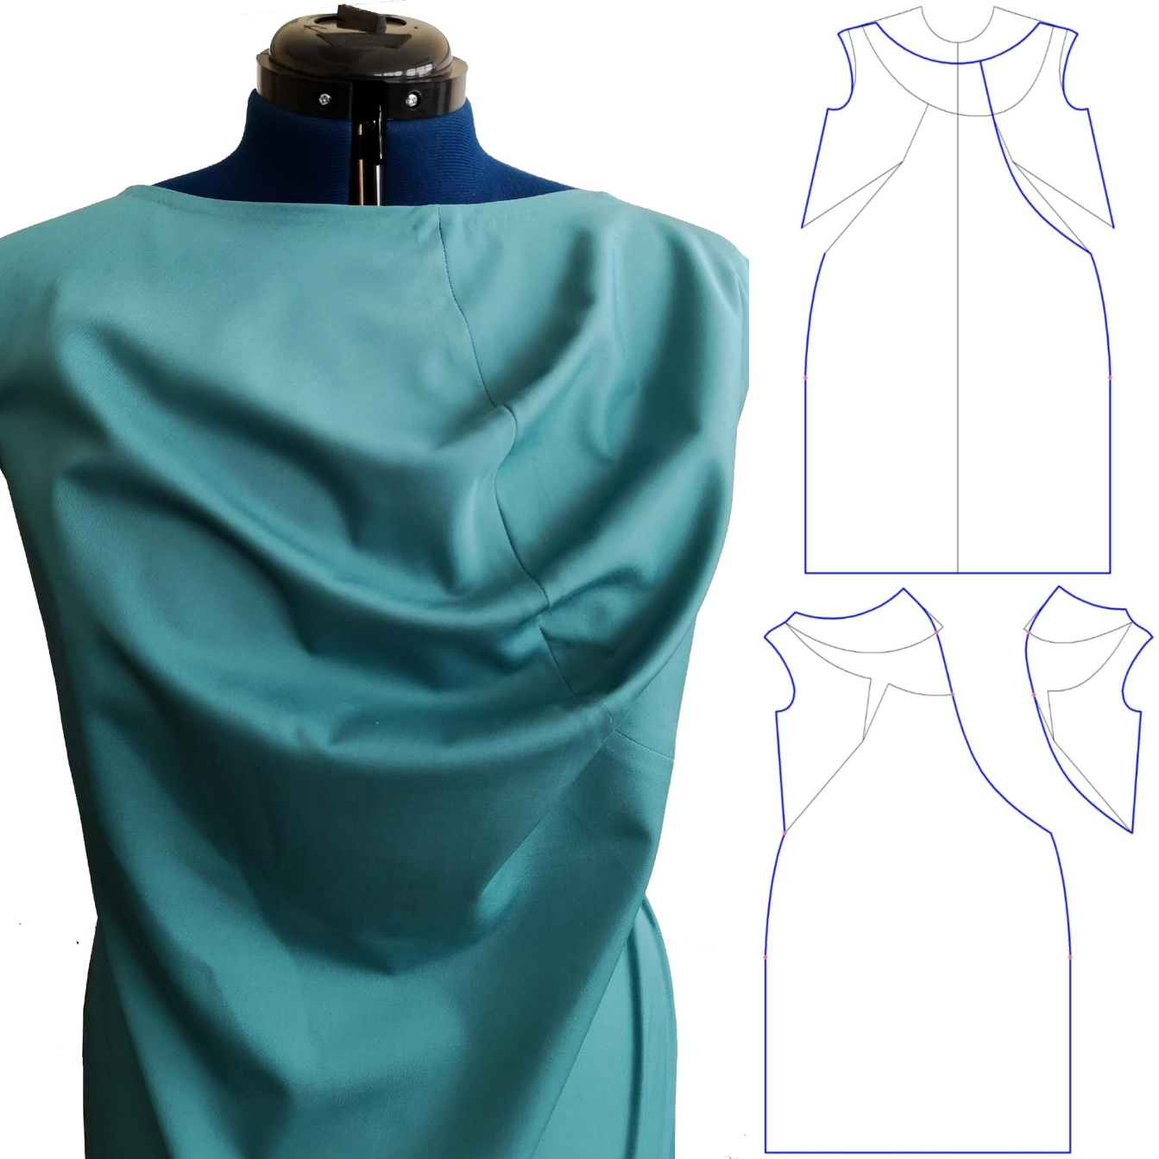
Drape Formed with
a Seam or Darts
Similarly to the symmetric draped neckline (free drape), the pattern making of clothes with asymmetric draped neckline (made with a seam or darts), is constructed based on rotation of darts and additional opening in the rotated darts or other divisions. Minimized number of splits gives more accuracy and facilitates the pattern design.
CC BY Kazlacheva
Notes:
Kazlacheva, Z., Ilieva, J., Peneva, T. (2019). Fashion and Pattern Design of Ladies’ Dresses with Transformation of Different Types of Draperies. ARTTE Applied Researches in Technics, Technologies and Education 7 (1): 10-23

Slide 7
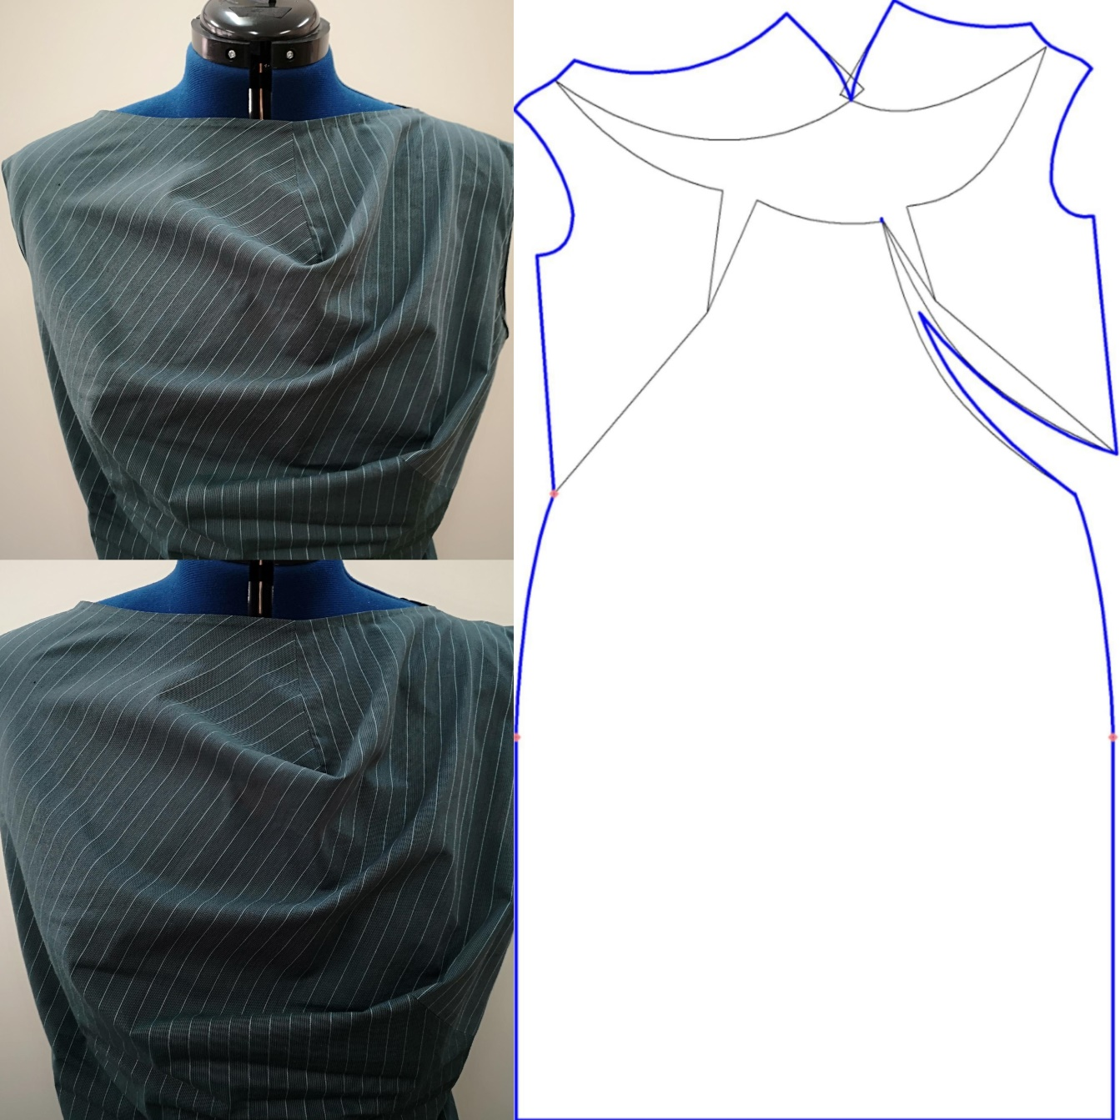
CC BY Kazlacheva
Pattern designs, made with a seam (in blue) and with darts (in green).

Slide 8
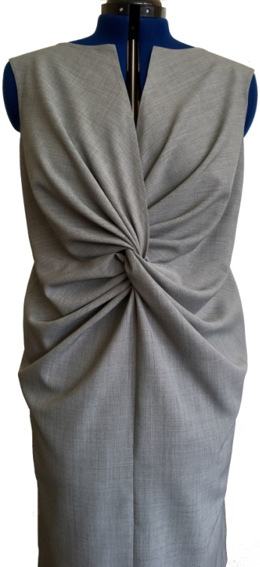
Twist Knot Drape
The correct and facilitated pattern making is a result of the minimizing of the piece’s divisions for drape’s folds and a dependence between the diameter of the twist knot and the width of the draped places, presented by formulas:
W = 5,15 . D – 4,4,
D = 0,2 . W + 0,85,
where W, cm is the widths of the draped pieces in the place of twist; D, cm - the diameter of the knot.
CC BY Kazlacheva
Notes:
Kazlacheva, Z., Ilieva, J. (2018). An investigation of design of twist knot drape clothes. IOP Conf. Ser.: Mater. Sci. Eng. 459 012079. https://doi.org/10.1088/1757-899X/459/1/012079

Slide 9
Twist Knot Drape
Depending on the design idea, a variant of the formula is used.
The width of the draped pieces in the place of twist W is limited from 16,5 tо 32,5 cm. The width bigger than 32,5 cm leads to unnecessary volume. The minimal width is 16,5 cm, because the smaller width leads to small number and volume of folds.
The applying of the formulas gives possibility of correct pattern design for all combinations of sizes of the diameter of the knot D and the width of the draped pieces W in the limited values.
CC BY Kazlacheva
Notes:
Kazlacheva, Z., Ilieva, J. (2018). An investigation of design of twist knot drape clothes. IOP Conf. Ser.: Mater. Sci. Eng. 459 012079. https://doi.org/10.1088/1757-899X/459/1/012079

Slide 10
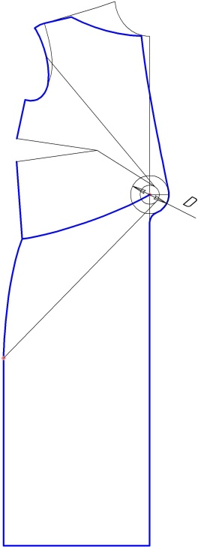
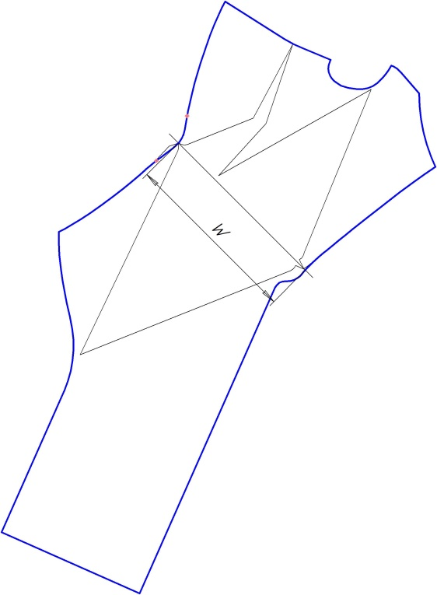
Twist Knot Drape
For presented design:
D = 7,0 cm, W = 31,65 cm.
W is calculated on the base of D, using the equation:
W = 5,15 . D – 4,4.
CC BY Kazlacheva

Slide 11
Twist Knot Drape
The pattern making on the front is shown. The center of the circle of the knot with diameter D = 7,0 cm is located on the front middle line between the waist and the bust dart apex. The seam of connection of both twisted pieces is under the knot circle by the middle line. The neck opening is formed over the circle of the knot. The seam of drapery fixing is situated between the center of the knot circle and the point of intersection of the waist and the side seam.
CC BY Kazlacheva

Slide 12
Twist Knot Drape
A second circle is drawn with the same center of the knot circle, but with diameter which is half of the dimeter of the knot. The lines, which determine the places of additional volume for drapery, are tangents to the smaller circle. They start from the arm hole and bust dart for the top part of the draped piece, and the point of interaction of hip and side seam for the down part of the draped piece.
CC BY Kazlacheva

Slide 13
Twist Knot Drape
It is presented the pattern of the draped piece after additional opening for drapery volume, which sizes the width of the draped pieces in the place of twist W = 31,65 cm. After the additional opening the upper and lower parts of the draped piece are connected each other on a line in diagonal direction (the skew direction of the fabric), which determines the place of twisting.
CC BY Kazlacheva

Slide 14
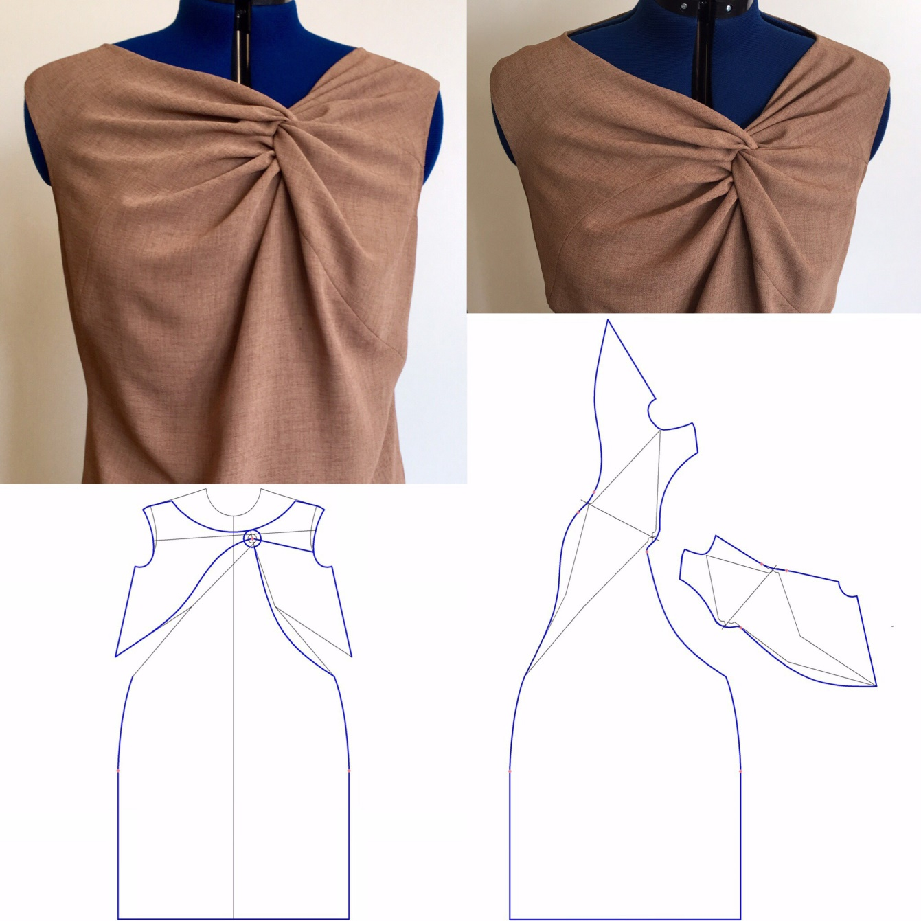
Twist Knot Drape
For presented design:
W = 16,5 cm, D = 4,15 cm.
D is calculated on the base of W, using formula:
D = 0,2 . W + 0,85.
CC BY Kazlacheva

Slide 15
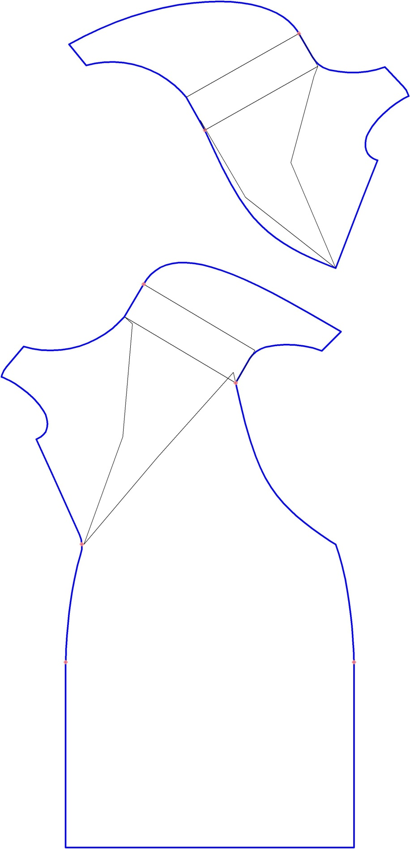
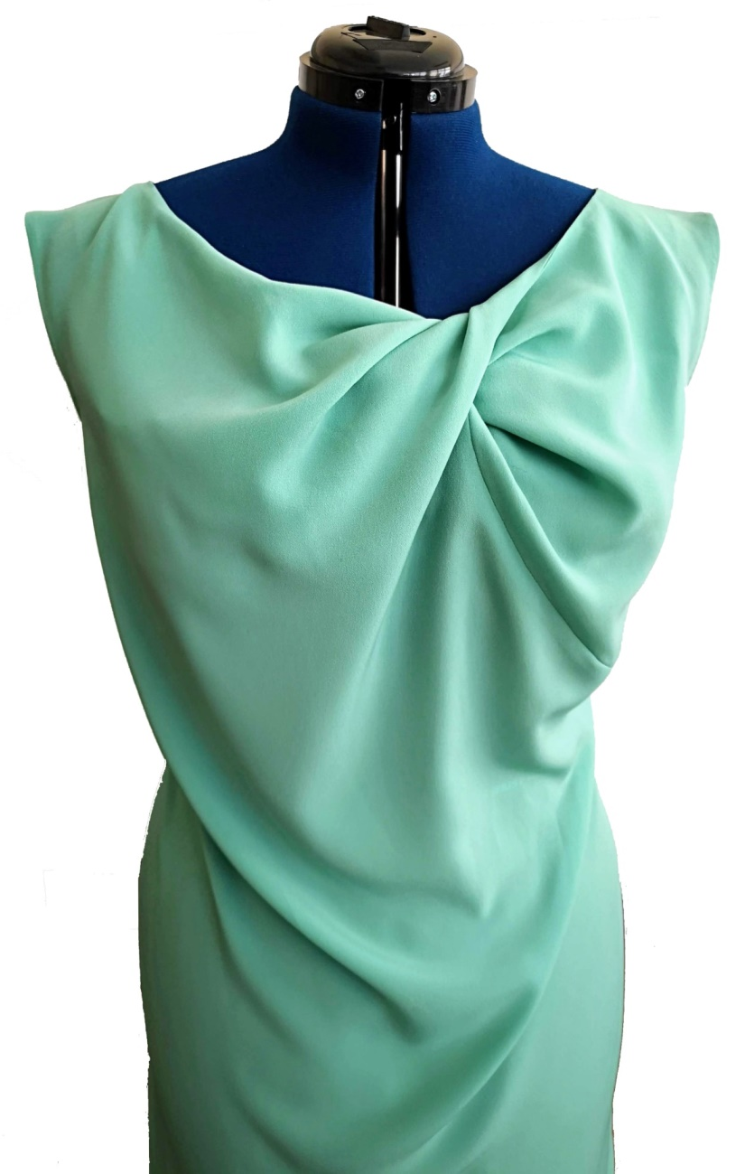
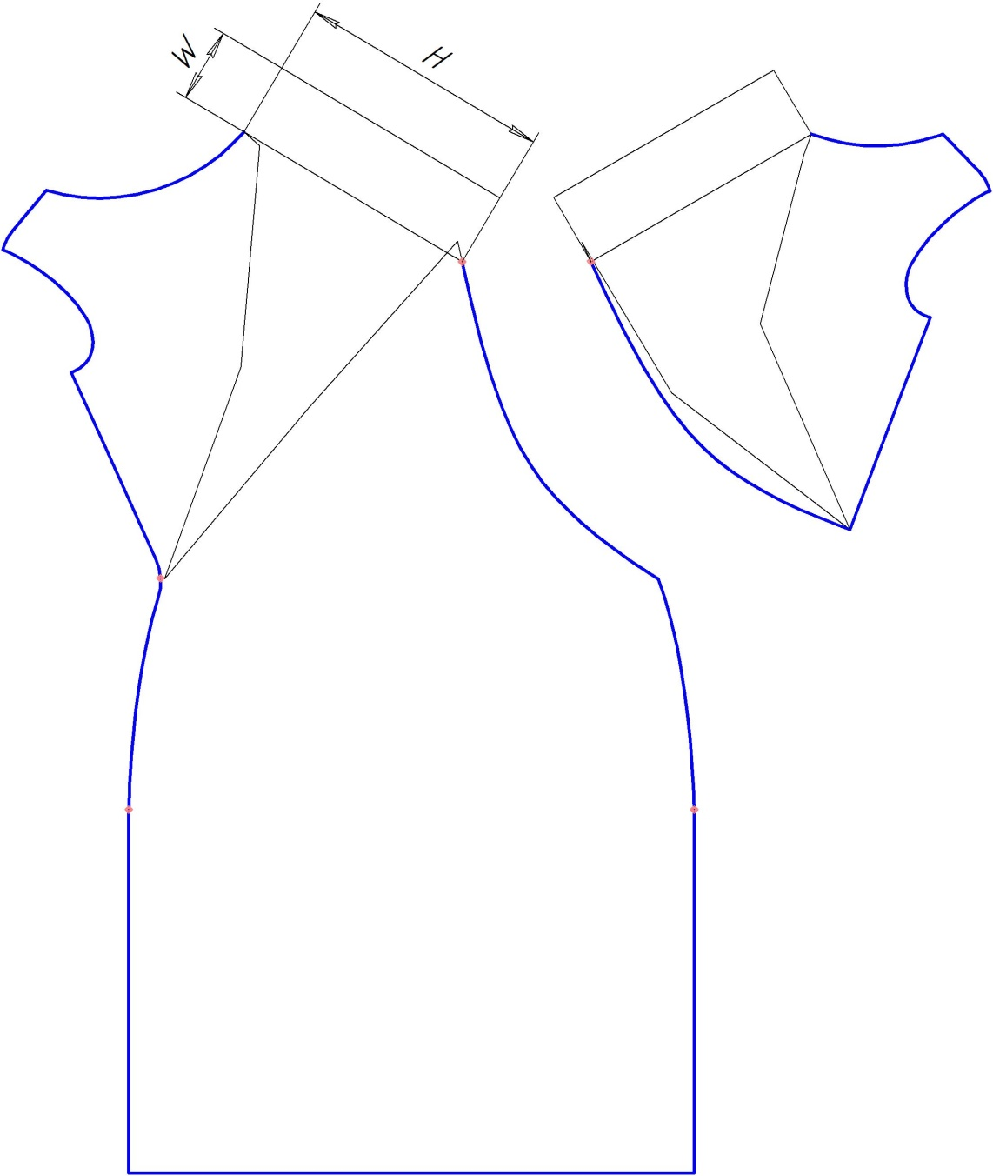
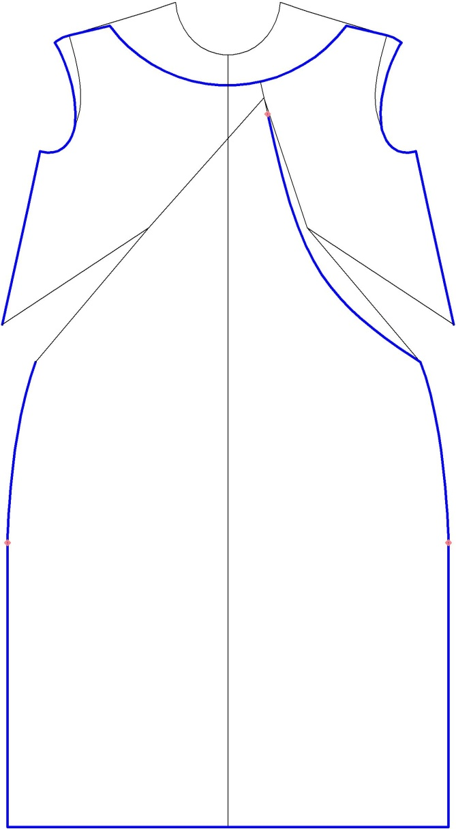
Twisted Drape
CC BY Kazlacheva
Notes:
Kazlacheva, Z. (2019). Pattern Design of Twisted Draperies with Decorative and Constructive Function. ARTTE Applied Researches in Technics, Technologies and Education 7 (1): 1-9

Slide 16
Twisted Drape
The accurate and easy pattern design depends on the dependence for calculation of the sizes of the rectangle of twisting, presented by equation:
W = 0,4 . H – 2,65,
where W, cm is the width of the twisting or the width of rectangles of twisting; H, cm – the height of drapery or the height of the rectangles of twisting.

Slide 17
Twisted Drape
The height of the draped pieces in the place of twisting H is limited from 15 tо 30 cm. The height bigger than 30 cm leads to unnecessary volume. The height smaller than 15 cm leads to small number of folds and volume of drape. The applying of the formula gives possibility of correct pattern design for all combinations of sizes of the diameter of the width W and the height H of twisting in the limited values.
In example, shown in the previous the slide: H = 24 cm, W = 6,95 cm. W is calculated on the base of H, using presented in the previous slide formula.

Slide 18
Twisted Drape
The decorative and constructive seam, which divides the front in two pieces, is drawn with a curve between the neckline and the left side seam in the waist. This seam is the line of fixing of the drapery. The place of the twisted drapery is in the connection between the neckline and the decorative and constructive seam. The place of the twisting is measured from the neckline on the seam and it is 4,0-5,0 cm, and the center point of this place is connected with apexes of the bust darts with straight lines. These straight lines define the main directions of the drape folds and they are the lines of dividing of the front pieces for the drapery.
CC BY Kazlacheva

Slide 19
Twisted Drape
The figure shows the openings for folds and volume of drapery in the pieces of the front. The bust darts are rotated and included in the divisions and by this reason the drapery. Additional openings are made with help of rotation of divided pats around points of intersection between the side seams and waist. The height of drapery in the place of twisting H for both pieces is defined by place for twisting (4,0-5,0 cm on the fixing seam) plus the opening for folds and volume.
CC BY Kazlacheva

Slide 20
Twisted Drape
The figure presents the determination of the width of the twisting and the forming of the place of twisting with rectangles in both pieces. The width of twisting or the width of the rectangles W is defined by the height of drapery or the height of the rectangles H. In the presented design the height of drapery H = 24,0 cm is chosen, result of bust dart transformation and additional opening. The width of twisting W = 6,95 cm is calculated with the use of dependence: W = 0,4 . H – 2,65.
CC BY Kazlacheva

Slide 21
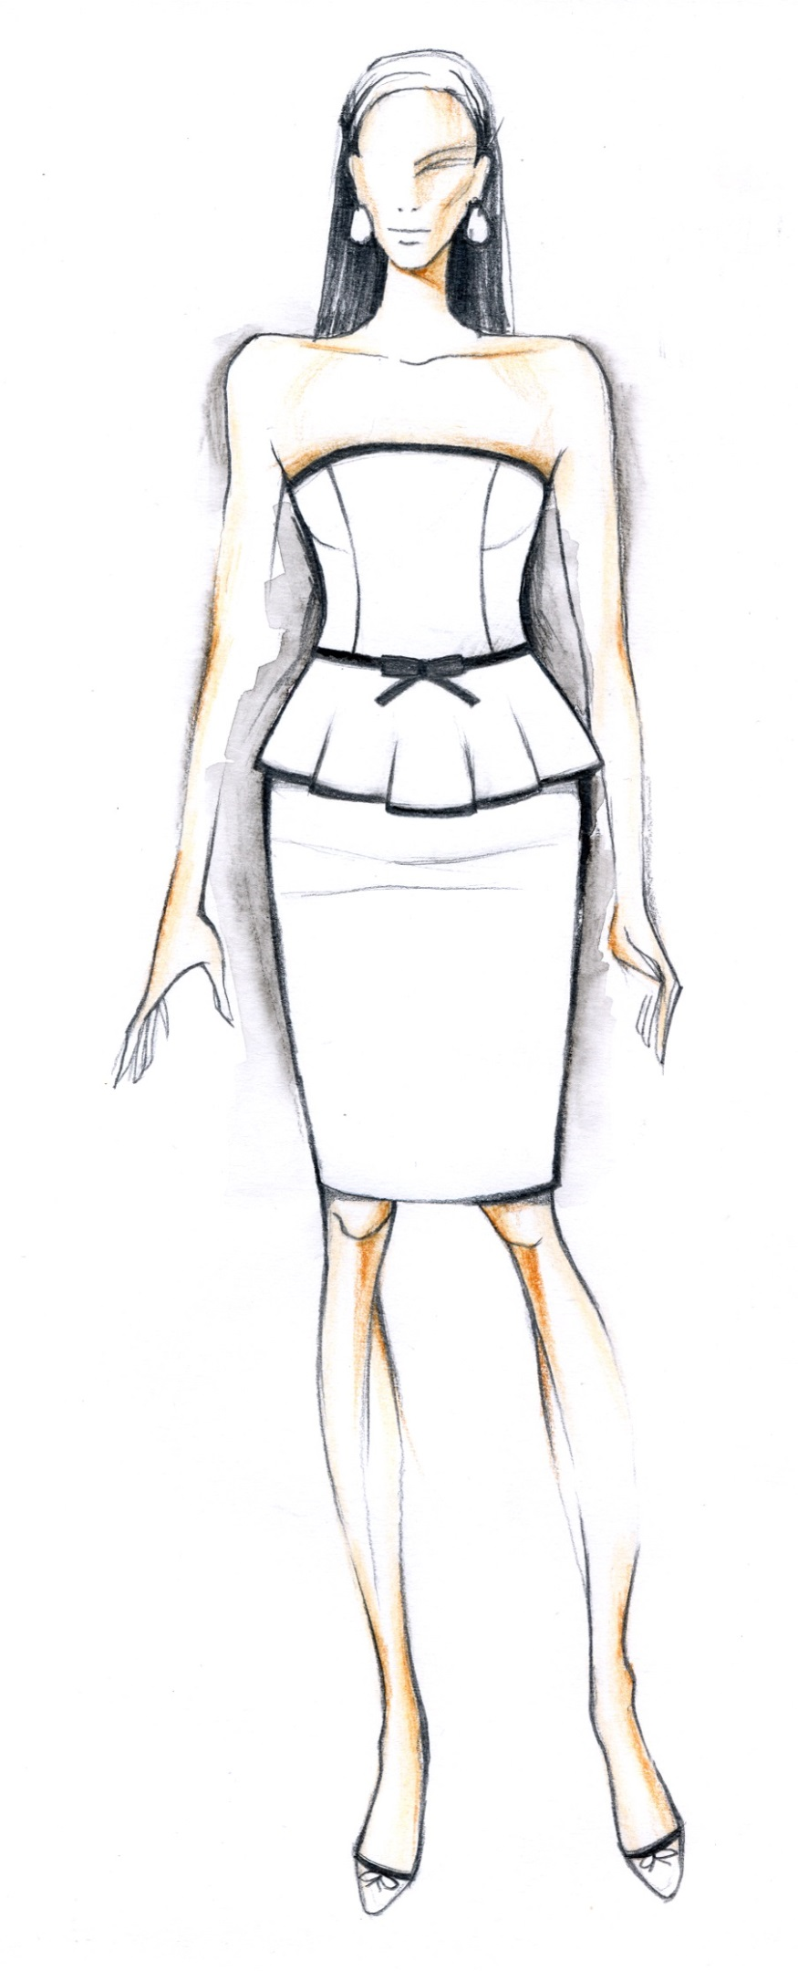
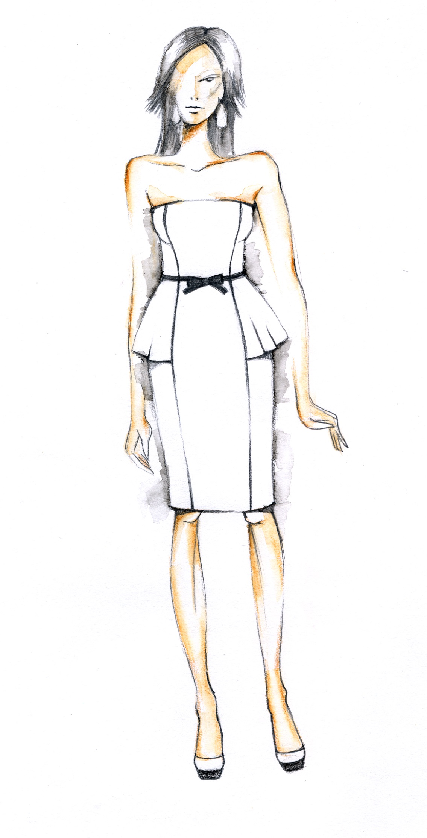
Peplum
The pattern design of peplums is a result of additional openings in vertical divisions. The openings are made with rotation of the piece parts around the points of intersection of the dividing lines and the line of connection of the peplum to the bodice.
The next two slides presents pattern designs of women’s dresses with full and partial peplums.
CC BY Dineva

Slide 22
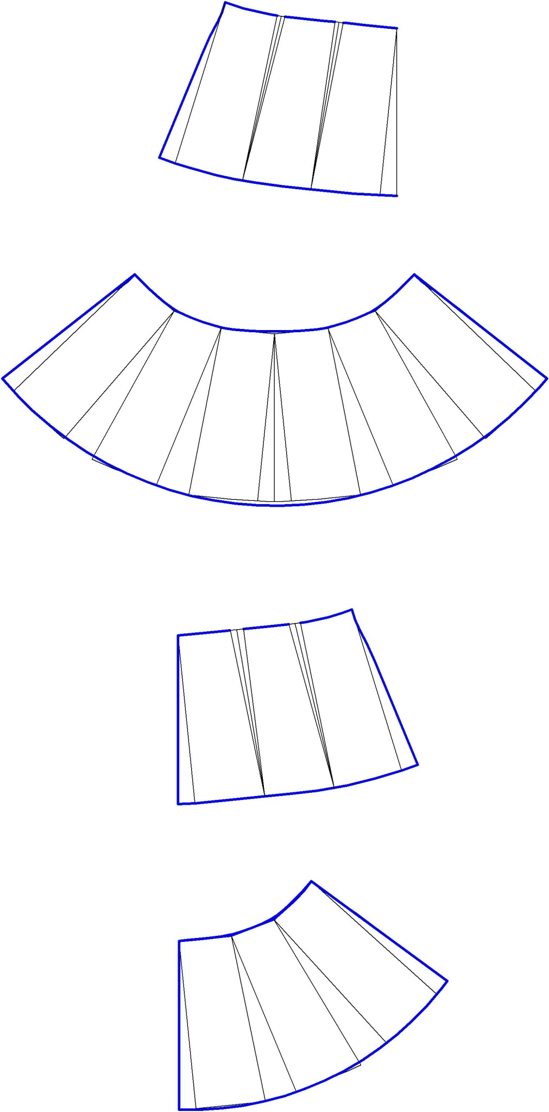
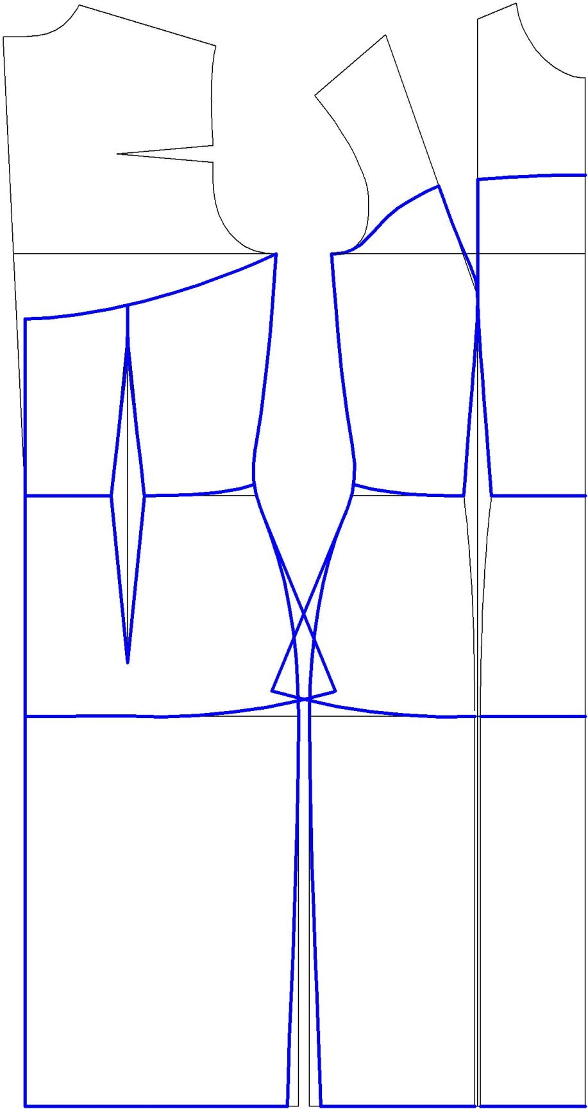
Pattern making of a women’s dress with a full peplum.
CC BY Dineva

Slide 23
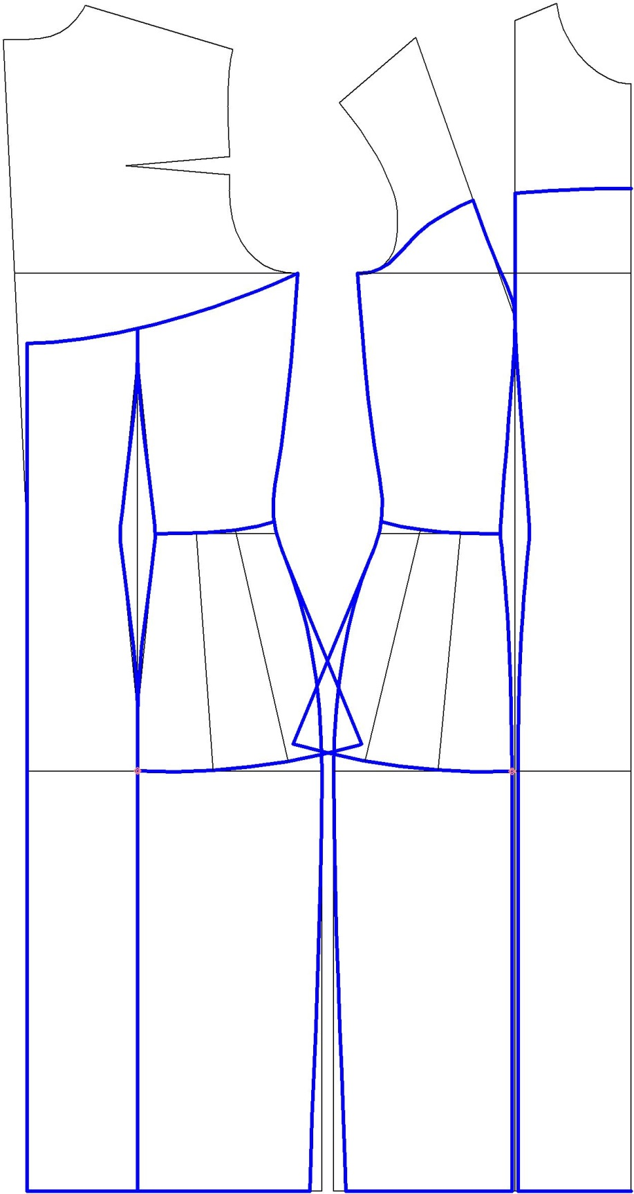
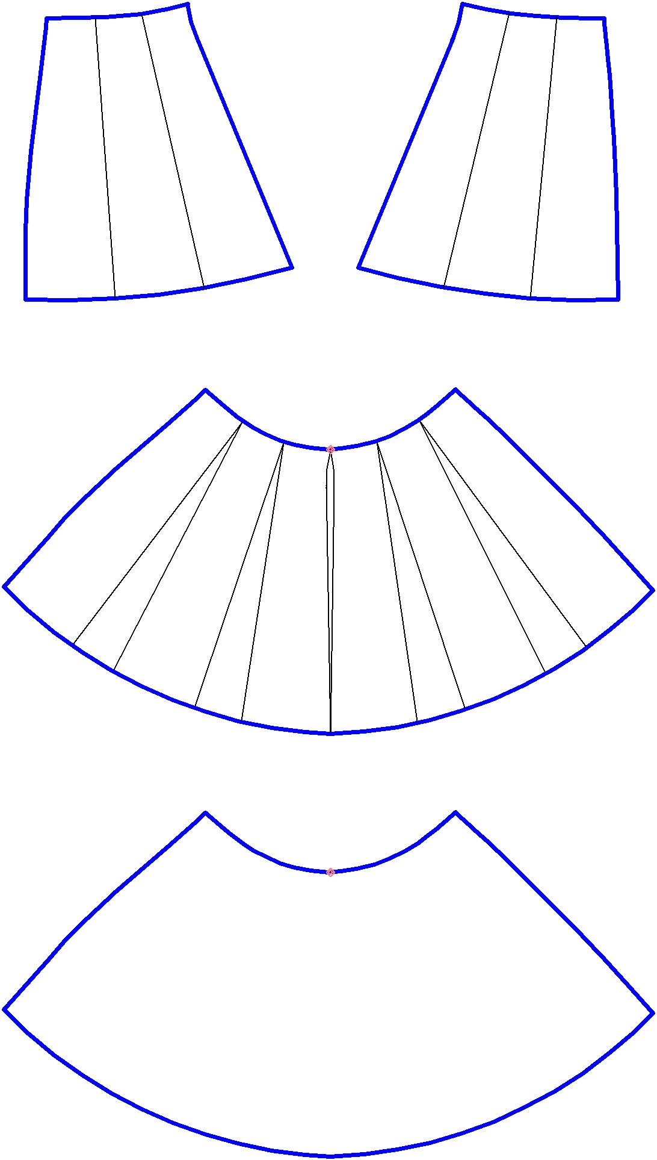
Pattern making of a women’s dress with a partial peplum.
CC BY Dineva

Slide 24
Pattern making using golden and Fibonacci
proportions
The previous topic has presented the application of the golden ratio and Fibonacci sequence as sustainable proportions in fashion design. In most cases, they are applied is in pattern making as direct proportioning or through geometrical figures. The figures are used as shapes of elements and pieces, or as a frame of forming of shapes of elements and pieces.
The next slides show examples of applying of the golden section and Fibonacci series in pattern making through directly use or geometric figures: the golden triangle, the golden rectangle, the golden ellipse. Some of designs combine the golden ratio and Fibonacci sequence proportioning and long life fashion elements of different types of drapes and 3D elements.
Notes:
Kazlacheva, Z. (2017). An investigation of application of the golden ratio and Fibonacci sequence in fashion design and pattern making. IOP Conf. Ser.: Mater. Sci. Eng. 254 172013. https://doi.org/10.1088/1757-899X/254/17/172013
Kazlacheva, Z., Ilieva, J. (2013). The Golden Triangle in Fashion Design. Proc. of International Symposium in Knitting and Apparel - ISKA 2013, Iasi, Romania: 187-193
Kazlacheva, Z., Ilieva, J., Genova, K. (2022). A study on sustainable fashion design and pattern making with combination of drapes and golden and Fibonacci proportions. AIP Conference Proceedings (in print)

Slide 25
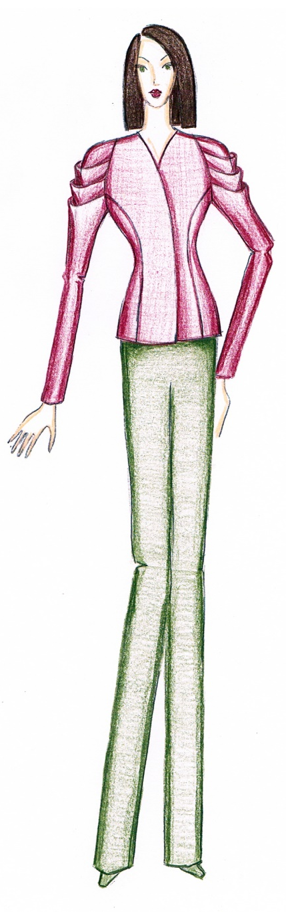
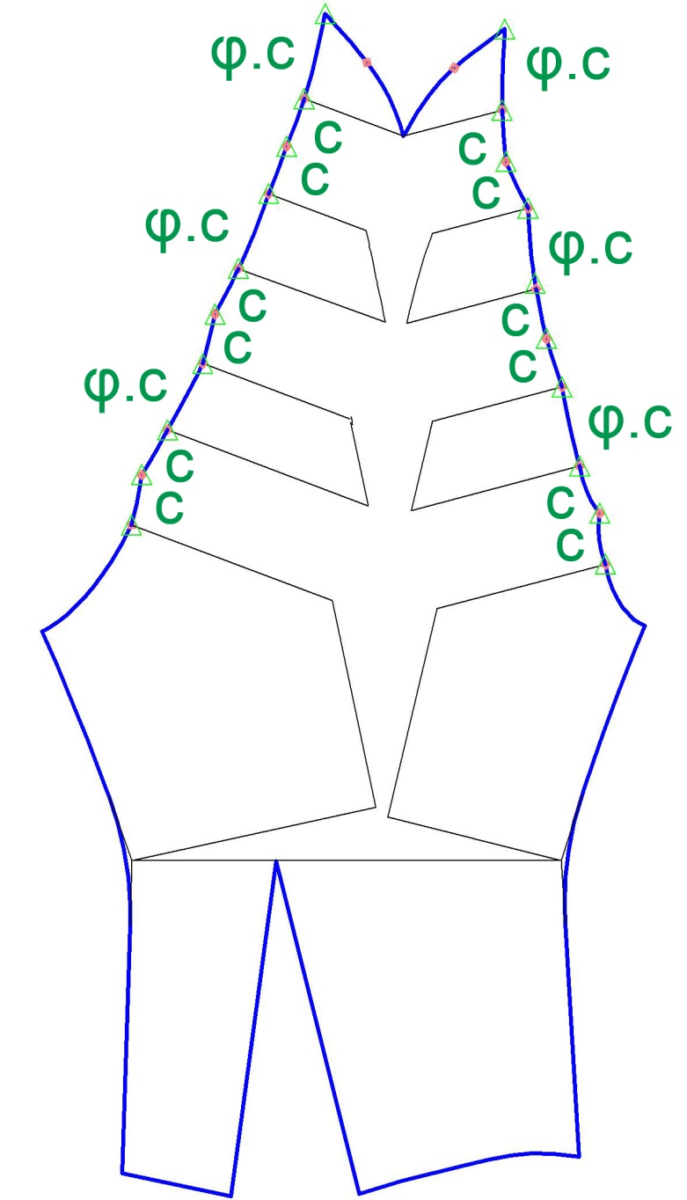
Pattern making of a jacket’s draped sleeves using the golden proportion. The proportion between the distances between tucks and their width is equal to the golden ratio.
CC BY Kazlacheva
Notes:
Some examples of combining of golden proportions with elements of clothes with long life in fashion: drapes and other 3D elements.

Slide 26
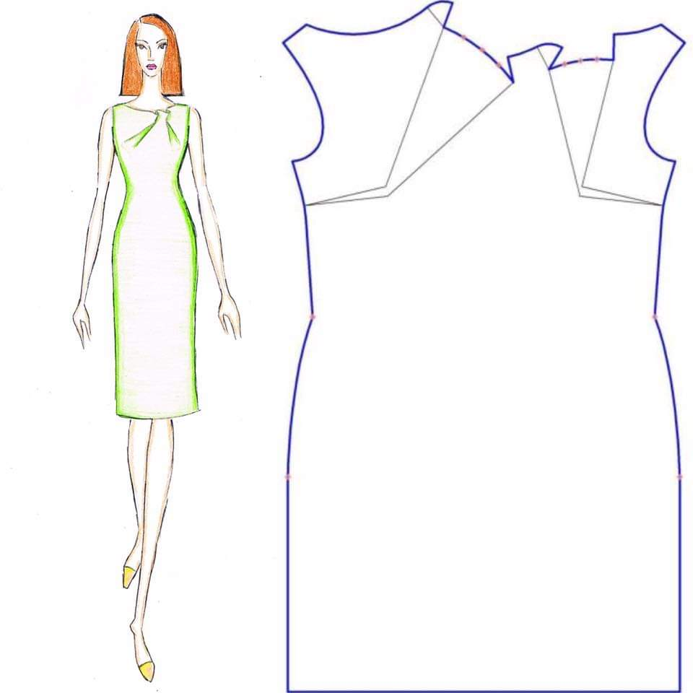
Pattern making of a dress with combined 3D element with the use of golden proportions. The ruffles divide the neck opening in proportions of the golden ratio.
CC BY Kazlacheva

Slide 27
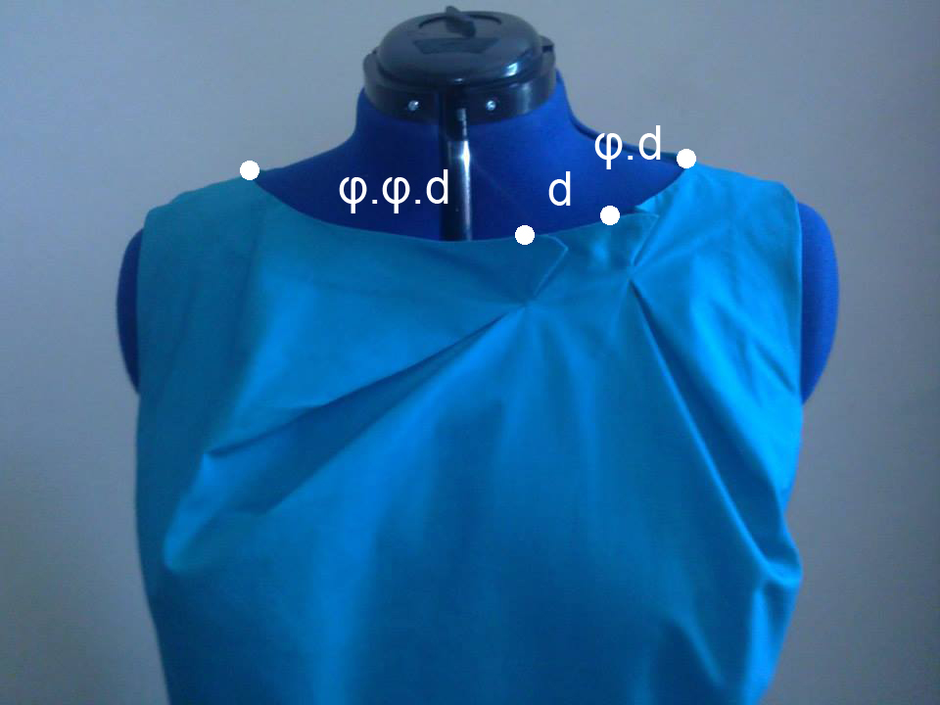
Pattern making of a dress with combined 3D element with the use of golden proportions. The ruffles divide the neck opening in proportions of the golden ratio: d, φ.d, and φ².d (or φ.φ.d).
CC BY Kazlacheva

Slide 28
Pattern making of a women’s dress with asymmetric draped neckline in golden proportion. The forming seam divides the neckline and the drape in the golden ratio.
CC BY Kazlacheva

Slide 29
Pattern making of a women’s dress with asymmetric draped neckline in golden proportion. The forming darts divide the neckline and the drape in the golden ratio.
CC BY Kazlacheva

Slide 30
Pattern making of a dress with twist knot drape in a proportion of the golden ratio. The knot divides the neckline in golden proportion.
CC BY Kazlacheva

Slide 31
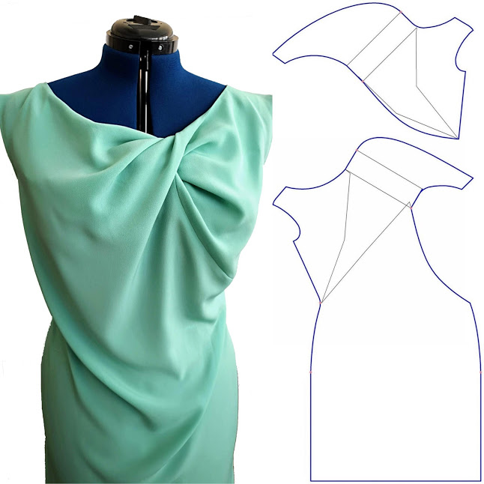
Pattern making of a dress with twisted drape in a proportion of the golden ratio. The twisting divides the neckline in golden proportion.
CC BY Kazlacheva

Slide 32
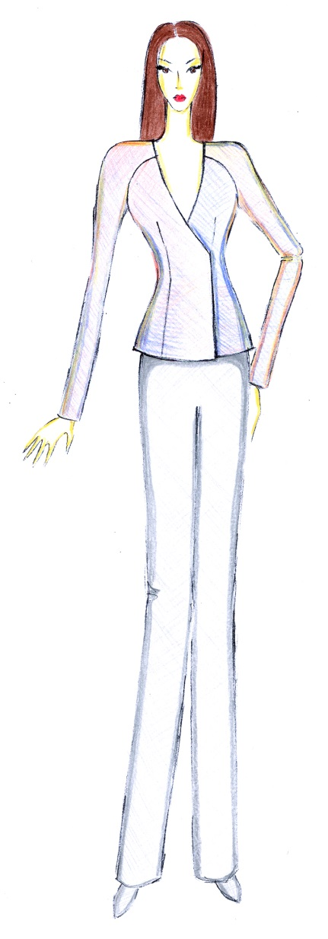
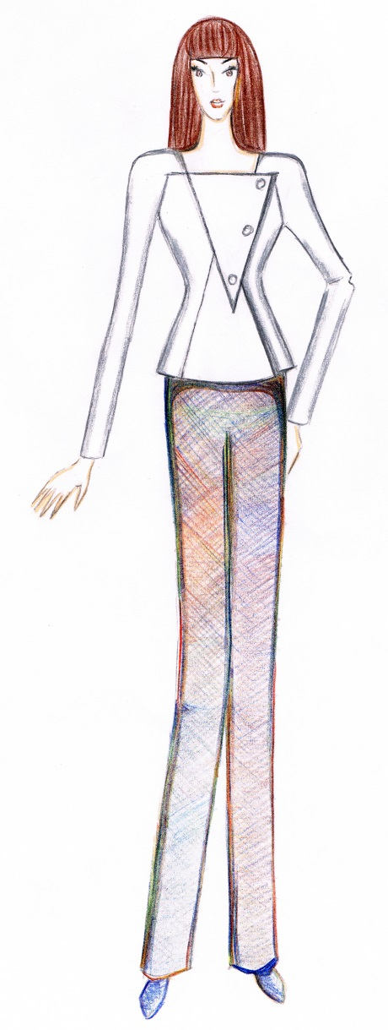
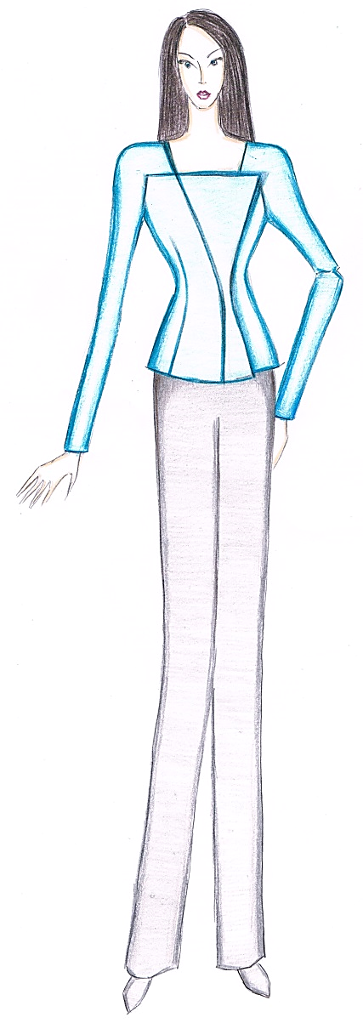
Application of the golden triangle in pattern making
The triangle is used directly or as a frame of forming of shapes of elements and pieces in presented designs.
CC BY Kazlacheva

Slide 33
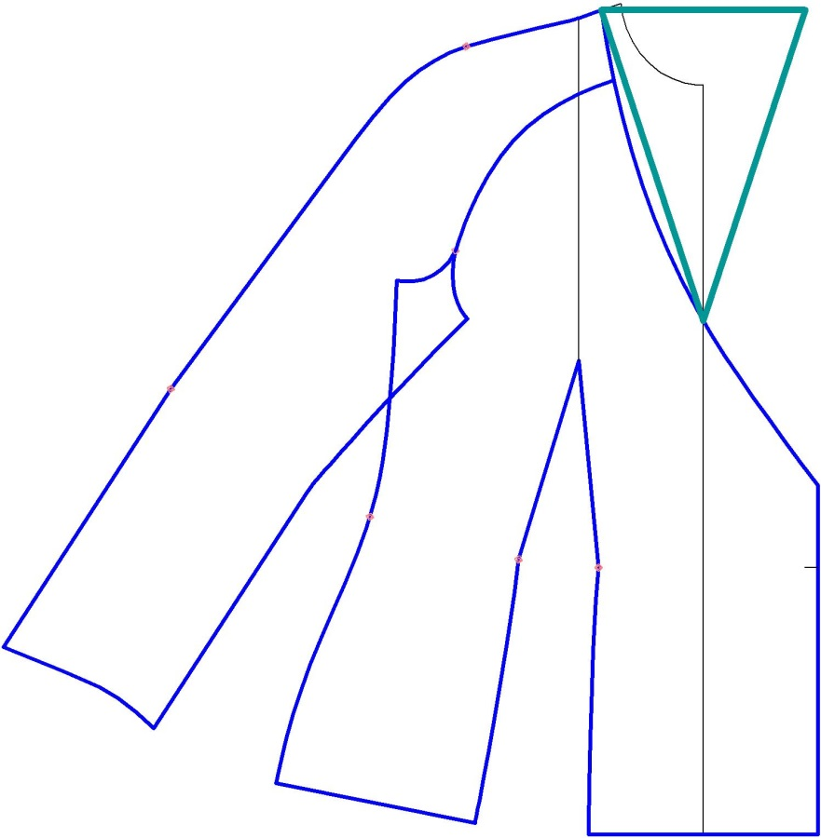
Pattern making of a jacket: Applying the golden triangle (in green) as a frame of forming of the neck opening.
CC BY Kazlacheva

Slide 34
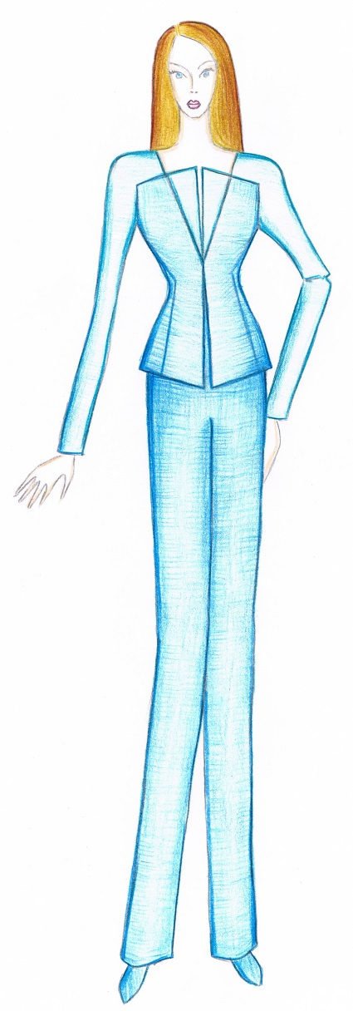
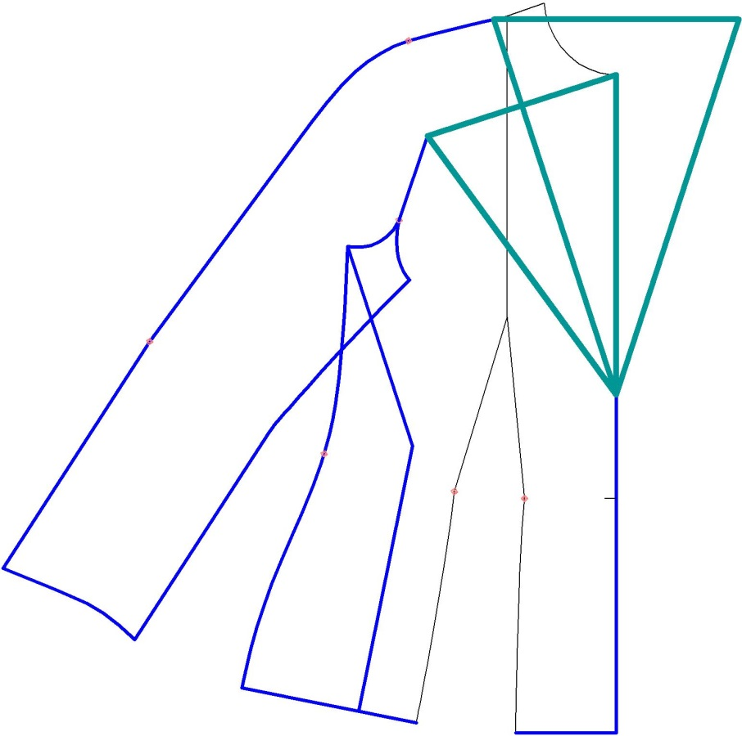
Pattern making of jacket: Applying the golden triangle in forming of the neck opening and raglan sleeve.
CC BY Kazlacheva

Slide 35

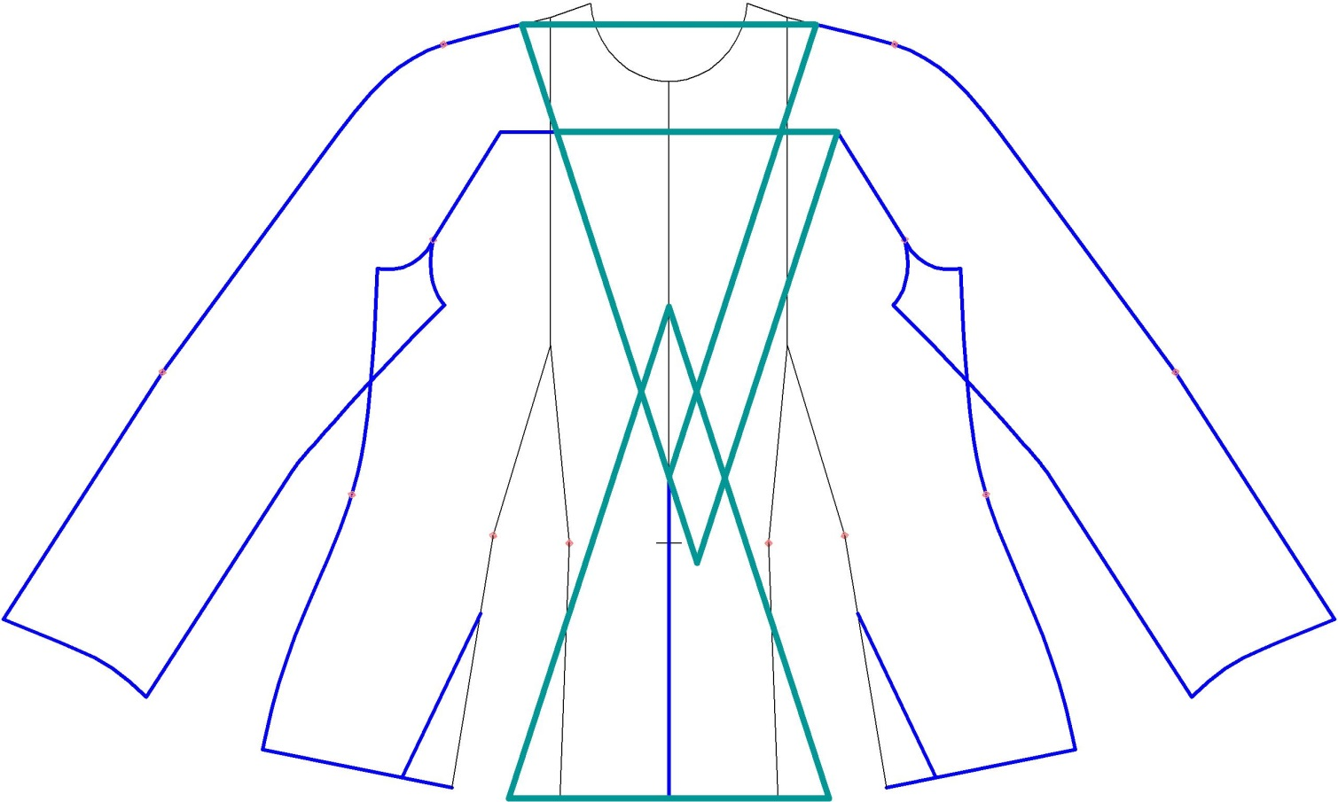
CC BY Kazlacheva
Applying the golden triangle as a form of the neckline and the central front pieces.

Slide 36
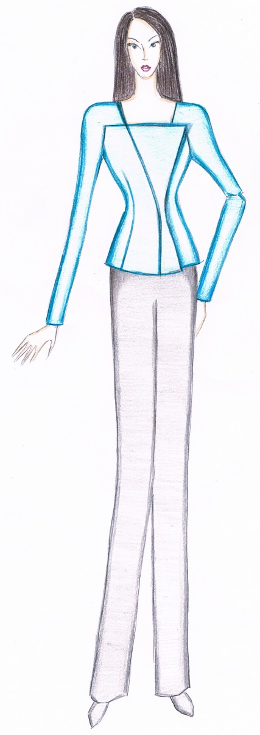
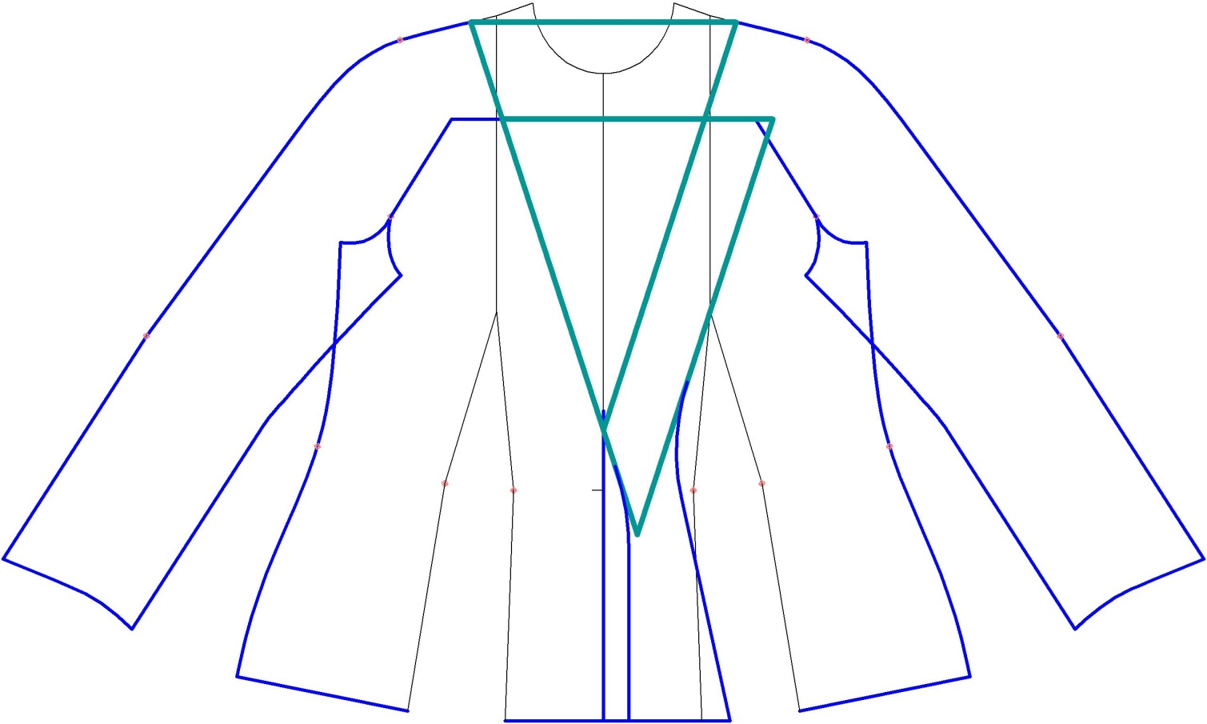
CC BY Kazlacheva
Applying the golden triangle as a form of the neckline and a frame of forming of the central front piece.

Slide 37
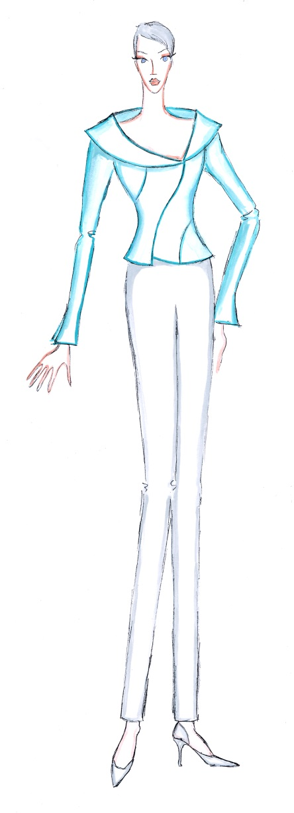
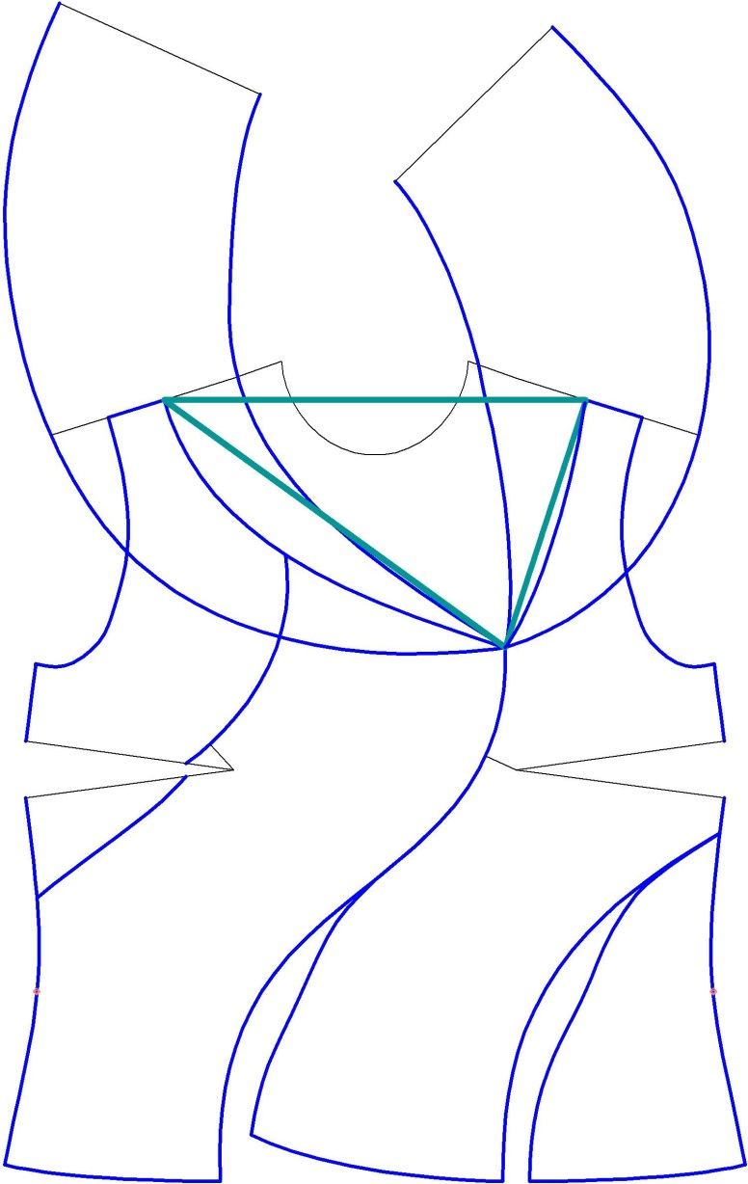
Applying the golden triangle as a frame of forming of the neck opening.
Asymmetrical position of the frame.
CC BY Kazlacheva

Slide 38
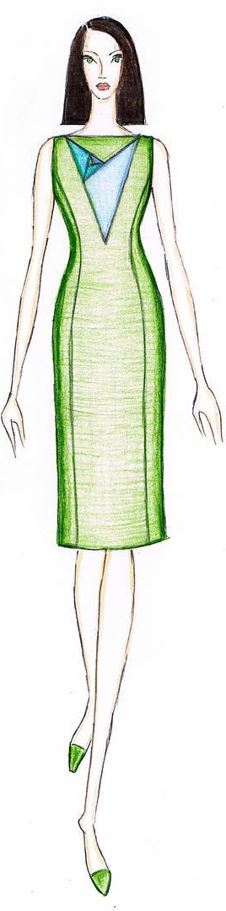
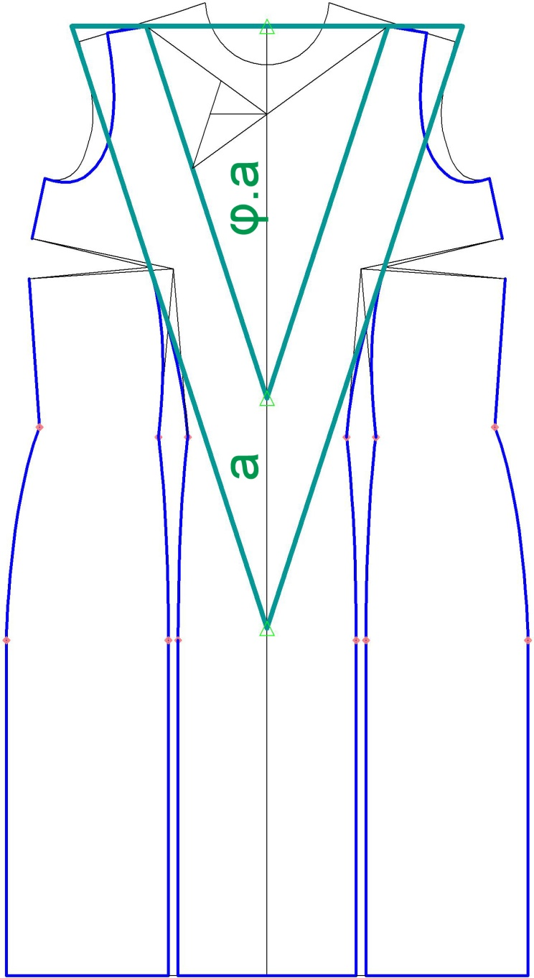
Pattern making of a dress with the use of golden triangles, presented with green lines, directly and as a frame.
CC BY Kazlacheva

Slide 39
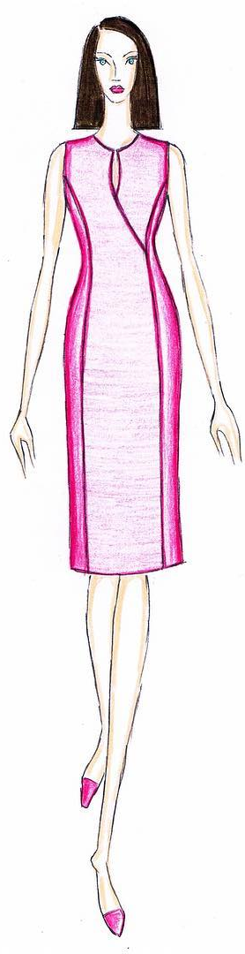
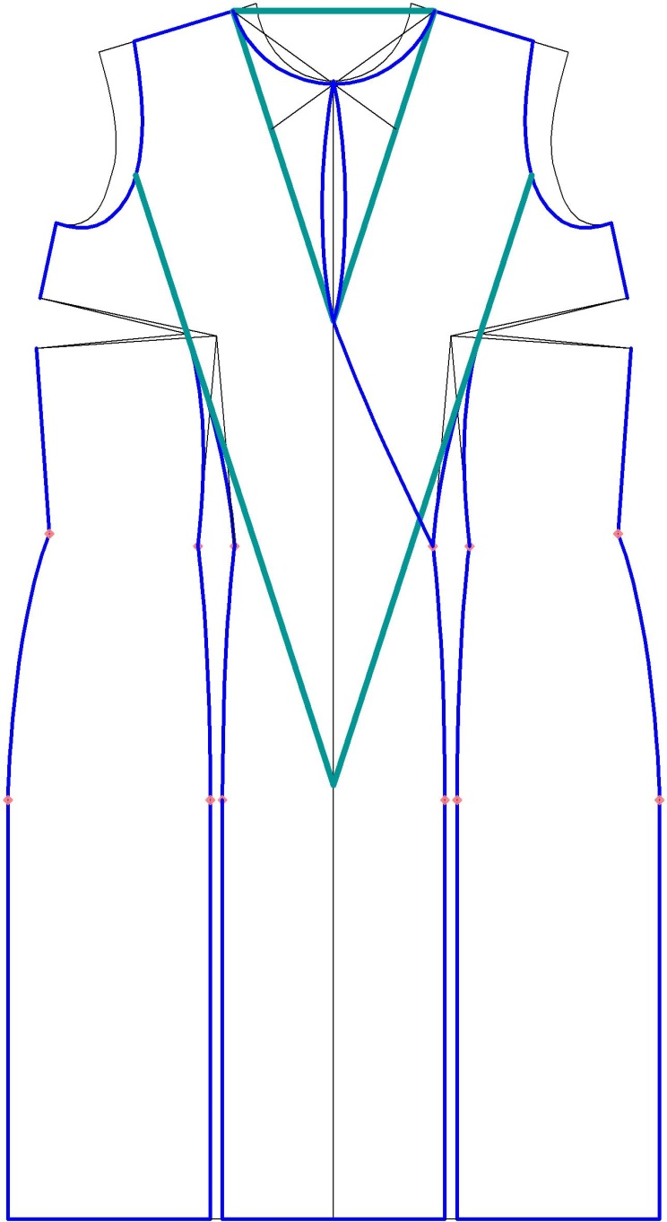
Pattern making of a dress with the use of golden triangles, which are shown with green lines, as frames.
CC BY Kazlacheva

Slide 40
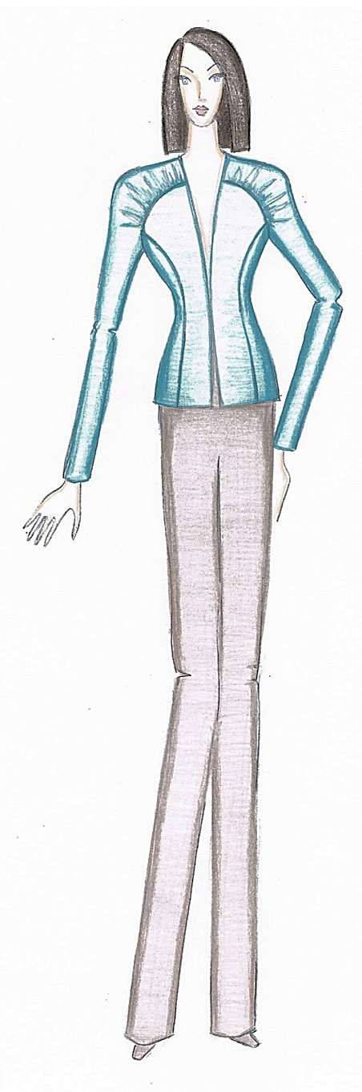
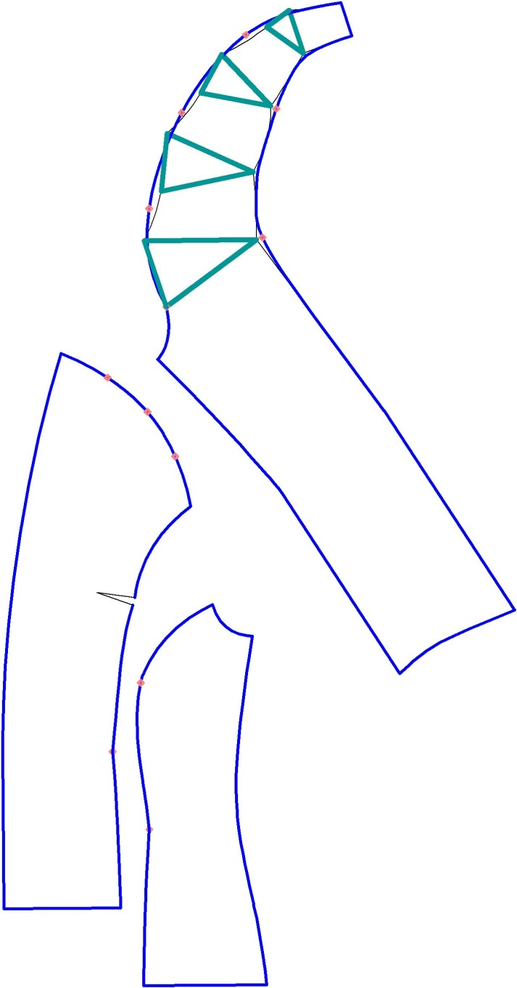
Pattern making of a jacket with 3D elements gathers with the use of the golden triangles, presented in green tick lines.
CC BY Kazlacheva

Slide 41
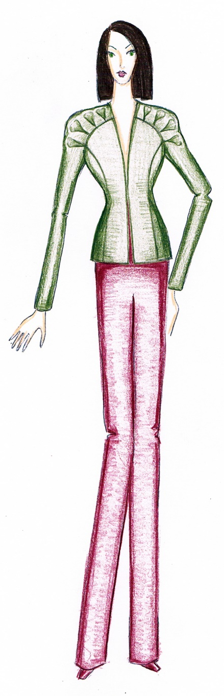
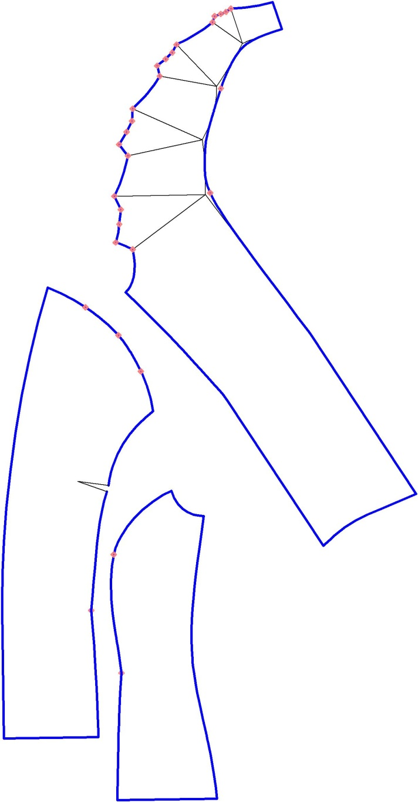
Pattern making of a jacket with 3D elements bi-sided tucks with the use of the golden triangles, presented in green tick lines.
CC BY Kazlacheva

Slide 42
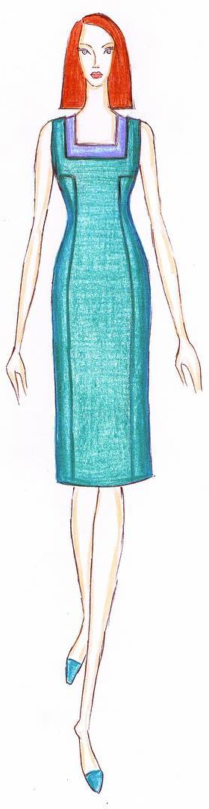
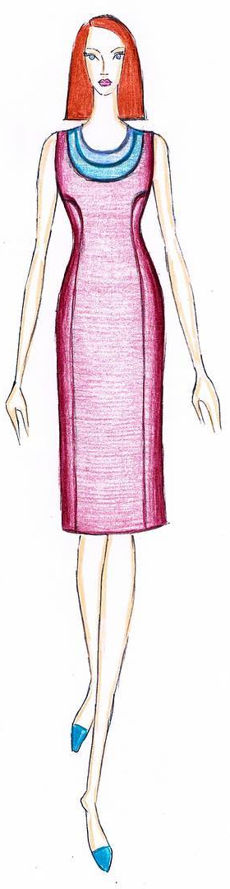
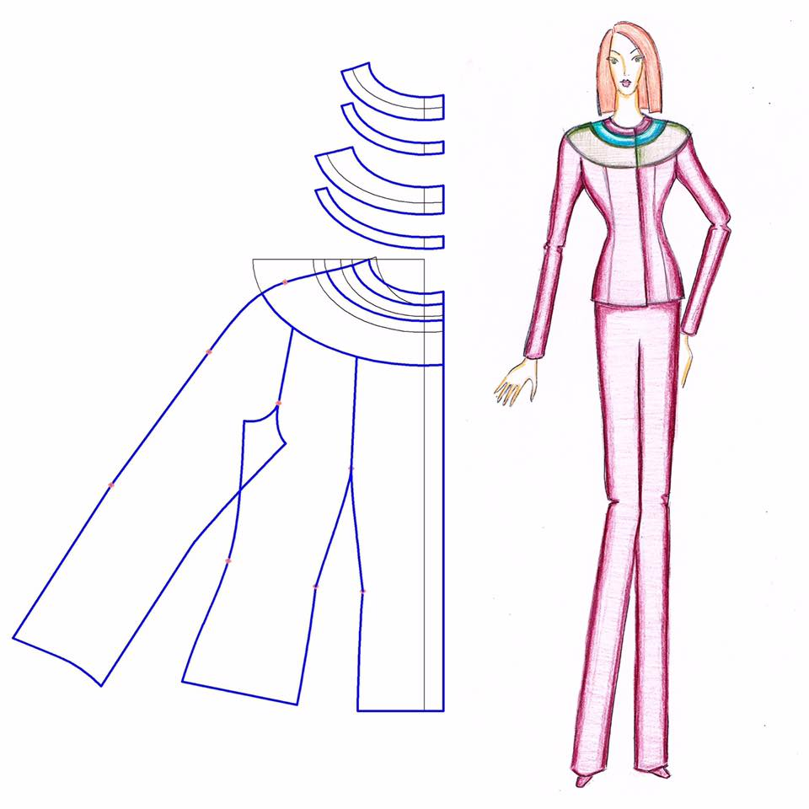
Application of the golden rectangle and the golden ellipse in pattern making
The rectangle is used directly or as a frame of forming of a shape. Usually, the ellipse is used directly of forming of a shape.
CC BY Kazlacheva

Slide 43
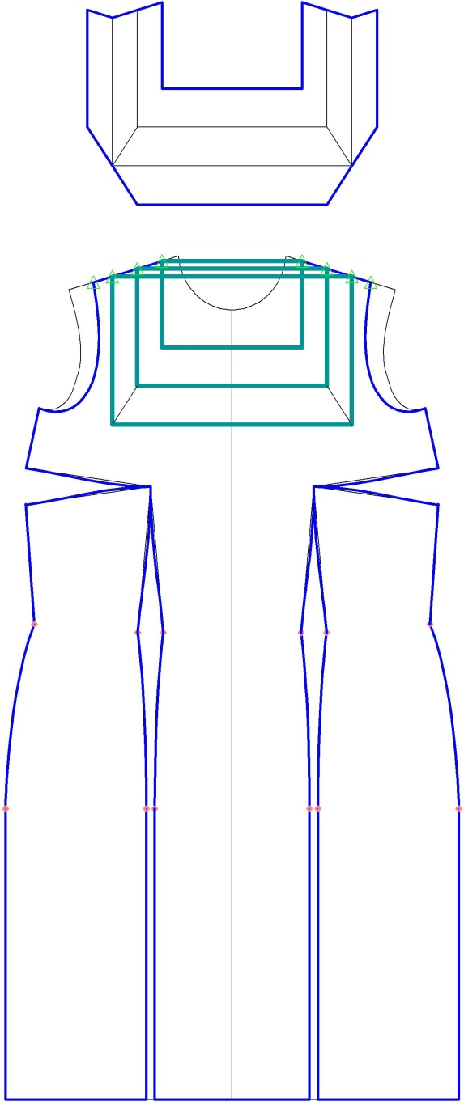
Pattern making of a dress with the direct use of golden rectangles, shown with green lines.
CC BY Kazlacheva

Slide 44
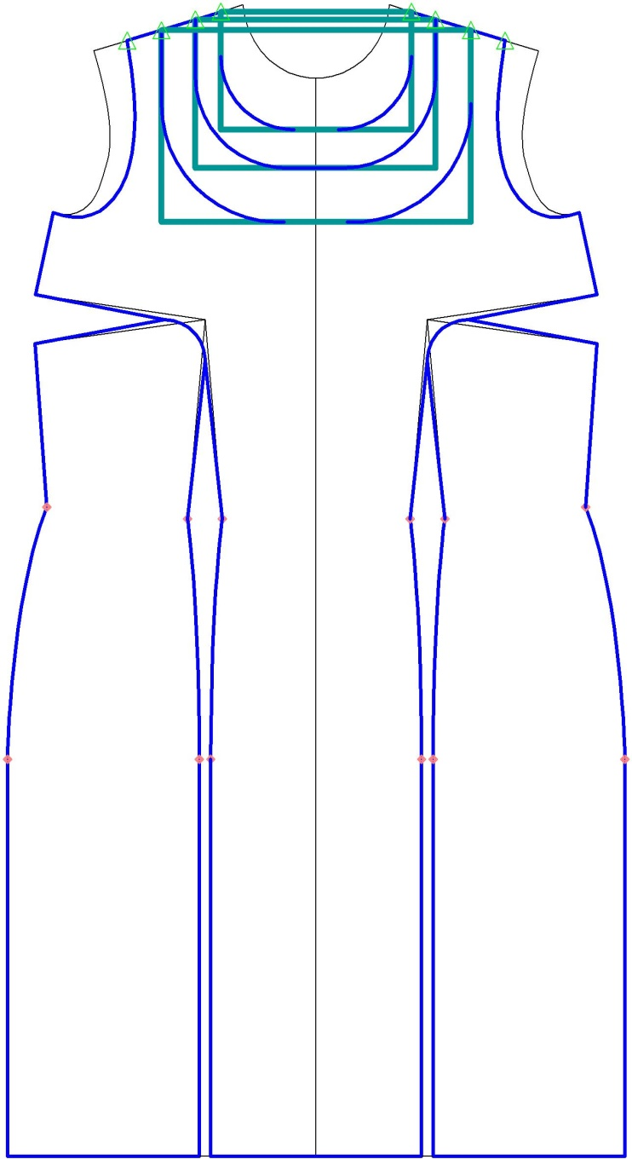
Pattern making of a dress with the use of golden rectangles, presented in green lines, as frames.
CC BY Kazlacheva

Slide 45
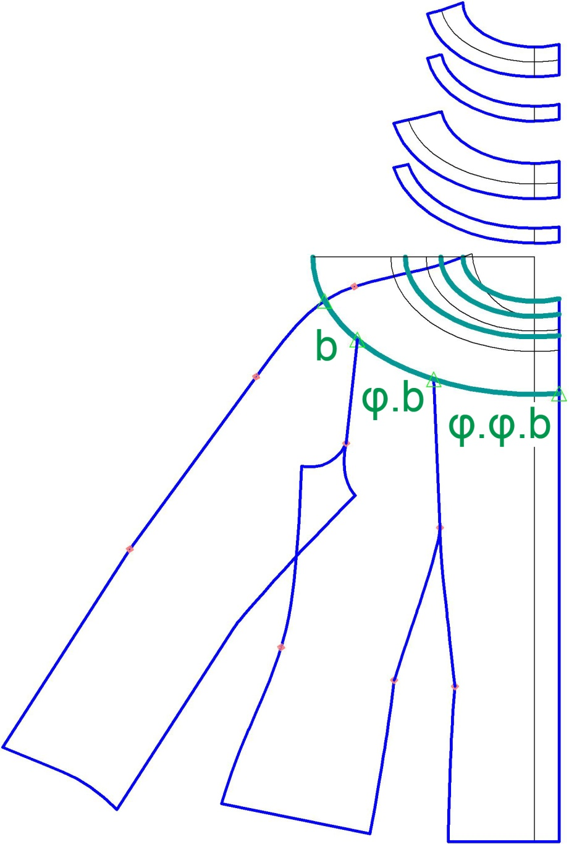
Pattern making of a jacket with direct use of golden ellipses, presented in green curves, and golden proportions.
CC BY Kazlacheva

Slide 46
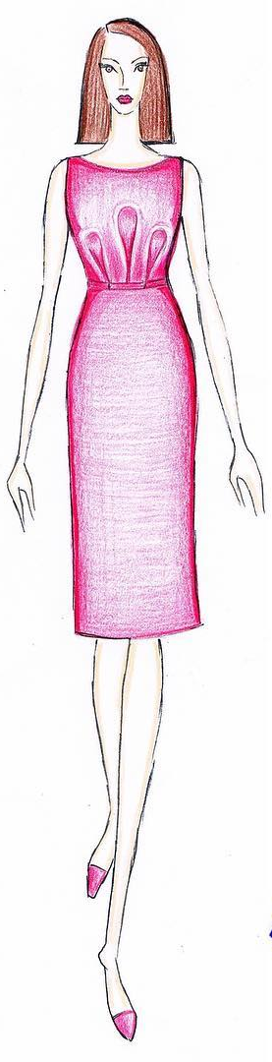
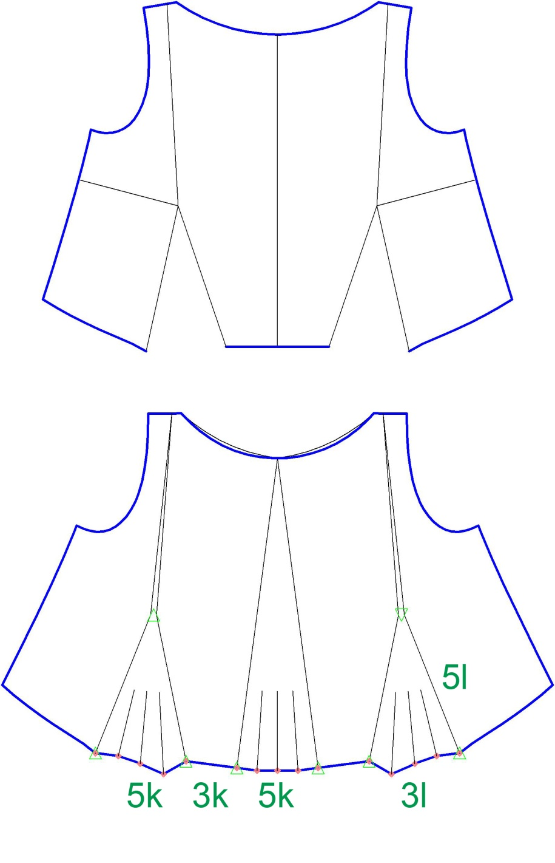
Fibonacci proportions
Pattern making of a women’s dress with the use of Fibonacci proportions
CC BY Kazlacheva

Slide 47
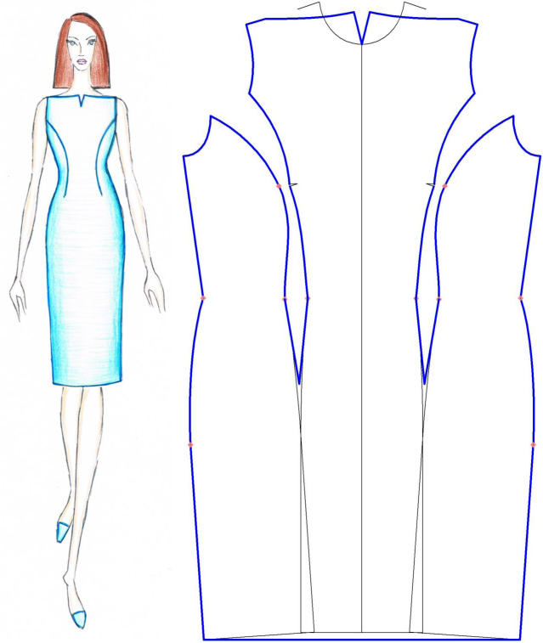

Pattern making of a women’s dress with the use of Fibonacci proportions
CC BY Kazlacheva

Slide 48

Minimizing waste
Some pattern making solutions offer lower consumption of textile material and minimizing waste cutting. With the help of these constructive solutions, minor changes can be made to the design, keeping the main idea of the design.
For example, the classic one-piece or two pieces sleeves in women’s jackets can be replaced with drop shoulder ones. This only one change in the design and pattern making of the jacket leads to the lower consumption of textile material and minimizing waste cutting.
CC BY Kazlacheva
Notes:
Kazlacheva, Z. (2020). Pattern Making Solutions for Sustainable Fashion – Case Studies. ARTTE Applied Researches in Technics, Technologies and Education 8 (3-4): 184-197

Slide 49

Drop Shoulder Sleeves
Two variants of a design of a lady’s jacket with only one difference in the type of sleeves: an orange one with one-piece sleeves and a green one with drop shoulder sleeves.
CC BY Kazlacheva

Slide 50
Drop Shoulder Sleeves
Pattern making of a lady’s jacket with drop shoulder sleeves, presented in the previous slide (in green).
CC BY Kazlacheva

Slide 51


Drop Shoulder Sleeves
Front and back pieces of lady’s jacket with drop shoulder sleeves (in green) and one with one-piece sleeves (in orange).
CC BY Kazlacheva

Slide 52


Drop Shoulder Sleeves
The piece of drop shoulder sleeves (of a jacket in green) and the piece of one-piece sleeves (of a jacket in orange).
CC BY Kazlacheva

Slide 53
Drop Shoulder Sleeves
The lower consumption of textile material in cutting of garments with drop shoulder sleeves mainly is a result of the difference between the heights of the drop shoulder sleeve and other types.
CC BY Kazlacheva

Slide 54
Drop Shoulder Sleeves
The lower consumption of textile material is better seen in made to measure clothing, which are one of the objects of the slow fashion – clothes with sustainable design and quality pattern making made from quality textile materials.
CC BY Kazlacheva

Slide 55
Drop Shoulder Sleeves
The cutting waste of drop shoulder sleeves jacket is reduced not only as result of lower material consumption. The drop shoulder parts of the front and back fill partially the armhole. And it is better not only for made to measure garments, but also for the big cutting markers for ready to wear clothing too.
CC BY Kazlacheva

Slide 56
Drop Shoulder Sleeves
Regardless of the marker constructing the armhole has to be filled for the waste reducing and it is possible with small pieces. But according to the fashion trends the small pieces of clothing are not sustainable fashion elements because they don’t have long life in trends.
CC BY Kazlacheva

Slide 57


Zero Waste
Zero waste fashion conception about design and pattern making, which eliminate cutting waste, offers interesting constructional ideas.
An idea for easy zero waste cutting of A line skirts, lower parts of dresses, or peplums is presented in next slides.
CC BY Kazlacheva
Notes:
TLFB Team. (2019). Zero Waste Fashion: A New, Sustainable Fashion Practice. The Last Fashion Bible. https://thelastfashionbible.com/2019/04/18/zero-waste-fashion/
Shaping Sustainable Fashion: Changing the Way We Make and Use Clothes. Ed. A Gwilt and T. Rissanen. London, Routledge. (2012)
Rissanen, T., McQuillan, H. (2016). Zero Waste Fashion Design. Bloomsbury Academic, ISBN: 978-1-3500-9483-3
Ross, Ch. B. (2017). What is Zero Waste Fashion Design All about?. The Sustainable Fashion Colective. https://www.the-sustainable-fashion-collective.com/2017/04/26/zero-waste-fashion-design?fbclid=IwAR1_HLHWuWa3nNoPxc6spEXsccPMzHg20Ly6HZvcq8TKhR386jcABumGw18

Slide 58

Zero Waste a Line Skirts and Peplums
The zero waste pattern making of the A line skirt is based on zero waste cut of five pieces, which form four trapeziums – three whole ones and one from two pieces. In the construction: W, cm is the waist width. The shorter base of trapeziums is equal to W/4 + 2,0 cm (for two seam allowances). The length of the larger base of trapezium depends on the waist width W and the fabric width.
CC BY Kazlacheva
Notes:
Kazlacheva, Z. (2020). Pattern Making Solutions for Sustainable Fashion – Case Studies. ARTTE Applied Researches in Technics, Technologies and Education 8 (3-4): 184-197

Slide 59

Zero Waste a Line Skirts and Peplums
The four trapeziums with all seam allowances are shown in different colors.
CC BY Kazlacheva

Slide 60

Zero Waste a Line Skirts and Peplums
On the base of their connections, the fourth trapeziums form an A line skirt with uneven hem. The slope of the A line of skirt depends on the waist width W and the length of the skirt.
CC BY Kazlacheva

Slide 61


CC BY Kazlacheva
The way of zero waste pattern making of A line skirt or peplum based of four trapeziums can be applied in pattern design with 6, 8, or bigger even number trapeziums. A larger number of trapeziums results in a more flattened hem.

Slide 62

Zero Waste Design of
Hictorical Costumes
The historical and folk costumes can be seen as sources of zero waste design ideas. In the previous topic the ancient Greek and ancient Thracian chiton was presented as an example of zero waste cut. Tronska Bulgarian women’s folk costume, presented in the picture, is another zero waste design example.
CC BY-SA-ND Kazlacheva

Slide 63

Zero Waste Design of
Hictorical Costumes
The cut of the dress, named sukman of Tronska women’s folk costume. The front and back are cut by one double long rectangular piece with a hole for the neck opening. The side wedges are cut by rectangles with the same width as the front and back. The rectangles are divided in diagonal directions.
CC BY Kazlacheva

Slide 64

Zero Waste Design of
Hictorical Costumes
CC BY Kazlacheva
The cut of the shirt of Tronska women’s folk costume. The front and back are cut by one rectangular piece with a hole for the neckline. The sleeves are cut by rectangles in the same width. The side wedges are cut by rectangles with a quarter width.

Slide 65
Conclusion
The accuracy of presented approaches of pattern making of women’s clothes with drapes is based on the correct and facilitated geometric sequences of constructing of the fourth types, and the correct and easy formulas, used for the twist knot and twisted draperies. The applying of the formulas lead to correct pattern design for all possible combinations of sizes of the elements of drapes.
The presented pattern designs are examples of sustainable and correct pattern making of women’s clothes with sustainable long life fashion elements of all types of drapes, peplums, and 3D elements; sustainable golden and Fibonacci sequence proportions through direct proportioning or geometric figures; lower consumption of textile material and minimizing waste cutting; zero waste pattern cutting; and combinations between them.

Slide 66
References and Further Reading
Kazlacheva, Z., Kosinkova-Stoeva, A. (2021). An investigation of pattern design of draped necklines. IOP Conf. Ser.: Mater. Sci. Eng. 1031 012022. https://doi.org/10.1088/1757-899X/1031/1/012022
Kazlacheva, Z., Ilieva, J., Peneva, T. (2019). Fashion and Pattern Design of Ladies’ Dresses with Transformation of Different Types of Draperies. ARTTE Applied Researches in Technics, Technologies and Education 7 (1): 10-23
Kosinkova-Stoeva, A., Kazlacheva, Z. (2022). A study on making of patterns of asymmetric draped necklines. AIP Conference Proceedings (in print)
Nakamichi, T. (2010). Pattern Magic. Laurence King, ISBN: 978-1856697057
Nakamichi, T. (2011). Pattern Magic 2. Laurence King, ISBN: 978-1856697064
Kazlacheva, Z., Ilieva, J. (2018). An investigation of design of twist knot drape clothes. IOP Conf. Ser.: Mater. Sci. Eng. 459 012079. https://doi.org/10.1088/1757-899X/459/1/012079

Slide 67
Kazlacheva, Z. (2019). Pattern Design of Twisted Draperies with Decorative and Constructive Function. ARTTE Applied Researches in Technics, Technologies and Education 7 (1): 1-9
Kazlacheva, Z. (2017). An investigation of application of the golden ratio and Fibonacci sequence in fashion design and pattern making. IOP Conf. Ser.: Mater. Sci. Eng. 254 172013. https://doi.org/10.1088/1757-899X/254/17/172013
Kazlacheva, Z., Ilieva, J. (2013). The Golden Triangle in Fashion Design. Proc. of International Symposium in Knitting and Apparel - ISKA 2013, Iasi, Romania: 187-193
Kazlacheva, Z., Ilieva, J., Genova, K. (2022). A study on sustainable fashion design and pattern making with combination of drapes and golden and Fibonacci proportions. AIP Conference Proceedings (in print)
Kazlacheva, Z. (2020). Pattern Making Solutions for Sustainable Fashion – Case Studies. ARTTE Applied Researches in Technics, Technologies and Education 8 (3-4): 184-197

Slide 68
TLFB Team. (2019). Zero Waste Fashion: A New, Sustainable Fashion Practice. The Last Fashion Bible. https://thelastfashionbible.com/2019/04/18/zero-waste-fashion/
Shaping Sustainable Fashion: Changing the Way We Make and Use Clothes. Ed. A Gwilt and T. Rissanen. London, Routledge. (2012)
Rissanen, T., McQuillan, H. (2016). Zero Waste Fashion Design. Bloomsbury Academic, ISBN: 978-1-3500-9483-3
Ross, Ch. B. (2017). What is Zero Waste Fashion Design All about?. The Sustainable Fashion Colective. https://www.the-sustainable-fashion-collective.com/2017/04/26/zero-waste-fashion-design?fbclid=IwAR1_HLHWuWa3nNoPxc6spEXsccPMzHg20Ly6HZvcq8TKhR386jcABumGw18

Slide 69
Contacts
Faculty of Technics and Technologies of Yambol,
Trakia University of Stara Zagora, Bulgaria
Prof. Dr. Zlatina Kazlacheva
e-mail: zlatinka.kazlacheva@trakia-uni.bg

