Slide 1




Clothing Technology and Production Methods in the Context of Sustainability

Slide 2
Learning Objectives
After this lecture you should be able to:
Describe sustainable manufacturing system.
Characterize the functional sportswear.
Describe new technologies in functional sportswear.
Describe assembling technologies for functional sportswear.
Understand the design and clothing technology for disassembly.

Slide 3
Sustainable manufacturing system
What is sustainable manufacturing system
What is the purpose of a sustainable product system?
Which necessitates the implementation of a sustainable product system
What is the way to move towards sustainable production

Slide 4
Sustainable Production System
Problems
  Pollution and waste problem.
  Consumption of non-recyclable resources (oil, for example).
  Rapid growth in world population (which implies a growth in demand, both production and consumption).
Functions for Sustainability
  Economically sustainable.
  Socially sustainable.
  Sustainable with the environment.

Slide 5





SUSTAINABLE APPAREL PRODUCTION
SUSTAINABLE TEXTILE RAW MATERIALS AND MANUFACTURING PROCESSES FOR APPAREL MANUFACTURE;
ENVIRONMENTAL AND SOCIAL ASSESSMENT OF APPAREL MANUFACTURING;
SUSTAINABILITY AND CONSUMPTION BEHAVIOR OF THE APPAREL INDUSTRY;
ASSESSMENT OF SUSTAINABLE APPAREL PRODUCTION;
SUSTAINABILITY AND FASHION.

Slide 6
Technology trends in the apparel industry for sustainability
Big data
Blockchain technology
Technology for manufacturing
Design technology
Technology for sustainability
Wearable Technology

Slide 7
Technology trends in the apparel industry for sustainability
New manufacturing technologies enable the apparel industry to move from labor-intensive production to capital-intensive production.
New manufacturing technology include faster production, less waste, restoring and localization of production nearer to market and lower carbon footprints.
New manufacturing technology solutions include:
innovations to sewing machines
sewing robots
stitch-free clothing
3D printing
digital textile printing

Slide 8
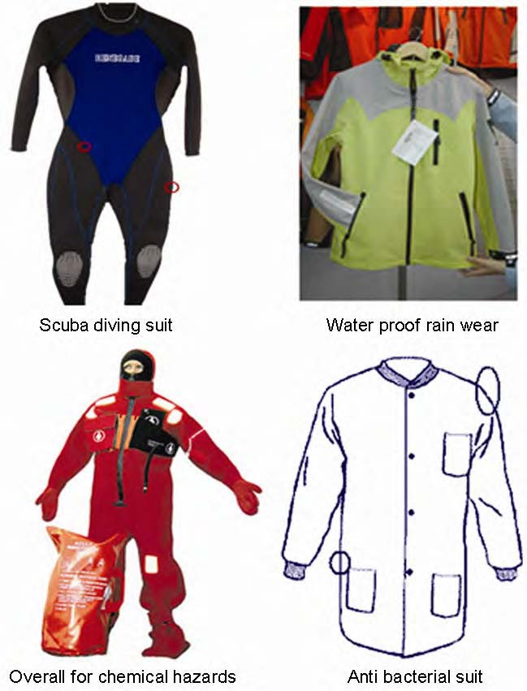
What does functional clothing mean?
Designed to be practical and useful rather than attractive.
Designed especially with their needs in mind
Garments and accessories that protect the body or increase physical body function, to achieve a high degree of mobility, thermal comfort, etc.
Examples of functional clothing
CC BY Prabir Jana (2011), source: https://www.researchgate.net/publication/297687236_Assembling_technologies_for_functional_garments-An_overview
Notes:
Prabir Jana. 2011. Indian Journal of Fibre and Textile Research 36 (4): 380-387

Slide 9
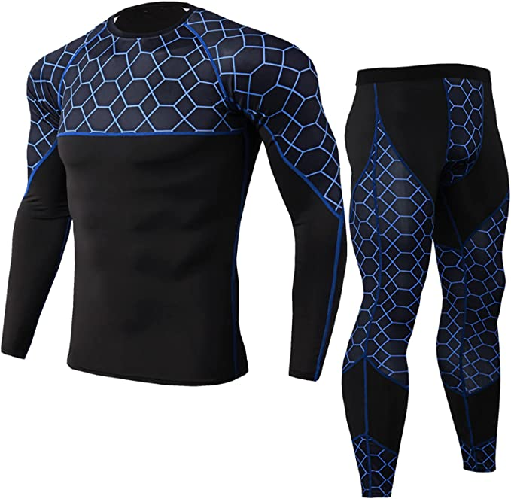
What is specific about functional sportswear
Garments to meet specific functional requirements, which will depend on the sport and its environment, as well as the construction, mechanical, physiological and/or aerodynamic characteristics and form of the clothing
Functional garments in this section are used to enhance the functionality of Sportsperson by providing a high level of breathability, moisture/vapor transfer, heat insulation, wind proofing, waterproofing, and/or UV protection depending upon the sport and environment requirements.
Source:
https://m.media-amazon.com/images/I/71BIoZpHtwL._AC_UX679_.jpg

Slide 10
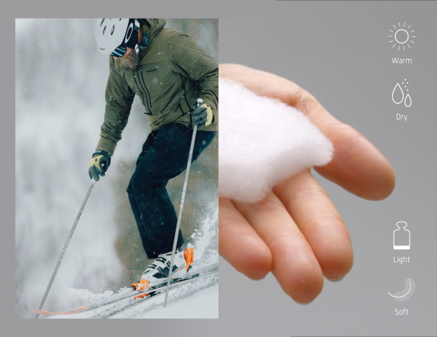
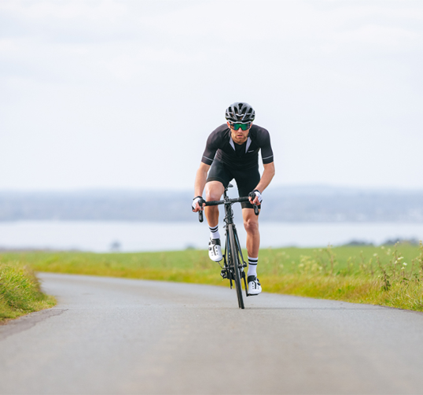
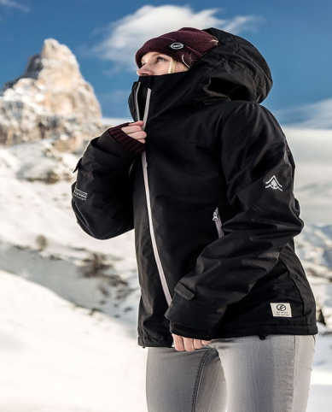
New technologies in functional sportswear
Many innovations in specialized clothing technology (for the military, police uniforms, mountaineering clothing, extreme sports, etc.) are gradually entering the production of leisure and even casual clothing.
PrimaLoft Technology
Polygiene technology
Sympatex membrane.
source: https://sewport.com/
fabrics-directory/sympatex-fabric
source: https://primaloft.com/
source: https://polygiene.com/buy-it/

Slide 11
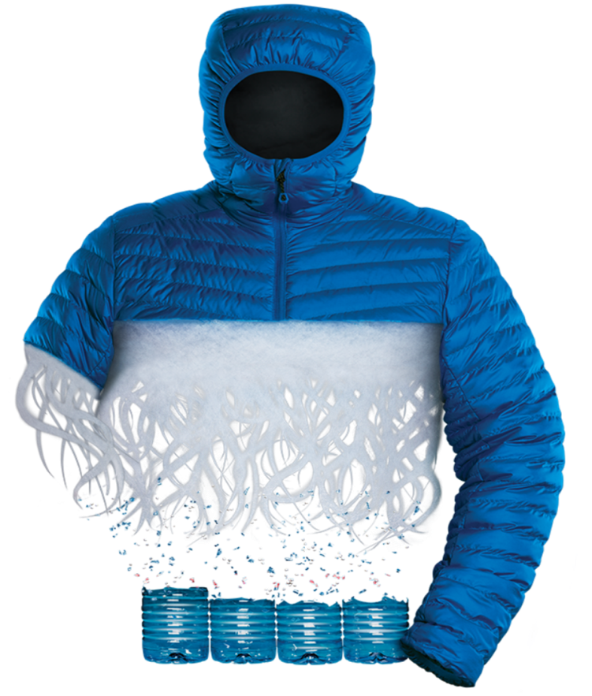
PrimaLoft Technology
The first synthetic insulation made from 100% recycled, biodegradable fibers
Technology October 23, 2018
Developed over the last four years by PrimaLoft’s team of scientists and engineers, PrimaLoft achieved this textile breakthrough without altering the characteristics and performances of the insulation in any way.
It’s actually by nearly 50%. Apparently over 231,075kgs of carbon emissions have been avoided by PrimaLoft’s very creation of this technology.

Slide 12
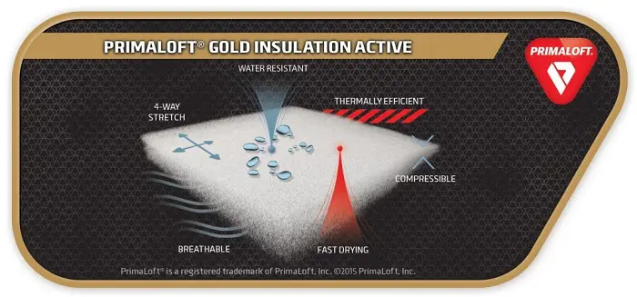







Benefits of Primaloft technology
Warmth without Bulk
Water Resistant
4-Way Stretch
Breathable
Packable & Lightweight
Superior Softness
Made from 45% post-consumer recycled content
Source: https://keelaoutdoors.com/primaloft/

Slide 13
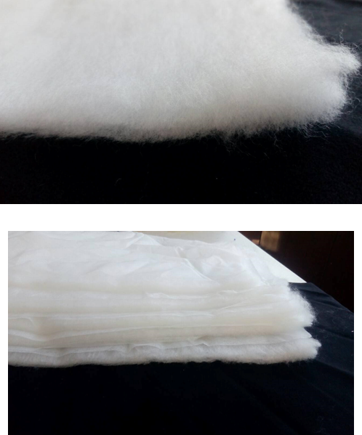
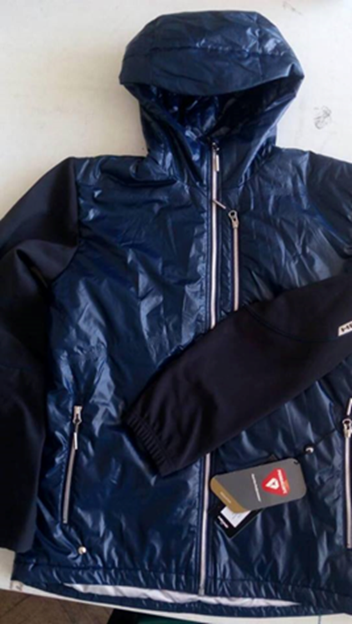
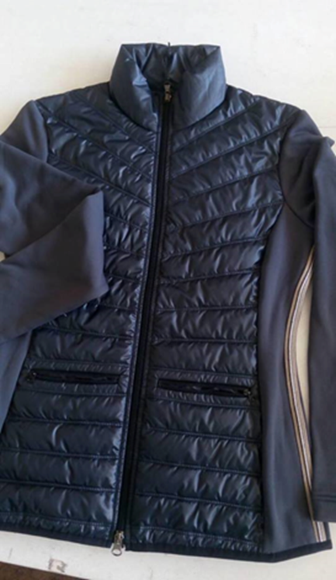
Application
CC BY Penkova

Slide 14
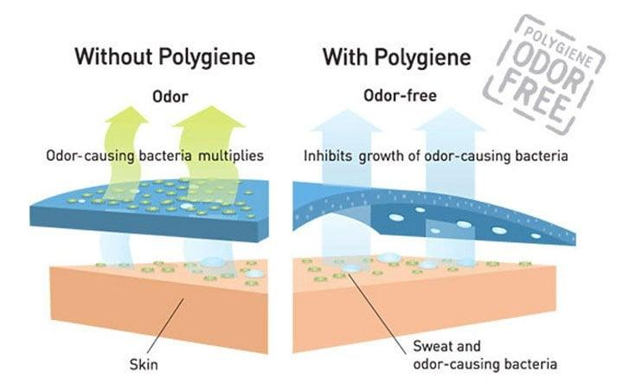
Polygiene - STAYS FRESH TECHNOLOGY
BIOSTATIC
How it Works?
What are the benefits of Biostatic stays fresh technology?
What is Biostatic stays fresh technology and how does it work?
Are there any effects when worn next to skin?
Application
Does it have any environmental approvals?
Can Polygiene® treated garments be recycled?
Source: ttps://ultralightoutdoorgear.co.uk/polygiene-technology-i130

Slide 15
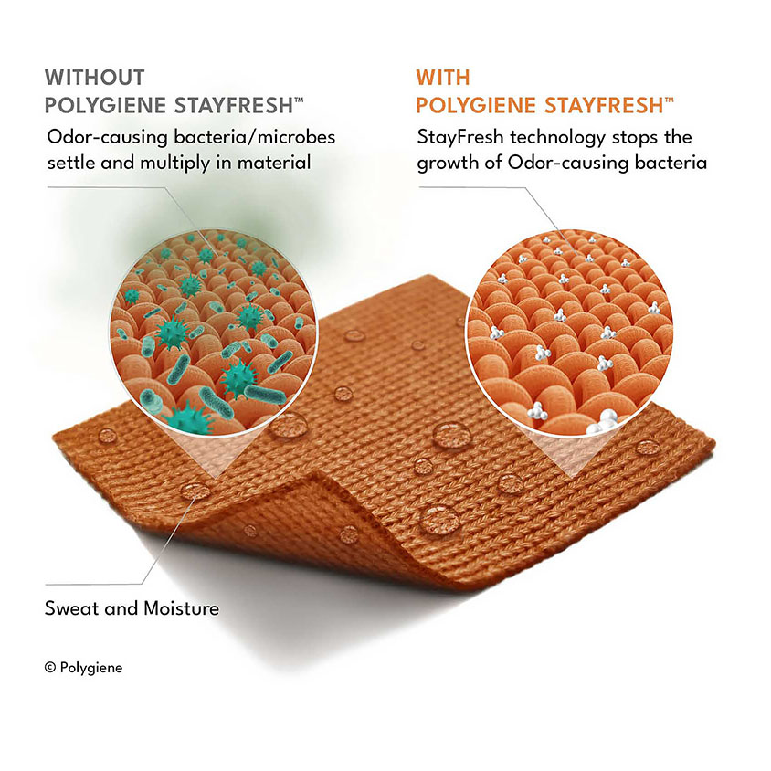
Polygiene - STAYS
FRESH TECHNOLOGY
ODOR CRUNCH
  How it Works?
  What is the treatment made of?
  Does it have any environmental approvals?
  What is the combination product and why is it the best solution?
Sourse: https://polygiene.com/stayfresh/

Slide 16
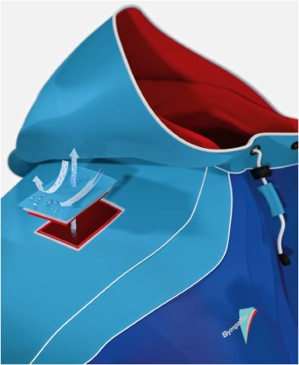
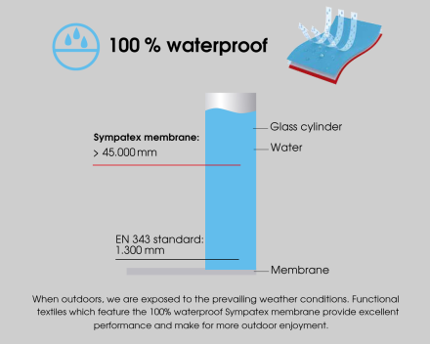
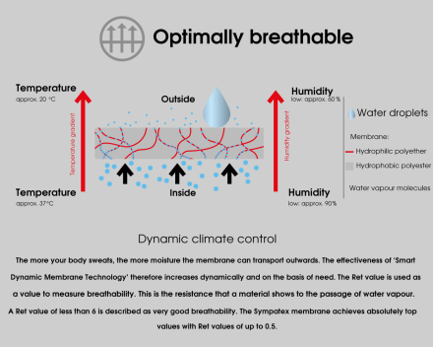
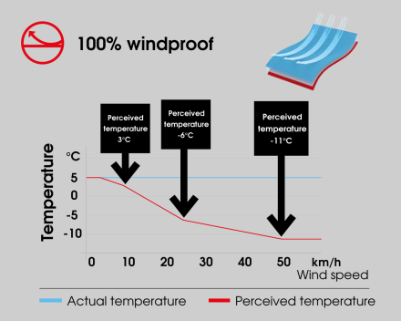
THE SYMPATEX MEMBRANE
SUSTAINABILITY MEETS PERFORMANCE
Source: https://omsight.com/product/omsight-bib-pants/
TOP PERFORMANCE
  100 % waterproof
  100 % windproof
  Optimally breathable
  Durable
  Dynamic climate control
  Very thin and high stretch poreless membrane
  Extremely hard-wearing
MAXIMUM ECOLOGY
  100% climate neutral membrane
  100% recyclable membrane
  100% recyclable and recycled laminates
  STANDARD 100 by OEKO-TEX® certified, bluesign® approved
  PTFE-free and PFC-free membranes and laminates
  Fluorocarbon-free treatments
  Laminates with a completely balanced carbon footprint

Slide 17
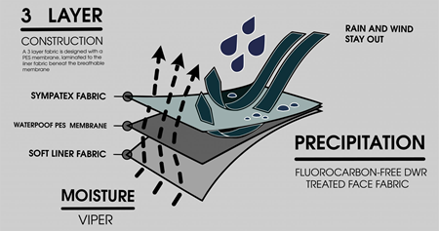
THE SYMPATEX MEMBRANE
A 3-layer construction developed to keep wind, water and dirt out while maintaining high breathability.
Technology: The special 3-layer-laminate is made from 100% organic cotton interlock jersey in combination with bluesign proved compact (poreless) hydrophilic membrane - 100% waterproof, optimal breathable - oxygen and water vapour permeable.
Source: https://omsight.com/product/omsight-bib-pants/

Slide 18
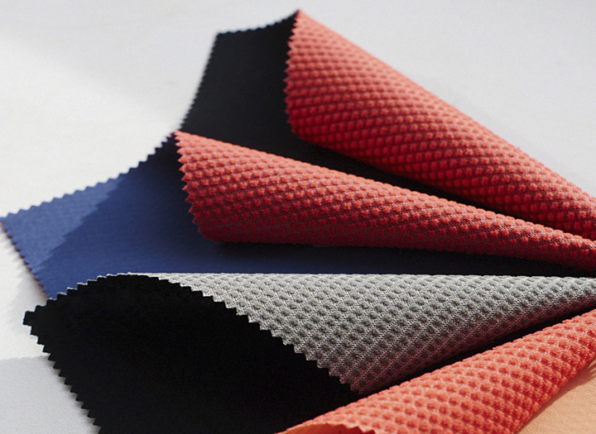
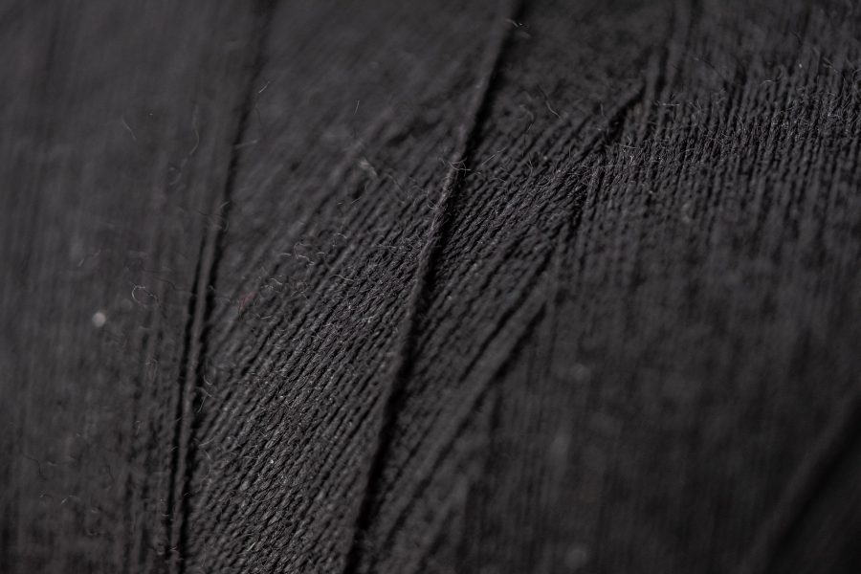
THE SYMPATEX MEMBRANE
BENEFITS:
  touches the skin punctually in the form of foam points.
  creates an insulating air layer between the skin and the laminate
  better moisture transport and breathability
  Sympatex does not use any solvents for its technology.
  The carbon footprint is also kept as low as possible
  the high productivity
  Guaranteed green - recyclable
Source: https://www.ecotextile.com/2016122122507/materials-production-news/sympatex-to-launch-climate-neutral-membrane.html

Slide 19
Sympatex Fabric
Sympatex is a type of functional textile developed by the German company SympaTex Technologies GmbH. This fabric was developed as an eco-friendly alternative to other functional fabrics, such as GORE-TEX, and like its main competitors, Sympatex serves the function of promoting breathability while remaining 100 percent waterproof.
The word “Sympatex” is a portmanteau of “sympathetic” and “textiles,” and this name is intended to evoke the eco-friendly benefits of this material.
The word “Sympatex” is a portmanteau of “sympathetic” and “textiles,” and this name is intended to evoke the eco-friendly benefits of this material.

Slide 20
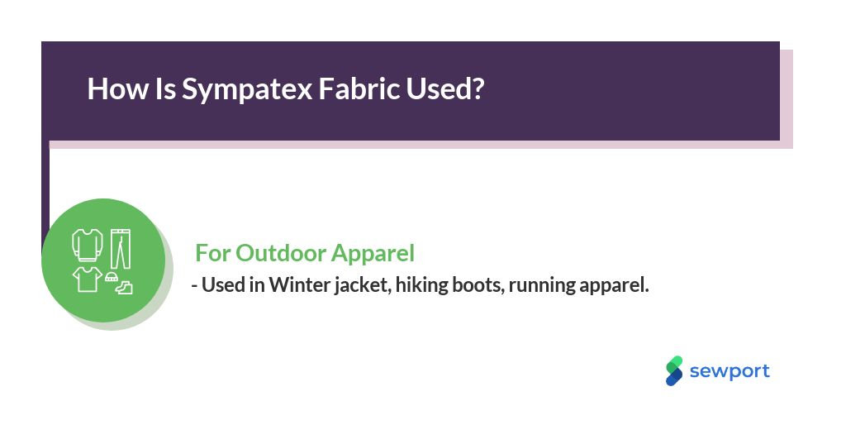

Slide 21
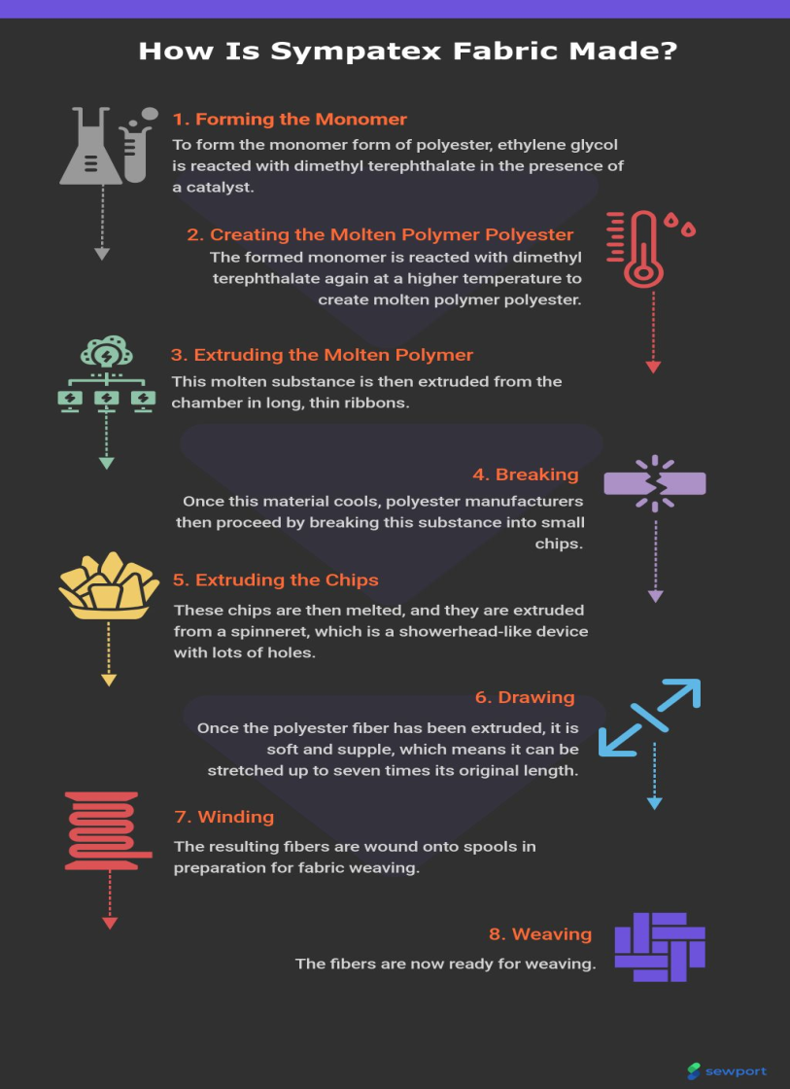
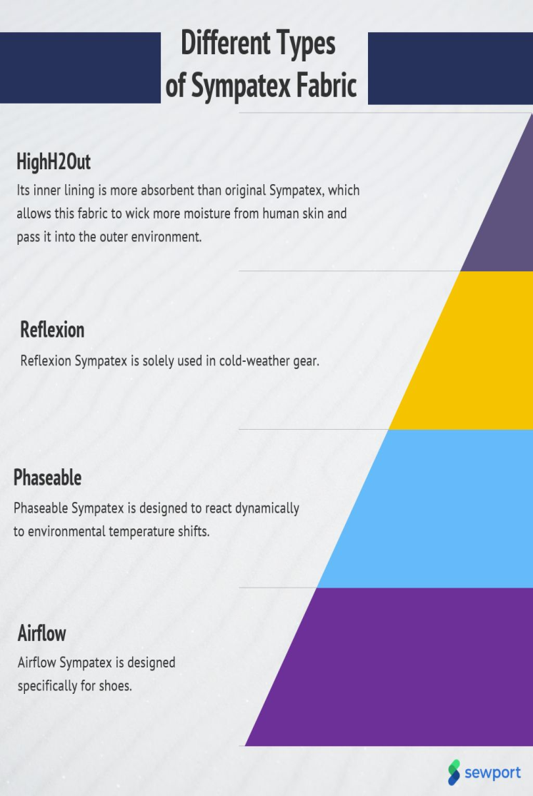
Source: https://sewport.com/fabrics-directory/sympatex-fabric

Slide 22
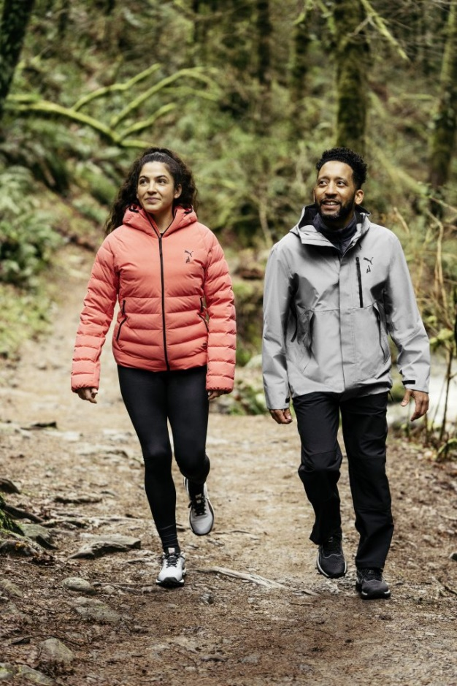
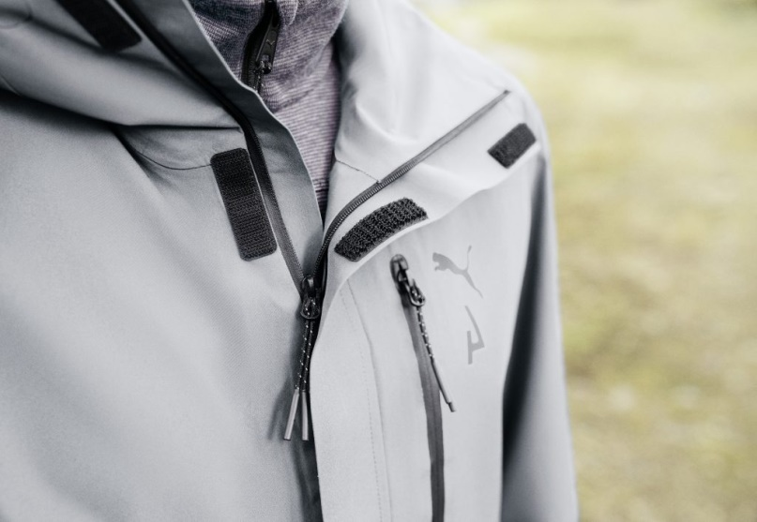
Sympatex partners with PUMA
Innovative approach to recycled polyester-based materials
Source: https://www.scandinavianmind.com/news/sympatex-partners-with-puma-on-an-innovative-approach-to-recycled-polyester-based-materials

Slide 23





The functional apparel design process begins with :
ANALYSIS OF THE ANTICIPATED USER, AND HE IDENTIFICATION OF THE PHYSICAL, EMOTIONAL, AND SITUATIONAL NEEDS OF THAT USER;
CLIMATE AND OTHER HAZARDS IN THE ENVIRONMENT;
PHYSICAL NEEDS OF THE WEARER FOR MOVEMENT
CHOOSING VARIOUS ACCESSORIES TO BE CONNECTED TO THEM TO PERFORM THE DESIRED FUNCTIONS
CHOOSING ASSEMBLING TECHNOLOGIES SUCH AS STITCHING, WELDING AND BONDING, TOGETHER

Slide 24
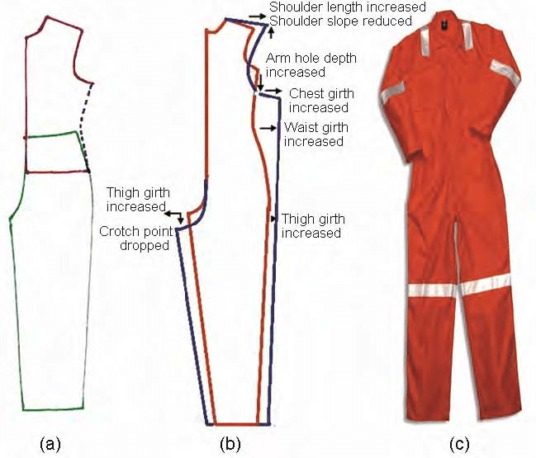
Assembling Technologies
Functional garments, like conventional garments, are made up by joining several pattern pieces together.
These pieces, in turn, are joined with accessories comprising membranes, linings, buttons, zippers, tapes and waddings, to create a composite garment.
The quality of seam in terms of strength, flexibility, elasticity, appearance, comfort and permeability can have a significant effect on the quality and performance of the garment assembly.
Jumpsuit block (a) made by joining the upper and lower body block, (b) pattern modification by addition of ease at critical body parts, and (c) finished garment
CC BY Noopur Anand (2011), source: https://www.researchgate.net/publication/
297514997_Pattern_engineering_and_functional_clothing
https://www.researchgate.net/profile/Noopur-Anand/publication/297514997/figure/fig3/AS:403888474738702@1473305924661/Jumpsuit-block-a-made-by-joining-the-upper-and-lower-body-block-b-pattern.png
Notes:
Noopur Anand. 2011. Indian Journal of Fibre and Textile Research 36 (4): 358-365

Slide 25
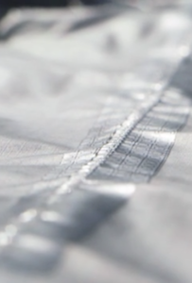
Choice of seam
The correct choice of seam is therefore critical in case of performance wear. Garment assembling technologies therefore include those that are used for joining fabric to fabric or those that join fabric to accessories.
The most common and conventional method of joining fabrics is by sewing with needles and threads. These seams can be used in garments made from porous fabrics.
Seam sealed with tapes;
Sealed seam based on welding and bonding of layers;
Fully sealed seams.
Some newer methods of sewing being used to join technical
textiles- one-sided sewing technologies such as blind-stitching.
Source: https://www.can-dotape.com/product-category/products/heat-seal-tapes/seam-tapes/

Slide 26
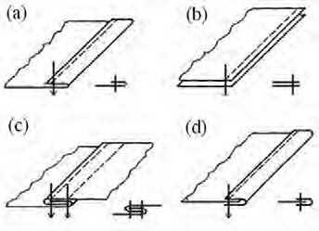
Conventional Sewing
Figure shows the 2D and 3D representation of some seams as per British standard, as shown above. Garments that eventually undergo seam sealing operation, use superimposed or flat and fell seam, as these are among the strongest and most secure seams.
Seam types (a) edge finishing EFa-1, (b) superimposed SSa-1, (c) lap felled LSc-1, and (d) bound BSa-1
CC BY Prabir Jana (2011), source: https://www.researchgate.net/publication/297687236_Assembling_technologies_for_functional_garments-An_overview
Notes:
Prabir Jana. 2011. Indian Journal of Fibre and Textile Research 36 (4): 380-387

Slide 27
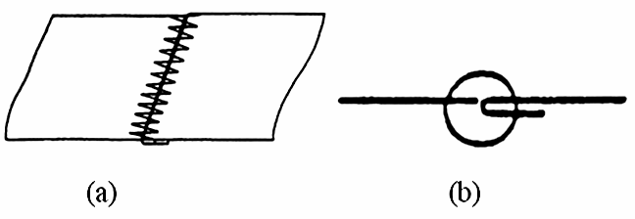
Conventional Sewing
Butt seam FSb-1 (a) 2D view and (b) schematic
CC BY Prabir Jana (2011), source: https://www.researchgate.net/publication/297687236_Assembling_technologies_for_functional_garments-An_overview
Garments made with bulkier fabrics(like scuba diving suit) generally use 607 stitch type and butt seam or overlap seam as these yield some of the flattest seams possible with good stretch and strength. The two fabric pieces are butted against each other, edge to edge. The stitch goes to and fro across the seam, creating a flat stitch (Fig. 3).
The seam is without bulk and comfortable but slightly less strong than overlocked one due to formation of needle holes on either side of the seam. Cost of the seam can also be a consideration in its choice. For example, Overlocked seams, though strong and cheap to produce give a raised bead on the inside of the garment which can be irritating in the armpit or crotch areas of close fitted garments. The seam is also not watertight.
Notes:
Prabir Jana. 2011. Indian Journal of Fibre and Textile Research 36 (4): 380-387

Slide 28
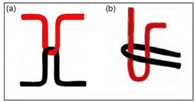
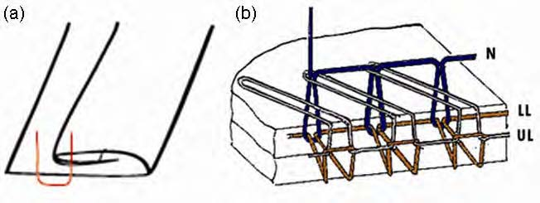
Conventional Sewing
Stitch types are classified into 6 classes (100-600), depending on the configuration and the mechanism of entanglement of threads.
The most commonly used stitch types are lock stitch (Class 300) and chain stitch (Class 400). The two classes differ in that, the lock stitch is formed by interlacement of the needle thread with the bottom shuttle thread, while chain stitch is based on inter-looping of the top with bottom thread (Fig. 4).
Lockstitch and chain stitch
Other important classes for functional clothing are overlock (Class 500) or top and bottom cover stitch (Class 600). Blind stitch based on the principle of 103 stitch type is used to make one sided stitches (Fig. 5).
A curved needle of 25 mm radius is used with a blind looper at the other side to form chains at the back of material. As the needle does not puncture the material, no holes are introduced
Blind stitch and overlock stitch

Slide 29
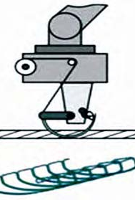
KSL blind-stitch mechanism and stitch architecture
CC BY Prabir Jana (2011), source: https://www.researchgate.net/publication/297687236_Assembling_technologies_for_functional_garments-An_overview
Notes:
Prabir Jana. 2011. Indian Journal of Fibre and Textile Research 36 (4): 380-387

Slide 30
Seam Sealing
Conventional stitched seams have small needle holes, these seams can be sealed and made water and
wind proof by taping. Fabrics which have been ultrasonically or laser cut and sealed are also taped for reinforcement and a smooth comfortable finish.
Typical applications of sealed seams include outdoor gear (skiing, hiking, climbing, marine and fishing gear), sports wear, diving suits, military gear and hazardous material suits.

Slide 31
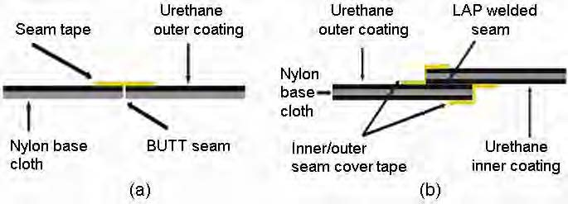
Seam Sealing
Principle of Seam Sealing
Seam sealing tape has a thermoplastic adhesive
coating on one side. Hot air at precisely controlled temperature is applied to the hot melt adhesive which is activated. In the activated form, the tape is applied on the fabric seam under pressure. On cooling, a strong bond is formed between the tape and the seam which prevents wind or water from penetrating, thus making the assembly waterproof.
Butt seam with tape, and overlap seam with tape
CC BY Prabir Jana (2011), source: https://www.researchgate.net/publication/297687236_Assembling_technologies_for_functional_garments-An_overview
Notes:
Prabir Jana. 2011. Indian Journal of Fibre and Textile Research 36 (4): 380-387

Slide 32
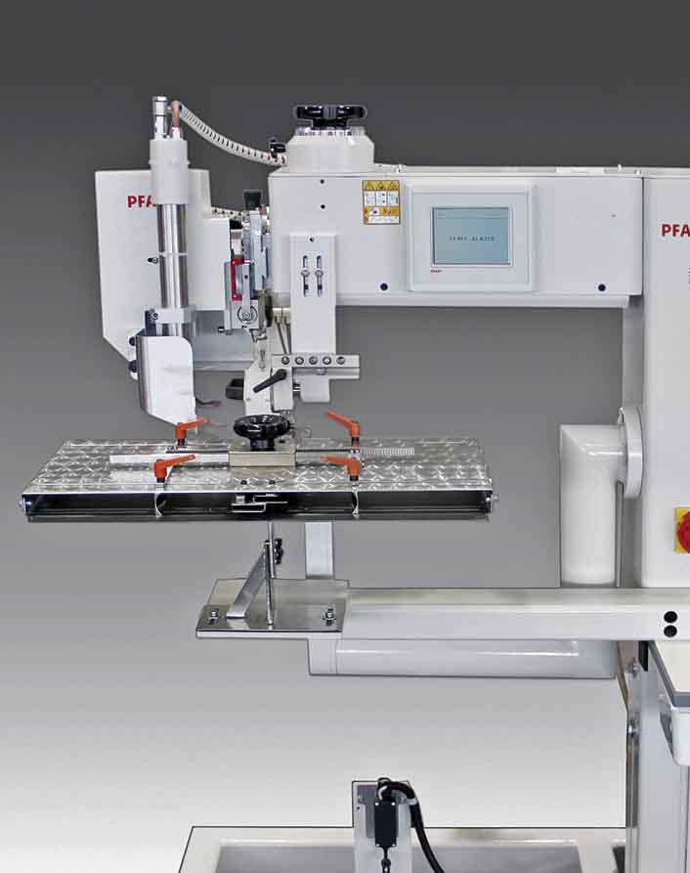
Welding Technology
The term welding refers to the thermal bonding and sealing of seams in knitted, woven, and nonwoven thermoplastic materials without adhesives, chemical binders, staples, needle, or thread. The three principles for welding are heat, speed, and pressure.
The precise combination of these principles allows one to achieve a properly welded seam in thermoplastic materials either by point bonding of fabric or continuous sealing of film. The efficiency of welding of a woven fabric is affected by yarn density, thermoplastic content, tightness of weave and uniformity of material thickness while the random orientation of fibres in nonwovens gives them excellent bond strength. In knits, the style and elasticity of construction affect the bond strength.
Source: ttps://apparelresources.com/technology-news/manufacturing-tech/stitchless-fabric-joining-the-beginning-of-a-new-chapter/

Slide 33
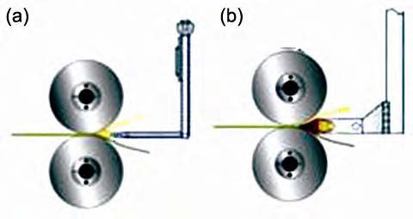
Hot Air Fabric Welding
Hot air welding is used to thermally bond (melt) foils and textiles. In this method, a hot air nozzle is used to deliver heat. The machine is equipped with a pneumatic tape cutter, a temporized tape feeding system and an electronic temperature control regulator with digital display to allow the monitoring of working temperature. Fabric transport is provided by two rollers, speed and pressure of rollers is controlled by specific electronic/pneumatic device and can be adjusted to cope with all different fabric types and thicknesses.
(a) Hot air welding, and (b) hot wedge welding
Source: http://www.weldmaster.com

Slide 34
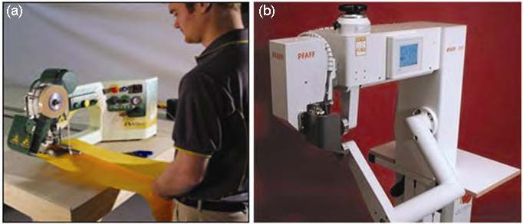
Hot Wedge Fabric Welding
In hot wedge welding, a small metal wedge is used to deliver heat to the fabric immediately before it passes between the drive wheels where pressure is applied to seal the fabric together.
PFAFF 8320-010 is a highly sophisticated programmable fabric joining hot-wedge welding equipment. Equipped with a touch screen, it allows electronic control of all parameters with 100% accuracy. An integrated control board monitors the sealing temperature, air volume, sealing power and he two motors for controlling the speed of the top and bottom rollers.
T3 from Miller Weldmaster, Source: http://www.weldmaster.com
PFAFF 8320-010 hotwedge welding, Source: http://www.pfaff-industrial.de

Slide 35
Ultrasonic Welding
What is it used for?
What is the technology?
What are the advantages?

Slide 36
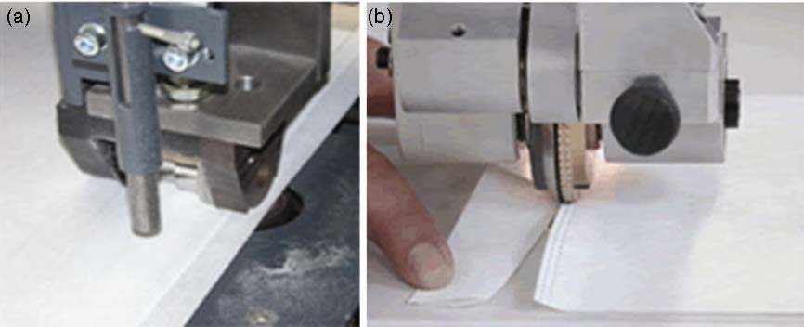
Ultrasonic Welding machine
plunge welding, source:http://www.belsonic-machines.com
continuous welding, source:http://www.pfaff-industrial.com

Slide 37
Laser Welding
This process is based on the knowledge that most polymeric materials transmit near infrared wavelengths. Thus, there is a need to introduce an IR absorber at the interface between the materials to be fused.
The beneficial features of the process include:
Control of melt volume and hence seam flexibility
Sealed seams in one operation, avoiding use of tapes - curved seams become possible
Potential for high speed seaming and automation
A novel appearance to the seam - new design opportunities
Welding may be achieved through several layers, so closed products with internal welded structures are possible
The process is suitable for automation

Slide 38
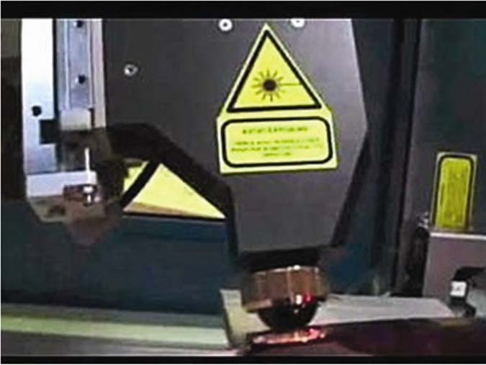
Laser Welding Machine
[Source: http://www.leister.com

Slide 39
Radio Frequency Welding
Radio frequency or high frequency welding is a proprietary plastics welding technology that enables sealing of polyethylene, polypropylene and nearly any low-loss polymer or phthalate-free material.
This technology is ideal for manufacturers needing to transition away from PVC or polyurethane for ecological, financial or regulatory reasons.
This technology works in 27.12 MHz (+/- 5%) frequency range. Hot air, hot wedge, and ultrasonic welding are generally categorized as rotary welding, where the fabric moves continuously through the machine while it is being welded.
Radio frequency welders are a stamping type machine similar to plunge ultrasonic machines. The fabric pieces don’t move but are held in place while they are being welded.
Advantages of radio frequency welding are opportunities for cost savings, increased product performance, great versatility in the selection of plastics materials, and meeting of regulatory and environmental standards.

Slide 40
Impact Welding
There are other lesser known welding technologies available like impact welding technologies which are still at experimental stage and their use as of now is restricted to non-apparel applications.
In impact welding, pressure is applied to the seam area by two impulse-heating bars. Heat is created by pulsing energy through the heating element in the top and bottom bars for the duration of the weld.
After a set weld time is completed, liquid is flushed through the bars to allow a cool down cycle, helping eliminate wrinkles.

Slide 41
Bonding Technology
Bonding technology is different from welding in the sense that while welding is based on thermal bonding, the former is based on chemical or liquid glue bonding. It uses an adhesive between two layers of materials and bonding occurs through the effect of heat, pressure and moisture.
Depending on the type of textile to be welded, different types of adhesives such as hot-melt adhesives and spray glues are also used in some systems. Sufficient adhesion between the textile surfaces is important for durability.
This technology is also used to seal the insertion holes made by the needles.
Applications are mainly in medical use garments, protective clothing and sportswear.

Slide 42
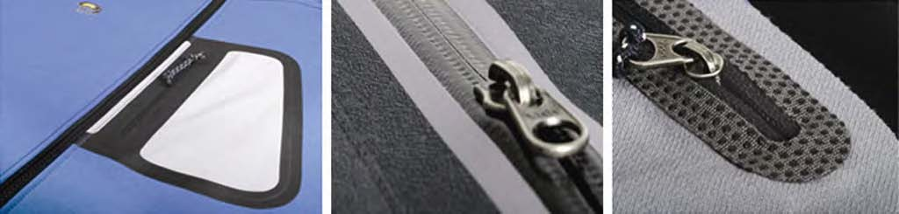
Joining Fabric to Accessories
Seam less taping of pockets and zippers
Sourrce:www.hh.com.hk
Automatic cutting of zipper tapes and hook-n-loop fasteners from a roll can be done by programming the length and loading into the holding clamp. The operator loads the garment over the pre-positioned tape, which is underneath the garment. After the initial start, the rest of the sewing is fully automatic.
Zippers and fasteners can be attached to fabric by ultrasonic welding with a seam structure according to customer's requirements. Ultrasonic bonding with special adhesive tapes or coated elastic tapes can also be done. Some manufacturers use spot welding with ultrasonic machines.

Slide 43

Attaching Labels and Logos
Thermal welding is used to attach thermoplastic labels on garments. For seam free labels, the label is directly printed on the fabric by thermal transfer printing. Logos and other design details can be incorporated by flock printing technique.

Slide 44
Design for disassembly
Combining of natural and synthetic materials in apparel products caused problems with material recovery, reuse, recycling, or composting at the end of product life
The concept of design for disassembly was first established during the 1970s
In the past few decades, environmental pollution and resource depletion have gained public awareness, and product lifecycle analysis has become more and more important in industry of all kinds.
Because product materials have a significant recycled value only when they can be divided into clean, separate types, interest in design for disassembly has been growing.

Slide 45

Design for disassembly
Within the area of apparel design, natural textile fibers are typically classified as biological nutrients, meaning they can biodegrade, and synthetic fibers are typically technical nutrients that can be recycled through industry. Though it is possible to use 100 percent biological nutrients, e.g. cotton yarns to produce children’s knitwear, most apparel products use a combination of different materials.
To design an eco-friendly product in which both biological and technical nutrients are used, McDonough and Braungart (2002) suggested the concept of “design for disassembly” as a strategy for aiding material recovery, reuse, recycling, or composting. Products that are designed for disassembly are easily broken down into their separate biological and technical nutrients.

Slide 46
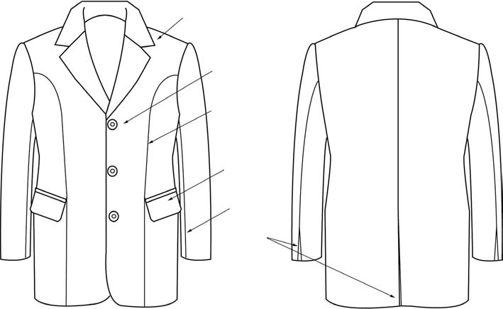
The design of a man’s jacket
Basic notch/lapel collar
The researchers purchased three used men’s blazers of different brands and examined them to identify the traditional construction process of a jacket and the obstacles that make it difficult to disassemble.
Each of the three blazers had a similar design with the basic notch/lapel collar; three button closure; armhole princess line; welt pocket with flat, two- piece sleeve; and vent at the end of sleeve and center back, as shown in Figure 1.
3 buttons
Armhole
princless line
Welt pocket with flap
Two piece sleeve
Vent
CC BY Hae Jin Gam et al. (2011), source:
https://www.researchgate.net/publication/233627271
Notes:
Hae Jin Gam et al. 2011. International Journal of Clothing Science and Technology 23 (2-3): 83-94

Slide 47
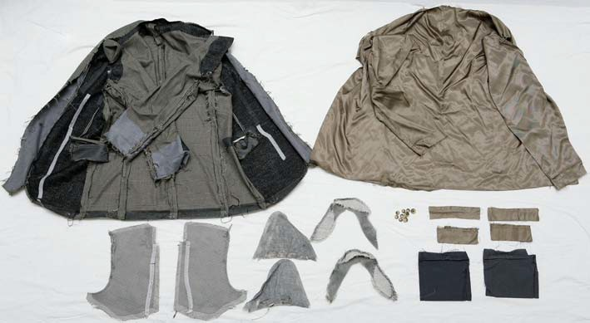
Components after disassembling a conventional man’s jacket
1 - outer shell ; 2- lining ; 3 -chest pieces; 4- shoulder pads ;5 -sleeve headers; 6 - buttons; 7 -pocking facing ; 8 -pocket lining.
Contaminated parts: 1 - front bodice, lapel, collar, bodice hem, sleeve hem, flaps were contaminated by fusible interfacing; 3 - two layers of interfacing used adhesive and they are different fabrics; 4- two layers were attached with adhesive to the pad; 5 - Two of three layers used adhesive
1
2
5
6
4
7
3
8
CC BY Hae Jin Gam et al. (2011), source:
https://www.researchgate.net/publication/233627271
Notes:
Hae Jin Gam et al. 2011. International Journal of Clothing Science and Technology 23 (2-3): 83-94

Slide 48
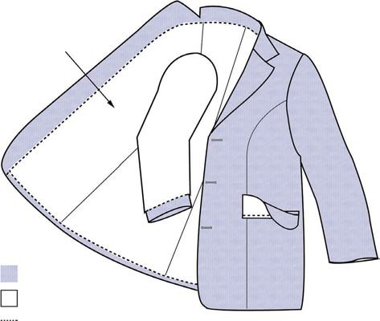
Design for disassembly man’s jacket
In this design, the only points at which biological and technical nutrients are joined are the sewing lines between the outer shell and lining (dotted lines in Figure 3). Organic cotton threads were used to sew the outer shell and lining together. The design for disassembly focused on the easy separation of the outer shell and lining, while maintaining a wearable product during use.
Inside of jacket
Outer shell
Lining
Outer shell and lining assembly place
CC BY Hae Jin Gam et al. (2011), source:
https://www.researchgate.net/publication/233627271
Notes:
Hae Jin Gam et al. 2011. International Journal of Clothing Science and Technology 23 (2-3): 83-94

Slide 49
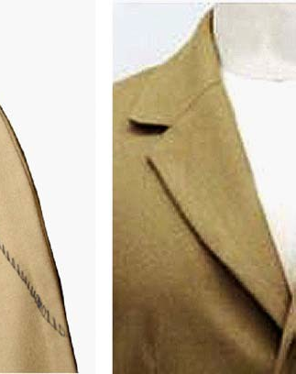
Blind stitches to replace fusible interfacing
To avoid material contamination and maintain the biological nutrient nature of the wool fabric, interfacing had to be removed from the design. At first, the omission of the interfacing made the collar and lapel have an unfinished appearance. This problem was solved by using blind stitches under the collar and on the backside of the lapel. Figure 4 shows that blind stitches can give the collar and lapel a crisp finished appearance without interfacing. Organic cotton threads were used in the blind stitches and a mixture of organic cotton and wool does not change the biological nutrient nature of the material.
Note: Black color thread in the left image was used for visibility
Blind stitches to replace
fusible interfacing
CC BY Hae Jin Gam et al. (2011), source:
https://www.researchgate.net/publication/233627271
Notes:
Hae Jin Gam et al. 2011. International Journal of Clothing Science and Technology 23 (2-3): 83-94

Slide 50
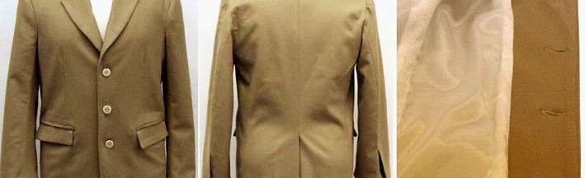
The design for disassembly man’s jacket
CC BY Hae Jin Gam et al. (2011), source: https://www.researchgate.net/publication/233627271
To avoid material contamination, organic cotton threads were used to make the three button holes and sew three Tagua buttons to the wool fabric in the front of the jacket. Owing to the thickness of the wool flannel fabric, the assembly method of the pockets had to be adjusted, and the flap of the pocket had to be lengthened for an improved appearance. Blind stitches were used under the collar and on the backside of the lapel to replace fusible interfacing. Finally, the outer shell and lining were sewn together using organic cotton thread. The finished jacket is shown in figure.

Slide 51
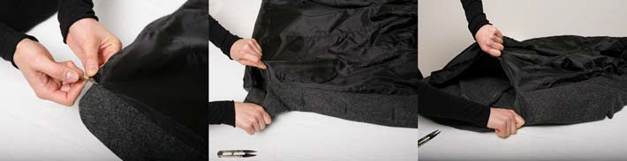
Disassembly process
CC BY Hae Jin Gam et al. (2011), source: https://www.researchgate.net/publication/233627271
Notes:
Hae Jin Gam et al. 2011. International Journal of Clothing Science and Technology 23 (2-3): 83-94

Slide 52
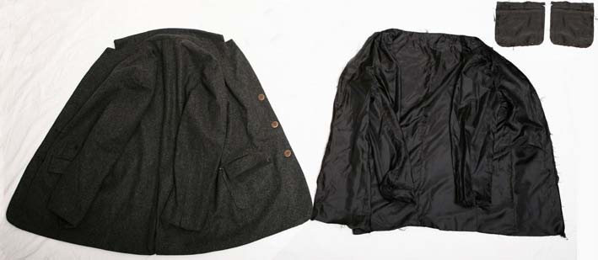
Components after disassembling the jacket
Left – biological nutrients (wool fabrics, organic cotton threads, tagua buttons);
Right – technical nutrients (polyester fabrics, polyester threads)
CC BY Hae Jin Gam et al. (2011), source: https://www.researchgate.net/publication/233627271
Notes:
Hae Jin Gam et al. 2011. International Journal of Clothing Science and Technology 23 (2-3): 83-94

Slide 53
Purpose - The combination of natural and synthetic materials in clothing products has caused problems with material recovery, reuse, recycling or composting at the end of the product's life.
Design/Methodology/Approach – After analyzing men's jackets on the market and identifying barriers to disassembly, a design and construction of a men's jacket that can be easily disassembled was presented. Deconstructed jacket design focuses on material selection, jacket design, and stitching evaluation and selection. Disassembly time was also measured.

Slide 54
Findings - Minimizing the variety of materials and sewing similar materials together where possible, replacing the fusible link with blind seams for hemming under the collar and on the back of the lapel and using a suitable low-density stitch to sew the wool outer shell and polyester lining together can make the jacket disassemble easily into a compostable outer shell and recyclable lining within 1.5 min.
Originality/Value – This research provided a pilot study demonstration of applying 'design for disassembly' in apparel design and construction. Findings can be used in different garments products that help reduce environmental pollution and resource depletion issues associated with clothing production.

Slide 55
Conclusion
The presented clothing technologies for the sustainable production of sportswear can be seen as examples of new ideas for creating technologies and realizing new slow fashion designs with a minimal footprint on the environment.

Slide 56
References and Further Reading
Otero, M. , Pastor, A. , Portela, J. M., Viguera, J. L., and Huerta, M. (2011). Methods of Analysis for a Sustainable Production System, Climate Change - Research and Technology for Adaptation and Mitigation, InTech. http://www.intechopen.com/books/climate-changeresearch-and-technology-for-adaptation-and-mitigation/methods-of-analysis-for-a-sustainable-productionsystem
Sewport Support Team (2023). What is Sympatex Fabric: Properties, How its Made and Where. Sewport. https://sewport.com/fabrics-directory/sympatex-fabric
Blackburn, R., ed. (2015). Sustainable Apparel: Production, Processing and Recycling. Woodhead Publishing Series in Textiles

Slide 57
References and Further Reading
Gam, H., Cao, H., Bennett, J., Helmkamp, C. (2021). Application of design for disassembly in men's jacket: A study on sustainable apparel design. International Journal of Clothing Science and Technology 23 (2-3): 83-94
Penkova, M., Pantulova, M. (2018). Innovative technologies in the manufacture of sport-functional clothing. Proc. of 27th International Conference for Young Scientists “Management and Quality”, Yambol, Bulgaria: 1-5
Jana, Pr. (2011). Assembling technologies for functional garments — An overview. Indian Journal of Fibre & Textile Research 36 (4): 380-387
Anand, N. (2011). Pattern engineering and functional clothing. Indian Journal of Fibre & Textile Research 36 (4): 358-365
Rosen, M., Kishawy, H. (2012). Sustainable Manufacturing and Design: Concepts, Practices and Needs. Sustainability 4 (2): 154-174

Slide 58
Contacts
Faculty of Technics and Technologies of Yambol,
Trakia University of Stara Zagora, Bulgaria
Assoc. Prof. Dr. Diana Balabanova
e-mail: diana.balabanova@trakia-uni.bg

